Slide 1
Last Class

Slide 2
Admin
1. Final exam - December 12th @
2. December 8th - essay hand back and extra office hours.

Slide 3
The missing news
Notes:
http://www.straight.com/article-551646/vancouver/newswatch-canada-identifies-top-25-underreported-stories-year

Slide 4
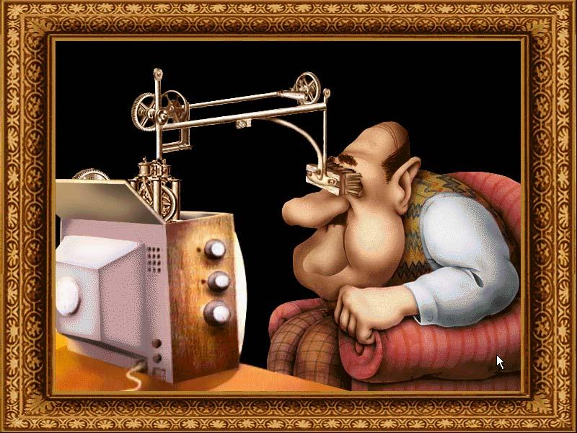
1. Media Effects

Slide 5
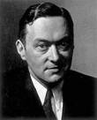
Walter Lippmann
Public Opinion (1922)
"the mass of the reading public is not interested in learning and assimilating the results of accurate investigation."
“The bewildered herd”
"the manufacture of consent"

Slide 6
Hypodermic needle
Passive audience, monolithic audience
Democratic
The media “does” something to us.

Slide 7
Minimal effects models
Two-step flow model
Status conferral/Agenda setting
Narcoticizing dysfunction

Slide 8
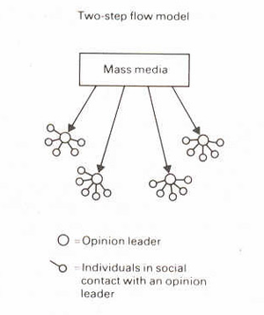
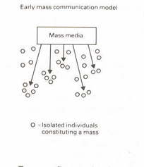
Two-Step Flow

Slide 9
Minimal effects models
Two-step flow model
Status conferral/Agenda setting
Narcoticizing dysfunction

Slide 10
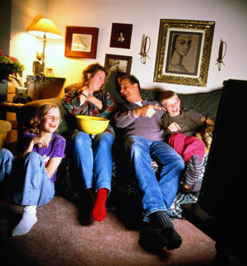
2. Uses and Gratifications Theory

Slide 11
Basic Functions
Surveillance
Socialization
Diversion

Slide 12
3. Socialization
teach children who to be members of society
role models
stereotyping

Slide 13
Overview
The impact (effect) of the media is not clear or straighforward.
The audience is not passive
And the impact can’t be separated from other social/cultural contexts

Slide 14
4. Rather than ‘effects’
Communication studies ….
Content of media messages
Organization – production and transmission of media messages
Audience – reception of media messages
A critical analysis of these
Critical meaning

Slide 15
Significance of media
Media are significant:
  Politically
  Culturally
  Economically

Slide 16
Media Ethics

Slide 17
Free Speech
Canadian Charter of Rights and Freedoms
freedoms of the press in the Bill of Rights 1961
Part of Constitution 1982

Slide 18
Canadian Charter of Rights and Freedoms
Section 2:
youtube

Slide 19
Limits of free speech
1. Hate Speech.
Is it still free speech?
Balance human rights with free speech.

Slide 20
Limits of free speech
2. Defamation - slander or libel
Words or pictures
a) defamatory
b) published or broadcast
c) refer to a specific, living person

Slide 21
Problems with defamation
1. Increasing problem with blogging and social networking
What is a broadcast? What’s published? (Michael Geist)
Jurisdiction (Potts and Harris)
2. Libel chill

Slide 22
So … Can we really have free speech?

Slide 23
Final Exam
Questions
Exam Roulette

Slide 24
THANK YOU!
See you at the Exam

