Slide 1

Marketing Communications
MARK 453
Week 5
Advertising

Slide 2
Agenda for today
Administrative stuff
Midterm
Advertising

Slide 3
Important administrative stuff is important
MOODLE
Creative exercise (optional)
Midterm exam study questions
Final project
Deadline to review surveys: next week!
Brand & cause confirmation/update
Consent form
Report example

Slide 4
Midterm

Slide 5
What’s up with the midterm?
Details
During class time
Closed book
Content
Based on what is mentioned in the slides
Study questions available on Moodle

Slide 6
What’s up with the midterm?
Sections
5 short answer questions (about half a page)
3 long answer questions (about 1-2 pages)
Make-up exam
Read course outline carefully!

Slide 7
What’s up with the midterm?
Needed
Student ID
Allowed
Translation dictionaries (hard copies)
Watch (old school)
Forbidden
Electronic devices

Slide 8
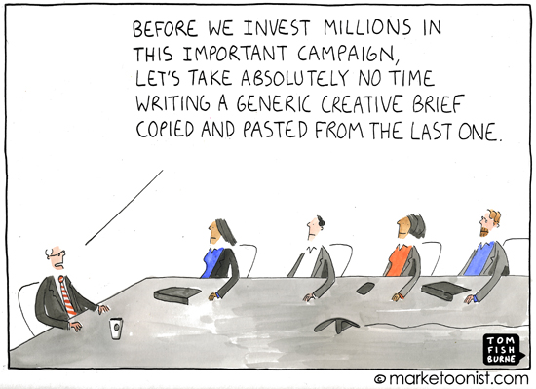
What did we cover last week?
Chapters 5 & 6
Creative strategy
Creative tactics

Slide 9
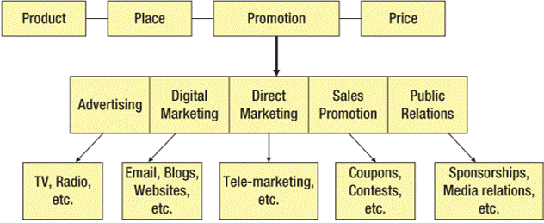
What are we going to cover in the next couple of weeks?
Week 5
Week 9
Week 8
Week 7
Week 8

Slide 10
Advertising: Media Plan

Slide 11
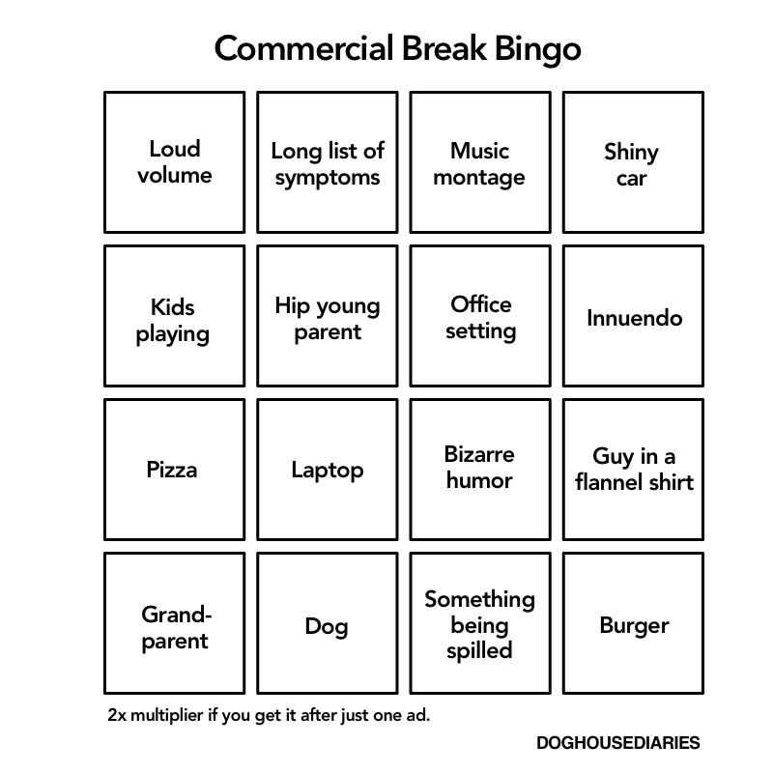
What is advertising?

Slide 12
How do you determine where to advertise?
ADVERTISING TERMINOLOGY
Reach
Frequency
Opportunities to see
Rating points
Gross rating points
Cost per thousand

Slide 13
What is reach?
REACH
Number of members of your target audience exposed at least once to a medium over a specific period of time
PROBLEM
No way to know if exposure to certain medium results in exposure to the ad!
EFFECTIVE REACH
Percentage of your target audience that must be exposed to a particular message to achieve a particular objective
Increase awareness from 40-70% to reach target 80%

Slide 14
What is frequency?
Frequency
Number of times a member of your target audience is exposed to a medium during a specific period of time
Problem
NO WAY TO KNOW IF EXPOSURE TO MEDIUM RESULTS IN EXPOSURE TO AD!
EFFECTIVE FREQUENCY
Number of times a target audience must be exposed to a message to achieve a particular objective
If you expose 3 times consumers are more likely to remember *

Slide 15
What is opportunity to see?
Opportunity to see (OTS)
Cumulative exposure achieved in a given time period
Example
Pizza Hut billboard in the Guy-Concordia metro station for a month
OTS = 2 day x 5/week x 4/month =40
40 opportunities to see ad
PROBLEM
OTS > ACTUAL EXPSURE
ASSUMED THAT OTS=EXPOSURE

Slide 16
Determining reach and frequency is not easy
Ideal situation
Almost impossible to have actual numbers
technology
DEPENDS ON
Clutter
Objective
Market share
Recency
Ad characteristics
Number of media/tools
Intrusion value(how much ur consumers cannot ignore) low instrusion value – u can easily ignore
Stage of purchase decision

Slide 17
What is the purpose of reach and frequency?
Have a quantitative assessment of the effectiveness of your advertising campaign
RATING POINTS (RPs)
The ad appears once
Percentage of potential audience
1 rating point
1% of your target audience was exposed to the ad once

Slide 18
How do you calculate rating points?
Example
KitchenAid ad aired once during an episode of Downton Abbey (reaches 50% of target audience)
Reach = __50__; Frequency = __1__; RPs =50(Rating pointsS) ____

Slide 19
Since an ad usually appears more than once, we need a better measure
GROSS RATING POINTS (GRPs)
The ad appears more than once
Sum of RPs
Reach x frequency (CTS)
Example
KitchenAid ad aired five times during an episode of Downton Abbey (reaches 50% of target audience)
Reach = _50____; OTS = __5___; GRPs =250(5X50) _____

Slide 20
Calculations get more complicated when you use more than one medium
Example
GRPs = 90
Frequency?
Depends on:
TARGET AUDIENCE OVERLAP BETWEEN MEDIA
Reach = _90___; Frequency = __1__; GRPs =90 _NO OVERLAP___
COMPLETE OVERLAP
Reach = _30___; Frequency = 3____; GRPs =90 ____
Medium | Reach
A | 30%
B | 30%
C | 30%

Slide 21
Calculations get more complicated when you use more than one medium
Example
Nike TV commercial aired…
Once on TSN (reaches 30% of target audience)
Once on Golf Channel (reaches a different 30% of target audience)
FINAL EXAM TYPE QUESTION **
SOLUTION
A
Unduplicated reach: | 60% | Frequency (OTS): | 2 (1+1)
Duplicated Reach: | 0% | NO OVERLAP
Total Reach: | 60% | Total GRPs: | 60 (1x30+1x30)

Slide 22
GRPs calculation exercise 1
Example
BMW TV commercial aired…
Four times on TSN (reaches 30% of target audience)
Five times on Golf Channel (reaches a different 20% of your target audience)
SOLUTION
A
Unduplicated reach: | 50 | Frequency (OTS): | 9(4+5)
Duplicated Reach: | 0
Total Reach: | 50 | Total GRPs: | 220(4X30+5X20)

Slide 23
GRPs calculation exercise 2
Example
BMW TV commercial aired…
Once on TSN (reaches 30% of target audience)
Once on Golf Channel (reaches 20% of target audience who also watches TSN and 40% who doesn't watch TSN)
Ad not shown at same time on both channels
SOLUTION
See it once
See it twice
A
Unduplicated reach: | (30-20+40) 50% | Frequency (OTS): | 2
Duplicated Reach: | 20
Total Reach: | 70%(30+40) | Total GRPs: | 90(1X30+1x(20+40)) or (1x50)+(2x20)=90

Slide 24
How do GRP calculations work in “real life”?
6 months out-of-home campaign in Halifax
FOR THE FINAL PROJECT!
COST
National GRP cost = __$400/group________
Canadian population = __35 M______
Halifax population = ____300 K______
Millennials (20-34) = ___86 K_____
Cost = 300,000/35,000,000 X 400=$3.50/GRP

Slide 25
How do GRP calculations work in “real life”?
REACH
Halifax population = __300 K_______
Millennials (20-34) = ___86 K______
Reach = 86,000/300,000 =30%
FREQUENCY (OTS)
Assumption: __1 /DAY______ during weekdays
Frequency =5/WEEK X 4/MONTH X 6 MONTHS= 120 OPPORTUNITIES

Slide 26
How do GRP calculations work in “real life”?
GRP CALCULATIONS
Reach = ___30%____
Frequency (OTS) = _120_____
Cost = _____$3.50/GRP__
GRP = 30 X 120= 3600
Cost =3600 X$3.50= $12,600

Slide 27
There are several other ways to calculate the cost of an ad placement
Cost per thousand (CPM)
Dollar cost of reaching 1,000 members of the media vehicle’s audience
Compare cost effectiveness of different ad placements
(COST of media buy/total) x 1000 audience

Slide 28
Example of CPM calculations
The Simpsons
18–49 demographic
Average cost for 30-second spot: $190,000
Average audience (S25): 5,020,000
CPM
(190,000/5000,000)x1000= $37.86
Superbowl XLVIII
Cost for 30-second spot: $4,500,000
Audience: 114,400,000 (US)
CPM
(4,500,000/14,400,000)x 1000=$40.36
Big Bang Theory
18–49 demographic
Average cost for 30-second spot: $345,000
Average audience (S7): 19,960,000
CPM
(345,000/10,960,000) x 1000 =$17.28


Slide 29
How do CPM calculations work in “real life”?
Sponsored keywords campaign in Halifax
COST
CPM = _$3_____
See sponsored keywords at least __5___ times
Halifax population of Millennials (20-34) = _86k_____
Cost =86,000/1000 x(3x5)=$1290

Slide 30
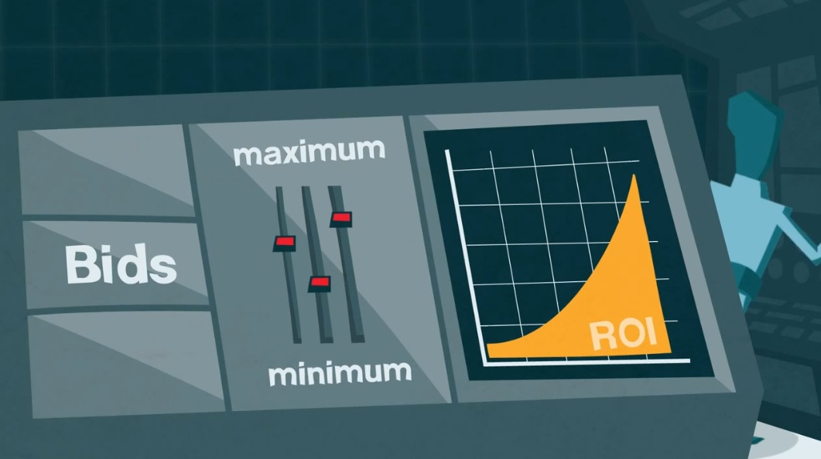
What is the future of media buying?


Slide 31
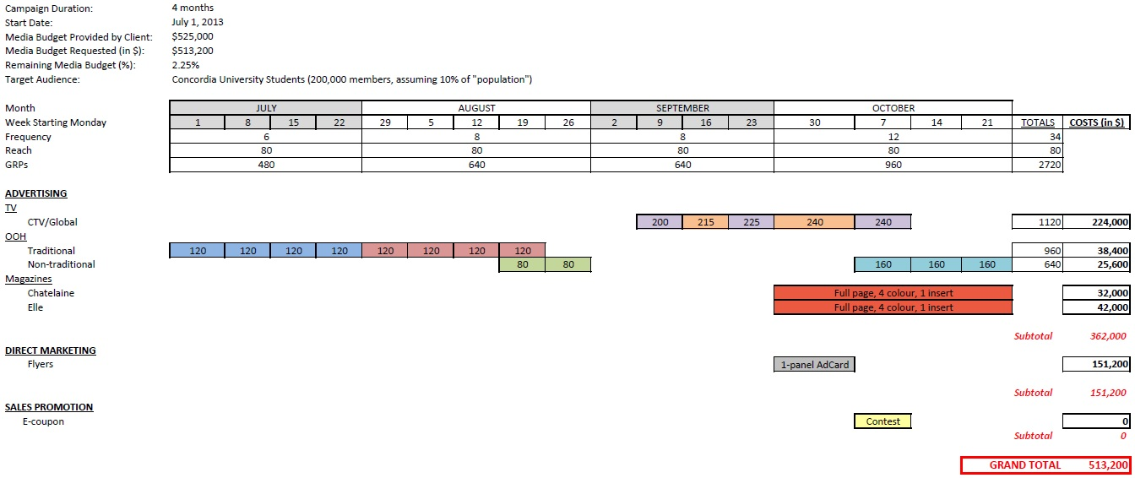
Once you decided where you should advertise, then you need to decide when
What times of the year are particularly important to the market, product or brand?
Need to this for project *
BLOCKING CHART

Slide 32
What are the different types of media schedules?
Continuous
Discontinuous/Flighting
Pulsating/Pulsing
Jan Feb Mar Apr May Jun Jul Aug Sep Oct Nov Dec

Slide 33
What are the different types of media schedules?
CONTINUOUS
Regular continuous pattern
Every [day/week/month]
Products consumed on an ongoing basis
Continuous
Jan Feb Mar Apr May Jun Jul Aug Sep Oct Nov Dec

Slide 34
What are the different types of media schedules?
DISCONTINUOUS/FLIGHTING
On and off
During peak times
Seasonal products
Discontinuous/Flighting
Jan Feb Mar Apr May Jun Jul Aug Sep Oct Nov Dec

Slide 35
What are the different types of media schedules?
Build up (movies)
Blitz (not attached to a season)
DISCONTINUOUS/FLIGHTING
Skip
Seasonal (bikinis)

Slide 36
What are the different types of media schedules?
Pulsating/pulsing
Combination of continuous and flighting
Increase number of advertisement around high buying times
Mix of continuous & discontinuous
Pulsating/Pulsing
Jan Feb Mar Apr May Jun Jul Aug Sep Oct Nov Dec

Slide 37
Advertising: Media Selection

Slide 38
Many different adverting medium can be used in a campaign!
MEDIUM
Television
Radio
Newspapers
Magazines
Out-of-Home
Challenge – finding the right combination

Slide 39
What are the strengths and limitations of television?
TELEVISION
Strengths | Limitations
High reach High frequency potential Low cost per contact Creative opportunities High intrusion value Segmentation | Greater clutter Lower recall Channel surfing Short amount of copy High cost per ad

Slide 40
How do you calculate television audiences?
Universe estimate
Households Using Television (HUT)
Persons Viewing Television (PVT)
Share (of audience)
Rating

Slide 41




How do you calculate television audiences?
UNIVERSE ESTIMATE (UE)
Total number of households 10 TVS
(Assume each household has one TV)
30% WATCH THE
SIMPSONS

Slide 42
How do you calculate television audiences?
RATING
Percentage of UE tuned to a specific [program/channel]
30% WATCH THE SIMPSONS

Slide 43
How do you calculate television audiences?
Households Using Television (HUT)
Persons Viewing Television (PVT)
[Households/Persons] using TV
Total TV households
60%

Slide 44
How do you calculate television audiences?
Share (of Audience)
Percent of [HUTs/PVTs] tuned to a specific [program/channel]
3 OUT OF 6
50%

Slide 45
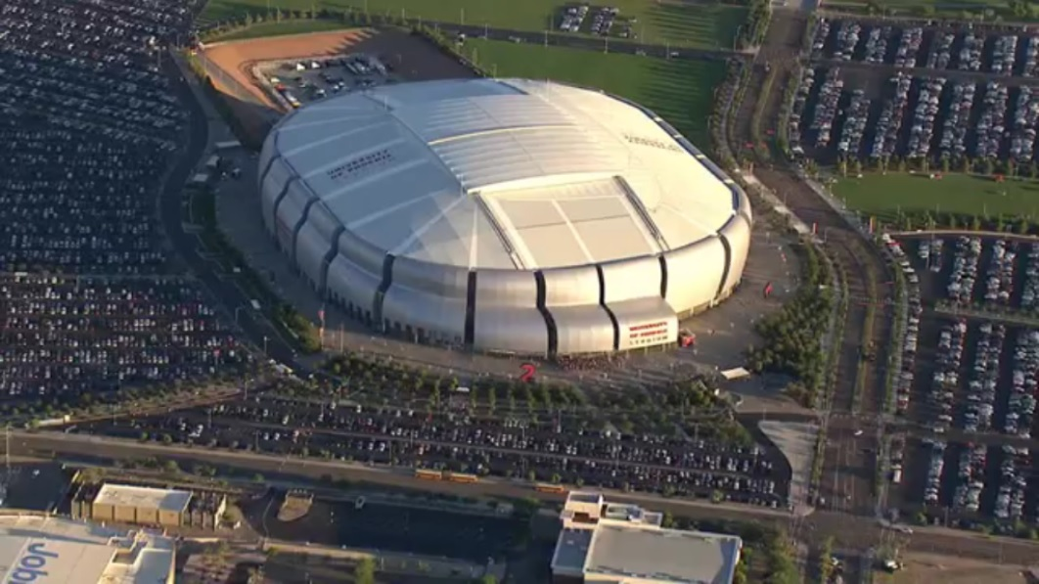
Example of creative use of TV advertising


Slide 46
What are the strengths and limitations of radio?
RADIO
Strengths | Limitations
High recall Narrower target markets Match ad & station High segmentation Flexible Fit local conditions Intimacy Mobile Creative opportunities | Short exposure time Low attention Hard to reach national audience Target duplication Information overload

Slide 47
Example of creative use of radio advertising

University of Hannover’s Music Department
Elite school for musicians
Wanted to recruit people with perfect pitch
Can identify a specific musical note without any other external assistance or context
Less than 3% of the population can do it

Slide 48
What are the strengths and limitations of newspapers?
NEWSPAPERS
Strengths | Limitations
Geographic selectivity High flexibility High credibility Strong audience interest Longer copy Volume discount Responses features | Poor buying procedures Short life span Major clutter Poor quality Internet competition

Slide 49

Example of creative use of newspaper advertising

Slide 50
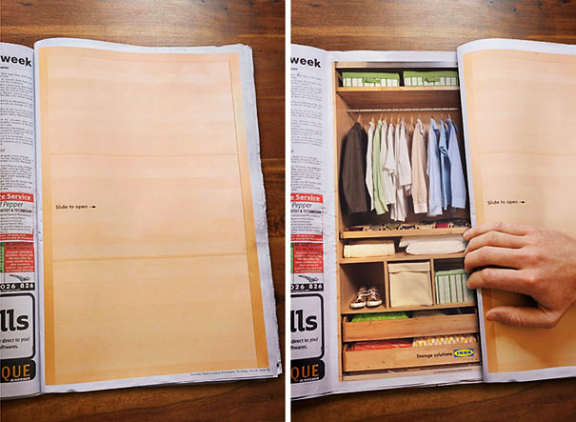
Example of creative newspaper advertising

Slide 51
What are the strengths and limitations of magazines?
MAGAZINES
Strengths | Limitations
Market segmentation Audience targeting Direct-response High color quality Special features Long life Longer attention | Declining readership High level of clutter Long lead time Little flexibility High cost

Slide 52
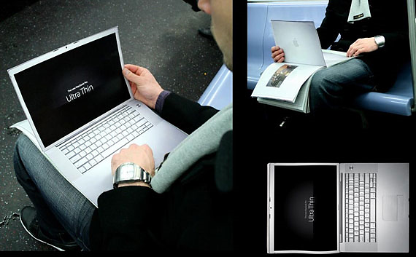
Example of creative use of magazine advertising

Slide 53
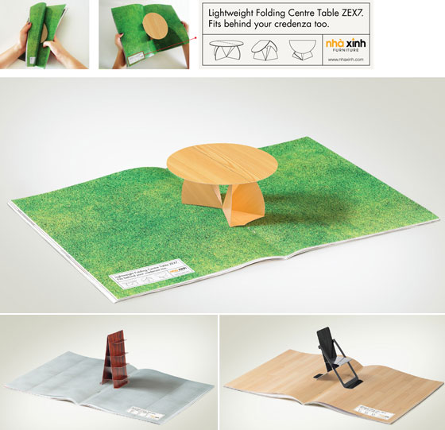
Example of creative use of magazine advertising

Slide 54
What are the strengths and limitations of out-of-home?
OUT-OF-HOME (OOH)
Strengths | Limitations
Select geographic areas Accessible for local ads Low cost per impression Broad reach High frequency potential Can be spectacular | Short exposure time Brief message Little segmentation Cluttered areas

Slide 55
What is out-of-home advertising?
Outdoor | Transit | Place-Based
Poster/billboard | Interior/exterior PT poster | Bar, restaurant, hotel
(backlit, superboard, video/electronic) | PT mural | Mall, cinema
Wall banner, mural | Station/shelter poster/video display | Arena, stadium
Mobile signage (trucks, vehicles) | Station/shelter domination | Golf, ski, fitness centre
Aerial (Banners, dirigibles, smoke) | Interior/exterior taxi | Office building
Public spaces | Airport poster/video display | University, college
(bench, garbage can, parking lot, bike rack, etc.) | In-flight video/magazine | Washroom, elevator
Guerilla


Slide 56
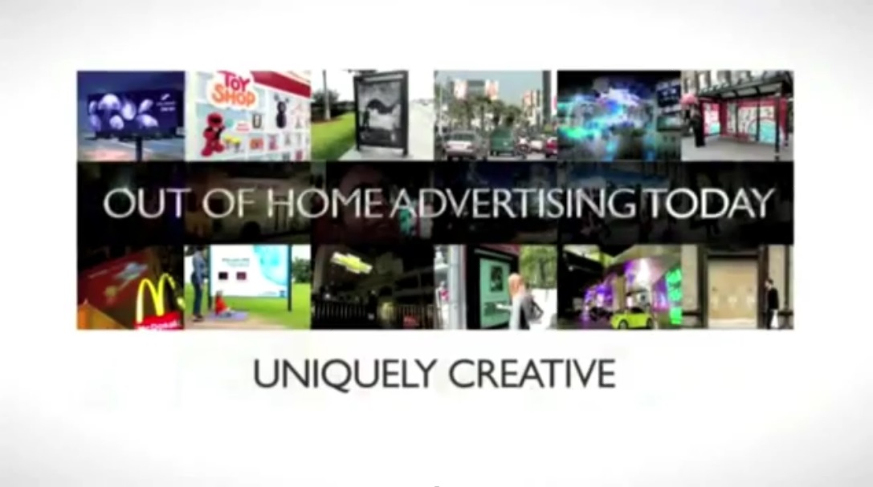
What is out-of-home advertising?


Slide 57
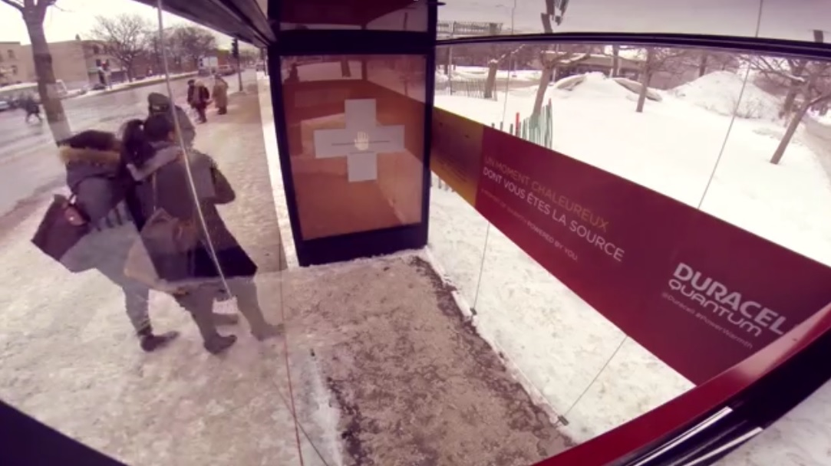
Example of creative OOH advertising


Slide 58
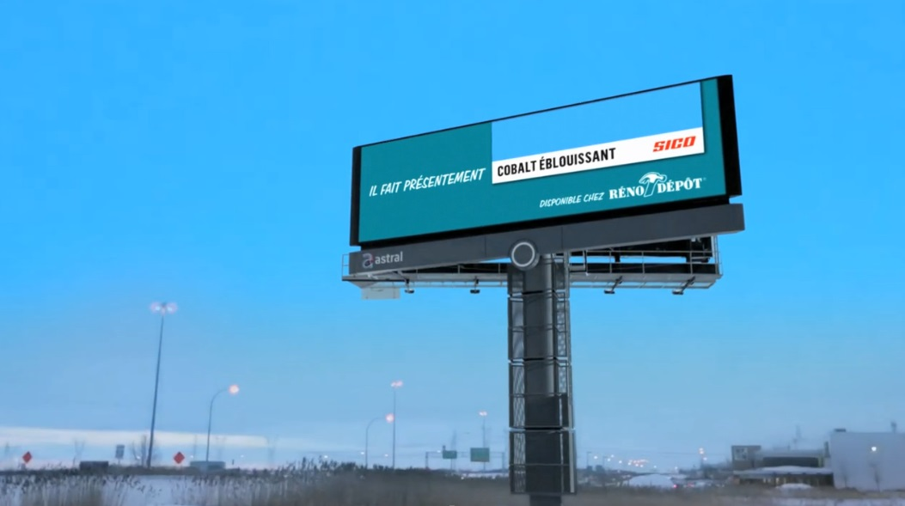
Example of creative OOH advertising


Slide 59
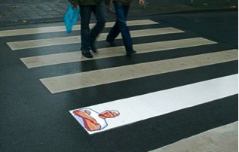
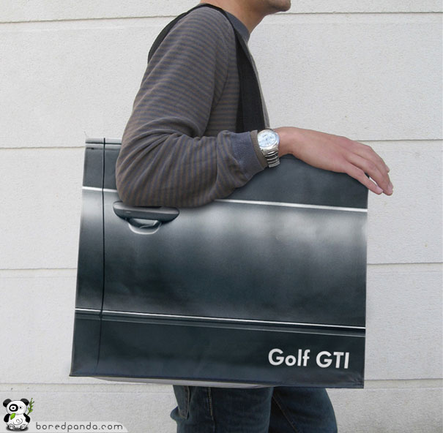
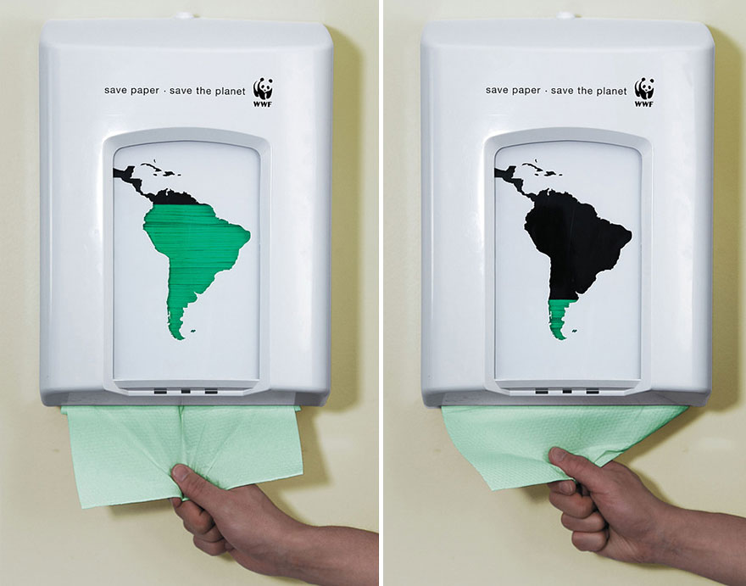
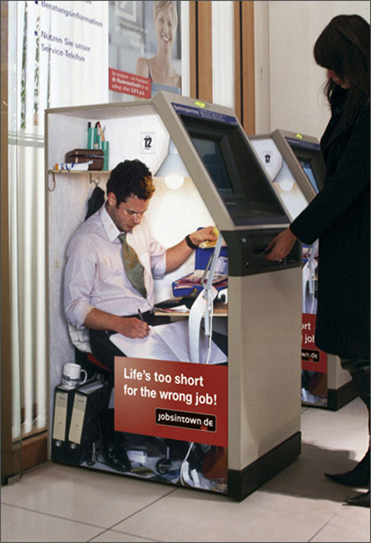
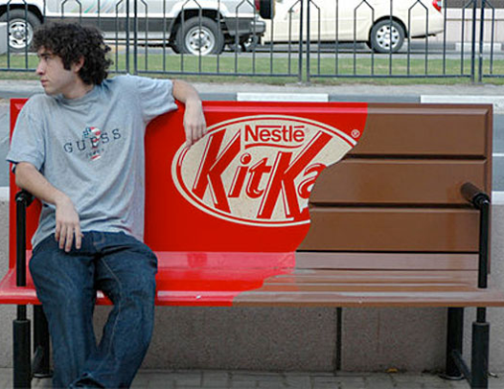
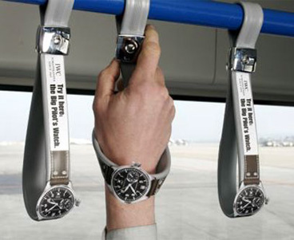
Examples of creative OOH advertising
Can be very creative!

Slide 60
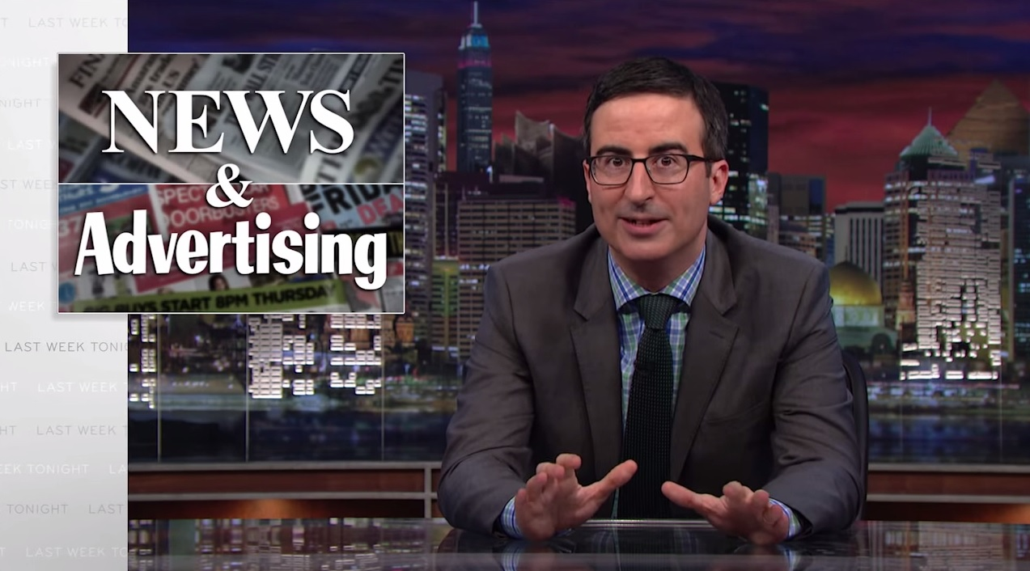
Trend: Native advertising


Slide 61
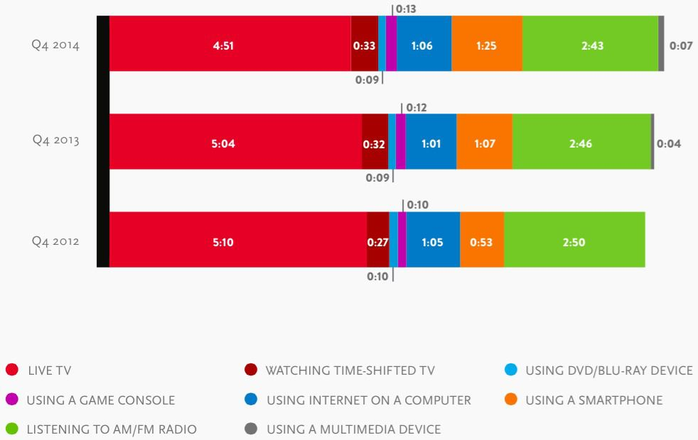
Recent evolution of advertising media usage by consumers

Media Habits

Slide 62
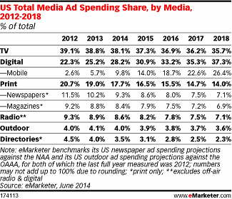
Recent evolution of advertising media buying by marketers

Ad Spending

Slide 63
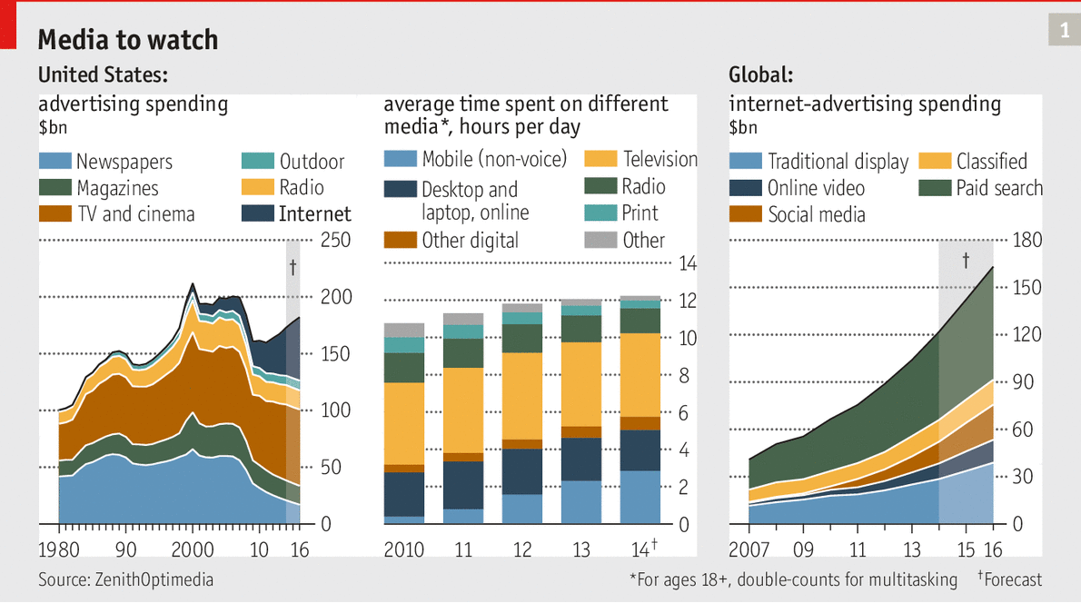
How digital is redefining marketing communications

Little Brother

Slide 64
Almost Done for Today!

Slide 65
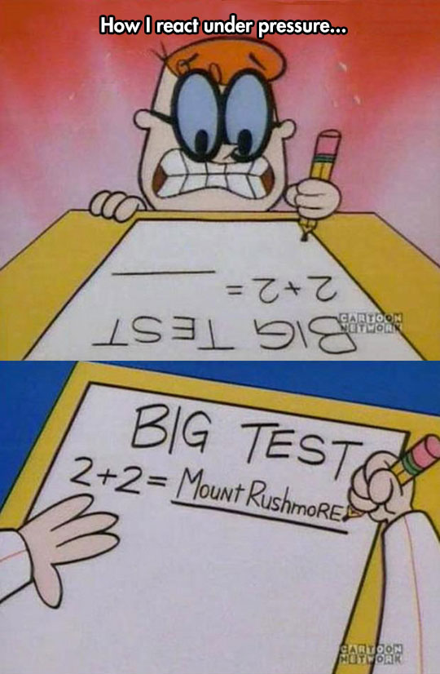
What to do for next week?
FINAL PROJECT
Survey review by next week
Brand & cause
Midterm
Study questions on Moodle
Happy studying!
Week 7: Sales promotion
Chapter 9

