Slide 1
Control of Gene Expression in Eukaryotes: Maturation of mRNA
BCH/BIO3170: Molecular Biology
Lecture 16, December 1st
Luc Poitras, lpoitras@uottawa.ca
Notes:
Dec 1/ 2015

Slide 2
Transcription
Transcription in Eukaryotes
Control of Gene Expression in Eukaryotes: Regulatory Proteins
Control of Gene Expression in Eukaryotes: Combinatorial Control
Control of Gene Expression in Eukaryotes: DNA Methylation
Control of Gene Expression in Eukaryotes: Maturation of mRNA
Control of Gene Expression in Eukaryotes: Transport and Translation control

Slide 3
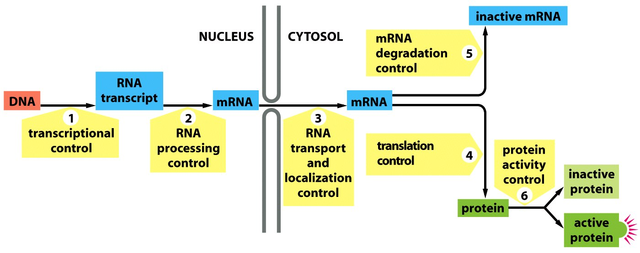
Levels of control of gene expression
Level | Main characteristic
Transcriptional | Controls the transcription initiation frequency of a gene
mRNA maturation | Quality control, splicing
mRNA transport and localization | Distribution to cell compartments
mRNA stability | Transcript half-life
Translation | Control at the level of mRNA decoding
Protein activity | Folding, localization, modification, half-life

Slide 4
Control of Gene Expression
Maturation of mRNAs
  Capping of the mRNA at the 5’ end
  Splicing of the primary transcript and assembly of exons
  Addition of a Poly A tail at the 3’ end
mRNA processing control
  Alternative splicing
  Alternative polyadenylation
  Nuclear degradation by RNases
  mRNA editing
mRNA degradation control
  Degradation of nonsense mRNA

Slide 5
Maturation of mRNAs

Slide 6
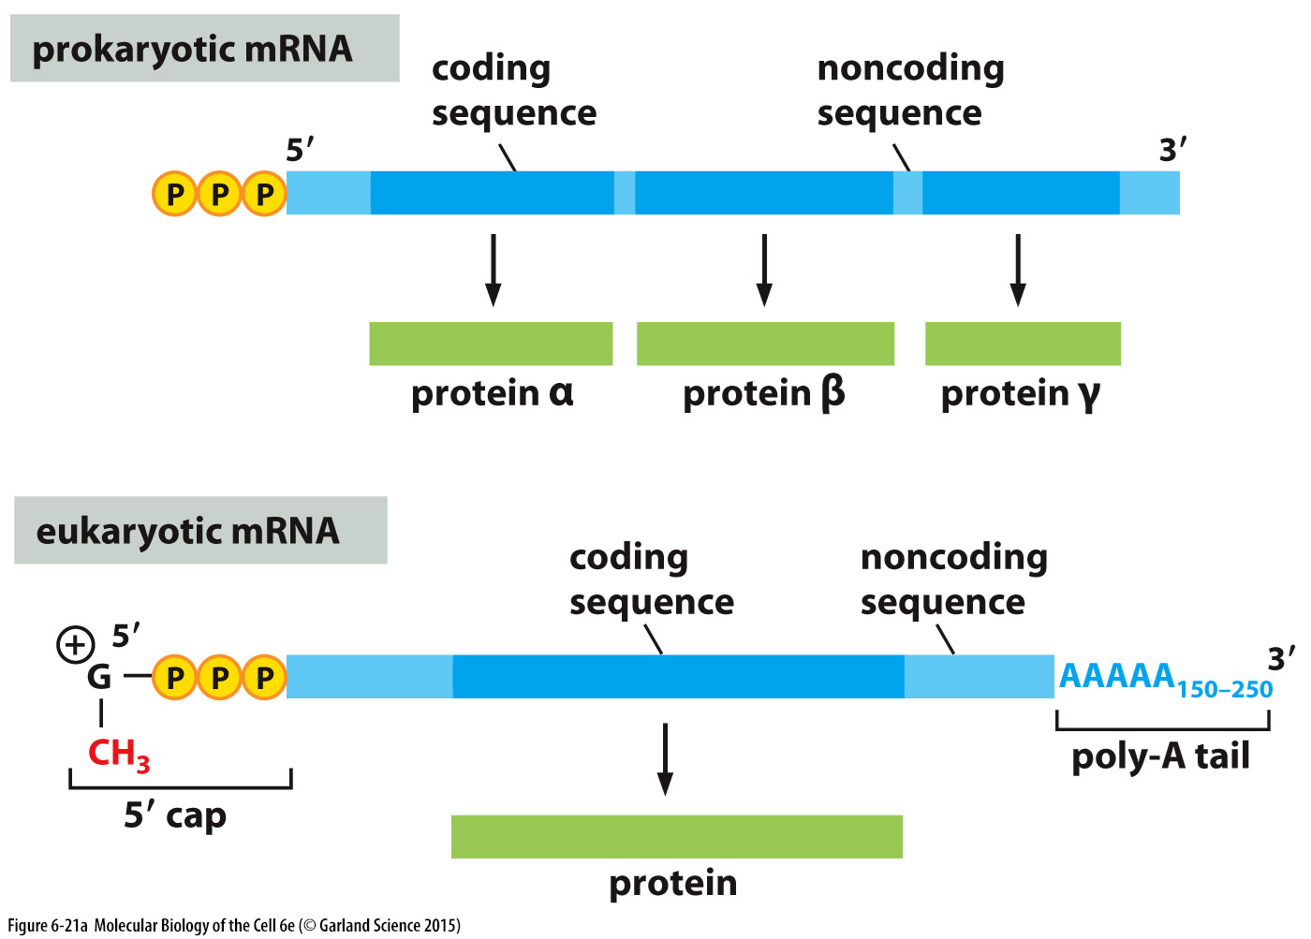
Capping of the mRNA transcript
Notes:
Guanosine mono-phosphate
5’ caop and poly-a tail are the differences

Slide 7
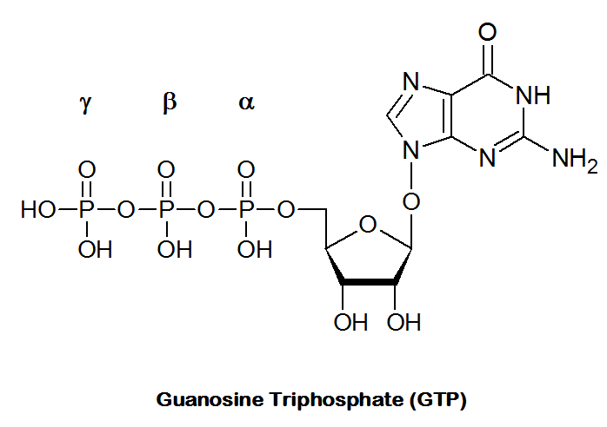
Capping of the mRNA transcript
Capping of the precursor mRNA occurs when about 20-30 nt have been synthesized.
Capping of mRNA involves three different enzymes.
Notes:
Guanosine mono-phosphate
Capping and splicing etc happen independently … not always in the same order, depends on the mRNA (not a fixed set in place)
One of the first, simply one three steps with 3 diff enzymes
Note the nomenclature on the diagram

Slide 8
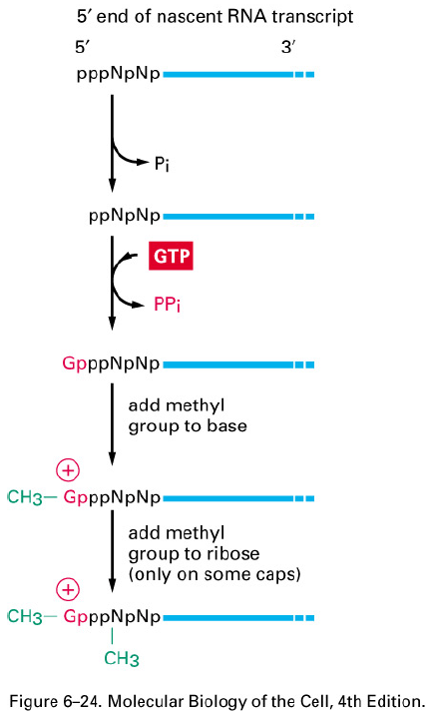
Capping of the mRNA transcript
Capping of mRNA :
  The 5’ end of the transcript is recognized by a phosphatase that removes the γ phosphate of the terminal rNTP to create a rNDP end.
  A guanyl transferase converts a GTP molecule into GMP by removing the β and γ phosphates. Then, this GMP is transferred to the rNDP through an inverse phosphodiester bond, 5’ to 5’.
  A ribonucleotide methyl transferase adds a methyl group at position 7 of the guanosine to protect it.
1. Phosphatase
2. Guanyl transferase
3. Ribonucleotide
methyl transferase
Notes:
The primes are the position of the carbon
Cappin of 5’ protects from degreation

Slide 9
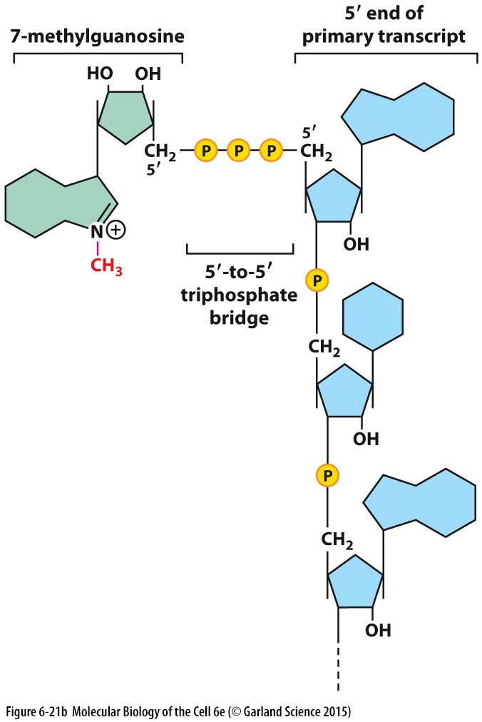
Capping of the mRNA transcript
Also methylated
in many eukaryotic
mRNA

Slide 10
Role of the 5’methyl cap
The 5’ end cap allows the cells to:
  distinguish transcripts produced by the RNA polymerase II from those produced by the other two RNA polymerases (these polymerases produced uncapped transcripts).
  protect mRNAs from degradation by exoribonucleases.
  facilitate interaction with the Cap Binding Complex (CBC). This binding is an essential step for the processing, transport and translation of mRNAs.

Slide 11
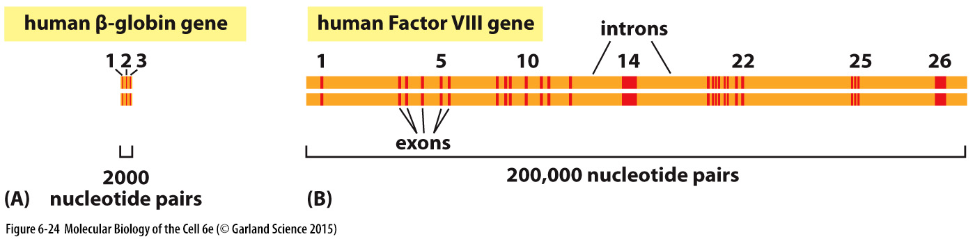
Splicing of the primary transcript
Notes:
Beta-globin mRNA = 625 bases
Human Factor VIII mRNA = 9009 bases
We will look at the splicing mechanism, there area multiple proteins involved

Slide 12
RNA splicing
Intron and exon sequences are transcribed into RNA.
Introns are removed from the newly transcribed pre-RNA through a process called splicing.
It takes place inside the nucleus before the RNA is exported to the cytoplasm.

Slide 13
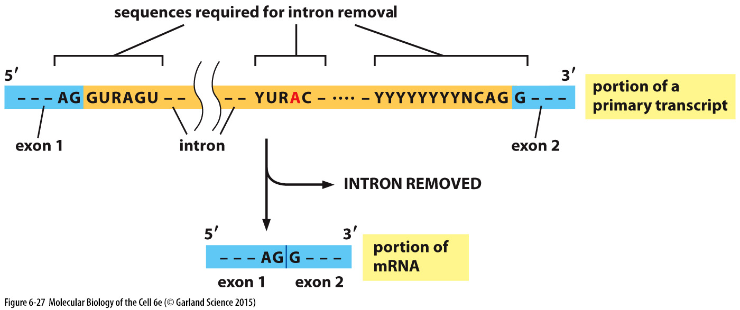
RNA splicing: key sequence motifs
5’ Splice site or
“Donor” site
3’ Splice site or
“Acceptor” site
Branch site
N= A,T, C or G
R= A or G
Y= C or T
Notes:
Need these sites for splicing
Its not always this best case scenario (alternative splicing, could have more that one concensus, where one is better than another)

Slide 14
RNA splicing: key sequence motifs
N= A,T, C or G
R= A or G
Y= C or T

Slide 15
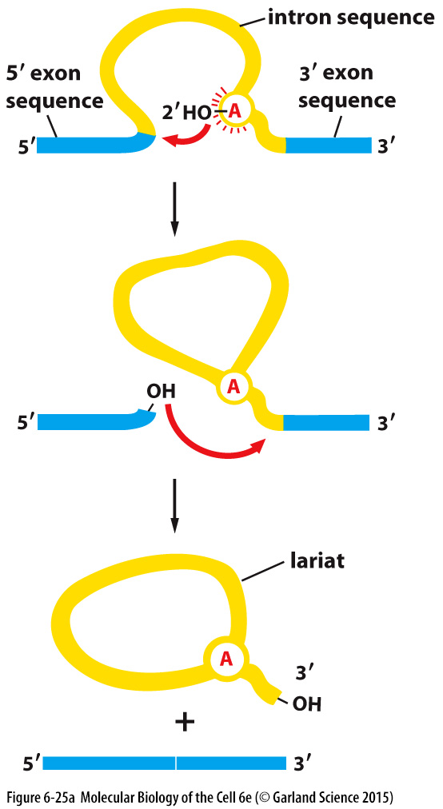
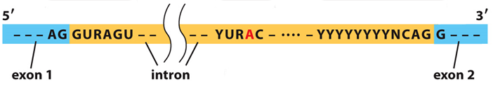
RNA splicing: Overall mechanism
It begins when the adenine in the intronic sequence YURAC (branch site) targets the phosphodiester bond located between the two guanine of the consensus splice donor site AG/GURAGU and cleaves it by a nucleophilic hydrolysis.
Notes:
Adenine targets the bond in the 5’ splice site

Slide 16
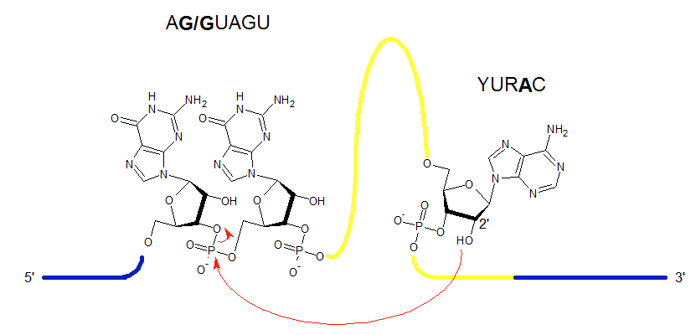
RNA splicing: Overall mechanism

Slide 17
RNA splicing: Overall mechanism
The newly exposed α phosphate group at the 5’ end of GURAGA can now formed a covalent bond with the 2’ OH group on the ribose of the adenine at the branching point.
  Transesterification reaction
  5’ to 2’ phosphodiester bond

Slide 18
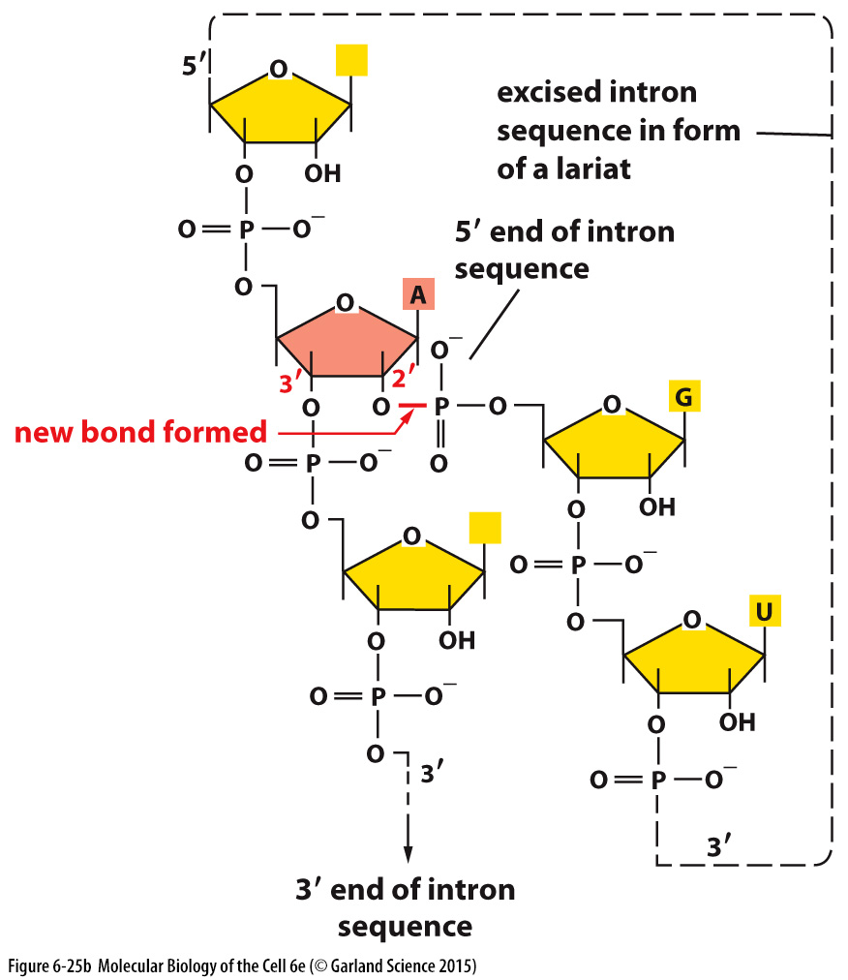
RNA splicing: Overall mechanism
5’
Notes:
5’-2’ bond versus 5’-3’

Slide 19
RNA splicing: Overall mechanism
The free 3’ OH group located on the ribose of the guanine at the end of the exon (exon AG-3'-OH) can now serve as substrate in a second transesterification reaction involving the 5' α phosphate group of a guanine located at the 5’ end of the next exon in the acceptor site, (Y)nNCAG/G (5’ to 3’ bond).

Slide 20
RNA splicing: Overall mechanism
End results:
  The two exons are merged into a continuous reading frame for translation.
  The lariat structure will eventually be degraded by ribonucleases and its rNMPs recycled.
Notes:
But how come these specific sequence are chosen
the cell will degrade the lariat structure

Slide 21
Spliceosome
mRNA splicing is carried out by RNAs with catalytic activity called small nuclear RNAs or snRNAs.
  These snRNAs are less than 200 nucleotides in size.
  They have name such as U1, U2, U4, U5 and U6 (snRNA U1)
  They used complementary base pairings to recognize exon-intron junction and carried out transesterification reaction.
  Each snRNA is associated to 7 or more proteins to form a complex called small nuclear ribonucleoproteins or snRNPs.
  These various snRNPs collectively form the spliceosome.
Notes:
Each one is associated with a group or protein … snrnp
Ex, you will have a snrnp u1 complex

Slide 22
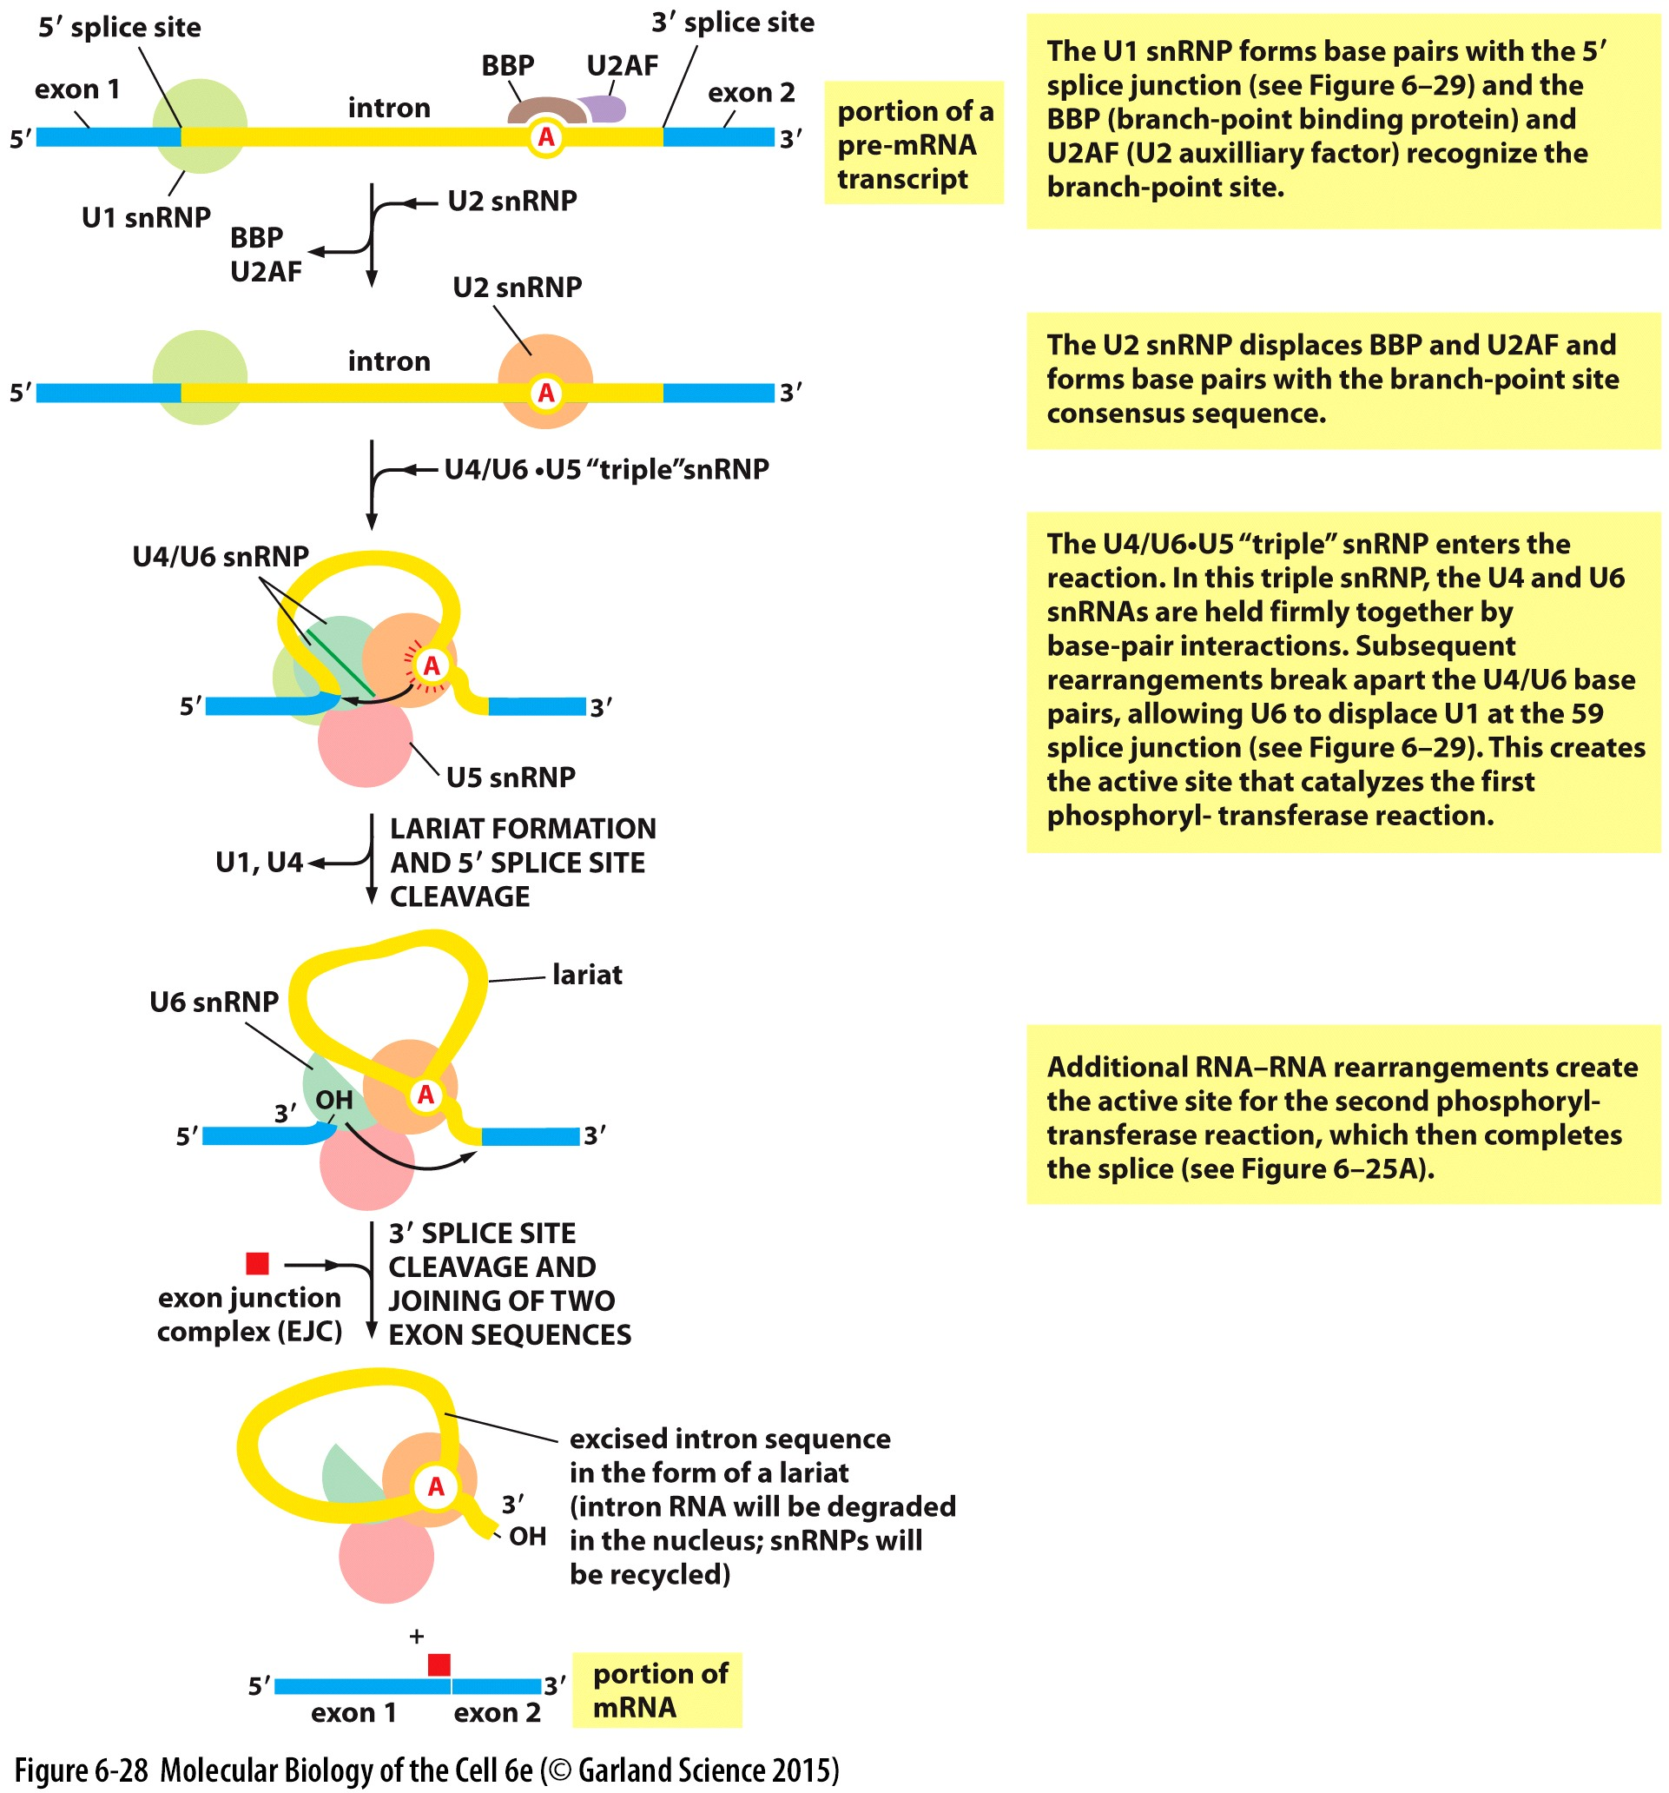
Spliceosome

Slide 23
Splicing mechanism (spliceosome)
The assembly
  The branching point is recognized by two proteins: the Branching point Binding Protein (BBP) and an accessory protein named U2AF.
  Soon after, these proteins are replaced by the U2 snRNP. Within the U2 snRNP, the U2 RNA pairs with the YURAC consensus sequence. This base pairing exposes the catalytic center.
  At the same time, the U1 snRNP recognizes the upstream exon/intron junction, it allows the U1 RNA to bind to the donor consensus site.
  Finally, the U4/U6 and U5 “triple” snRNPs is recruited by U1 and U2 snRNP to complete the assembly.

Slide 24
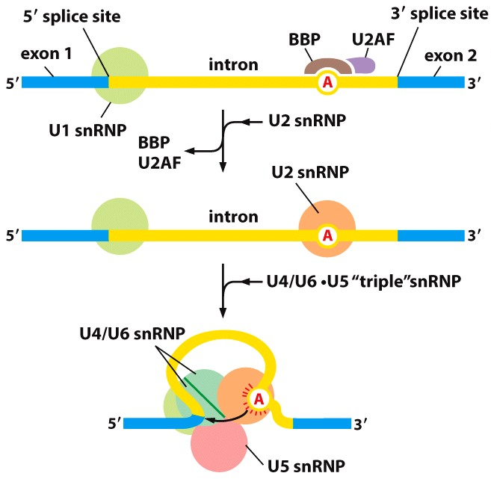
Splicing mechanism (spliceosome)
Notes:
U4 and u6 are closely linked together and will attract the triple one

Slide 25
Splicing mechanism (spliceosome)
The splicing reaction
  U4 and U6 snRNPs are held together by base pairing within their respective RNAs.
  ATP-dependent rearrangements break apart the U4/U6 base pairing Subsequently, U6 displaces U1 snRNP on the 5’splice site creating the active site that catalyzes the first transesterification reaction.
    U4 snRNP is released from the spliceosome during the rearrangements.
  Others ATP-dependent rearrangements allows the U2/U5/U6 snRNPs to make up a new active site at the 3’ acceptor site to catalyze the second esterification reaction.
Notes:
Each successful splice reaction requires more than 200 proteins
you will get an atp dependent rearrangement
U6 rna displaced the u1 on the 5’ splice site → get rid of u1 and u4
The new active site will be at the level of the second splice site and will catalyze the second round of esterification

Slide 26
Splicing mechanism (spliceosome)
Notes:
All these structures are help together, that’s why the consensus sequences are so important

Slide 27
Exon definition hypothesis
The spliceosome plays a crucial role in recognizing the exon-intron junctions.
  These factors are “placed” on their consensus sequences as the transcription takes places.
Notes:
How can it tell which is which (exon vs intron)
Splisozome does part of the job
Each time you pass a site you drop a factor

Slide 28
Exon definition hypothesis
To reduce splicing errors, the eukaryotes have developed mechanisms to recognize exons.
  Exons are recognized by SR proteins (SR because they are rich in serine and arginine)
  According to current model, SR proteins bind preferentially to exon sequences and then recruit, U1 snRNP and U2AF.
  This recruitment occurs as the transcription takes place.
Another group of RNA-binding proteins helps identify introns.
  These proteins bind preferentially, but not exclusively, to intron sequences to form hnRNP (heterogenous nuclear ribonucleoproteins) complexes.
  Another role of these hnRNPs would be to condense large introns to facilitates their excision.
Notes:
Will use two groups of proteins
At the end all of the splicing factors will come together

Slide 29
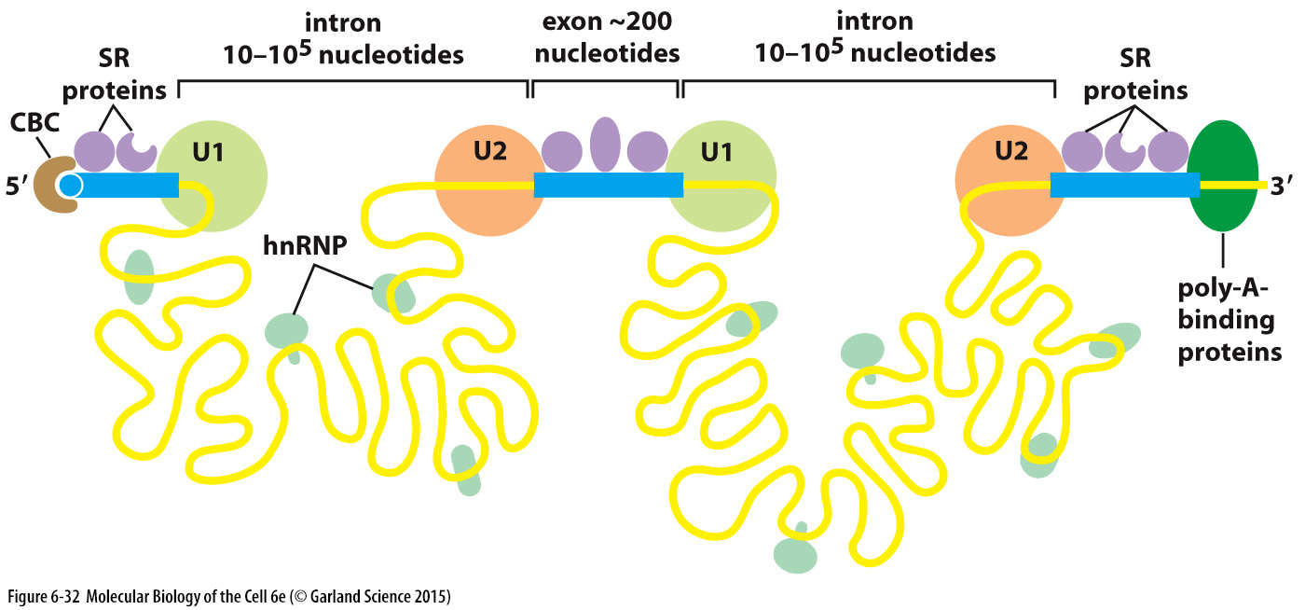
Exon definition hypothesis
The spliceosome, SR proteins and hnRNP allow the cell to « read » the information in the precursor mRNA.
  It is important to note that the removal of the introns does not necessarily occurs in the same order as the occur in a mRNA molecule
  Some splicing reaction occurs even after transcription is completed.
Notes:
100 kb intron

Slide 30
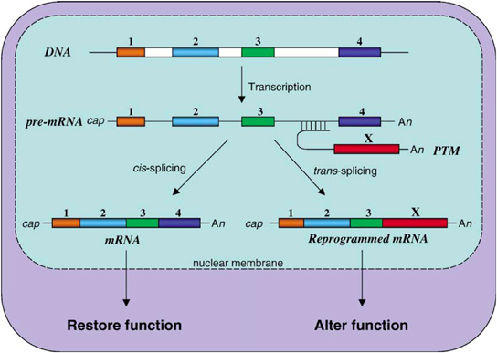
Other form of splicing
Minor spliceosome
  Recognition of different consensus sequences
Trans-splicing
  Rarely occurs.
  Trans-splicing generates a new mRNA from multiple separate pre-mRNA.
Notes:
Wont be on exam at all

Slide 31
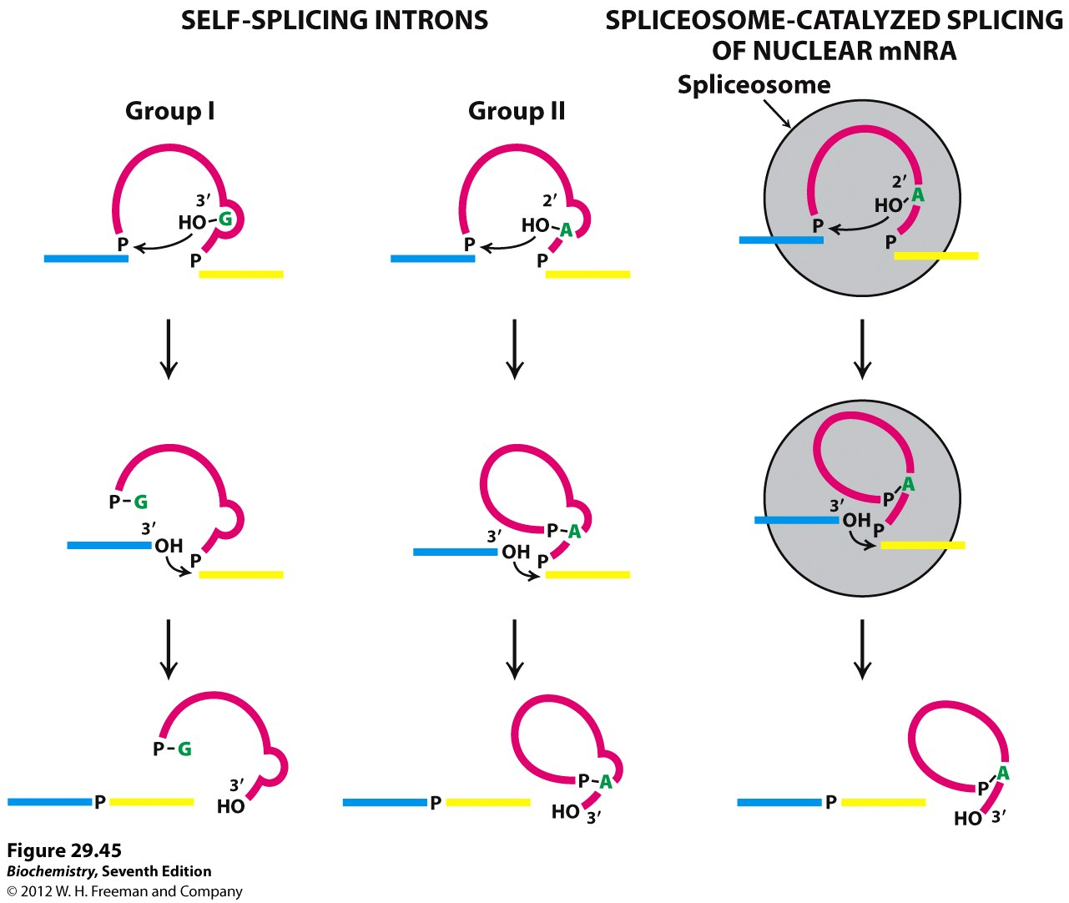
Other form of splicing
Self-splicing

Slide 32
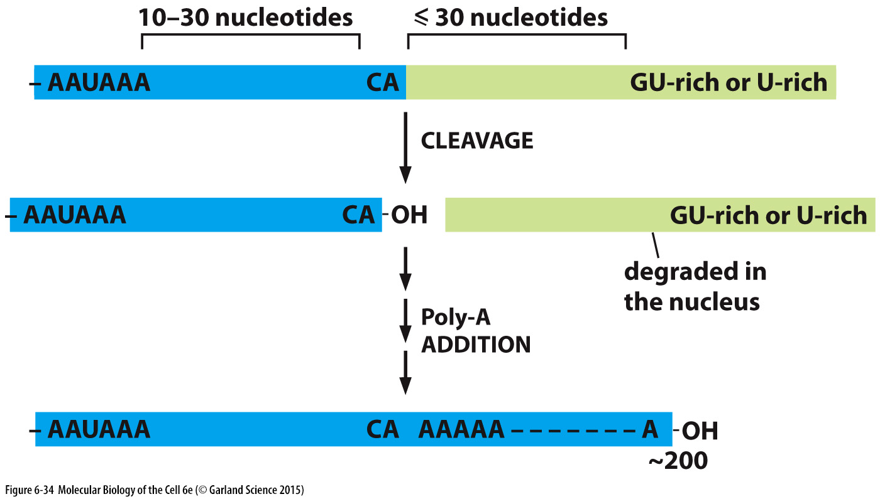
Polyadenylation
Consensus sequences
  Three sequences found in the 3’ untranslated region of the mRNA are necessary for the polyadenylation of a mRNA
    The AAUAAA consensus sequence, the CA dinucleotide and a GU-rich regions.

Slide 33
Polyadenylation
Mechanism
  CPSF (cleavage and polyadenylation specificity factor) and CstF (Cleavage stimulation factor F) are “recruited” by the phosphorylated CTD of the RNA polymerase II.
  These two proteins are in charge of recognizing the AAUAAA (CPSF) and the GU-rich (CstF) consensus sequences.
  Once they are bound to their consensus sequences, additional factors are recruited, mainly an endoribonuclease that cleaves the transcript following the CA dinucleotide of the cleavage site.
  This cleavage produces a free 3’ OH at the end of the transcript which will be used as the substrate for the poly-A polymerase (PAP)
    The PAP is ATP dependent and template independent
  As the poly-A is synthesized, the poly-A binding protein (PABP) binds to the poly-A
    Ratio of 1 PABP for each 30 A units.
    The PABP molecules will remain on the mRNA until the end of its processing and will accompany the mature mRNA during its transport to the cytoplasm.
Notes:
Cpsf recognizes the aauaa
The pap will just keep going

Slide 34
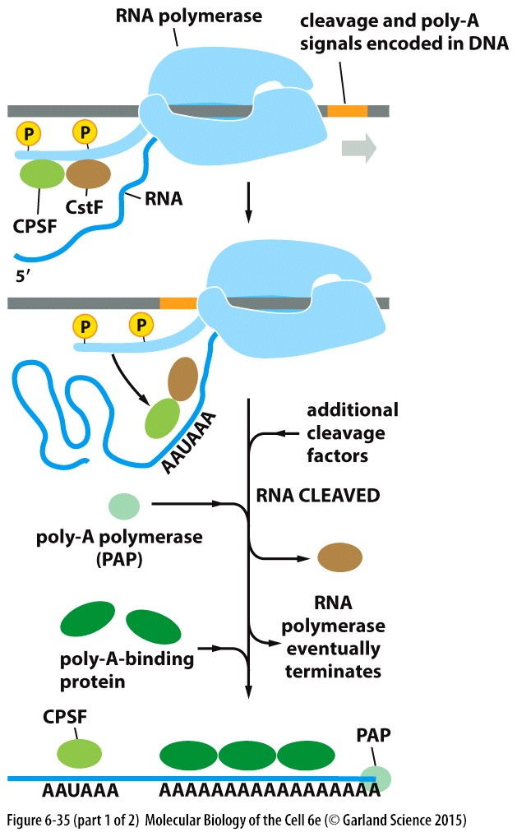
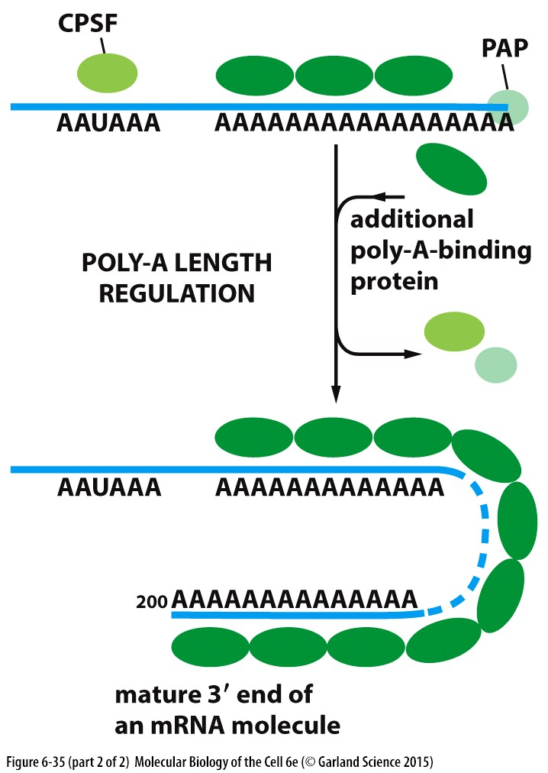
Polyadenylation
Endoribonuclease

Slide 35
Polyadenylation
Roles of polyadenylation:
  Protects against degradation by exonucleases
  Increases the efficiency of mRNA nuclear export
  Increases translation efficiency

Slide 36
mRNA transcription and maturation in eukaryotes
The phosphorylation of the C-terminal domain of the RNA polymerase bridges transcription initiation with mRNA maturation.
  Before transcription begins, the CTD is not phosphorylated. It is associated with the mediator complex and various proteins that constitute the pre-initiation complex.
  Partial phosphorylation of the CTD takes place on Serine 5 during transcription initiation (TFIIH). This allows the recruitment of the capping factors.
    Tyr-Ser-Pro-Thr-Ser(*)-Pro-Ser
  Gradual phosphorylation of Serine 2 during the elongation phase allows the recruitment of the splicing factors.
    Tyr-Ser(*)-Pro-Thr-Ser-Pro-Ser
  Cleavage and polyadenylation factors are finally recruited to the phosphorylated CTD once the transcription machinery has reached the polyadenylation signal.
Notes:
You will just place the splicing factor as you go
Once poly a signal is reached they will disassociate

Slide 37
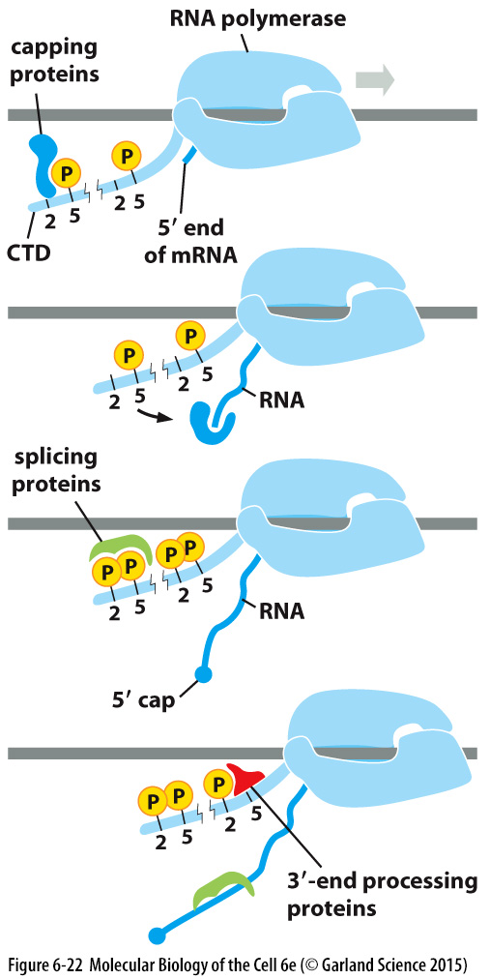
mRNA transcription and maturation in eukaryotes

Slide 38
mRNA processing

Slide 39
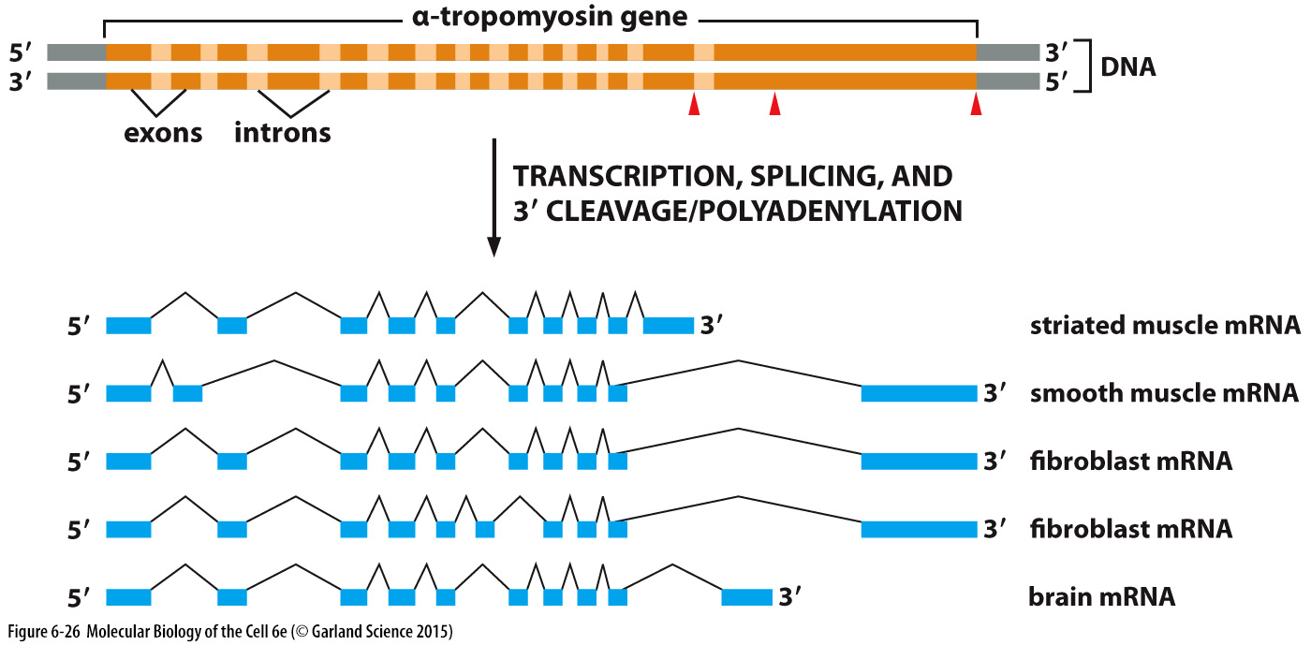
Alternative splicing
Notes:
One gene creates many rna
In one cell you can have multiple versoins coming from one gene

Slide 40
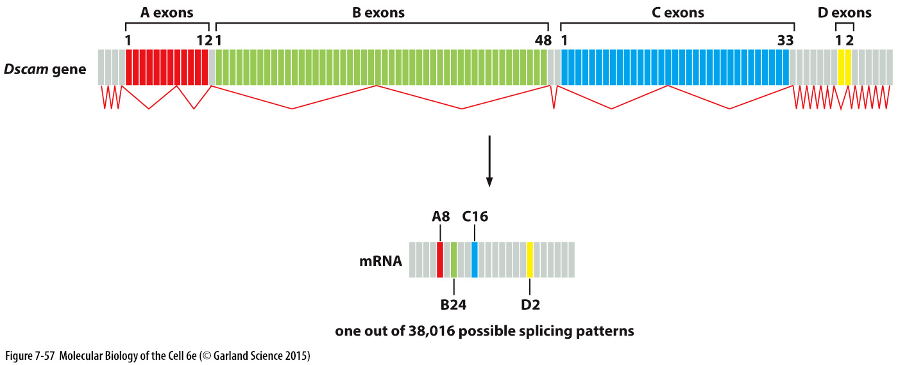
Alternative splicing
Drosophila Dscam (Down syndrome cell adhesion molecule) receptor.
  Dscam gene contains 115 exons
  Dscam mature mRNA is 24 exons
Notes:
Accessory proteins in the spliceosome are responsible for this alternative splicing
Drosophila genome contains 15,016 genes
Good example
Everything in grey, you have to have it, they will always be present
In groups a,b,c and d the gene will choose only one from each
The first transcript will be all of them, it’s the splicing that will make them all different

Slide 41
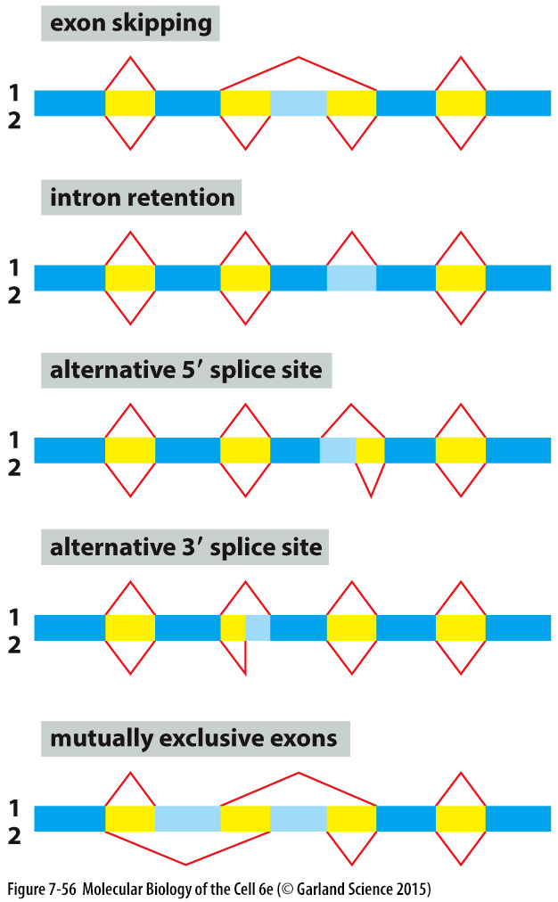
Alternative splicing
Alternative splicing occurs through 5 possible scenarios.
Notes:
Accessory proteins in the spliceosome are responsible for this alternative splicing
Drosophila genome contains 15,016 genes
Blue is exon, yellow intron
Intron retention→ the intron is kept in
Mutually exclusive → will always

Slide 42
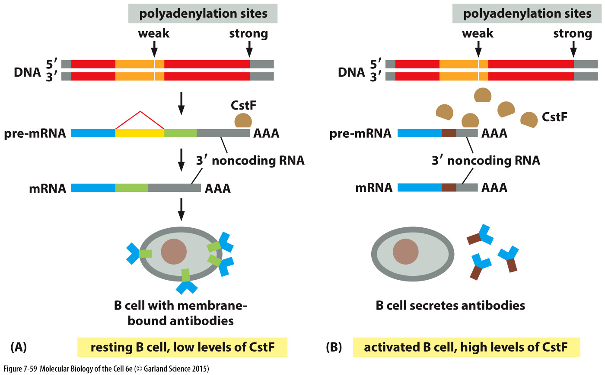
Alternative polyadenylation (APA)
(Immunoglobulin heavy-chain M gene)
Notes:
Strong one may have mutation that makes it less attractive
It will go to the strong site
Hydrophobic region makes the antibody stick to the mem
The hydrophobic aa will for a ddomain, the antibodies will get stuck to the mem
If you activate the cells, npw there is so much cstf it will also bind to the weak one
Even before you get splicing cscf will bind and recruit the endoribonuclease and do the polyadenylation, once you cut it gets degraded → but you gain part of the intron, you will get a new mrna produced, now the hydrophobic domain is gone and the antibodies will be secreted

Slide 43
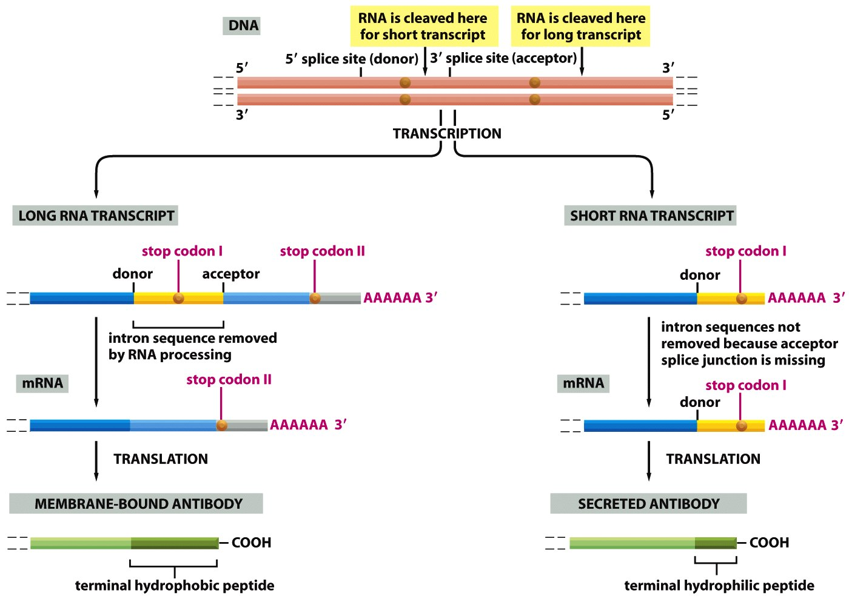
Alternative polyadenylation (APA)
Notes:
Shows same thing as last slide, just more detail

Slide 44
Nuclear turnover of RNA
In eukaryotes, about 90% of the ribonucleotides incorporated into mRNA precursors during synthesis are later eliminated, and recycled, because they are part of introns or of the 3’UTR beyond the polyadenylation site.
Also, mRNAs are carefully examined to eliminate mRNAs that contains an incomplete reading frame or other detrimental alterations.
  These verifications are done before the mature mRNA is exported towards the cytoplasm.
Notes:
How to control the level of mrna in the cell via degradation
A large amount of whats transcribed gets degraded
Once the pre-mrna is cleaved … a hige portion of what will be transcribed will be degraded
This is done before they leave the nucleous
Will always involve Rnase’s

Slide 45
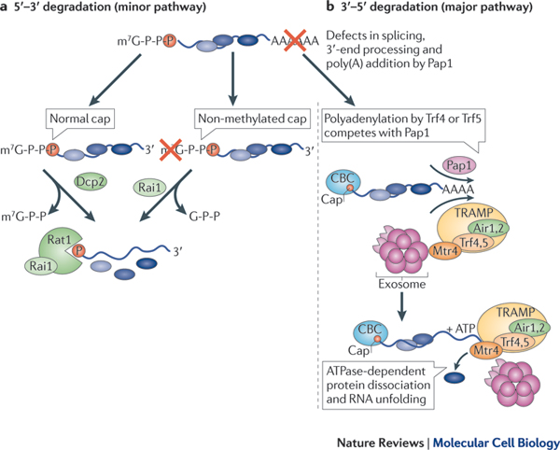
mRNA degradation by the RNAses
RNases
Nature Reviews Molecular Cell Biology 12, 377-384 (June 2011)
Notes:
Normally it will go from the pol-a tail going in
If you have a non-methylated cap you will gets lots of degradation
Don’t neeed to know the details of all these pathways

Slide 46
mRNA degradation by the RNAses
Exosome complex
  This multi-proteins complex is able to degrade various types of RNA.
  The core of the enzyme contains six proteins arranged into a ring structure.
    These proteins belong to the same class of RNases, the PH-like RNases.
    3’ to 5’ exonucleases
  Roles of the exosome complex
    Involved in the surveillance and nuclear degradation of aberrant pre-messenger RNAs
      Errors splicing or 3’ end processing (polyadenylation)
    Involved in the degradation of mRNA with incomplete reading frame.
      Non-sense mediated mRNA decay
    Involved in the 3’ turnover of normal mRNAs
    Involved in the degradation of mRNAs containing specific A+U-rich sequence elements (AREs).
Notes:
Big complex but the core is 6 protein in a ring structure, other factors will be recruited
Depending on what you put in your exosome will give it different action
Will scan mrna and if anything is wrong they will degrade

Slide 47
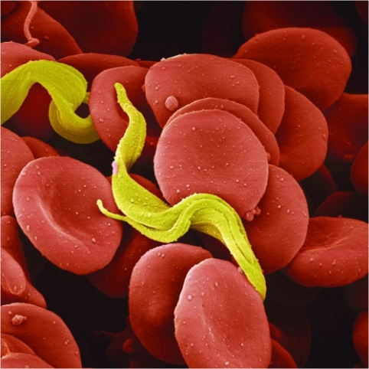
Nuclear edition
Eukaryotic cell possess the ability to edit mRNAs to modify its information contents
  Mainly observed in trypanosomes
    Trypanosome caused sleeping sickness
  Addition (or removal in some cases) of UMP (Uridine monophosphate) residues in mitochondrial mRNAs.
  Use of guide RNAs to transform a transcript without a meaningful information into something meaningful.
UC San Diego Health Sciences
Notes:
There are 2 different ways, one is the use of guide
Doesn’t interfere with the transcription process
The yellow piece is using the rna guide →
Nuclear addition will not be on the exam

Slide 48
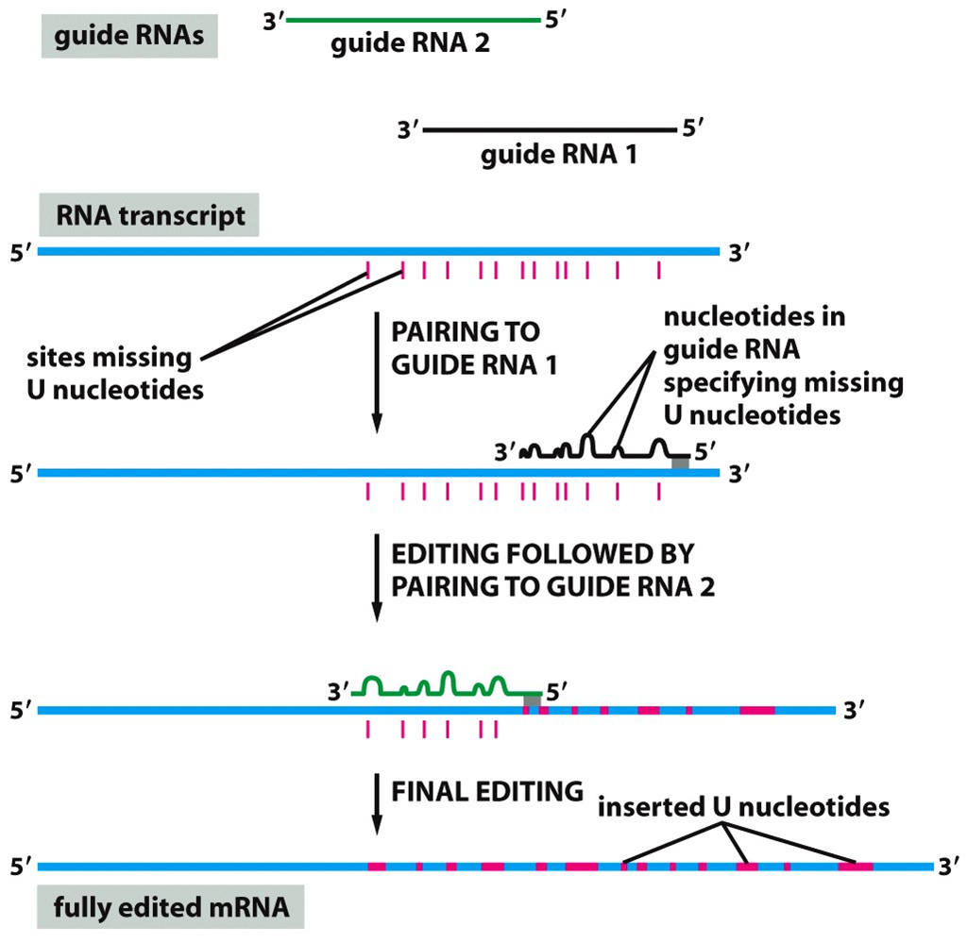
Nuclear edition
Notes:
This will not be on the exam, just to show that it exists
Will create a whole new mrna, insert new nucleotides at specific points

Slide 49
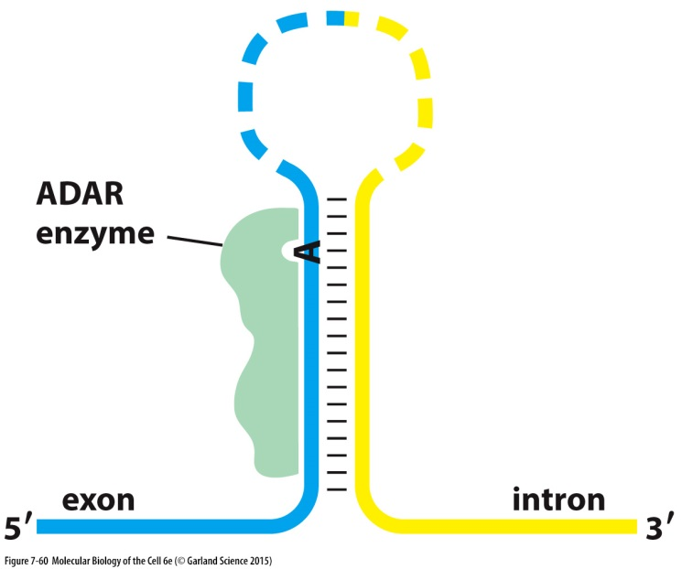
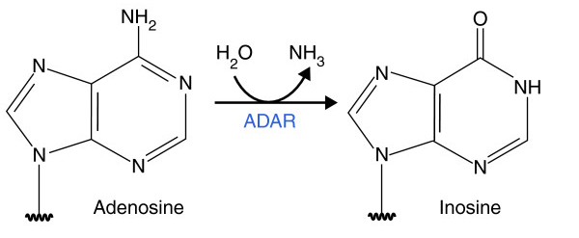
Nuclear edition in mammals
ADAR (Adenosine Deaminase Acting on RNA) editing
  Enzymatic reaction that changes an adenine into an inosine residue.
  This deamination reaction is catalyzed by the ADAR enzyme (adenosine deaminase acting on RNA enzyme).
  The location of the editing site is often determined by the presence of a secondary hairpin structure.
Genome Medicine 11/2013; 5(11):105.

Slide 50
Nuclear edition in mammals
ADAR (Adenosine Deaminase Acting on RNA) editing
  Allow the cell to modify a splice site
  As inosine can pair well with an adenine or a cytosine, this modification in first two positions of a codon can lead to a protein with a different amino acid from the one predicted by the information found in the gene.
    Wobble hypothesis
  A similar mechanism performs C to U editing (see example)

Slide 51
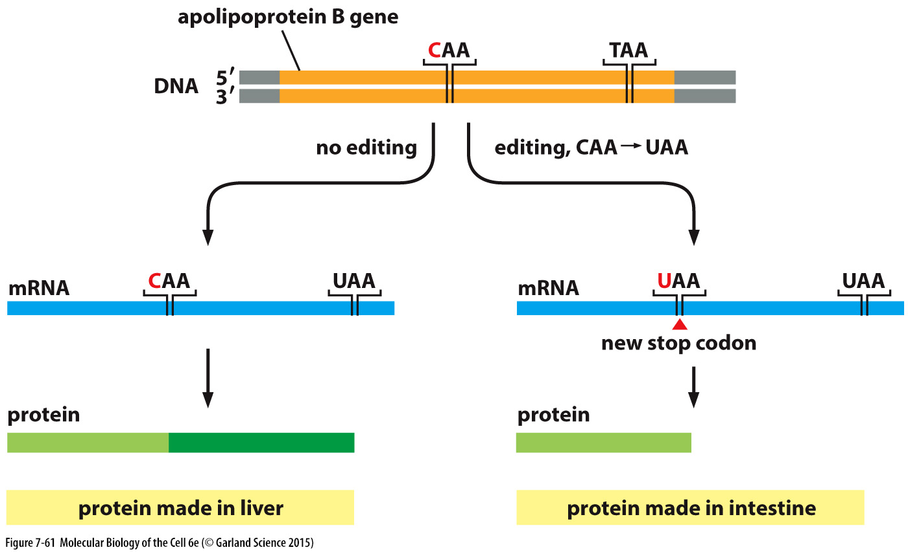
Nuclear edition in mammals

Slide 52
Levels of control of gene expression
Level | Main characteristic
Transcriptional | Controls the transcription initiation frequency of a gene
mRNA maturation | Quality control, splicing
mRNA transport and localization | Distribution to cell compartments
mRNA stability | Transcript half-life
Translation | Control at the level of mRNA decoding
Protein activity | Folding, localization, modification, half-life

Slide 53
Degradation of nonsense mRNA
Non-sense mediated mRNA decay (NMRD)
  This mechanism eliminates mRNAs that have an incomplete reading frame.
    Non-sense mutations that introduce a stop codon at the wrong place.
    Frameshift mutations (insertions or deletions)
    Splicing errors
    Recombination events that would produce a hybrid transcript with a shorter reading frame.

Slide 54
Degradation of nonsense mRNA
Non-sense mediated mRNA decay (NMRD)
  Non- sense mRNA degradation depends on the location of the first stop codon with respect to exon- exon boundaries generated during mRNA splicing.
    If the first stop codon is downstream of the last exon-exon boundary (further in the 3’ direction), the transcript escapes degradation by this mechanism. The exon-exon boundary is identified by proteins of the Exon-Junction Complexes (EJC).

Slide 55
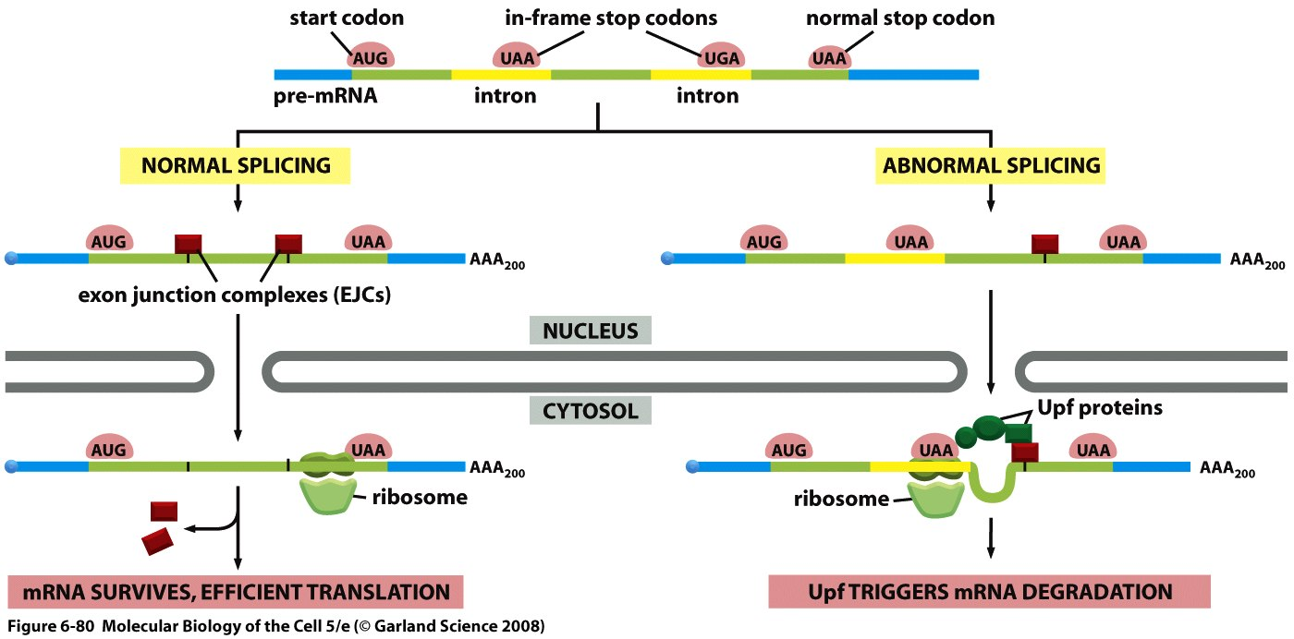
Degradation of nonsense mRNA
Non-sense mediated mRNA decay (NMRD)
Nonsense- mediated mRNA decay prevents synthesis of truncated proteins.
Figure 6-80 Molecular Biology of the Cell (© Garland Science 2008)
Notes:
As a mRNA exits the nucleus, it is met by a ribosome that performs a “trial run of translation”. This ribosome displaces the EJC proteins as it encounters them during translation. However, if the ribosome stalls because it encounters a premature stop codon, there will be EJC proteins downstream of the ribosome and this will, in turn bring in proteins such as Upf that will trigger degradation of the mRNA that failed the test. You can guess why this mechanism will not work should there be a premature stop codon in the last exon.

