Slide 1
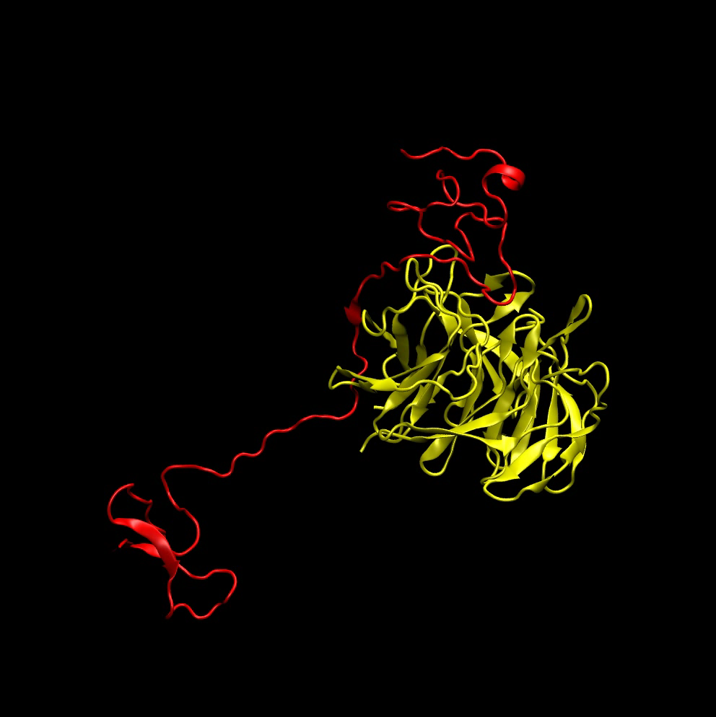
James Choy (Office: MSB 302)
jchoy4@uwo.ca
Protein folding and stability
Misfolding & Aggregation
Protein-protein interactions
Intrinsically disordered proteins

Slide 2
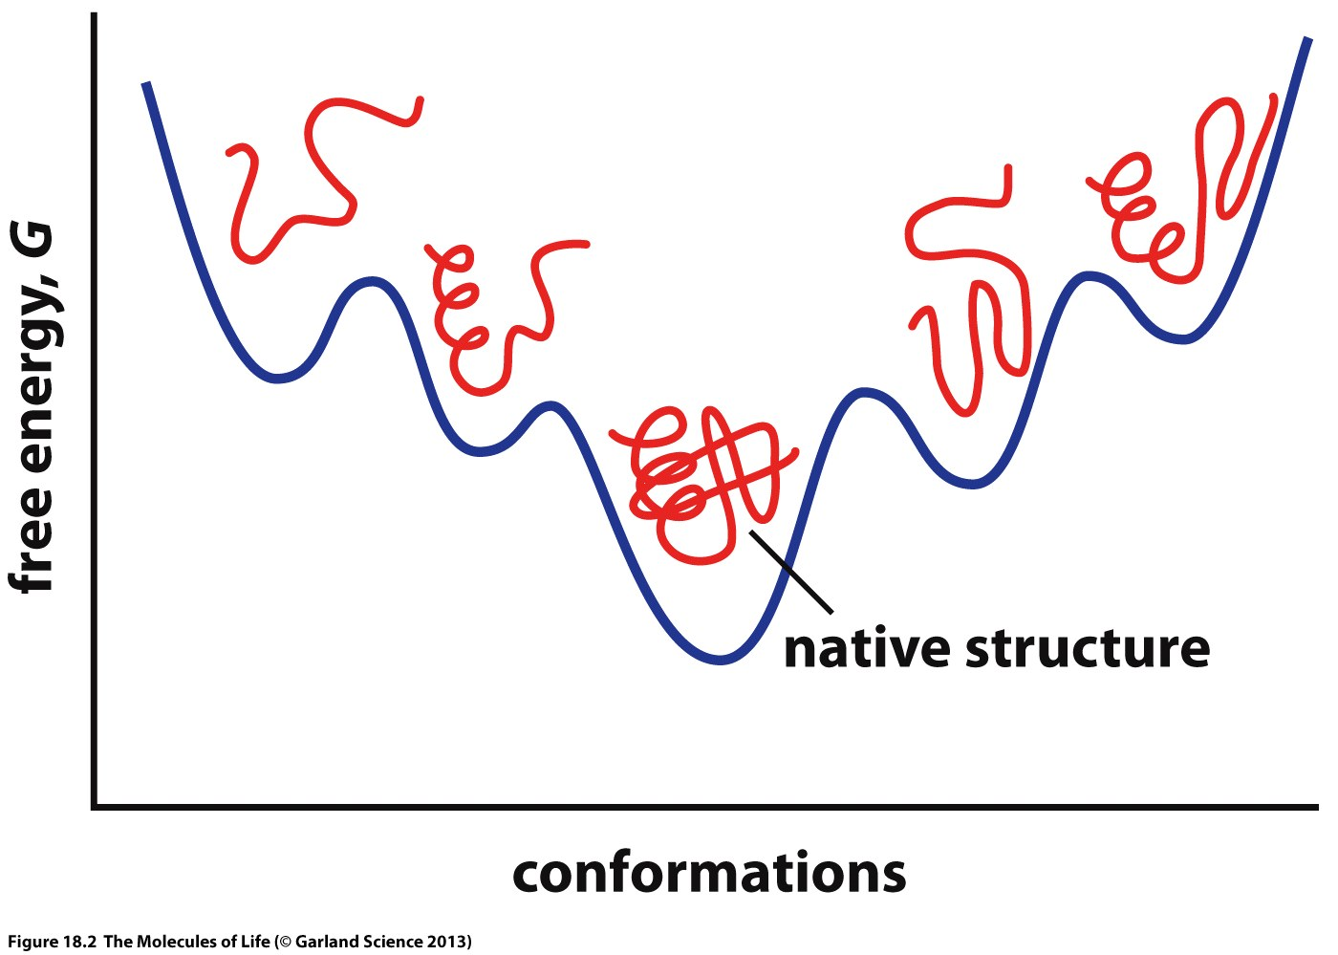
How Proteins Fold?
Figure 18.2 The Molecules of Life (Garland Science 2013)
Notes:
Misfolding can cause aggregation, denaturation or fibres (AD)

Slide 3
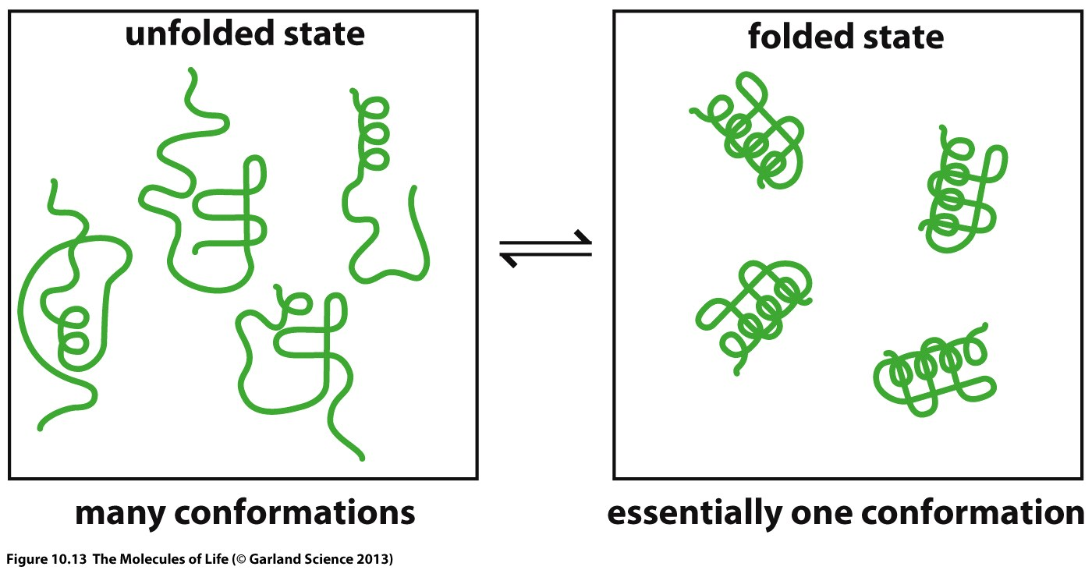
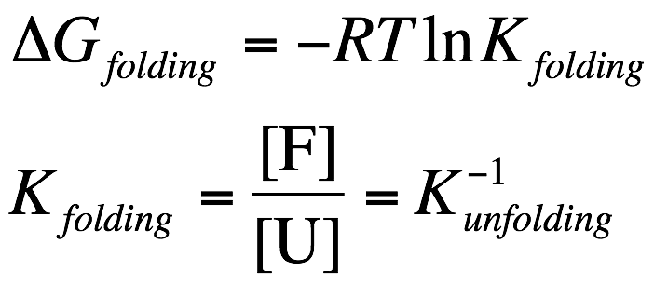
What determine the position of this equilibrium ?
ΔG_{folding} (310 K) | % in folded state | % in unfolded state
-5.7 kcal/mol | ~99.99% | ~0.01%
-3.3 kcal/mol | ~99.5% | ~0.5%
-2.4 kcal/mol | ~98% | ~2%
Figure 10.13 The Molecules of Life (Garland Science 2013)
Notes:
Intrinsically disordered proteins have no established structure but still have function
One hydrogen bonds can be 1-2 kcal, so 5.7is not a lot
Lots of proteins in our cells have lower delta G
Drop to 98% from losing one or two hydrogen bonds, that 2% can show their hydrophobic portions and aggregate, which can push more protein towards unfolded state

Slide 4


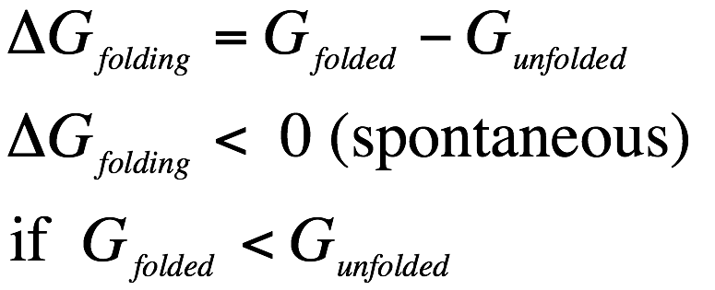
Free energy difference between the folded and the unfolded states
In a biochemical system, enthalpy (H) is the “heat content”
Entropy (S) can be defined as the degree “randomness” (disorder) of the system.
U
Gibbs Free energy (G)
F
Degree of folding
Enthalpy change (ΔH) is the change of enthalpy of the system in a biochemical reaction or transformation
Entropy change (ΔS) is the change of the degree of “randomness” of the system in a biochemical reaction or transformation.
Notes:
Only focus on enthalpy and entropy
DeltaH is change in bonding of unfolded and folded states, more interactions has lower enthalpy (lower is more)
Low entropy in folded state, rigid structure

Slide 5
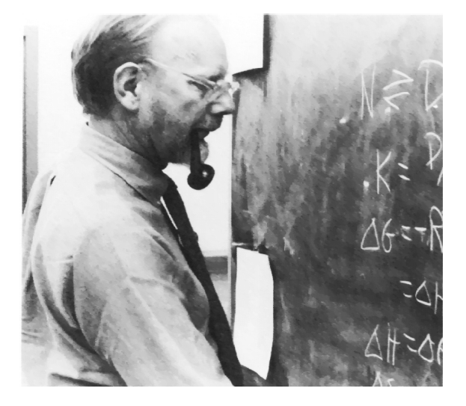
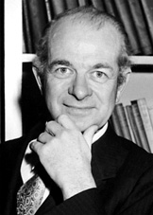
Linus Carl Pauling (1901-1994)
1954 Nobel Prize in Chemistry
1962 Nobel Peace Prize
Walter J. Kauzmann (1916-2009)
Introduce the concept that hydrophobic effect is the driving force of protein folding.
"for his research into the nature of the chemical bond and its application to the elucidation of the structure of complex substances"
Kauzmann, W. (1959) Adv. Protein Chem. 14, 1-63.
Mirsky & Pauling (1936) PNAS, 22, 439-447
Biophysical Chemistry (2003), vol. 105
For Walter Kauzmann’s 85th birthday.

Slide 6
The structure and biological activity of a protein are mediated by its interactions with the environment, which includes water, ions, other proteins, DNA, membrane, etc.. Therefore, when we investigate a protein folding process, we need to consider the free energy change of the whole system, not just that of the protein itself.
Quick review of some important non-covalent interactions:
Electrostatic interaction
Van der Waals interaction
Hydrogen bond
Reading: Thomas E. Creighton (1993), Proteins: structures and molecular properties 2nd ed. W.H. Freeman and Company, New York, p 140-148. (2-hour reserve)

Slide 7
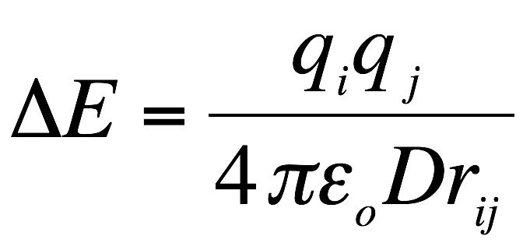
Electrostatic interaction
The energy of the electrostatic interaction between two atoms, i and j, is described by the Coulomb’s law (valid only when r_{ij} is significantly larger than the size of the atoms):
i
j
r_{ij}
(distance between i and j)
q_{i} and q_{j} are the charges on atom i and j, respectively. If the signs of q_{i} and q_{j} are opposite, ΔE < 0 (attraction)
If the q_{i} and q_{j} have the same sign, ΔE > 0 (repulsion)
ε_{o} is the permittivity of free space (constant)
D is dielectric constant of the medium.
For vacuum, D = 1, and for water, D ≈ 80
The apparent dielectric constant of a solution increases in the presence of small ions (i.e. Na⁺, K⁺, Cl⁻, etc.)
Notes:
Increase in D due to polar or charged media is because of interference

Slide 8
Dipoles
Electronegativity is defined as the power of an atom to attract electrons to itself.
O: 3.45 C: 2.55 N: 2.98 S: 2.53 H: 2.13
O
C^{α}
O⁻
C^{α}
C
N
C
N
C^{α}
H
C^{α}
H⁺
δ⁻
Dipoles interact with point charges and with other dipoles.
Interactions between dipoles are weaker than those interactions between ions.
Short-range (inversely proportional to third power of the distance)
O
C
N
Dipole moment
μ
H
δ⁺

Slide 9
Van der Waals interaction
A transient dipole arises from a temporarily asymmetric orientation of the electrons and nucleus.
A transient dipole can induce a dipole in neighboring atoms, resulting in an attractive interaction.
Short-range and weak
Occurs among all atoms and molecules
δ⁻
δ⁺
δ⁻
Hydrogen bonding
D
H
A
(Donor)
(Acceptor)
Backbone C=O and N-H groups are frequently involved in H-bonds in proteins.
Distance between the nitrogen and oxygen involved in a H-bond is ~ 3 Å.
N
H
O
C
Notes:
Hydrogen bonding can induce dipole so can be considered Van der Waals interactionds

Slide 10
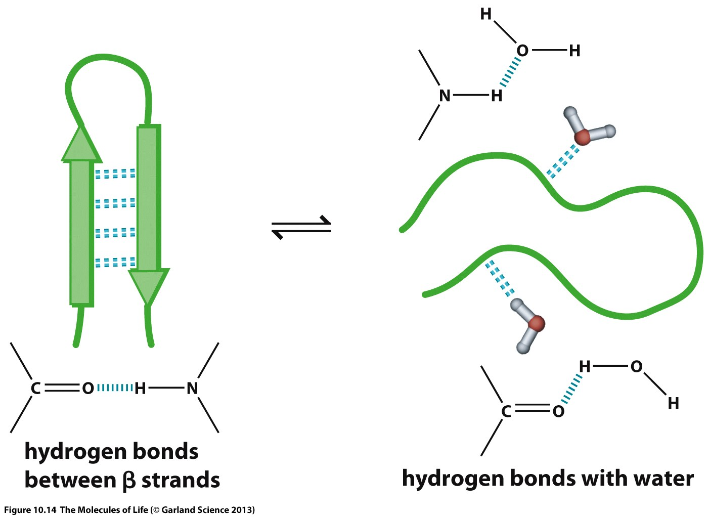
Protein folding results from a balance between enthalpy and entropy

Slide 11
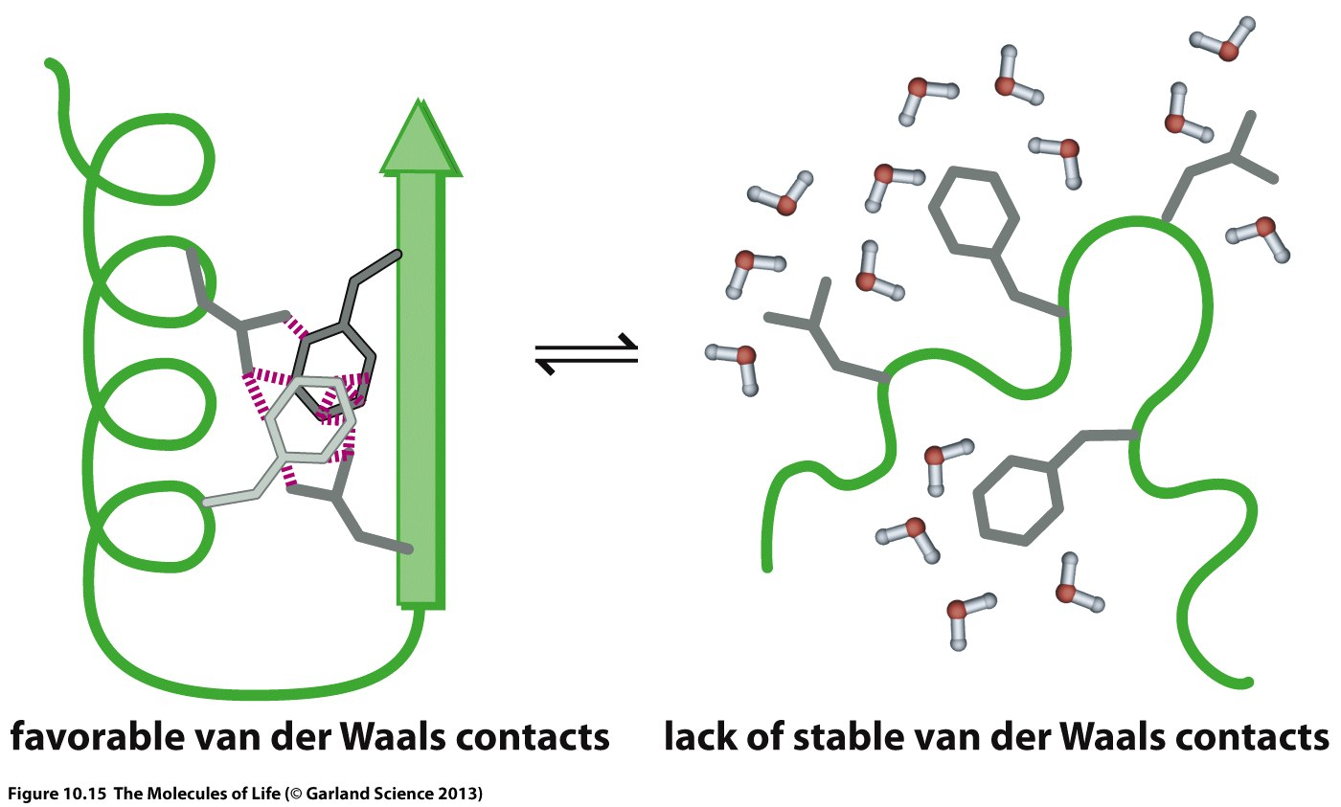

Slide 12
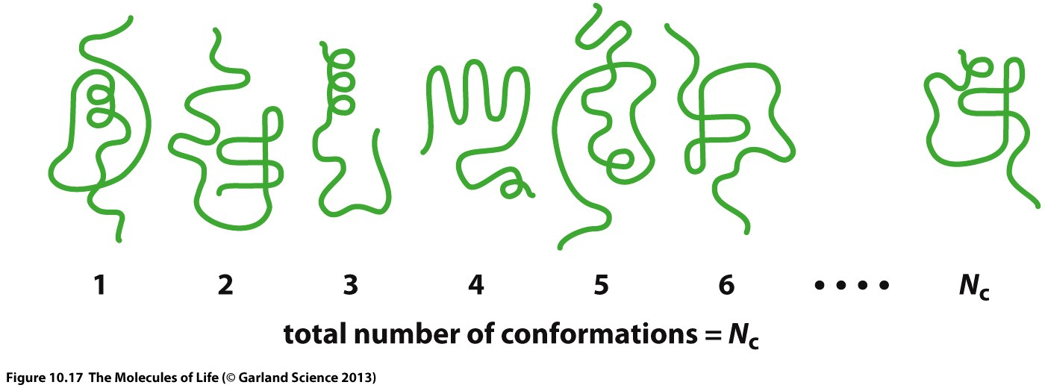
A protein can adopts a large number of conformations in its unfolded state
If only the protein is considered,
S_{unfolded} should be significantly higher than S_{folded}
Notes:
Lose DeltaS and don’t gain much from DeltaH in water

Slide 13
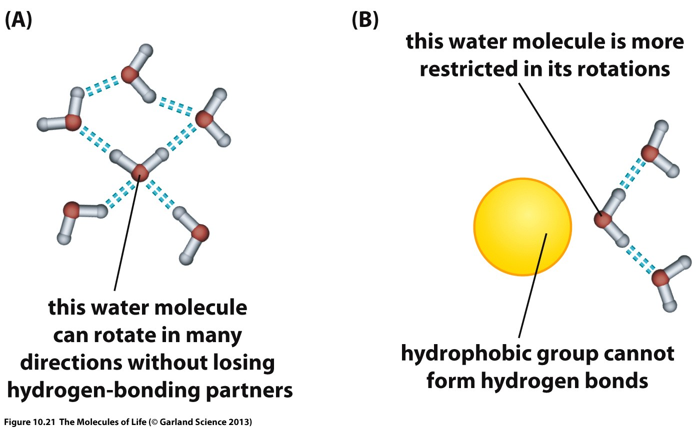

Slide 14
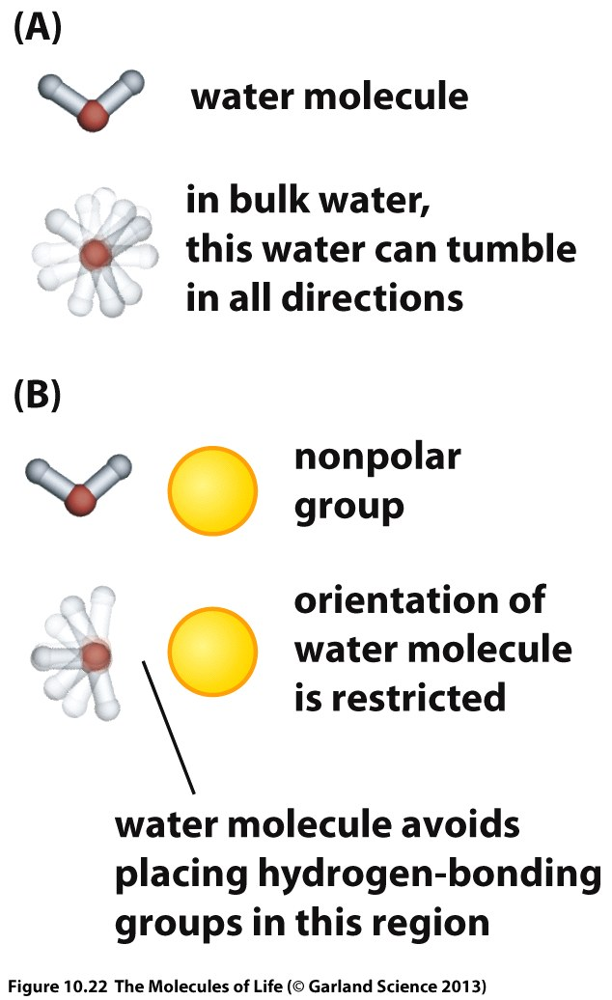
Notes:
Protein in water reduces entropy of the system, less freedom of water molecules

Slide 15
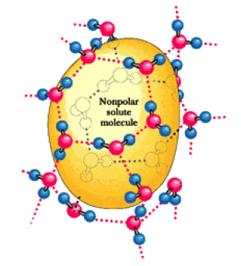
Hydrophobic Interaction
The preference of nonpolar atoms for non-aqueous environments
Reorganization of water molecules surrounding the nonpolar solute.
To maximize the van der Waals interactions with the solute and more importantly, the H-bonds among the water molecules.
The water molecules around the nonpolar solute become more “structured”, therefore, the entropy of the system decreases (ΔS < 0)
“Water cage”
Garrett & Grisham, Biochemistry, 3rd edition.

Slide 16
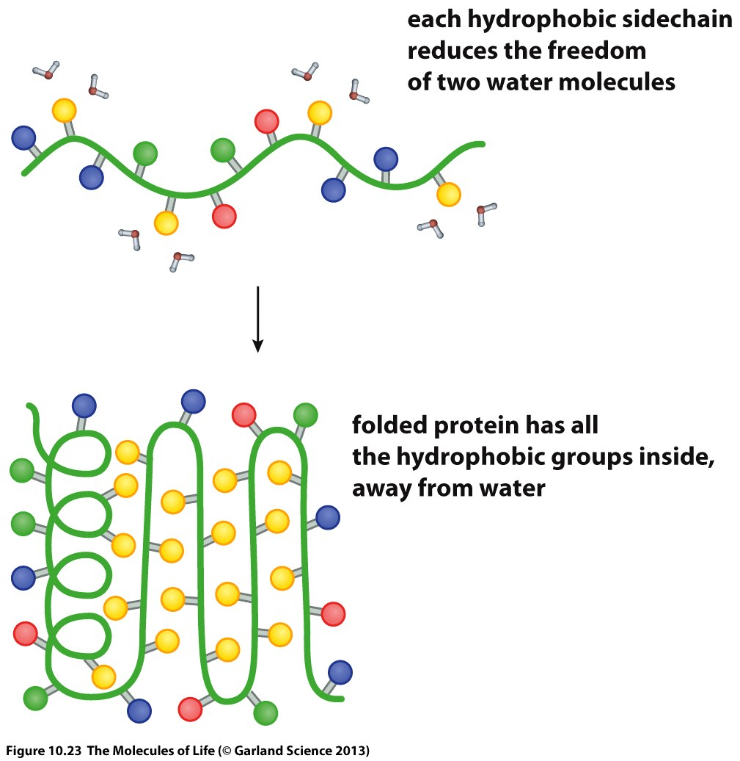
Notes:
DeltaH is not always be the driving force, in this case the entropy is the driving force
Entropy of protein decreases because of folding so it’s not favourable but the driving force is the increase in entropy of water due to freedom of movement when hydrophobic portions hidden in water or solution

Slide 17
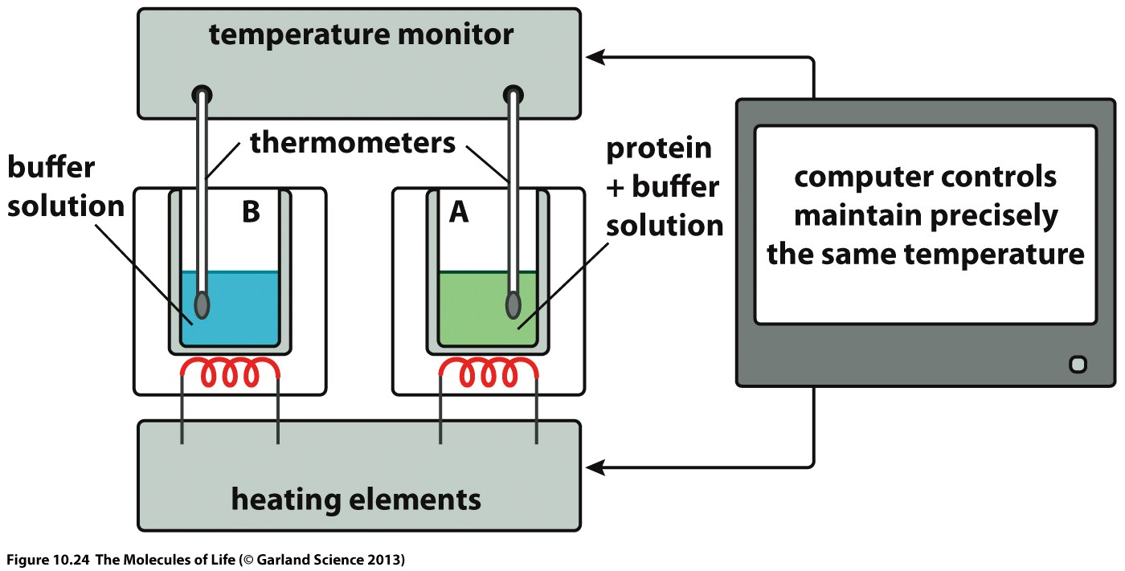
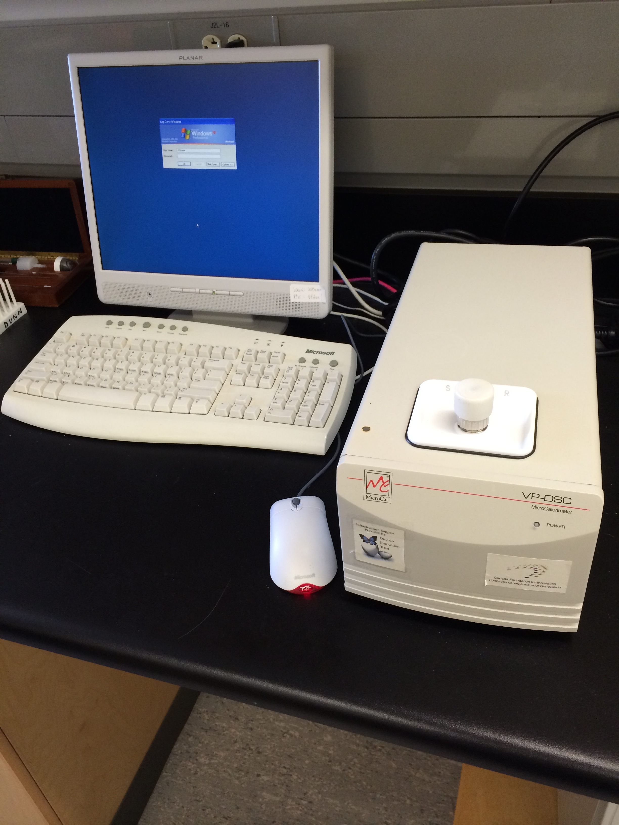
Differential Scanning Calorimetry (DSC)
- An experimental technique for measuring the heat capacity of a solution of solute as a function of temperature.
DSC can be used to measure the ΔH_{unfolding} due to heat denaturation.
Based on the DSC data, we can also extract the change in heat capacity (ΔC_{p}) of denaturation.

Slide 18
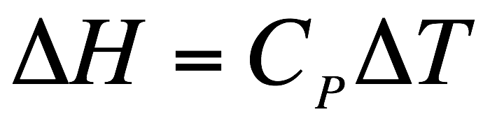
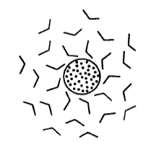
Heat capacity change (ΔC_{p})
- Heat capacity is the heat absorbed by a substance to raise the temperature by 1 K.
As the temperature increases, the ordered water molecules surrounding the non-polar solute become more mobile.
Aqueous solutions of non-polar solutes have large heat capacity (C_{p}).
C_{p} of the aqueous solution of a non-polar solute is generally proportional to the exposed non-polar surface area of the molecule
For example:
Absorbs heat
293 K
294 K
Notes:
In order to heat the solution you have to break hydrogen bonds between water and protein

Slide 19
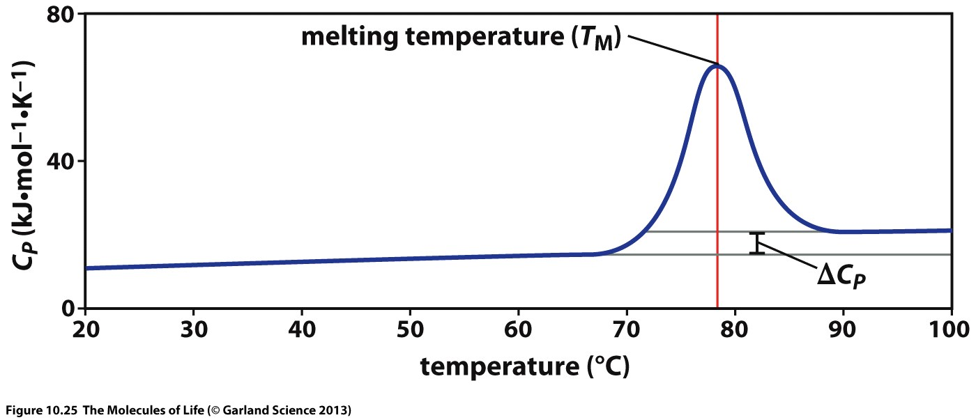
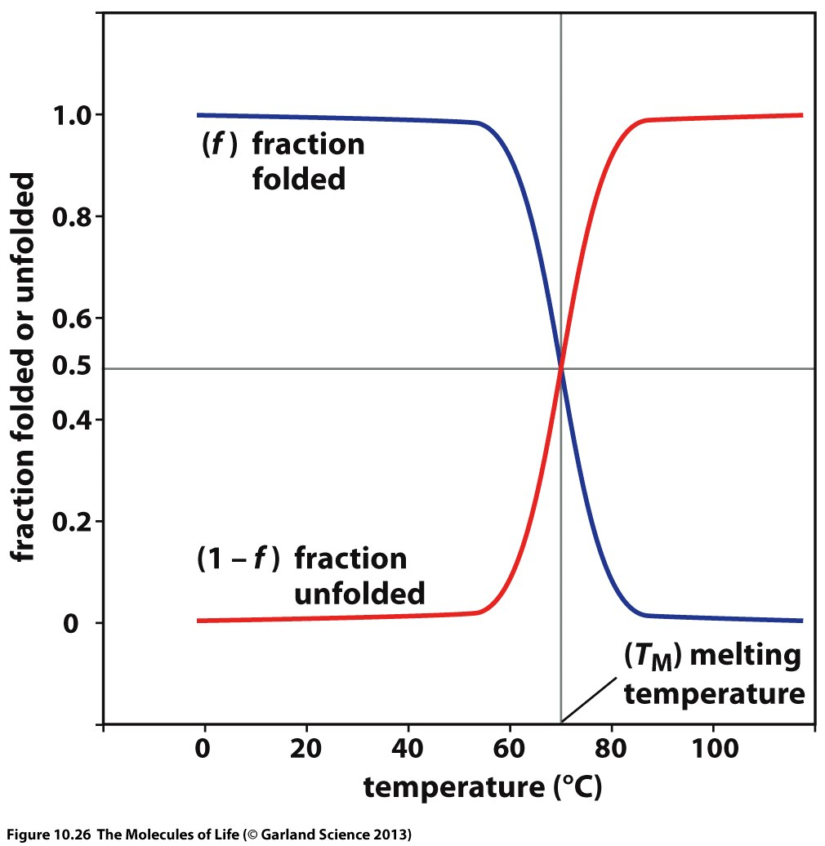

$${ΔC}_{P}=C_{P}^{U}−C_{P}^{F}$$
The heat capacity of a protein solution is higher when the protein molecules are in the unfolded state ( ΔC_{p} > 0 ).
This is mainly due to the interactions of the solvent with the protein groups that were buried in the folded state but become exposed in the unfolded state.
Non-polar groups that become exposed in the unfolded state have large positive contributions to the ΔC_{p}.
Notes:
Once Cp rises, it takes a lot of energy to raise the temperature so increase in temp. slows down, that energy goes into breaking bonds within the protein
DeltaCp is the difference between folded and unfolded states
Non-polar molecules now interacting within polar, so Cp is higher for unfolded state

Slide 20
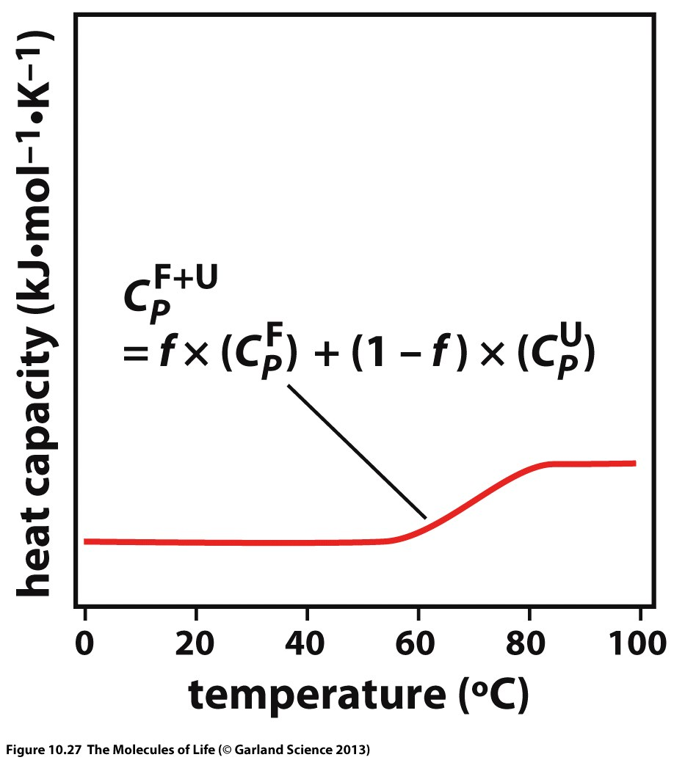
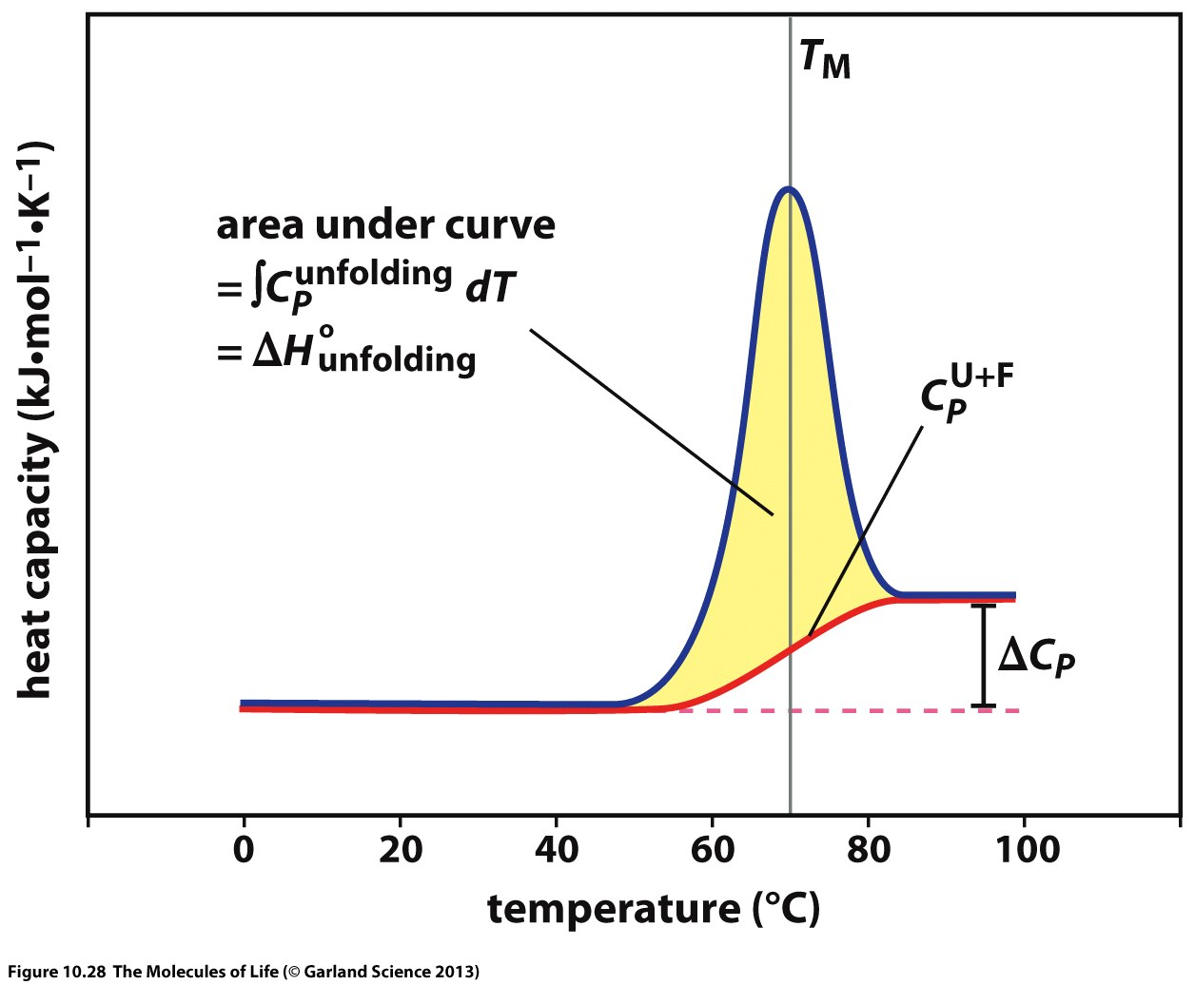
The red line shows the heat capacity due to the folded and unfolded proteins. It does not include the contributions that arises from the heat required to convert the folded form to the unfolded form.
At the melting temperature (T_{M}),
[U] = [F]

Slide 21
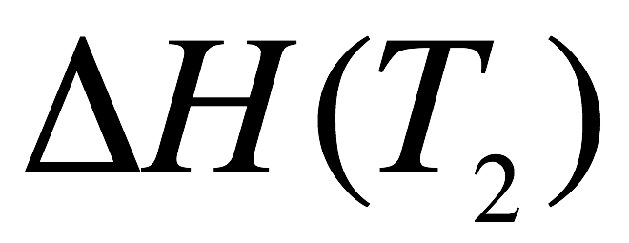
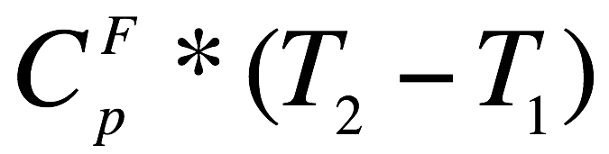
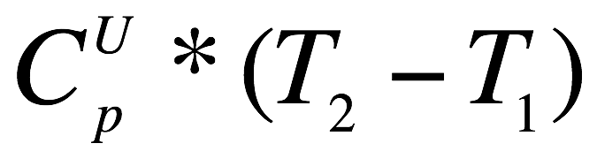
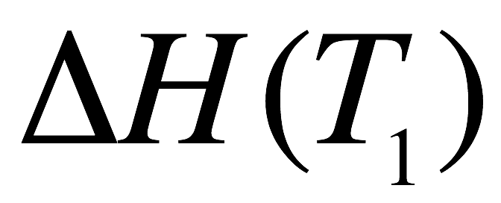
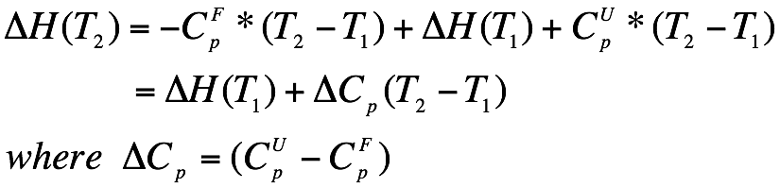
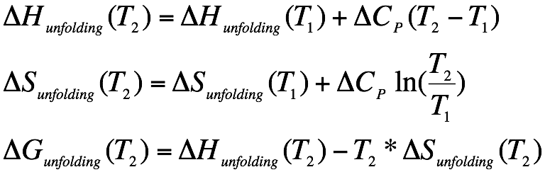
Protein unfolding
F - folded U - unfolded
F (T₂)
U (T₂)
F(T₂)
U(T₂)
F (T₁)
U (T₁)
F(T₂)
F(T₁)
U(T₁)
U(T₂)
Assume ΔC_{p} is independent of temperature,
Notes:
Have value at 70C, want value at 37C, this is how to calculate it

Slide 22
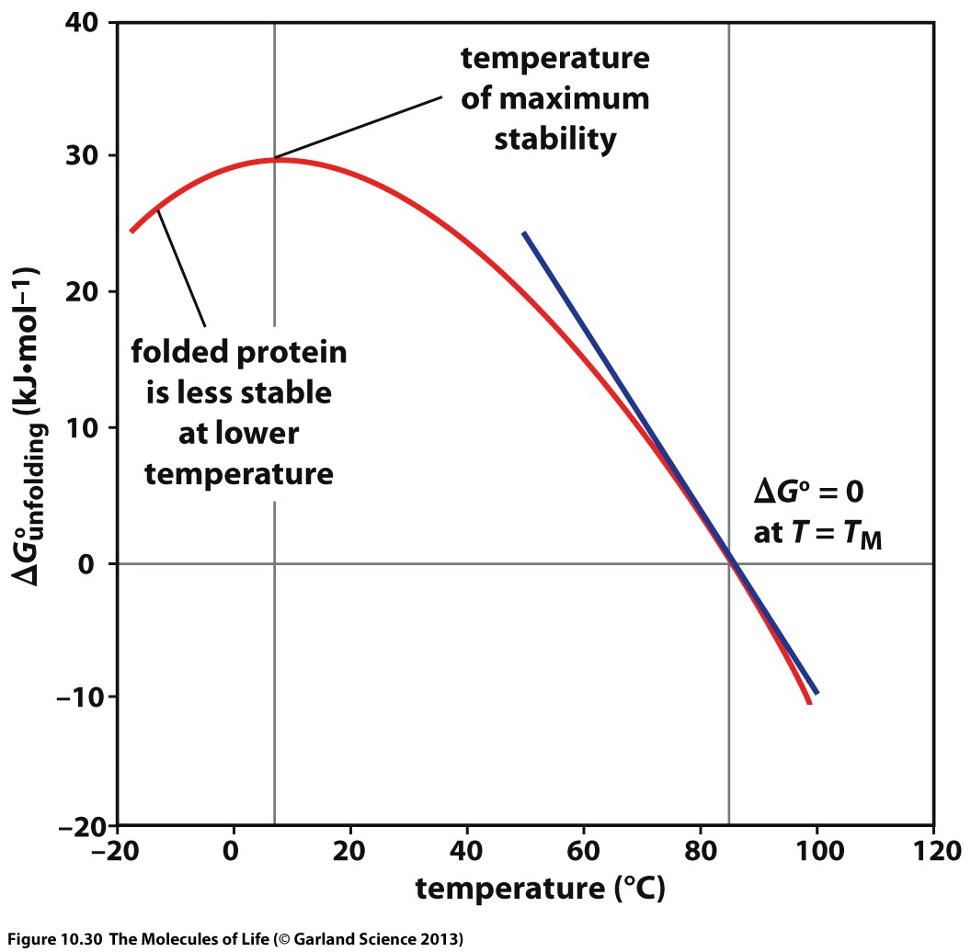
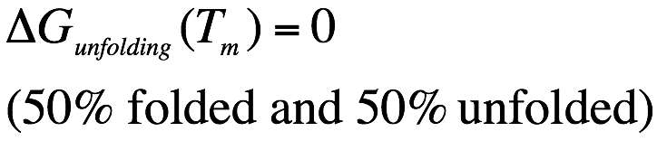
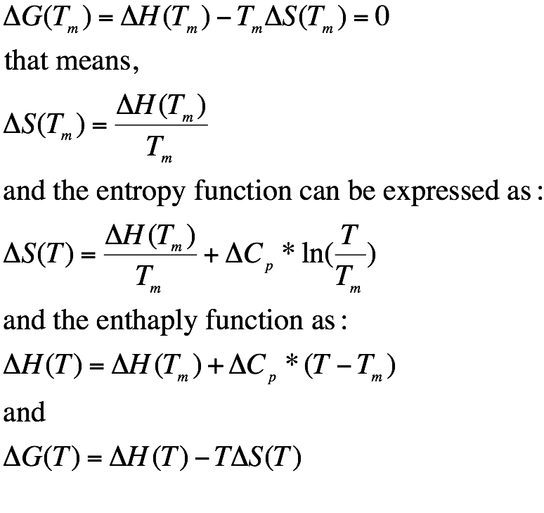
From the DSC data, we can determine the values of ΔH(T_{m}), T_{m} and ΔC_{p.} Based on the equations given on the right-hand side, we can then calculate the thermodynamic parameters, ΔH, ΔS, and ΔG, at any given temperature (T).
Notes:
Know deltaG, can calculate DeltaH at Tm, can calculate deltaS
Once you know deltaS at 70C, can calculate for other temps with last slide

Slide 23
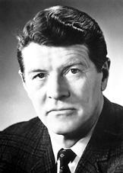
Anfinsen’s paradigm
The amino acid sequence contains all the information that defines the three-dimensional structure and the function of a protein.
“……the native conformation is determined by the totality of interatomic interactions and hence by the amino acid sequence, in a given environment.”
When the fully reduced Ribonuclease (with 8 cysteines) was re-oxidized under denaturing conditions, a mixture of “scrambled” (with non-native disulfide bonds) ribonucleases were formed. However, after the denaturants were removed and the “scrambled” products were exposed to a small amount of mercaptoethanol (reducing agent), the protein gradually returns to its native conformation.
Christian B. Anfinsen
1972 Nobel prize winner in Chemistry
Anfinsen, C.B. (1973) Science, 181, 223-230.

Slide 24
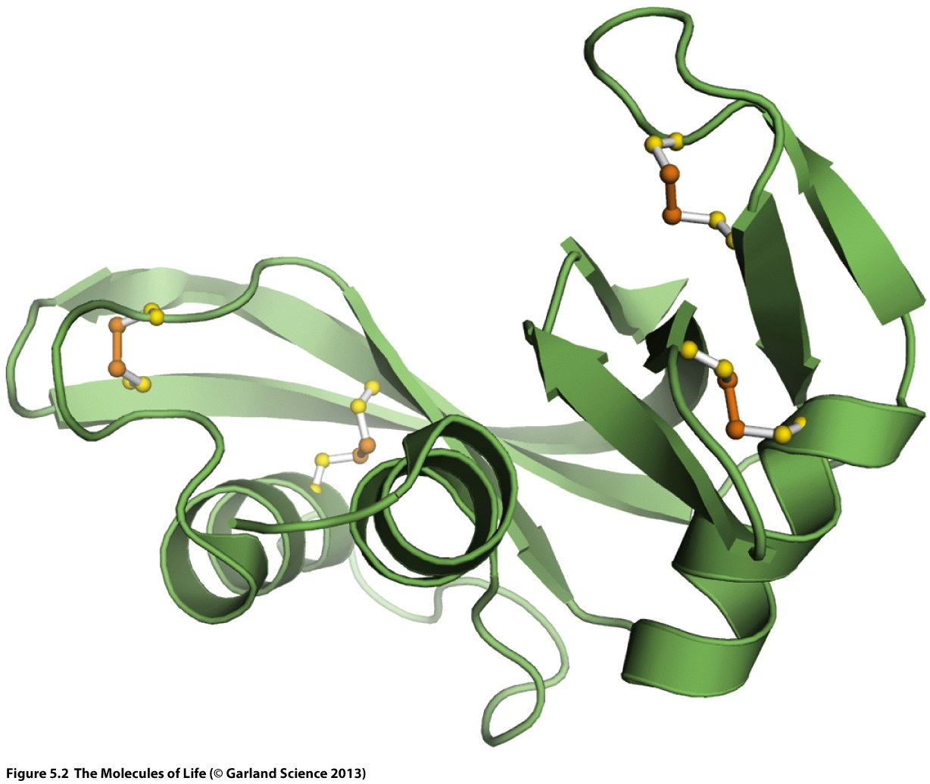
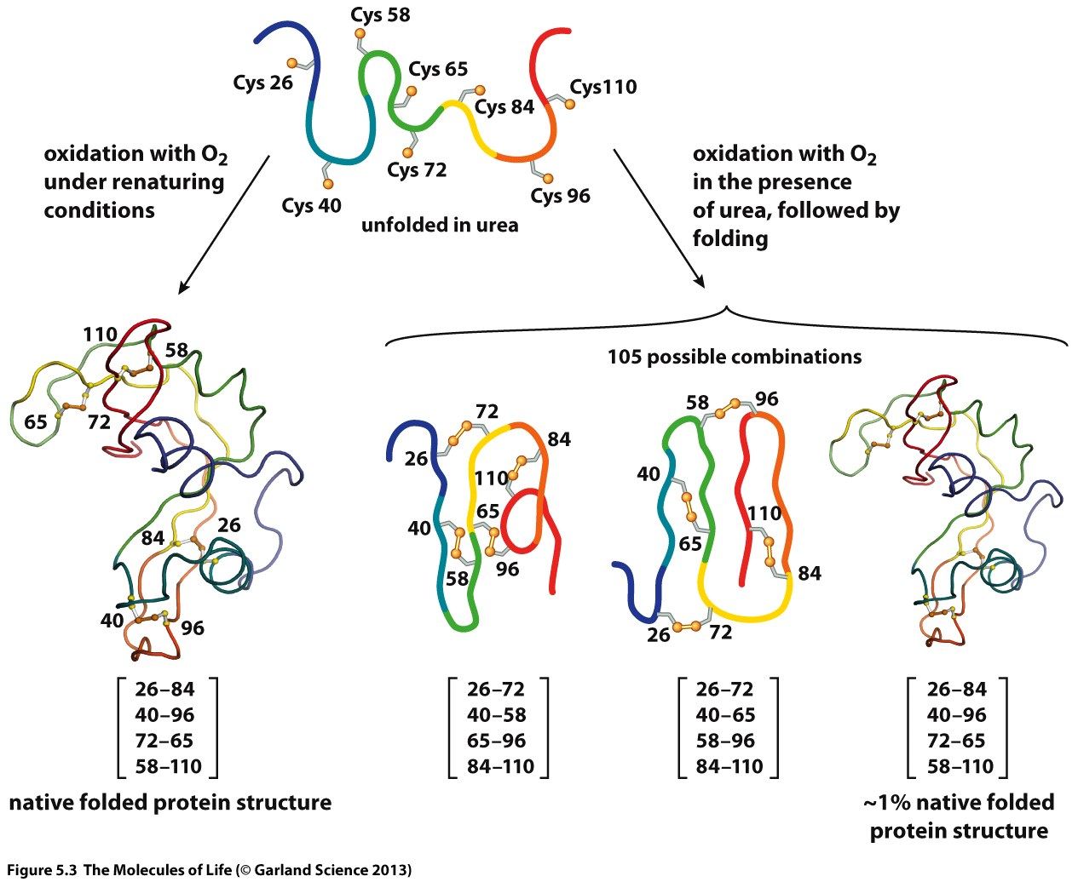
Anfinsen’s experiment
Ribonuclease-A
PDB: 5RSA
Chapter 5 (sections 5.1 and 5.2), The Molecules of Life. Garland Science
Notes:
Four pairs of numbers are disulfide bonds

Slide 25
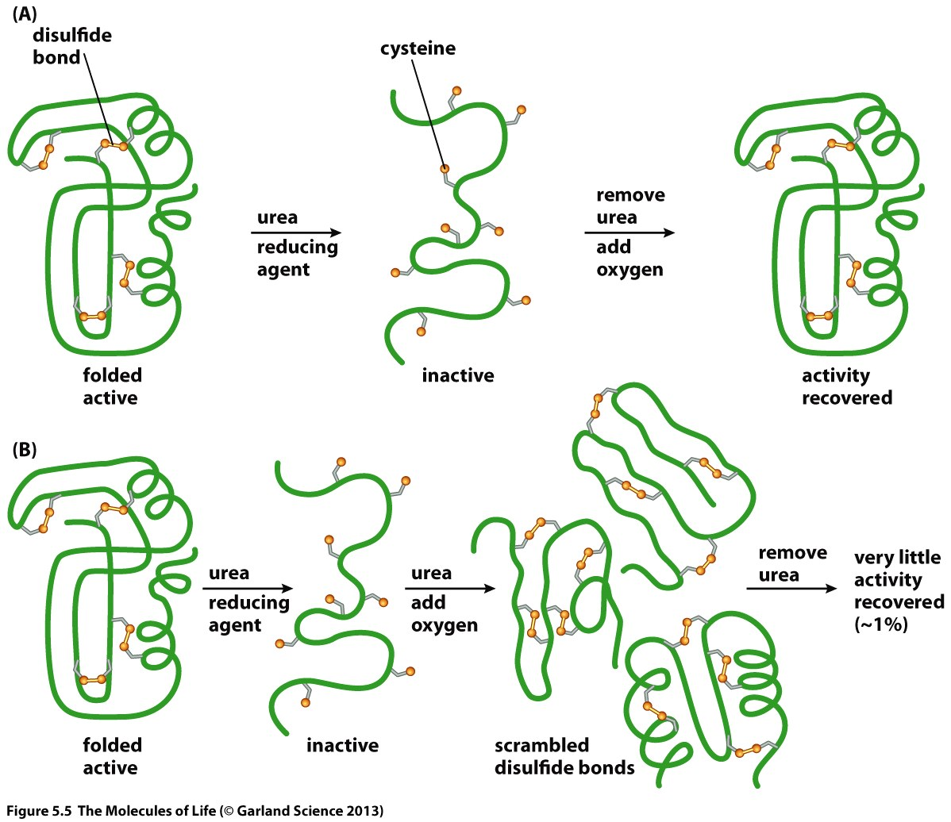
Figure 5.5
The Molecules of Life
A) When refolding and disulfide bond formation occur together, the activity that is lost upon denaturation is regained. (B) When the disulfide bonds are allowed to form in the presence of urea, very little activity is regained upon subsequent removal of urea. This is interpreted to mean that, in the presence of urea, the protein chain adopts random conformations that allow the disulfide bonds to be scrambled.
Notes:
Urea allows denatured protein to be in random conformations, allows random disulfide bonds to form

Slide 26
Levinthal’s paradox
Assumption: Besides the native state, all conformations of a polypeptide chain are equally probable. Therefore, for a polypeptide to fold into its native conformation, it needs to undergo unbiased random search.
Folding time = (number of configurations) x (time required to find one)
Example: For a 100-residue protein, assume that 4 conformations are allowed for each amino acid and the time required to convert from one conformation to another is 10⁻¹¹ seconds (10 ps).
Folding time ≈ 4¹⁰⁰ x 10⁻¹¹ seconds ≈ 1.6x10⁴⁹ seconds ≈ 5x10⁴¹ years.
(Age of the universe ~ 13.8x10⁹ years)
But the folding time of a protein is generally on the order of milliseconds to seconds.
So there must be a pathway of folding that restricts the conformational search of the
protein.
Levinthal, C. (1968) J. Chim. Phys. 65, 44-45.
Karplus, M. (1997) Folding & Design, 2, S69-S75.

Slide 27
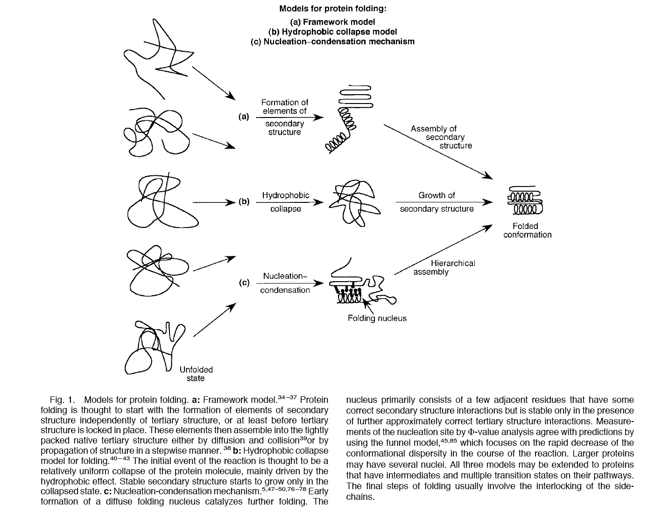
Taken from Nolting, B. & Andret, K. (2000) Proteins, 41, 288-298.
Folding pathway and mechanisms
(diffusion collision)
Notes:
The first one suggests the formation of secondary structures is easy but their orientation is the difficult portion

Slide 28
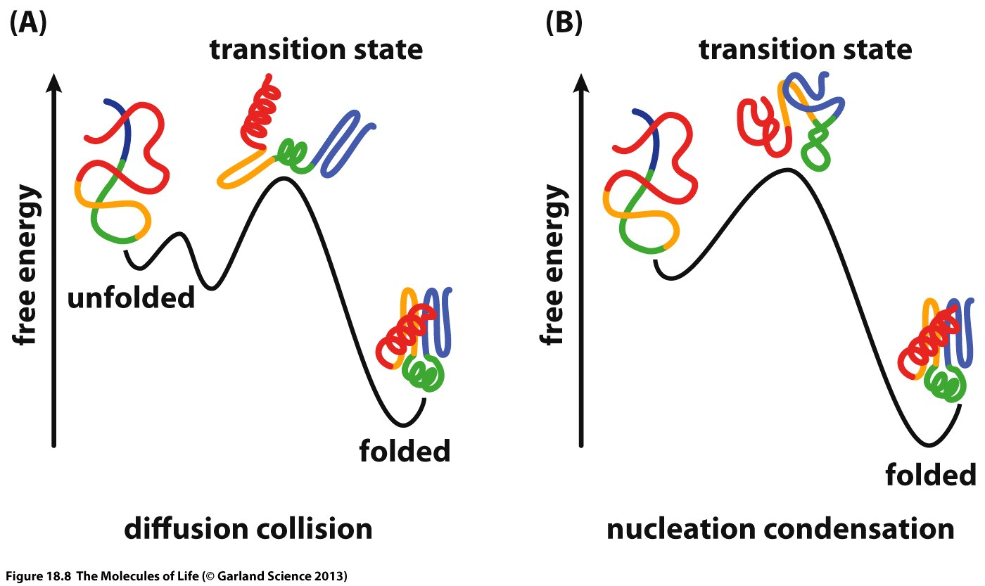
Schematic representations of a diffusion collision process (A) and a nucleation condensation process (B). In the diffusion collision model, secondary structure forms first, and the rate limiting process is the organization of the secondary structural elements into the fully folded structure. In the nucleation condensation model, the protein chain collapses into a compact form, followed by full formation of secondary structure.

Slide 29
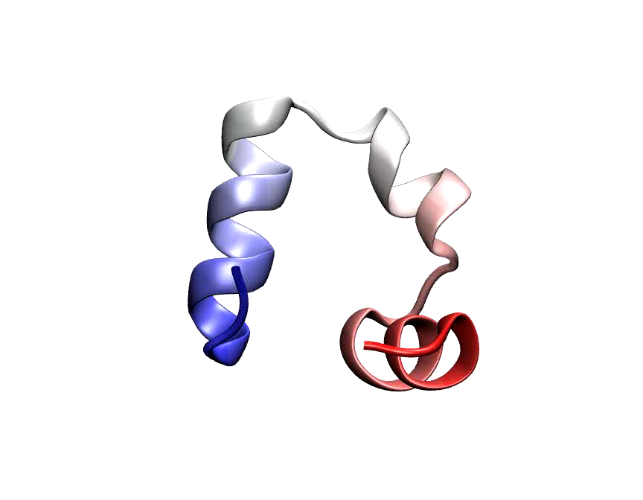
Villin Headpiece
http://www.ks.uiuc.edu/Research/folding/

Slide 30
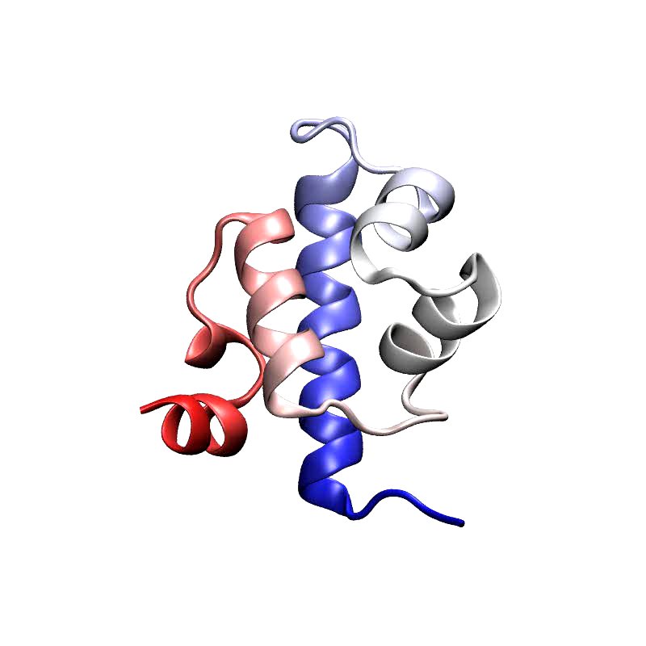
λ-repressor
http://www.ks.uiuc.edu/Research/folding/
Notes:
Blue helix is first to form, rest forms around that helix, acts as the nucleus and folding occurs around that
This would be considered nucleation condensation

Slide 31
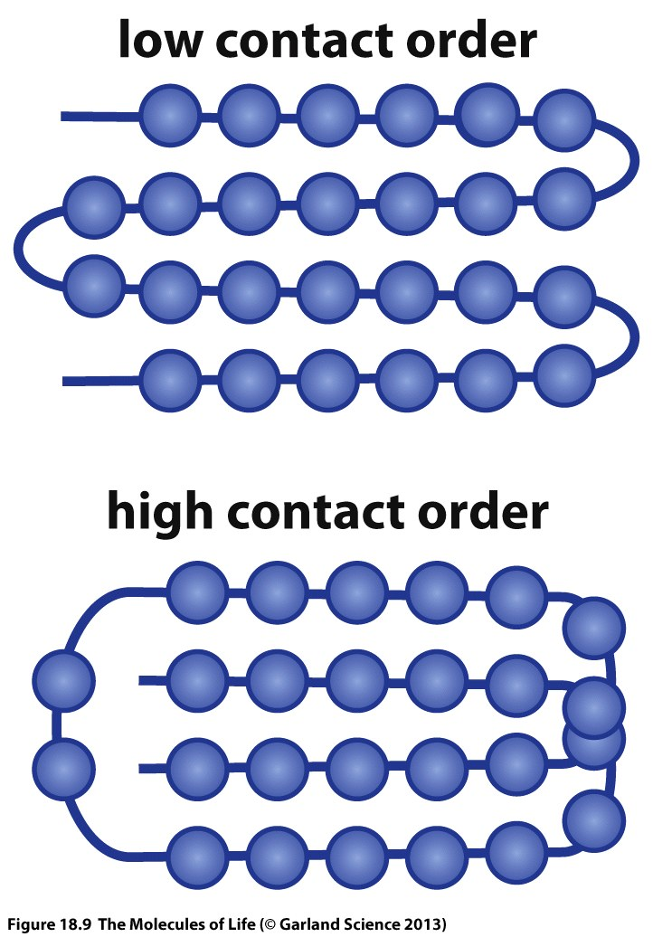
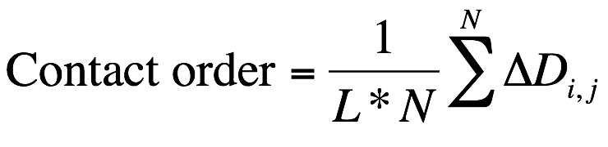
Contact order
L – total number of residues in the protein
N – total number of contacts
ΔD_{i,j} - the sequence separation, in residues, between contacting residues i and j.
Plaxco, K.W. et al (1998) J Mol Biol, 277, 985-994.
Kuriyan, J., Konforti, B., & Wemmer, D. (2013). Chapter 18. The Molecules of Life. Garland Science
Notes:
If a protein folds faster, less chance for aggregation, slow folding proteins can create issues
DeltaD counts amino acids between two contacting residues
Tells you whether contacts are long range or short range, a protein with low contact order will fold faster

Slide 32
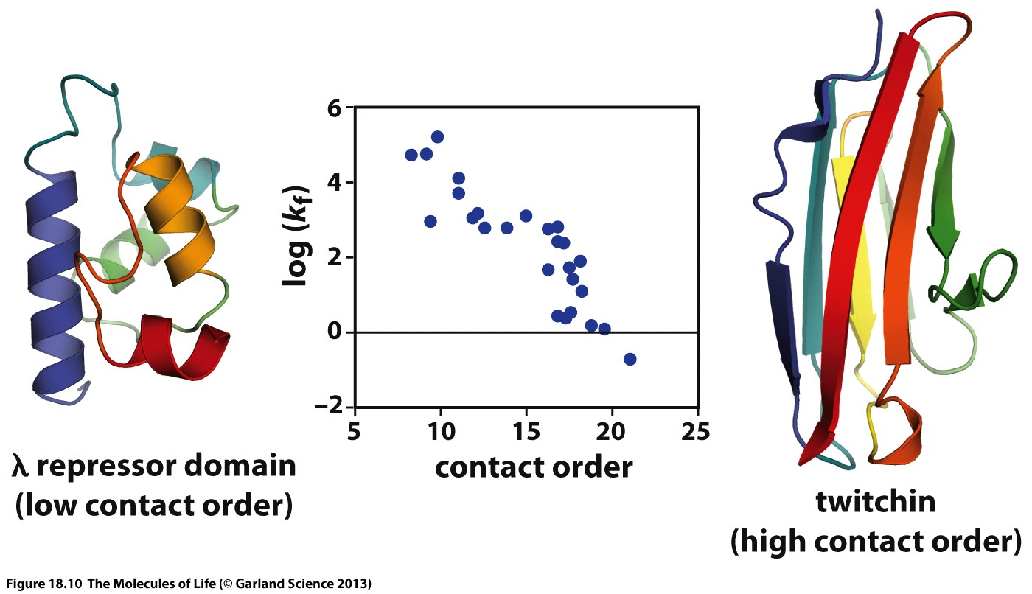
k_{f} – folding rate
Figure 18.10 The molecules of Life, Garland Science.
The graph shows the logarithm of the folding rate (k_{f}) as a function of contact order. The structures shown on either side have low (left) and high (right) contact order. The sequence is color coded with the N-terminus blue and C-terminus red, following the order of colors in the rainbow between. (Adapted from K.W. Plaxco et al. and D. Baker, Biochemistry 39: 11177–11183, 2000.)
Notes:
Graph shows higher folding rates have lower contact orders

