Slide 1
Adolescence
Canadian Edition
McMahan/Thompson
Chapter 8
Gender

Slide 2
Biology, Sex, And Gender
Sex differences and gender differences
Gender roles and gender typing
Effects of prenatal hormones on fetus
Gender differences in amygdala, prefrontal cortex
Prenatal testosterone levels and masculinity
Contributions, interactions of genetics, environment

Slide 3
Clarifying the Difference
Gender
  Refers to the social categories of male and female
  Result of developmental and social experience
Sex
  Refers to the biological status of being male or female

Slide 4
Clarifying the Difference
Gender difference vs sex difference
  Cultural/social factors vs rooted in biology (chromosomes)?
    e.g., longer hair in women vs. baldness in men
  Notion of gender roles and gender typing

Slide 5
Clarifying the Difference
Gender roles
  Set of shared cultural expectations about gender
Gender typing
  How children come to take on specific gender roles
    Biological factors?
    Socialization?
    Cognition?

Slide 6
Biological factors
High level of testosterone (T) around 8th week of gestation lead to male genitalia
Prenatal hormones may affect dev of brain structures (but maybe experience)
  amygdala, prefrontal cortex
Higher prenatal T levels in girls related to more interest in traditionally “masculine” toys, games, activities at 3½ y.o.
  similar effect also seen for both sexes

Slide 7
Biological factors
Case of congenital adrenal hyperplaisa (CAH)
    genetic condition that causes adrenal glands to overproduce androgens (male sex hormones) prenatally
      causes genitalia to develop in a masculine direction
    CAH boys not affected much
    CAH girls like “boy toys” and “boy activities” more than the norm (girls); play more with boys
    Better throwing skills than the norm (girls); less satisfied with being women; less sexually interested in men

Slide 8
Biological factors
Case of CAH
    Differences due to parenting approaches?
      When asked, parents of girls with CAH deny “boy” oriented family practices
    Prenatal androgen “masculinizes” influential parts of the brain?
Genetic influence?
      How about atypical gender behaviour in twins?
      Research findings suggest genetics and environment make significant contribution, but that environment may be more important

Slide 9
Biological factors
Hormonal changes at puberty?
  release of adrenocortical hormones linked to emergence of child’s first romantic interest
    gender typical characteristics considered particularly attractive
Notes:
DHEA di-hydro-epi-androsterone

Slide 10
Socialization And Gender
Socialization: effects of others, society
Treatment differences from earliest days
Clothing, toys, stories coded by gender
Bandura: observing same-sex models
Consequences to others affect standards, behaviors

Slide 11
Cognition And Gender
Importance of ideas about sex and gender
Kohlberg:
  Cognitive-developmental theory of gender
  A way of organising ideas about the world
    How does one think about gender?
  gender consistency ‑ knowing gender is stable
  gender identity - child identifies with own-gender role
    involves self-labelling and gender consistency

Slide 12
Cognitive Developmental Theory of Gender
Gender is a fundamental way of organizing ideas about the world
Age 3
Understand themselves as being either male or female
Age 4 or 5
Identify things as appropriate for either males or females
Age 6 to 10
Perceptions of gender become less rigid
Age 12 to 16
Perceptions of gender become more rigid – gender intensification
Beginning of Gender Identity
Self-socialization
Gender consistency
As adolescents become more capable of reflecting on these issues,
they become more concerned with compliance to gender norms
for themselves and others.

Slide 13
Cognition And Gender
Gender schemas: child constructs gender understanding
Schemas direct person’s attention, behavior

Slide 14
Cognition and gender
Gender schema theory (Martin & Ruble, 2004)
  Gender a fundamental way that people organize information about the world
  Gender one of most important schema in childhood
  People apply schemas to world around them as well as themselves (self-socialization)
  Once gender identity emerges, children start to process gender-related information differently
    Pay more attention to information about their own gender and remember it better (e.g., gadgets presented as “boy things” or “girl things”)

Slide 15
Gender Intensification In Adolescence
Pressure to conform strengthens in early adolescence
Parents worry about “inappropriate” interests, activities
Peers less tolerant of cross-gender behaviors
Dating and conformity to traditional roles
Research evidence for gender intensification mixed

Slide 16
“Gender Intensification Hypothesis”
John Hill and Mary Ellen Lynch (1983, 1991)

Slide 17
Gender Intensification Hypothesis
Psychological and behavioral difference between males and females become more pronounced at adolescence because of the intensified socialization pressures to conform to culturally prescribed roles
Gender intensification occurs especially for adolescents who are exposed to socialization pressures to conform to traditional gender roles
Adolescence may increase the external and internal pressures to think, feel and act in “gender-appropriate ways”

Slide 18
Gender Intensification Hypothesis
Holds that physical changes at puberty alert parents, teachers, peers that child is becoming an adult
See themselves in more gender-typed terms; less tolerant of cross-gender behaviour
Research support?
    Galambo et al. (1990). Some indication self-description become more gender-typed from 6th to 8th grade (not stronger for girls);
    Polce-Lynch et al. (2001). Gender-linked differences in expressive behaviour became more pronounced over adolescence;
    Crouter et al. (1995). Occurs when exposed to family socialization pressures.
    Jacobs et al (2005). Some gender-type attitudes well established in childhood (do not get stronger)
Degree of gender intensification may depend on multiple factors
(e.g., social context, specific attitude/beh, individual diff)

Slide 19
Gender confusion?
What if child confused about gender identity?
  Cross-gender dressing and play
Is this a disorder?
  Gender Dysphoria (DSM-5)

Slide 20
Gender confusion?
Alternatively, notion of transgendered
  Individual feels they have the gender identity of the other sex
  May alter biological sex (transsexual)
In 2013, Canada passed legislation that makes it illegal to discriminate against transgender Canadians

Slide 21
Gender And Achievement
Stereotypes: boys like math, girls like English
Classroom disadvantages for girls and boys
Boys somewhat better on mental rotation tasks
Gender differences in math performance small

Slide 22
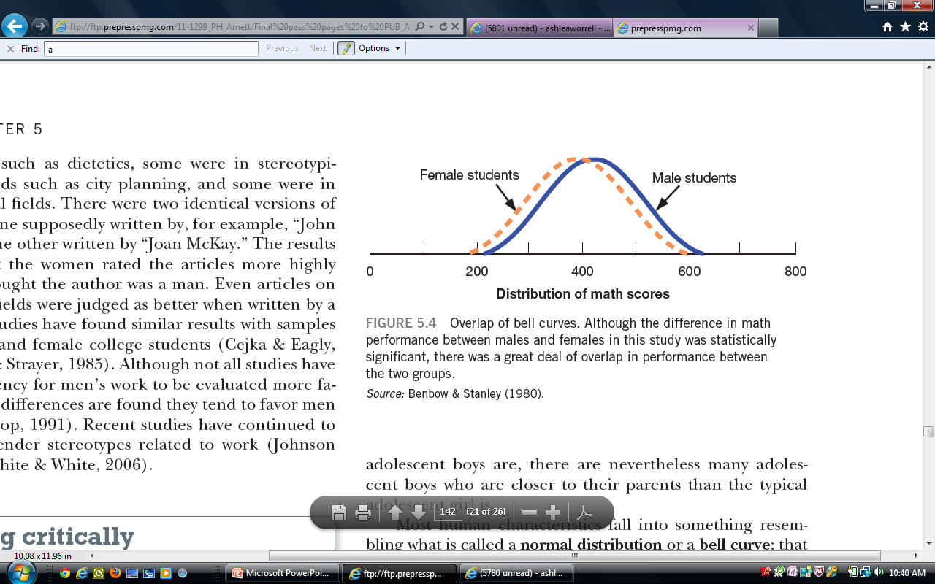
The Bell Curve: looking at math and gender
Figure 5.4 – Benbow & Stanley, 1980
Even when gender difference exist between males and females
the portion of the two bell curves that overlap is much
greater than the portion that is distinctive to either gender
Benbow & Staley 1980; Sex Differences In Mathematical Ability, Factor or Artifact? Science

Slide 23
Achievement
Math and Science
  1992 Teen Talk Barbie
  “Math class is tough!”
Are boys just better at math?
  boys better mental rotation

Slide 24
Achievement
Male advantage for mental rotation?
  related in part to T levels
  environmental factors (e.g., toys, video games)?

Slide 25
Achievement
Back to math
  Elementary school girls just as good as boys at understanding math concepts, and better at computations; get better math grades than boys
  Beginning in adolescence, boys do a little better at some forms of math reasoning
    linked to spatial ability?
  Canada shows fewer gaps than in many other countries

Slide 26
Gender And Achievement
Learned helplessness, competitiveness, stereotype threat
  Role of math stereotype
  Woman who endorse math stereotype do worse in math courses
  Mathematically gifted young women are about half as likely to get a degree in math compared to their counterparts
  Even woman who persist in math/science careers endorse math stereotype

Slide 27
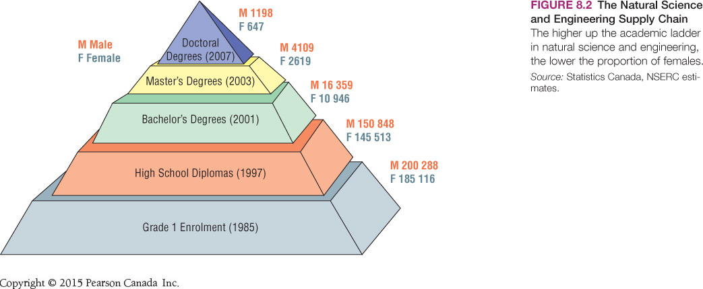

Slide 28
Gender And Self-Esteem
Effects of body image on self-esteem
Girls more affected by personal relationships
  “False self”: pretenses to protect relationships
Gilligan: girls “lose voice” with adolescence
  Girls’ sensitivity to others not valued

Slide 29
Gender and identity
Carol Gilligan’s notion that girls lose their “voice” in adolescence
  Dilemma faced by girls in adolescence
    Girls more relationship oriented than boys, but society values assertiveness and independence more
      girls valued for physical appearance and maternal traits
    Girls succumb to gender socialization pressures
      become more tentative, insecure
      more vulnerable to mental heath problems?

Slide 30
Gender And Self-Esteem
Self-esteem declines during adolescence for both genders

Slide 31
Gender, Emotion, And Mood
Emotionality differences result of experiences, expectations
Depression levels equal during childhood
With puberty, twice as many girls depressed

Slide 32
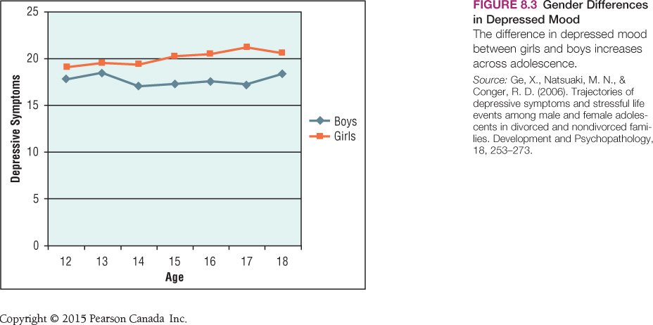

Slide 33
Gender, Emotion, And Mood
Why more depression in girls?
  Body image issues
  Girls more aware of own emotions
  Rumination: brooding about problems, negative emotions
  Relationship problems major cause of depression

Slide 34
Gender And Aggression
Boys more physically aggressive on average
Few consistently aggressive boys or girls
For most, aggressiveness declines across adolescence
Relational aggression: harming another’s social relationships
  Girls use more relational than physical aggression
Boys use both physical and relational aggression

Slide 35
Gender And Personal Relationships
Boys—larger, less intimate groups of friends
Girls—relationship goals friendship, support, involvement
Girls—more conversation, more self-disclosure
Topics: feelings, friends (girls); cars, sports (boys)
Co-rumination: dwelling on problems with friends
Homophobia: fear of attraction to own sex

Slide 36
Ethnicity, Culture, And Gender
Gender roles widely different across cultures
Traditional: men more important, dominate
Modern: equal rights, opportunities, social position
Canada falls between traditional, modern
Ethnic differences in gender role expectations
Mainstream culture exposure weakens traditional gender values

Slide 37
Families And Gender Development
Mothers talk to children more, more supportive
Fathers ask questions, offer information, directions
Parents encourage gender-typed interests, activities
Siblings as models, teachers, sources of praise/criticism
Older siblings influence gender roles of younger siblings
Those with other-sex older siblings less stereotyped

Slide 38
Peers And Gender Development
Gender segregation in childhood
Boys more competition, girls more intimacy
Adolescence: need to impress, attract other gender
“Feminine” girls and “masculine” boys more attractive
Gender nonconformity rejected by and in boys

Slide 39
Gender And The Media
Media give information about gender roles
Media depictions rely on traditional stereotypes
Women unrealistically young, beautiful, thin, compliant
Watching television, reading fashion magazines linked to poor body image
Music video viewing and gender-stereotyped attitudes

Slide 40
Magazines… a special issue
Magazines, more than any other medium, display the most obvious focus on gender socialization, especially for adolescent girls
  Physical appearance is stressed as being of ultimate importance
  There is also an intense focus on how to be appealing to boys
  Direct and indirect effects
Boy magazines are not clearly gender focused

Slide 41
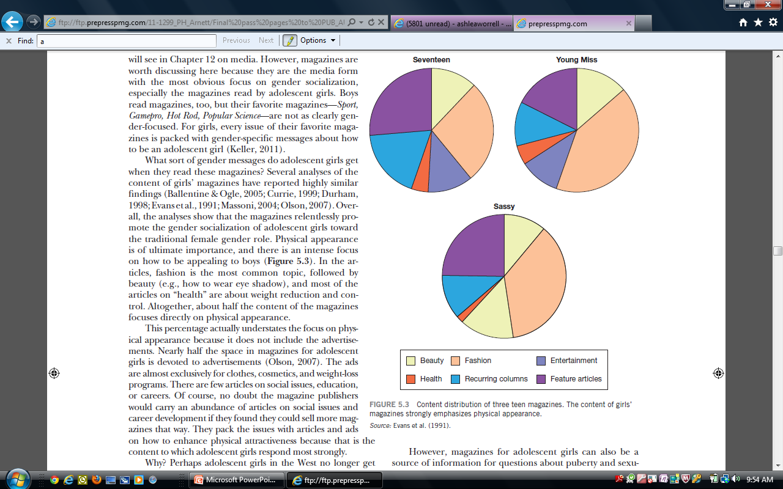
Content distribution of three teen magazines
(does not include ads)
Evans et al, Teen Magazine Content, Youth & Society, Sept. 1991, Copyright © 1991 Sage Publications. Used with permission.

Slide 42
Where Are Gender Roles Going?
The Bem Sex Role Inventory (BSRI; Bem, 1974)
  Describes traits regarded by most members of the American majority culture as being masculine or feminine
  Most widely used measure of gender role perception
  A cross-national study of young people in 30 countries found similar gender role perceptions with remarkable consistency (Williams & Best, 1990)

Slide 43
Androgyny
The term used for the combination of masculine and feminine traits in one person
Advocates of androgyny have argued that being androgynous is better than being either masculine or feminine because an androgynous person has a greater repertoire of traits to draw on in their daily lives
Advocates point to research that show androgynous children are more flexible and creative than other children (Hemmer and Klieber, 1981)
Androgynous women are better at saying “no” to unreasonable requests (Kelly et al., 1981)
But what about adolescents? Is androgyny best for them?
Androgyny more likely to be related to positive self-image for girls

Slide 44
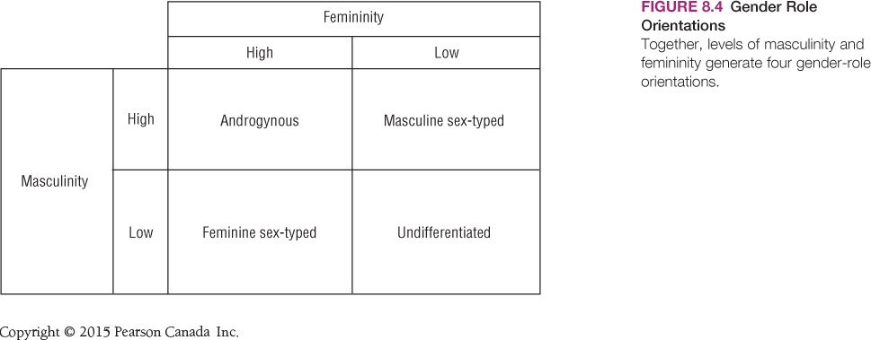

Slide 45
Where Are Gender Roles Going?
Psychological androgyny: both masculine, feminine attitudes
Androgynous individuals more flexible, responsive, well-adjusted
Androgyny may be more advantageous for girls
Cultures differ in accepting range of gender roles

