Slide 1
Lecture 6
3D structure of proteins
Secondary structure

Slide 2
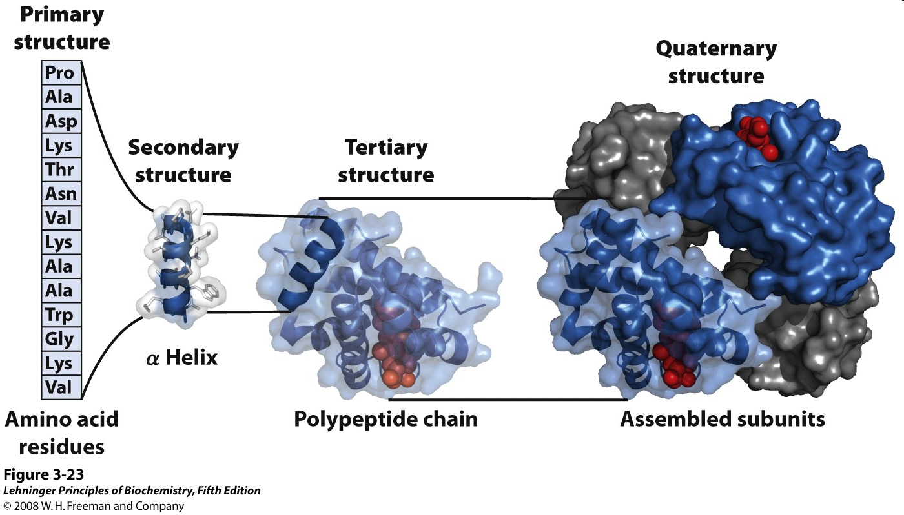
Hierarchy of protein structure
Notes:
CBC: We think of protein structure in heirarchical terms. We can think of proteins at several different levels of structure. In fact, it’s hard to think about proteins any other way, because they are so big and complicated. Primary structure is amino acid sequence - the linear order of the amino acids in the polypeptide. Local regions of polypeptide - maybe stretches of 10-25 residues - usually wrap up into rather regular (i.e., repeating) geometries or spatial conformations, which we call “secondary structure”. The whole peptide chain wraps up into a compact ball, in a very specific and beautiful way, and we call this “tertiary structure”. And in most cases, these balls stick to one another in specific ways, to form “quaternary” structures or “multimers” or “aggregates” or “complexes” (people use lots of different descriptions for this).
It’s sort of like clicking on the “zoom” button on “Google Earth”, and zooming out from a single house to a city block, and then to a neighbourhood, and then to an entire city ...
We will spend the next few lectures elaborating this idea.

Slide 3
Structure of Proteins
Proteins adopt a specific three-dimensional conformation.
This 3D structure is called the native fold
The native fold has a large number of favorable interactions within the protein

Slide 4
Weak non-covalent interactions
Hydrophobic effect
Hydrogen bonds
London dispersion
Electrostatic interactions

Slide 5
The peptide bond
-
O
O
..
+
C
N
H
C
N
H
➔ shorter than C-N single bond
➔ partial double-bond character
➔ restricted rotation
Notes:
The peptide bond is shown above. We usually draw it as shown on the left, with a double bond between the C and O atoms. But we can “donate” an electron pair from the N, as shown, forming the valence-bond representation on the right, which has a C=N double bond. This is what a chemist calls “resonance”.
“Resonance” is a chemist’s term that means “the naïve “valence-bond” structures that chemists have always drawn for molecules, in which each bond is either single or double or triple, is actually a lousy representation of the real (molecular-orbital, quantum-mechanical, and delocalized) distribution of the electrons in this molecule; but, if we pretend that the molecule is sort of “half-way in between” two different valence-bond structures, then we get something a bit more realistic.” That’s a mouthful, so we just say “resonance” instead. We indicate resonance by drawing a double-headed arrow.
Resonance is not at all the same thing as chemical equilibrium. The peptide bond does not rapidly “jump back and forth” between two different states, one state having a C=O double bond and the other state having a C=N double bond. No. The molecule is always in a state that has intermediate bond order; the C-N and C-O bonds have bond orders, and bond lengths, and bond strengths, that are intermediate between those of typical single bonds and those of typical double bonds. (Similarly, all six C-C bonds in benzene are identical, with a bond order of 1½.)
40% double bond character, C-N bond 0.13A short, C-O bond 0.02A longer

Slide 6
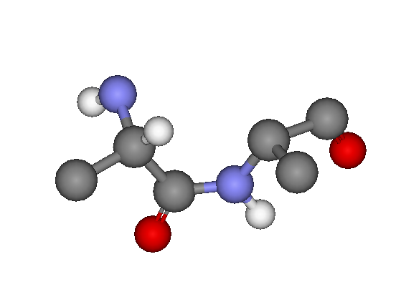
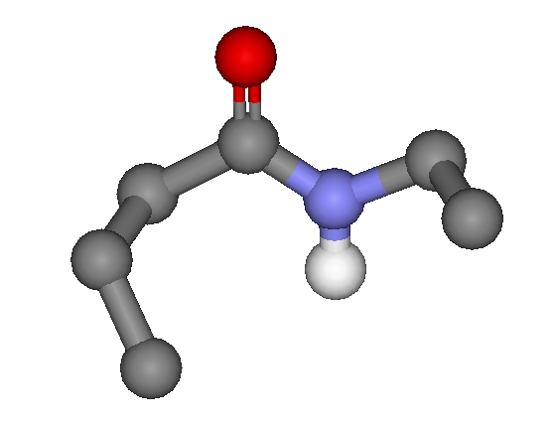
Most peptide groups in proteins adopt the trans configuration
C
C
O
C
C
N
C
N
O
H
C
H
trans
cis (∼ 1%)
Notes:
The partial-double-bond characteristics of the C-N and C-O bonds in peptides have major consequences. Rotation around the C-N bond of a peptide is severely constrained, much like rotation around the C=C bond of an alkene. Just as we have “cis” and “trans” alkenes (you heard about that in first-year chemistry) we also have “cis” and “trans” peptides, and when a particular peptide (in a protein, say) is cis, it pretty much stays that way; interconversion to the trans conformation is very very slow.
We know, from X-ray crystallography and other techniques, that about 99% of peptide groups in proteins are trans (picture on the left) versus only about 1% cis (picture on the right). It’s not obvious why this is so. The cis peptide (right) does not have any obvious steric clashes that would forbid such a geometry, and there really are a few cis peptides in proteins. But the cis geometry probably has energetically unfavourable consequences, in terms of longer-range side-chain interactions. People still argue about the explanation, but the result is clear enough.

Slide 7
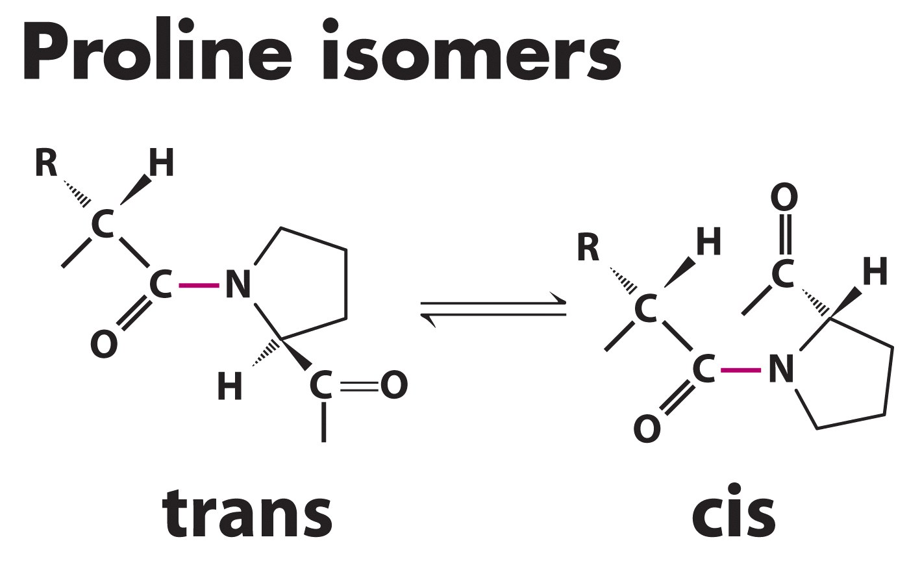
Proline is unique: can adopt both
Normal = trans In β-turns, Proline is cis
Notes:
10% cis. Important for turn as we will see.

Slide 8
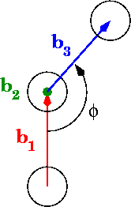
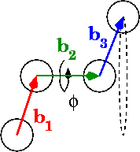
Peptide bonds are planar
dihedral angles
4 atoms
3 bonds
ω angle varies little
Notes:
Omega does not vary much.

Slide 9
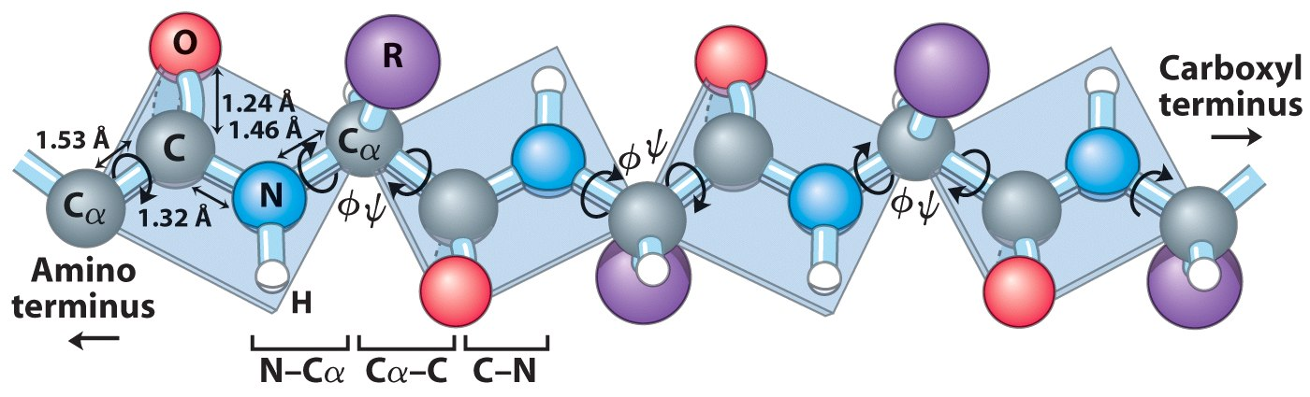
Only non-planar Bonds Rotate
Each α-Carbon has a Φ and Ψ
Notes:
The alpha carbon has two rotatable bonds: Φ between the amino nitrogen and its alpha carbon and Ψ between the alpha carbon and its carboxyl.

Slide 10
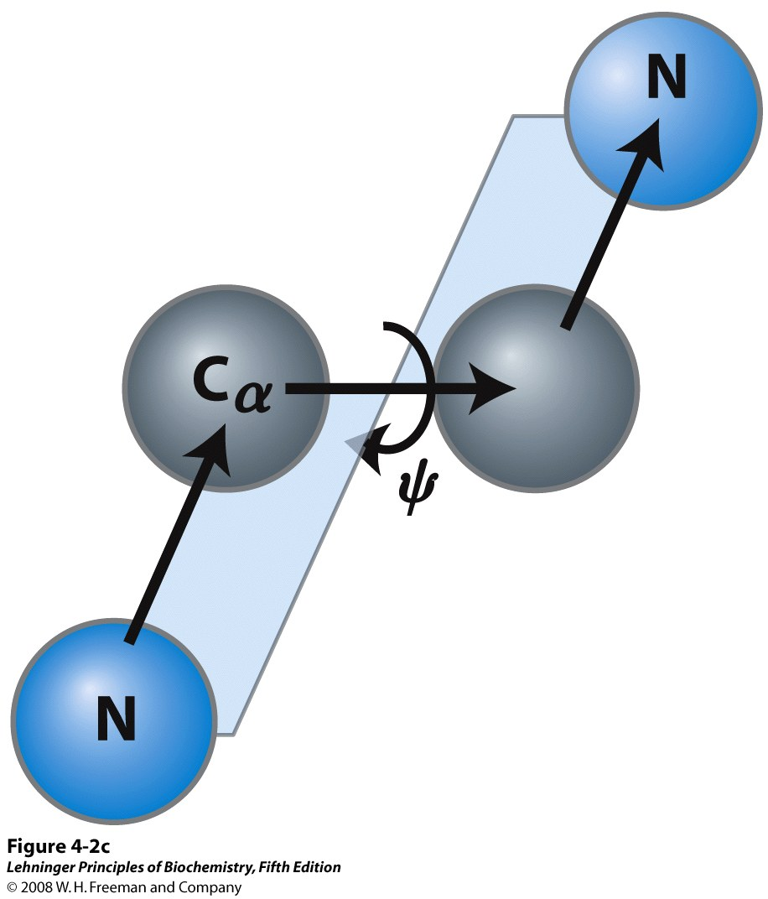
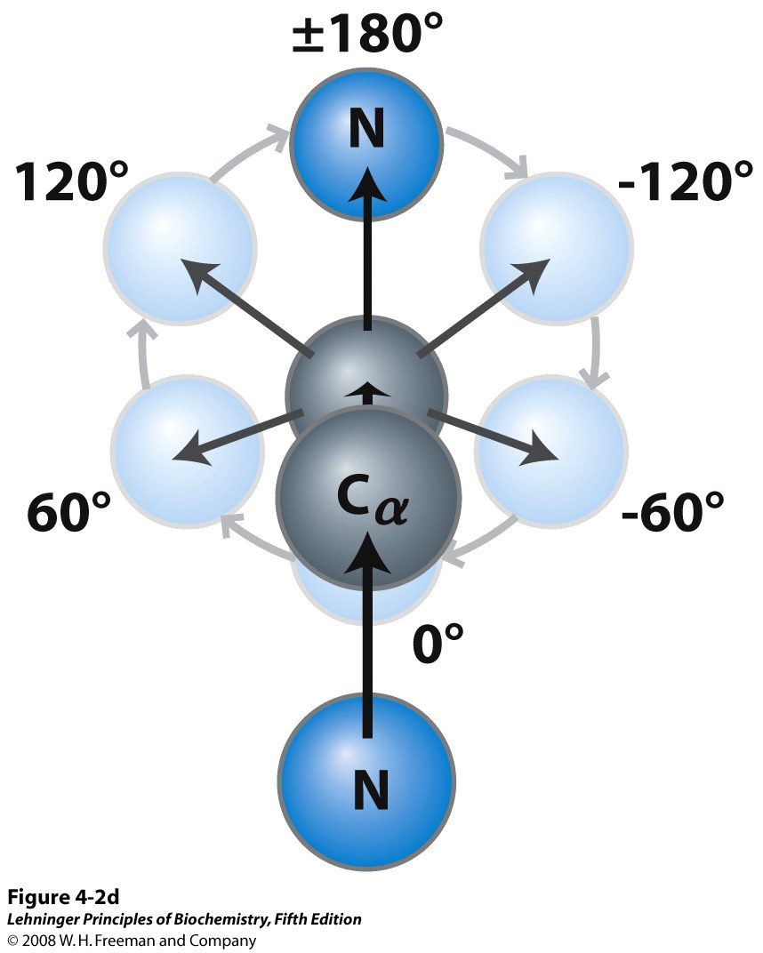
Getting the Angles
Notes:
The angles relate to the angles between the two planes. These angles are established using X-ray crystallography or protein NMR…see later.
Phi and psi = 180 fully extended peptide structure

Slide 11
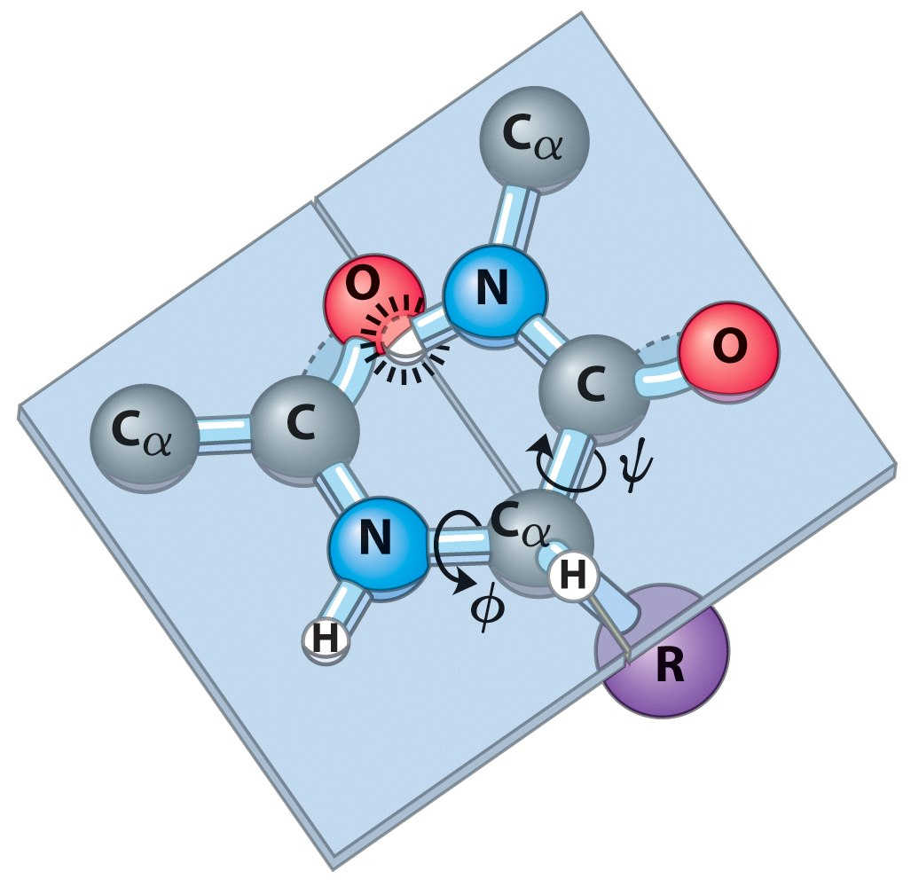
Many Angles are Prohibited due to Steric Overlap
Notes:
Pretty obvious, not all angles will work. Phi and Psi = 0 here.

Slide 12
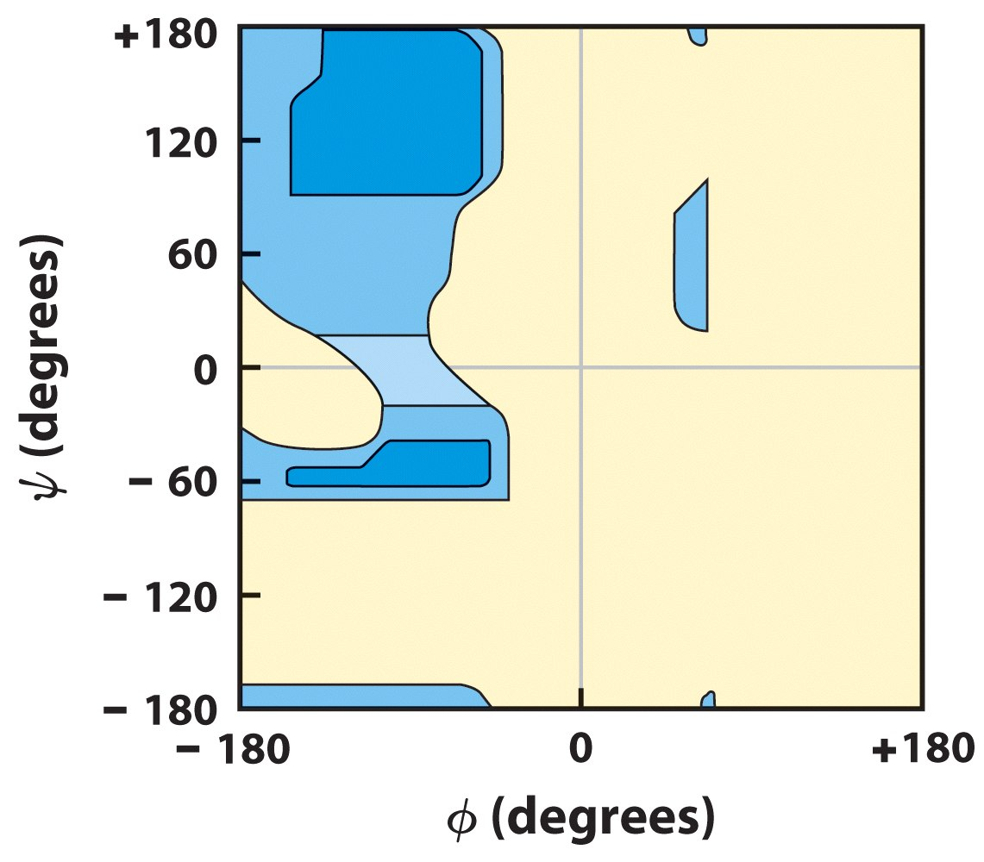
Ramachandran Plot
Notes:
Allowed angles for a polypeptide. The blue areas are angles that are not sterically forbidden – ie where two atoms are occupying the same space. The tan areas are formally forbidden. Calculated for poly alanine. Beta branched amino acids have even smaller range of allowable angles.

Slide 13
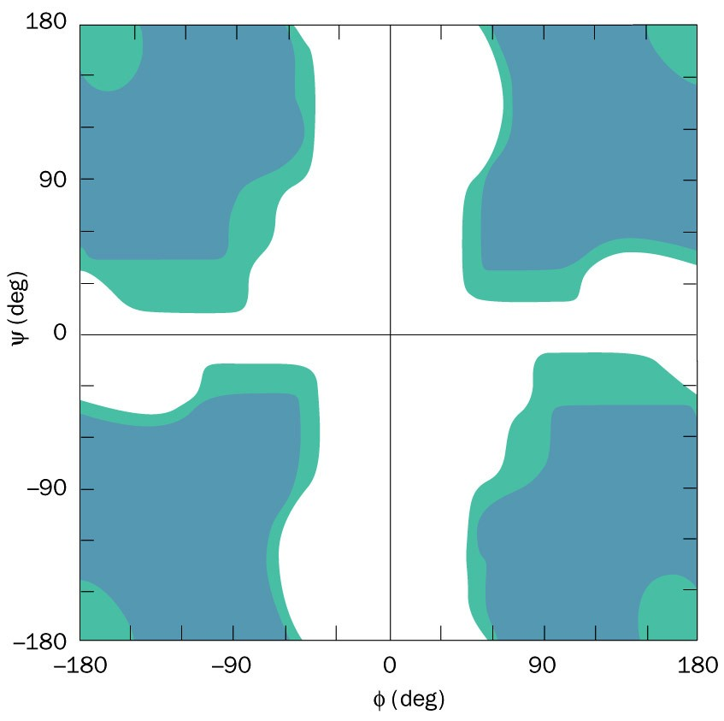
Ramachandran Plot for glycine
Notes:
Gly has no beta carbon atom so it is much less sterically hindered than other amino acid residues.
Gly often is where the polypeptide backbone makes a sharp turn since it is not sterically hindered.
Proline also unique only Phi = -60 +-25

Slide 14
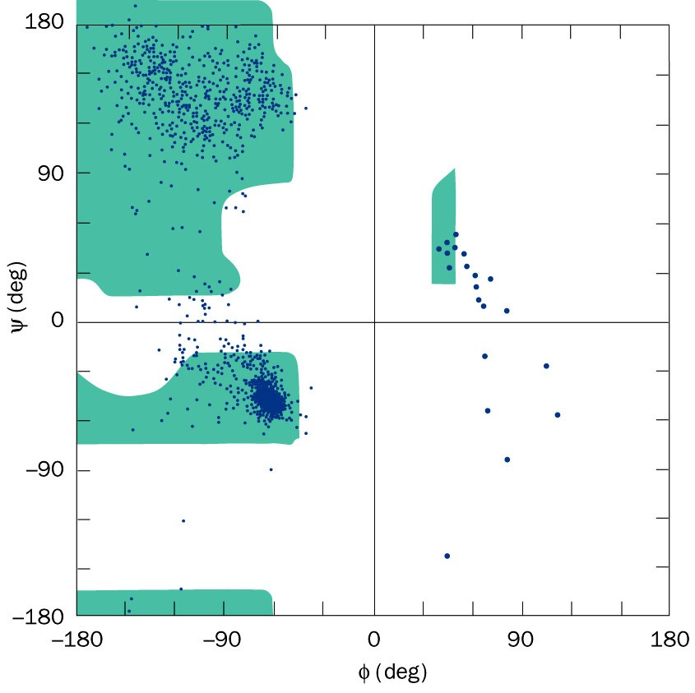
Conformation angles in real proteins.
Notes:
Experimental evidence supporting the Ramachandran chart.
This is the conformation angle distribution of all residues but Gly and Pro from 12 high resolution x-ray structures (blue dots) superimposed.
Why is glycine excluded?

Slide 15
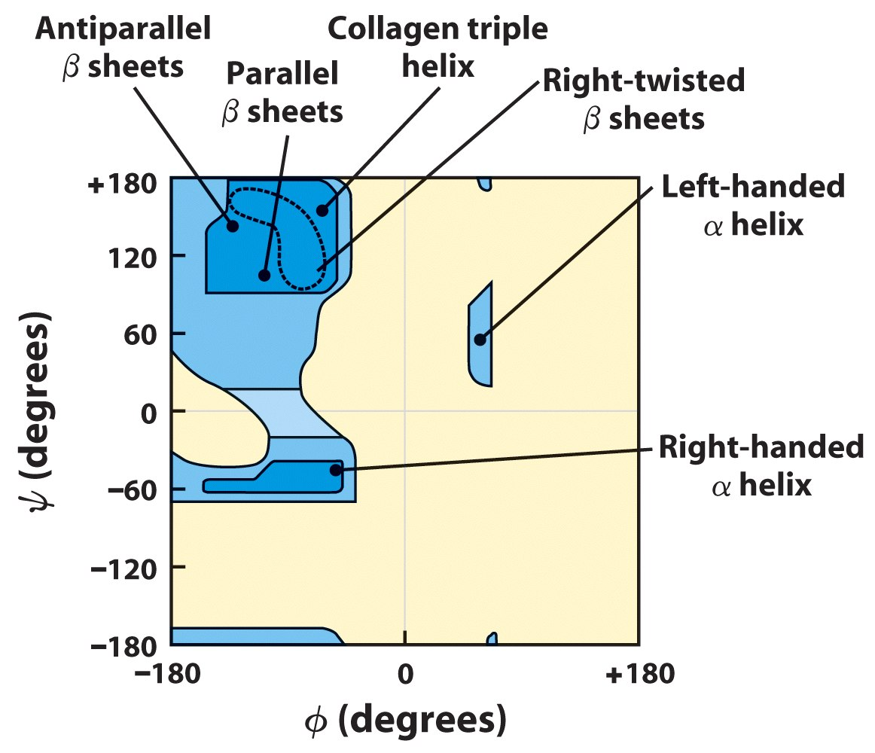
Secondary structures have small ranges of ψ and ϕ
Notes:
CBC: Particular Ramachandran angles correspond to particular secondary structures.
Each regular secondary structure corresponds to a specific set of Ramachandran angles, the same angles at each alpha carbon. The region at the top left is the beta structure region. And the region at the middle left is the alpha structure region. So the plots on the previous pages tell you that most residue in those proteins are in conformations close to either the “ideal” or “perfectly regular” alpha helix or the ideal beta strand. (But a few residues are in quite different conformations.)
(There are a few other regular secondary structures indicated on the slide, like the “left-handed alpha helix” and the “collagen triple helix”, but these are not as common as alpha and beta, so we are not going to talk about them in this course.)

Slide 16
Secondary structure
3 main types of secondary structure
  Alpha helix (α-helix)
  Beta-sheet (β-sheet)
  Turns or bends
Notes:
Average globular protein 31% a helix, 28% beta sheet, rest other.
Some proteins all a-helix = myoglobin or cytopchrome b562, some all b-sheet = immunoglobulin, many a mix

Slide 17
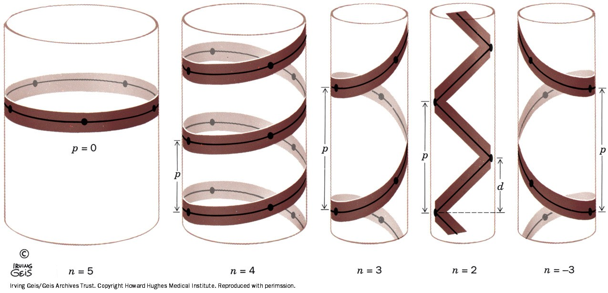
Helical structures
A helix may be characterized by the number, n, of peptide units per helical turn and by its pitch, p, the distance the helix rises along its axis per turn.
Notes:
Defiitions of helical pitch the number of repeating units per turn and the helical rise per prepeating unit.
Right handed helices have positive values
Left handed helices have negative values.
If n = 2 the helix turns into a nonchiral ribbon.
If p = 0 the helix becomes a closed ring.

Slide 18
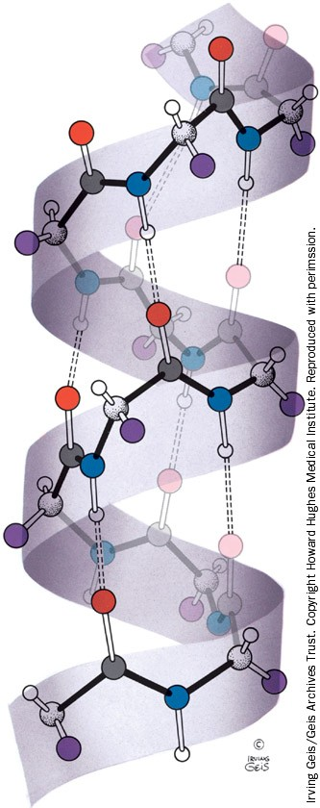
Right-handed α helix.
Notes:
Phi=-57, Psi = -47, n=3.6, p=5.4A what would these be for D-amino acid helix?
NH of nth residue H bonds to CO of nth-4 residue, distance = 2.8A.
Tight packing on interior – van der waal radius of atoms = London Forces
R project out of helix avoiding steric contact with backbone
Range from 12-140 aa long, very common structural feature.

Slide 19
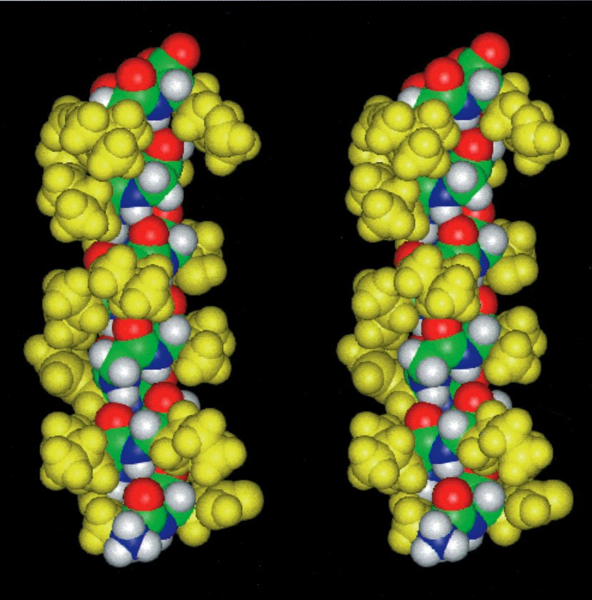
Space-filling representation of an α helical segment of sperm whale myoglobin.
Notes:
Use? See sidechains sticking out and core of helix on the interior.

Slide 20
Helical structures
Helices are formed by hydrogen bonding and are described by the notation n_{m}
  n = number of residue per helical turn
  m = number of atoms, including H, in the ring that is closed by the hydrogen bond.

Slide 21
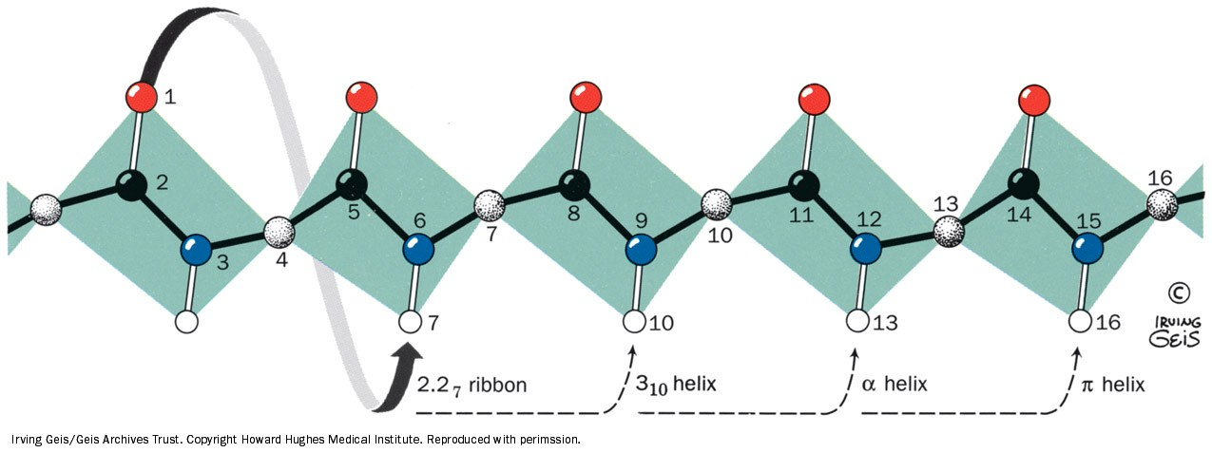
Figure 8-13 The hydrogen bonding pattern of several polypeptide helices.
Notes:
In the cases shown the polypeptide chain is helically wound such that the N-H group on residue n forms a hydrogen bond with the C=O groups on residues n-2, n-3, n-4, or n-5
2.27 has never been observed, 310 is common at the end of helices – rises faster, thinner, sidechains have more steric interactions
Pi-helix wide and flat, axial hole is too big for London force stabilization, too small for water – destabilized.

Slide 22
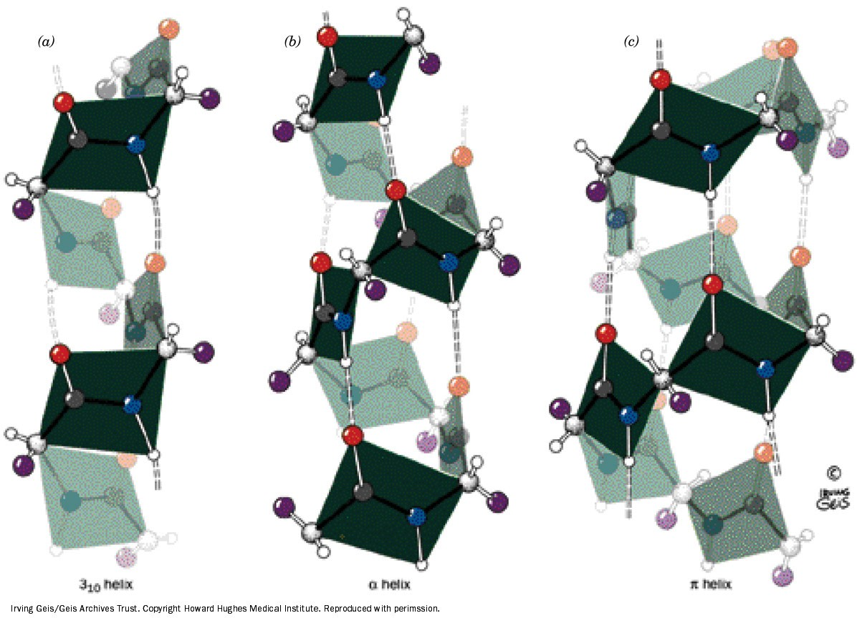
Comparison of the two polypeptide helices that occasionally occur in proteins with the commonly occurring α helix.
Notes:
Comparison of the two polypeptide helices that occasionally occur in proteins with the commonly occursing alpha helix.
The 310 helix which has 3.0 peptide units per turn and a pitch of 6 A, making it thinner and more elongaterd than that alpha helix
The alpha helix which has 3.6 peptide units per turn and a pitch 5.4 A
The pi helix wich has 4.4 peptide units per turn and a 5.2 A making wider shorter than the alpha helix . The peptide planes are indicated.

Slide 23
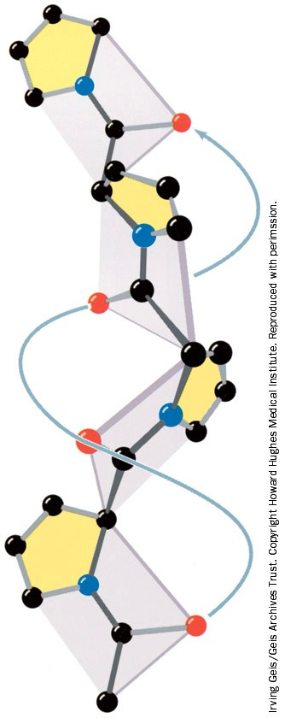
The polyproline II helix.
Notes:
Pro can’t adopt phi, psi angles of alpha helix. Also no H-bond to stabilize
Polyglycine forms a nearly identical helix (polyglycine II).
N=3, p = 9.4A. Very extended. Forms the basic structure of collagen

Slide 24
Beta structures
In β pleated sheets H-bonding occurs between neighboring strands.
2 types
  Antiparallel β pleated sheet
  Parallel β pleated sheet
Common structural motifs
Notes:
2-22 strands in a row, average is 6
Each strand up to 15 residues, average of 6

Slide 25
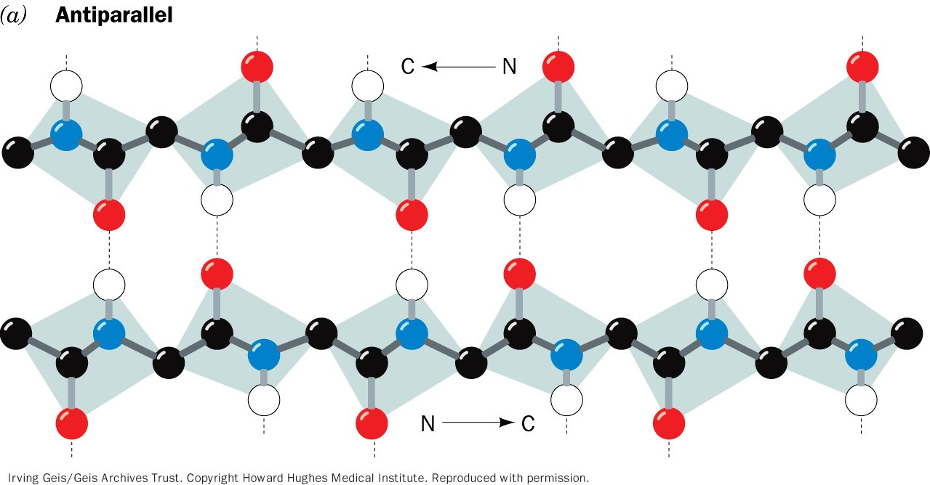
The antiparallel β pleated sheets.
Notes:
Hydrogen bonds are indicated by dashed lines and side chains are omitted for clarity. Often drawn in cartoon style as a wide arrow.
The H-bonds in the antiparallel beta sheet are perfectly matched to be linear – maximizing their strength. Very stable structue.

Slide 26
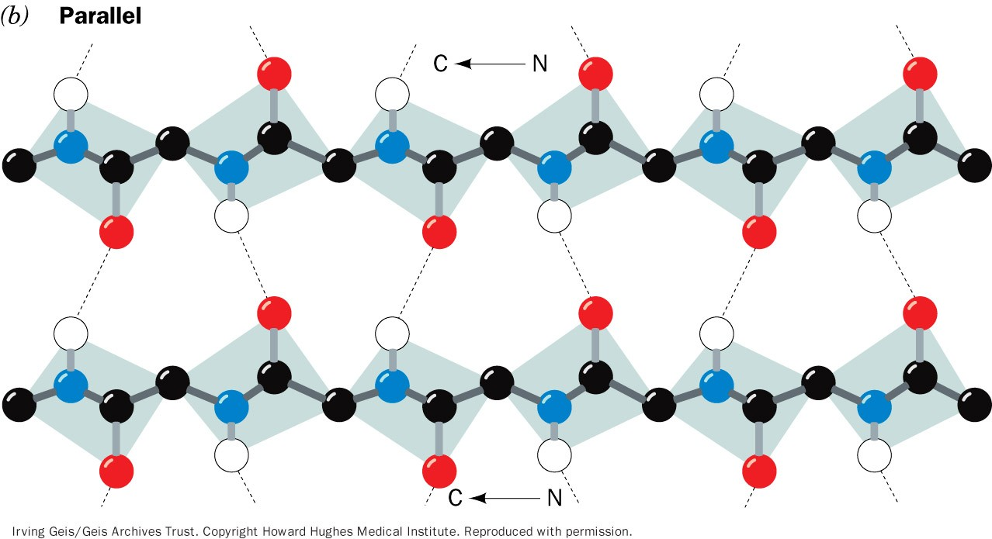
The parallel β pleated sheets.
Notes:
The conformation in which these beta structures are optimally hydrogen bonded for a fully extended polypeptide (phi psi 180). They therefore have ripled or pleated edge-on appearance, which accounts for the appellation pleated sheet.
Note the H-bonds are at an angle thus less strong. Parallel beta sheets are less stable. About 20% of all beta strands are parallel. 50% if it was random. Confirms the greater stability of antiparallel.

Slide 27
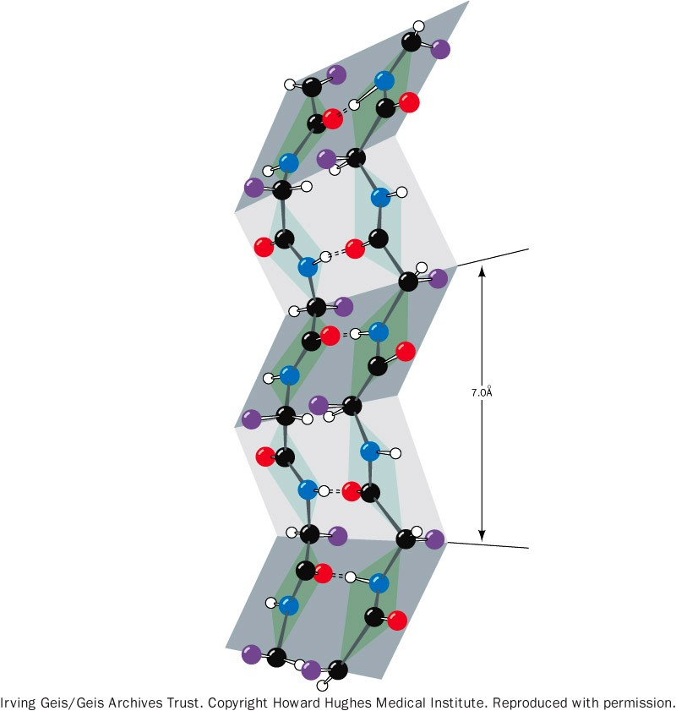
“pleated” two-stranded antiparallel β sheet
Notes:
Side chains alternate which face they protrude from.

Slide 28
Structural Motifs in Proteins.
Individual units of 2ndary structure combine into stable, geometrical arrangements.
Called supersecondary structure or motifs.
Are often repeated in same protein, different proteins.
Certain motifs have associated biological functions:
  α−Helix−loop−α−helix motif binds DNA, sequesters calcium ion.
Secondary structures often depicted as ribbon diagrams
Ribbons invented by Jane Richardson, originally drawn by hand, now done by computer programs.

Slide 29
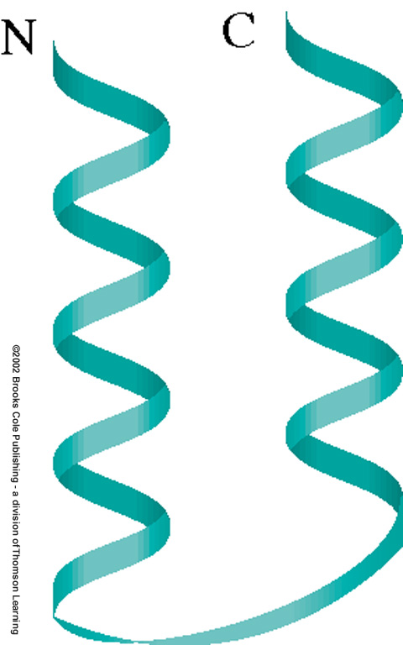
Some common structural motifs of folded proteins
The αα motif
(helix-turn helix)
Notes:
04_03_20 amino acids.jpg

Slide 30
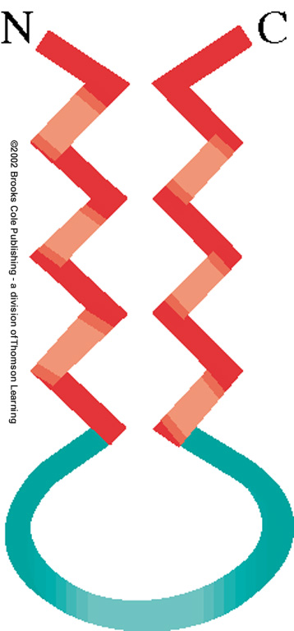
Some common structural motifs of folded proteins
b) The ββ motif; antiparallel
Notes:
04_03_20 amino acids.jpg

Slide 31
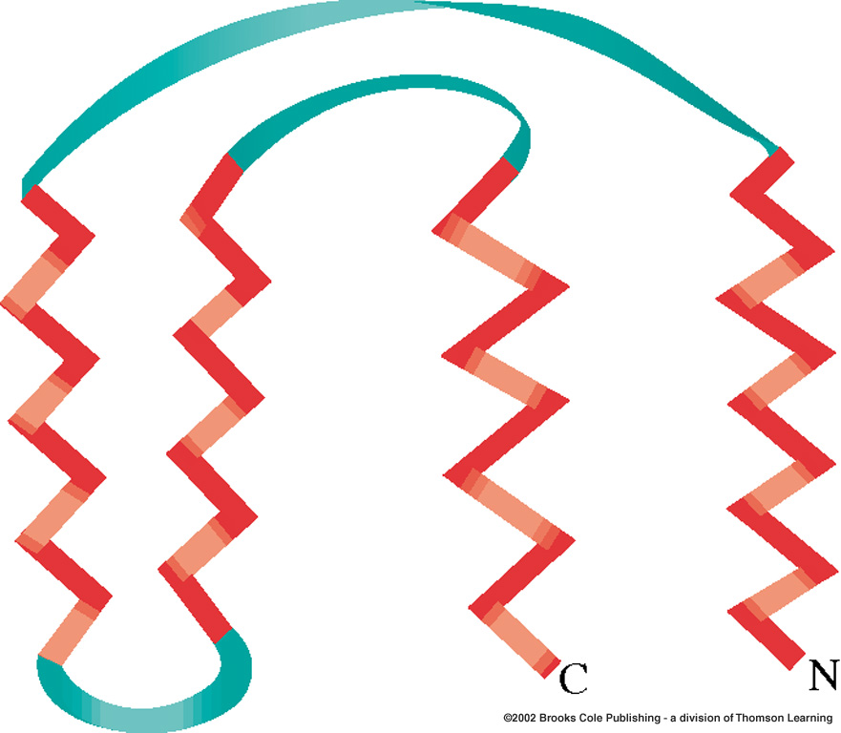
Some common structural motifs of folded proteins
c) The ββββ “Greek Key” motif
Notes:
04_03_20 amino acids.jpg

Slide 32
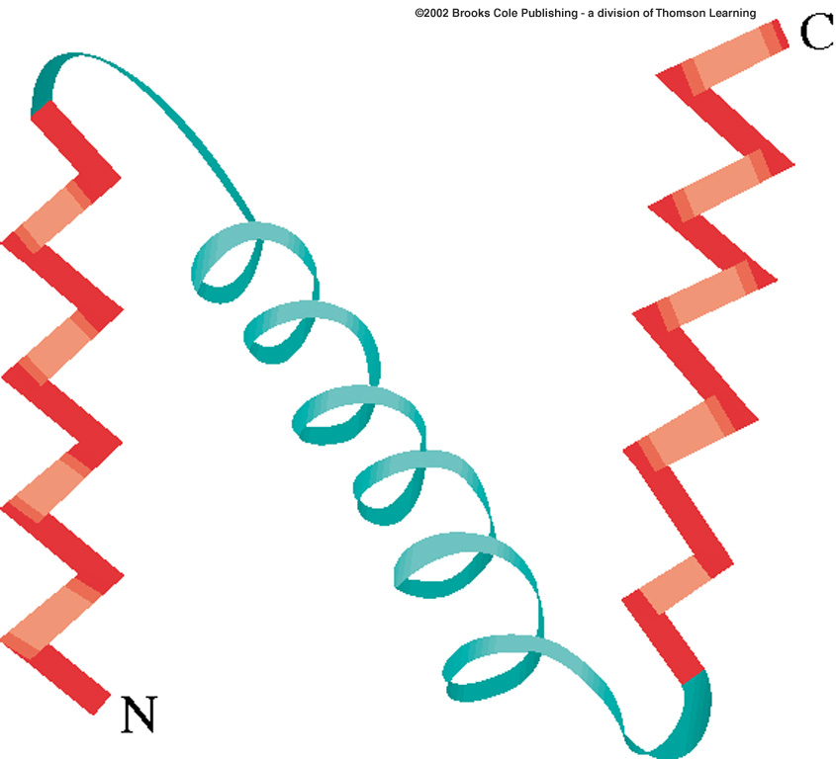
Some common structural motifs of folded proteins
d) The βαβ motif
Notes:
04_03_20 amino acids.jpg

Slide 33
Beta structures
Link that connects antiparallel strands is a simple hairpin turn.
For tandem parallel strands, linked by a crossover connection that is out of the plane of the β-sheet and almost always have a right-handed helical sense.

Slide 34
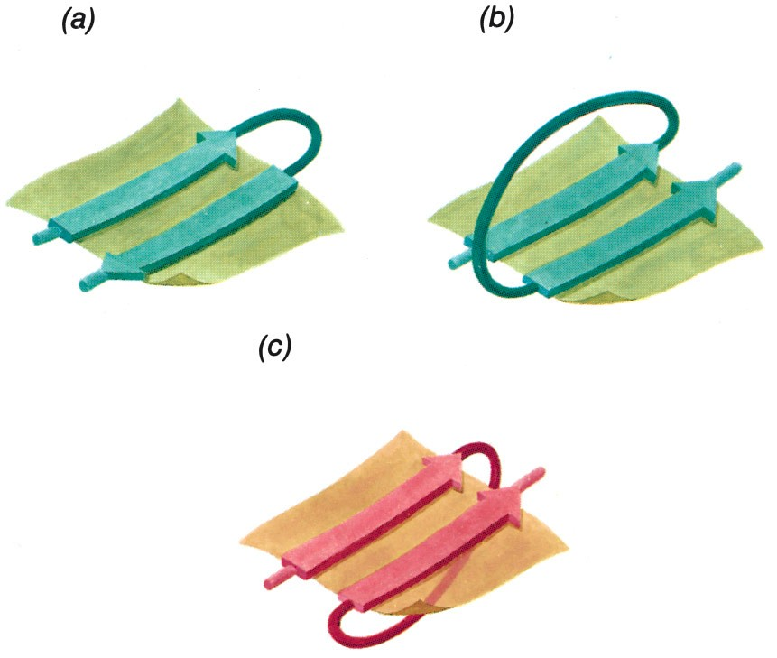
Figure 8-20 Connections between adjacent polypeptide strands in β pleated sheets.
Page 229
Notes:
Simple hairpin connection between beta sheets.
a right handed crossover between successive strands of parallel beta sheets
a left handed crossover connection between parallel beta sheets.

Slide 35
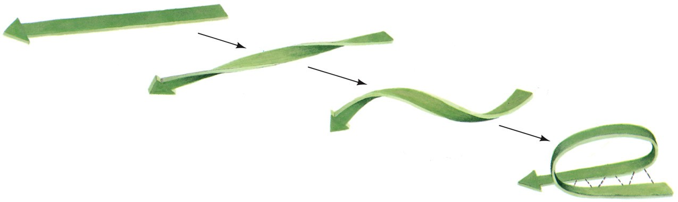
Figure 8-21 Origin of a right-handed crossover connection.
Page 230

Slide 36
Coil and loop conformations
50% of regular secondary structure is helices and β pleated sheets, the other segments are coil or loop conformations. These have structure (e.g. not random coils)
Globular proteins consist of largely straight runs of 2 structure joined by stretches of polypeptide that abruptly change direction (reverse turns or β bends).
Usually connect strands of antiparallel β sheets.
Almost always occur on surface of the protein.
Involve 4 successive amino acid residues arranged in one of two ways

Slide 37
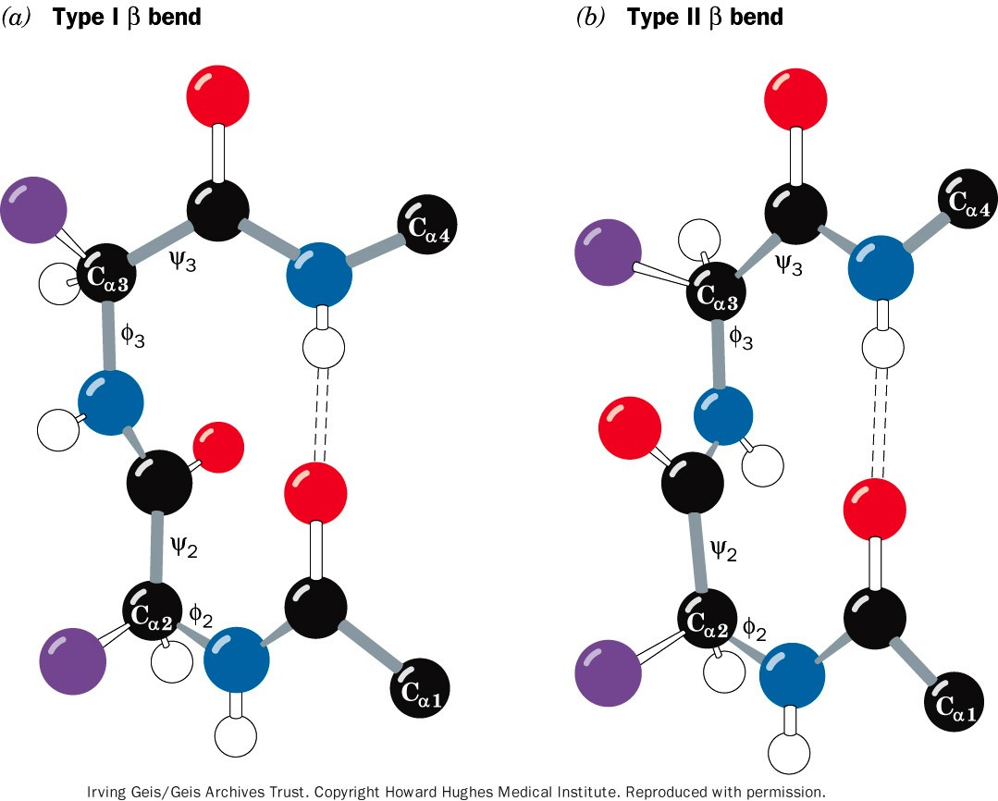
Figure 8-22 Reverse turns in polypeptide chains.
Page 230
Notes:
Type I and type II bends differ by a 180 flip of the peptide unit linking residues 2 and 3. Both bends contain a hydrogen bond although deviations from these ideal conformations often disrupt this hydrogen bond.

Slide 38
Coil and loop conformations
Almost all proteins >60 residues have one or more loops
  Each loop is 6-16 residues that are not components of β sheets or helices called Ω loops.
  Look like the Greek letter Ω
Almost always located on the protein surface
Involved in recognition.

Slide 39
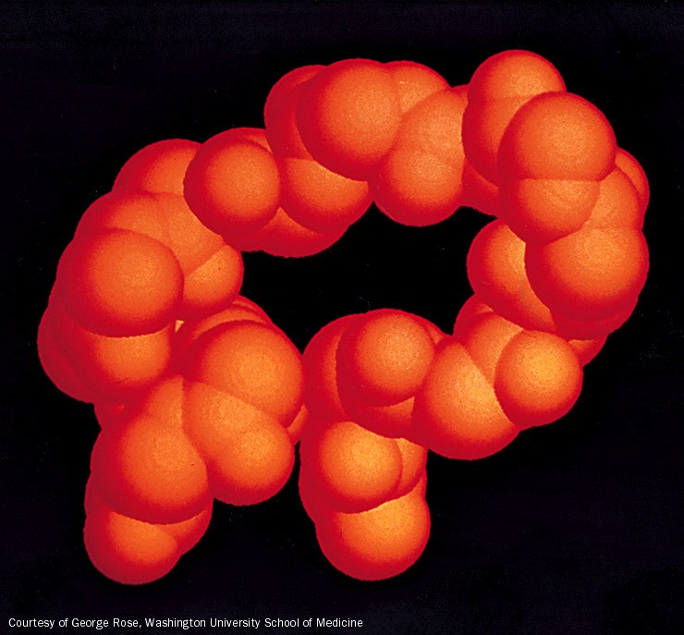
Figure 8-23 Space-filling representation of an Ω loop comprising residues 40 to 54 of cytochrome c.
Page 231

