Slide 1
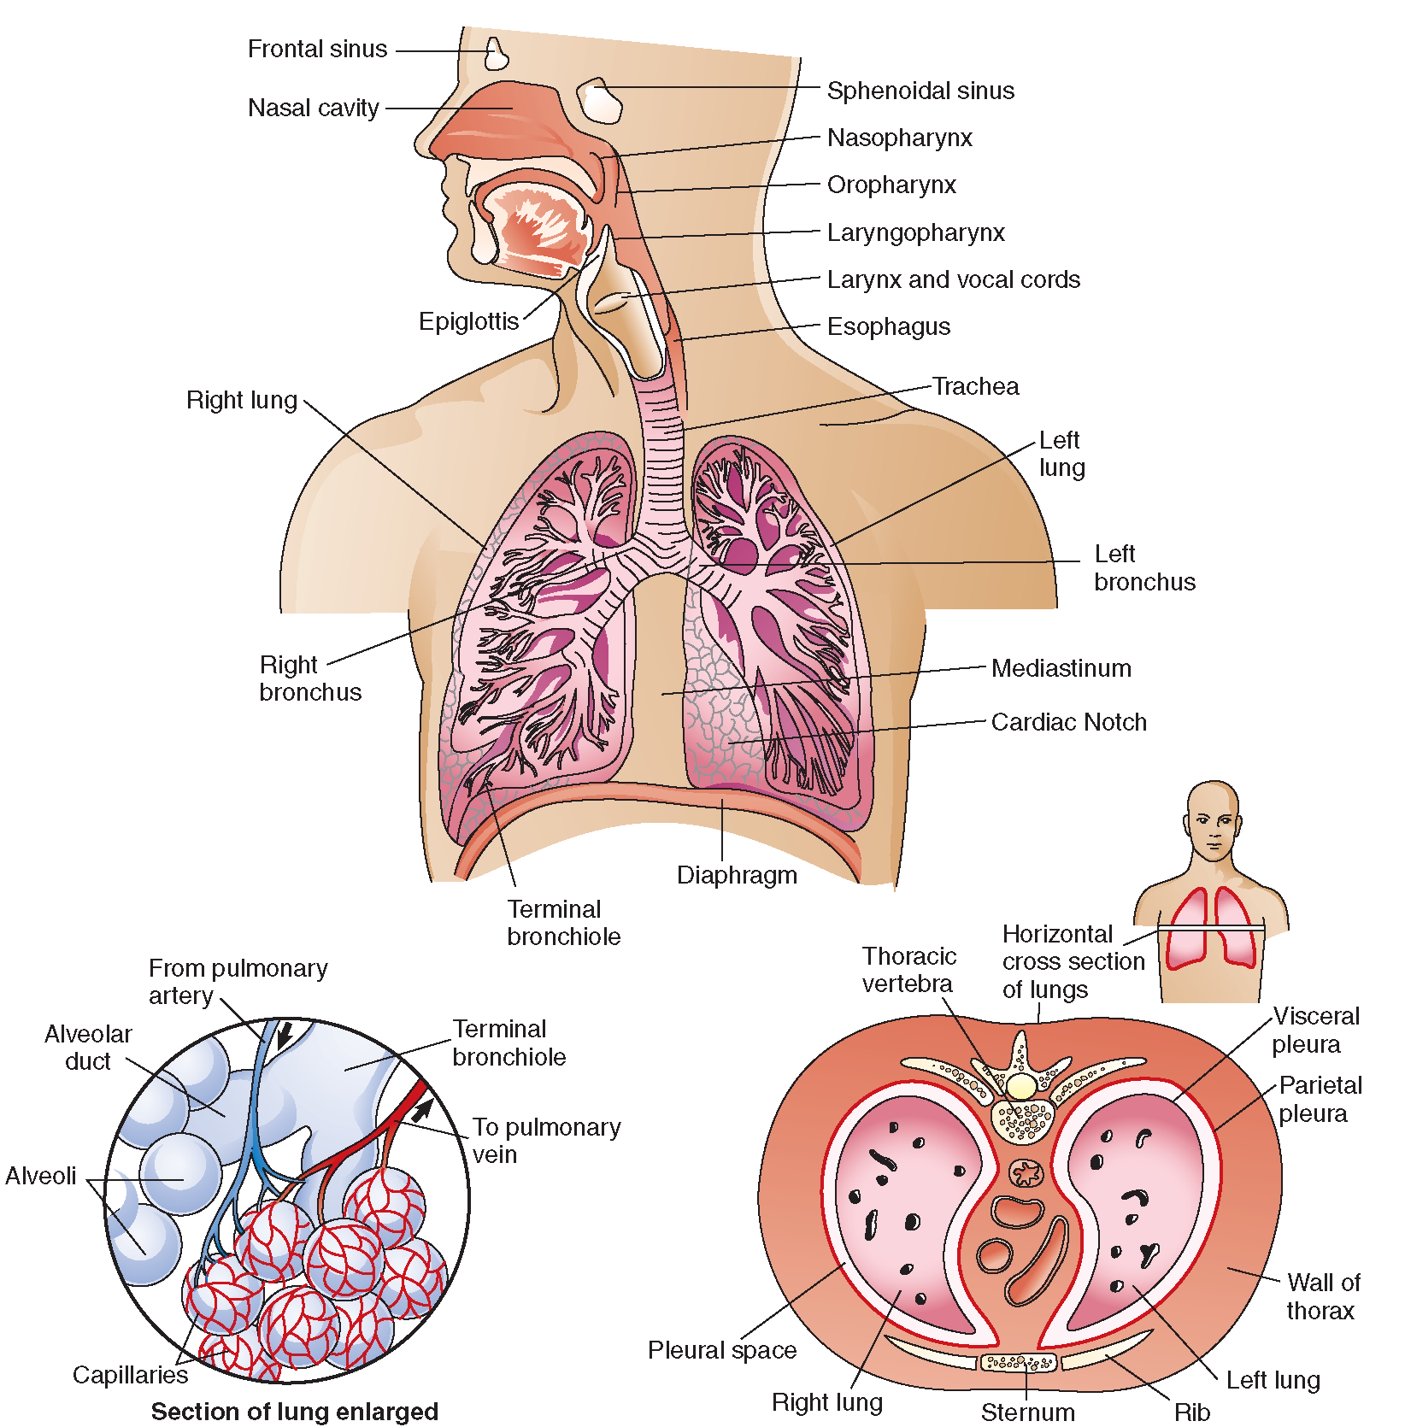
Respiratory System
Anatomy
Nov 27, Dec 01, 04, 08
Chapter 22
November 27
pp. 807-822 in the 10th edition
November 27
pp. 801-816 in the 9th edition

Slide 2

INTRODUCTION
• major function of respiratory system is to supply O₂ and dispose of CO₂
• 4 distinct processes:
1) Pulmonary ventilation: movement of air in and out of lungs
2) External respiration: exchange of gases between blood & air of alveoli
3) Transport of respiratory gases: role of blood in transport of gases between lungs & tissues of body
4) Internal respiration: at the level of the tissues, exchange of gases between blood in systemic capillaries and tissue cells
• first 2 functions handled by respiratory system; other two by CV system
J. Carnegie, UofO
Notes:
1.breathing! Via inspiration and expiration. Gases continuously refreshed=resp. system
2.O2 diffuses from lungs to blood. CO2 diffuses from blood to lungs=resp. system
3.blood=transporting fluid for gas exchange=CV
4.O2 diffuses from blood to tissue cells. CO2 diffuses from tissue cells to blood=CV
Cellular respiration: use of O2 and production of CO2 by tissue cells

Slide 3
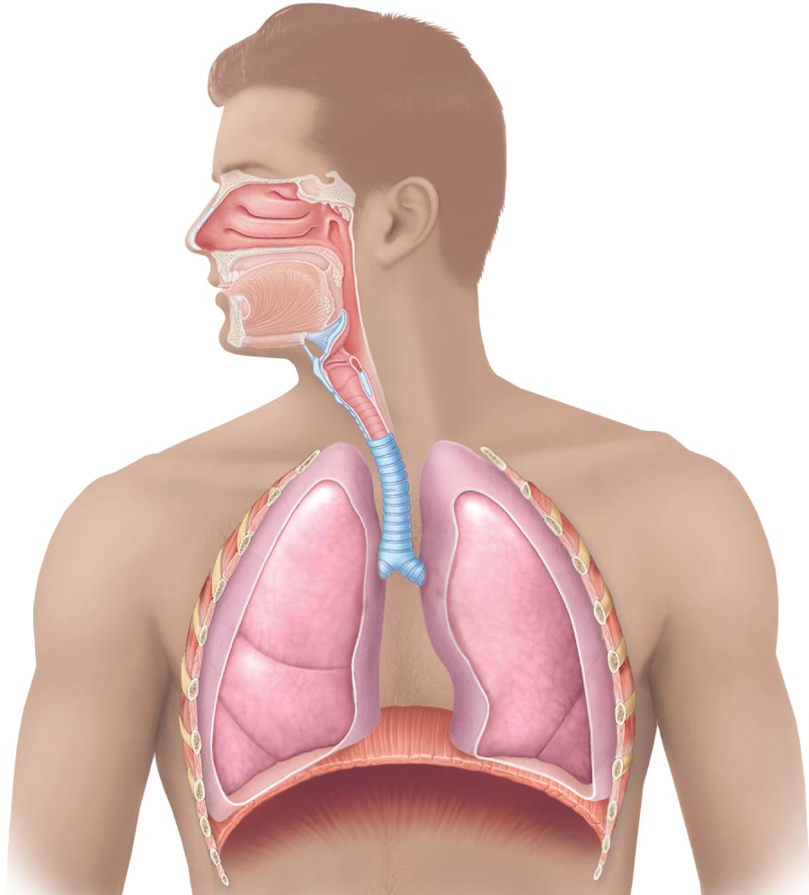
6.1 Describe the structure of each one of the components of the conduction and respiratory zones
• conducting zone: (passageways) »»»» 1 nose, 2 nasal cavity, 3 pharynx, 4 larynx, 5 trachea, 6 bronchi, bronchioles, terminal bronchioles / as well as providing a passageway, conducting zone organs also cleanse, humidify & warm incoming air
• respiratory zone: (= site of gas exchange) »» composed of respiratory bronchioles, alveolar ducts & alveoli (microscopic)
2
1
3
4
5
6
Notes:
Respiratory zone: microscoipic structures!!
Conducting zone: all other respiratory passageways. Rigid conduits for air to reach gas exchange sites
As a result of cleanse etc. air reaching lungs have fewer irritants (e.g. dust, bacteria, etc.) than when it entered the body.

Slide 4
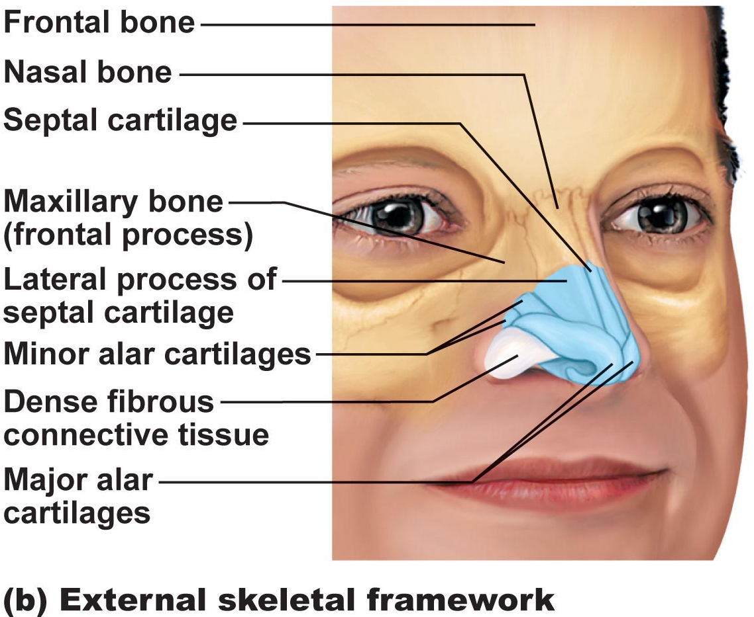
1. Nose
• functions:
a) airway for respiration
b) moistens & warms incoming air
c) filters & cleans inspired air
d) resonating chamber for speech
e) olfactory (smell) receptors
• structure of external nose: differences in nose size/shape due to differences in nasal cartilages
skin covering dorsal/lateral aspects of nose is thin; contains many sebaceous glands
philtrum
Fig. 22.2b
Notes:
Structures of nose are divided into the internal nasal cavity and external nose
External openings of the nose (nostrils or nares) are bounded laterally by the flared alae.

Slide 5
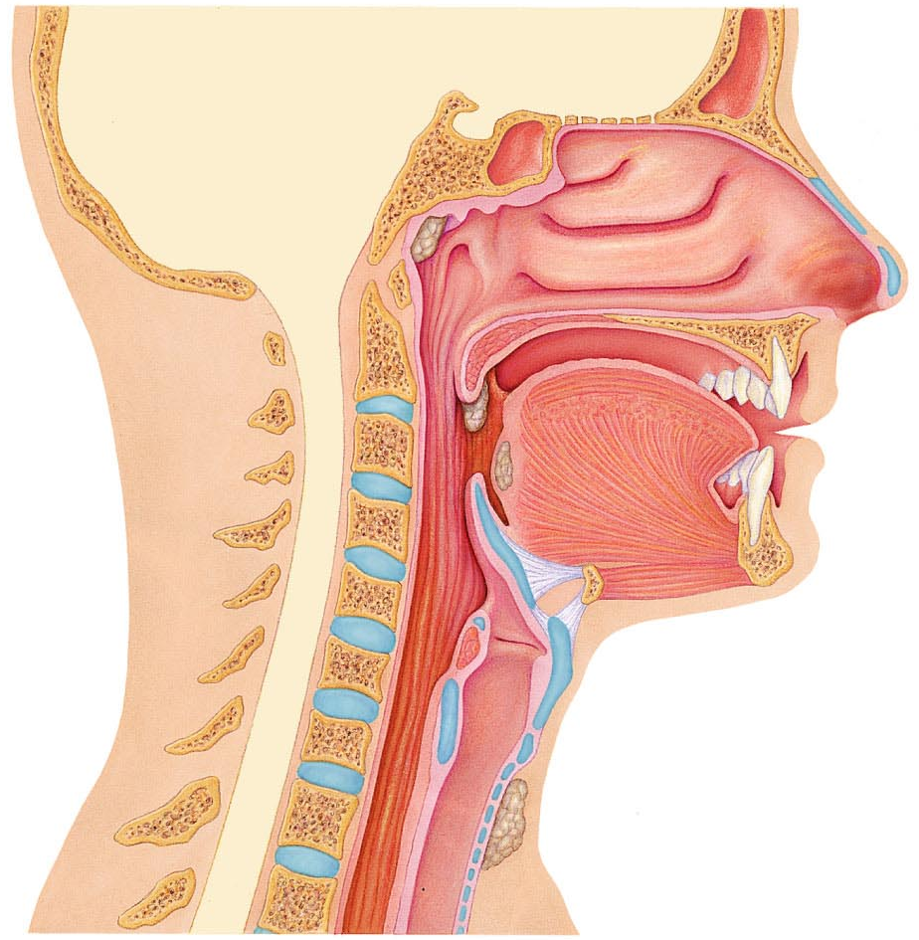
air enters nasal cavity via external nares (nostrils) -cavity divided by midline nasal septum (cartilage » bone); air then goes via internal nares to nasopharynx
• roof of nasal cavity formed by ethmoid & sphenoid bones of skull
• floor of nasal cavity formed by palate (anterior is hard; posterior is soft)
• vibrissae: what are these?-Hairs that filter coarse particles (dust, pollen) from inspired air.
• nasal cavity lined by 2 types of mucosa
a) olfactory mucosa: contains receptors for sense of smell (olfactory epithelium)
-lines slit like superior region of the nasal cavity
Fig. 22.3
Notes:
Nasal cavity lies in and posterior to the external nose
Anterior has support of maxillary bone structure
Posterior is unsupported so it is muscular

Slide 6
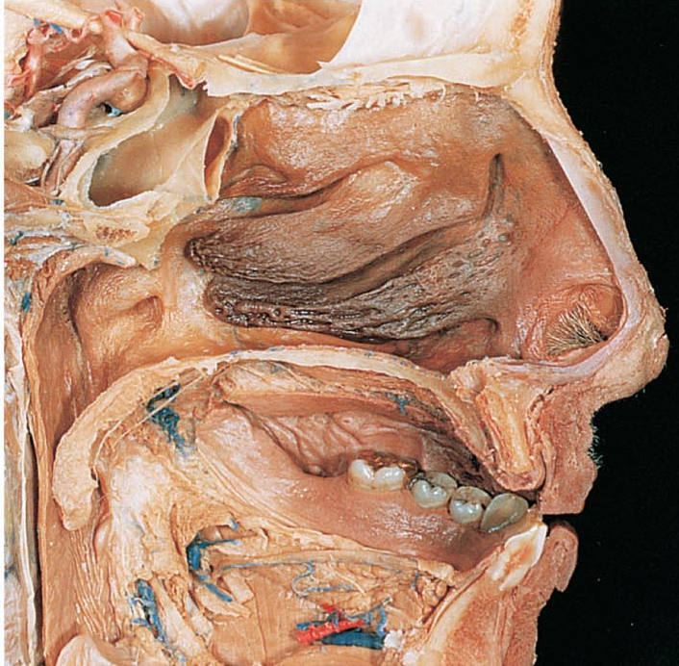
b) respiratory mucosa: pseudostratified ciliated columnar epithelium with goblet cells; lamina propria has mucous & serous glands (1 L/day sticky mucus containing lysozyme)
• resp mucosa cilia move contaminated mucus posteriorly to pharynx
• cold air slows cilia → runny nose
• thin-walled veins under nasal epithelium ➢ role? cold air & nosebleeds?
-when inspired air is cold. The vascular plexus becomes engorged with blood, intensifying the air heating process
-because blood vessels are located superficially and abundant nosebleeds are common
• What are nasal conchae? *
• nasal mucosa richly supplied with sensory nerves ➢ irritants trigger sneeze reflex
*
*
Fig. 22.3a
J. Carnegie, UofO
Notes:
Lines most of the nasal cavity
Pseudostratified columnar epithelium
Contain goblet cells that rest on lamina propria which is richly supplied with seromucous nasal glands.
• What are nasal conchae? Protrude medially on lateral wall of nasal cavity, three scroll-like mucosa covered projections: the superior, middle and inferior nasal conchae.
-groove inferior to each concha is a nasal meatus
-curved conchae increase the mucosal surface area exposed to air and enhance air turbulence in the cavity
-gases in inhaled air swirl through the twists and turns, deflecting heavier, nongaseous particles onto the mucous coated surfaces where they become trapped.
-during exhalation, cooled conchae precipitate moisture and heat lost form the body through breathing, helping us survive in dry and cold climates

Slide 7
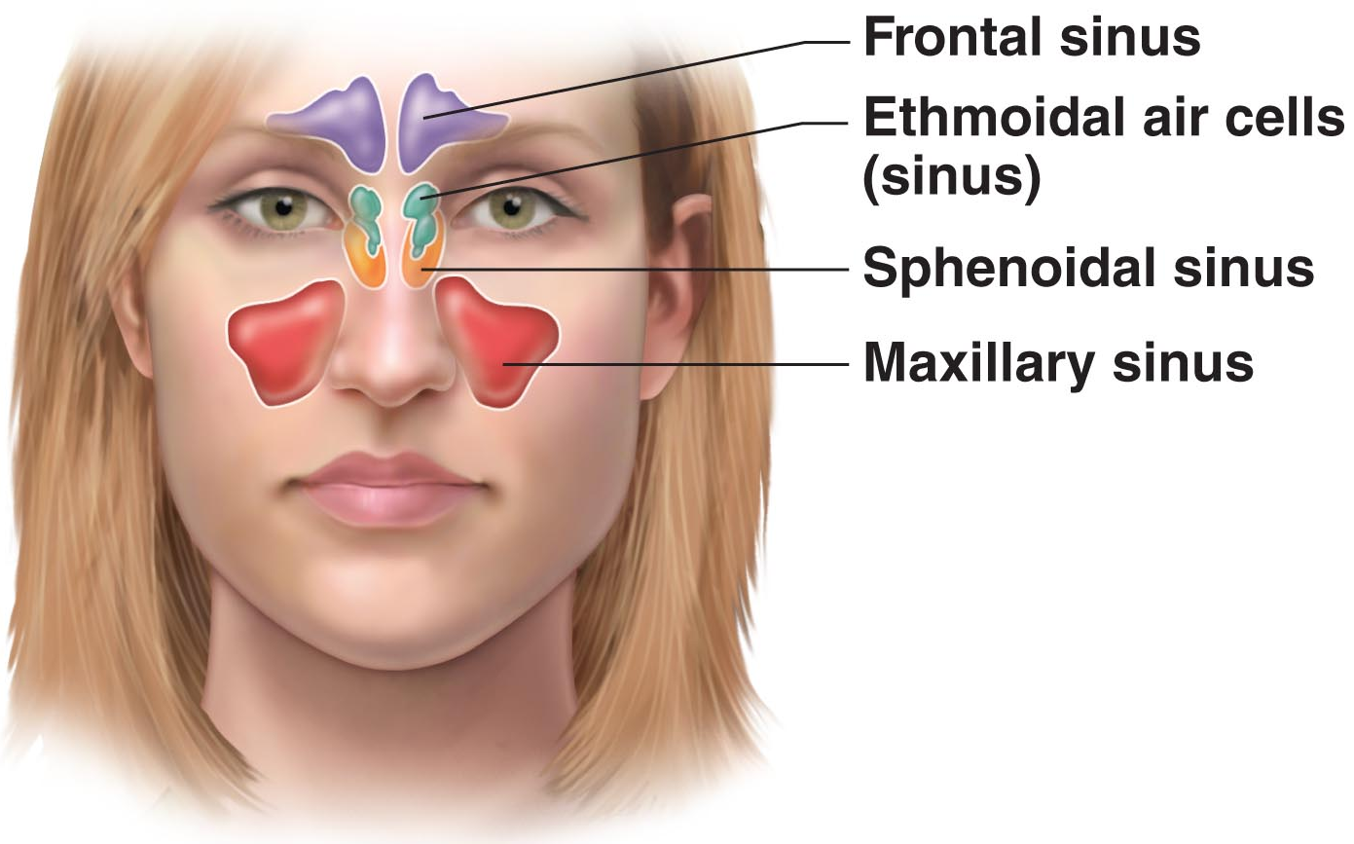
Fig. 7.11a
Paranasal Sinuses
surround nasal cavity
Location: frontal, sphenoid, ethmoid, maxillary bones
lighten skull, produce mucus, also warm & moisten air
sinus mucosa continuous with nasal mucosa »» spread of infections
sinus headache: passageways connecting sinuses to nasal cavity blocked » air in sinus absorbed » partial vacuum
Notes:
Mucosa-lined
Air filled cavities in cranial bones surrounding nasal cavity
Have same function as nasal cavity except no receptors fro smell; also lighten skull
-mucous produced flows into nasal cavity and suctioning effect created by nose blowing helps drain nose
Remember function of nose (internal and external): produce mucous, filters, warms, and moistens incoming air, resonance chamber for speech. Receptors for smell

Slide 8
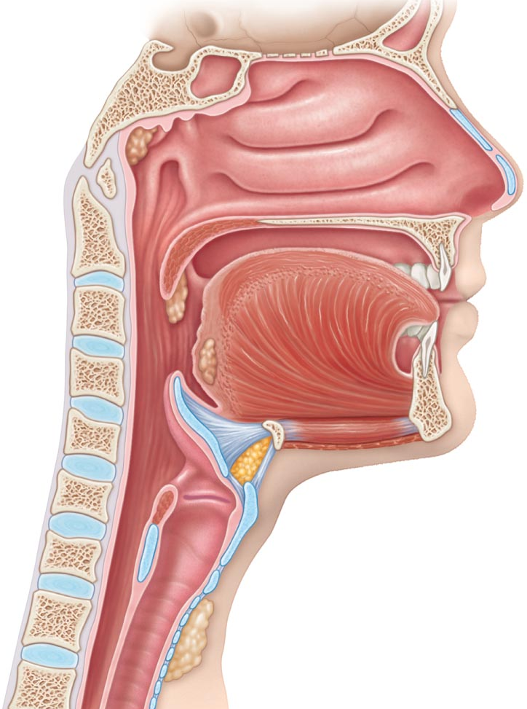
Pharynx • common pathway for food and air, wall composed of skeletal muscle throughout ~13 cm length; mucosal lining varies
3a) Nasopharynx psterior to nasal cavity and inferior to sphenoid bone------------
• below sphenoid bone, above (superior to) soft palate
• only an air passageway
• what happens when swallowing?
• pseudostratified ciliated epithelium
• pharyngeal tonsils
• pharyngotympanic (auditory) tubes drain from middle ear
3b) Oropharynx --------
• fauces connects oral cavity with oropharynx
• from soft palate to epiglottis (air and food)
• epithelium becomes stratified squamous
• paired palatine tonsils + single lingual tonsil
3c) Laryngopharynx -------------
• also both food and air
• stratified squamous
• from epiglottis to larynx – then respiratory
& GI pathways diverge, during swallowing, food has “right-of-way” before air (will temporarily stop)
-----------------
---------
----------
Fig. 22.3
Notes:
Passageway connecting nasal cavity to larynx and oral cavity to esophagus.
Three sub divisions
Houses tonsils (lymphoid tissue masses involved in protection against antigens)
Ultimate functions: passageway for food and air
For tonsils: facilitates exposure of immune system to inhaled antigens
3.a) what happens when swallowing? the soft plate and uvula move superiorly which closes the nasopharynx and prevents food from entering nasal cavity (when we giggle this may fail, so why food comes out of nose)
pharyngeal tonsils : on posterior wall; traps and destroys pathogens entering nasopharynx for air
b) Lies posterior to oral cavity and is continuous with it through the archway called isthmus of the fauces.
-extends inferiorly form soft plate to the epiglottis. Both swallowed food and inhaled air move through it
-change in epithelium from nasaopharynx (strcutural adaptation) accomodates increased friction and chemical trauma (hot and spicy foods)
-palatine tonsils embedded in lateral walls of oropharyngeal mucosa, posterior of oral cavity
-lingual tonsil: covers the posterior surface of the tongue
c)Lies directly posterior to upright epiglottis and extends to larynx, where respiratory and digestive pathways diverge. At that point the laryngopharynx is continuous with the esophagus posteriorly

Slide 9
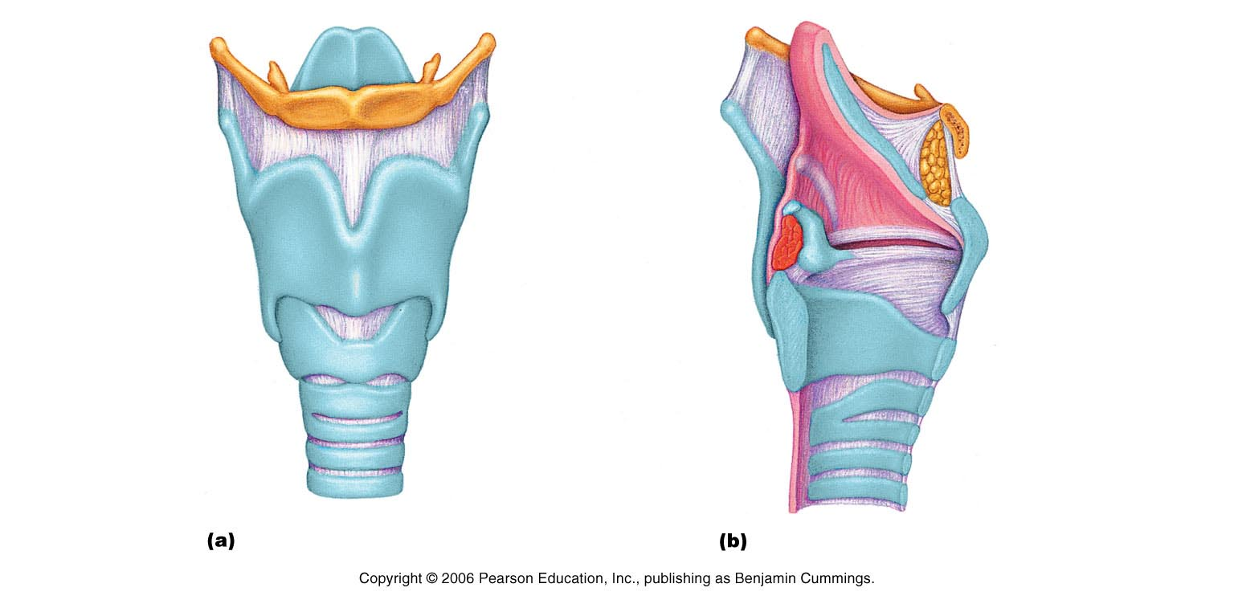
Larynx aka voice box
• ~5 cm (4th-6th cervical vertebrae)
• attached to hyoid bone (above); continuous with trachea (below)
• 3 functions:
(i) open, 2-directional airway
(ii) switching: food vs air
(iii) voice production
• 9 cartilages in total
thyroid cartilage: large, shield-shaped cartilage in front (puberty in males?)
arytenoid cartilages (2): lateral, pyramid-shaped, anchor vocal cords: cuneiform and corniculate
9th cartilage is epiglottis: elastic cartilage, anchored to anterior rim of thyroid cartilage & extends up to base of tongue
true vocal cords: white (avascular); vibrate in response to air movement up from lungs (what is the glottis?)
false vocal cords: above true vocal cords
• epithelial lining of upper versus lower larynx?
Figs. 22.4a &b
J. Carnegie, UofO
Notes:
Connects pharynx to trachea
Has framework of cartilage and dense CT
Opening (glottis) can be closed by epiglottis or vocal folds. =>air passageway; prevents food from entering lower respiratory tract
Houses vocal folds (true vocal folds)=>voice production
Thyroid cartilage: (puberty in males?) The midline laryngeal prominence, which marks the fusion point of the two cartilage plates is obvious externally as the Adam's apple. This cartilage typically larger in males because male sex hormones stimulate its growth during puberty
epithelial lining of upper versus lower larynx? Stratified squamous lines the superior portion of larynx, an area subject to food contact. Below the vocal folds the epithelium is pseudostratfied ciliated columnar that filters dust. The power stroke of the cilia is directed upward towards the pharynx to continually move mucous away from the lungs.
-we help move mucus up and out of the larynx when we “clear our throat”

Slide 10
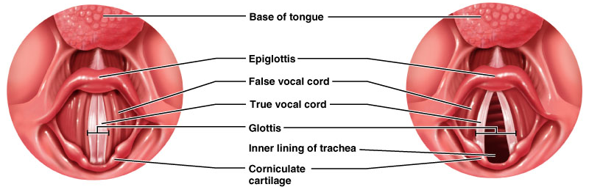
Voice Production:
• speech = intermittent release of expired air + opening & closing of glottis
• length of vocal cords & size of glottis altered by action of laryngeal muscles that move arytenoid cartilages
• male voice at puberty: vocal cords vibrate more slowly – why?
• loudness of voice: force of air across vocal cords; depends on the force with which the airstream rushes across the vocal folds. The greater the force the louder the sound.
• laryngitis: inflammation of vocal cords ⇒ vibration impaired
• sphincter functions of vocal cords:
(i) epiglottis closes respiratory tract during swallowing
(ii) Valsalva’s maneuver: What is this?
What is the Heimlich maneuver??
Notes:
male voice at puberty: vocal cords vibrate more slowly – why?
-a boy’s larynx enlarges during puberty, his vocal cods become longer and thicker. This causes slower vibration.
Valsalva’s maneuver: What is this?
-during abdominal straining associated with defecation, the glottis closes to prevent exhalation and the abdominal muscles contract causing the intra-abdominal pressure to rise.
-these events help empty the rectum and can also splint (stabilize) the body trunk when lifting a heavy load

Slide 11
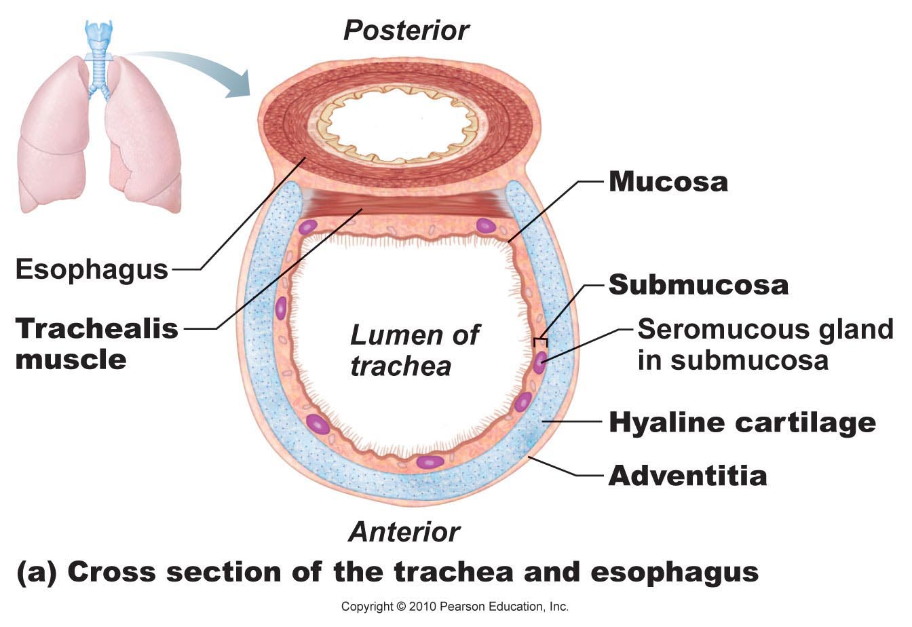
Trachea->aka windpipe
• 10-12 cm long; ~2.5 cm diameter; flexible, mobile
• pseudostratified ciliated columnar; cilia move mucus/debris up to pharynx
smoking inhibits & then destroys cilia; only coughing to clear mucus
• submucosa is CT with seromucous glands
• outer adventitia reinforced internally by 16-20 C-shaped cartilaginous rings; keep airway open during pressure changes associated with breathing
Fig. 22.6a
Notes:
-flexible tube running from larynx and dividing inferiorly into 2 main bronchi. Walls contain C-shaped cartilages that are incomplete posteriorly where connected by trachealis
=>air passageways; cleans, warms and moistens incoming air
-subdivided into 2 at the midthorax
-several layers: mucosa, submucosa, adventitia plus a layer of hyaline cartilage
Mucosa: has the same goblet cell containing pseudostratified epithelium that occurs throughout most of the respiratory tract
Epithelium: rests on thick lamina propria that has a rich supply of elastic fibers

Slide 12
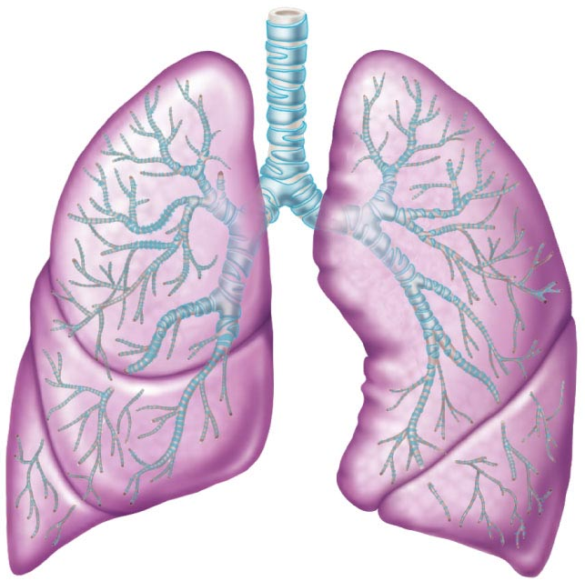
The Bronchial Tree
Conducting zone structures:
• right primary bronchus is wider, shorter, more vertical than left
• air in bronchi is warm, cleansed of most impurities & humidified
• ~23 orders of branching air passages in lungs = bronchial or respiratory tree
bronchi (1⁰, 2⁰, . . )
bronchioles (< 1 mm diam)
terminal bronchioles (< 0.5 mm diam)
• changes in wall composition as one moves through tree:
a) cartilage: (cartilage) rings to plates (cartilage) to none
b) epithelium: pseudostratified columnar to columnar to cuboidal; no cilia or mucous cells in bronchioles (so any debris found must be removed by macrophages in alveoli)
c) smooth muscle: relative amount increases as passages become smaller
Fig. 22.7
J. Carnegie, UofO
Notes:
Consists of: left and right main bronchi which subdivide within the lungs to form lobar and segmental bronchi and bronchioles. Bronchiolar walls lack cartilage but have a complete layer of smooth muscle. Contraction of smooth muscle-impedes expiration
Air passageways connecting trachea with alveoli; cleans, warms and moistens incoming air
b)Mucousal epithelium thins as it changes from pseudo to columnar then cuboidal in terminal bronchioles
c) A complete layer of circular smooth muscle in the bronchioles and lack of supporting cartilage (would hinder constriction) allows bronchioles to provide substantial resistance to air passage under certain condtions

Slide 13
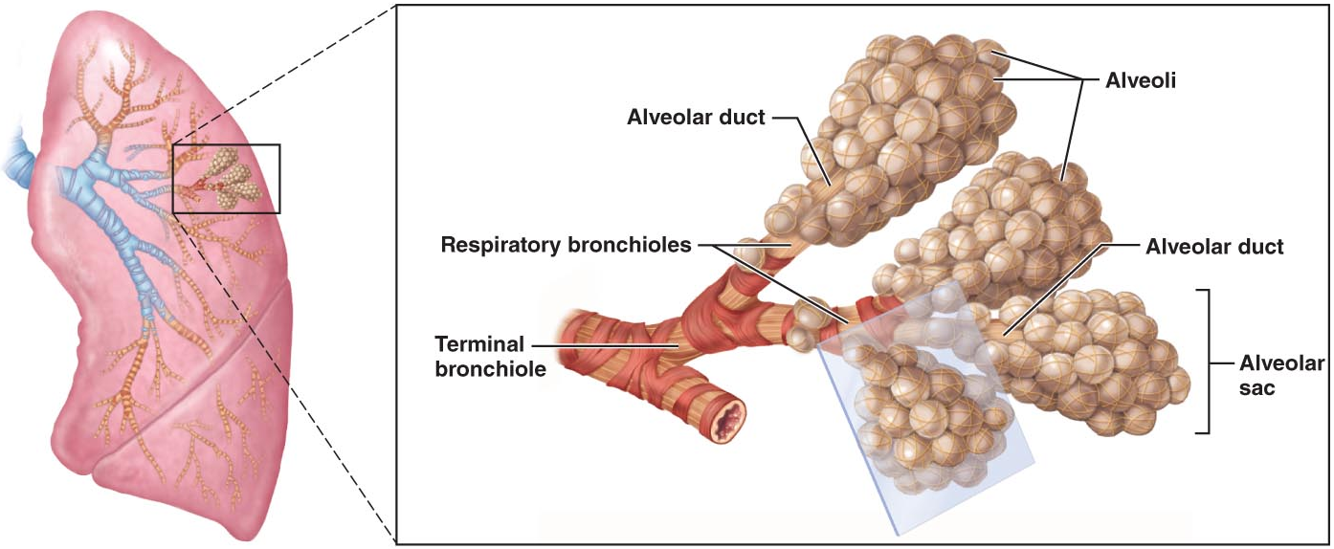
2. Respiratory Zone
terminal bronchioles branch into respiratory bronchioles
~300 million alveoli = huge surface for gas exchange
Fig. 22.8a
Notes:
-defined by presence of thin walled sacs called alveoli. (gas exchange in lungs)
-zone begins at the terminal bronchioles which feed in the respiratory bronchioles within the lung.
-protruding from smaller bronchioles are scattered alveoli
-respiratory bronchioles lead into winding alveolar ducts” walls consist of diffusely arranged tings of smooth muscle cells, CT fibers, and outpocketing alveoli
-alveolar ducts lead into terminal cluster alveoli called alveolar sacs or alveolar saccules
Alveolar sacs and alveoli are NOT the same thing!
Sac is like a bunch of grapes and alveoli is individual grape

Slide 14
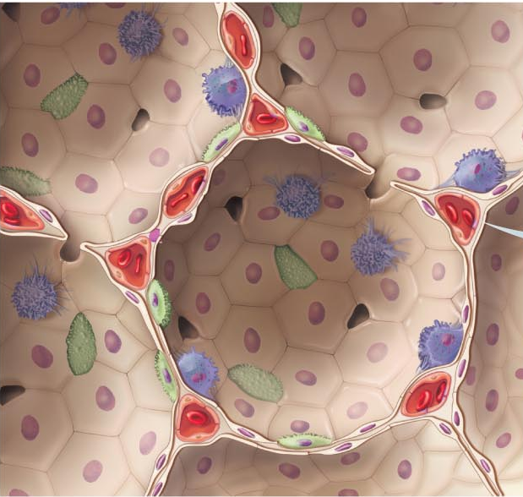
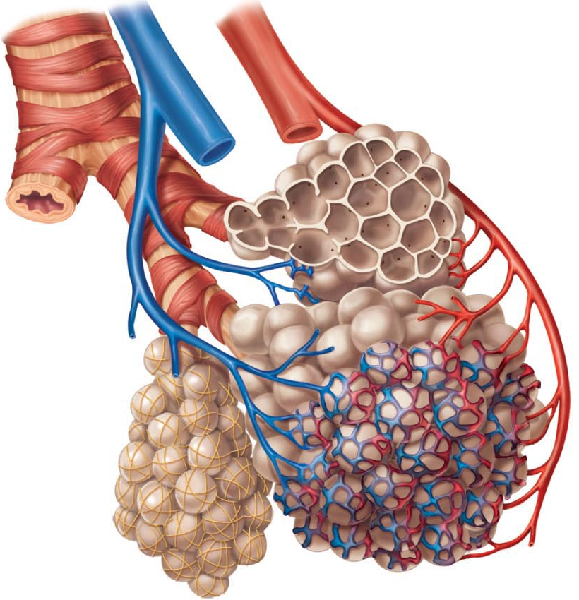
Fig. 22.9
Identify the cell types shown in this diagram
Notes:
1) Smooth muscle, elastic fibers, alveolus, terminal bronchiole, respiratory bronchiole
2) alveoli, red blood cell in capillary, Type 2 alveolar cell, Type 1 alveolar cell, respiratory membrane, endothelial cell nucleus, macrophage, capillary, alveolar pores, nucleus of type 1 alveolar cell
p.813

Slide 15
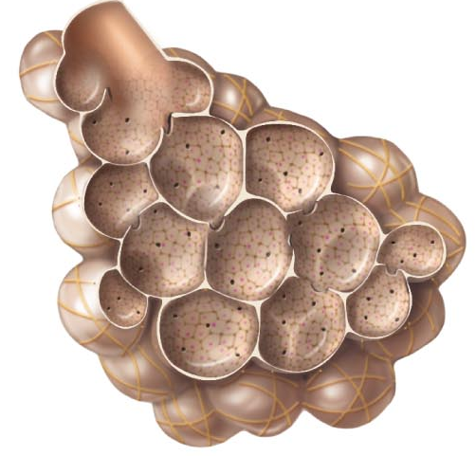
respiratory membrane = alveolar wall + capillary wall + basal laminae
• respiratory membrane is an air-blood barrier; gas exchange by simple diffusion
• type II cells: scattered among type I cells; secrete surfactant
• other characteristics of lung alveoli:
(i) surrounded by fine elastic fibers
(ii) alveolar pores: allow equalization of air pressure throughout lung; alternate air routes if bronchi collapsed
(iii) alveolar macrophages = dust cells; inner alveolar surface; clear & swallow > 2 million dust cells/hour!
Fig. 22.8
J. Carnegie, UofO
Notes:
Labels: p.812
-alveolar duct, alveoli, alveolar pores

Slide 16
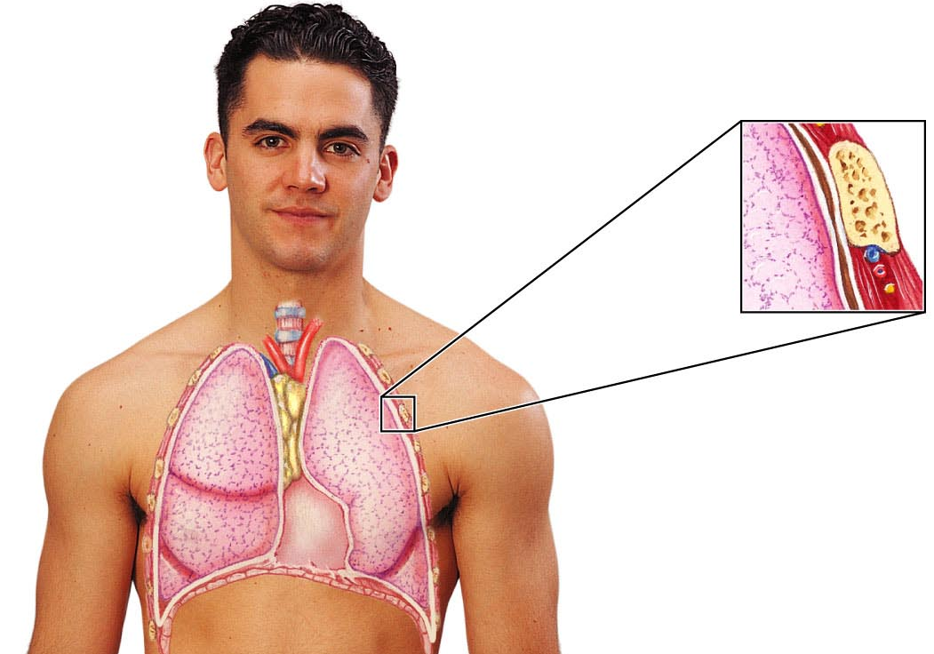
6.2 Describe the gross structure of the lungs and the pleural coverings
• paired lungs occupy entire thoracic cavity except mediastinum
• each lung suspended in own pleural cavity; connected to mediastinum by vascular & bronchial attachments (= root)
• costal surface = anterior, lateral & posterior lung surfaces in close contact with ribs
apex, base; also hilus »» blood vessels enter & leave lungs
1⁰ bronchus enters lungs
fissures: oblique, horizontal » septa subdivide each lung into 10 bronchopulmonary segments (CT divisions; own artery & vein)
pulmonary disease often segmental & can be treated that way
Fig. 22.10
Notes:
Labelled p.814
Base: the concave, inferior, surface that rests on the diaphragm
Hilum: on the mediastinal surface of each lung is an indentation, where pulmonary and systemic blood vessels, bronchi, lymphatic vessels, and nerves enter and leave the lungs
-each main bronchus plunges into hilum on its own side and begins to branch immediately
-all conducting and respiratory passageways distal to main bronchi are found in the lungs
-2 lungs differ in shape and size slightly because the apex of the heart is slightly to the left of the median plane: left lung smaller than right.
Cardiac notch: concavity in median-is molded to and accommodates the heart

Slide 17
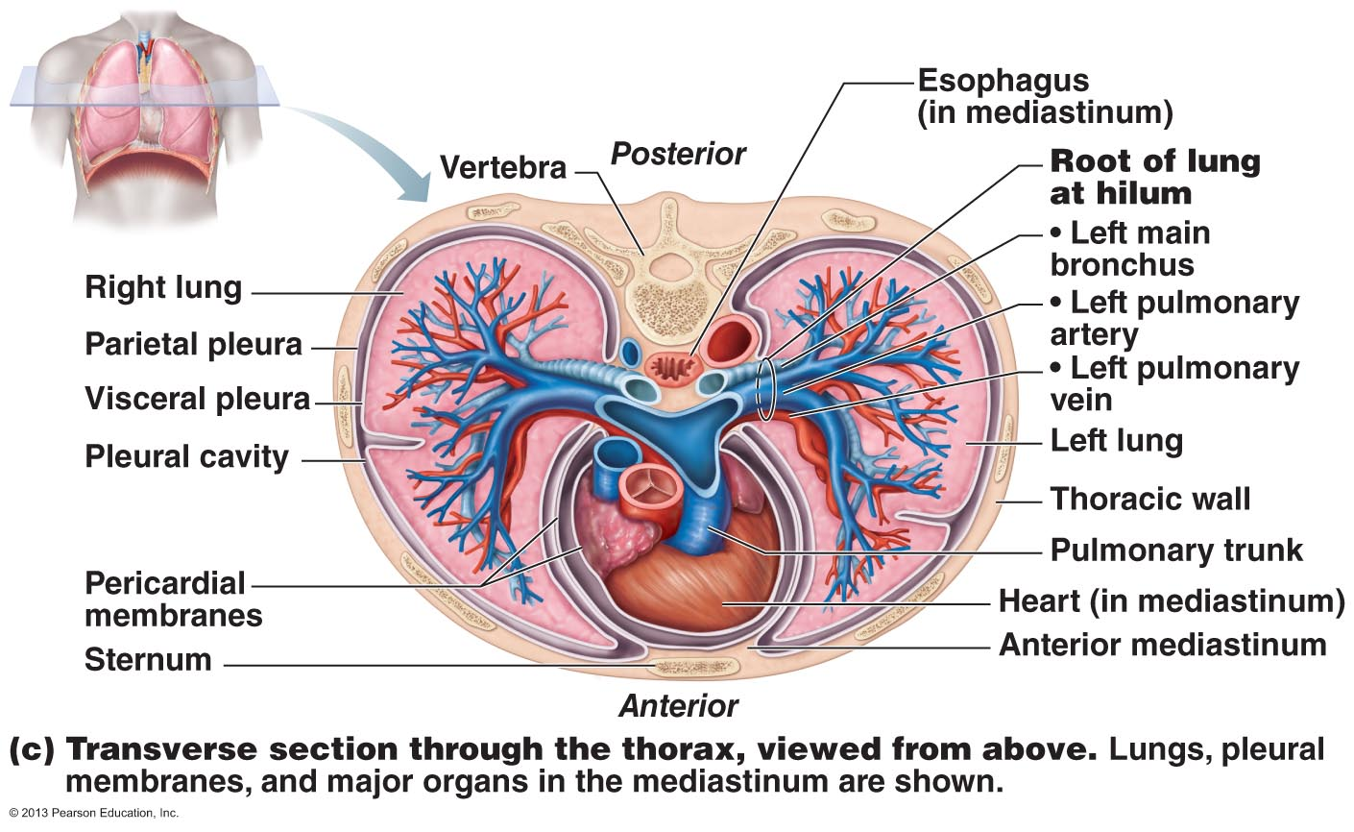
• lobule: smallest subdivision seen with naked eye; hexagon ~ size of pencil eraser; served by large bronchiole
• lung : primarily air spaces; rest is elastic CT
Blood Supply & Innervation
• pulmonary arteries bring blood to be oxygenated ; anterior to main bronchi, branch a lot
• pulmonary veins return oxygenated blood from resp. zone to heart. Course back to hilum
• bronchial arteries provide oxygenated systemic blood to lungs ⇒ bronchial veins
• innervation primarily parasymp (effect?) + some symp (effect?)
Fig. 22.10c
Notes:
Left lung: sub divided into superior and inferior lobes by the oblique fissure
Right lung: partitioned into superior, middle, and inferior lobes by the oblique and horizontal fissures
-each lobe contains pyramid shaped bronchopulmonary segments separated form one another by CT septa. Right lung has 10 segments whereas left has 8-10. Each segemnt has it’s own artery and vein and receives air from an individual segmental (tertiary) bronchus
MOTOR FIBERS VIA PULMONARY PLEXUS:
innervation primarily parasymp (effect?): cause air tubules to constrict
some symp (effect?):cause air tubules to dialate

Slide 18
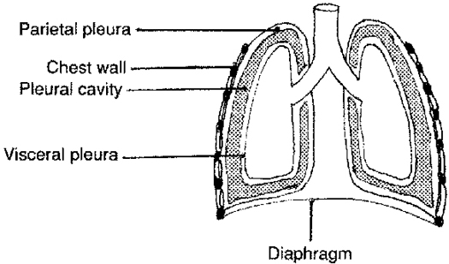
Pleura
• thin, double-layered (parietal & visceral) serosa
• pleural fluid: serous secretion that fills pleural cavity »» lungs slide easily during breathing; surface tension keeps pleurae from separating
• 3 chambers: central mediastinum + 2 lateral pleural compartments
• pleurisy: inflammation of pleurae
J. Carnegie, UofO
http://www.answers.com/topic/pleura
Notes:
p.816 if want more detail.

