Slide 1
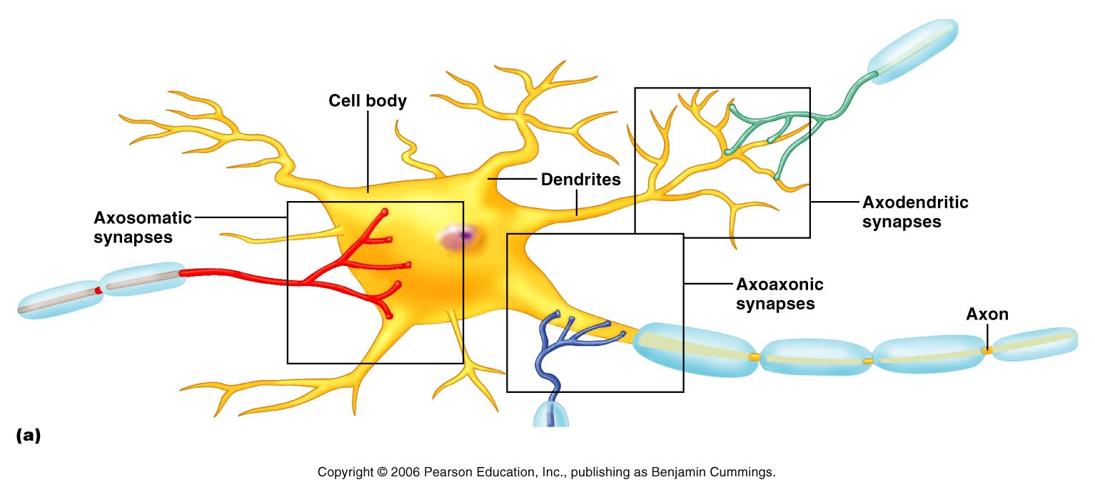
Synapses
A junction that mediates information transfer from one neuron:
  To another neuron
  To an effector cell
Presynaptic neuron – conducts impulses toward the synapse
Postsynaptic neuron – transmits impulses away from the synapse

Slide 2
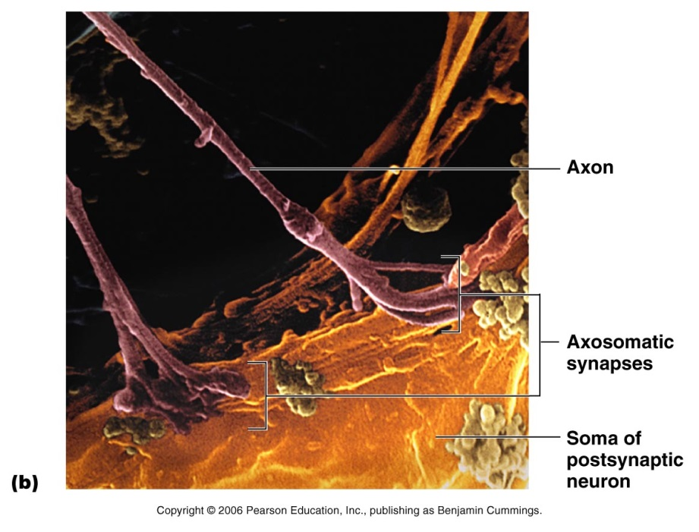
Synapses
Figure 11.17

Slide 3
Types of Synapses
Axodendritic – synapses between the axon of one neuron and the dendrite of another
Axosomatic – synapses between the axon of one neuron and the soma of another
Other types of synapses include:
  Axoaxonic (axon to axon)
  Dendrodendritic (dendrite to dendrite)
  Dendrosomatic (dendrites to soma)
PLAY
InterActive Physiology ®:
Nervous System II: Anatomy Review, page 5

Slide 4
Electrical Synapses
Electrical synapses:
  Are less common than chemical synapses
  Correspond to gap junctions found in other cell types , role in synchronization.
  Are important in the CNS in:
    Arousal from sleep
    Embryonic nervous tissue
    Mental attention
    Emotions and memory
    Ion and water homeostasis
    Eye movement
PLAY
InterActive Physiology ®:
Nervous System II: Anatomy Review, page 6

Slide 5
Chemical Synapses
Specialized for the release and reception of neurotransmitters
Typically composed of two parts:
  Axonal terminal of the presynaptic neuron, which contains synaptic vesicles
  Receptor region on the dendrite(s) or soma of the postsynaptic neuron
PLAY
InterActive Physiology ®:
Nervous System II: Anatomy Review, page 7

Slide 6
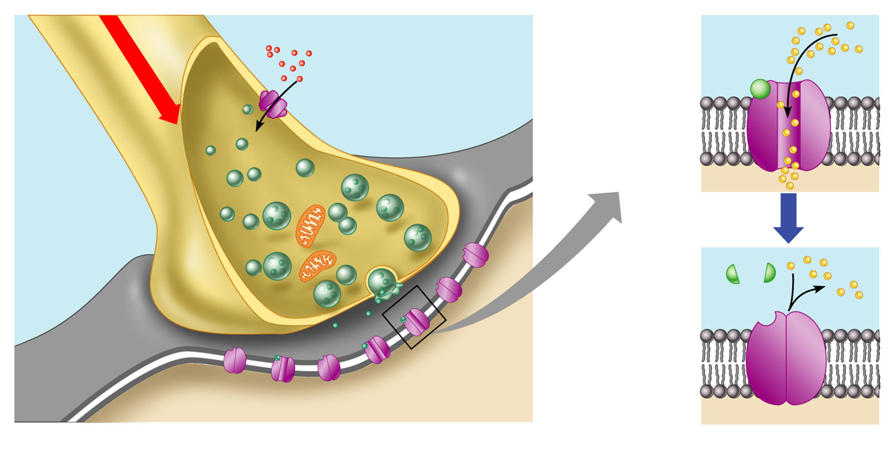
Synaptic Cleft
Fluid-filled space separating the presynaptic and postsynaptic neurons
Prevents nerve impulses from directly passing from one neuron to the next
Transmission across the synaptic cleft:
  Is a chemical event (as opposed to an electrical one)
  Ensures unidirectional communication between neurons
PLAY
InterActive Physiology ®:
Nervous System II: Anatomy Review, page 8

Slide 7
Synaptic Cleft: Information Transfer
Nerve impulses reach the axonal terminal of the presynaptic neuron and open Ca²⁺ channels
Neurotransmitter is released into the synaptic cleft via exocytosis in response to synaptotagmin (calcium detector)
Neurotransmitter crosses the synaptic cleft and binds to receptors on the postsynaptic neuron
Postsynaptic membrane permeability changes, causing an excitatory or inhibitory effect
PLAY
InterActive Physiology ®:
Nervous System II: Synaptic Transmission, pages 3–6

Slide 8

Synaptic Cleft: Information Transfer
Ca²⁺
Neurotransmitter
Na⁺
Action potential
Axon terminal of
presynaptic neuron
Receptor
1
Mitochondrion
Postsynaptic
membrane
Axon of
presynaptic
neuron
Postsynaptic
membrane
Ion channel open
Synaptic vesicles
containing
neurotransmitter
molecules
5
Degraded
neurotransmitter
2
Synaptic
cleft
3
4
Ion channel
(closed)
Ion channel closed
Ion channel (open)
Figure 11.18

Slide 9
Termination of Neurotransmitter Effects
Neurotransmitter bound to a postsynaptic neuron:
  Produces a continuous postsynaptic effect
  Blocks reception of additional “messages”
  Must be removed from its receptor
Removal of neurotransmitters occurs when they:
  Are degraded by enzymes
  Are reabsorbed by astrocytes or the presynaptic terminals
  Diffuse from the synaptic cleft

Slide 10
Synaptic Delay
Neurotransmitter must be released, diffuse across the synapse, and bind to receptors
Synaptic delay – time needed to do this (0.3-5.0 ms)
Synaptic delay is the rate-limiting step of neural transmission

Slide 11
Postsynaptic Potentials
Neurotransmitter receptors mediate changes in membrane potential according to:
  The amount of neurotransmitter released
  The amount of time the neurotransmitter is bound to receptors
The two types of postsynaptic potentials are:
  EPSP – excitatory postsynaptic potentials
  IPSP – inhibitory postsynaptic potentials
PLAY
InterActive Physiology ®:
Nervous System II: Synaptic Transmission, pages 7–12

Slide 12
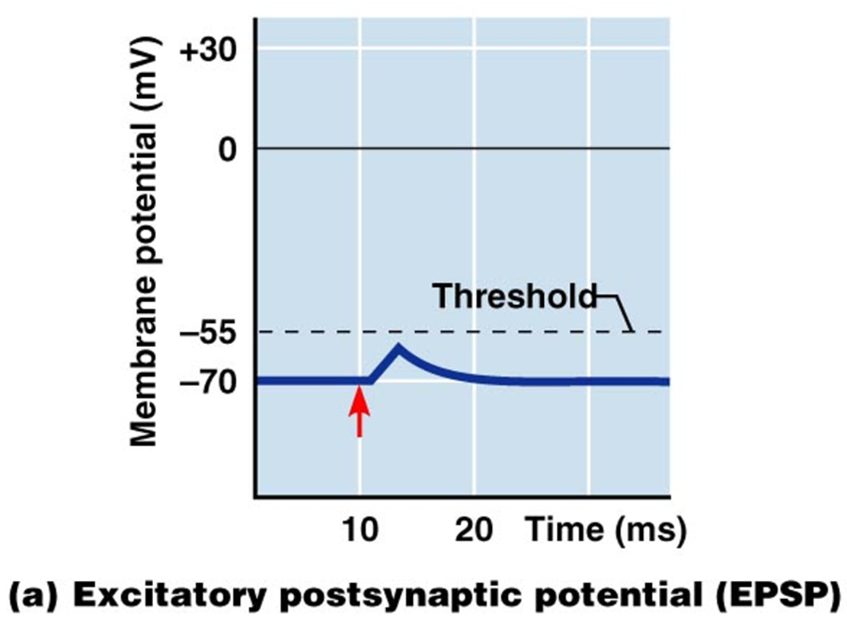
Excitatory Postsynaptic Potentials
EPSPs are graded potentials that can initiate an action potential in an axon
  Use only chemically gated channels
  Na⁺ and K⁺ flow in opposite directions at the same time
Postsynaptic membranes do not generate action potentials

Slide 13
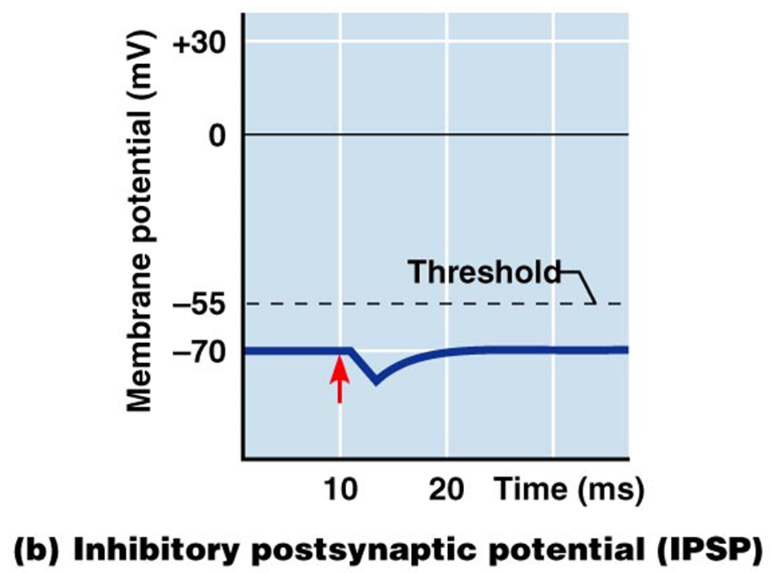
Inhibitory Synapses and IPSPs
Neurotransmitter binding to a receptor at inhibitory synapses:
  Causes the membrane to become more permeable to potassium and chloride ions
  Leaves the charge on the inner surface negative
  Reduces the postsynaptic neuron’s ability to produce an action potential

Slide 14
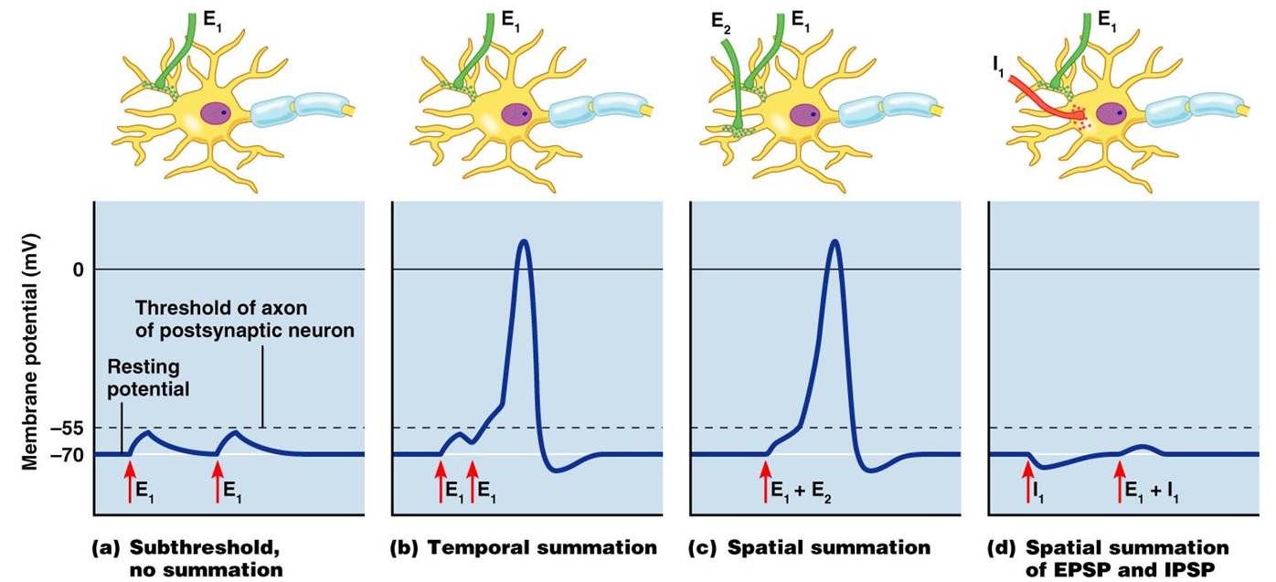
Summation
A single EPSP cannot induce an action potential
EPSPs must summate temporally or spatially to induce an action potential
Temporal summation – presynaptic neurons transmit impulses in rapid-fire order

Slide 15
Summation
Spatial summation – postsynaptic neuron is stimulated by a large number of terminals at the same time
IPSPs can also summate with EPSPs, canceling each other out
PLAY
InterActive Physiology ®:
Nervous System II: Synaptic Potentials

Slide 16
Chemical Neurotransmitters
Acetylcholine (ACh)
Biogenic amines
Amino acids
Peptides
Novel messengers: ATP and dissolved gases NO and CO

