Slide 1

PowerPoint Presentations for
Principles of Microeconomics
Sixth Canadian Edition
by Mankiw/Kneebone/McKenzie
Adapted for the
Sixth Canadian Edition by
Marc Prud’homme
University of Ottawa

Slide 2
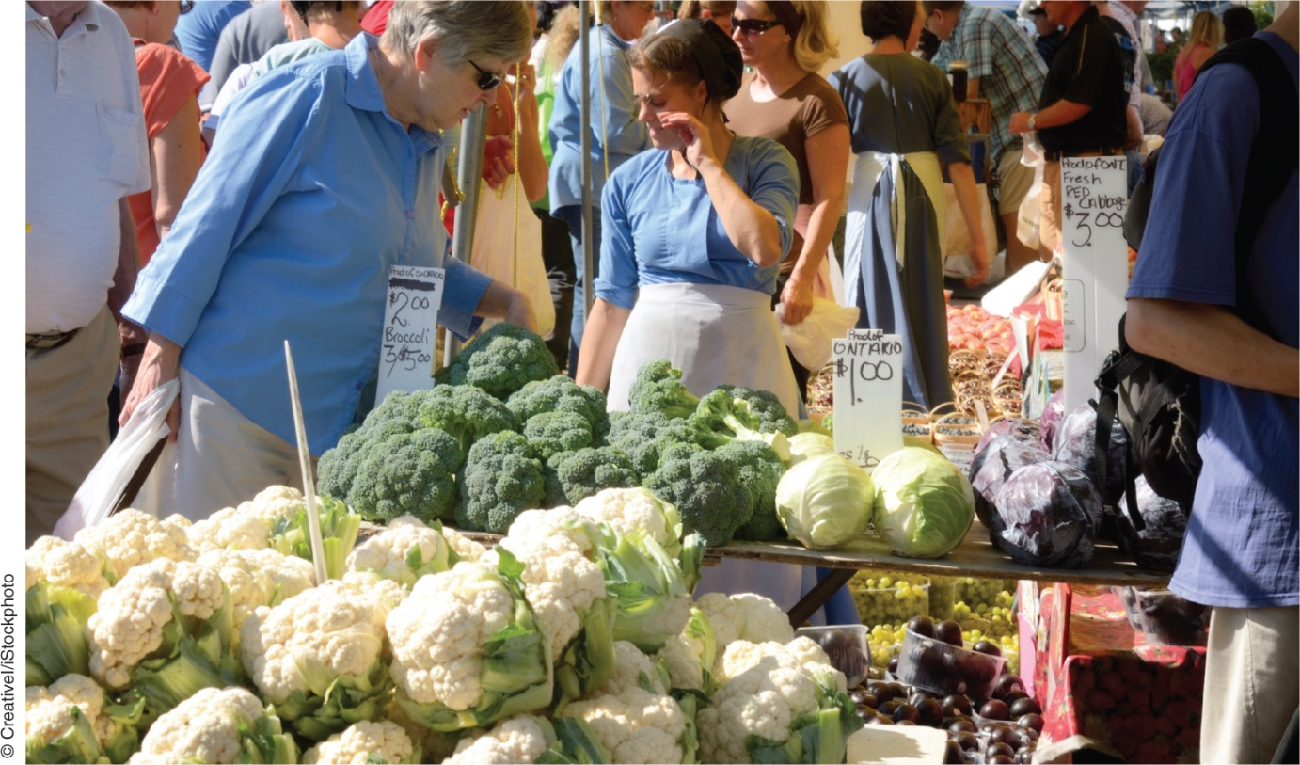
Interdependence and the Gains from trade
Chapter 3

Slide 3
INTERDEPENDENCE AND
THE GAINS FROM TRADE
  One of the ten principles of economics highlighted in Chapter 1 is that trade can make everyone better off.
  This principle explains why people trade with their neighbours and why nations trade with other nations.
  What exactly do people gain when they trade with one another?
  Why do people choose to become interdependent?

Slide 4
A PARABLE FOR THE
MODERN ECONOMY
Imagine that in the world there are:
  two goods—meat and potatoes—
  and two people—a cattle rancher and a potato farmer—each of whom would like to eat both meat and potatoes.
It is easy to see that trade would allow them to enjoy greater variety.
Notes:
Each could then have a steak with a baked potato or a burger with fries.

Slide 5
A PARABLE FOR THE
MODERN ECONOMY
Suppose, for example, that the potato farmer is able to raise cattle and produce meat, but that he is not very good at it.
Suppose that the cattle rancher is able to grow potatoes, but that her land is not very well suited for it.
The farmer and the rancher can each benefit by specializing in what he or she does best and then trading with the other.
The gains from trade are less obvious, however, when one person is better at producing every good.

Slide 6
Production Possibilities
A production possibilities frontier shows the various mixes of output that an economy can produce.
It illustrates one of the ten principles of economics in Chapter 1: People face tradeoffs.
Notes:
Here the farmer faces a tradeoff between producing meat and producing potatoes.

Slide 7
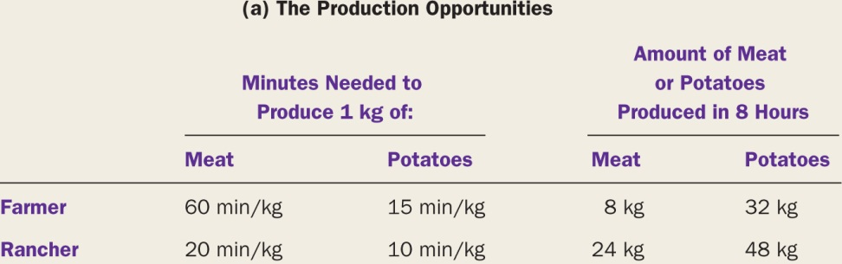
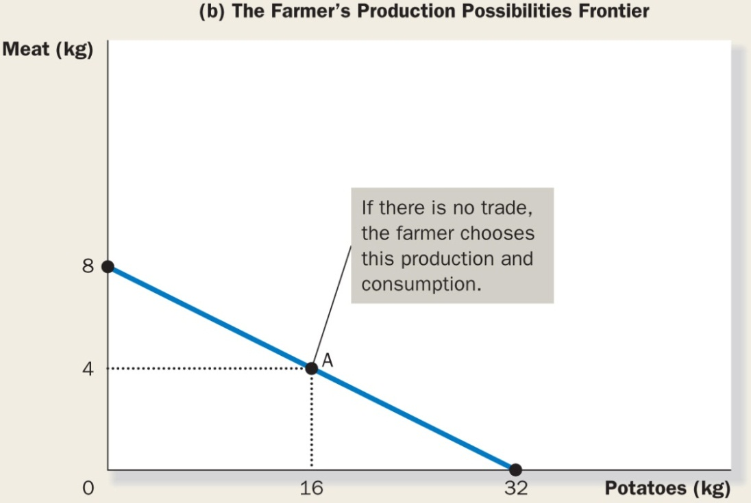
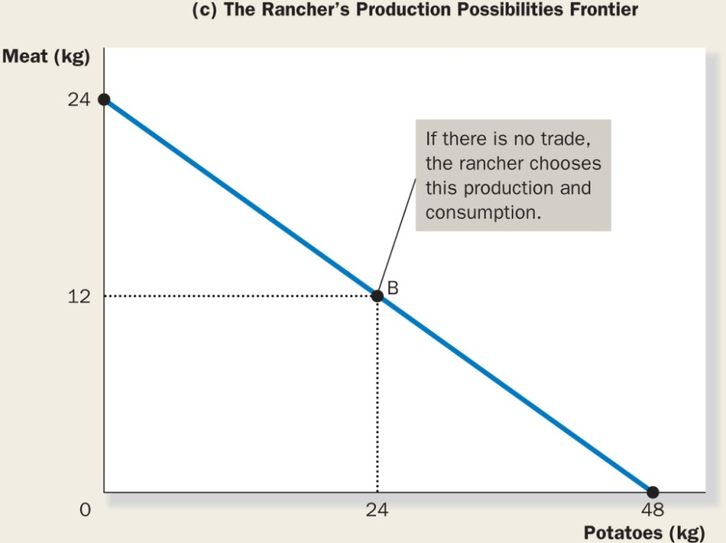
FIGURE 3.1
The Production Possibilities Frontier
Notes:
The Production Possibilities Frontier
Panel (b) shows the combinations of meat and potatoes that the farmer can produce. Panel (c) shows the combinations of meat and potatoes that the rancher can produce. Both production possibilities frontiers are derived from panel (a) and the assumption that the farmer and rancher each work 8 hours a day.
The farmer’s technology for producing meat and potatoes (as summarized in panel (a) of Figure 3.1) allows him to switch between one good and the other at a constant rate. Whenever the farmer spends 1 hour less producing meat and 1 hour more producing potatoes, he reduces his output of meat by 1 kg and raises his output of potatoes by 4 kg—and this is true regardless of how much he is already producing. As a result, the production possibilities frontier is a straight line.
If the farmer and rancher choose to be self-sufficient, rather than trade with each other, then each consumes exactly what he or she produces. In this case, the production possibilities frontier is also the consumption possibilities frontier. That is, without trade, Figure 3.1 shows the possible combinations of meat and potatoes that the farmer and rancher can each consume. These production possibilities frontiers are useful in showing the tradeoffs that the farmer and rancher face, but they do not tell us what the farmer and rancher will actually choose to do.
To determine their choices, we need to know the tastes of the farmer and the rancher. Let’s suppose they choose the combinations identified by points A and B in Figure 3.1: The farmer produces and consumes 16 kg of potatoes and 4 kg of meat, while the rancher produces and consumes 24 kg of potatoes and 12 kg of meat.

Slide 8
Active Learning
Production and Consumption with and without Trade
Two countries: Canada and Japan
Two goods: computers and wheat
One resource: labour (measured in hours)
We will look at how much of both goods each country produces and consumes:
  if the country chooses to be self-sufficient
  if it trades with the other country

Slide 9
Active Learning
Derive Canada’s PPF
Use the following information to draw Canada’s PPF.
  Canada has 50 000 hours of labour available for production per month.
  Producing one computer requires 100 hours of labour.
  Producing one ton of wheat requires 10 hours of labour.
  Your graph should measure computers on the horizontal axis.

Slide 10
Active Learning
Canada’s PPF
Wheat (tons)
Canada has enough labour to produce
500 computers,
5000
4000
or 5000 tons of wheat,
3000
or any combination along the PPF.
2000
1000
Computers
0
100
200
300
400
500

Slide 11
Active Learning
Canada without Trade
Wheat (tons)
Suppose Canada uses half its labour to produce each of the two goods.
5000
4000
Then it will produce and consume
250 computers and 2500 tons of wheat.
3000
2000
1000
Computers
0
100
200
300
400
500

Slide 12
Active Learning
Derive Japan’s PPF
Use the following information to draw Japan’s PPF.
  Japan has 30 000 hours of labour available for production per month.
  Producing one computer requires 125 hours of labour.
  Producing one ton of wheat requires 25 hours of labour.
Your graph should measure computers on the horizontal axis.

Slide 13
Active Learning
Japan’s PPF
Wheat (tons)
Japan has enough labour to produce 240 computers, or 1200 tons of wheat, or any combination along the PPF.
2000
1000
0
Computers
100
200
300

Slide 14
Active Learning
Japan without Trade
Wheat (tons)
Suppose Japan uses half its labour to produce each good.
2000
Then it will produce and consume
120 computers and 600 tons of wheat.
1000
0
Computers
100
200
300

Slide 15
Active Learning
Consumption with and without Trade
Without trade,
  Canadian consumers get 250 computers and
  2500 tons of wheat.
  Japanese consumers get 120 computers and
  600 tons wheat.
We will compare consumption without trade to consumption with trade.
First, we need to see how much of each good is produced and traded by the two countries.

Slide 16
Active Learning
Production under Trade
1. Suppose Canada produces 3400 tons of wheat. How many computers would Canada be able to produce with its remaining labour? Draw the point representing this combination of computers and wheat on Canada’s PPF.
2. Suppose Japan produces 240 computers.
How many tons of wheat would Japan be able to produce with its remaining labour? Draw this point on Japan’s PPF.

Slide 17
Active Learning
Canada’s Production with Trade
Wheat (tons)
5000
Producing 3400 tons of wheat requires 34 000 labour hours.
4000
The remaining 16 000 labour hours are used to produce 160 computers.
3000
2000
1000
Computers
0
100
200
300
400
500

Slide 18
Active Learning
Japan’s Production with Trade
Wheat (tons)
Producing 240 computers requires all of Japan’s 30 000 labour hours.
2000
So, Japan would produce
0 tons of wheat.
1000
0
Computers
100
200
300

Slide 19
Active Learning
Consumption under Trade
Suppose Canada exports 700 tons of wheat to Japan and imports 110 computers from Japan.
(So, Japan imports 700 tons wheat and exports 110 computers.)
How much of each good is consumed in Canada? Plot this combination on Canada’s PPF.
How much of each good is consumed in Japan? Plot this combination on Japan’s PPF.

Slide 20
Active Learning
Canada’s Consumption with Trade
Wheat (tons)
computers
wheat
5000
produced
160
3400
4000
+ imported
110
0
– exported
0
700
3000
= amount consumed
270
2700
2000
1000
0
Computers
100
200
300
400
500

Slide 21
Active Learning
Japan’s Consumption with Trade
Wheat (tons)
computers
wheat
produced
240
0
2000
+ imported
0
700
– exported
110
0
= amount consumed
130
700
1000
0
Computers
100
200
300

Slide 22
Active Learning
Trade Makes Both Countries Better Off
Canada
consumption without trade
consumption with trade
gains from trade
computers
250
270
20
wheat
2500
2700
200
Japan
consumption without trade
consumption with trade
gains from trade
computers
120
130
10
wheat
600
700
100

Slide 23
Active Learning
Answers
Point F: 100 computers, 3000 tons of wheat
Point F requires 40 000 hours of labour.
Possible but not efficient: could get more of either good without sacrificing any of the other
F

Slide 24
Specialization and Trade
After several years of eating combination B, the rancher gets an idea and goes to talk to the farmer.
Notes:
Rancher: Farmer, my friend, have I got a deal for you! I know how to improve life for both of us. I think you should stop producing meat altogether and devote all your time to growing potatoes. According to my calculations, if you work 8 hours a day growing potatoes, you’ll produce 32 kg of potatoes. If you give me 15 of those 32 kg, I’ll give you 5 kg of meat in return. In the end, you’ll get to eat 17 kg of potatoes and 5 kg of meat, instead of the 16 kg of potatoes and 4 kg of meat you now get. If you go along with my plan, you’ll have more of both foods. [To illustrate her point, the rancher shows the farmer panel (a) of Figure 3.2.]
Farmer: (sounding skeptical) That seems like a good deal for me. But I don’t understand why you are offering it. If the deal is so good for me, it can’t be good for you too.
Rancher: Oh, but it is! Suppose I spend 6 hours a day raising cattle and 2 hours growing potatoes. Then I can produce 18 kg of meat and 12 kg of potatoes. After I give you 5 kg of my meat in exchange for 15 kg of your potatoes, I’ll end up with 13 kg of meat and 27 kg of potatoes. So I’ll also consume more of both foods than I do now. [She points out panel (b) of Figure 3.2.]
Farmer: I don’t know. . . . This sounds too good to be true.
Rancher: It’s really not as complicated as it seems at first. Here—I’ve summarized my proposal for you in a simple table. [The rancher indicates panel (c) of Figure 3.2.]
Farmer: (after pausing to study panel [c]) These calculations seem correct, but I’m puzzled. How can this deal make us both better off?
Rancher: We can both benefit because trade allows each of us to specialize in doing what we do best. You will spend more time growing potatoes and less time raising cattle. I will spend more time raising cattle and less time growing potatoes. As a result of specialization and trade, each of us can consume more meat and more potatoes without working any more hours.

Slide 25
Draw an example of a production possibilities frontier for Robinson Crusoe, a shipwrecked sailor who spends his time gathering coconuts and catching fish.
Does this frontier limit Crusoe’s consumption of coconuts and fish if he lives by himself?
Does he face the same limits if he can trade with natives on the island?

Slide 26
COMPARATIVE ADVANTAGE
If the rancher is better at both raising cattle and growing potatoes, how can the farmer ever specialize in doing what he does best?
The farmer doesn’t seem to do anything best.
To solve this puzzle, we need to look at the principle of comparative advantage.
Notes:
As a first step in developing this principle, consider the following question: In our example, who can produce potatoes at lower cost—the farmer or the rancher?
There are two possible answers, and in these two answers lie the solution to our puzzle and the key to understanding the gains from trade.

Slide 27
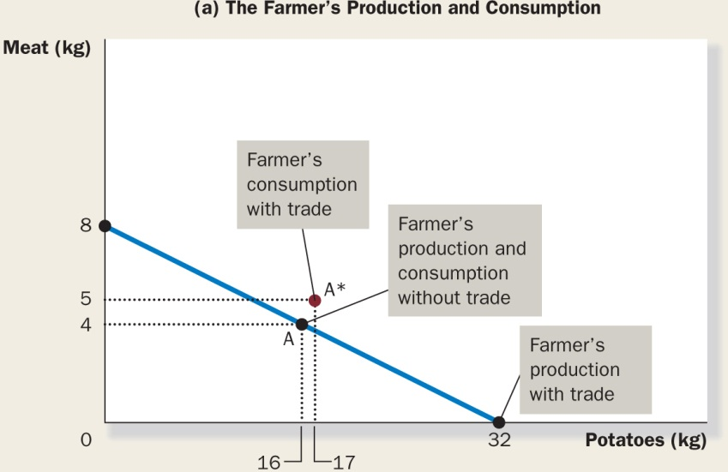
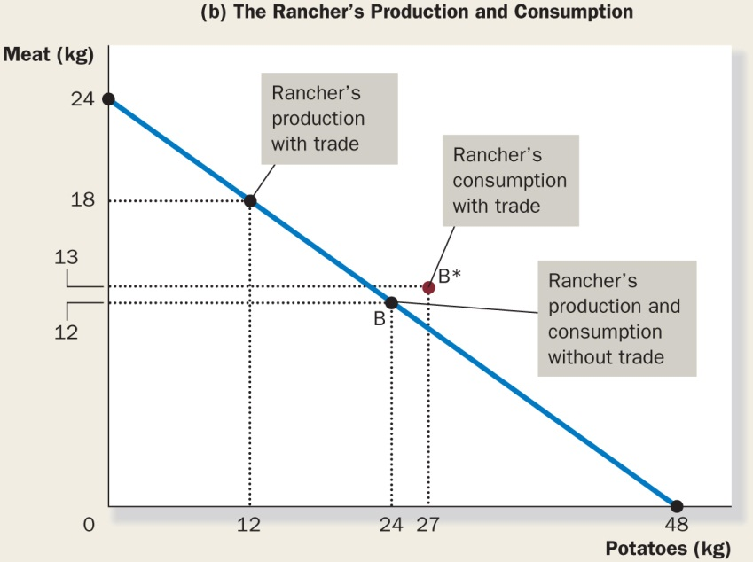
FIGURE 3.2:
How Trade Expands the Set of Consumption Opportunities
Notes:
How Trade Expands the Set of Consumption Opportunities
The proposed trade between the farmer and the rancher offers each of them a combination of meat and potatoes that would be impossible in the absence of trade. In panel (a), the farmer gets to consume at point A* rather than point A. In panel (b), the rancher gets to consume at point B* rather than point B. Trade allows each to consume more meat and more potatoes.

Slide 28
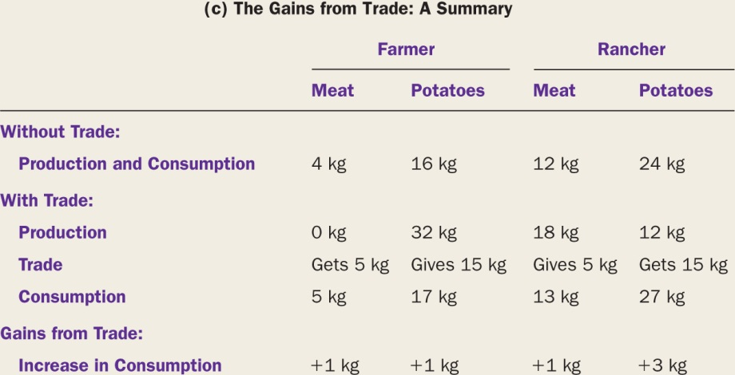
FIGURE 3.2 (continued)

Slide 29
Absolute Advantage
Absolute advantage: the comparison among producers of a good according to their productivity
Notes:
One way to answer the question about the cost of producing potatoes is to compare the inputs required by the two producers. Economists use the term absolute advantage when comparing the productivity of one person, firm, or nation to that of another. The producer that requires a smaller quantity of inputs to produce a good is said to have an absolute advantage in producing that good.

Slide 30
Opportunity Cost and Comparative Advantage
Rather than comparing inputs required, we can compare the opportunity costs.
Opportunity cost: whatever must be given up to obtain some item
Notes:
In our example, we assumed that the farmer and the rancher each spend 8 hours a day working. Time spent producing potatoes, therefore, takes away from time available for producing meat. As the rancher and farmer reallocate time between producing the two goods, they move along their production possibility frontiers; they give up units of one good to produce units of the other. The opportunity cost measures the tradeoff between the two goods that each producer faces.
Let’s first consider the rancher’s opportunity cost. According to the table in panel (a) of Figure 3.1, producing 1 kg of potatoes takes her 10 minutes of work. When the rancher spends that 10 minutes producing potatoes, she spends 10 minutes less producing meat. Because the rancher needs 20 minutes to produce 1 kg of meat, 10 minutes of work would yield 0.5 kg of meat. Hence, the rancher’s opportunity cost of producing 1 kg of potatoes is 0.5 kg of meat.
Now consider the farmer’s opportunity cost. Producing 1 kg of potatoes takes him 15 minutes. Because he needs 60 minutes to produce 1 kg of meat, 15 minutes of work would yield 0.25 kg of meat. Hence, the farmer’s opportunity cost of 1 kg of potatoes is 0.25 kg of meat.
Table 3.1 shows the opportunity costs of meat and potatoes for the two producers. Notice that the opportunity cost of meat is the inverse of the opportunity cost of potatoes. Because 1 kg of potatoes costs the rancher 0.5 kg of meat, 1 kg of meat costs the rancher 2 kg of potatoes. Similarly, because 1 kg of potatoes costs the farmer 0.25 kg of meat, 1 kg of meat costs the farmer 4 kg of potatoes.

Slide 31
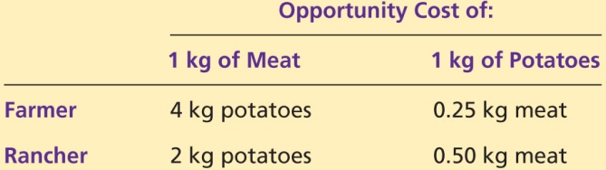
TABLE 3.1:
The Opportunity Cost of Meat and Potatoes

Slide 32
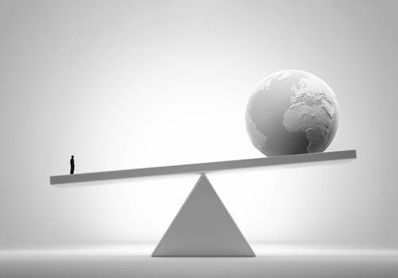
Opportunity Cost and Comparative Advantage
Comparative advantage: the comparison among producers of a good according to their opportunity cost
Vinko93/Shutterstock
Notes:
Economists use the term comparative advantage when describing the opportunity cost of two producers. The producer who gives up less of other goods to produce good X has the smaller opportunity cost of producing good X and is said to have a comparative advantage in producing it. In our example, the farmer has a lower opportunity cost of producing potatoes than does the rancher: A kilogram of potatoes costs the farmer only 0.25 kg of meat, while it costs the rancher 0.50 kg of meat.
Conversely, the rancher has a lower opportunity cost of producing meat than does the farmer: A kilogram of meat costs the rancher 2 kg of potatoes, while it costs the farmer 4 kg of potatoes.
Thus, the farmer has a comparative advantage in growing potatoes, and the rancher has a comparative advantage in producing meat. Although it is possible for one person to have an absolute advantage in both goods (as the rancher does in our example), it is impossible for one person to have a comparative advantage in both goods.

Slide 33
Comparative Advantage and Trade
The gains from specialization and trade are based not on absolute advantage but rather on comparative advantage.
When each person specializes in producing the good for which he or she has a comparative advantage, total production in the economy rises.
Each benefits from trade by obtaining a good at a price that is lower than his or her opportunity cost of that good.
Notes:
In our example, the farmer spends more time growing potatoes, and the rancher spends more time producing meat. As a result, the total production of potatoes rises from 40 to 44 kg, and the total production of meat rises from 16 to 18 kg. The farmer and the rancher share the benefits of this increased production.
Consider the proposed deal from the viewpoint of the farmer. The farmer gets 5 kg of meat in exchange for 15 kg of potatoes. In other words, the farmer buys each kilogram of meat for a price of 3 kg of potatoes. This price of meat is lower than his opportunity cost for 1 kg of meat, which is 4 kg of potatoes. Thus, the farmer benefits from the deal because he gets to buy meat at a good price.
Now consider the deal from the rancher’s viewpoint. The rancher buys 15 kg of potatoes for a price of 5 kg of meat. That is, the price of potatoes is one-third of a kilogram of meat. This price of potatoes is lower than her opportunity cost of 1 kg of potatoes, which is 0.5 kg of meat. The rancher benefits because she can buy potatoes at a good price.

Slide 34
Comparative Advantage and Trade
The moral of the story of the farmer and the rancher:
Trade can benefit everyone in society because it
allows people to specialize in activities in which
they have a comparative advantage.
Notes:
Video: Canada and Free Trade with the European Union
www.youtube.com/watch?v=ONqAaDszhoY

Slide 35
The Price of Trade
What determines the price at which trade takes place?
How are the gains from trade shared between the trading parties?
For both parties to gain from trade, the price at which they trade must lie between the two opportunity costs.
Notes:
In our example, the farmer and rancher agreed to trade at a rate of 3 kg of potatoes for each 1 kg of meat. This price is between the rancher’s opportunity cost (2 kg of potatoes per 1 kg of meat) and the farmer’s opportunity cost (4 kg of potatoes per 1 kg of meat). The price need not be exactly in the middle for both parties to gain, but it must be somewhere between 2 and 4. To see why the price has to be in this range, consider what would happen if it was not.
If the price of 1 kg of meat was below 2 kg of potatoes, both the farmer and the rancher would want to buy meat, because the price would be below their opportunity costs. Similarly, if the price of meat was above 4 kg of potatoes, both would want to sell meat, because the price would be above their opportunity costs.
But there are only two members of this economy. They cannot both be buyers of meat, nor can they both be sellers. Someone has to take the other side of the deal. A mutually advantageous trade can be struck at a price between 2 and 4. In this price range, the rancher wants to sell meat to buy potatoes, and the farmer wants to sell potatoes to buy meat.

Slide 36
Robinson Crusoe can gather 10 coconuts or catch 1 fish per hour.
His friend Friday can gather 30 coconuts or catch 2 fish per hour.
What is Crusoe’s opportunity cost of catching one fish?
What is Friday’s?
Who has an absolute advantage in catching fish?
Who has a comparative advantage in catching fish?

Slide 37

APPLICATIONS OF
COMPARATIVE ADVANTAGE
Should Sidney Crosby shovel his own sidewalk?
Should Canada trade with other countries?
  Imports: goods and services produced abroad and sold domestically
  Exports: goods and services produced domestically and sold abroad

Slide 38
Suppose that a skilled brain surgeon also happens to be the world’s fastest typist.
Should he do his own typing or hire a secretary? Explain.

Slide 39
Classroom Activity
A Short Trip with Many Contributors
Answer the following questions.
Think of a recent trip you have taken. The distance travelled is unimportant, just choose a specific trip. Where did this trip start and finish?
Who produced the goods and services that made your trip possible? (List as many types of workers as possible.)
How were the different elements of your trip financed
(e.g., the vehicle, the road network, or the airport)?
Notes:
Activity 2: A Short Trip with Many Contributors
Type: In-class assignment
Topics: Specialization, interdependence, self-interest, international linkages, role of government
Materials needed: None
Time: 20 minutes
Class limitations: Works in any size class
Purpose: This assignment shows the advantages of specialization, division of labour, and global links. It also introduces concepts of public and private financing.
Instructions: Ask the class to answer the following questions. Give them time to write an answer to a question, and then discuss their answers before moving to the next question.
1. Think of a recent trip you have taken. The distance travelled is unimportant, just choose a specific trip. Where did this trip start and finish?
2. Who produced the goods and services that made your trip possible? (List as many types of workers as possible.)
3. How were the different elements of your trip financed (e.g., the vehicle, the road network, or the airport)?
Common Answers and Points for Discussion
2. Who produced the goods and services that made your trip possible?
The specific answers will vary depending on the mode of travel. The discussion below focuses on automobiles but the ideas easily extend to airplanes, busses, trains, or boats. Most students will include autoworkers, gas station attendants, and, if they travelled through snow, road maintenance crews. These answers touch on three important elements—the vehicle, the fuel, and the transportation network—but the details are much more complex. Any single element represents the work of a vast interlinking network of firms and individuals. One important point is the complexity and connectedness of the modern economy. Change in one part of the world can affect many other countries. A second point is people work to earn money. The Chinese goose farmer isn’t motivated by concern for an automobile produced 7000 miles away, or even for the individuals wearing the goose down parka. He works to better his own economic well-being. Wages, profits, and rents coordinate this complex network.
3. How were the different elements of your trip financed?
Public and private financing are both involved in transportation. The students (or their parents) typically pay for gasoline, automobiles, airfare, or bus tickets, often using some form of credit. Highways, roads, and airports are usually publicly financed through bonds and taxes. This can be a good place to introduce credit markets, their regulation, and the role of government.

Slide 40
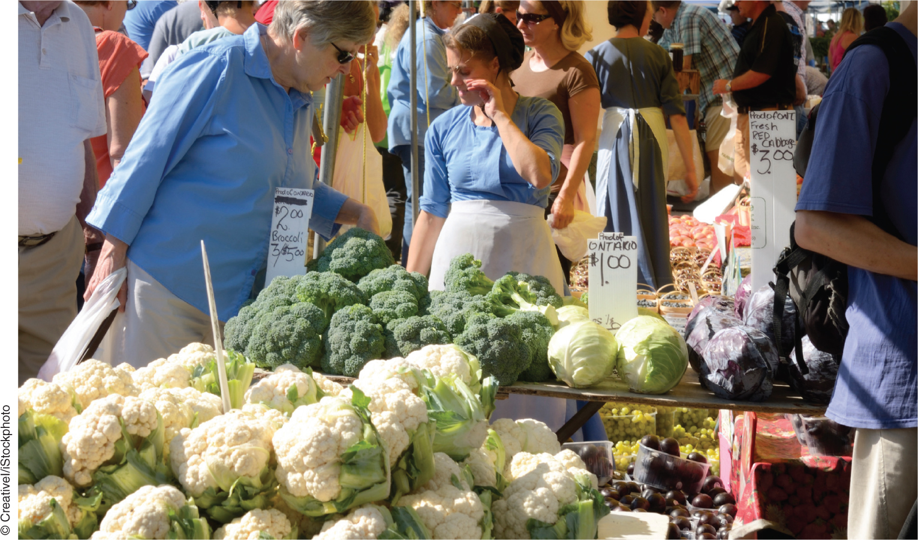
The end
Chapter 3

