Slide 1

PowerPoint Presentations for
Principles of Microeconomics
Sixth Canadian Edition
by Mankiw/Kneebone/McKenzie
Adapted for the
Sixth Canadian Edition by
Marc Prud’homme
University of Ottawa

Slide 2

The Market
Forces of Supply and demand
Chapter 4

Slide 3
THE MARKET FORCES
OF SUPPLY AND DEMAND
Supply and demand are the two words that economists use most often.
Supply and demand are the forces that make market economies work.
They determine the quantity of each good produced and the price at which it is sold.
If you want to know how any event or policy will affect the economy, you must think first about how it will affect supply and demand.

Slide 4
MARKETS AND COMPETITION
The terms supply and demand refer to the behaviour of people as they interact with one another in competitive markets.
Before discussing how buyers and sellers behave, let’s first consider more fully what we mean by a market and competition.

Slide 5
What Is a Market?
Market: a group of buyers and sellers of a particular good or service
Notes:
A market is a group of buyers and sellers of a particular good or service. The buyers as a group determine the demand for the product and the sellers as a group determine the supply of the product.
Markets take many forms. Some markets are highly organized, such as the markets for many agricultural commodities. In these markets, buyers and sellers meet at a specific time and place, where an auctioneer helps set prices and arrange sales. More often, markets are less organized. For example, consider the market for ice cream in a particular town. Buyers of ice cream do not meet together at any one time.

Slide 6
What Is Competition?
Competitive market: a market in which there are many buyers and many sellers so that each has a negligible impact on the market price
Notes:
The market for ice cream, like most markets in the economy, is highly competitive. Each buyer knows that there are several sellers from which to choose, and each seller is aware that his or her product is similar to that offered by other sellers. As a result, the price of ice cream and the quantity of ice cream sold are not determined by any single buyer or seller. Rather, price and quantity are determined by all buyers and sellers as they interact in the marketplace.
A competitive market is a market in which there are many buyers and many sellers so that each has a negligible impact on the market price. Most markets in the economy are highly competitive. Each buyer notes that there are several sellers from which to choose. Each seller is aware that his or her product is similar to that offered by other sellers. Economists use the term competitive market to describe a market in which you have so many buyers and so many sellers that each has a negligible impact on the market price.
in this chapter we assume that markets are perfectly competitive: 1) the goods offered for sale are all exactly the same; 2) the buyers and sellers are so numerous that no single buyer or seller has any influence over the market price. Because buyers and sellers accept the price as determined in the market, they are said to be price takers.

Slide 7
What is a market?
What are the features of a competitive market?

Slide 8
DEMAND
We begin our study of markets by examining the behaviour of buyers.

Slide 9
The Demand Curve: The Relationship
Between Price and Quantity Demanded
Quantity demanded: the amount of a good that buyers are willing and able to purchase
Law of demand: the claim that, other things equal, the quantity demanded of a good falls when the price of the good rises
Notes:
Our study begins by examining the behaviour of buyers.
Quantity demanded is the amount of a good that buyers are willing and able to purchase. Quantity demanded is negatively related to the price because as price rises, quantity demanded falls.
It is straightforward finding examples for which students can relate to the law of demand. For example, increases in tuition fees, increases in the price of mobile phones, increases in the price of restaurant meals, and so on are all examples where students can easily identify with an increase in price and how they would react to it.
One can also give or ask for examples of cases where the law of the land is not seen respected. One such example would be where house prices increase and that the demand for houses also increases at the same time. This appears to violate the law of demand; however, what is really happening is that other factors are at play here and that the condition of “other things equal” is not holding. This will become obvious later in this chapter and a more complete explanation of this phenomenon will be provided once the supply curve is introduced.

Slide 10
The Demand Curve: The Relationship
Between Price and Quantity Demanded
Demand schedule: a table that shows the relationship between the price of a good and the quantity demanded
Demand curve: a graph of the relationship between the price of a good and the quantity demanded

Slide 11
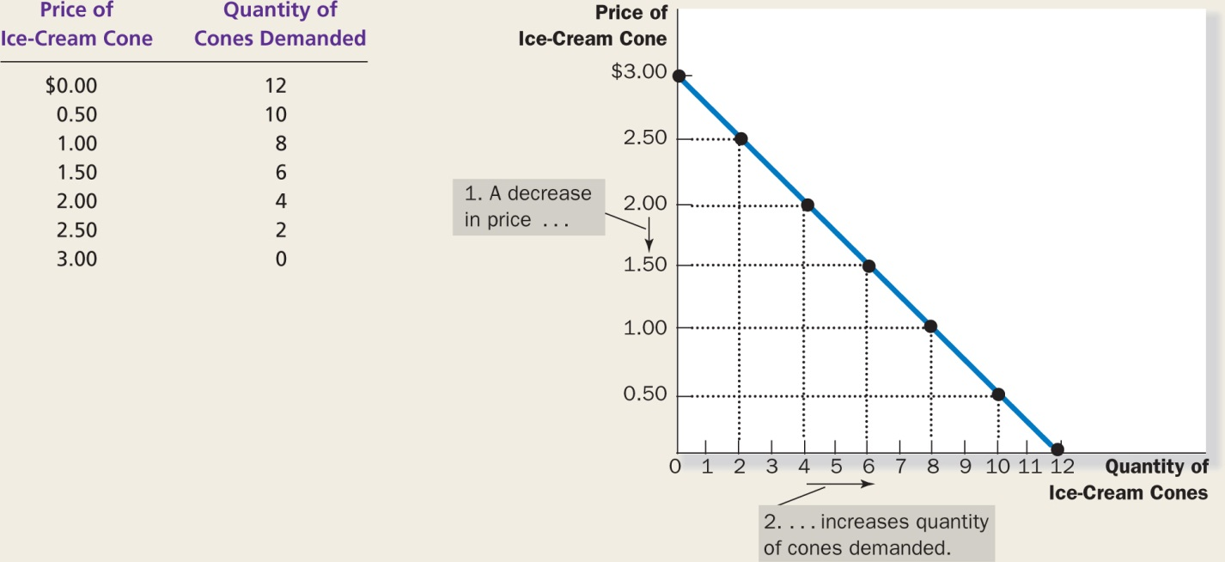
FIGURE 4.1:
Catherine’s Demand Schedule and Demand Curve

Slide 12
Market Demand versus Individual Demand
Market demand: the sum of all the individual demands for a particular good or service

Slide 13
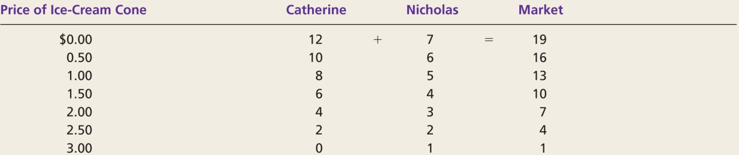
FIGURE 4.2:
Market Demand as the Sum of Individual Demands
Notes:
The quantity demanded in the market is the sum of the quantities demanded by all of the individual buyers at each price. Thus, the market demand curve is found by adding horizontally the individual demand curves.
At a price of $2, Catherine demands 4 ice cream cones, and Nicholas demands 2 ice cream cones. The quantity demanded in the market at this price is 7 cones.

Slide 14
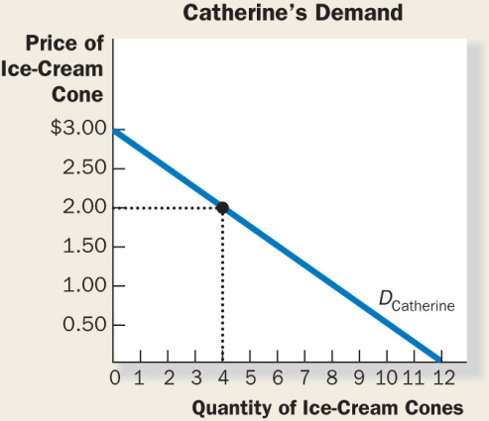
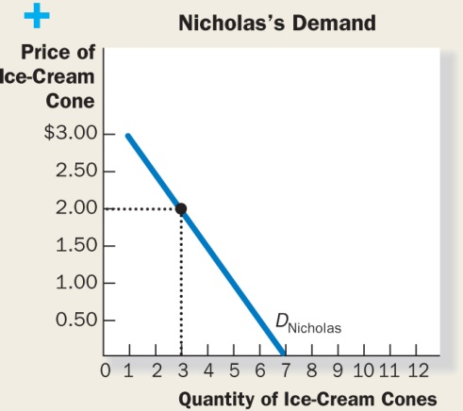
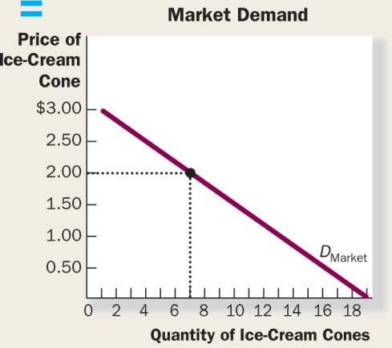
FIGURE 4.2 (continued)

Slide 15
Shifts in the Demand Curve
Any change that rises the quantities that purchasers wish to purchase at a given price shifts the demand curve to the right and vice versa.
Notes:
The demand curve for ice cream shows how much ice cream people buy at any given price, holding constant the many other factors beyond price that influence consumers buying decisions. Consequently, the demand curve need not be static over time but is likely dynamic, that is, shifting continuously.
For example, if the Canadian Medical Association discovered that people live longer if they eat peanuts every day, then the demand curve for peanuts would shift to the right for any given price.

Slide 16
Shifts in the Demand Curve
Factors that shift the demand curve:
  Income:
    Normal good: a good for which, other things equal, an increase in income leads to an increase in demand
    Inferior good: a good for which, other things equal, an increase in income leads to a decrease in demand

Slide 17
Shifts in the Demand Curve
Factors that shift the demand curve (cont’d):
  Prices of related goods:
    Substitutes: two goods for which an increase in the price of one leads to an increase in the demand for the other
    Complements: two goods for which an increase in the price of one leads to a decrease in the demand for the other

Slide 18
Shifts in the Demand Curve
Factors that shift the demand curve (cont’d):
  Tastes
  Expectations
  Number of buyers

Slide 19
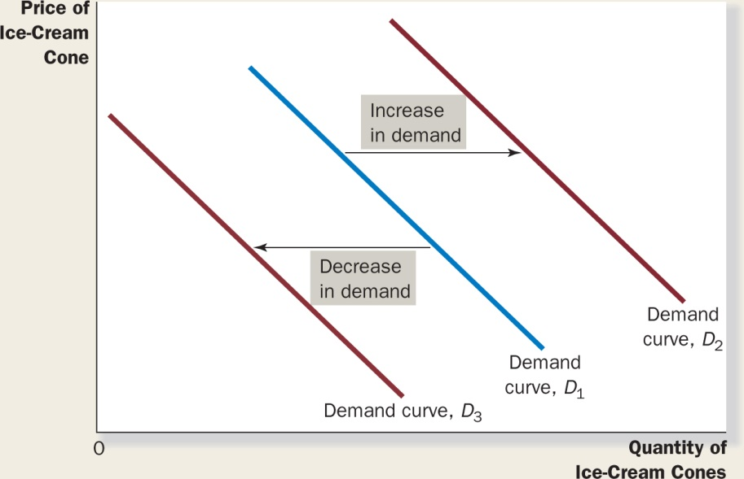
FIGURE 4.3:
Shifts in the Demand Curve
Notes:
The list of factors that can affect the demand curve appear on the next slide.
A fall of people’s incomes will shift the demand curve to the left.
If people’s taste change in a way that the good in question has fallen out of favour with consumers then the demand curve will shift to the left.
If the price of the product is expected to fall, the demand curve shifts to the left.
If the number of buyers decreases, the demand curve shifts to the left.
If the price of a substitute good decreases (good B), then the demand for good A will fall (the demand curve will shift to the left).
If the price of a complementary good decreases (good B), then the demand for good A will increase (the demand curve will shift to the right).
An increase of people’s incomes will shift the demand curve to the right.
If people’s taste change in a way that the good in question becomes trendy with consumers then the demand curve will shift to the right.
If the price of the product is expected to increase, the demand curve shifts to the left.
If the number of buyers increases, the demand curve shifts to the right.
If the price of a substitute good increases (good B), then the demand for good A will increase (the demand curve will shift to the right).
If the price of a complementary good increases (good B), then the demand for good A will decrease (the demand curve will shift to the left).
If the price of the product increases, then the quantity demanded will decrease and this is illustrated by a movement from right to left along the demand curve.
If the price of the product decreases, then the quantity demanded will increase and this is illustrated by a movement from left to right along the demand curve.

Slide 20
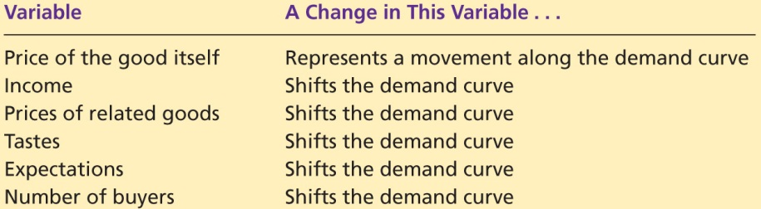
TABLE 4.1:
Variables That Influence Buyers

Slide 21
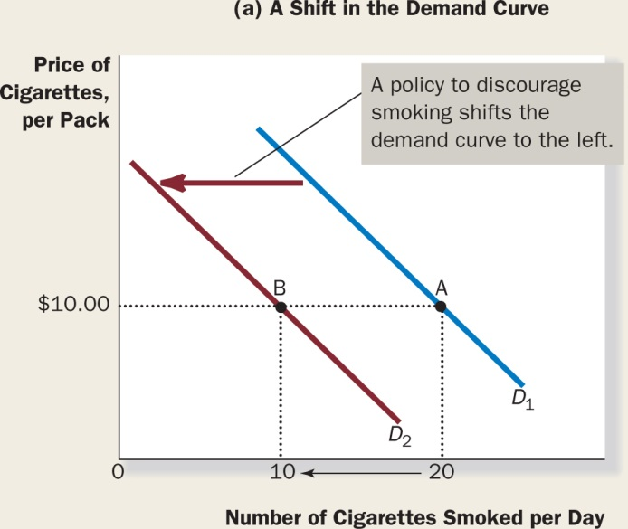
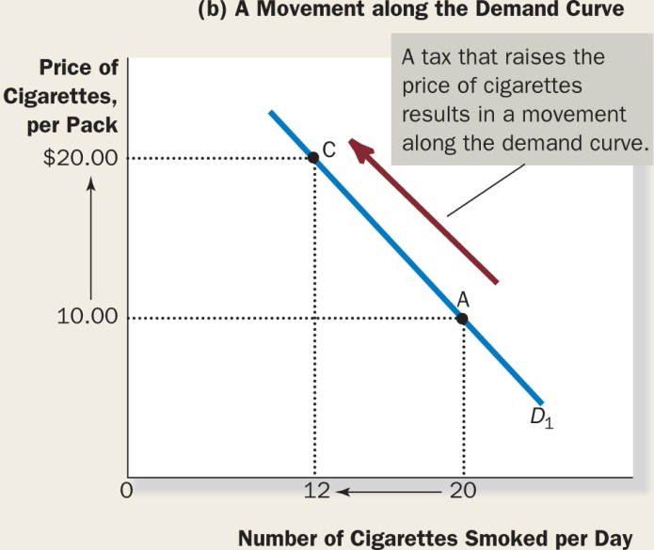
FIGURE 4.4:
Shifts in the Demand Curve versus Movements along the Demand Curve
Notes:
If warnings on cigarette packages convince smokers to smoke less, the demand curve for cigarettes shifts to the left. This is illustrated in panel (a), where the demand curve shifts from D1 to D2.
At a price of $10 per pack, the quantity demanded falls from 20 to 10 cigarettes per day, as reflected by the shift from point A to point B.
By contrast, if a tax raises the price of cigarettes, the demand curve does not shift. Instead, we observed a movement to a different point under the manager, in panel (b) when the price rises from $10 to $20, the quantity demanded falls from 20 to 12 cigarettes per day, as reflected by the movement from point A to point C.

Slide 22
Make up an example of a monthly demand schedule for pizza, and graph the implied demand curve.
Give an example of something that would shift this demand curve.
Would a change in the price of pizza shift this demand curve?

Slide 23

Active Learning
Demand Curve
Draw a demand curve for music
downloads. What happens to it
in each of the following scenarios?
Why?
A. The price of iPods falls
B. The price of music downloads falls
C. The price of CDs falls
Burlingham/Shutterstock

Slide 24
Active Learning
A. The Price of iPods Falls
Price of music down-loads
Music downloads and iPods are complements.
A fall in the price of iPods shifts
the demand curve for music downloads to the right.
P₁
D₁
D₂
Q₁
Q₂
Quantity of
music downloads

Slide 25
Active Learning
B. The Price of Music Downloads Falls
Price of music down-loads
The D curve does not shift.
Move down along the curve
to a point with lower P,
higher Q.
P₁
P₂
D₁
Q₁
Q₂
Quantity of
music downloads

Slide 26
Active Learning
C. The Price of CDs Falls
Price of music down-loads
CDs and music downloads are substitutes.
A fall in the price of CDs shifts demand for music downloads to the left.
P₁
D₂
D₁
Q₂
Q₁
Quantity of
music downloads

Slide 27
SUPPLY
We now turn to the other side of the market and examine the behaviour of sellers.

Slide 28
The Supply Curve: The Relationship
Between Price and Quantity Supplied
Quantity supplied: the amount of a good that sellers are willing and able to sell
Law of supply: the claim that, other things equal, the quantity supplied of a good rises when the price of the good rises
Notes:
The quantity supplied of any good or service is the amount that sellers are willing and able to sell. There are many determinants of quantity supplied, but once again price plays a special role in the analysis. When the price of ice cream is high, selling ice cream is profitable, and so the quantity supplied is large. Sellers of ice cream worked long hours, by many ice cream machines, and hire many workers, so as to take advantage of the greater profit opportunities.
The relationship between price and quantity supplied is called the law of supply. Other things equal, when the price of a good rises, the quantity supplied of the group also rises, and when the price falls, the quantity supplied falls as well.

Slide 29
The Supply Curve: The Relationship
Between Price and Quantity Supplied
Supply schedule: a table that shows the relationship between the price of a good and the quantity supplied
Supply curve: a graph of the relationship between the price of a good and the quantity supplied

Slide 30
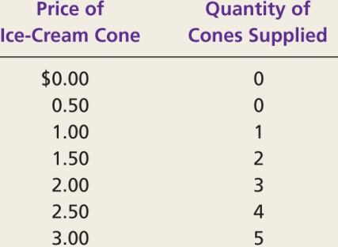
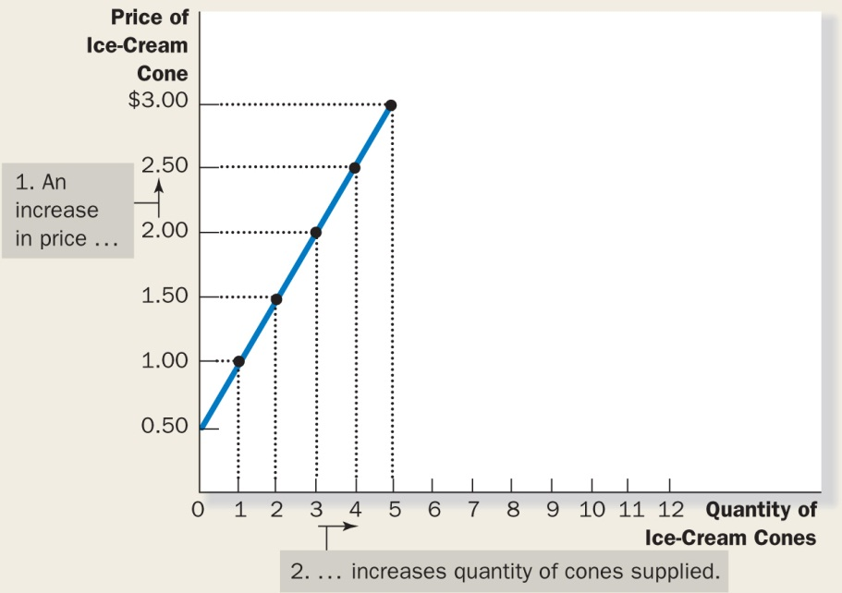
FIGURE 4.5:
Ben’s Supply Schedule and Supply Curve

Slide 31
Market Supply versus Individual Supply
Market supply: the sum of supplies of all sellers
Notes:
Just as market demand is the sum of the demands of all buyers, market supply is the sum of the supplies of all sellers.
The table in Figure 4.6 shows the supply schedules for two ice-cream producers—Ben and Jerry. At any price, Ben’s supply schedule tells us the quantity of ice cream Ben supplies, and Jerry’s supply schedule tells us the quantity of ice cream Jerry supplies. The market supply is the sum of the two individual supplies.

Slide 32
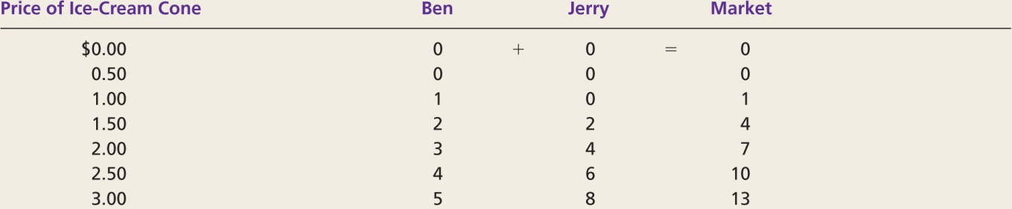
FIGURE 4.6:
Market Supply as the Sum of Individual Supplies
Notes:
The quantity supplied in the market is the sum of the quantities supplied but all the sellers at each price. Thus, the market supply curve is found by adding horizontally the individual supply curves. At a price of $2, Ben supplies 3 ice cream cones, and Jerry supplies 4 ice cream cones. The quantity supplied in the market at this price is 7 cones.

Slide 33
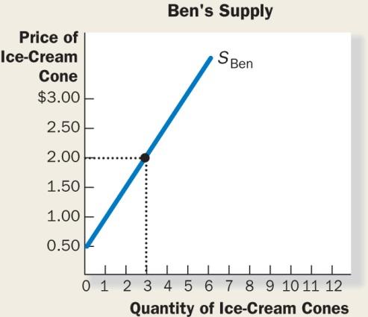
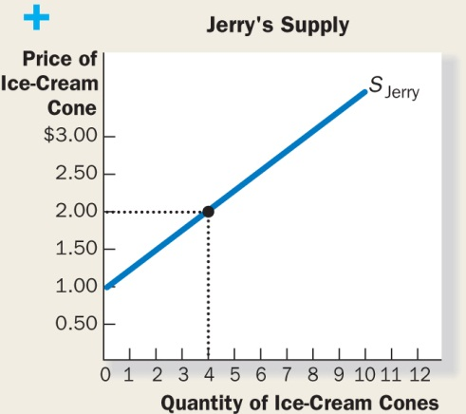
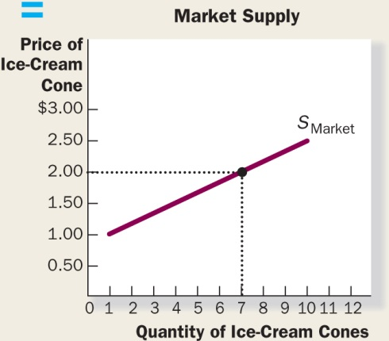
FIGURE 4.6 (continued)

Slide 34
Shifts in the Supply Curve
Any change that rises the quantities that sellers wish to produce at a given price shifts the supply curve to the right and vice versa.
Notes:
Because the market supply curve holds other things constant, the curve shifts when one of the factors changes. For example, suppose the price of sugar falls, sugar is an input into producing ice cream, the fall in the price of sugar makes selling ice cream more profitable. This raises the supply of ice cream: at any given price setters are now willing to produce a larger quantity. Many factors can shift the supply curve.

Slide 35
Shifts in the Supply Curve
Factors that shift the supply curve:
  Input prices
  Technology
  Expectations
  Number of sellers

Slide 36
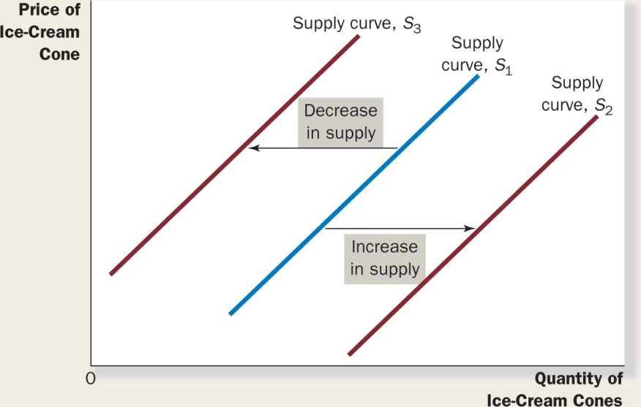
FIGURE 4.7:
Shifts in the Supply Curve
Notes:
The list of factors that can affect the supply curve appear on the next slide.
An increase in the price of an input shifts the supply curve to the left.
A technological deterioration shifts the supply curve to the left.
If the price of the product is expected to fall, the supply curve shifts to the left.
If the number of sellers decreases, the supply curve shifts to the left.
A decrease in the price of an input shifts the supply curve to the right.
A technological progress shifts the supply curve to the right.
If the price of the product is expected to increase, the supply curve shifts to the right.
If the number of sellers increases, the supply curve shifts to the right.
Assume two substitute goods in production (A and B) and that the supply curve is that of good A. If the price of B, the substitute good increases, then producers will reduce their production of good A in favour of B, and the supply curve of good A will shift to the left. Example goods are Wheat vs. Barley or growing oranges vs. growing lemons.
Note that an increase in the price of the product will result in a movement along the supply curve and a a change in QUANTITY SUPPLIED.
If the price of the product increases, then the quantity supplied will increase, and this is illustrated by a movement from left to right along the supply curve.
If the price of the product decreases, then the quantity supplied will decrease, and this is illustrated by a movement from right to left along the supply curve.

Slide 37
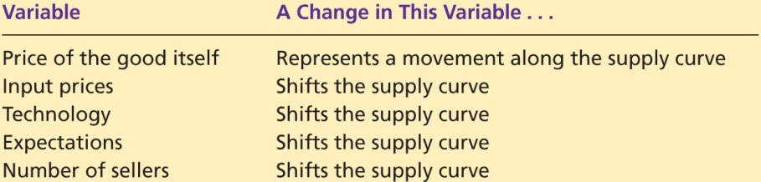
TABLE 4.2:
Variables That Influence Sellers

Slide 38
Make up an example of a monthly supply schedule for pizza, and graph the implied supply curve.
Give an example of something that would shift this supply curve.
Would a change in the price of pizza shift this supply curve?
Notes:
Mozzarella cheese is an input in the production of pizzas. If the price of mozzarella cheese increases, the supply curve of pizzas shifts to the left.
As more producers enter the market, the supply curve will shift to the right.

Slide 39
SUPPLY AND DEMAND TOGETHER
Having analyzed supply and demand separately, we now combine them to see how they determine the price and quantity of a good sold in the market.

Slide 40
Equilibrium
Equilibrium: a situation in which the price has reached the level where quantity supplied EQUALS quantity demanded

Slide 41
Equilibrium
Equilibrium price: the price that balances quantity supplied and quantity demanded
Equilibrium quantity: the quantity supplied and the quantity demanded at the equilibrium price

Slide 42
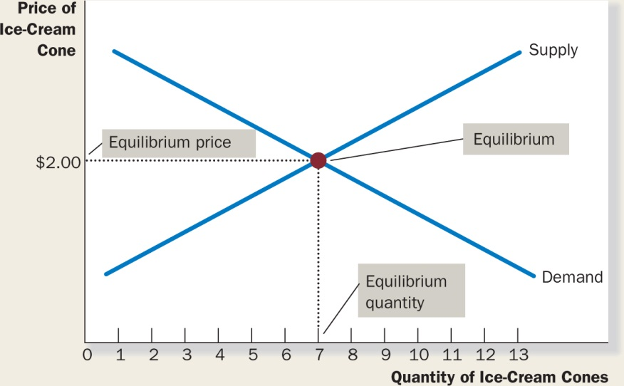
FIGURE 4.8:
The Equilibrium of Supply and Demand
Notes:
The following figure shows the market supply curve and market demand curve together. There is one point at which the supply and demand curves intersect. The point is called the market’s equilibrium. The price at this intersection is called the equilibrium price, and the quantity is called the equilibrium quantity.
Here the equilibrium price is $2 per cone. The equilibrium quantity is 7 ice cream cones. At the equilibrium price, the quantity of the good that buyers are willing to buy exactly balances the quantity that sellers are willing to sell. The equilibrium price is sometimes called the market clearing price because, at this price, everyone in the market has been satisfied. Buyers can buy all they want to buy and sellers can sell all they want to sell.

Slide 43
Equilibrium
Surplus: quantity supplied is greater than quantity demanded
Shortage: quantity demanded is greater than quantity supplied

Slide 44
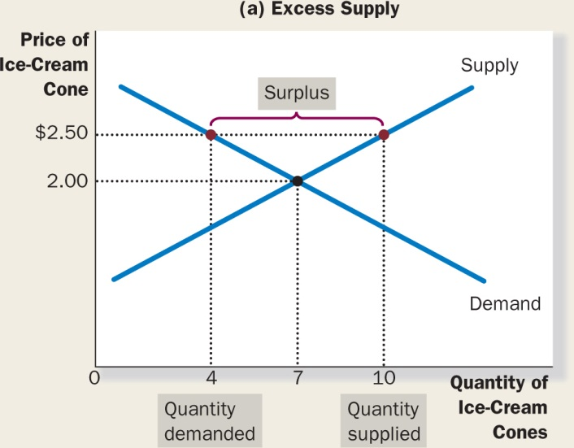
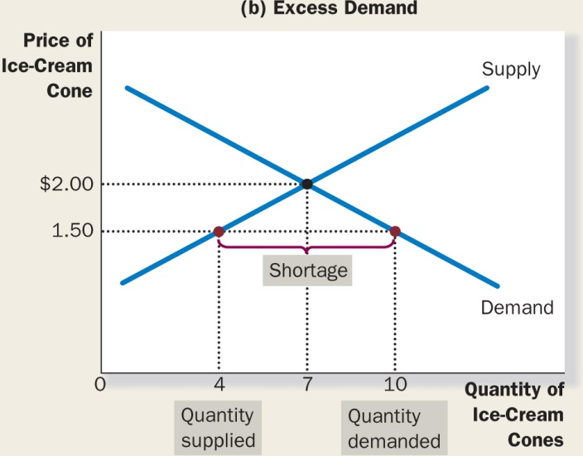
FIGURE 4.9:
Markets Not in Equilibrium
Notes:
In panel (a) there is a surplus. Because the market price of $2.50 is above the equilibrium price, the quantity supplied of 10 cones exceeds the quantity demanded of 4 cones. Suppliers try to increase sales by cutting the price of a cone, and this moves the price toward its equilibrium level.
In panel (b), there is a shortage. Because the market price of $1.50 is below equilibrium price, the quantity demanded of 10 cones exceeds the quantity supplied of 4 cones. With too many buyers chasing too few goods, suppliers can take advantage of the shortage by raising the price.
Hence, in both cases, the price adjustment moves the market toward the equilibrium of supply and demand.

Slide 45

Equilibrium
Law of supply and demand: the claim that the price of any good adjusts to bring the quantity supplied and the quantity demanded for that good into balance
Thinkstock
Notes:
How quickly equilibrium is reached varies from market to market, depending on how quickly prices adjust. In most free markets, surpluses and shortages are only temporary because prices eventually move toward their equilibrium levels.
Indeed, this phenomenon is so pervasive that it is called the law of supply and demand: the price of any good adjusts to bring the quantity supplied and quantity demanded for that good into balance.

Slide 46
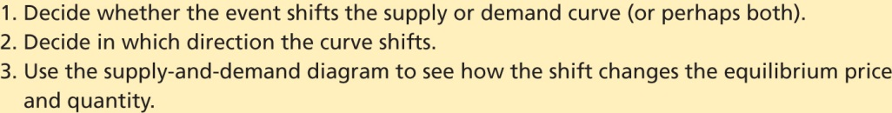
TABLE 4.3:
A Three-Step Program for Analyzing Changes in Equilibrium
Notes:
The equilibrium price and quantity depend on the position of the supply and demand curves. When some event shifts one of these curves, the equilibrium in the market changes, resulting in a new price and a new quantity exchanged between buyers and sellers.

Slide 47
Three Steps to Analyzing
Changes in Equilibrium
Example: a change in market equilibrium due to a shift in demand
Suppose that one summer the weather is very hot.
How does this event affect the market for ice cream?
To answer this question, let’s follow the three steps.
Notes:
1. The hot weather affects the demand curve by changing people’s taste for ice cream. That is, the weather changes the amount of ice cream that people want to buy at any given price. The supply curve is unchanged because the weather does not directly affect the firms that sell ice cream.
2. Because hot weather makes people want to eat more ice cream, the demand curve shifts to the right. Figure 4.10 shows this increase in demand as the shift in the demand curve from D1 to D2. This shift indicates that the quantity of ice cream demanded is higher at every price.
3. At the old price of $2, there is now an excess demand for ice cream, and this shortage induces firms to raise the price. As Figure 4.10 shows, the increase in demand raises the equilibrium price from $2.00 to $2.50 and the equilibrium quantity from 7 to 10 cones. In other words, the hot weather increases the price of ice cream and the quantity of ice cream sold.

Slide 48
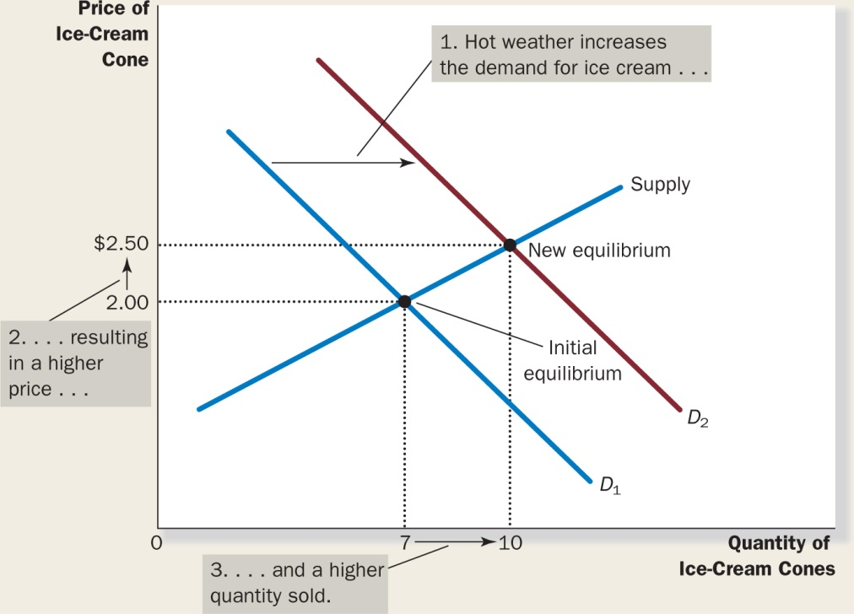
FIGURE 4.10:
Increase in Demand
Notes:
Example: A Change in Market Equilibrium Due to a Shift in Demand Suppose that one summer the weather is very hot. How does this event affect the market for ice cream? To answer this question, let’s follow our three steps.
An event that raises quantity demanded at any given price shifts the demand curve to the right.
The equilibrium price and the equilibrium quantity both rise.
Here, an abnormally hot summer causes buyers to demand more ice cream.
The demand curve shifts from D1 to D2.
This causes the equilibrium price to rise from $2 to $2.50.
And the equilibrium quantity to rise from 7 to 10 cones.
Shifts in Curves versus Movements along Curves Notice that when hot weather drives up the price of ice cream, the quantity of ice cream that firms supply rises, even though the supply curve remains the same. In this case, economists say there has been an increase in “quantity supplied” but no change in “supply.”

Slide 49
Three Steps to Analyzing
Changes in Equilibrium
Example: A change in market equilibrium due to a shift in supply
Suppose that, during another summer, a hurricane destroys part of the sugar cane crop and drives up the price of sugar.
How does this event affect the market for ice cream?
Once again, to answer this question, we follow our three steps.
Notes:
1. The change in the price of sugar, an input into making ice cream, affects the supply curve. By raising the costs of production, it reduces the amount of ice cream that firms want to produce and sell at any given price. The demand curve does not change because the higher cost of inputs does not directly affect the amount of ice cream households wish to buy.
2. The supply curve shifts to the left because, at every price, the total amount that firms are willing to sell is reduced. Figure 4.11 illustrates this decrease in supply as a shift in the supply curve from S1 to S2.
3. At the old price of $2, there is now an excess demand for ice cream, and this shortage causes firms to raise the price. As Figure 4.11 shows, the shift in the supply curve raises the equilibrium price from $2.00 to $2.50 and lowers the equilibrium quantity from 7 to 4 cones. As a result of the sugar price increase, the price of ice cream rises and the quantity of ice cream sold falls.

Slide 50
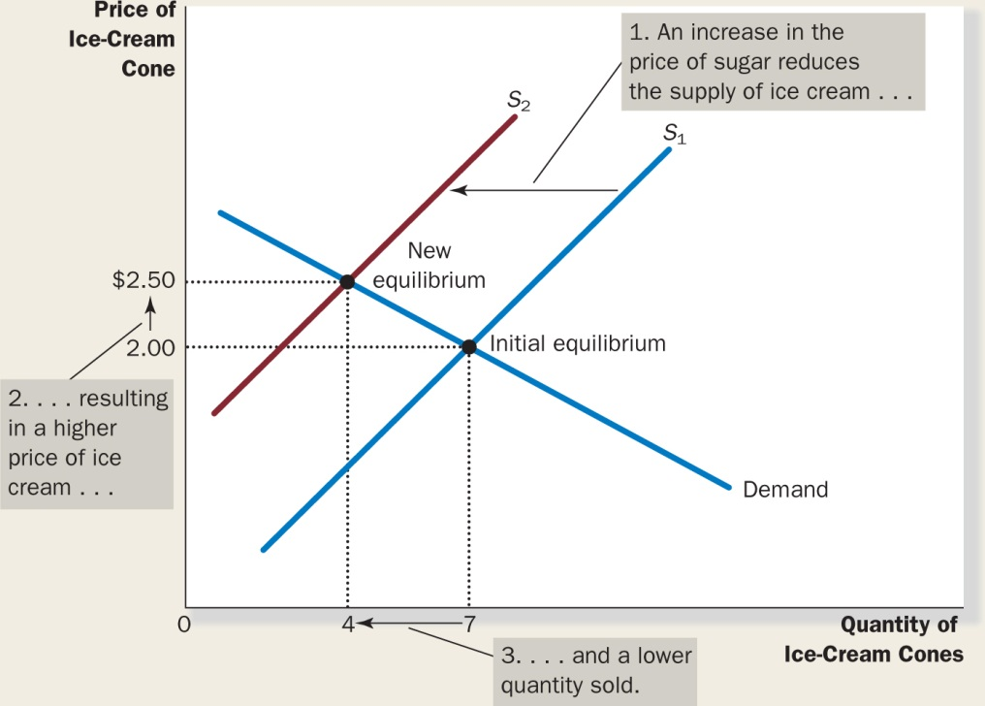
FIGURE 4.11:
Decrease in Supply
Notes:
An event that raises quantity supplied at any given price shifts the supply curve to the left.
The equilibrium price rises
The equilibrium quantity falls.
Here, an increase in the price of sugar (an input) causes sellers to supply less ice cream.
The supply curve shifts from S1 to S2.
This causes the equilibrium price to rise from $2 to $2.50.
And the equilibrium quantity to fall from 7 to 4 cones.

Slide 51
Three Steps to Analyzing
Changes in Equilibrium
Example: Shifts in both supply and demand
Now suppose that the heat wave and the hurricane occur during the same summer.
To analyze this combination of events, we again follow our three steps.
Notes:
We determine that both curves must shift. The hot weather affects the demand curve because it alters the amount of ice cream that households want to buy at any given price. At the same time, when the hurricane drives up sugar prices, it alters the supply curve for ice cream because it changes the amount of ice cream that firms want to sell at any given price.
The curves shift in the same directions as they did in our previous analysis: The demand curve shifts to the right, and the supply curve shifts to the left. Figure 4.12 illustrates these shifts.
As Figure 4.12 shows, there are three possible outcomes that might result, depending on the relative size of the demand and supply shifts. In both cases, the equilibrium price rises. In panel (a), where demand increases substantially while supply falls just a little, the equilibrium quantity also rises. By contrast, in panel (b), where supply falls substantially while demand rises just a little, the equilibrium quantity falls. In panel (c), supply and demand both change by the same magnitude such that the equilibrium quantity stays the same but the price rises. Thus, these events certainly raise the price of ice cream, but their impact on the amount of ice cream sold is ambiguous (that is, it could go either way).

Slide 52
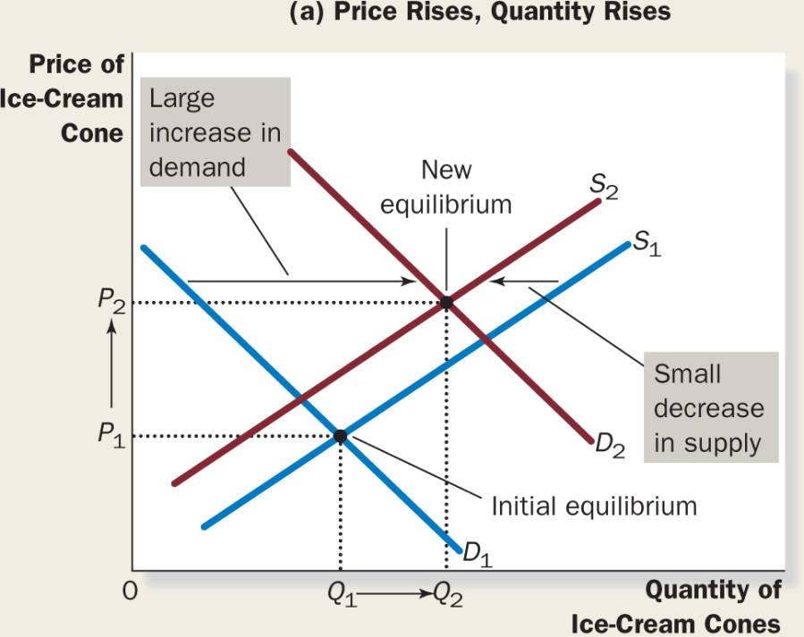
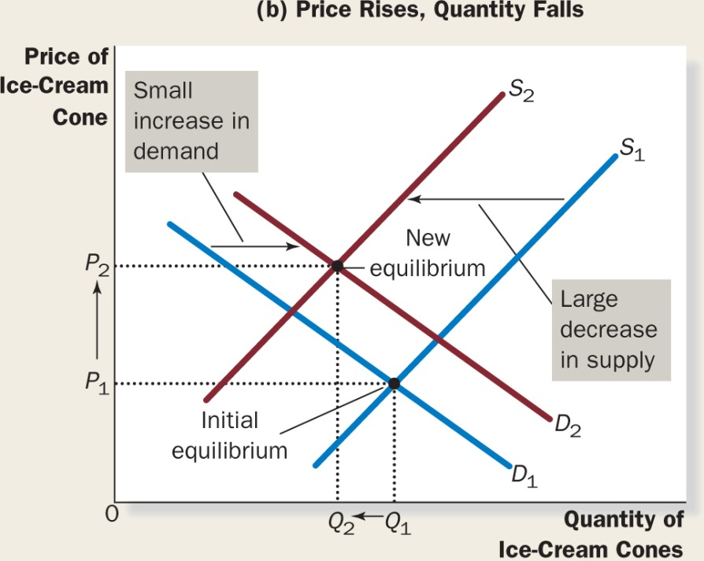
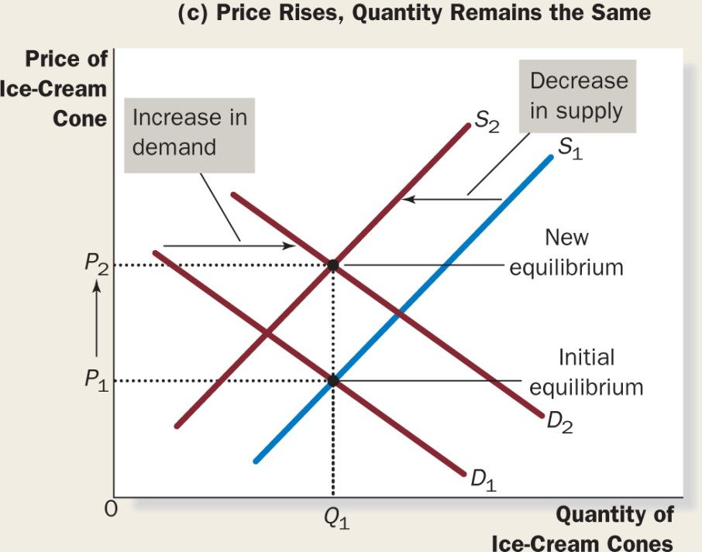
FIGURE 4.12:
A Shift in Both Supply and Demand
Notes:
Here, we observe a simultaneous increase in demand and decrease in supply. Three outcomes are possible.
In panel (a), the equilibrium price rises from P1 to P2 and the equilibrium quantity rises from Q1 to Q2.
In panel (b), the equilibrium price again rises from P1 to P2, but the equilibrium quantity falls from Q1 to Q2.
In panel (c), the equilibrium price rises from P1 to P2, but the equilibrium quantity remains unchanged at Q1.

Slide 53
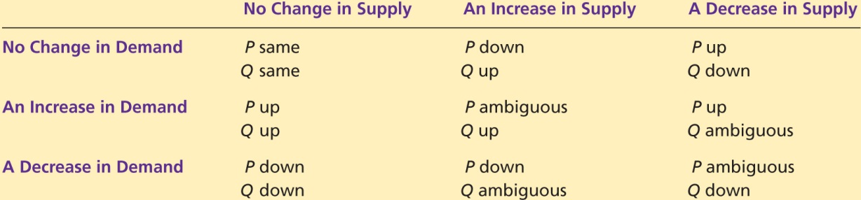
TABLE 4.4

Slide 54
On the appropriate diagram, show what happens to the market for pizza if the price of tomatoes rises.
On a separate diagram, show what happens
to the market for pizza if the price of hamburgers falls.
Notes:
A drop in the price of mozzarella cheese shifts the supply curve for pizzas to the right; with everything else remaining constant, the price pizzas will go down.
The increase in the number of pizza lovers shifts the demand curve for pizzas to the right while an increase in the wages of pizza chefs, an input to producing pieces, shifts the supply curve of pizzas to the left.
The combined effect of the shifting of both curves results in an unambiguous increase in the price of pizzas; however, the net effect on the equilibrium quantity is uncertain, it will depend on the relative shifts of the demand curve and the supply curve.

Slide 55
Classroom Activity
Getting Dressed in the Global Economy
I need volunteers to participate in a market for cookies.
How many cookies would each one of you be willing to buy at various prices?
Notes:
Activity 1 – A Market Example
Type: In-class demonstration
Topics: Individual demand, market demand, equilibrium price, allocation
Materials needed: A bag of Pepperidge Farm cookies (15 cookies), 5 volunteers
Time: 35 minutes
Class limitations: Works in large lectures or small classes with over 15 students
Purpose: This is an example of a real world market, where real goods are exchanged for real money. It is a free market, so there will be no coercion, but participants should think carefully about their answers since actual trades will take place.
Instructions: Ask for five volunteers to participate in a market for Pepperidge Farm cookies. Read some of the package copy describing these “distinctively delicious” cookies. Write each volunteer’s name on the board. Ask the volunteers how many cookies they would be willing to buy at various prices. Record these prices and quantities. Give the volunteers the opportunity to revise their numbers, if the figures don’t accurately reflect their willingness to pay. Remind them this isn’t a hypothetical exercise and they will have to pay real money. At this point there will be five individual demand curves, which can be graphed if desired. Add the individual quantities at each price to find the market demand at that price. This overall demand is used to find the market equilibrium. Sketch a graph of the market demand. Supply, in this case, is fixed at the number of cookies in the bag. There are fifteen cookies. No more can be produced, and any leftovers will spoil. This gives a vertical supply curve in the very short run at Q = 15. [Sketch the supply curve.] Try various prices until the individual quantities sum to 15. This will give the equilibrium price and quantity. Distribute the cookies and collect money from each participant.
Points for Discussion: The demand curves display the typical inverse relation between price and quantity. [Remark on any unusual patterns.] These tell us about each individual’s willingness-to-pay and reveal information about the marginal benefits of additional cookies to each consumer. Market demand is aggregated from individual demand curves. Notice the consumers do not get an equal number of cookies. This is typical of markets, since tastes and incomes vary across individuals.

Slide 56

The end
Chapter 4

