Slide 1
Chapter 7
Firms, Investors and Capital Markets
Microeconomics
Curtis and Irvine, 2013

Slide 2
Learning Outcomes
By the end of this chapter you should understand…
The several forms of business organizations
Corporate goals
Risk and the investor
Utility and risk reduction
Uncertainty, returns, and the risky firm
Financing the firm and diversification

Slide 3
Business Organization Key Terms
Sole proprietor
  The single owner of a business
Partnership
  A business owned jointly by two or more individuals, sharing the profits and jointly responsible for any losses
Company or Corporation
  An organization legally allowed to trade and produce, and having limited liability
Shareholders
  Individuals who invest in companies and therefore are the owners

Slide 4
Business Organization Key Terms
Dividends
Payments made from after-tax profits to shareholders
Capital gains
Income resulting from selling shares at a price higher than the original purchase price
Limited liability
The liability of the company is limited to the value of the company’s assets
Retained earnings
Profits retained by a company for reinvestment and not distributed in dividends

Slide 5

Business Organizations
Use capital, labor and human expertise to produce a good, to supply a service or to act as an intermediary with the objective of earning a profit
Businesses are required to produce annual income statement that accurately describes the operation of the company

Slide 6
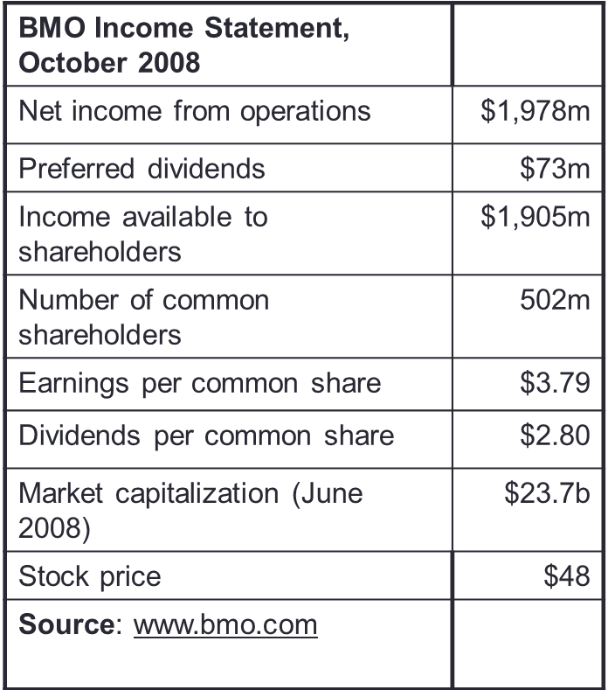
Business Income Statement
Net income from operations of $1,978m (represents after-tax profits). Of this amount, $78m was paid to holders of a special class of shares, and $1,905m was available for either reinvesting in the company or paying dividends
502 million shares outstanding at end 2008
If the $1,905m were allocated over all such shares, $3.79 would go to each share
Of the $3.79 earnings per share, $2.80 was distributed to shareholders and $0.99 was retained inside the company

Slide 7
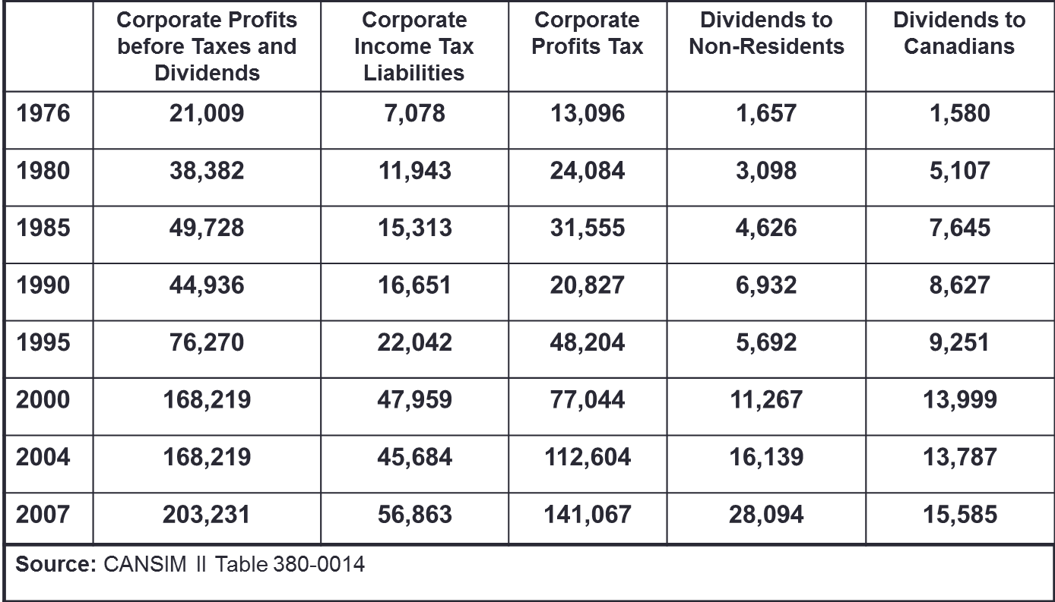
Corporate Profits in Canada in $ millions
Corporate profits fell in 1990, the worst year of the early 1990s recession
Significant amount of foreign ownership in the Canadian corporate sector as shown by high amounts of dividends to non-residents

Slide 8
Profit, Ownership, and Corporate Goals
Economists believe that profit maximization accurately describes a typical firm’s objective
Corporate goals sometime deviate from profit maximization
  Principal-agent relationship
    Management (agent) different from ownership (principal)
  Principal-agent problem
    If the principal cannot easily monitor the actions of the agent, the agent may not always act in the best interests of the principal

Slide 9
Risk and the Investor - Key Terms
Fair gamble
  On average yields a zero profit
Example 1:
  A coin toss game yielding $0 to a participant on ‘heads’ and $10 on ‘tails’ that has a fee for play of $5 is fair.
    (0.5 * $0 + 0.5 * $10 = $5)
Example 2:
  A fire insurance policy costing $1,000 to insure a $100,000 home is fair if the house may burn down one time in a hundred
    (0.01 * 100,000 + 0.99 * $0 = $1,000)
Example 3:
  If the Casino in Las Vegas pays out $0.95 for ever $1.00 bet, the casino is not offering fair odds.

Slide 10

Risk and the Investor - Key Terms
Risk-averse person
  Prefers to avoid risk, but may choose to bet or gamble if the odds are sufficiently in their favour, despite their inherent dislike of risk.
  Will avoid a fair game or fair gamble
Risk-neutral person
  Only interested in whether the odds yield a profit on average, and ignores the dispersion in possible outcomes
    (0.5 * $0 + 0.5 * $10 = $5)

Slide 11
Diminishing Marginal Utility and Risk
Individuals have diminishing marginal utility
  Successive equal increments in consumption yield progressively less additional utility
Risk pooling
  Aggregates independent risks to make the aggregate less uncertain and thereby increases average utility: individuals pool their risk as in home insurance
Risk spreading
  Works by reducing the stake of each participant: insurers reduce their risk exposure by spreading the risk to other insurers
  Illustrations…

Slide 12
Risk Pooling and Individual Incomes
 |  | IT Consultant
 |  | Good month 50% | Bad month 50%
Musician |  | $5,000 | 0
Good month 50% | $5,000
Bad month 50% | 0
By pooling their investments, each party reduces the variation in their monthly income.
Variation normally lowers utility
$5,000
$2,500
$2,500
$0
Alone: 50% of the time $5,000 and 50% of the time $0
Together: 25% of the time $5,000, 50% of the time $2,500, and 25% of the time $0

Slide 13
Independent Risks
In the previous example the risk incurred by each individual was independent of the risk incurred by the other
This means that the income profile of the IT consultant does not depend upon whether the musician has a good or bad month
In everyday life this may not be always true – macroeconomic conditions may impact the incomes of both individuals in a similar manner - this is sometimes called system risk
In the case of stock markets, there is some correlation between the movements of many of the stocks – when one company in the mining sector has a good year, other companies in that sector tend to have a good year also; the returns are not completely independent

Slide 14
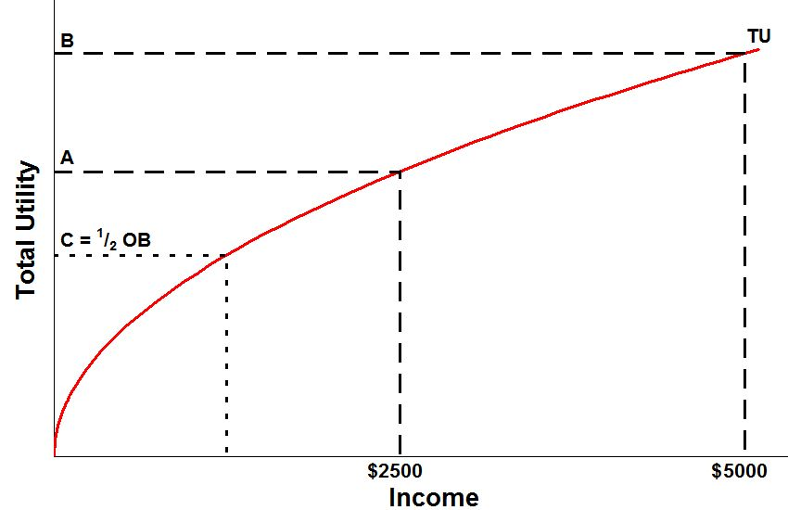
Utility from Extremes and Utility from Averages
Concave TU indicates diminishing MU
Utility level with $2,500 every time
While the average payout is $2,500 in both cases, the risk averse person prefers the certain outcome
Utility level with $0 half the time and $5,000 half of the time
Conclude: Less variation yields higher average utility

Slide 15
Risk pooling: Insurance
The previous figure indicates that certainty has a utility value
This explains why, for example, individuals come together via a home insurer to reduce risk
Since certainty yields higher utility, home owners should be willing to pay an annual amount to avoid the variability in outcome – the insurance premium
This can be illustrated by using the preceding graphic

Slide 16
Utility from Extremes and Utility from Averages
Concave TU indicates diminishing MU
Eliminating uncertainty improves utility by the amount $(2,500 – X). Hence the individual should be willing to pay some of this in the form of a ‘premium’ in a risky situation
$x

Slide 17
Risk Aversion and Risk Neutrality
In the preceding graphic the individual preferred to avoid risk – so the individual was risk averse
Question: If the individual was risk neutral, what would be the shape of the utility curve?
Answer: It must be linear - illustrate
U
$

Slide 18
Risk Spreading
If an insurer is asked to insure a nuclear reactor the insurer may not be able to assume all of the risk – the potential damage is too great
Thus the insurer, rather than refusing the opportunity for profit, may chose to reduce her risk exposure….
…. by spreading the risk to other firms in the insurance industry.
The initial insurer offloads much of the risk to a group of insurers
Hence even very big risks can be covered by the insurance industry

Slide 19

The Role of Financial Markets
Since investing in an enterprise is a risky business, and most investors dislike assuming too much risk, why do individuals invest in risky firms?
Financial markets provide risk pooling and risk spreading as means of channeling saving to investment

Slide 20
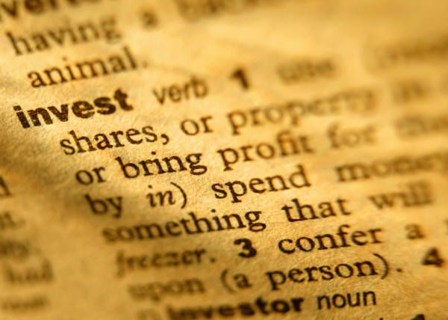
Uncertainty and Asset Returns
The real return
  - is the nominal return minus the rate of inflation
Real return to investing in a company share/stock
  - is the sum of the dividend and the capital gain or loss, adjusted for the rate of inflation

Slide 21


Financing the Risky Firm: Diversification
The capital market is the set of financial institutions that funnels financing from investors into bonds and stocks
A portfolio is a combination of assets that is designed to secure an income from investing and to reduce risk
Diversification reduces the total risk of a portfolio by pooling risks across several different assets
Total degree of risk can be measured by the variance

Slide 22
Diversification Example
Investor can invest in two stocks with profiles:
The returns on these stocks are independent of each other
Investment Strategy | Possible Outcomes in Dollars |  |  | Variance
(i) $200 in oil | 220 (pr. = 50%) |  | 200 (pr. = 50%) | 100
(ii) $200 in banks | 220 (pr. = 50%) |  | 200 (pr. = 50%) | 100
(iii) $100 in each | 220 (pr. = 25%) | 210 (pr. = 50%) | 200 (pr. = 25%) | 50
The expected return is the same for each strategy = $210
Conclude: diversification (by investing in both oil and banks) reduces the risk: the probability of ‘extreme’ outcomes diminishes.
Let’s now compute the variance…..

Slide 23
The Variance
The variance is a measure of how dispersed the outcomes are
– how far the outcomes are from the average outcome
  It is a weighted sum of the squared deviations from the mean
  In each strategy the mean return is $210
  Strategy (i):
    Since each outcome has an equal probability the weights are 0.5
      Variance = 0.5 * (220 – 210)² + 0.5 * (200 – 210)² = 100
  Strategy (ii): Yields the same result as strategy (i)
  Strategy (iii):
    Outcomes have different weights here:
      Variance = 0.25*(220 – 210)² + 0.5*(210-210) + 0.25*(200 – 210)² = 50

Slide 24
Netflix Stock Price
Most stocks exhibit considerable price variation; hence investors who are risk averse avoid putting all of their eggs in the one basket

Slide 25
Nortel Stock Price 1995-2005
This is an illustration of investment risk, as the payoff changed dramatically over time; it is desirable to attempt to diversify away from this risk

Slide 26
Chapter Summary
There are three main types of firm:
  Self-employed sole traders
  Partnerships
  Companies/Corporations - owned by shareholders
Important variable for firms are:
  Revenue
  Costs
  Profits – directed to dividends or retained earnings
Capital gain is the difference between the purchase value of a stock and its current market value
Firms are assumed to maximize profits

Slide 27
Chapter Summary
The principal-agent relationship refers to the relation between a firm's owners and its managers
  Principal agent problems occur when management does not maximize profits
Firms are financed by investors who channel their funds through capital markets
Risk pervades economic life
Risk-aversion arises because individuals have diminishing marginal utility
  Most investors seek to reduce risk
  Fair gambles are typically refused by risk-averse individuals in favor of less risky investments

Slide 28
Chapter Summary
Insurers pool risks that are substantially independent and spread risk across many other insurers
Risk reduction is a driving force in investment strategies
Investment strategies depend on individual’s willingness to trade off higher risk with higher return
Portfolio diversification provides investors with the opportunity to invest some of their funds to highly risky ventures
The degree of risk within a portfolio can be measured by its variance, which is the weighted sum of the squared deviations from the mean
Not all risk can be diversified away: remaining risk is called system risk, and depends upon macroeconomic conditions

