Slide 1
Chapter 2
Theories, Models and Data
Microeconomics,
Curtis & Irvine, 2013

Slide 2
Learning outcomes
In this chapter we will examine…
  Economic theory and models
  Variables, data & index numbers
  Testing economic models
  Diagrams and economic analysis
  Normative and positive economics
  The role of government

Slide 3
Observations, Theories and Models
Economists:
observe and study economic behaviour, experience and events.
  Example: what is the impact of price on alcohol purchases
think in terms of economic costs, benefits and incentives
  Example: what is the impact of tax deductibility of retirement savings on the decision to save
try to determine and understand causes and consequences – theorize
  Example: impact of incarceration on crime reduction

Slide 4

Observations, Theories and Models
Economists use economic theories and models to explain behavior and predict policy outcomes
  Example: A model of the housing market helps to predict the impact of a change in the mortgage rate on home prices
  Modelling tools…

Slide 5
Observations, Theories and Models
Economists illustrate and evaluate their models using a set of techniques and tools, namely:
  Verbal explanations
  Diagrams
  Algebra
  Data tables and charts
  Statistical tests
  Illustration……

Slide 6
Illustration: A Simple Economic Model
Theory: Mortgage rates determine the finance cost of buying a house, therefore we:
  Hypothesize that changes in mortgage rates cause changes in house prices
  Construct a model to test the hypothesis and gather data
  Observe in the data: Increasing house prices and falling mortgage interest rates simultaneously
  Infer: House prices are inversely related to mortgage rates
  Prediction: Does the model help with prediction

Slide 7
The Model in a Diagram
Suppose the mortgage rate falls and we observe that prices rise, and vice versa
Mortgage rate %
This suggests a negative relationship between the two variables – as one rises the other falls. Let us represent this by the line P_{house}
6.0
5.0
P_{house}
Average house price
P₁
P₂
With all other things constant, the downward sloping line P_{house} represents a negative relationship between the two variables

Slide 8

Economic Models in Different Forms
The previous representation of the model was graphical
The model can also be expressed in simple algebraic or mathematical form
Illustration…

Slide 9
The Model in ‘Algebra’
The relationship between mortgage rates (MR) and house prices that we have drawn is a straight line. Straight line functions are convenient and simple to work with
We will see below that such a line can be described completely by its slope and the value of one of the intersection points with the axes
For now we infer that if the straight line we have inserted accurately reflects the relationship between mortgage rates and house prices, we could ‘predict’ the impact of a change in the MR on prices
We will write the equation for this line presently

Slide 10
Variable, Data and Index Numbers
Economic theories and models work with economic variables and are tested with economic data
Economic variables:
Measures that can take on different values
Economic data:
Actual recorded values of variables
Forms of data:
  Time series data of different frequencies
  Cross-section data
  Longitudinal data
Illustrations….

Slide 11
Time Series Data in a Table
TABLE 2.1 House Prices by Time Period
1 | 2 | 3
Date | Price of detached bungalows, N. Vancouver | House price index (1999Q1=100)
2006Q1 | 580,000 | 175.76
2007Q1 | 630,000 | 190.91
2008Q1 | 710,000 | 215.15
2009Q1 | 605,000 | 183.33
2010Q1 | 740,000 | 224.24
2011Q1 | 800,000 | 242.42
2012Q1 | 870,000 | 263.33
Column 3 will be used later..
Source: Prices for North Vancouver houses come from Royal Le Page and the CPI is obtained from
Statistics Canada, CANSIM II, Series V41692930 and author’s calculations.

Slide 12
Time Series Data Plotted
This is a plot of the house price series – going back to 1999. The line joins every pair of date-price points
For example, 2009, Q1 prices fall to $605,000

Slide 13
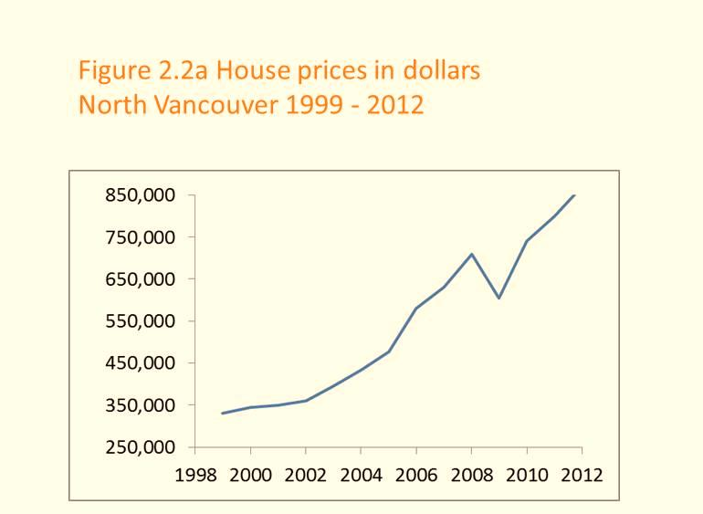
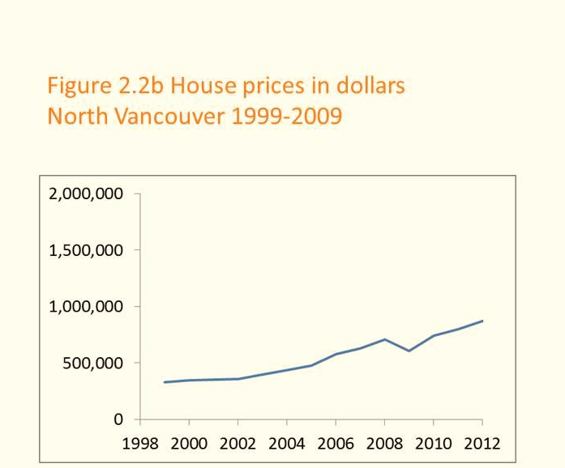
Interpretation of Plots
These plots present the same information
The vertical axis has been compressed in the second figure

Slide 14
Cross – Section Data Table
Table 2.2 Unemployment rates, Canada and Provinces, monthly 2012 (% seasonally adjusted)
 | Jan | Feb | Mar | Apr | May | Jun
CANADA | 7.6 | 7.4 | 7.2 | 7.3 | 7.3 | 7.2
NFLD | 13.5 | 12.9 | 13.0 | 12.3 | 12.0 | 13.0
PEI | 12.2 | 10.5 | 11.3 | 11.0 | 11.3 | 11.3
NS | 8.4 | 8.2 | 8.3 | 9.0 | 9.2 | 9.6
NB | 9.5 | 10.1 | 12.2 | 9.8 | 9.4 | 9.5
QUE | 8.4 | 8.4 | 7.9 | 8.0 | 7.8 | 7.7
ONT | 8.1 | 7.6 | 7.4 | 7.8 | 7.8 | 7.8
MAN | 5.4 | 5.6 | 5.3 | 5.3 | 5.1 | 5.2
SASK | 5.0 | 5.0 | 4.8 | 4.9 | 4.5 | 4.9
ALTA | 4.9 | 5.0 | 5.3 | 4.9 | 4.5 | 4.6
BC | 6.9 | 6.9 | 7.0 | 6.2 | 7.4 | 6.6
Source: Statistics Canada CANSIM Table 282-0087
Canada’s provinces at a moment in time form a cross-section

Slide 15
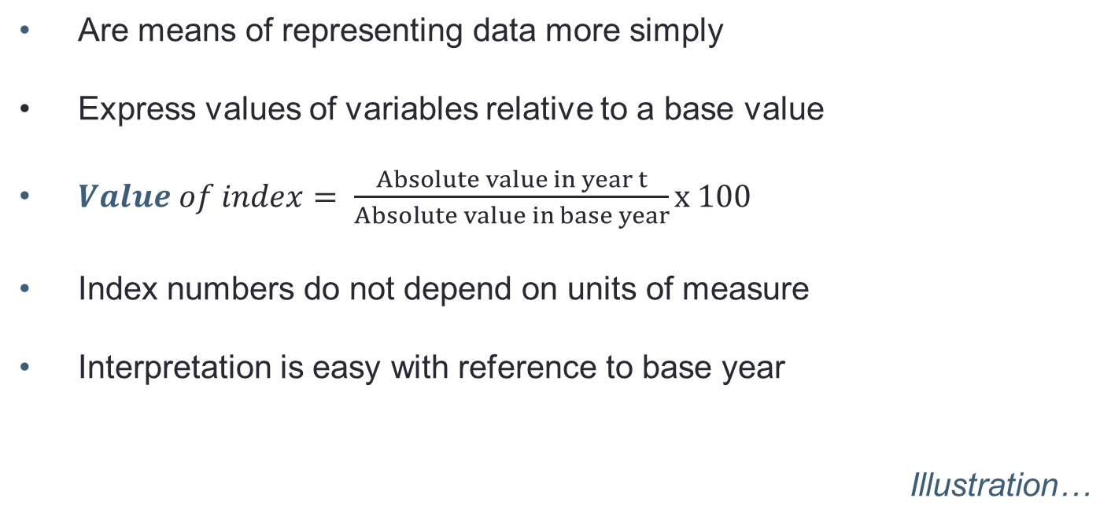
Index Numbers
Are means of representing data more simply
Express values of variables relative to a base value
$Value of index= \frac{Absolute value in year t}{Absolute value in base year}x 100$
Index numbers do not depend on units of measure
Interpretation is easy with reference to base year
Illustration…

Slide 16
Price indexes in Table 2.1
We can use the data in columns 1 & 2 to construct a price index
Year, Q1 | Price in $ | House Price Index
1999 | 330,000 | 100
2000 | 345,000 | 104.6
… | … | …
2006 | 580,000 | 175.8
2007 | 630,000 | 190.9
2008 | 710,000 | 215.2
2009 | 605,000 | 183.3
2010 | 740,000 | 224.2
2011 | 800,000 | 242.4
2012 | 870,000 | 263.3
Relative to 1999Q1, house prices in 2012 increased 163.3%
Relative to 1999Q1 house prices in 2009Q1 increased 83.3%

Slide 17
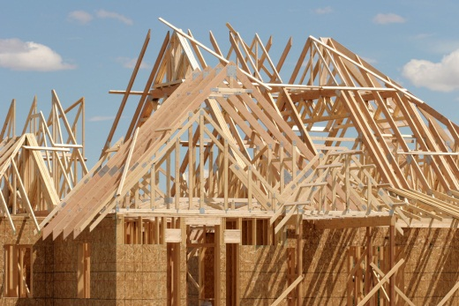


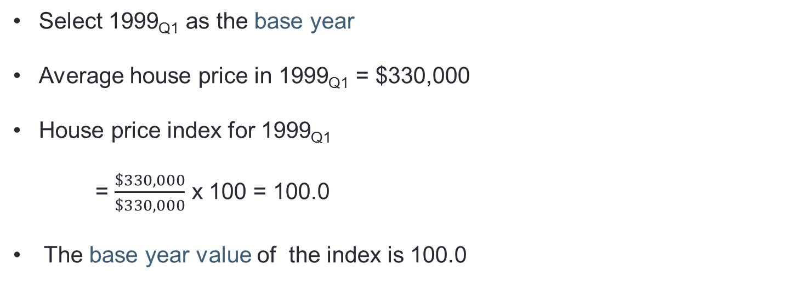
Constructing a House Price Index
Select 1999_{Q1} as the base year
Average house price in 1999_{Q1} = $330,000
House price index for 1999_{Q1}
= $\frac{\$330,000}{\$330,000}$ x 100 = 100.0
The base year value of the index is 100.0

Slide 18
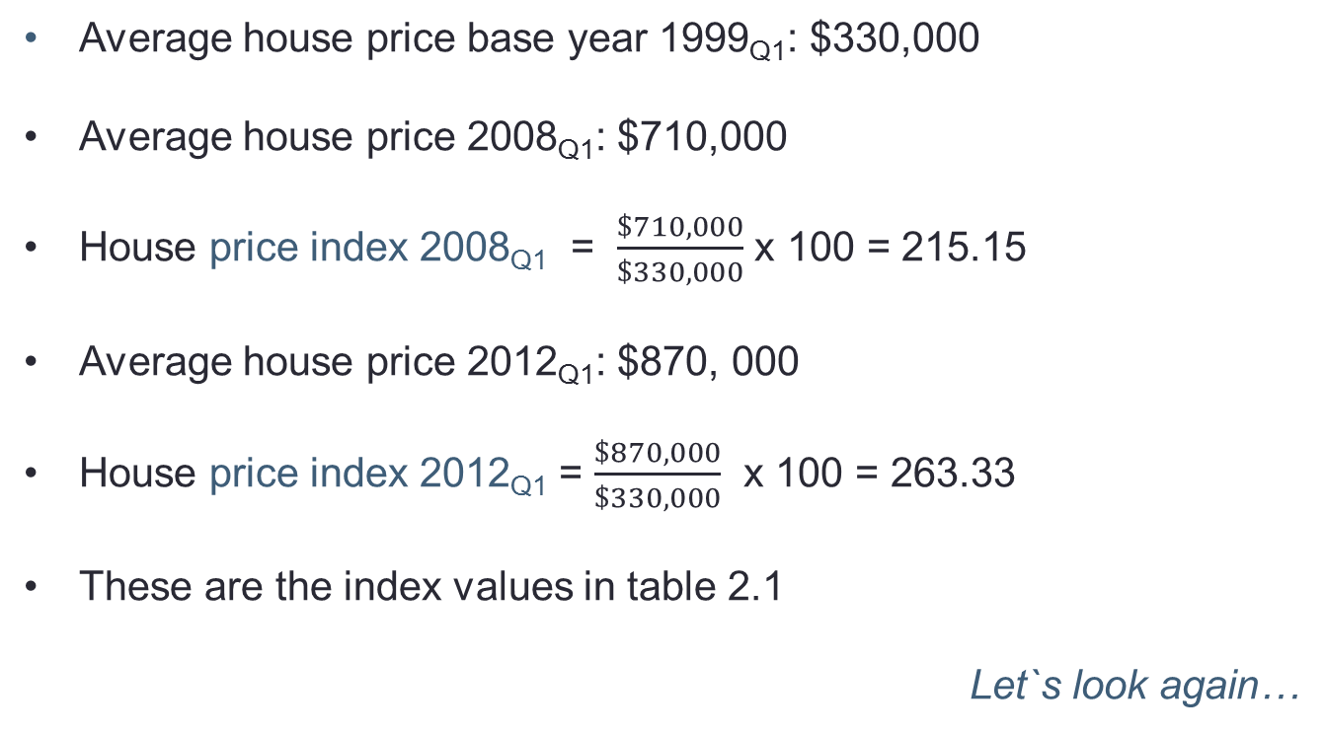
Constructing a House Price Index (cont’d)
Average house price base year 1999_{Q1}: $330,000
Average house price 2008_{Q1}: $710,000
House price index 2008_{Q1} = $\frac{\$710,000}{\$330,000}$ x 100 = 215.15
Average house price 2012_{Q1}: $870, 000
House price index 2012_{Q1} = $\frac{\$870,000}{\$330,000}$ x 100 = 263.33
These are the index values in table 2.1
Let`s look again…

Slide 19



Composite Index Numbers
Examples:
A fuel price index:
- based on an average of prices of different fuels
A consumer price index (CPI)
- based on a ‘basket’ of consumer goods and services
A wage rate index
- based on an average of earnings in different occupations

Slide 20
A Fuel Price Index
A weighted average of different fuel prices
Weights based on relative importance of the component in the overall index – e.g. the percentage of total fuel used
Example:
Fuel price index = 0.6 x oil price index
+ 0.25 x natural gas price index
+ 0.15 x coal price index
Figure 2.3 illustrates…

Slide 21
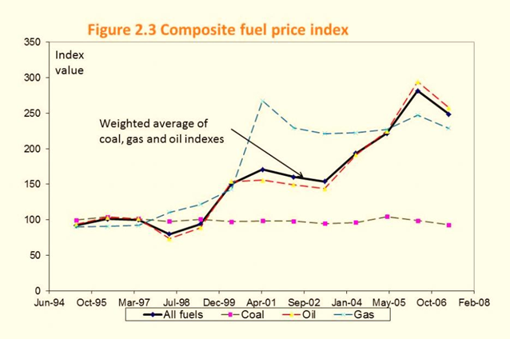
Fuel Price Index

Slide 22
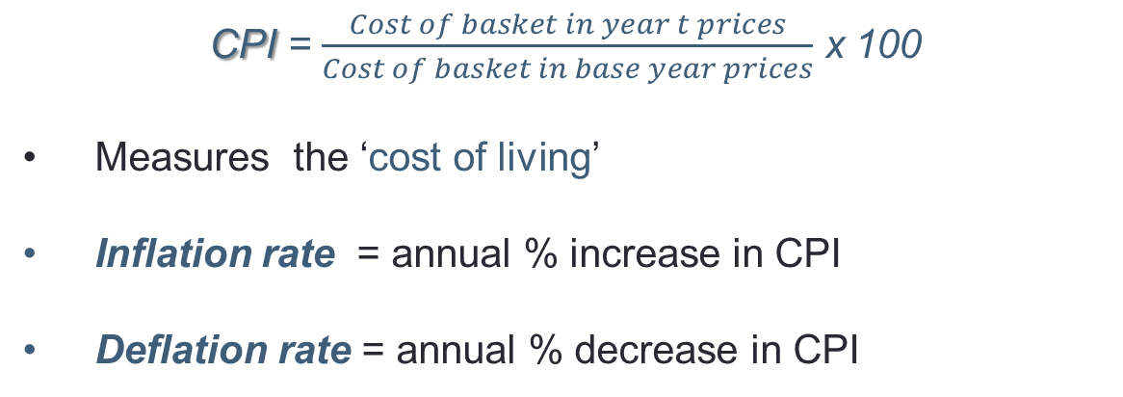
The Consumer Price Index (CPI)
CPI = $\frac{Cost of basket in year t prices}{Cost of basket in base year prices}$ x 100
Measures the ‘cost of living’
Inflation rate = annual % increase in CPI
Deflation rate = annual % decrease in CPI

Slide 23
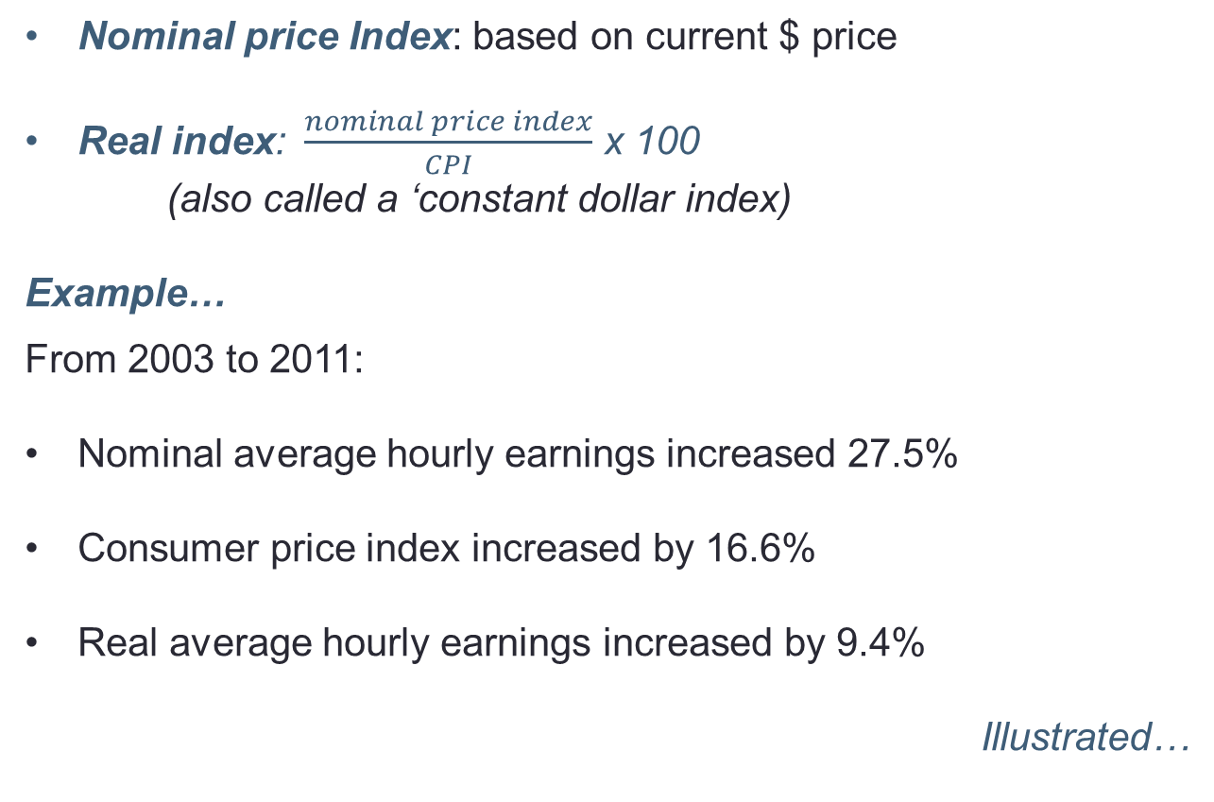
Nominal and Real Values Using CPI
Nominal price Index: based on current $ price
Real index: $\frac{nominal price index}{CPI}$ x 100
(also called a ‘constant dollar index)
Example…
From 2003 to 2011:
Nominal average hourly earnings increased 27.5%
Consumer price index increased by 16.6%
Real average hourly earnings increased by 9.4%
Illustrated…

Slide 24
Nominal and Real Values: Illustration
Relative real hourly earnings 2003 → 2011 = $\frac{127.5}{116.6 }$x 100 = 109.4

Slide 25
Testing Economic Models
Simple model:
Changes in mortgage rates cause changes in house prices, ceteris paribus, and the relationship is inverse
Broader model:
House prices = f(mortgage rates, incomes, supply
of housing, population growth, rents….)
Statistical test of simple model:
Examine house price and mortgage rate data in conjunction with other variables.
Illustration using data and scatter plot…

Slide 26
Mortgage Rates and House Prices 2007-2010
Year, quarter | 5-year conventional mortgage rate | Resale house price index 2006q4 = 100
2007Q1 | 6.5 | 108.4
2007Q2 | 7.2 | 118.4
2007Q3 | 7.2 | 128.7
2007Q4 | 7.5 | 139.4
2008Q1 | 7.2 | 150.5
2008Q2 | 7.2 | 157.1
2008Q3 | 6.9 | 160.9
2008Q4 | 6.8 | 157.2
2009Q1 | 5.8 | 149.2
2009Q2 | 5.8 | 143.4
2009Q3 | 5.5 | 142.2
2009Q4 | 5.5 | 149.9
2010Q1 | 5.9 | 167.3
2010Q2 | 5.9 | 183.7
2010Q3 | 5.4 | 195.4
2010Q4 | 5.2 | 207.5
Source: Mortgage rate: Statistics Canada, CANSIM Series V122521; Resale Housing Price index: www.royallepage.com, and authors' calculations

Slide 27
From Data to Scatter Plot
Consider the data in the preceding table
The first data combination is {6.5, 108.4}
This can be plotted as a single point in a two-dimensional diagram with appropriate axes
All of the combinations in the table can be plotted in the same way
The question:
  Does the resulting data plot suggest there is a relationship between the variables in question?
Illustration….

Slide 28
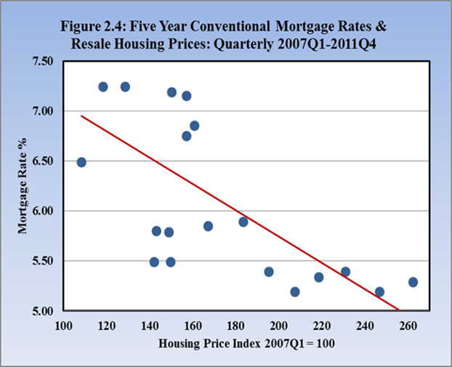
Scatter Plots and Regression Lines
Scatter diagram plots pairs of values of mortgage rates
and house prices in the same year and quarter.
Regression line is a line through the points that reflects their pattern
(2008: 6.75, 157.2)
Regression line
The closer the dots are to the regression line the better the ‘fit’ and the stronger the support for the model
The data support the theory expressed in the model: that there is a negative relationship between mortgage rates and prices

Slide 29
Regression Lines
Econometrics is the science of quantifying relationships between economic variables
Regression line shows average relationship between variables – here the mortgage rates and house prices
The equation of the regression line quantifies the relationship between mortgage rates and house prices.

Slide 30
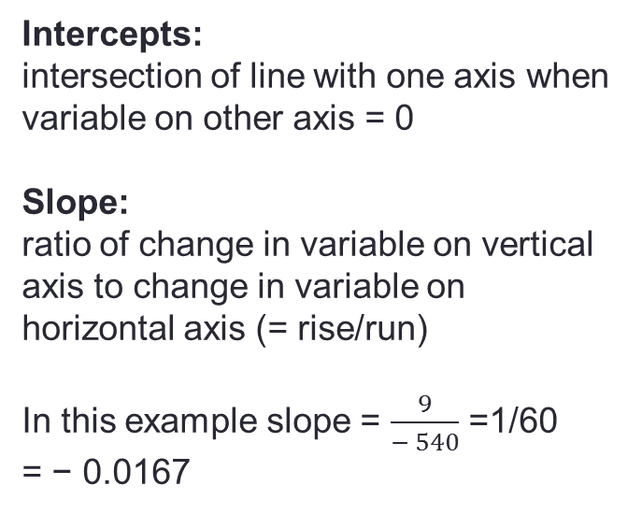
Properties of the Regression Line
Mortgage rate
MR %
Intercepts:
intersection of line with one axis when variable on other axis = 0
Slope:
ratio of change in variable on vertical axis to change in variable on horizontal axis (= rise/run)
In this example slope = $\frac{9}{− 540}$ =1/60
= − 0.0167
9
5
Rise
4
Run
0
240
300
540
House price index

Slide 31
Regression line: illustration
Suppose the regression line intersects the horizontal axis at a value of ‘540’ (see next slide)
And the intersection with the vertical axis is ‘9’
It follows that the slope has a value of 1/60 (= vertical distance divided by horizontal distance)
Hence the regression line can be written as
MR = 9 – 1/60 × P_{H} or P_{H} = 540 – 60 × MR
graphical illustration…

Slide 32
Diagrams and Economic Analysis
Diagrams are important tools for economic illustrations and analysis
Straight line diagrams provide useful simplifications of economic relationships
In some cases curved lines are better illustrations of economic relationships and fit the data better
Changes in economic conditions and relationships change parameters of the model and shift the lines in diagrams – we explore this in chapter 3

Slide 33
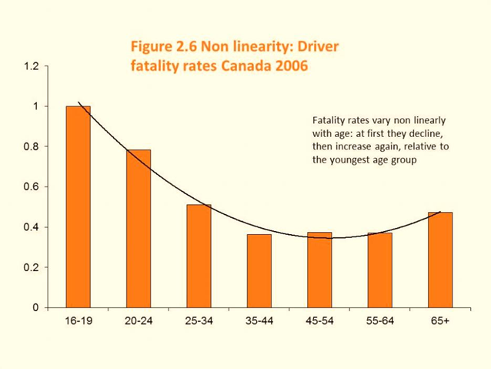
Statistics and Policy Design
Figure 2.6 presents data on fatalities per driver by age group in Canada relative to the youngest age group..
Note the strong non-linear pattern to the data – fatalities decline quickly, then level off and again increase for the oldest age group.
In keeping with these data, drivers are now required to pass a driving test in most provinces once they attain a certain age – usually 80, because the data indicate that fatalities increase when drivers age.
See: CANADIAN MOTOR VEHICLE TRAFFIC COLLISION STATISTICS 2009, Transport Canada

Slide 34
Ethics, Efficiency and Beliefs
Positive economics: objective and scientific explanations of how the economy functions.
Example on inference
Normative economics: recommendations that incorporate value judgements
Example using political perspectives
Economic equity: the distribution of well – being among members of society
  Pursuit of happiness: curvilinear relationship between average happiness and national income

Slide 35
Government
Provides the legal framework essential for a mixed economy
– market and public sectors. Government is integral to the economy, not an appendage.
Intervenes to support efficient market functions through:
  Competition policy and regulatory frameworks
  Social policy – an educated workforce
  International trade policy – reduce protectionism
  Monetary policy and fiscal policy – to foster growth
Intervenes to redistribute to individuals and other levels of government

Slide 36
Revisiting the Definition of Economics
A set of ideas (and policies) and methods for the betterment of society
Markets are critical: Permit trade, specialization and efficiency
Incentives matter – economic agents react to incentives
Governments are critical: for stability through legal institutions, for an efficient operation of the economy and to ensure an equitable set of outcomes

Slide 37
Chapter Summary
Economics is concerned with the interplay of theories, models and data
A model is a simplified representation of reality, often formulated to test a hypothesis
Hypothesis can be refuted or supported by analyzing data
Data come in time-series, cross-section and longitudinal form
Index numbers provide a simplified way of analyzing data relative to a base year. Index numbers may also be averages of components
Nominal financial data values are translated into real values by dividing the nominal series by the CPI

Slide 38
Chapter Summary
Data can be represented by means of a scatter plot and a regression line through the plot
Economic relationships may be linear or non-linear
A straight line is defined totally by its two intercepts or one intercept and the slope
Economics is concerned with equity as well as markets
Government is essential to the functioning of a modern economy

