Slide 1
Chapter 3
Supply and Demand
Microeconomics,
Curtis & Irvine, 2013

Slide 2
Learning Outcomes
By the end of the chapter you should understand…
The market and trading
Demand and supply curves: concepts and equilibrium solutions
Behind the demand curve and demand curve shifts
Behind the supply curve and supply curve shifts
Simultaneous shifts in supply and demand
Free and managed markets
From individuals to markets

Slide 3
Some Key Terms
Market: a set of arrangements by which buyers and sellers interact in order to exchange goods or services
Demand: the quantity of a good buyers wish to purchase at each conceivable price
Supply: the quantity of a good sellers wish to sell at each conceivable price
Illustrated…
Notes:
See Sections 3-1 and 3-2 in the main text.

Slide 4
Some Key Terms
Quantity demanded is the exact quantity purchased at a given price
  Think in terms of one value
Quantity supplied is the exact quantity supplied at a given price
  Think in terms of one value
At the equilibrium price:
quantity demanded = quantity supplied
We say that this price clears the market

Slide 5
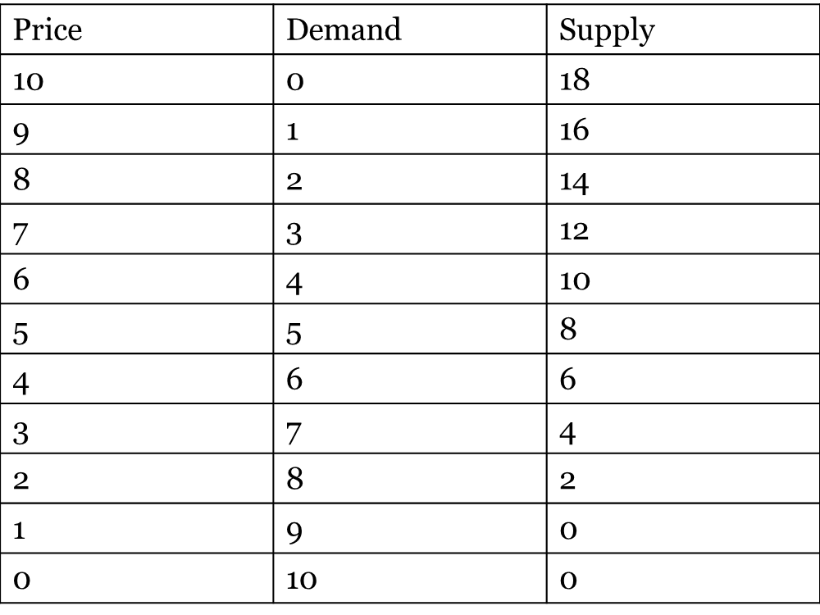
Demand and Supply of Natural Gas
Quantity demanded
Demand
Similarly; supply and quantity supplied
Note: “Other Things Being Equal” Assumption

Slide 6
The Equilibrium Price
Price | Demand | Supply | Excess Demand/Supply
10 | 0 | 18
9 | 1 | 16
8 | 2 | 14
7 | 3 | 12
6 | 4 | 10
5 | 5 | 8
4 | 6 | 6
3 | 7 | 4
2 | 8 | 8
1 | 9 | 0
0 | 10 | 0
Supply > Demand
Excess Supply
Equilibrium
Demand > Supply
Excess Demand
Ch 3.2

Slide 7

Demand and Supply Curves
The demand curve is a two-dimensional graph of the demand function
The supply curve is a two dimensional graph of the supply function
When drawing them, all factors except price are held fixed

Slide 8
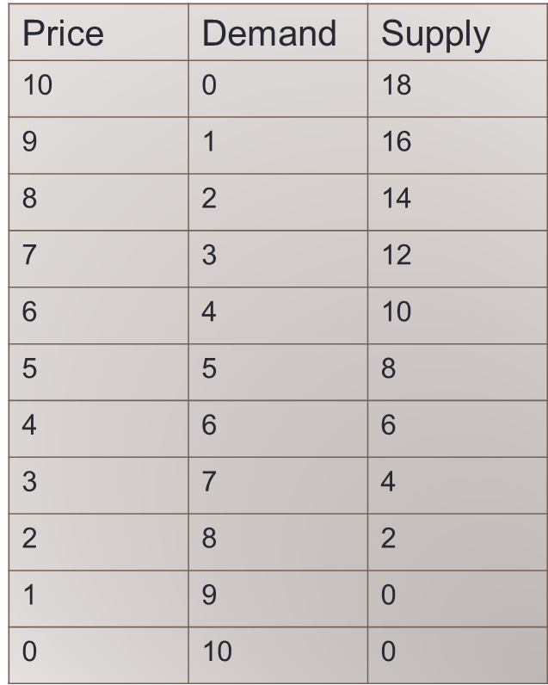


Deriving the Equations for Demand and Supply
Demand
  Intercept: at Q = 0, P=10
  Slope (ΔP/ΔQ)
  (-1)/(1) = -1
  Hence: P = 10-1×Q
Supply
  Intercept: at Q=0, P=1
  Slope (ΔP/ΔQ)
  (1)/(2) = 0.5
  Hence: P=1 +0.5×Q

Slide 9
Deriving the Equations for Demand and Supply
Price | Demand | Supply
10 | 0 | 18
9 | 1 | 16
8 | 2 | 14
7 | 3 | 12
6 | 4 | 10
5 | 5 | 8
4 | 6 | 6
3 | 7 | 4
2 | 8 | 2
1 | 9 | 0
0 | 10 | 0
Demand
  Intercept: at Q = 0, P=10
  Slope (ΔP/ΔQ)
  (-1)/(1) = -1
  Hence: P = 10-1×Q
Supply
  Intercept: at Q=0, P=1
  Slope (ΔP/ΔQ)
  (1)/(2) = 0.5
  Hence: P=1 +0.5×Q

Slide 10
Demand and Supply Curves
Price
10
Excess Supply at Price Above 4
Supply
4
E
Demand
1
Quantity
6
Excess Demand at Price Below 4

Slide 11
Computing the Market Equilibrium
Demand: P = 10 – 1Q
Supply: P = 1 +0.5Q
Market equilibrium
  Demand price = Supply price
  Quantity demanded = Quantity supplied
  10 -1Q = 1 + 0.5Q or 9 = 1.5Q
  Q = 9/1.5 = 6
  Demand (Supply) price at Q = 6
  P = 10 – 1 × 6 = $4

Slide 12
Excess Demand and Supply
At prices below the equilibrium level, quantity demanded exceeds quantity supplied
  ==> Upward pressure on prices
At prices above the equilibrium level, quantity supplied exceeds quantity demanded
  ==> Downward pressure on prices emerges
At the equilibrium, the market is in balance, and there is no incentive to change
Example: too many items sitting on eBay for a long time period leads suppliers to accept a lower price or to post a lower reserve price

Slide 13
Behind the Demand Curve
  What might cause a change in the demand relationship?
  What might shift the demand curve?
  The Prices of Related Goods
  Consumer Incomes
  Tastes and Networks
  Expectations

Slide 14
Behind the Demand Curve
Prices of Related Goods
  Complementary goods are consumed together
    If the price of one good increases, the demand for the other decreases
    Example: electronic readers and electronic books
  Substitute goods are consumed in lieu of each other
    If the price of one good increases, the demand for the other increases
    Examples: electronic books and paper books; or iphones and android phones

Slide 15
Behind the Demand Curve
Effects of Consumer Incomes
  As incomes rise, the demand for normal goods rises
    Most goods are normal:
    Examples: Restaurants; concerts; clothing
  As incomes rise, the demand for inferior goods falls
    Inferior goods are not necessarily of low quality:
    Examples: Laundromats; public transit

Slide 16


Behind the Demand Curve
Effects of tastes and fashions
  When goods or services become more popular, the demand expands:
  Example: Clothing of a particular style
Effects of price expectations
  If prices are expected to rise in the future, the demand expands today:
  Example: if we think gold will increase in price tomorrow we buy it today

Slide 17
Shifts in Demand Curve - Summary
A change in the prices of related goods, consumer incomes, consumer preferences or price expectations will each shift the demand curve
A change in price results in a move along the demand curve

Slide 18
Shifts in Demand Curve
A rise in consumer incomes implies that more is demanded at each price: D shifts to D₁
Price
S
P₁
E₁
Supply = Demand (E₀)
P₀
E₀
D₁
If price stayed at P₀ there
would be excess demand,
So, the market moves to a
new equilibrium at E₁.
D
Q₀
Q₁
Quantity
Notes:
See Sections 3-4 and 3-5 in the main text.

Slide 19
Shifts in Demand Curve
New Demand Curve. Suppose its new form is:
D₁: P = 13 – 1Q
Supply remains as: P = 1 + 0.5Q
Equating the two yields:
13 – 1Q = 1 + 0.5Q
13 – 1 = 1Q + 0.5Q
12 = 1.5Q
Q = 8
Therefore P = 13 – 1×8 = $5
As a result of demand increase, both the equilibrium quantity traded and the equilibrium price in the market increase

Slide 20
Behind the Supply Curve
Effect of technology
  An improvement expands the supply
Effect of input costs
  A rise in input costs contracts the supply
  A fall in input costs expands the supply
Effect of the number of suppliers
  The greater then number of firms, the greater the supply

Slide 21
Shifts in Supply Curve
New technology
Price
S
More will be supplied at
each price. S shifts to S₁
S₁
P₀
E₀
Supply = Demand (E₀)
P₁
E₁
If price stayed at P₀ there
would be excess supply
D
So, the market moves to a
new equilibrium at E₁.
Q₀
Q₁
Quantity
Notes:
See Sections 3-4 and 3-5 in the main text.

Slide 22
Simultaneous Shifts in Supply and Demand
Example 1…
Price of natural gas
Growth in the demand for energy over time
Technological developments in shale gas discovery and supply
Illustrated…

Slide 23
Simultaneous Shifts in Supply and Demand
Price
Initial equilibrium at E₀
Demand for gas grows
Supply increases due to new discoveries and technology
New equilibrium at E₁
P decreases, Q increases in this example
If the demand shift had been stronger and the supply shift weaker, price would have increased
S
D
E₀
P⁰
S¹
E₁
P¹
D¹
Quantity
Q⁰
Q¹

Slide 24
Simultaneous Shifts in Supply and Demand
Example 2…
A Model of the Housing Market
Was it primarily demand-side or supply-side forces that generated the observed price pattern?
Illustrated…

Slide 25
A Model of the Housing Market
Initial equilibrium in 1997
Vertical supply curve – means what?
Supply in 2002 is less than 1997
Demand was stronger due to higher incomes and lower mortgage rate
New equilibrium
Higher price in 2002, due to pressures on both sides of the market
S₂₀₀₂
S₁₉₉₇
300
E₂₀₀₂
D₂₀₀₂
E₁₉₉₇
D₁₉₉₇
200
50
75

Slide 26
Free Markets and Managed Markets
Price controls are government rules or laws that inhibit the adjustment of price to clear markets:
  Price ceilings
  Price floors
Quotas are physical restrictions on output

Slide 27
Price Ceilings as Rent Controls
Price ceiling is less than the equilibrium price
Price
S
A price ceiling succeeds in holding down the price but leads to excess demand
E₀
P₀
P^{c}
Excess Demand
D
Q^{c}
Q₀
Quantity

Slide 28
Price Floors as Minimum Wage
Price = wage
Price floor exceeds equilibrium price
S
Excess Supply
P^{f}
P₀
E₀
A minimum wage raises the hourly wage, but reduces the hours of work demanded and leads to excess supply
D
Quantity
Q^{f}
Q₀
Unemployment? Think of the impact of a less elastic supply curve

Slide 29
The Effect of a Quota
Equilibrium price is deemed too low to support agricultural producers, so government decides to restrict supply
Price
Supply under quota
S
P^{q}
A production quota reduces the supply
E₀
P₀
D
Q^{q}
Q₀
Quantity

Slide 30
Markets
The forces of supply and demand frequently work to offset or moderate the intended goal of the regulated price or quantity in ways that are predictable
“the law of unintended consequences”
states that policy measures frequently produce impacts that are unintended, and that these impacts may undermine the primary goal of the regulation
  Examples….

Slide 31
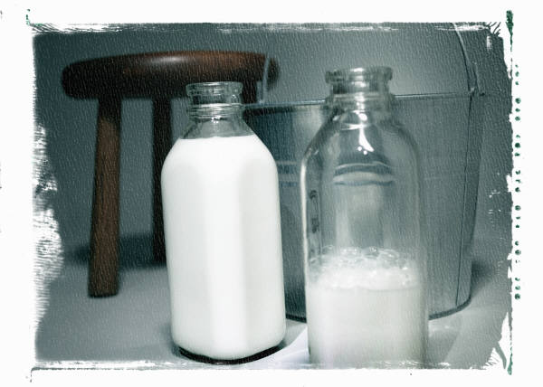
Law of Unintended Consequences
Example: Impact of a quota
Quotas are a way of reducing supply and increasing the price.
They are valuable to the individuals who have the right to them.
If the quotas are valuable, a market in quotas may develop – either legally or illegally.
In agriculture, the right to bring milk to market may be
worth $30,000 per cow

Slide 32
Summing Individual Decisions
At P₁ market demand Q₁ = Q_{A1} + Q_{B1}
At P₂ market demand Q₂ = Q_{A2} + Q_{B2}
D_{A}
D_{B}
Market demand is the horizontal summation of the individual demand curves
P₁
D_{market}
P₂
Q_{B1}
Q_{A1}
Q₁
Q₂
Q_{B2}
Q_{A2}

Slide 33

What, How and For Whom
The market determines
  How much of a good or service will be supplied
  For whom the goods and services are produced
  What goods and services are produced

Slide 34
Chapter Summary
Demand defines a relationship between price and quantity on the part of buyers.
Quantity demanded is the particular amount demanded at a given price
Supply defines a relationship between price and quantity on the part of suppliers.
Quantity supplied is the particular amount supplied at a given price
When price equates the quantity supplied and the quantity demanded, the market clears (in equilibrium)

Slide 35
Chapter Summary
Incomes, tastes, networks, and expectations shift the demand curve
A technological innovation or a reduction in input costs will shift/lower the supply curve
Supply and demand curves can shift simultaneously, resulting in a new market equilibrium
Managed markets can involve price ceilings, floors, and quotas
The Law of Unintended Consequences states that market controls may have consequences not envisaged or desired
Market demand is the horizontal sum of individual demands

