Slide 1
ENG 8404
Introduction to Structural Design
John Cochrane
Week 10
Notes:
Good afternoon, my name is John Cochrane and I will be your professor for Statics course ENG 8101 this semester. I work as an engineer in the Canadian Army and have attended university studying in Civil and Structural engineering. I have very little experience in the College environment.

Slide 2
Outline (Today’s class)
Review test #2a
Method of Virtual Work
Notes:
This is the outline for what we will be covering today in class. I have already introduced myself and would like to ask who you are and what program you are in and what do you expect to learn from this course? Where do you see this course relevance in your future work or studies? I will ask you at the end of this class if you could be prepared to tell me answers to these questions next week…ie think over what program you are in and in your words try and find out where this course fits in your program.

Slide 3
Test #2a Review

Slide 4
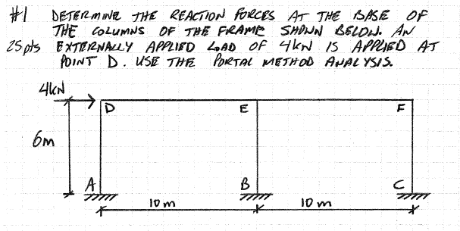

Slide 5
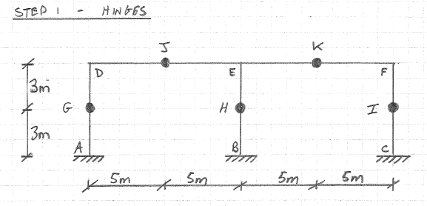

Slide 6
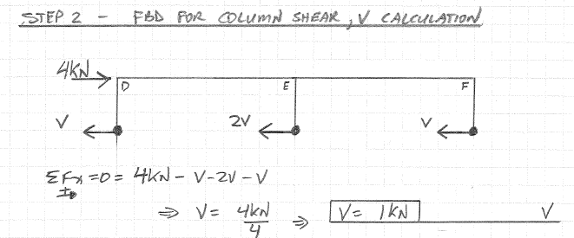

Slide 7
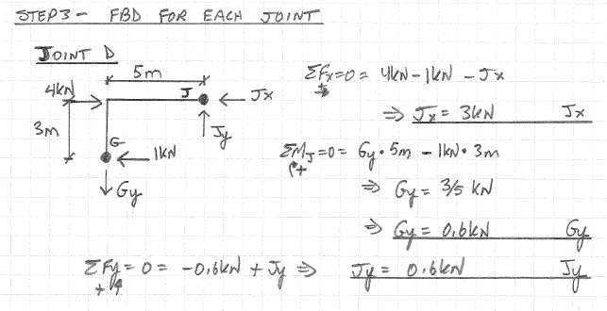

Slide 8
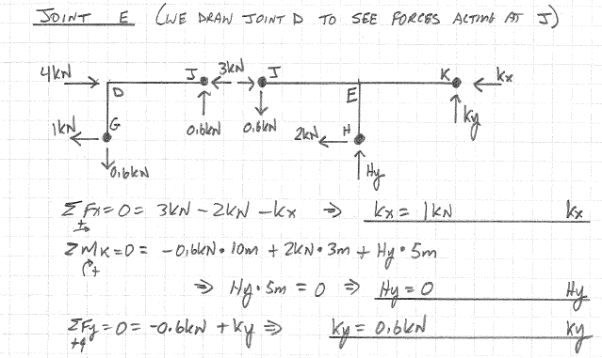

Slide 9
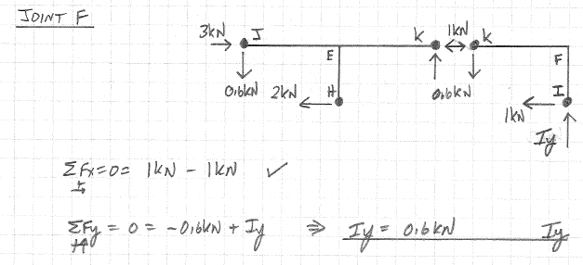

Slide 10
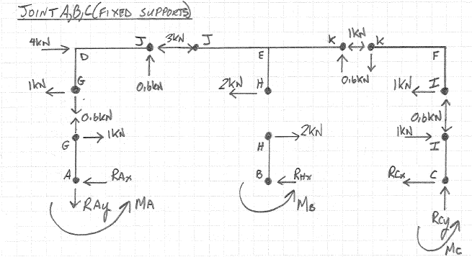

Slide 11
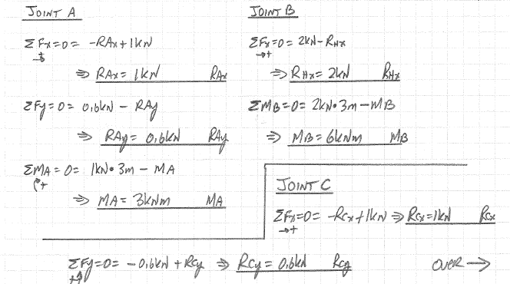

Slide 12
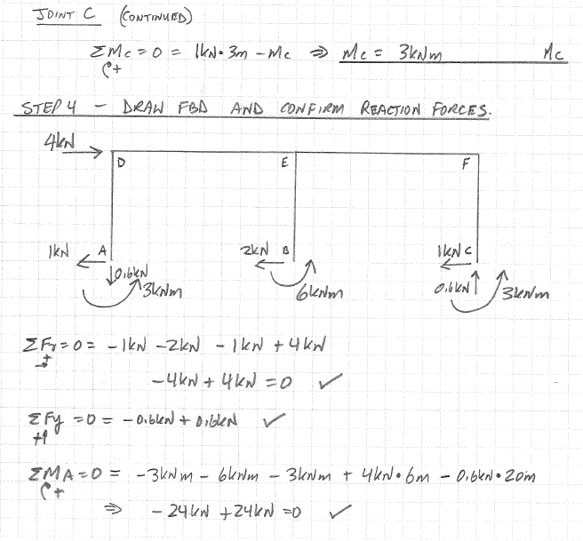

Slide 13
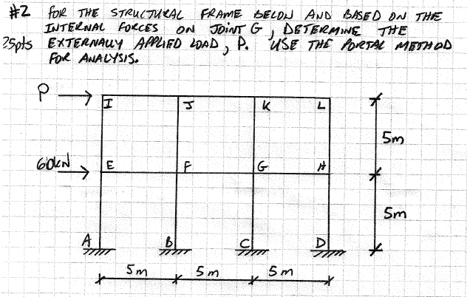

Slide 14
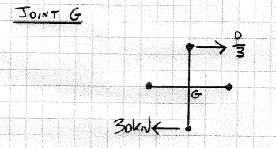

Slide 15
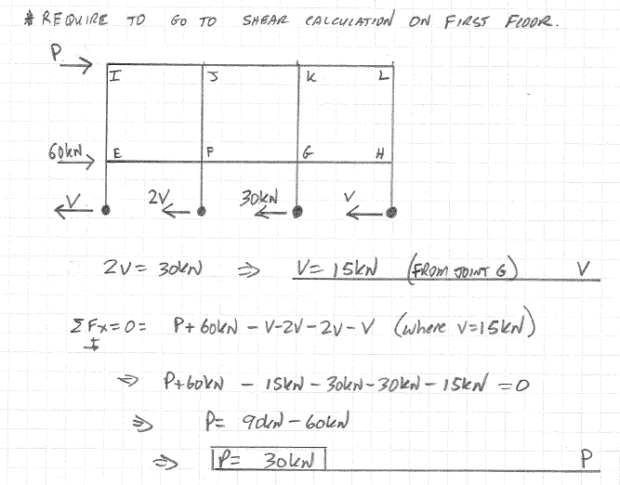

Slide 16
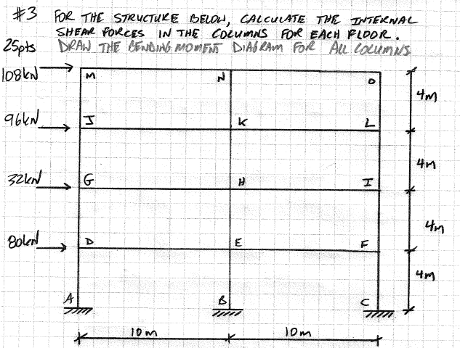

Slide 17
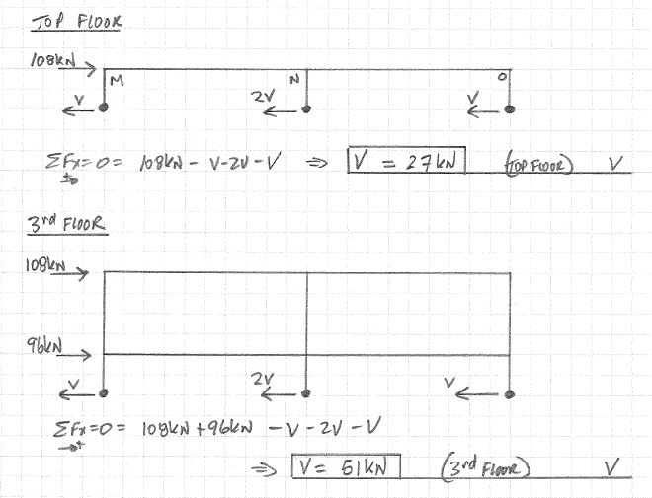

Slide 18
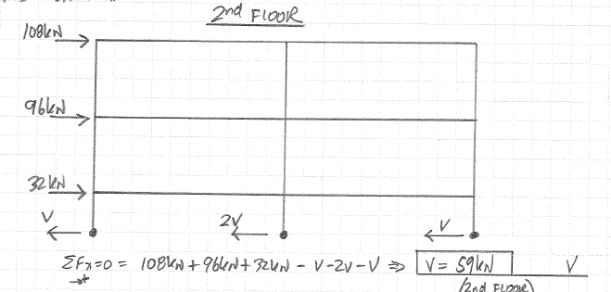

Slide 19
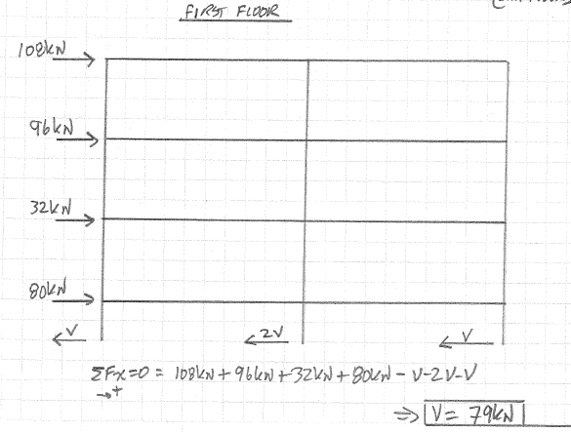

Slide 20
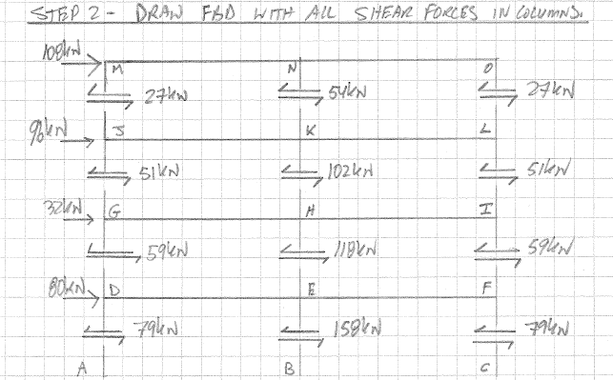

Slide 21
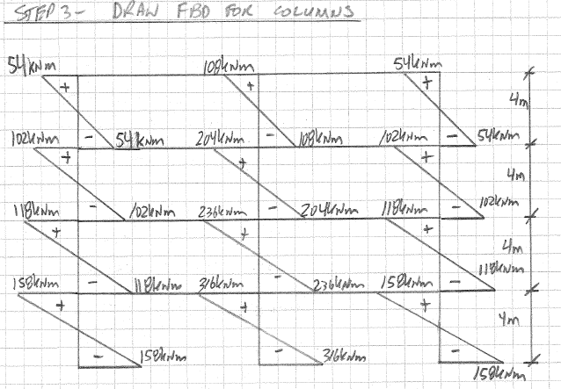

Slide 22
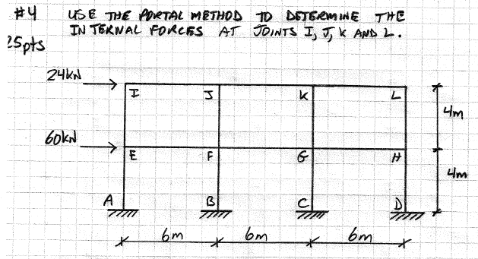

Slide 23
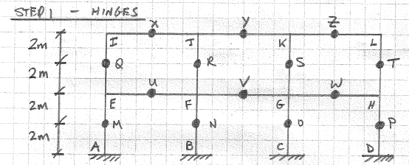
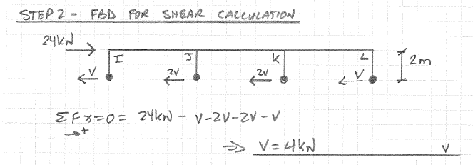

Slide 24
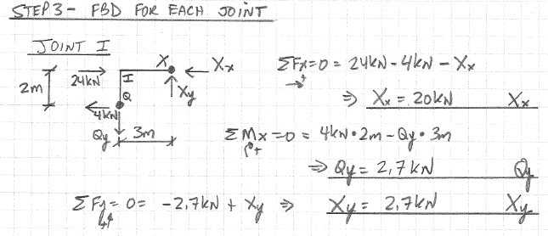

Slide 25
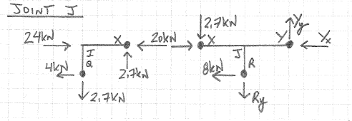
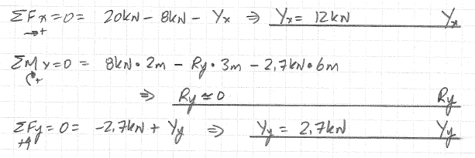

Slide 26
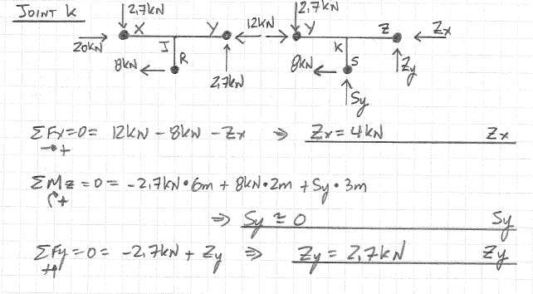

Slide 27
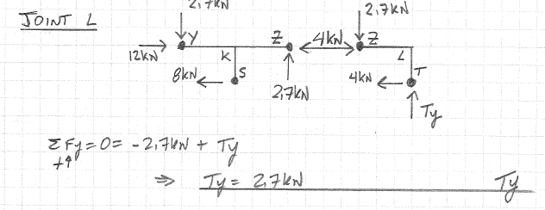

Slide 28
Method of Virtual Work

Slide 29
Virtual Work Method
Bernoulli 1717
Unit-load method
Obtain déplacement at a specific point on a structure
Our focus on truss

Slide 30
Virtual Work Method
Can be used for:
  External load
  Temperature change
  Fabrication errors
We will learn how to use with external loads
Work of External Loads = Work of Internal Loads
1 x Δ = Σu x dL

Slide 31
Real displacements
1 x Δ = Σu x dL
Virtual loadings

Slide 32
1 x Δ = Σu x dL
Show on stress/strain graph for elastic region
Σ
nNL
1 x Δ =
AE
External virtual unit load creates internal virtual forces n
Each member displaces NL/AE

Slide 33
Let’s start with looking at a truss

Slide 34
Animation
Hibbeler
..\..\..\..\..\..\..\..\..\Desktop\Hibbeler SA Videos 7th ed\Main_Menu_SA.exe

Slide 35
Virtual Work – Steps (truss)
Draw free body diagram
Calculate forces in members due to applied loads
Remove applied loads and apply virtual load at location of desired deflection
  If deflection is positive then it is in direction of virtual load
  if deflection is negative then it is in opposite direction of virtual load

Slide 36
Virtual Work – Steps (truss)
Calculate forces in members when virtual load is applied
Tabulate calculations
Determine deflection based on stress strain relationship of axial forces in members

Slide 37
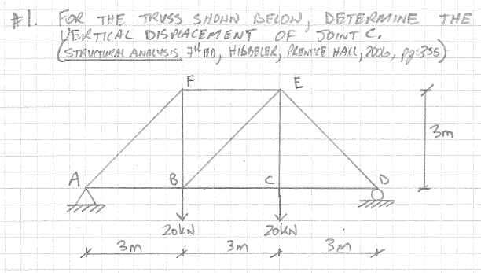


Slide 38
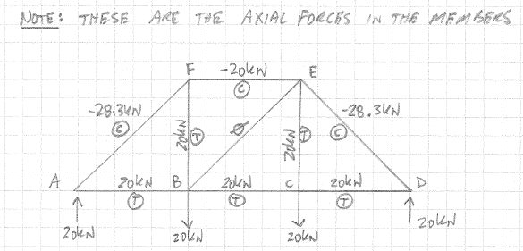

Slide 39
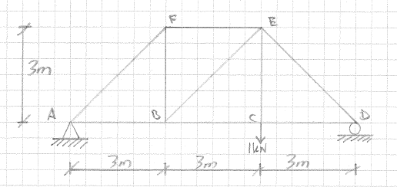

Slide 40
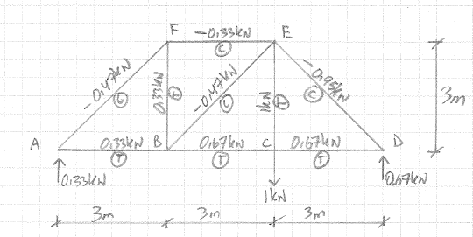

Slide 41
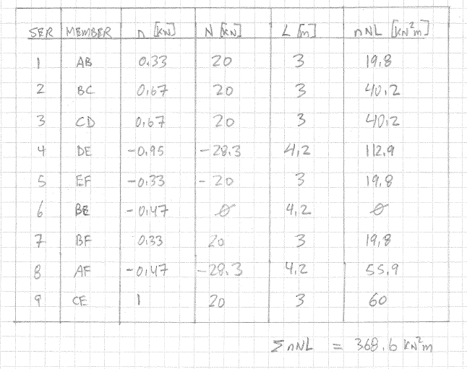

Slide 42
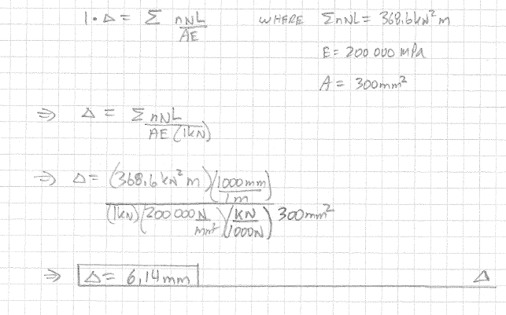

Slide 43
Work on
Example Problems 009 Virtual Work

Slide 44
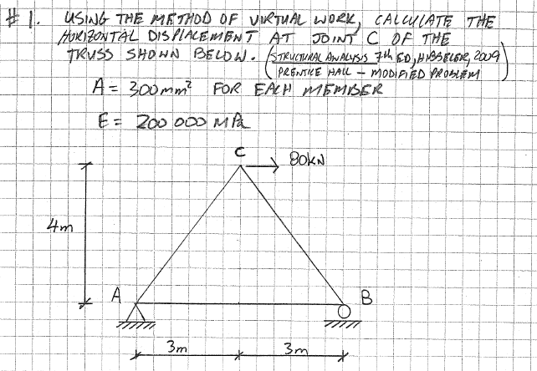

Slide 45
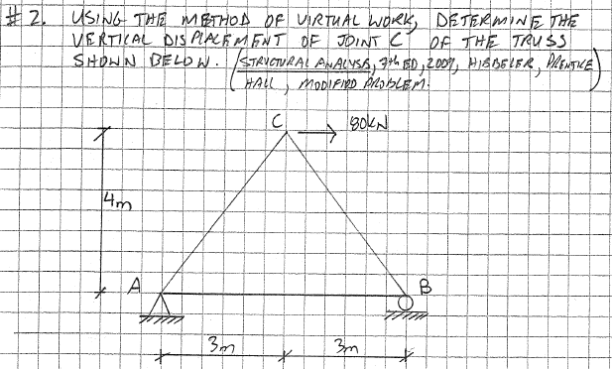

Slide 46
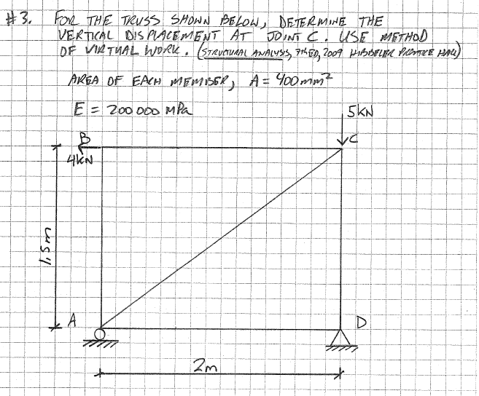

Slide 47
Redo this problem but use different member cross-sectional areas

Slide 48
Questions?
48
Notes:
2013-12-11
48
This is the outline for what we will be covering today in class. I have already introduced myself and would like to ask who you are and what program you are in and what do you expect to learn from this course? Where do you see this course relevance in your future work or studies? I will ask you at the end of this class if you could be prepared to tell me answers to these questions next week…ie think over what program you are in and in your words try and find out where this course fits in your program.

