Slide 1

Econ 203 Study Group
Date: 8.10.2015
Leader: Marina Antonova

Slide 2
Day | Time | Room
Mondays | 1:15 pm – 2:30 pm 4:15 pm – 5:30 pm | H-501 MB S2.285
Tuesdays | 10:15 am – 11:30 am 1:15 pm - 2:30 pm | H-523 H-540
Wednesdays | 8:45 am – 10:00 am 11:45 pm – 1:00 pm | H-609 H-621
Thursdays | 10:15 am – 11:30 am 2:45 pm – 4:00 pm | H-400-2 H-609
Fridays | 2:45 pm – 4:00 pm | H-565

Slide 3
Three main indicators of macroeconomics activity
Output
Price
Employment

Slide 4
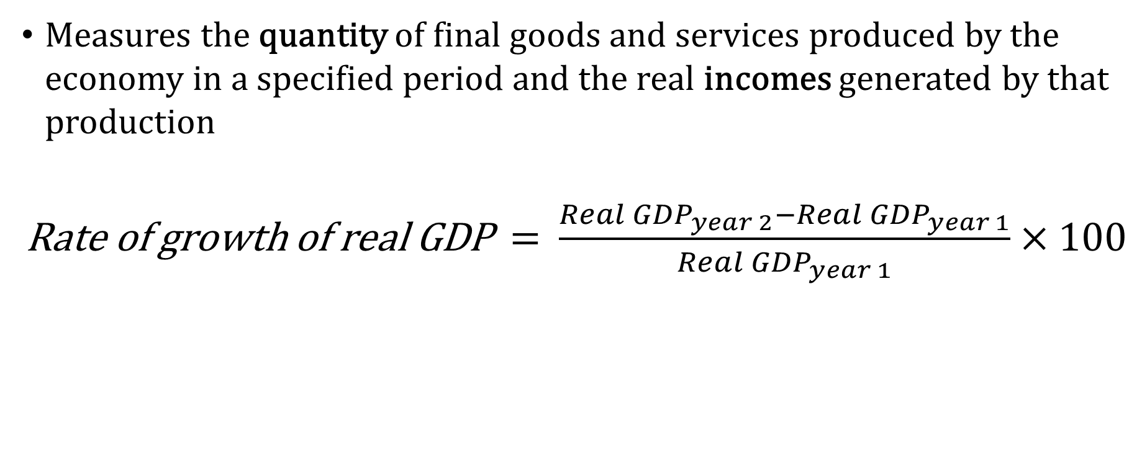
Real Gross Domestic Product ( real GDP)
Measures the quantity of final goods and services produced by the economy in a specified period and the real incomes generated by that production
Rate of growth of real GDP = $\frac{{Real GDP}_{year 2}−{Real GDP}_{year 1}}{{Real GDP}_{year 1}}×100$

Slide 5
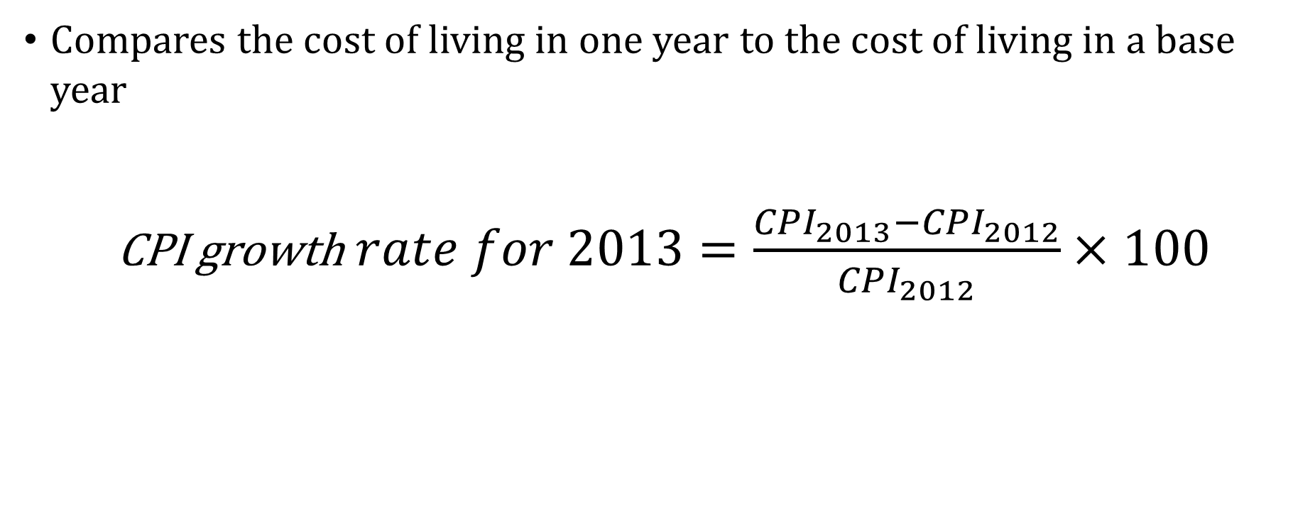
Consumer Price Index (CPI)
Compares the cost of living in one year to the cost of living in a base year
CPI growth$rate for 2013=\frac{{CPI}_{2013}−{CPI}_{2012}}{{CPI}_{2012}}×100$

Slide 6
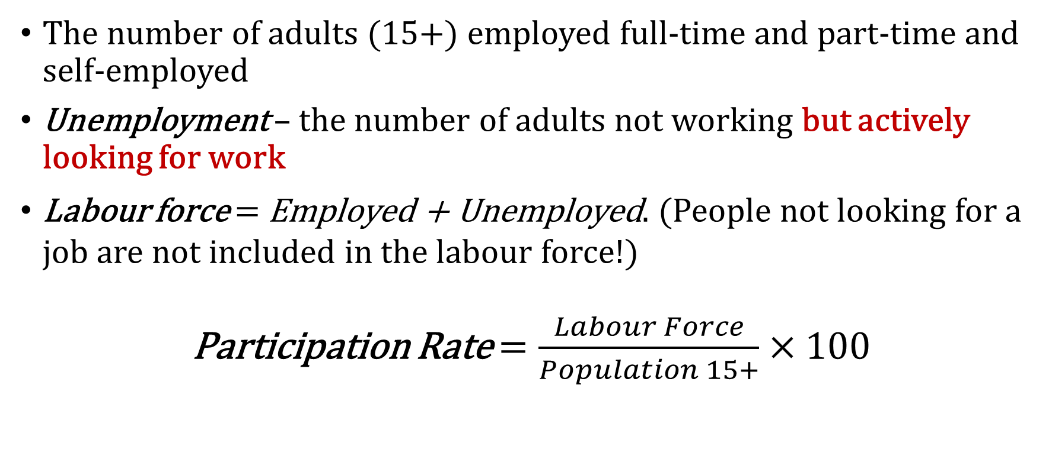
Employment
The number of adults (15+) employed full-time and part-time and self-employed
Unemployment – the number of adults not working but actively looking for work
Labour force = Employed + Unemployed. (People not looking for a job are not included in the labour force!)
Participation Rate $=\frac{Labour Force}{Population 15+}×100$

Slide 7
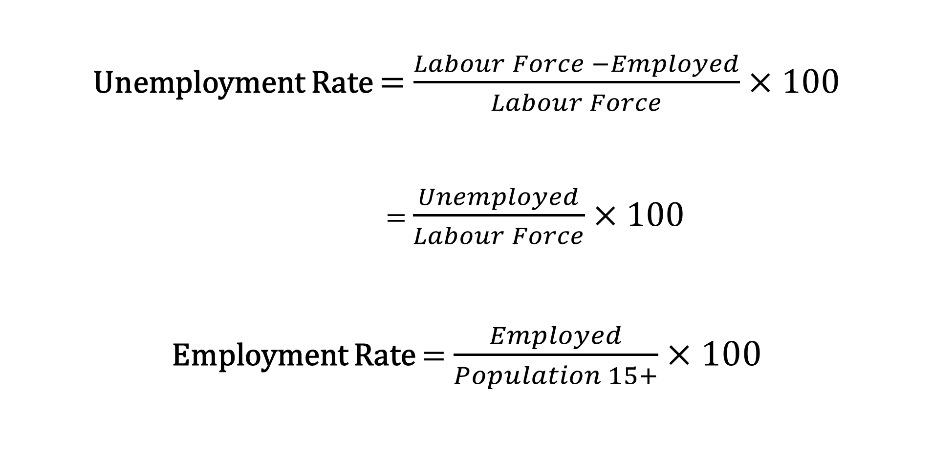
Employment
Unemployment Rate = $\frac{Labour Force −Employed}{Labour Force}×100$
= $\frac{Unemployed}{Labour Force}×100$
Employment Rate = $\frac{Employed}{Population 15+}×100$

Slide 8
Types of Unemployment
Cyclical
Frictional
Structural
In recent years in Canada, estimates of frictional and structural unemployment suggest a natural unemployment rate of about 6.0 %
Full-employment does not mean that unemployment rate = 0!
Make up the “full-employment” level of unemployment (natural unemployment rate)

Slide 9
Measuring GDP
Output-based GDP is the sum of value added (output less the cost of goods and services purchased from other business) by all industries in Canada;
Income-based GDP records the earnings generated by the production of goods and services;
Expenditure-based GDP is equal to expenditure on final goods and services produced.
Output-based GDP = Income-based GDP = Expenditure-based GDP

Slide 10
Output-based GDP
Value-added approach (difference between the market value of the output of the business and the cost of inputs purchased from other businesses)
Need to avoid double counting!
Example: A coffee shop sells 100 cups of coffee at a price of $1.50. To make 100 cups of coffee the shop uses 2 kilos of ground coffee costing $10.00 per kilo, 25 litres of pure spring water costing $0.40 a litre, and electricity and dairy products costing, in total $20. The coffee shop’s sales are $150 using inputs costing $50. Its value added is $150 - $50 = $100.

Slide 11
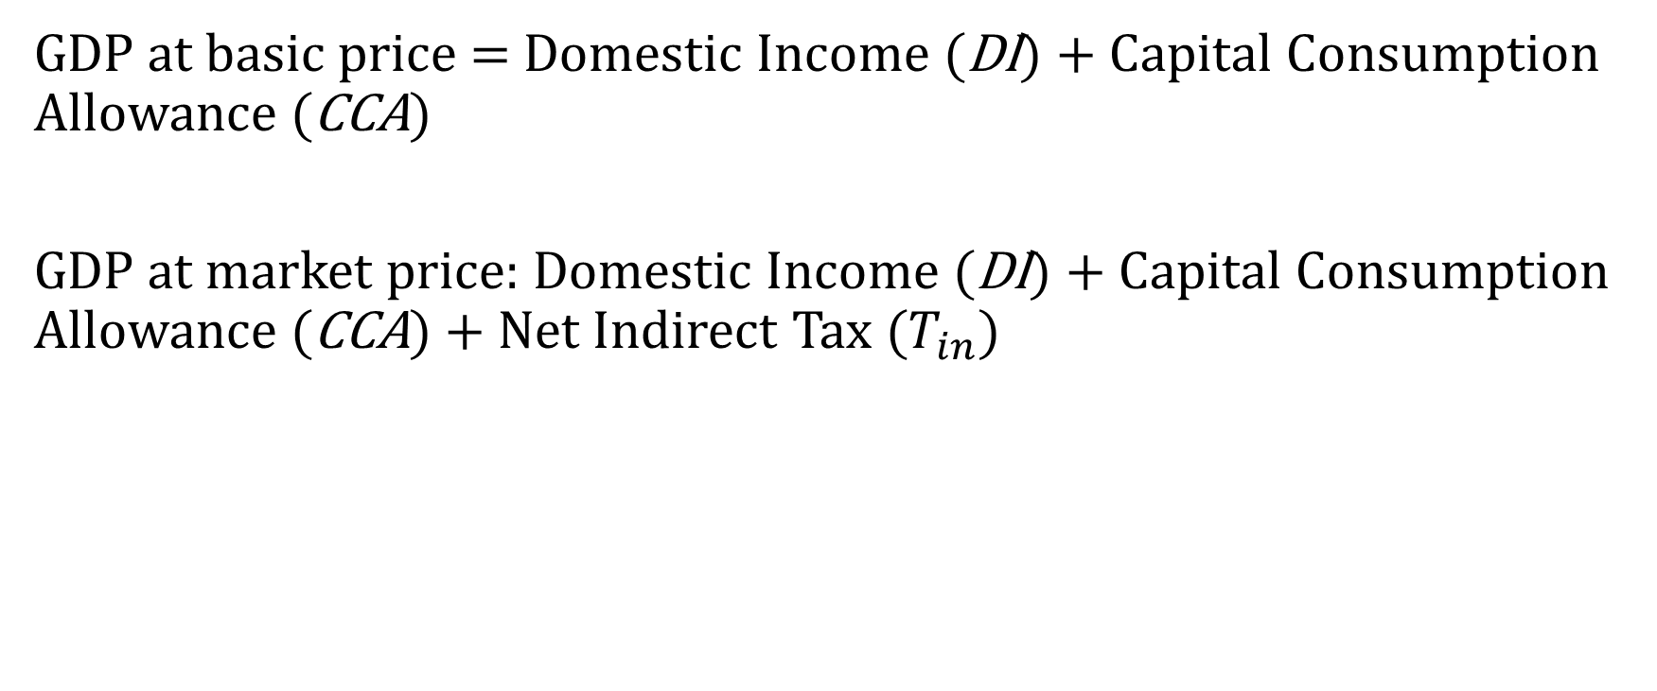
Income-based GDP
GDP at basic price = Domestic Income (DI) + Capital Consumption Allowance (CCA)
GDP at market price: Domestic Income (DI) + Capital Consumption Allowance (CCA) + Net Indirect Tax ($T_{in})$

Slide 12
Expenditure-based GDP
GDP = C + I + G + X - IM
Five main categories:
Consumption (C)
Investment (I)
Government Expenditure (G)
Exports (X)
Imports (IM)

Slide 13
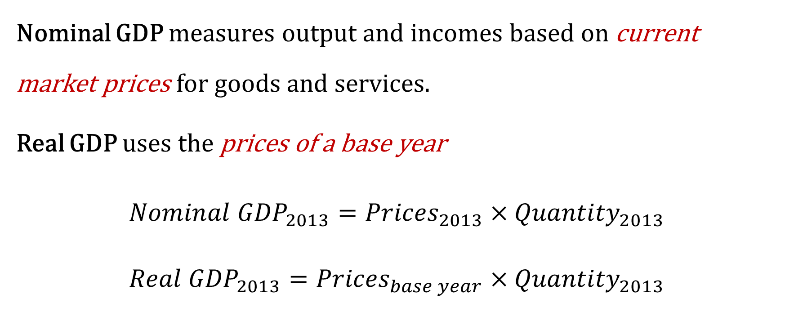
Nominal and Real GDP and the GDP Deflator
Nominal GDP measures output and incomes based on current market prices for goods and services.
Real GDP uses the prices of a base year
${Nominal GDP}_{2013}={Prices}_{2013}×{Quantity}_{2013}$
$${Real GDP}_{2013}={Prices}_{base year}×{Quantity}_{2013}$$

Slide 14
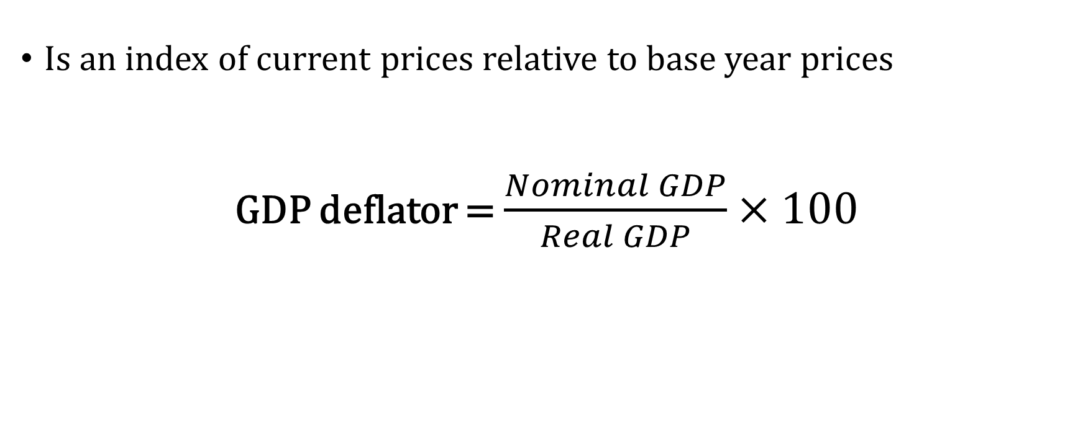
GDP deflator
Is an index of current prices relative to base year prices
GDP deflator = $\frac{Nominal GDP}{Real GDP}×100$

Slide 15
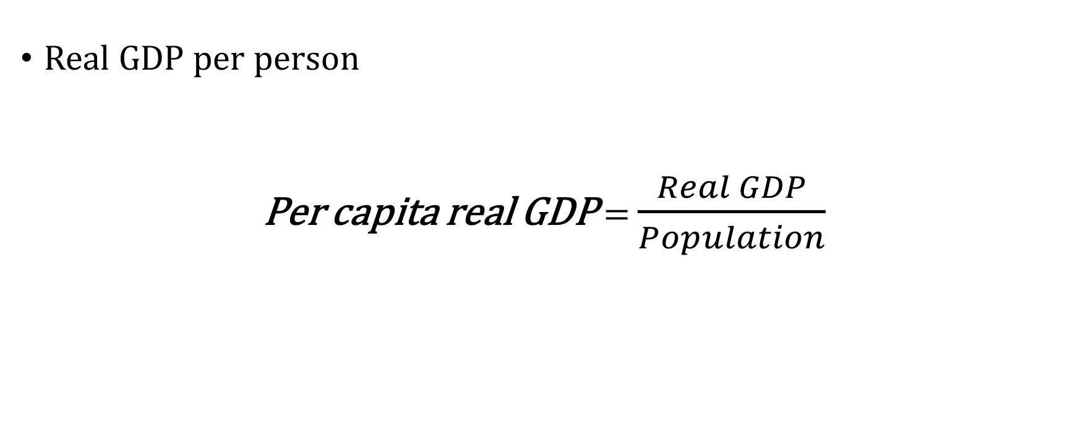
Per Capita Real GDP
Real GDP per person
Per capita real GDP = $\frac{Real GDP}{Population}$

Slide 16
MCQ
A bakery sells its monthly output for $26,000. It pays $12,000 in wages to its workers, $4,000 in rent and $4,000 to its suppliers for materials, such as flour, sugar and oil. Its profit is $6,000. What is the bakery’s value added?
$6,000.
$10,000.
$20,000.
$22,000.
None of the answers is correct

Slide 17
Answer
D) $22,000.

Slide 18
MCQ
In 2013, Pluto’s real gross domestic product (GDP) was $250 million. Plutonians earned $30 million on Mars and Martians earned $55 million on Pluto. What was Pluto’s gross national product (GNP)?
A) $15 million.
B) $225 million.
C) $275 million.
D) $305 million.
E) None of the answers is correct

Slide 19
Answer
B) $225 million.

Slide 20
MCQ
Nominal wages are currently $10 per hour and the consumer price index (CPI) is 105. Unions want a new nominal wage for next year so that its members can continue to afford the same goods and services that they can buy now. If the union accepts a nominal wage of $12 per hour, it believes next year’s CPI will be at most…
126.
130.
133.
138.

Slide 21
Answer
A) 126.

Slide 22
MCQ
In 1981, total output in a single-good economy was 23,946 cars, each priced at $23,128. In 1985, 14,828 cars were purchased at a price per car of $7,534. Assume that 1981 is the base year.
What is the value of the GDP deflator in 1985?
A) 22.34.
B) 32.58.
C) 43.70.
D) 102.35
E) 115.20.

Slide 23
Answer
B) 32.58.

Slide 24
MCQ
In 1981, total output in a single-good economy was 23,946 cars, each priced at $23,128. In 1985, 14,828 cars were purchased at a price per car of $7,534. Assume that 1981 is the base year.
What is the real GDP growth rate between 1981 and 1985?
A) 8.55 percent.
B) 12.35 percent.
C) -17.50 percent.
D) -38.08 percent.
E) -79.83 percent.

Slide 25
Answer
D) -38.08 percent.

Slide 26
Steel Company |  | Lobster Company |  | Car Company
Revenues from sales | $400 | Revenues from sales | $200 | Revenues from sales | $1000
Expenses |  | Expenses |  | Expenses
Wages | $200 | Wages | $100 | Wages | $600
 |  |  |  | Steel purchases | $460
Profits | $80 | Profits | $45 | Profits | $115
According to the income approach, the GDP of this economy is ___

Slide 27
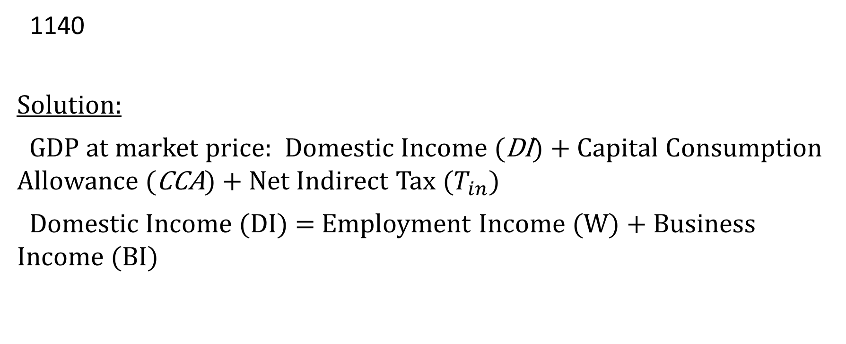
Answer
1140
Solution:
GDP at market price: Domestic Income (DI) + Capital Consumption Allowance (CCA) + Net Indirect Tax ($T_{in})$
Domestic Income (DI) = Employment Income (W) + Business Income (BI)

Slide 28
Suppose production and prices of pizzas and calzones in 1997 and 2013 are as follows:
Year Q of pizzas P of pizzas Q of calzones P of calzones
2003 25 $5 25 $5
2013 100 $10 50 $10
What are the values of nominal GDP for 2003 and 2013, respectively?
A. $250; $1,500.
B. $250; $750.
C. $500; $1,500.
D. None of the answers is correct.

Slide 29
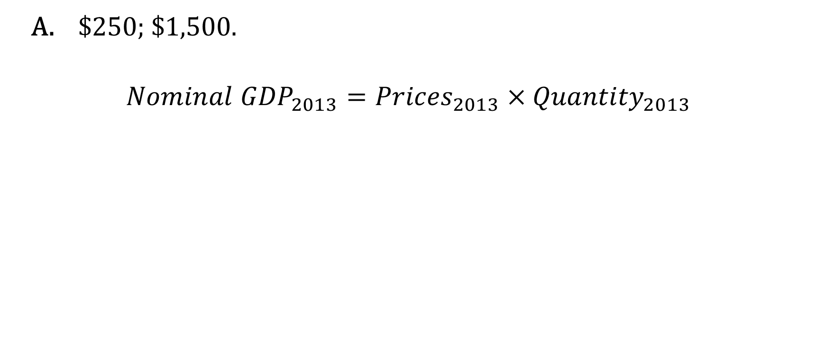
Answer
A. $250; $1,500.
$${Nominal GDP}_{2013}={Prices}_{2013}×{Quantity}_{2013}$$

Slide 30
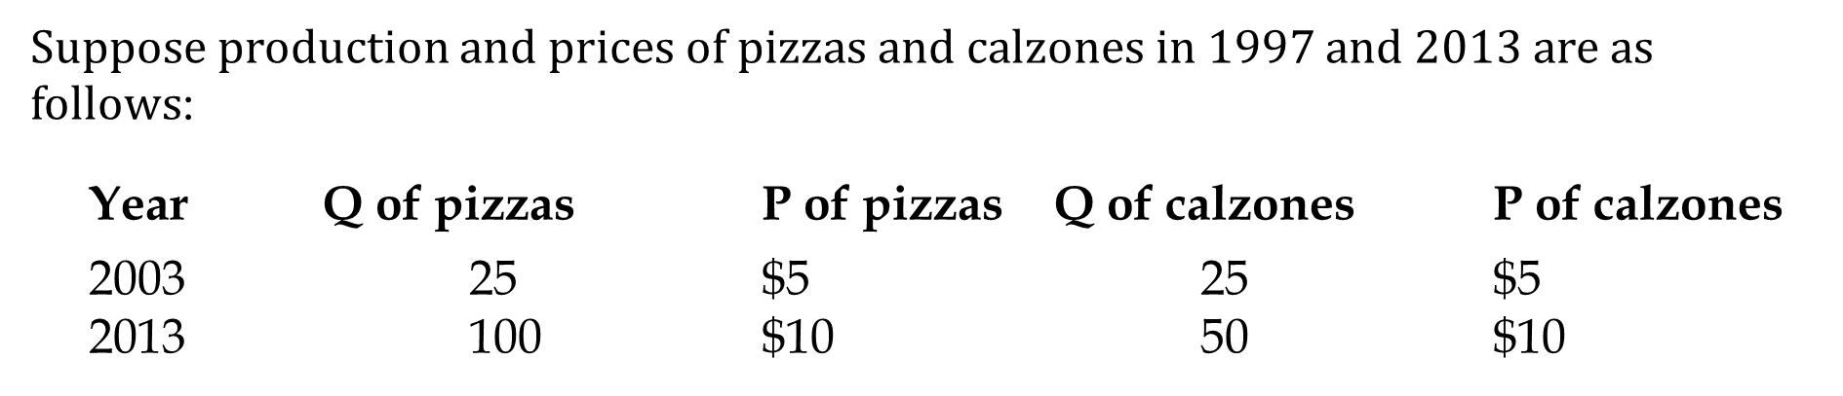
Assume that 2003 is the base year. What are the values of real GDP for 2003 and 2013, respectively?
A. $250; $1,500.
B. $250; $750.
C. $500; $1,500.
D. None of the answers is correct.

Slide 31
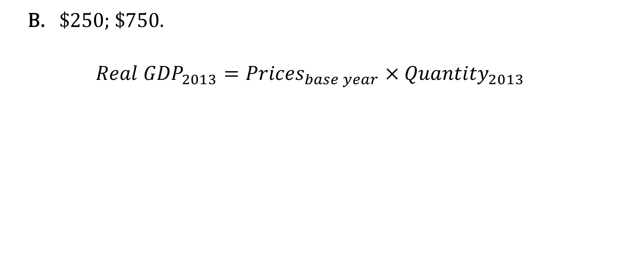
Answer
B. $250; $750.
$${Real GDP}_{2013}={Prices}_{base year}×{Quantity}_{2013}$$

Slide 32
MCQ
Suppose that for the year 2005, a company spends $200 million on intermediate goods and $400 million on wages, with no other expenses. Also assume that its total sales are $700 million. The value added by this company is:
A. $300 million.
B. $500 million.
C. $800 million
D. $700 million.

Slide 33
Answer
B. $500 million.

Slide 34
Suppose there is an economy that produces only four goods in one year.
Paper: $7,000
Books: $14,000
Toner: $3,500
Envelopes: $5,000
The production of books requires the following amount of intermediate goods:
Paper: $2,000
Toner: $2,000
The production of envelopes requires the following amount of intermediate goods:
Paper: $3,500
(i) Find the total GDP for the economy.

Slide 35
Answer
Sales - Value of intermediate goods= 7000+14000+3500+5000 – (2000+2000+3500)= 22000

Slide 36
Paper: $7,000
Books: $14,000
Toner: $3,500
Envelopes: $5,000
The production of books requires the following amount of intermediate goods:
Paper: $2,000
Toner: $2,000
The production of envelopes requires the following amount of intermediate goods:
Paper: $3,500
(ii) Find the value of paper and toner sold as a final good.

Slide 37
Answer
Intermediate paper= 2000+3500= 5500
Paper as a final good= 7000-5500=1500
Intermediate toner=2000
Toner as a final good=3500-2000=1500

Slide 38
Assume that 2010 is the base year.
Year Pa Pb Qa Qb
2010 10 5 100 100
2011 12 6 120 120
What was the GDP deflator for the year 2011?
A) 120.
B) 144.
C) 155.
D) 160.
E) None of the answers is correct.

Slide 39
Answer
A) 120.

Slide 40
Assume that 2010 is the base year.
Year Pa Pb Qa Qb
2010 10 5 100 100
2011 12 6 120 120
What was the 2011 inflation rate?
A) 20.
B) 44.
C) 55.
D) 60.
E) None of the answers is correct.

Slide 41
Answer
A) 20.

Slide 42
Continue with the previous question: If your hourly nominal wage in 2010 was $11, what hourly nominal wage will you ask for in 2011 if you want to maintain the same standard of living, that is, to have the same real wage?
A) $10.0.
B) $12.0.
C) $13.2.
D) $15.5.
E) None of the answers is correct.

Slide 43
Answer
C) $13.2.

Slide 44
Inflation rate 2005-2006 = 20%
Inflation rate 2006-2007 = 15.13%
Inflation affects lenders and borrowers. Suppose the Canadian borrowers borrowed $1,000 from the Canadian lenders on December 31, 2005 and promised to pay back $1,300 on December 31, 2006.
(a) Find the real interest rate
(b) Do the creditors gain or lose from this transaction? Explain briefly

Slide 45
Answer
$1300 versus $1000, this is a 30% nominal interest. Real interest=30%-20%=10%.
They gain because they get paid $300, but it only costs them $200 more to buy the same goods and services

Slide 46
MCQ
Suppose the population of Canada is 3,400. Of all adult Canadians, 2,760 were employed, 240 were unemployed, and 150 were not in the labour force.
How many Canadians are under the age of 15?
What is the unemployment rate?
(iii) Assume that 50 of the previously retired workers are now looking for work. Find the new unemployment rate in Canada

Slide 47
Answer
250
8%
9.51%

Slide 48
Basic AD/AS Model
Aggregate Demand (AD) is planned Aggregate Expenditure (AE) on final goods and services (C + I + G + X - IM) at different price levels when all other conditions are constant.
Aggregate Supply (AS) is the output of final goods and services business produces at different price levels when other conditions are constant.
Price Level
AS
P
AD
Y
GDP

Slide 49
Aggregate Demand Curve
The AD curve shows planned expenditures at different aggregate price levels all things other than price held constant.
A change in the price level causes movement along the AD curve (not shift!!!) as from A to B if price falls from from P to P’
Price Level
P
A
P’
B
AD
Y
Y’
GDP

Slide 50
Aggregate Supply Curve
Price Level
A change in the price level causes movement along the AS curve (not shift!!!) as from A to B if price falls from from P to P’
AS
B
P’
A
P
Y
Y’
GDP

Slide 51
Inflationary Gap
Y – Yp > 0 → Inflationary Gap
Price Level
AS
Inflationary gaps reduce standards of living. They push up the price level, raising the cost of living. People on fixed money incomes suffer a reduction in their standards of living
AD
Yp
Y
GDP

Slide 52
Self-Adjustment Process to the Inflationary Gap
AS’
Low unemployment raises wage rates and costs. AS shifts up.
Price Level
AS
This adjustment process assumes that the AD curve is not changed by the fall in wage rates that shifts the AS curve.
AD
Yp
Y
GDP

Slide 53
Recessionary Gap
Y – Yp < 0 → Recessionary Gap
Price Level
AS
Recessionary gaps reduce the standard of living in the economy by reducing employment, real GDP, and per capita real GDP.
AD
Y
Yp
GDP

Slide 54
Self-Adjustment Process to the Recessionary Gap
High unemployment lowers wage rates and costs → AS shifts down
Price Level
AS
AS’
AD
Y
Yp
GDP

Slide 55
Government Intervention
Government has policies it can use to reduce or eliminate output gaps.
Fiscal policy: government expenditure (G) and tax changes designed to influence AD.
Monetary policy: changes in interest rates (i) and money supply (MS) designed to influence AD.
Both fiscal and monetary policy work to change aggregate demand (AD)

Slide 56
Government Intervention
Price Level
AS
Increase G, MS,
Decrease i, T
AD’
AD
Y
Yp
GDP

Slide 57
The Canadian economy was operating at Y=Yp before the following events took place.
WASHINGTON — U.S. Treasury Secretary Henry Paulson and Federal Reserve Board chief Ben Bernanke have acknowledged the housing slump isn't nearly over, rekindling economic gloom on Wall Street. In his starkest take yet on the housing and credit mess, Mr. Paulson called the situation “troubling” and warned the crisis would take “some time yet” to ease.
“Despite strong economic fundamentals, the housing decline is still unfolding, and I view it as the most significant risk to our economy,” Mr. Paulson said Tuesday in speech at Georgetown University in Washington. Mr. Bernanke likewise predicted the housing slump would be a “significant drag” on the economy into next year. He said it would take time for Wall Street banks to work through the credit crunch.

Slide 58
Given Article 1, and the fact that the US is our main trading partner, use the Y=AE and AD/AS/LAS diagrams to illustrate how Canada’s economy will be affected in the short run. Explain in words which curves would shift and why. How would the unemployment rate and inflation rate be affected? Explain

Slide 59
« Finance Minister Jim Flaherty said in an interview that Canada’s unemployment rate is too high and his government will try and do better at getting Canadians working again as part of commitments made by Group of 20 countries at a summit over the weekend. »
Explain what impact would this have on the three main macroeconomic indicators. Start by defining the indicators to which you are referring, and support your answer by showing the changes in the AD-AS graph.

Slide 60
This article emphasizes the necessity to bring the unemployment rate at its natural level.
The economy is not producing at Y potential, as the unemployment rate is too high. The effect of the Finance Minster promise are the following :
- decrease unemployment rate, by using monetary or fiscal policy (the AD curve shifts upward)
- Therefore the level of output (or income) is higher
- This put pressure on the market prices, leading to higher inflation.

Slide 61
Assume that the economy is currently in a recession phase due to a weaker AD. In the absence of government or central bank intervention, the self-adjustment mechanisms will lead to
A) Lower input prices, a leftward shift in the AS curve, and a rightward shift in the AD curve until Y=Yp.
B) Lower input prices, a rightward shift in the AS curve, and downward movements along the given AD curve until Y=Yp.
C) Lower input prices, no shift in the AS curve, a rightward shift in the AD curve until Y=Yp.
D) Deflation, no change in input prices or the AS curve, a leftward shift in the AD curve until Y=Yp.
E) A persistent recessionary gap that will never narrow.

Slide 62
MCQ
B) Lower input prices, a rightward shift in the AS curve, and downward movements along the given AD curve until Y=Yp.

Slide 63
MCQ
The potential output line shows:
A) that maximum sustainable output that can be produced from the existing set of inputs.
B) the maximum output that can be produced based on existing aggregate demand.
C) the maximum sustainable output that can be produced at the current price level.
D) the maximum output that can be produced when markets are quantity adjusting.

Slide 64
Answer
A) that maximum sustainable output that can be produced from the existing set of inputs

Slide 65
MCQ
The interest-rate effect suggests that:
A) a decrease in the supply of money will increase interest rates and reduce interest-sensitive consumption and investment spending.
B) an increase in the price level will increase the demand for money, reduce interest rates, and decrease consumption and investment spending.
C) an increase in the price level will increase the demand for money, increase interest rates, and decrease consumption and investment spending.
D) an increase in the price level will decrease the demand for money, reduce interest rates, and increase consumption and investment spending.

Slide 66
Answer
C) an increase in the price level will increase the demand for money, increase interest rates, and decrease consumption and investment spending.

Slide 67
MCQ
Which one of the following would not shift the aggregate demand curve?
A) a change in the price level.
B) depreciation of the international value of the dollar.
C) a decline in the interest rate at each possible price level.
D) an increase in personal income tax rates.

Slide 68
Answer
A) a change in the price level

Slide 69
MCQ
Suppose that nominal wages fall and productivity rises in a particular economy. Other things equal, the aggregate:
A) demand curve will shift leftward.
B) supply curve will shift rightward.
C) supply curve will shift leftward.
D) expenditures curve will shift downward.

Slide 70
Answer
B) supply curve will shift rightward

Slide 71
MCQ
Other things equal, serious recessions in Canada's trading partners will:
A) have no perceptible impact on the Canadian economy.
B) cause inflation in the Canadian economy.
C) depress real output and employment in the Canadian economy.
D) stimulate real output and employment in the Canadian economy.

Slide 72
Answer
C) depress real output and employment in the Canadian economy

Slide 73
MCQ
An inflationary gap is characterized by:
A) constant prices.
B) AD greater than AS at potential real GDP.
C) falling prices.
D) amount by which price level should increase to increase the total output level.

Slide 74
Answer
B) AD greater than AS at potential real GDP

Slide 75
MCQ
Other things being equal, a reorganization of the OPEC cartel to permit it to increase world oil prices by 70 percent would most likely have which effect?
A) It would shift the aggregate demand curve right.
B) It would shift the aggregate supply curve right.
C) It would shift the aggregate supply curve up.
D) It would shift the aggregate demand curve right and the aggregate supply curve up.

Slide 76
Answer
C) It would shift the aggregate supply curve up.

Slide 77
MCQ
In the short run with fixed wages and prices:
A) equilibrium real GDP is determined by aggregate demand.
B) equilibrium real GDP is determined by aggregate supply.
C) labour and the productive capacity of firms are always fully employed.
D) equilibrium real GDP is a fixed amount and will not change.

Slide 78
Answer
A) equilibrium real GDP is determined by aggregate demand.

Slide 79
MCQ
The Aggregate Demand curve is downward sloping in part because:
Of the net export effect
Higher price levels lower incentives for consumers to buy goods
Higher interest rates make it more expensive to borrow money
Higher price levels create incentives to expand output

Slide 80
Answer
b) Higher price levels lower incentives for consumers to buy goods

Slide 81


The graph shows the relationship between planned aggregate expenditure and income when the price level is fixed. It also shows that, if the aggregate expenditure function (AE) has the right position and slope, there is a level of output at which planned expenditure and output are equal. This equality between planned expenditure and output determines the position of the AD curve.
AE
Y=AE
AE
E’
$$A_{0}$$
45”
$$Y_{0}$$
Real GDP

Slide 82
Consumption, Saving, and Investment
Aggregate expenditure is the sum of planned consumption expenditure by households, investment expenditure by business, and expenditure by residents of other countries on exports of domestic output, minus the imports contained in all these planned expenditures on goods and services.
AE = C + I + G + X - IM

Slide 83
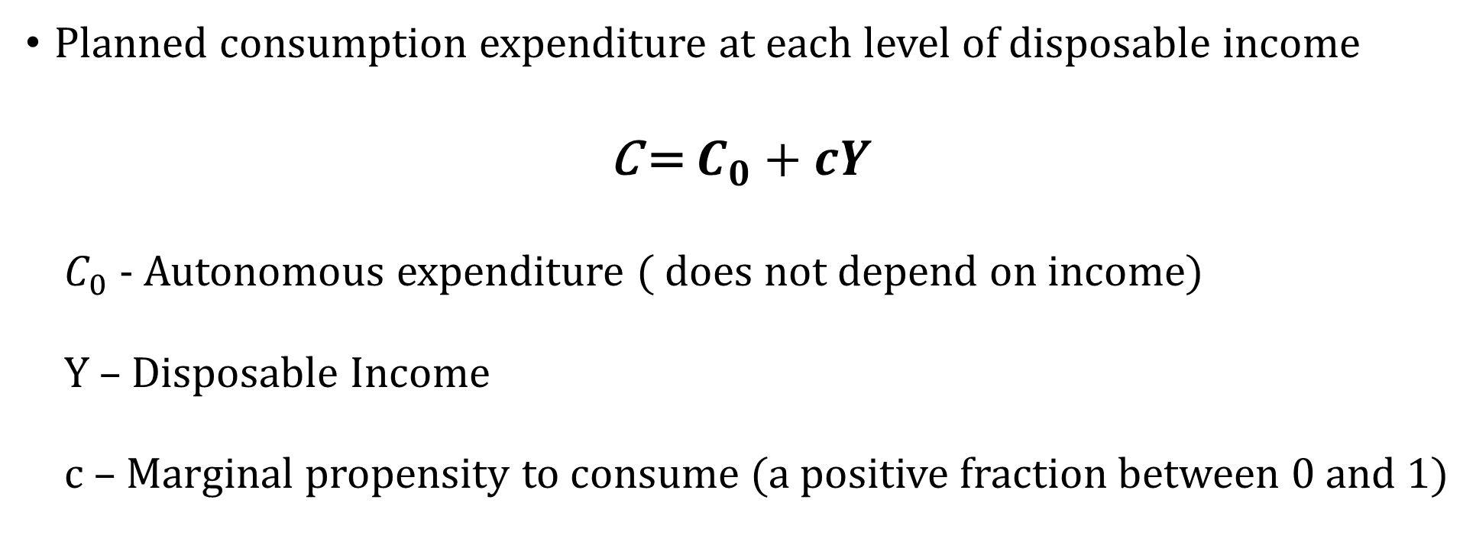
Consumption Function
Planned consumption expenditure at each level of disposable income
C = $C_{0}+cY$
$C_{0}$ - Autonomous expenditure ( does not depend on income)
Y – Disposable Income
c – Marginal propensity to consume (a positive fraction between 0 and 1)

Slide 84
Marginal Propensity to Consume (MPC)
MPC = $\frac{∆C}{∆Y}$
The MPC is the change in consumption expenditure caused by a change in income (also called induced expenditure)
MPC is the slope of consumption function

Slide 85
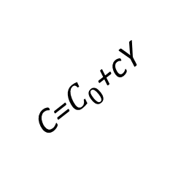


C
C=$C_{0}$+cY
$$C_{1}$$
$$C_{0}$$
$$Y_{1}$$
Real GDP

Slide 86
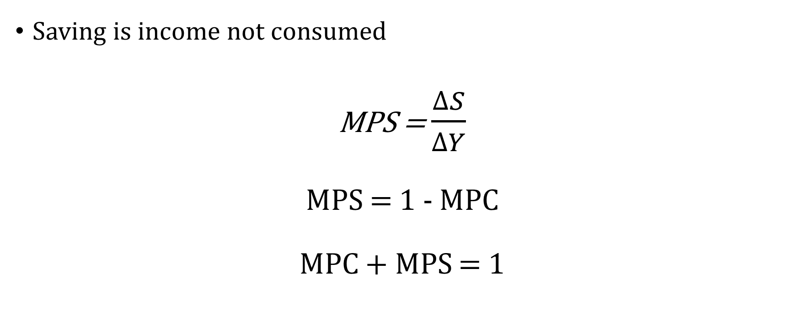
Saving, Marginal Propensity to Save ( MPS )
Saving is income not consumed
MPS = $\frac{∆S}{∆Y}$
MPS = 1 - MPC
MPC + MPS = 1

Slide 87

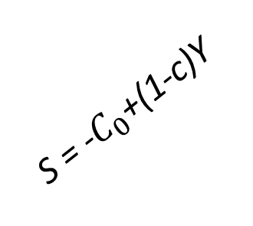
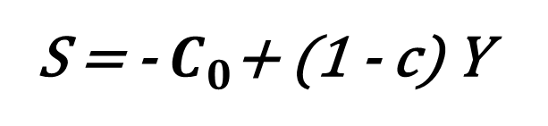


The Saving Function
S
S = -$C_{0}$+(1-c)Y
S = -${ C}_{0}$+ (1 - c) Y
$$S_{1}$$
$$Y_{1}$$
Real GDP
$${−C}_{0}$$

Slide 88


Investment Function
I
Planned investment expenditure is independent of current GDP. A change in the interest rate would shift the I line.
I = $I_{0}−{bi}_{0}$
$$I_{1}$$
Real GDP

Slide 89
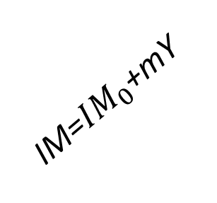
Exports and Imports
X, IM
IM=${IM}_{0}$+mY
X=X0
Real GDP

Slide 90





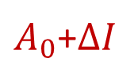
The Multiplier
A rise in investment (∆I) shifts AE up. Equilibrium GDP (Y) rises by a larger amount
Y=AE
AE
E’
AE’
AE
E
$A_{0}$+$∆I$
$$∆I$$
$$A_{0}$$
$$∆Y$$
45”
$$Y_{e}$$
$$Y_{e}′$$
Real GDP

Slide 91
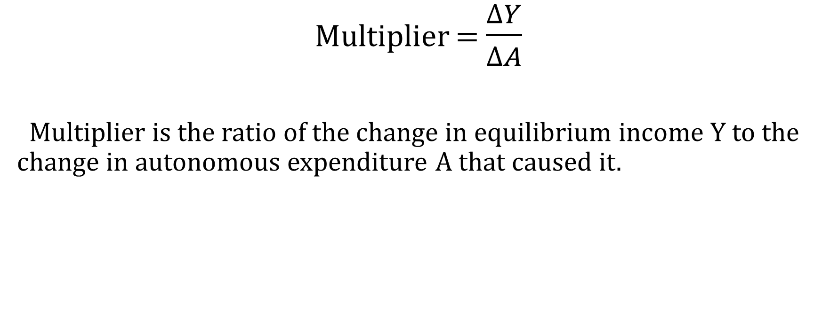
The Multiplier
Multiplier = $\frac{∆Y}{∆A}$
Multiplier is the ratio of the change in equilibrium income Y to the change in autonomous expenditure A that caused it.

Slide 92
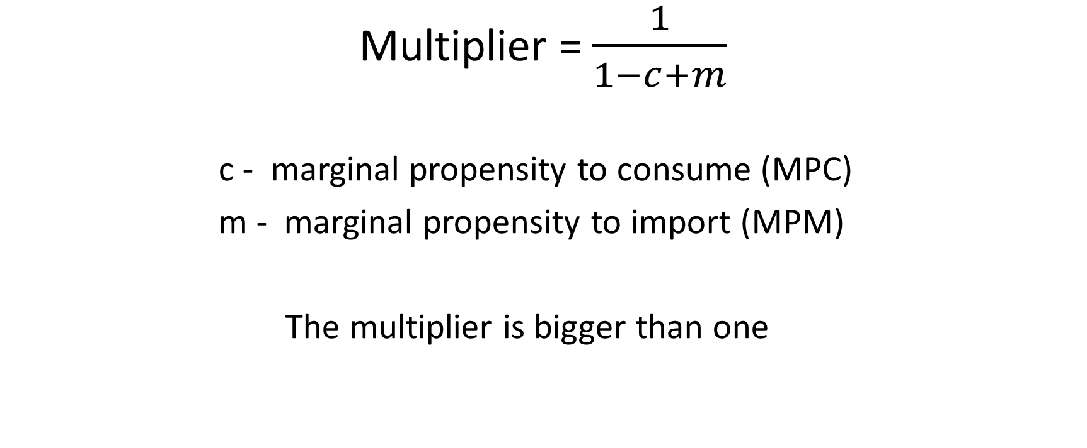
The Size of the Multiplier
Multiplier = $\frac{1}{1−c+m}$
c - marginal propensity to consume (MPC)
m - marginal propensity to import (MPM)
The multiplier is bigger than one

Slide 93








Equilibrium Output and Aggregate Demand
Y=AE
AE
E’
AE’
GDP Deflator
AE
E
AS
$$A_{1}$$
$$∆A$$
P
$$A_{0}$$
$$∆Y$$
AD’
AD
45”
$$Y_{e}$$
$$Y_{e}′$$
Real GDP
$$Y_{e}$$
$$Y_{e}′$$
Real GDP

Slide 94
Autonomous consumption, 40
Marginal propensity to consume, 0.80
Investment, 40
Government expenditure, 20
Exports, 20
Marginal propensity to import, 0.10
Autonomous imports, 0.
Find equilibrium income and illustrate the equilibrium on a fully-labeled diagram. (Assume no taxes)
If Yp = 380 how much is the output gap and what kind of gap is it?
What is the multiplier for this economy?

Slide 95
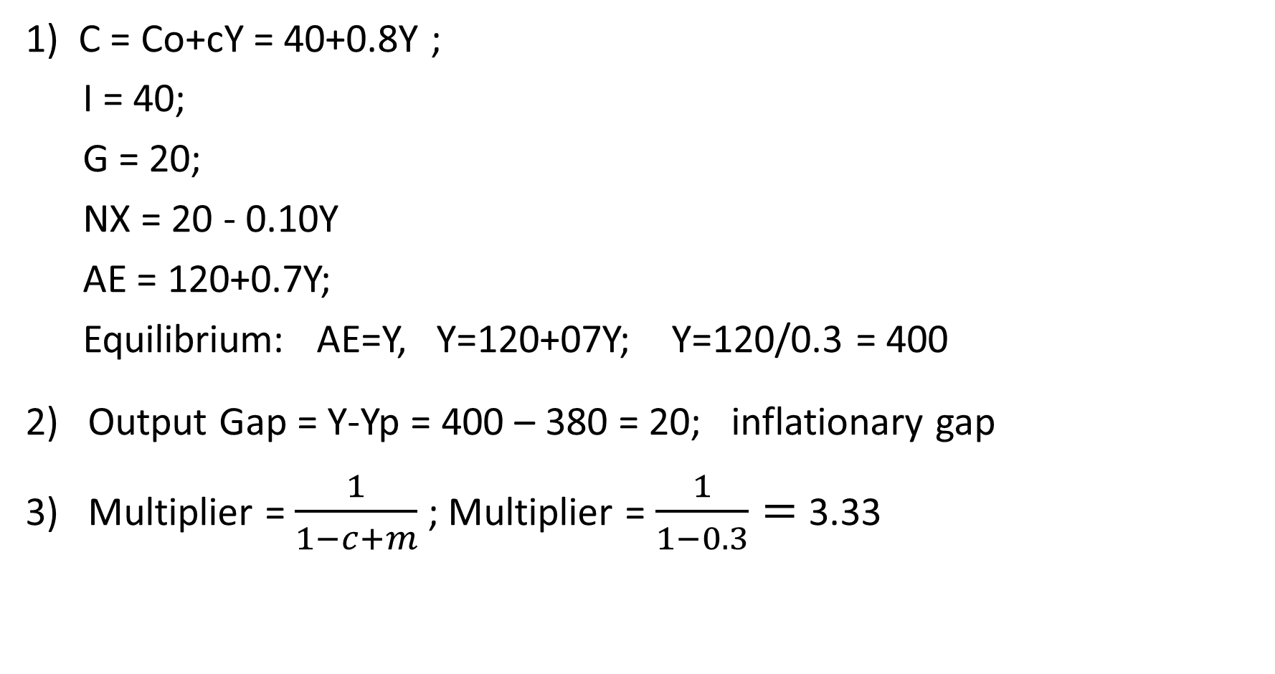
1) C = Co+cY = 40+0.8Y ;
I = 40;
G = 20;
NX = 20 - 0.10Y
AE = 120+0.7Y;
Equilibrium: AE=Y, Y=120+07Y; Y=120/0.3 = 400
2) Output Gap = Y-Yp = 400 – 380 = 20; inflationary gap
3) Multiplier = $\frac{1}{1−c+m}$ ; Multiplier = $\frac{1}{1−0.3}=$3.33

Slide 96
« […] Other budget highlights include: $270 million for 3,250 new social-housing units, including 500 for the homeless. »
According to the above article, what component of aggregate expenditure changes? Explain how this change can affect equilibrium GDP. Illustrate the changes graphically, using the AE curve, the Budget balance curve or the AD-AS model.

Slide 97
This is government spending. In our model, aggregate expenditure is defined as C+I+G+NX. As government spending increases, in the AE=Y graph, the AE function shifts up, and in the AD-AS graph the AD function shifts up and to the right. Both graphs show that this increase in government expenditure will increase production.

Slide 98
MCQ
Suppose consumption (C) is $30,000 when income is $32,000, and the marginal propensity to save (MPS) is 0.25. An increase in income causes C to rise to $36,000. What is the new income?
a. $24,500
b. $35,000
c. $40,000
d. $42,500
e. None of the above.

Slide 99
Answer
c. $40,000

Slide 100
MCQ
If consumption is $25,000 when income is $21,000, and consumption increases to $25,900 when income increases to $22,000, the Marginal Propensity to Save is
a. 0.9
b. -0.1
c. 0.1
d. -0.2
e. -0.3.

Slide 101
Answer
c. 0.1

Slide 102
MCQ
If a $100 billion increase in investment spending creates $100 billion of new income in the first round of the multiplier process and $60 billion in the second round, the multiplier in the economy is
a. 4.
b. 5.
c. 3.33.
d. 2.5.
e. None of the above.

Slide 103
Round | Initial Change in Investment | Change in Output | Change in Consumption
1 | $100 | $100.00 | $80.00
2 | 0 | $80.00 | $64.00
3 | 0 | $64.00 | $51.20
4 | 0 | $51.20 | $40.96
5 | 0 | $40.96 | $32.77
6 | 0 | $32.77 | $26.21
7 | 0 | $26.21 | $20.97
8 | 0 | $20.97 | $16.78
9 | 0 | $16.78 | $13.42
10 to inf. | 0 | $67.11 | $53.69
Totals | $100 | $500 | $400.00

Slide 104
Answer
d. 2.5.

Slide 105
MCQ
An increase in the marginal propensity to consume from 0.5 to 0.7 will cause:
A. the AE line to become steeper and a given change in government spending (G) to have a smaller effect on output.
B. the AE line to become flatter and a given change in government spending (G) to have a smaller effect on output.
C. the AE line to become steeper and a given change in government spending (G) to have a larger effect on output.
D. the AE line to become flatter and a given change in government spending (G) to have a larger effect on output.

Slide 106
Answer
C. the AE line to become steeper and a given change in government spending (G) to have a larger effect on output.

Slide 107
MCQ
If C = 100 + 0.8Y and S = 50, what is the value of C?
A. 700
B. 800
C. 900
D. None of the answers is correct

Slide 108
Answer
A. 700

Slide 109
MCQ
If the MPC is 0.8 and the government increases spending by $100 million, then we would expect the result to be:
A) an increase in real GDP of $500 million.
B) a reduction in equilibrium real GDP of $80 million.
C) an increase in equilibrium real GDP of $100 million.
D) no change in equilibrium real GDP.

Slide 110
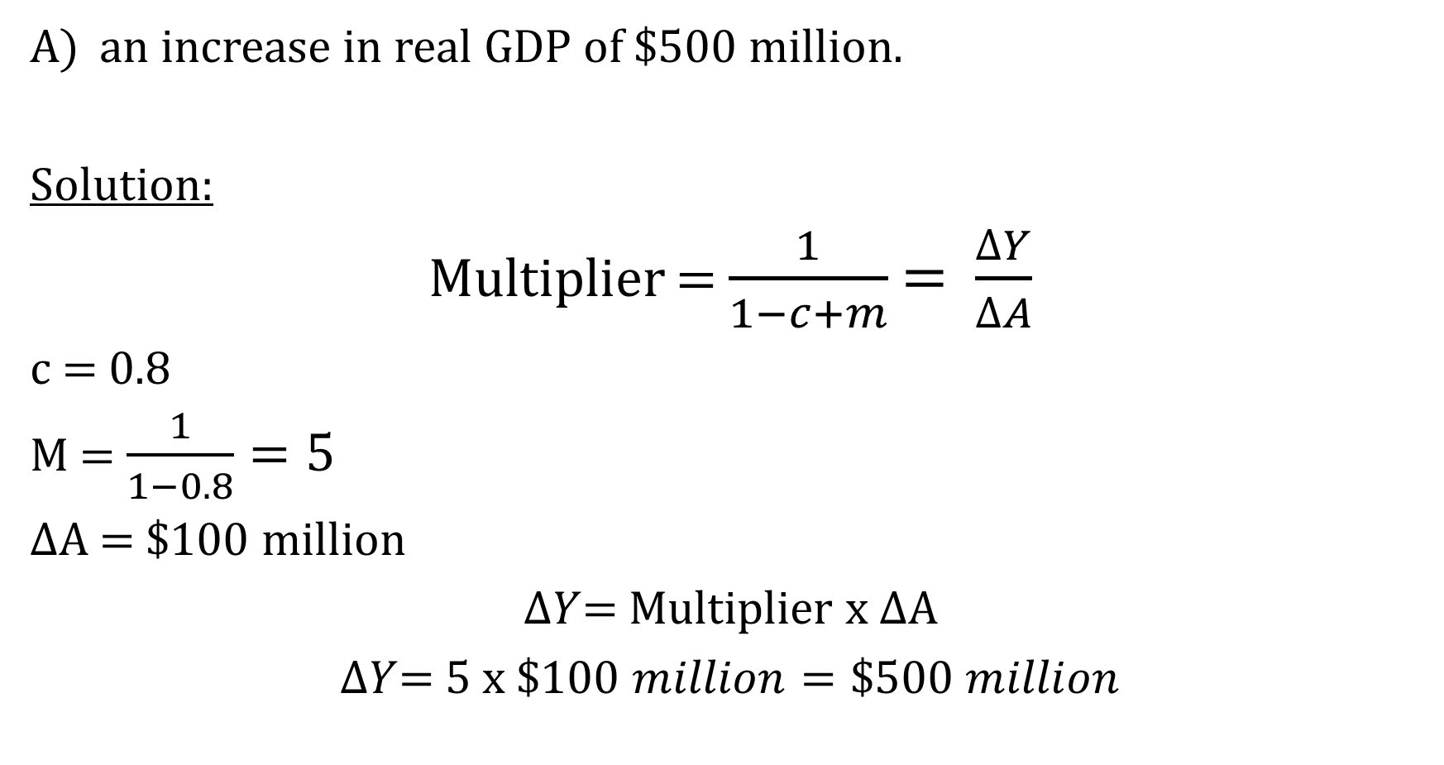
Answer
an increase in real GDP of $500 million.
Solution:
Multiplier = $\frac{1}{1−c+m}$= $\frac{∆Y}{∆A}$
c = 0.8
M = $\frac{1}{1−0.8}=5$
$∆$A = $100 million
$∆Y$= Multiplier x $∆$A
$∆Y$= 5 x $\$100 million=\$500 million$

Slide 111
MCQ
In a diagram illustrating the savings and investment functions for a closed economy with no government, an increase in saving at every level of income will:
A) shift the investment function up and increase equilibrium income.
B) increase the slope of the savings function and lower equilibrium income.
C) leave the level of investment and saving unchanged but lower the equilibrium income.
D) change the slope of the investment function but leave equilibrium income unchanged.

Slide 112
Answer
C) leave the level of investment and saving unchanged but lower the equilibrium income.

Slide 113
MCQ
The principle of the multiplier states that:
A) any increase in spending that causes the aggregate expenditure line to shift will result in a larger increase in national income.
B) in the long run, the aggregate expenditure line becomes relatively flat as the economy approaches full employment.
C) any increase in national income will result in a larger increase in aggregate spending.
D) for any given increase in income, there will be a less than proportional increase in consumer spending.

Slide 114
Answer
A) any increase in spending that causes the aggregate expenditure line to shift will result in a larger increase in national income.

Slide 115
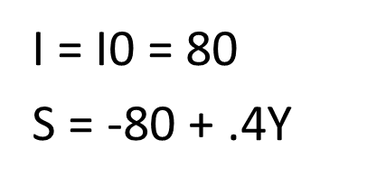
MCQ
In equilibrium saving will be:
A) $40
B) $120
C) $60
D) $80

Slide 116
Answer
D) $80

Slide 117
MCQ
If firms experience an unplanned reduction in their inventories of $75 billion, then:
A) planned inventories will rise by $75 billion.
B) planned inventories do not change.
C) firms have underestimated aggregate spending by $75 billion.
D) aggregate spending is at its equilibrium level.

Slide 118
Answer
C) firms have underestimated aggregate spending by $75 billion

Slide 119
The equation representing the investment schedule for the economy is:
A) I = 0.3Y.
B) I = 80 -0.3Y.
C) I = 30 + 0.1Y.
D) I = I0 = 30.
GDP (Y) Consumption (C) Investment (I)
$0 $60 $30
100 120 40
200 180 50
300 240 60
400 300 70
500 360 80

Slide 120
Answer
C) I = 30 + 0.1Y

Slide 121
MCQ
Other things constant, an increase in households' willingness to save more at every level of income will cause:
A) the consumption function to become flatter because the MPC rises.
B) the consumption function to make a downward parallel shift.
C) the consumption function to remain stationary but the saving function to shift upward.
D) the consumption function to become steeper because the MPC declines.

Slide 122
Answer
B) the consumption function to make a downward parallel shift

Slide 123
MCQ
Suppose that the Liberal party wants the Conservative government to spend more money on building low-income housing. If the Liberal party wants the spending to have maximum effect on economic growth, which of the following consumption equations would it prefer to see?
A. C = 90 + 0.4(Y-T)
B. C = 80 + 0.5(Y-T)
C. C = 150 + 0.75(Y-T)
D. C = 100 + 0.9(Y-T)

Slide 124
Answer
D. C = 100 + 0.9(Y-T)

Slide 125
MCQ
Let the goods market multiplier to be equal to 10. Suppose some private firms have gone into bankruptcy because of the stock market crash. If the losses in investment expenditures due to these bankruptcies are equal to $25,000,000, then the change in GDP would be equal to:
A. 0
B. $250,000,000
C. -$250,000,000
D. -$500,000,000

Slide 126
Answer
C. -$250,000,000

Slide 127
MCQ
In the Y=AE model, if Y < AE, then unplanned inventory would _____ and the price level would _____.
A) Increase; increase.
B) Increase; decrease.
C) Increase; stay constant.
D) Decrease; increase.
E) Decrease; stay constant.

Slide 128
Answer
E) Decrease; stay constant.

Slide 129
MCQ
The larger the Marginal Propensity to Save (MPS), the ____ is the AE curve, and the _____ is the fluctuation in the short run GDP.
A. Flatter; smaller
B. Flatter; larger
C. Steeper; larger
D. The fluctuation in short run GDP is not related to the size of the MPS.

Slide 130
Answer
A. Flatter; smaller

Slide 131
MCQ
Which of the following is false?
a) A discouraged worker is no longer in the labour force
b) Unanticipated inflation benefits borrowers
c) For a given nominal interest rate the real interest rate is lower when there is a low inflation rate
d) Increase in MPC increases the multiplier

Slide 132
Answer
c) For a given nominal interest rate the real interest rate is lower when there is a low inflation rate

Slide 133
MCQ
If consumption is $25,000 when income is $20,000, and consumption increases to $26,500 when income increases to $22,000, the Marginal Propensity to Save is
A) 0.4.
B) -0.4.
C) -0.2045.
D) -0.25.
E) None of the answers is correct.

Slide 134
Answer
E) None of the answers is correct.

Slide 135
MCQ
The potential output line or curve Yp is
A) Vertical because it shows that price level changes will not affect the value of Yp.
B) Vertical because it shows that price level changes will affect the value of Yp.
C) Vertical because Okun’s law states that if Yp growth exceeds actual Y growth, the actual unemployment rate will fall.
D) Upward-sloping because it shows that a higher price level will lead to a higher real output.
E) Upward-sloping because it shows that a higher price level will lead to a higher nominal output.

Slide 136
Answer
A) Vertical because it shows that price level changes will not affect the value of Yp.

Slide 137
MCQ
Canadian consumers are losing their consumer confidence because of the recent financial market fluctuations. As a result, consumers are cutting their spending and accelerating our economic slowdown. If you work for the Department of Finance, Ottawa and you hope for a minimal negative impact on the economy, which of the following consumption function would you like to see?
a. C = 100 + 0.4(Y-T)
b. C = 80 + 0.5(Y-T)
c. C = 150 + 0.75(Y-T)
d. C = 100 + 0.9(Y-T)
e. C = 100 + 0.95(Y-T)

Slide 138
Answer
a. C = 100 + 0.4(Y-T)

