Slide 1
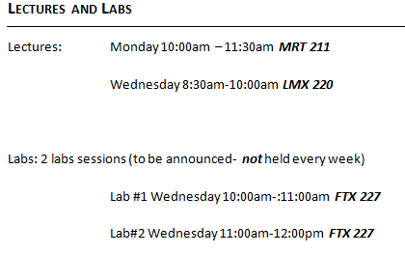

Slide 2
Basics in Unlearned and Learned Response

Slide 3
Why not innate?
Text refers to elicited and species-specific behaviour
Why not innate or instinctive anymore?
  Responses are not as inflexible as previously believed
  Although responses occur without previous, specific experience- environmental and developmental factors can still influence expression
Unlearned or Naïve
  Alternatives attempt to differentiate behaviour which will occur in the absence of specific previous experience with an eliciting stimulus from learned or experience dependent behaviour
  Unlearned: Learning has not occurred- does not mean learning has been undone
Notes:
Term vs definition change

Slide 4
Reflex
Reflex: an automatic response to a stimulus with or without prior experience→ elicited by the stimulus
    Startle Response (become alert) e.g. loud noise = stop talking and listen
    Orienting Response (attend to) e.g. loud noise behind you = turn around
    Flexion Response (act on) e.g. hand on hot surface = quickly move hand
  No experience needed
  Reflex Arc: simple sensory, inter and motor neuron response can occur at the same time signal is traveling to the brain
    e.g. removal of hand from hot surface occurs before or as pain signal is being perceived by the brain
    http://www.youtube.com/watch?v=Y5nj3ZfeYDQ

Slide 5
Reflexes
Reflexes are relatively simple and often singular in response
Often defensive but not always
  babies will orient to a touch on the cheek to facilitate feeding behaviour
Elicited responses can be more complex…

Slide 6


Fixed Action Patterns
Fixed Action Patterns
  More complex unlearned response to a stimulus incorporating a sequence of actions
    E.g. Play bow and wag among domesticated dogs
  Sign Stimulus/ Releaser: Features of a specific stimulus will elicit a response sequence
    http://www.youtube.com/watch?v=7PcteKRA3zs

Slide 7
Sign Stimulus
Some challenges so consistently faced by a species- elicited response will outperform a learned response
When there is little room for error:
  Defense
  Mating
  Identifying and handling food
  Raising young

Slide 8
Sign Stimulus Example
Both Siamese fighting fish and sticklebacks will react aggressively toward other males
  Releaser for fighting fish is an elaborate fin display
  Releaser for a stickleback is the red underbelly of males

Slide 9
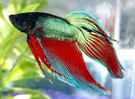
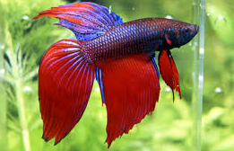
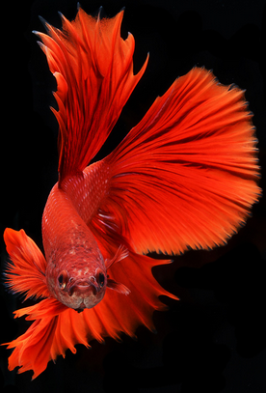
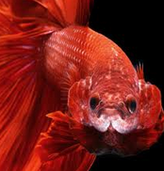
Sign Stimulus Example

Slide 10
Sign Stimulus Example
Releasers can be:
  broad and complex (variations in colour and display among Siamese fighting fish can still elicit a response)
  or
  highly specific (red colour on the underside of any object will elicit aggression from the stickleback)

Slide 11
Elicited vs Learned
Elicited responding is a good start
But- relatively rigid responding only increases the chances of a correct naïve response to common challenges- does not guarantee correct response under all instances
Learning = flexibility

Slide 12
Inflexible?
  Although unlearned behaviours are considered inflexible in comparison to learned behaviours, they can be modified with general experience
  Text example of aggression in rats (pg. 100)

Slide 13
Species Specific
Learning allows for individual flexibility to variable environments
Elicited behaviours address predictable challenges- species wide
  Species specific: something common to all members of a species
  E.g. Rats are likely to freeze in the presence of an aversive stimulus (shock)
    -this reaction is relatively robust even when repeated experience should teach the animal to respond in a different way (fleeing)
    Porcupine or skunk vs a car- species specific defense reactions are ineffective and incompatible with fleeing- a potentially successful response to a moving car

Slide 14
Species Specific
  There is always a trade off
  Overly specific and robust unlearned behaviour (such as skunk or porcupine defense strategies) can be a very successful but risky when environments and challenges change over time/ generations
  But, learning can also be risky if failure or delay in response results in death

Slide 15
Instinctive Drift
Elicited behaviour can limit the scope of potentially learned behaviours
  Training can result in the expression of very varied, flexible behaviour
  But, unlearned (instinctive) behaviour often undermines the extent to which an overly artificial response may ultimately be attained.
  Modification of behaviour is not limitless
  More when we discuss predisposition

Slide 16
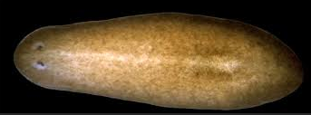
Learned Response
Simple changes in response can occur following repeated exposure to eliciting stimuli
Learned= Flexible responding; experience changes response
Even very ‘simple’ animals can exhibit basic learning
  Habituation and Sensitization

Slide 17
Habituation and Sensitization
Elicited response to a stimulus subject to change with experience (repeated exposure)
Initial exposure to a stimulus will elicit an unlearned response (attending to the stimulus) – repeated exposure will reflect a learned response:
  Is this stimulus relevant or not?
  Does this stimulus require a response?

Slide 18
Learned Response: Habituation
Habituation: Diminished strength in responding following repeated exposure to a stimulus
  Learning that a stimulus does not require a response- harmless
  Most common to low intensity stimuli
    Low intensity= less likely to be significant
  Highly specific to stimulus
    Avoid becoming complacent- assuming similar stimuli are also harmless
    E.g. A once skittish squirrel may habituate to the presence of a person who frequently, calmly feeds it but will not generalize that response to all people

Slide 19
Learned Response: Habituation
  A period of absence followed by a return of the stimulus may lead to renewed responding (usually weakened)
  Highly stimulus specific- Low generalizability allows for return of response following a small change to the stimulus or environment
    E.g. Habituation to train noise but if noise changes slightly you may begin to notice it again- only for a short time-> habituation will recur in a shorter time

Slide 20
Learned Response: Habituation
Dishabituation
  The emergence of a novel stimulus may also cause a recovery in responding
    E.g. Habituated to train noise, but if a new picture on the wall now rattles with the train→ you may begin to notice the sound again

Slide 21
Learned Response: Habituation
  Frequency of exposure = speed of habituation and recovery
  Long term habituation: longer spacing between exposures leads to more gradual diminishing and gradual recovery of response
    Takes longer to habituate to a relatively rare stimulus and longer to elicit a recovered response
  Short term habituation: short intervals between exposures leads to faster diminishing and faster recovery of response
  Takes less time to habituate and less time to recover response

Slide 22
Learned Response: Habituation
Example: Living beside a fire station
Long term habituation:
  E.g. Infrequent calls- faint fire truck sirens heard about once a day
    It will take relatively longer to habituate to the noise but once established habituation will be relatively robust even in the absence of the noise
Short term habituation:
  E.g. Frequent calls- faint fire truck sirens heard every hour
    It will take relatively less time to habituate to the noise but a return in response will occur with only a short absence

Slide 23
Habituation Examples
Partner who snores (faintly)
Sound of light rain on the roof
Traffic noise

Slide 24
Learned Response: Sensitization
Sensitization: Intensified strength in responding following repeated exposure to a stimulus
  Learn that something should be attended to (real or perceived threat)
  Easily generalizes among similar stimuli
  Most common to high intensity stimuli
    Sensitization- high intensity stimuli are more likely to be a threat

Slide 25
Sensitization followed by habituation
    Intermediate intensity stimuli can result in a mixed response: initial sensitization followed by habituation
  E.g. An alarm clock: an abrasive alarm sound may initially wake a sleeper quickly but after a few mornings it may not
  E.g. In a restaurant- loud and unusual noises made by another patron initially startling but may soon be ignored
    Can be facilitated by social expectations- expectation of tolerance

Slide 26
Learned Response: Sensitization
Better safe than sorry
Sensitization easily generalizes among stimuli
  Extent of generalization in proportion to threat- PTSD can result in inescapable and overwhelming sensitization in response to otherwise innocuous stimuli
Habituation can easily give way to recovery of response

Slide 27
Sensitization Examples
Child kicking the back of your seat on a plane
  Can be compounded by stressful or unpleasant situation/ environment
Frequently receiving a shock from a commonly used item (e.g. car door, an appliance etc.)
Co-worker speaking loudly on the phone

Slide 28
Comparison
Habituation | Sensitization
Decreased response strength →Learn that stimulus seems harmless | Increased response strength → Learn that stimulus may be a threat
Highly stimulus specific →Dangerous to assume similar stimuli are also harmless without specific experience | Easily generalized among similar stimuli → Better safe than sorry- respond with vigilance until experience proves the stimulus harmless
Low intensity stimuli | High intensity stimuli

Slide 29
Questions?

Slide 30
Opponent-Process Theory
Dual process mechanism- balance or ‘off-set’ intense response
Physiological and psychological experience of emotion accompanies most types of stimulus response
These reactions cannot continue indefinitely

Slide 31
Opponent-Process Theory
A: The stimulus will result in a response (emotion)
  E.g. Seeing a loved one- will likely correspond with feelings of happiness
B: With frequent repetition of the experience- compensatory response will begin to consistently follow
  E.g. When loved one is absent- will likely feel dejected
  With further repetition…
  E.g. Seeing a loved one everyday will still correspond with positive feelings but a well established compensatory response will result in that response seeming relatively diminished

Slide 32
Opponent-Process Theory
Physiological or psychological preparation to counter a stimulus effect
  ‘A’ process is the elicited response to a stimulus
    Primary process
    Response occurs and diminishes quickly in conjunction with stimulus
    E.g. Seeing a loved one causes feelings of immediate excitement or joy

Slide 33
Opponent-Process Theory
  ‘B’ Opponent process is the compensatory response to regain homeostasis
    Onset of the response is more gradual (slower to initiate) and diminishes more slowly than the ‘A’ process
    Both processes needed to respond to stimuli but opponent process prevents possible harmful continuation or compounding response (e.g. heart rate)
    ‘B’ process strength and longevity increased by repeated exposure

Slide 34
Opponent-Process Theory
The increased strength of the ‘B’ process with repeated exposure reduces the degree of stress the ‘A’ process could place on the subject
  Adaptive coping mechanism for unavoidable stress
  The ‘B’ process may become counter productive if the stressful situation is avoidable but compensation diminishes and even prevents desire to avoid (ex. domestic abuse).

Slide 35
Opponent-Process Theory
Homeostasis:
  Response to stimuli must be meaningful
  If response states or emotions are maintained at elevated or diminished levels for a prolonged time they serve no purpose
  Majority of time= moderated levels of arousal
  This allows for appropriate response under changing conditions- good or bad

Slide 36
Questions?

Slide 37
Learned Associations
Learned association: requires an association to be made between stimuli or between a response/behaviour and a consequence
Two main types:
  Classical Conditioning:
    association between stimuli→ conditioned response
  Operant Conditioning:
  association between behaviour and consequence → modified behaviour

Slide 38
Classical Conditioning
  Dog likes biscuits- Biscuits are an unconditioned stimulus (did not need to learn to like)
  Sound of cupboard door opening – Sound is a neutral stimulus (no inherent meaning)
  Sound of cupboard door opening frequently coincides with receiving a biscuit- Sound is becoming associated or conditioned by frequent pairing with the unconditioned stimulus
  Dog soon comes running every time the cupboard door opens- Sound is now a conditioned stimulus

Slide 39
Classical Conditioning
Classical Conditioning:
  An unconditioned stimulus (US) elicits an unconditioned response (UR)
    Unlearned response to a stimulus
  If US is associated with a neutral stimulus (NS) that NS may become a conditioned stimulus (CS)
    NS does not elicit an unlearned response but may come to elicit a conditioned response if paired with a US
  The CS will then elicit a conditioned response (CR)
    Learned response to a stimulus
  Multiple trials usually required to associate NS with US but single trial learning can occur
Notes:
Questions?

Slide 40
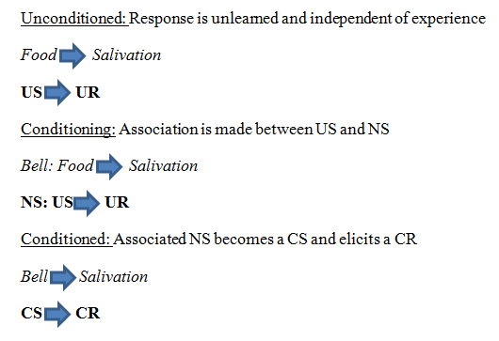
Examples of Classical Conditioning

Slide 41
Classical Conditioning
http://www.youtube.com/watch?v=hhqumfpxuzI

Slide 42
More complex conditioning
Higher order conditioning
  Once a first CS has been conditioned- pairing that CS with a new NS→ which then becomes an additional CS
Sensory Pre conditioning
  Conditioning may extend to commonly paired neutral stimuli when one of the stimuli undergoes conditioning
Blocking
  Conditioning to a new stimulus may not occur if a strong CS has already been established
Overshadowing
  Simultaneous conditioning to multiple stimuli may fail if one stimulus is relatively more salient than the other
Latent Inhibition
  Familiar and frequently experienced neutral stimuli are difficult to condition

Slide 43
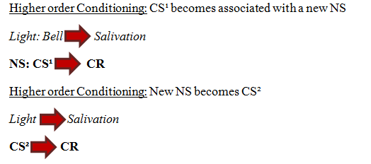
Higher Order Conditioning
Associating a second NS to an already conditioned CS

Slide 44
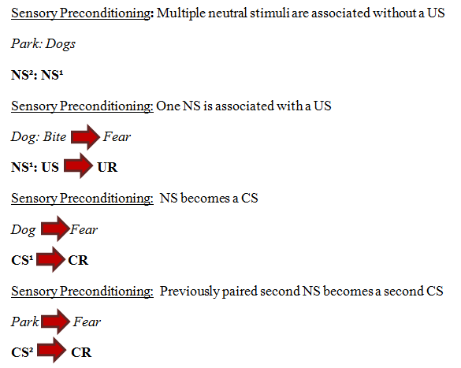
Sensory Pre-conditioning
Pairing of neutral stimuli can occur prior to either becoming a CS

Slide 45
Relative Ease of Conditioning
Unlike Preconditioning or Higher Order Conditioning:
  Blocking,
  Overshadowing
  Latent Inhibition
  Reduce the likelihood that an association will be made

Slide 46
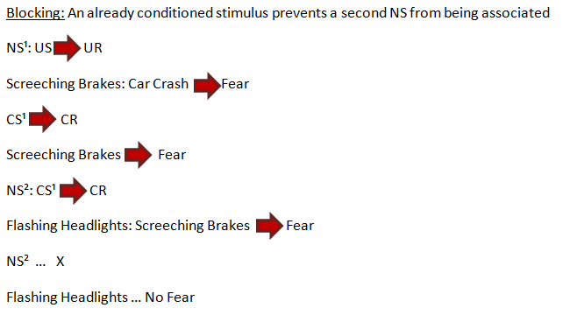
Blocking
A failure of higher order conditioning:
  Because an association has already been made and second CS is more difficult to establish

Slide 47
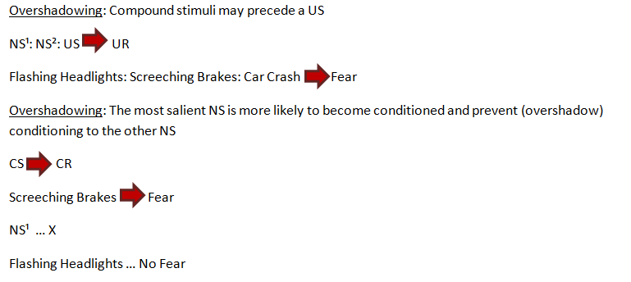
Overshadowing
Multiple stimuli may occur with a US but the most salient may be the only one learned

Slide 48
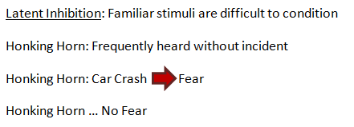
Latent Inhibition
A familiar stimuli (one encountered often prior to being paired with a US) is difficult to condition
  Not predictive, associated with many other stimuli and circumstances

Slide 49
Type of Conditioning
Appetitive: Subject pursues the stimulus
  E.g. Food
Aversive: Subject avoids the stimulus
  E.g. Shock
Excitatory: Signals the occurrence/ presence of the US
  E.g. Celebratory ‘falling change’ sound of a winning slot machine
Inhibitory: Signals the absence of the US
  E.g. Disappointing ‘wahn wahn’ sound of a loss

