Slide 1
Technology history timeline

Slide 2
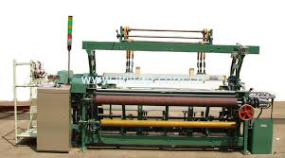
1801:
Loom
Uses punched wooden cards to automatically weave fabric designs.
Pattern making
Early computers would use similar punch cards.
The French government claimed the loom to be public property.

Slide 3
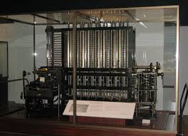
1822:
Difference Machine
Mechanical machine
Replaced human calculators
Used for making more accurate tables than those prepared by people making errors
Designed to tabulate polynomial functions.
British government gave him lots of money for this ( for navigation back then so people would die)

Slide 4
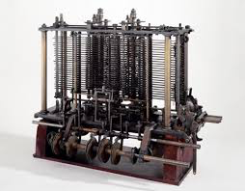
1822:
Analytical Machine
Business Machine
His second machine
Government was now interested in this
compute tables of numbers.
His vision was ahead of time and did not have the materials so failed and no money
Fist design as a general purpose computer : Separated computation from storage

Slide 5
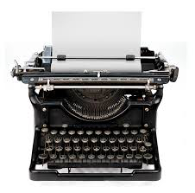
Typewriters
Business Machine
Mechanical or electromechanical machine
Did not stay in offices at first, because at first they were only created with capital letters, and they keys often stuck together (vowels because they were often used)
They separated the keys
The idea of typewriters stuck in offices once improved

Slide 6
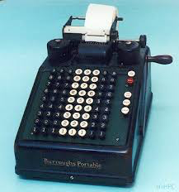
Adding machines
Business Machine
Were ubiquitous office equipment
Perform additions and subtractions directly and multiplication and divisions
They were phased out in favor of calculators in the 1970s and by personal computers beginning in about 1985.
The older adding machines were rarely seen in American office settings by the year 2000.

Slide 7
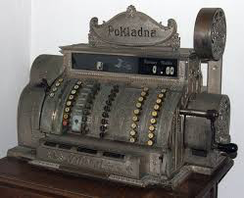
Cash register
Business Machine
There was a worry about people cheating him so this would keep track of transactions and money in his store
Mechanical or electronic device for registering and calculating transactions

Slide 8
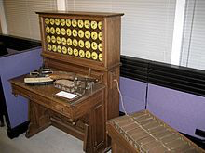
1890:
Punch Card Tabulating system
Herman Hollerith designs a punch card system to calculate the 1880 census.
Accomplishing the task in just three years and saving the government $5 million.
He establishes a company that would ultimately become IBM.
His original idea was to have census data recorded as a pattern of holes on punched paper tape/cards which would then be processed by a machine (machine would count holes and make calculations)

Slide 9
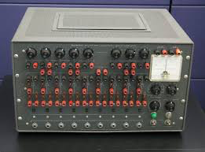
Analog Computing
silicon-based micro sensors that sense and react to external (natural) stimuli in something that approximates the rhythm of reality rather than the "artificial" binary behavior of digital computing.
Ex: Ocean Tide predictor

Slide 10
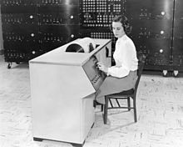
Differential Analyzer
Analog Computing
First general purpose
Designed to solve differential equations by integration, using wheel-and-disc mechanisms to perform the integration.
It was one of the first advanced computing devices to be used operationally.

Slide 11
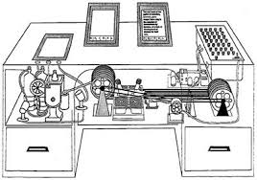
Memex
Analog Computing
Many people have compared to our modern day internet
Large scale crunching was still done by human computers until world was 2
The concept of the memex influenced the development of early hypertext systems

Slide 12
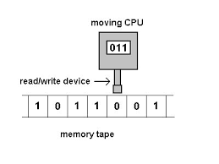
1936:
Turing machine
Analog Computing
Universal general purpose computing machine
consisting of a “scanning head that could read and write symbols on a tape of potentially infinite length, controlled by a construction table”
This “infinite” piece of paper would allow math symbols to be written, read and then erased, allowing you to tackle multiple problems
Significant because his computer wasn’t limited to solving math

Slide 13
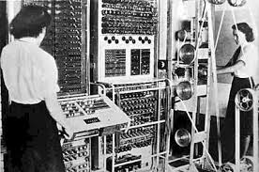
Colossus
Analog Computing
was the world's first electronic, digital, programmable computer.
British code breakers used Colossus to read secret German messages during World War II.
Colossus worked using vacuum tubes.
was designed to process text as opposed to performing mathematical calculations

Slide 14
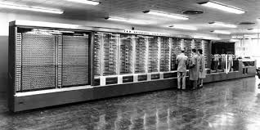
Harvard Mark 1 (IBM)
Digital Computing Machine
First fully automatic operational computer
First general purpose electronic computer
Automatic Sequence Controlled Calculator (ASCC)
used in the war effort during the last part of World War II.

Slide 15
Maunchly
Digital Computing Machine
was used to replace analogue machines and human computers
Notion of electronic computer was being developed elsewhere such as Germany and for code-breaking in US and Britain
Influenced by Atanasoff-Berry Computer which used binary arithmetic and electronic switching technology (later patent disputes)
Electronic version” copy of Bush’s analogue differential analyzer
Electronic computer that would be able to perform calculations in seconds

Slide 16
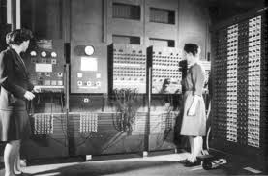
1943-1944:
Electronic Numerical Integrator and Calculator (ENIAC)
Maunchly
It fills a 20-foot by 40-foot room and has 18,000 vacuum tubes.
was the first electronic computer ever built.
It was capable of being reprogrammed to solve "a large class of numerical problems."
No storage programming, if you wanted to transfer the program you would have to do it manually
Was the first to solve different problems

Slide 17
ENIAC cons
Too little storage
too many vacuum tubes
physically rewired

Slide 18
ENIAC pros
The machine COULD solve different problems
Unique for its time
All computers still use the fundamental architecture

Slide 19
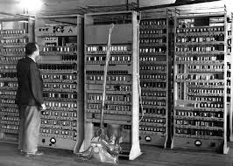
EDVAC
was one of the earliest electronic computers.
Unlike its predecessor the ENIAC, it was binary rather than decimal, and was a stored program computer.

Slide 20
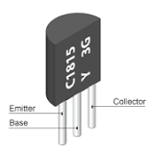
Transistor
An electronic device that switches in a solid piece of material like silicon or germanium
Used instead of vacuum tubes to save power and space

Slide 21
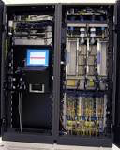
Mainframes
is a high-performance computer used for large-scale computing purposes
greater availability and security
IBM benifited from mainframe computers – they sold 75 % of them

Slide 22
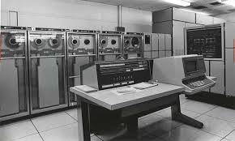
1946
UNIVAC
Funding from US census
The first commercial computer for business and government applications.
Made the right prediction about the election, which scared the inventors.
Developed for US census
Used magnetic tape storage as opposed to punched cards

Slide 23
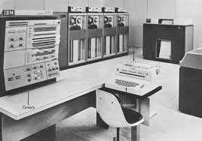
IBM System 360
Did not support time-sharing (multiple users for one computer)
was a mainframe computer system family
It was the first family of computers designed to cover the complete range of applications, from small to large, both commercial and scientific

Slide 24
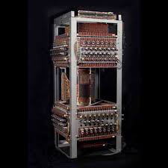
Whirlwind
Real-time computing use (where response time happens in seconds)
WWII project focused on creating real time aircraft trainer or simulator
funding by US Air Force
Government thought general-purpose was the best way to go but led to …. →

Slide 25
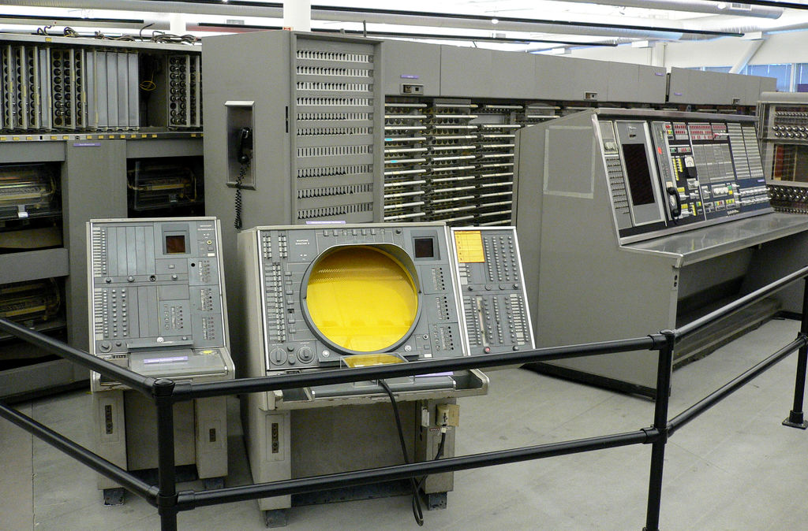
Sage
which established new US air-defense system to avoid any attack in war
one of the first computer “networks” to be built
Once up, it didn’t work with other technologies
Still was a large part of developing mass storage, and display
Lead to cililian computing (think industry involvement like IBM, training, technologies like printed circuits, core memories, mass storage, graphical displays, multiprocessing)

Slide 26
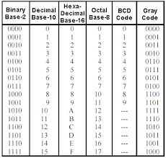
Binary Codes
is a system of representing numbers, letters, commands, images and sounds.
1 and 0.
Ex: 100101 = A
Ex: 110100 = a

Slide 27
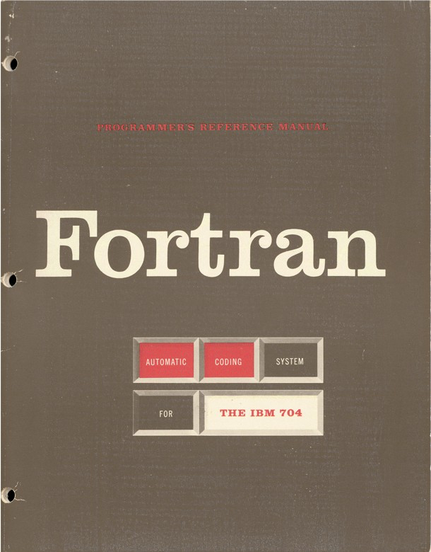
1954:
Forton (IBM)
The FORTRAN programming language is born.
considered first successful programming language
suited to numeric computation and scientific computing.
1.

Slide 28
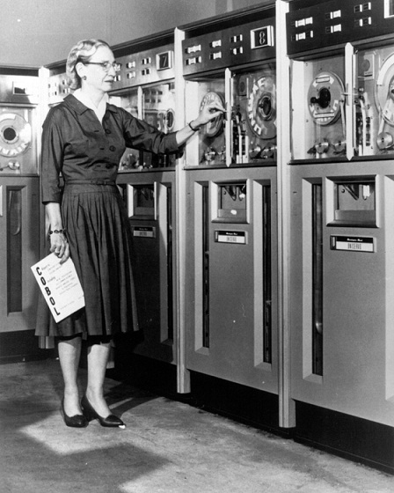
1953:
COBOL
based on “readability” of programming language
one of first “standard” languages
Language was also something managers could understand
2.

Slide 29
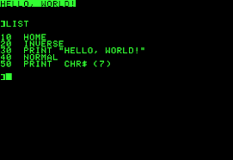
BASIC
taught in academic wolrd , made computers accessible to more people
(an acronym for Beginner's All-purpose Symbolic Instruction Code)
A family of general-purpose, high-level programming languages
3.

Slide 30
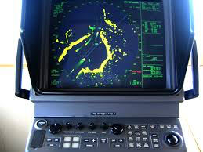
ARPA
Important in internet and creation of information processing
Really helped promote notion of “time-sharing”
Withstand an attack
Marine radar systems

Slide 31
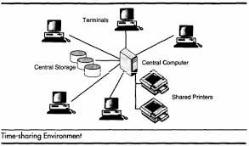
Time-Sharing
A single mainframe computer would be attached to different terminals that had their own printer and card reader with made it feel personal
Used BASIC single language which allowed non-experts to write their own programs
Before time sharing, only computer “operators” had frequent access to these expensive systems (responsible for magnetic tapes, punched cards, printer results)

Slide 32
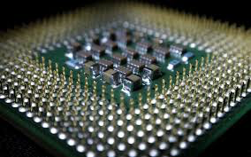
1958:
Integrated circuit Technology
Known as the computer chip. Nobel Prize in Physics in 2000 for his work.
Made computers smaller and took away vacuum tubes
Consists of multiple transistors on silicon which would make complete circuits
Combining many transistors onto the chip allowed computer memory and smaller computers
Used in calculators

Slide 33
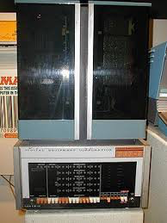
Mini computer
PDP-8
was a bargain price so everyone bought them (uni, small scale businesses)
Allowed for greater “hands-on” computing
Helped created a hobbyist culture and were considered “personal” computers
First successful minicomputer

Slide 34
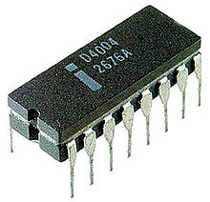
Multi-purpose circuits
Microprocessor (intel)
Single integrates circuit
create series of general purpose logic chips that could be programmed to do a variety of functions thanks to inclusion of input-output and memory chips

Slide 35
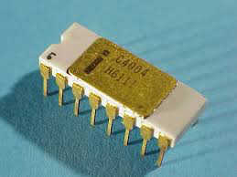
4004 (intel)
“microprogrammable computer on a chip”
Contained basic register and control functions of a small, general purpose stored program computer
RAM and ROM
4004 → 8008 → 8080 chip (more powerful than ENIAC computer!)
The higher the number, the more advanced chip
Used in: calculators, cash registers and bank machines

Slide 36
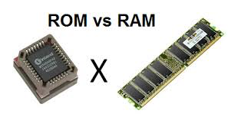
ROM:
Read Only Memory are types of computer memory that provide users with access to information stored on a computer.
RAM:
Random Access Memory

Slide 37
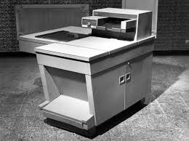
XEROX
was the most advanced computer at this time.
They think of printers and scanners and not computers
Researches were in the field of small scale computing
Created a home of personal computers and its features

Slide 38
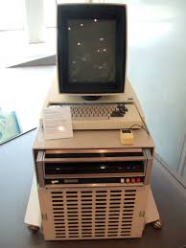
Alto
Xerosx
utilized microprocessor technology and had many features of our modern PCs today
(mouse, folders, icons, laser printers, WYSIWYG, Ethernet/LAN)
Type and see on computer
“wait and see”

Slide 39
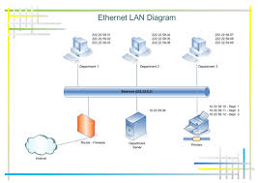
1973:
Ethernet
1973: Robert Metcalfe, a member of the research staff for Xerox, develops Ethernet
connecting multiple computers and other hardware.

Slide 40
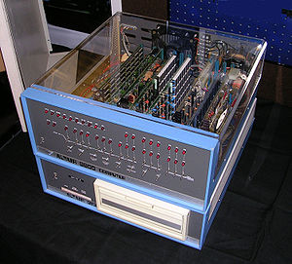
1975:
Altair 8080
"world's first minicomputer kit to rival commercial models.
Paul Allen and Bill Gates, offer to write software for the Altair, using the new BASIC language.
8800 chip was initially not available to hobbyist market
8080 was eight-bit chip that needed fewer support chips and contained more memory
Real start of personal computing
FIRST PERSONAL COMPUTER

Slide 41

MITS
Made from Altair
Couldn’t even be programed because it had no language unless VERY skilled could input data
Slots allowed hobbyists to insert new circuit boards and accessorys like keyboards, mosues…
Altair came with only four circuit boards
Offered add-on equipment like memory cards, computer terminals and memory modules in order to promote device as “complete system”

Slide 42
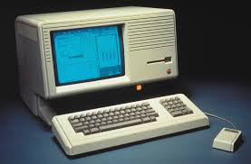
Alto- “Lisa” computer
Is a personal computer designed by Apple Computer, Inc.
It was the first personal computer to offer a graphical user interface in a machine aimed at individual business users.
Saved company from bankruptcy

Slide 43
1976:
Apple
1976: Steve Jobs and Steve Wozniak start Apple Computer.the first computer with a single-circuit board.
Were computer hobbyists

Slide 44
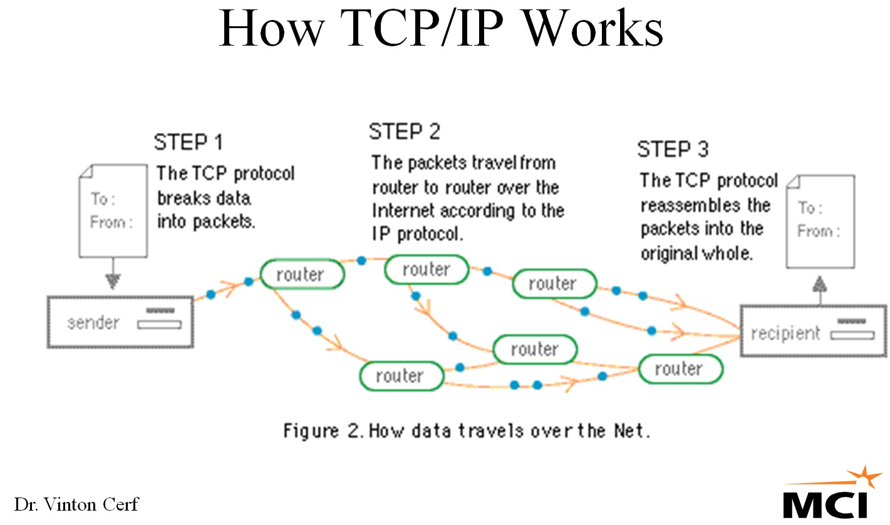
TCP/IP protocol
is the basic language or protocol of the Internet.
It can also be used as a communications protocol in a private network
Messages are transmitted through packet-switching
Send a digital file (information) is broken up into lots of pieces (digit packets) and each piece will have the same label attached in common. This label is an address, sending through different directions and get receive to the same computer. They are then put back together and you receive the original message.

Slide 45
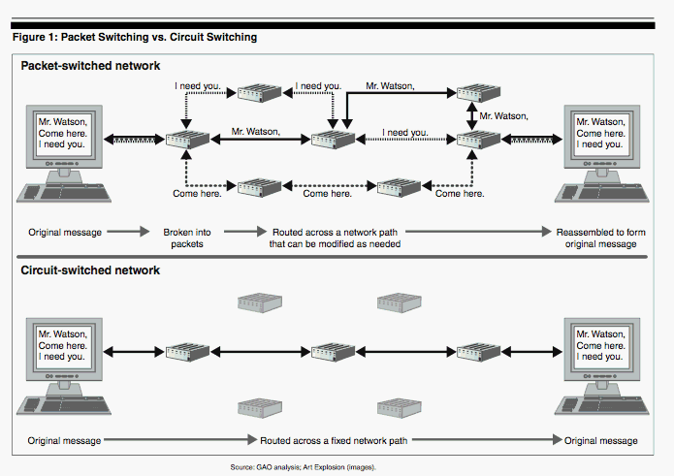

Slide 46
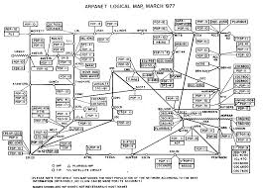
ARPANET
Helped during the cold war save system against nuclear attack

Slide 47
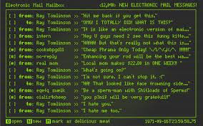
Email
by 1971 simple email programs being developed by Arpanet users to acsess data and resources- and more so eachother

Slide 48
Internet
Internet developed under authority of US military who wanted a system to be able to accommodate different types of networks u

Slide 49
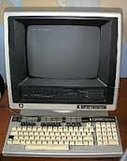
1981:
Acorn
The first IBM personal computer, code-named “Acorn,” is introduced.
It uses Microsoft’s MS-DOS operating system.
It has an Intel chip, two floppy disks and an optional color monitor
It also popularizes the term PC.

Slide 50
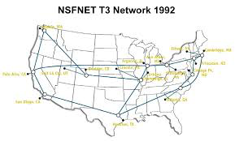
NSFNET
was a program of coordinated, evolving projects sponsored by the National Science Foundation (NSF) beginning in 1985 to promote advanced research and education networking in the United States.

Slide 51
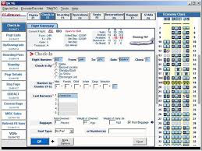
SABRE
enables companies such as American Airlines to search, price, book, and ticket travel services provided by airlines, hotels, car rental companies, rail providers and tour operators.

