Slide 1
ANP1105B
Anatomy & Physiology I
Chapter 2.
Cellular Physiology of Nerve and Muscle

Slide 2
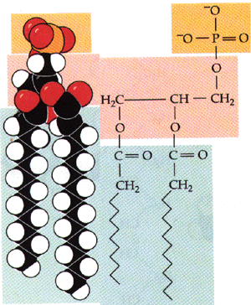
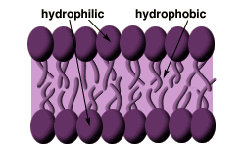
2.1 Membrane transport (pp. 63-79)
2.1.1 Describe the structure of the plasma membrane
basic structure according to fluid mosaic model:
phospholipid bilayer - what is a phospholipid?? what do we mean when we say the hydrophilic and hydrophobic ends of phospholipids??
Phospholipid bilayer
http://www.biology.arizona.edu/chh/problem_sets/kidneysmetals/07t.html
A phospholipid

Slide 3
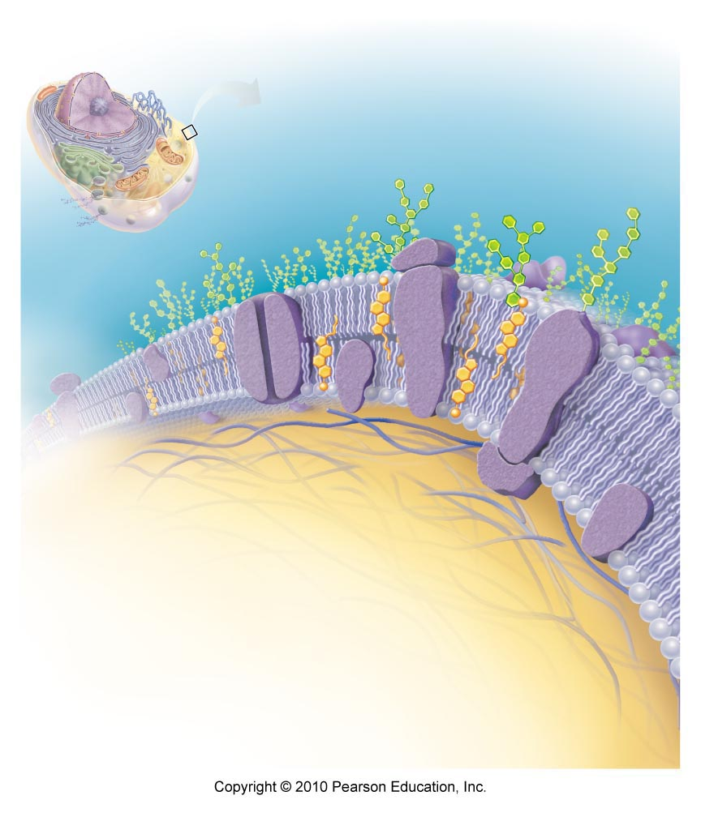
Why do we say fluid mosaic model??
integral membrane proteins - span PM (transmembrane); hydrophilic & hydrophobic regions; channels, carriers
Fig. 3.3

Slide 4
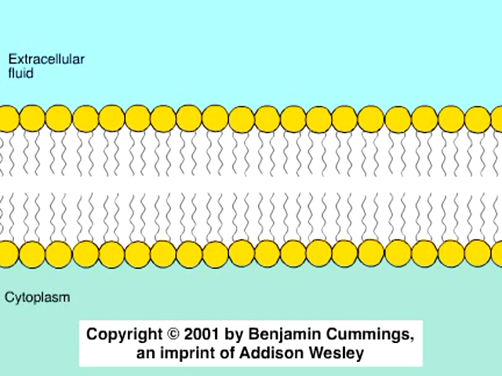
Chapter 3 Animation: Plasma Membrane Structure
(see Mastering Study Area)

Slide 5
2.1.1.2: Associate functions with each of the following: peripheral and integral membrane proteins, cytoskeleton, glycocalyx, cholesterol
1. Peripheral proteins: attached to integral proteins (usually internal side of PM); can be enzymes, involved in attachment functions, shape changes . .
2. Cytoskeleton: anchors to PM; can also interact with receptors (eg: ??)
3. Glycocalyx: ensemble of carbohydrates attached to lipids & proteins on extracellular face; “sugar coating” on PM
  NB: glycocalyx changes when cell becomes cancerous - can even change repeatedly to avoid recognition by immune system
4. Cholesterol: overall: reduces general membrane fluidity & stabilizes its structure – too much cholesterol causes membranes to lose flexibility
Fig. 3.3

Slide 6
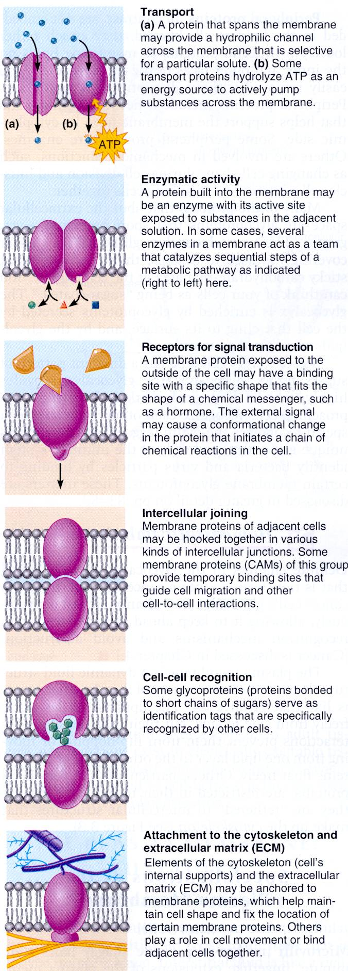
Some Functions of Plasma Membrane Proteins
transport
intercellular joining
enzyme activity
cell-cell recognition
receptors for signal transduction
attachment to ECM
Fig. 3.4

Slide 7
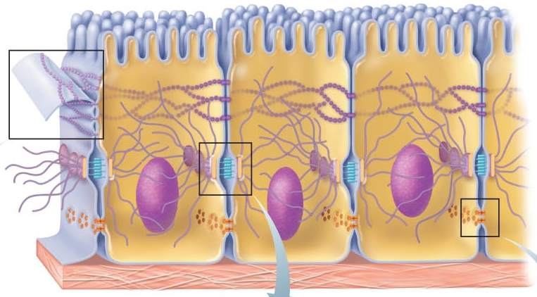
2.1.1.3: Distinguish (structurally and functionally) between: tight junctions, desmosomes, gap junctions
Fig. 3.5

Slide 8
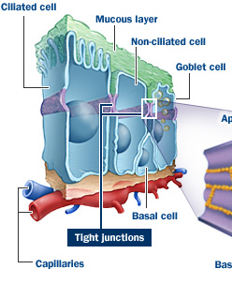
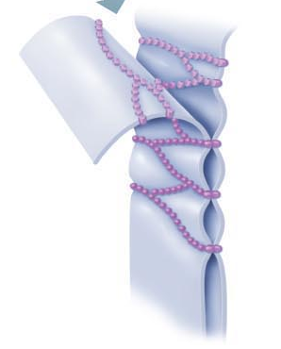

2a. Tight Junctions:
Fig. 3.5a
fusion of adjacent plasma membranes to prevent passage of molecules
why would these structures be important in the lining of the digestive tract?
http://www.nastech.com/nastech/junctions_biology
J. Carnegie, Uof O

Slide 9
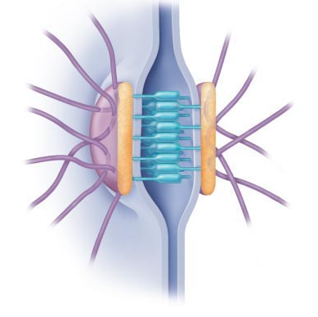
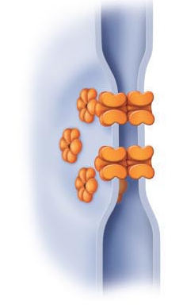
2b. Desmosomes:
anchoring junctions: molecular linking of cells to resist mechanical stress
plaque
linker proteins
keratin filaments
Where are desmosomes found?
2c. Gap Junctions:
molecular channels between cells to allow passage of cytoplasmic molecules
connexins
electrically-excitable tissues
Fig. 3.5b & c

Slide 10
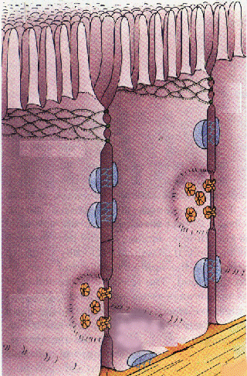
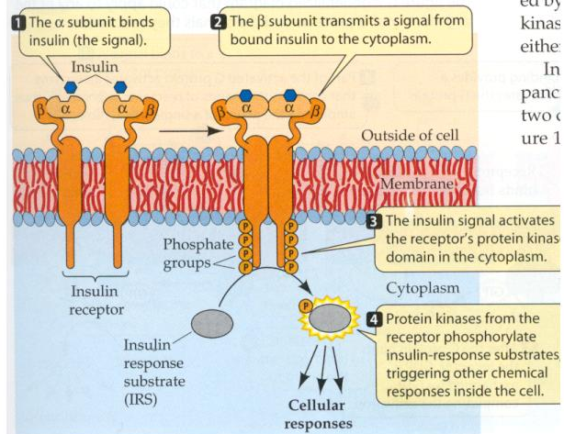
2.1.1.4: List 4 functions of plasma membranes
effective barrier between the intracellular & extracellular fluids
selectively permeable
allows the cell to respond to changes in the extracellular fluid
site of cell-to-cell interaction and recognition
http://www.bio.davidson.edu/Courses/Molbio/MolStudents/spring2003/Williford/assignment2_home.htm
http://www.bgsu.edu/departments/chem/midden/MITBCT/mem/junct.html

Slide 11
2.1.2 Describe and differentiate among the various types of transport across the plasma membrane
• selectively permeable barrier between interstitial fluid and cytoplasm
hydrophobic environment ➢ what about water-soluble substances?
• interstitial fluid a filtrate of blood - contains salts, sugars, amino acids, vitamins, hormones, metabolites, gases such as O₂ and CO₂, etc.
• to maintain homeostasis and function normally, a cell must be extract needed items , keep valuable materials inside & discard wastes
Transport across PM can be active or passive
Fig. 3.3

Slide 12

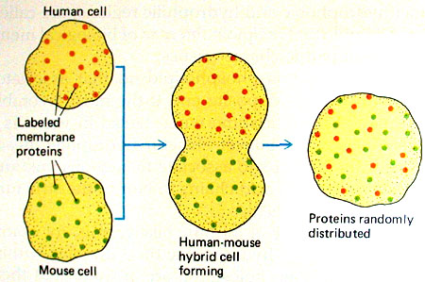
Think carefully about the chemistry of the plasma membrane, then answer this question: Why is minor damage to the plasma membrane usually not a problem?
J. Carnegie, Uof O
http://academic.brooklyn.cuny.edu/biology/bio4fv/page/fluid_p.htm

Slide 13
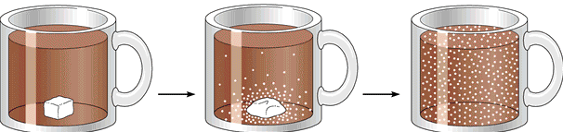
2.1.2.1 List 4 types of passive transport mechanisms
2.1.2.2. Define diffusion and indicate how diffusion is influenced by gradient slope, molecule size and temperature
A. Passive Processes
• diffusion: “tendency of molecules or ions to scatter evenly throughout the environment”
• molecules have kinetic energy: how does this facilitate diffusion?
• How is diffusion rate influenced by:
1. Gradient slope??
2. Molecule size??
3. Temperature??
• PM is hydrophobic barrier: to traverse PM a molecule must be lipid-soluble or have access to channels or transporters
simple diffusion
facilitated diffusion
filtration
osmosis
J. Carnegie, Uof O
Fig. 3.5 (5th ed)

Slide 14
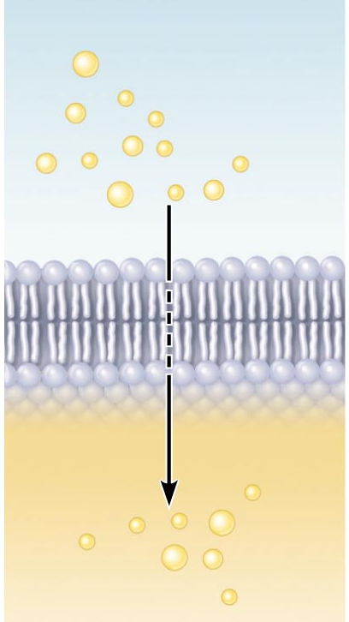
2.1.2.3 describe the mechanism of simple diffusion across the plasma membrane for lipid-soluble versus lipid-insoluble small molecules (give examples of each)
NH₂ - C - NH₂
O
Simple Diffusion:
nonpolar, lipid-soluble: O₂, CO₂, fats, urea, alcohol
O₂ & CO₂ follow gradients into and out of cells, respectively
molecule is moving down its concentration gradient!!
Fig. 3.7a
J. Carnegie, Uof O

Slide 15
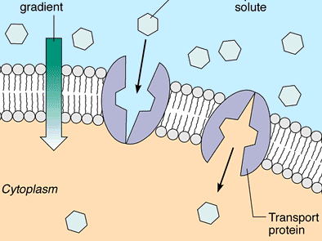
2.1.2.4 describe the process of facilitated diffusion using a physiological example; list 4 characteristics of this transport mechanism
Features of facilitated diffusion:
1) specific
2) not ATP-requiring (glucose to glucose-6-P right after entry)
3) limited by carrier saturation
4) movement down concentration gradient
5) can be inhibited by certain substances
Carrier-Mediated
lipid-insoluble molecules too large to pass through membrane pores/channels
J. Carnegie, UofO
What is the most well-known substance that is transported by carrier-mediated facilitated diffusion?
Fig. 3.7b: Carrier mediated facilitated diffusion

Slide 16
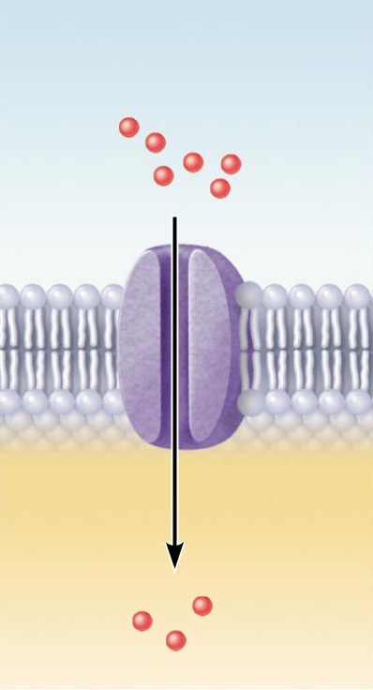
B. Channel-Mediated
selective due to pore size, charges of amino acids that line channels
some are always open (leakage channels)
opening of others is controlled (gated channels)
but movement always down concentration gradient
can be inhibited, can show saturation & are usually specific
Fig. 3.7c: Channel-mediated facilitated diffusion

Slide 17
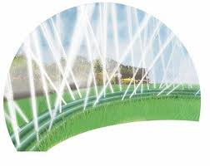
2.1.2.4A describe the process of filtration, using a physiological example; indicate what type of gradient is involved
• water & solutes forced through membrane or capillary wall by fluid or hydrostatic pressure
eg: fluid out of capillaries to cells of tissues to form urine
not selective: only RBCs and large protein molecules don’t get through
what kind of gradient ??
J. Carnegie, Uof O

Slide 18
2.1.2.5 distinguish between primary active and secondary active transport, giving an example of each; indicate the main differences between active and passive transport; differentiate between symport and antiport
ATP used because substance is:
(1) too large for pores
(2) lipid insoluble
(3) moving against concentration gradient
Active transport
Bulk transport
J. Carnegie, Uof O
B1. Active Transport:
like FD, requires a carrier: combines specifically & reversibly with substance
unlike FD, solute pumps move substances (amino acids, Na⁺, K⁺, Ca⁺) AGAINST CONCENTRATION GRADIENTS
many active transport systems are coupled systems:
(a) symport: eg: Na⁺ & amino acids or glucose, Na⁺,K⁺,2Cl⁻ cotransporter
(b) antiport: eg: Na⁺/K⁺ ATPase
• primary AT (Na⁺/K⁺ ATPase) vs secondary AT ( Na⁺ & amino acids )

Slide 19
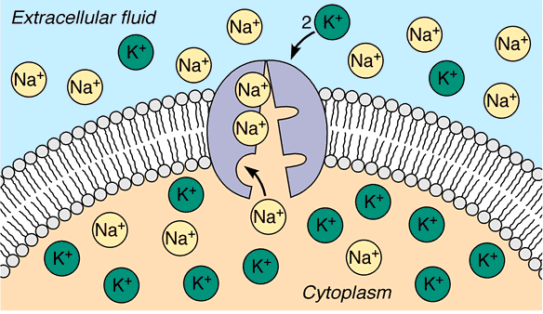
Primary Active Transport:
• [K⁺] 10-20X higher inside cell than out; [Na⁺] higher outside cell than in
• gradients essential to maintain normal cell function/responsiveness/volume
• maintenance of this gradient challenged by:
(1) slow leakage of K⁺ and Na⁺ along conc. gradients
(2) stimulation of muscle & nerve cells
• Na⁺/K⁺ ATPase functions continuously to maintain Na⁺ & K⁺ gradients
3 Na⁺ ions are pumped OUT for every 2 K⁺ ions pumped IN - moving AGAINST their concentration gradients to maintain cell responsiveness
J. Carnegie, Uof O
Na⁺/K⁺ ATPase (example of an antiport)

Slide 20
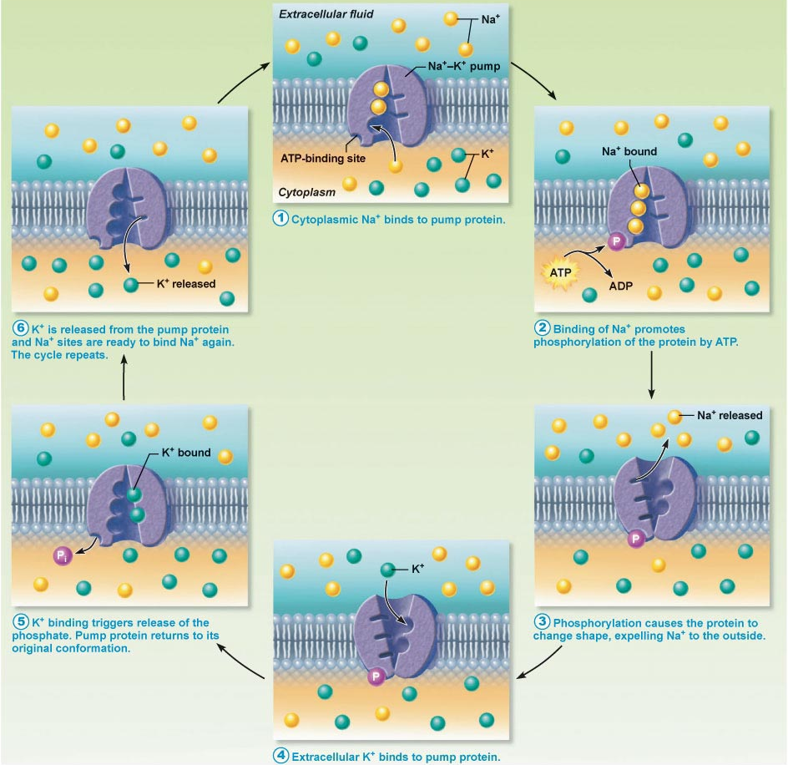
Fig. 3.10: Operation of the Na⁺/K⁺ ATPase, an antiport active transport pump

Slide 21
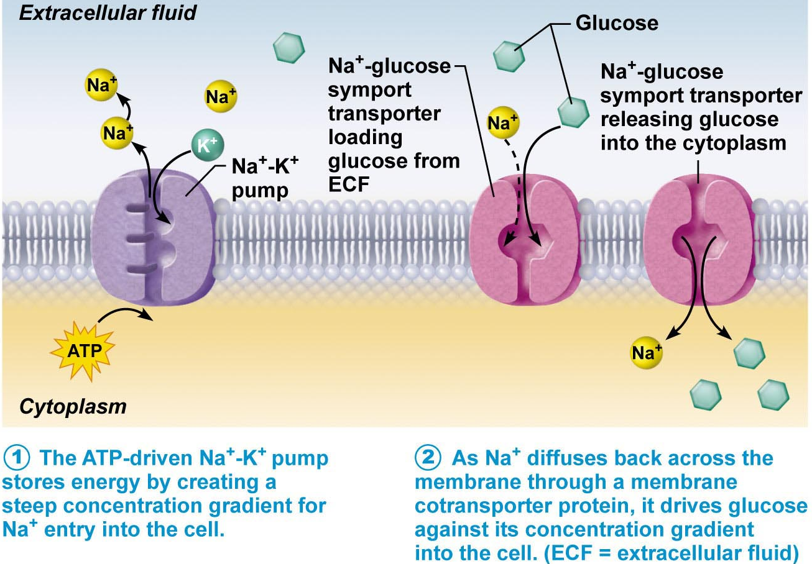
Secondary active transport: cotransport of amino acids, ions:
• transport of a solute is NOT coupled directly to energy-yielding reactions
• eg: transport of an ion or amino acid as Na⁺ leaks back into cell along its concentration gradient (gradient drives transport but gradient would not exist except for Na⁺/K⁺ ATPase)
Is this a symport or an antiport??
Fig. 3.11
J. Carnegie, Uof O
What is the ATP driving in this model of secondary active transport??

Slide 22
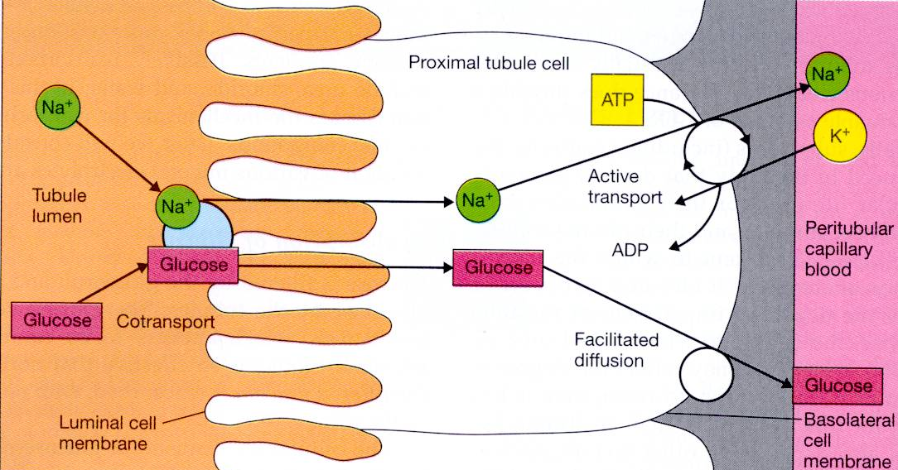
Secondary active transport associated with kidney tubules
R&P Fig. 23.12

Slide 23
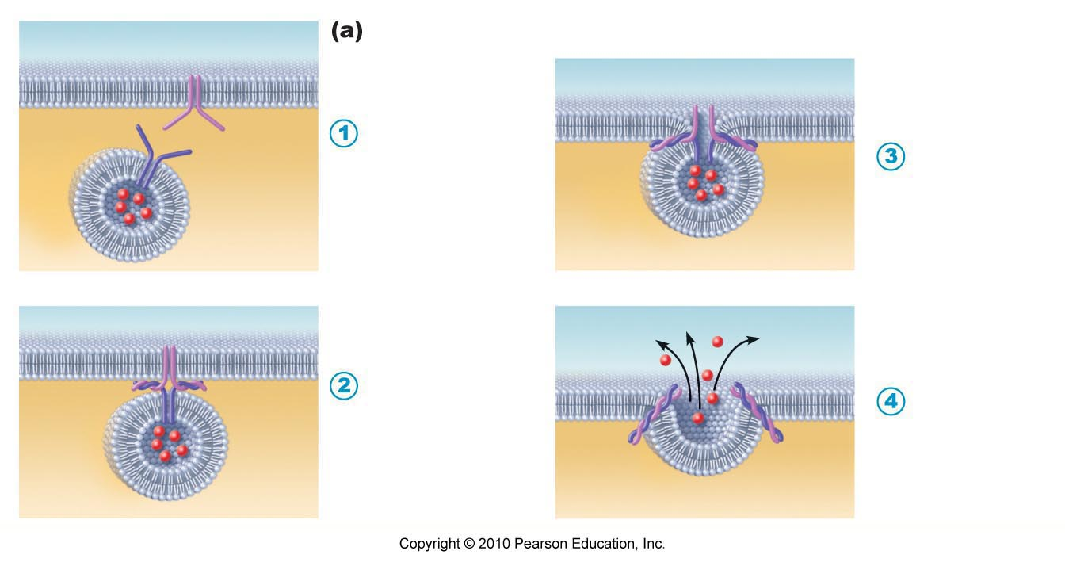
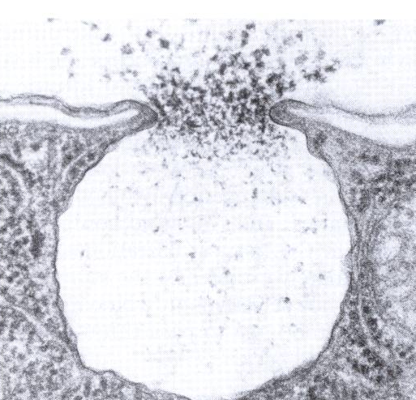
3.1.8 define: exocytosis, endocytosis (as active transport mechanisms);
in general, called vesicular transport
also ATP-requiring
exocytosis (out) and endocytosis (in)
Exocytosis:
• secretion of hormones, neurotransmitters, mucus, ejection of wastes
• substance is enclosed in a vesicle, vesicle moves to PM, fuses with PM, ruptures, releasing contents outside of cell
vesicle docking: What does this involve?? What is the net result of repeated vesicle docking??

Slide 24
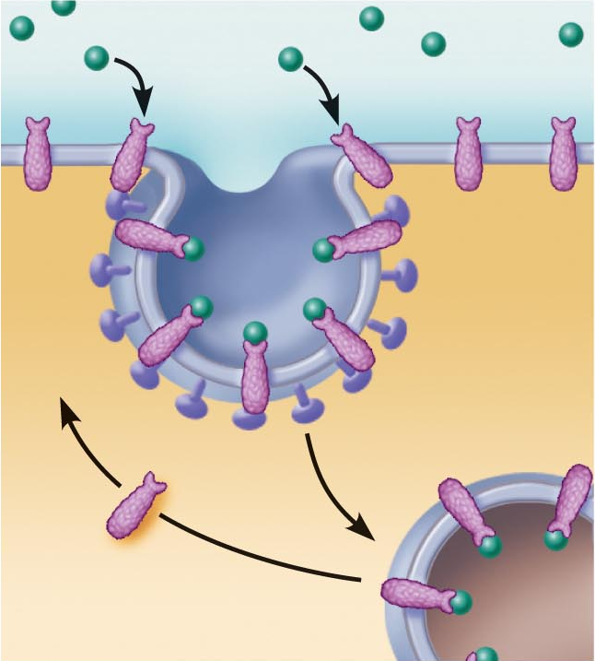
Endocytosis
• means by which large particles can enter cell; also ATP-requiring; energy for vesicle movement
• vesicle encloses substance; pinches off & moves into cytoplasm where contents are digested
Special case: receptor-mediated endocytosis
Fig. 3.13c
J. Carnegie, UofO

Slide 25
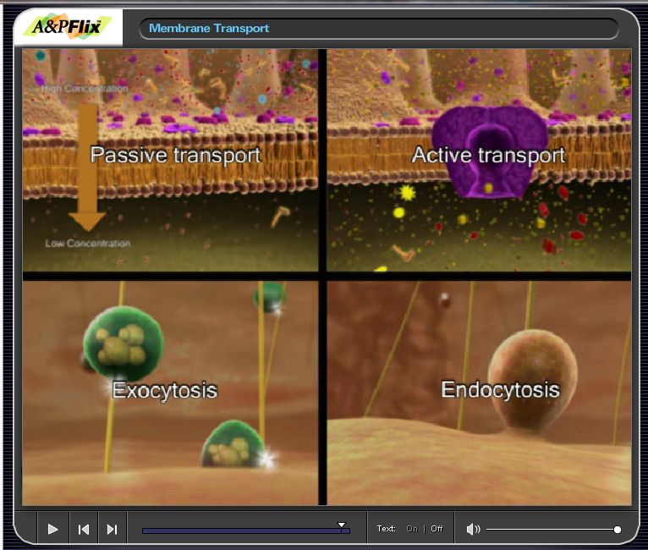
Chapter 3 – A&P Flix: Membrane Transport

Slide 26
2.1.3 Describe osmosis and explain its role in fluid homeostasis
unassisted diffusion of water from area of low to one of high solute conc across a semipermeable membrane
• polar, but small enough for most pores
• net movement due to water concentration gradient
what happens with plant vs animal cells?
• water conc ↓ in response to ↑ number solute particles in sol’n (osmolarity)
• animal cells swell or shrink in response to water movement until equilibrium or rupture
osmolarity and tonicity are not the same!!!
Osmolarity: total conc of solute particles in a solution (type doesn’t matter; mOsmol/L)
Tonicity: concentration of nonpenetrating solute particles in a solution = ability of solution to change the shape of a cell bathed by that solution – why??
Note: 1 mM NaCl = 2 mOsmol/L;
1 mM glucose = 1 mOsmol/L
J. Carnegie, Uof O

Slide 27
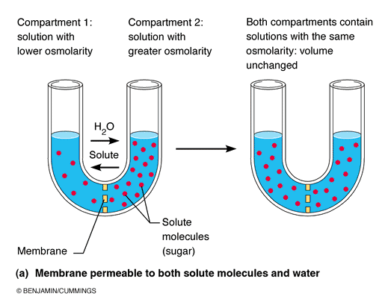
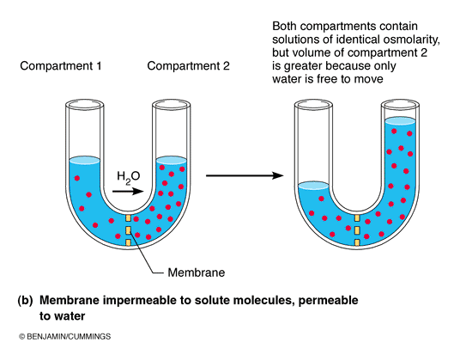
Fig. 3.8

Slide 28
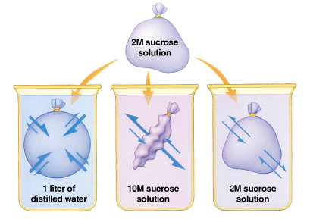
bio.winona.msus.edu/.../ images/tonicity.gif

Slide 29

2.1.3.2 distinguish between pairs of solutions that are: isotonic, hypertonic or hypotonic
8
4
12
Cl⁻
Cl⁻
Cl⁻
Cl⁻
⁺
Na⁺
Cl⁻
Cl⁻
Ca⁺⁺
Na
Ca⁺⁺
Cl⁻
Cl⁻
Cl⁻ Ca⁺⁺
Na⁺
Na⁺
Cl⁻
Ca⁺⁺
Cl⁻
Cl⁻
1 mM NaCl = 2mOsm
1 mM glucose = 1 mOsm
1 mM CaCl₂ = 3 mOsm
Q#1: What do we mean when we say that 0.9% NaCl is isotonic saline??
Q#2: What happens to a RBC when it is put into a hypertonic solution?? Into a hypotonic solution?? What does the term lysis mean??
Applications:
1. Hypertonic solutions for edema: pull water out of swollen tissues.
2. Hypotonic solutions to carefully rehydrate dehydrated patients.
J. Carnegie, Uof O

Slide 30
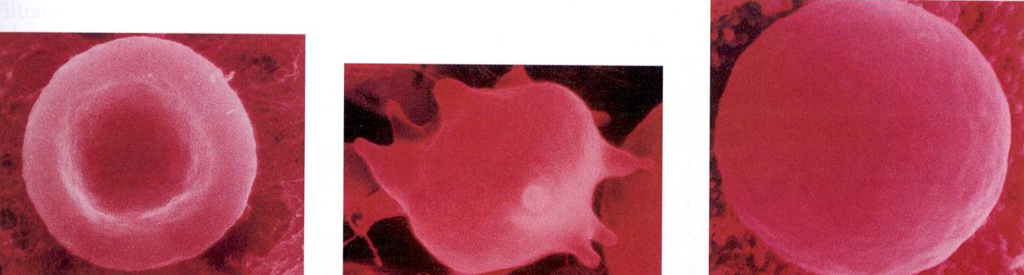
What are the responses (hint: there is an initial response and then a final equilibrium) of a RBC ([solutes] inside RBC=300 mOsm) put into a solution of 300 mOsm NaCl + 60 mOsm urea?? (another hint: cells are permeable to urea, not permeable to NaCl)
Initial response:
2. Final response
J. Carnegie, Uof O
300 mOsm NaCl
60 mOsm urea
RBC in:
isotonic
hypertonic
hypotonic
solutions

Slide 31
TOPIC #2.2: PHYSIOLOGY OF THE NEURON
2.2.1 Identify the different regions of the neuron and associate each region with the functions of reception, propagation and transmission of nerve impulses (pp. 390-393)
2.2.2. Explain the phenomena (diffusion of ions, types of ion channels) that are responsible for the electrical activity of neurons (resting membrane potential, action potential) (pp. 395-404)
2.2.3 Describe the factors that influence propagation of the action potential along an axon (pp. 404-407)
2.2.4 Explain the mechanisms of synaptic transmission (synapse, post- synaptic potentials, synaptic integration (pp. 407-414)
J. Carnegie, Uof O

Slide 32
2.2.1 Identify the different regions of the neuron and associate each region with the functions of reception, propagation and transmission
2.2.1.1 justify 3 special properties of neurons that set them apart from most other cells in the body
2.2.1.2 label and indicate the functions of the receptive, conducting and secretory regions of the neuron
structural units of NS: conduct electrical impulses from one body part to another
Special features:
1. Extreme longevity: adequately nourished ⇒ 100 yr+
2. Amitotic: why? what does this mean if neurons are damaged?
3. High metabolic rate: O₂/glucose requirements?
large, complex cells: all have a cell body + one or more processes
J. Carnegie, UofO

Slide 33
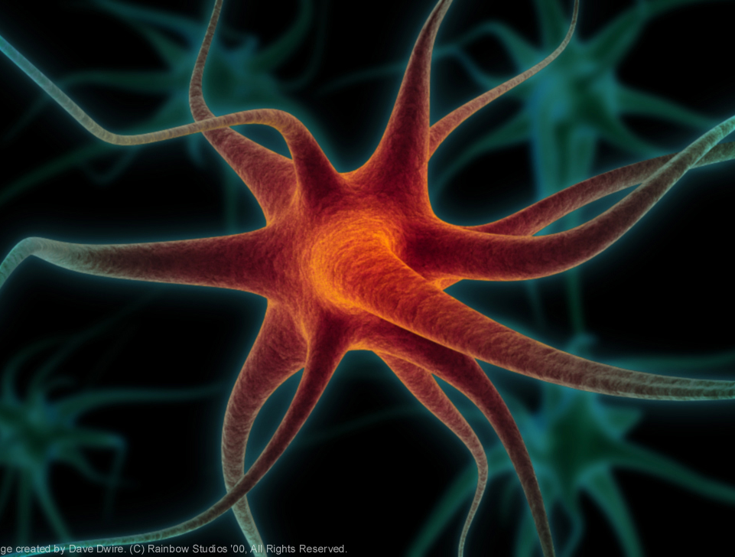
"There are perhaps about one hundred billion neurons, or nerve cells, in the brain, and in a single human brain the number of possible inter-connections between these cells is greater than the number of atoms in the universe." (Robert Ornstein and Richard Thompson, The Amazing Brain. Boston: Houghton Mifflin Company. 1984, 21)
http://www.holisticeducator.com/neuron.htm

Slide 34
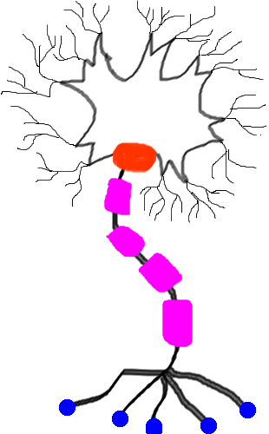
3 functional regions: (plasma membrane very important in all regions!)
1. Receptive region
2. Conducting region
3. Secretory region
http://www.ualberta.ca/~neuro/OnlineIntro/NeuronStructure.htm

Slide 35
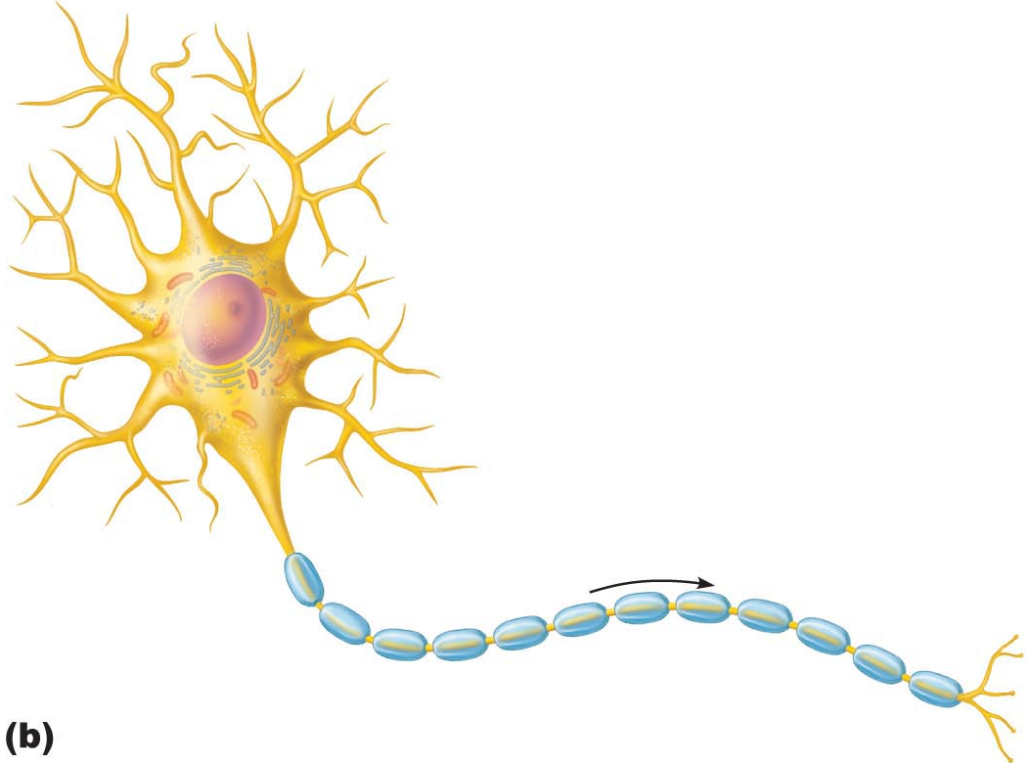
A. Neuron Cell Body
• large, spherical nucleus + granular cytoplasm ➢ biosynthetic centre
• extensive RER + ribosome clusters (Nissl bodies); also elaborate Golgi & lots of mitochondria Why??
• CNS/ PNS as a whole: What is a nucleus? What is a ganglion?
B. Neuron Processes
dendrites
axons
axonal terminals
2 more terms:
tract: bundle of nerve processes in CNS
nerve: bundle of nerve processes in PNS
Fig. 11.4
J. Carnegie, Uof O

Slide 36
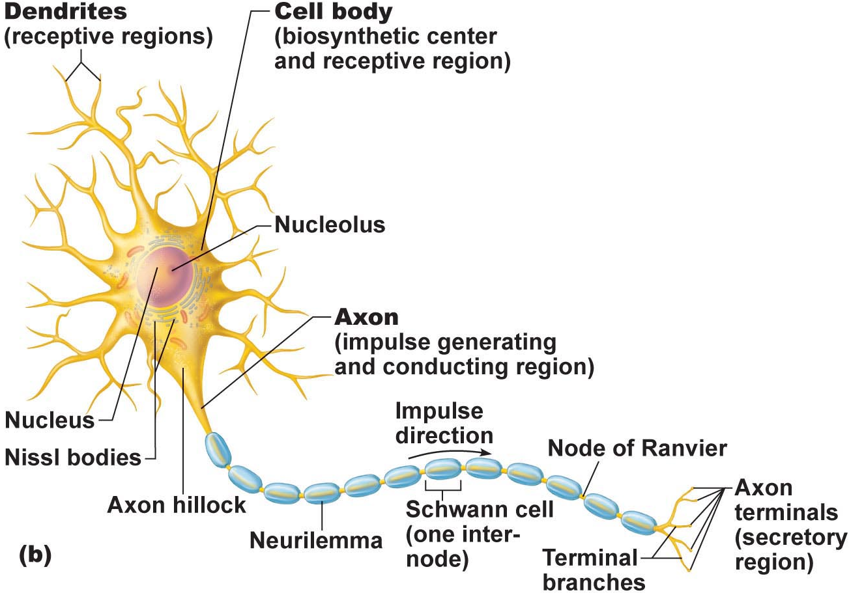
B1. Dendrites: (receptive region)
• short, tapering, branched extensions; usually hundreds/cell body
• enormous SA for reception from other neurons
• conduct impulses toward cell body
• short distance, graded potentials
J. Carnegie, Uof O
B2. Axon
• arises from axon hillock; variable length (can be > 1 metre)
• rate of conduction increases with axon diameter
• usu. 1 axon/neuron; branches at end (~10,000 telodendria) which end in axonal terminals

Slide 37

1. What is the conducting region of a neuron?
2. What is the secretory region of a neuron?
3. Where are the action potentials generated ?
4. In what direction do the action potentials travel?
5. From how many neurons does a single neuron receive information?
6. To how many neurons does a single neuron transmit information?
J. Carnegie, UofO

Slide 38

4.1.5 indicate the effect of axon diameter on neuron conduction velocity
4.1.6 distinguish between anterograde and retrograde transport
B2. Axons (cont.):
Neurotransmitters convey information from one axon to the next
Axon has same organelles as cell body, but no Nissl bodies; axons quickly degenerate if cut
Elaborate cytoskeleton in axon to move material to & fro:
anterograde (eg: mitos, cytoskeleton, membrane parts, NTs)
retrograde (eg: organelles to be degraded/recycled)
Conduction velocities depend on:
(i) axon diameter
(ii) myelin sheath
J. Carnegie, Uof O
Clinical Note:
Viruses such as polio, rabies, herpes simplex & tetanus toxin reach cell body by retrograde transport
Can this be used as a tool to introduce “corrected information” into genome???

Slide 39
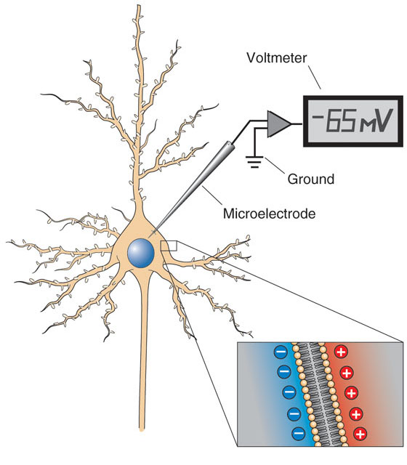
2.2.2.1 describe the resting membrane potential (RMP) of an excitable cell in terms of the differential permeability of the cell membrane to Na⁺ and K⁺; indicate which ion is found primarily inside cells and which is found primarily in the ECF
A. Creation of Resting Membrane Potential (RMP)
What do we mean when we say that neurons are excitable cells??
Some Fundamental Principles of Electricity:
voltage: electrical potential energy due to separation (PM) of oppositely-charged particles (ions) (-70 mV for many neurons)
resting membrane potential: all cells polarized; RMP cell-type-dependent (neg)
J. Carnegie, UofO
http://www.bioon.com/book/biology/whole/image/3/3-11.tif.jpg

Slide 40
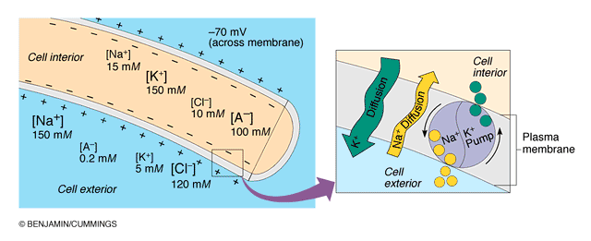
2.2.2.2. describe the Na+/K+ ATPase in terms of its role in maintaining the RMP of a neuron
NEGATIVE because INSIDE of cell negative compared to OUTSIDE
negativity only at level of membrane
RMP due to differential permeability of membrane to Na⁺ and K⁺ ions
Which ion primarily inside cells??
Which ion primarily outside cells??
3. At rest: membrane somewhat permeable to K⁺ but only very slightly permeable to Na⁺; so what happens??? What is the net result???
Fig. 11.8b (7th edition)

Slide 41
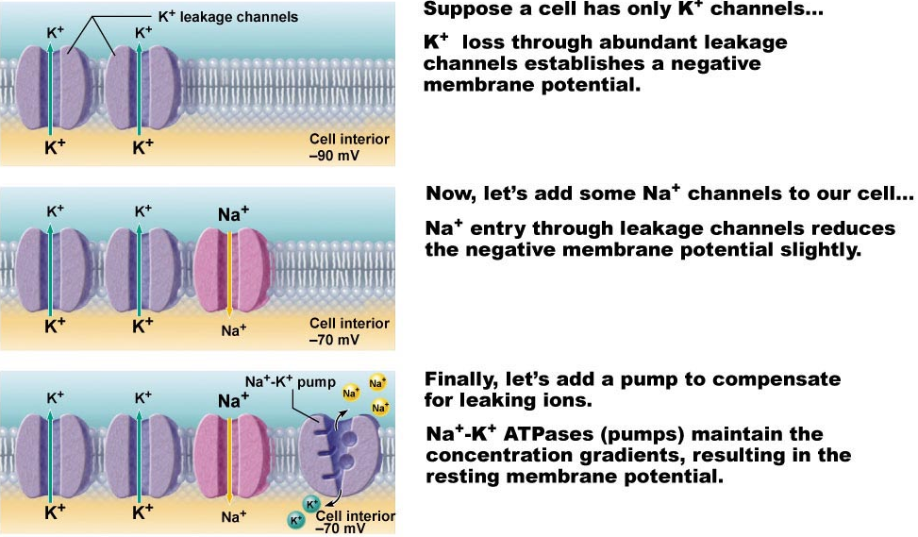
2.2.2.3 define electrochemical gradient
We have:
1. Differential resting membrane permeabilities to Na⁺ & K⁺
2. Also, Na⁺/K⁺ pump moves 3 Na⁺ OUT for every 2 K⁺ IN
Fig. 11.8

Slide 42
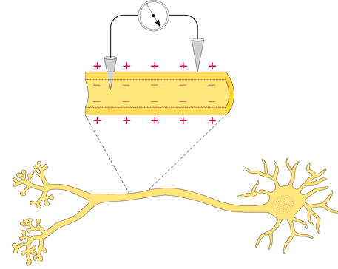
B. Measurement of Resting Membrane Potential (RMP)
RMP for a neuron is -40 to -90 mV (how is this measured???)
Fig. 11.7

Slide 43
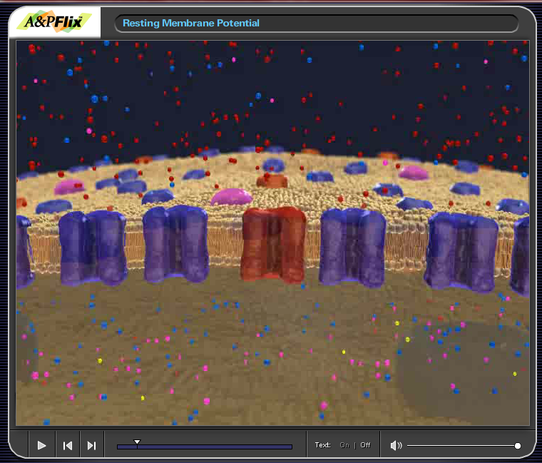
Chapter 11 A&P Flix: Resting Membrane Potential

Slide 44
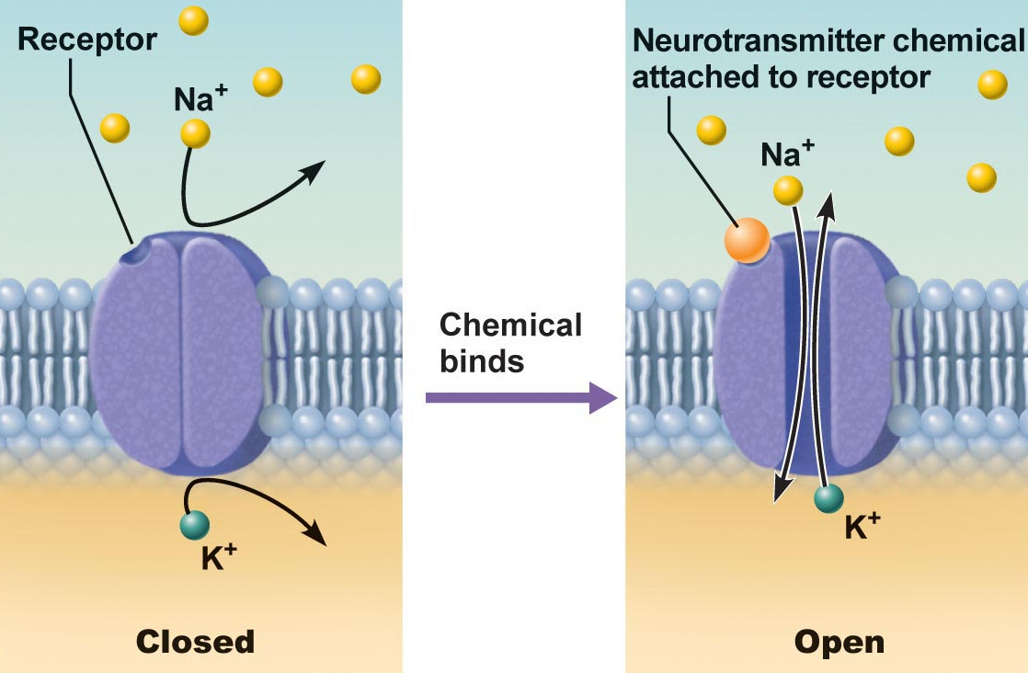
2.2.2.4 distinguish between passive (leakage) and active (gated) channels; list & describe the functioning of the 2 types of gated channels
Channels in plasma membranes:
1. Passive or leakage channels: always open
2. Active or gated channels: signal required to open/close
a) chemically-gated (neurotransmitter/hormone)
b) voltage-gated (change in membrane potential)
channels ion-specific: channels open ➔ ions move in response to electrochemical gradients
Fig. 11.6a
J. Carnegie, Uof O

Slide 45
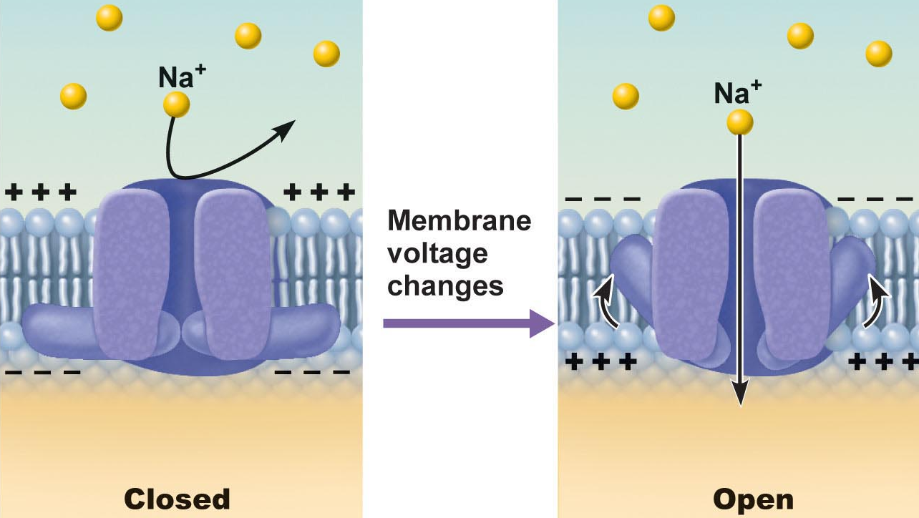
Fig. 11.6b
Fig. 11.6b
● neurons & muscle cells communicate by changing membrane potentials
● 2 types of signals:
graded potentials:……………………………………
action potentials:………………….…………………
J. Carnegie, UofO

Slide 46
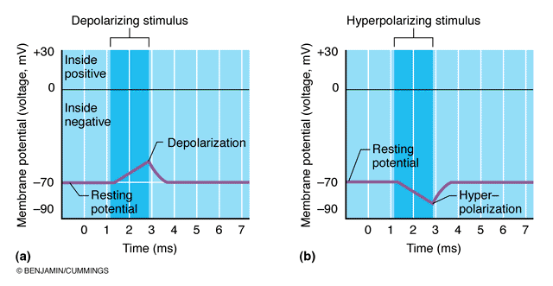
2.2.2.5 distinguish between depolarization and hyperpolarization
Fig. 11.9
depolarization increases the probability of producing nerve impulses
hyperpolarization decreases this probability

Slide 47
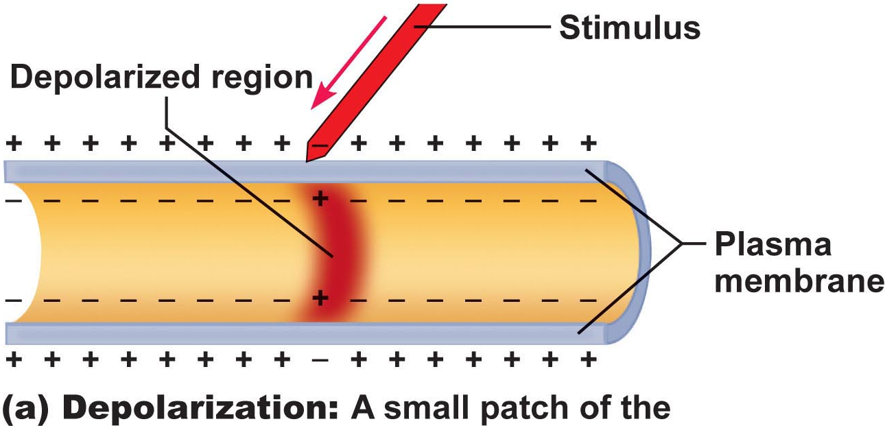
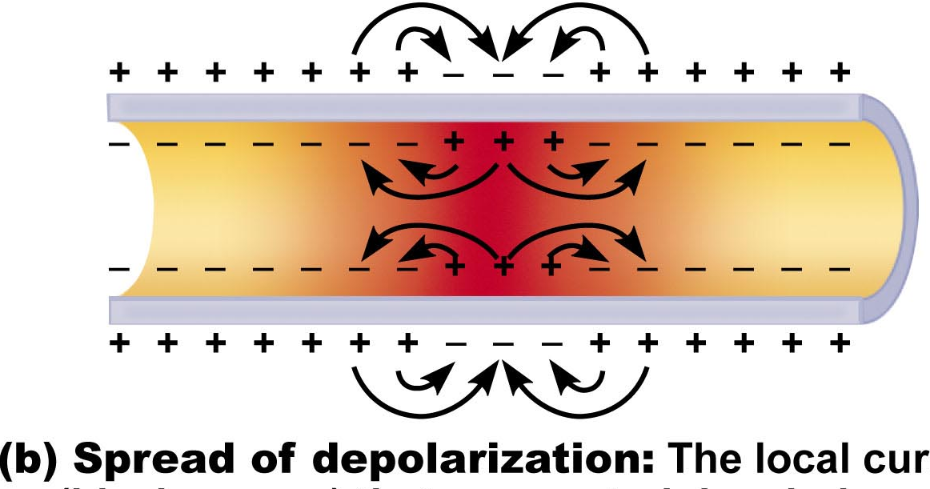
Graded Potentials
short-lived depolarizations or hyperpolarizations
current decreases with distance traveled
graded because magnitude determined by strength of stimulus
Initial stimulus depolarizes or hyperpolarizes local area of membrane
↓
decremental movement of ions on either side of membrane propagates signal for short distance
Fig. 11.10a
Generator potential
Postsynaptic potential
Fig. 11.10b

Slide 48
Check all descriptions that apply to a resting neuron:
1. Its inside is negative relative to its outside.
2. Its outside is negative relative to its inside.
3. The cytoplasm contains more Na⁺ and less K⁺ than does the ECF.
4. The cytoplasm contains more K⁺ and less Na⁺ than does the ECF.
5. A charge separation exists at the plasma membrane.
6. The electrochemical gradient for the movement of Na⁺ across the membrane is greater than that for K⁺.
7. The electrochemical gradient for the movement of K⁺ across the membrane is greater than that for Na⁺.
8. The membrane is more permeable (leaky) to Na⁺ than to K⁺.
9. The membrane is more permeable (leaky) to K⁺ than to Na⁺.
J. Carnegie, UofO

Slide 49
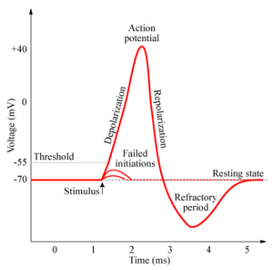
2.2.2.6 describe and graph a typical action potential, illustrating the 3 consecutive, overlapping changes in membrane permeability to specific ions; define: threshold, hyperpolarization undershoot, absolute refractory period, relative refractory period
Definition: a brief reversal of membrane potential; total amplitude = ~100 mV (from -70 to +30 mV)
• cells with excitable membranes (neurons, muscle cells) can generate action potentials; in neurons, only axons can generate action potentials
APs do not decrease in amplitude with distance travelled!!
• voltage-gated channels on axons open & close in response to local currents (graded potentials)
http://www.chm.bris.ac.uk/webprojects2006/Cowlishaw/mech%20synaptic%20transmission.htm
J. Carnegie, UofO

Slide 50
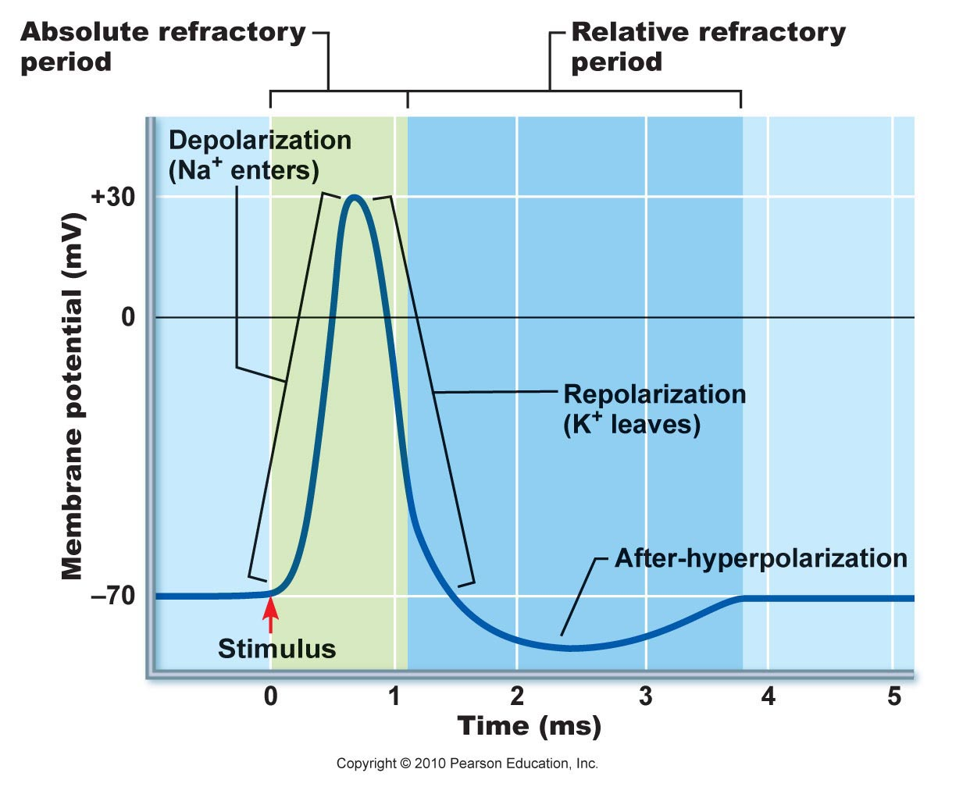
Generation of an Action Potential
transient increase in Na⁺ permeability
restoration of Na⁺ impermeability
transient increase in K⁺ permeability
(i) Increase in Na⁺ permeability
resting state: voltage-gated Na⁺ & K⁺ channels closed; normal leakage
local depolarization: voltage-gated Na⁺ channels open (fast activation gates)
What does threshold (-55 to -50 mV) mean? Why is AP then self-sustaining?
What is the spike of an AP? Concept of positive feedback
Fig. 11.14
Depolarizing Phase:
Both Na⁺ gates must be open for entry; closure of either gate stops Na⁺ entry
J. Carnegie, Uof O

Slide 51
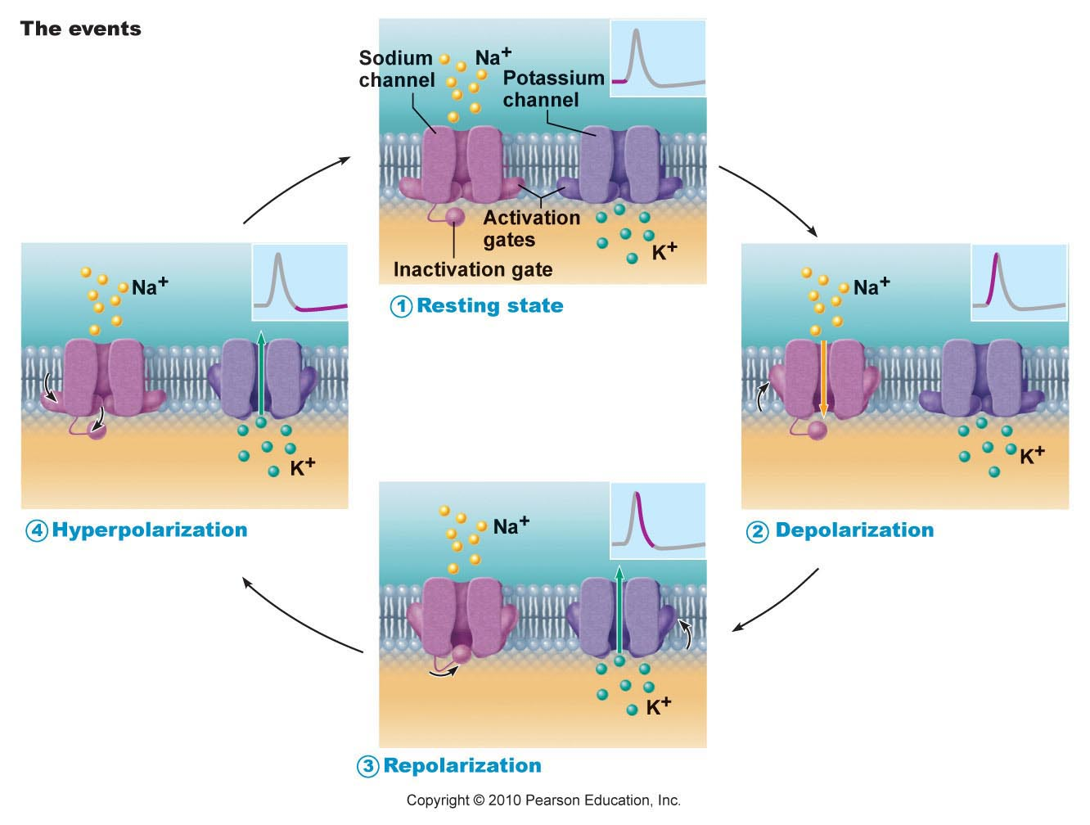
Fig. 11.11

Slide 52
(ii) Decrease in Na⁺ permeability
as membrane potential passes 0 mV, inside positivity resists further Na⁺ entry
Na⁺ gates begin to close; turning point in spike
cell will now begin to repolarize
Repolarizing phase:
(iii) Increase in K⁺ permeability
K⁺ leaves cell along electrochemical gradient & repolarizes cell
also slow gates: so slow that do not close quickly enough →
after-hyperpolarization
Na⁺/K⁺ pumps quickly restore ion gradients across membrane
J. Carnegie, Uof O

Slide 53
Fig. 11.14

Slide 54
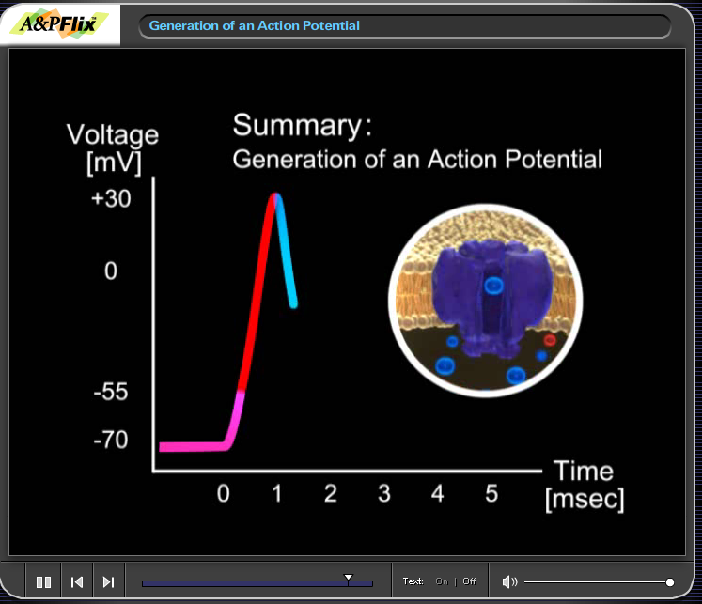
Chapter 11 A&P Flix – Generation of an Action Potential

Slide 55
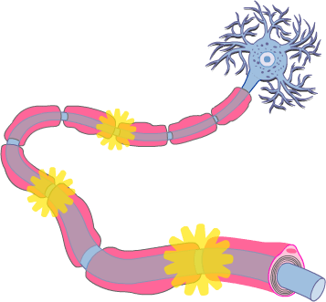
2.2.3.1 justify the unidirectional propagation of an AP and the description of an AP as an “all-or-none” event; indicate how stimulus intensity is coded in action potential production
Propagation of an Action Potential
• AP must traverse length of neuron to signal next neuron
• propagation rather than conduction of an AP - Why??
• unidirectional - Why?? What do we mean when we say that an area of a neuron is refractory to further stimulation? What does this mean about the Na⁺ channels??
J. Carnegie, UofO
http://www.getbodysmart.com/ap/nervoussystem/neurophysiology/actionpotentials/menu/menu.html

Slide 56
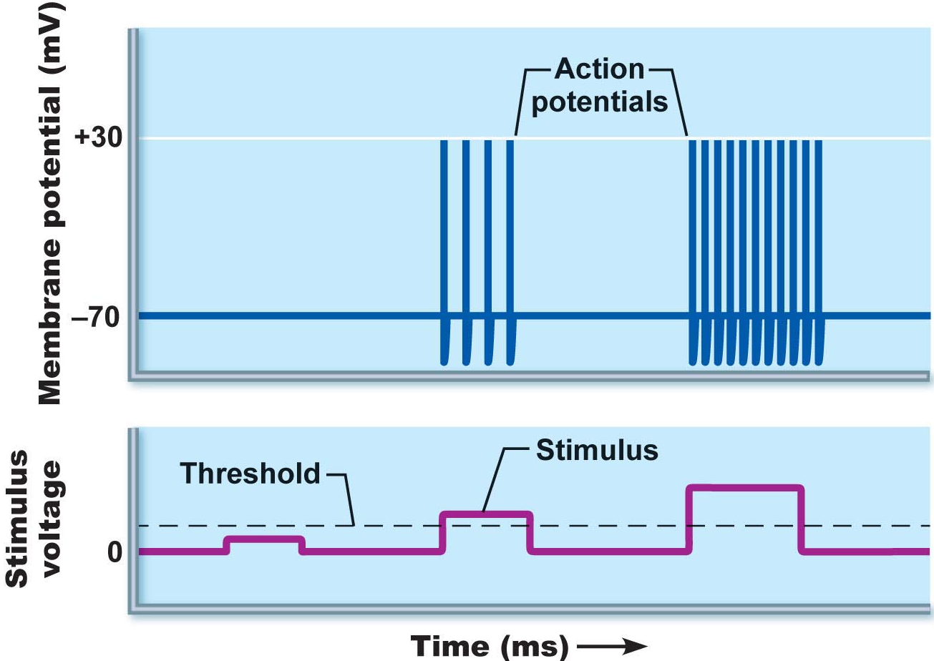
Threshold and the All-or-None Phenomenon
outward K⁺ current = inward Na⁺ current (~20 mV of depolarization)
can go either way!!
local depolarizations (graded) must sum to reach threshold or no AP
Why do we say that an AP is an all-or-none event?
NB: APs are all the same size: stimulus intensity is indicated by AP frequency
Fig. 11.13

Slide 57
Absolute & Relative Refractory Periods
Absolute RP: Na⁺ gates open & second depolarization impossible
Relative RP: Na⁺ gates closed but K⁺ gates open; can only be stimulated by a very strong stimulus (greater than threshold);
a means of increasing frequency when incoming stimulus is strong
Fig. 11.14

Slide 58

2.2.3.2 describe the production of myelin sheathes around peripheral neurons and indicate their role in AP propagation; define: Schwann cell, node of Ranvier, saltatory conduction, oligodendrocytes, multiple sclerosis as a disease affecting the myelin sheath
Myelin Sheath:
• white, lipid-protein; insulates/protects peripheral nerves
• increases (up to 150 X) rate of impulse propagation
• Schwann cells: membranes <25% protein (minimal channels ➢ Why?)
Node of Ranvier? saltatory conduction? Are dendrites myelinated?
Fig. 11.15. Myelin sheath speeds up impulse propagation

Slide 59


myelinated nerves also in CNS: oligodendrocytes; white vs gray matter
http://homepage.psy.utexas.edu/homepage/class/Psy332/Salinas/Cells/Cells.html
http://reinventioninc.blogspot.com/2005_01_01_reinventioninc_archive.html

Slide 60

Chapter 11: A&P Flix – Propagation of an Action Potential

Slide 61

A Clinical Note
Multiple Sclerosis:
persistent inflammatory response in which myelin sheaths gradually destroyed (autoimmune? persistent virus?)
cycles of relapse and remission: flare-ups and then some healing and myelin regeneration; axons develop more Na⁺ channels in demyelinated areas
blindness (optic nerve), muscle weakness, clumsiness, urinary incontinence
ultimately myelin destruction is permanent and axons “drop out” or degenerate
Therapy:
(1) reduce inflammatory destruction
(2) manage symptoms
(3) promote repair of damaged myelin
J. Carnegie, UofO

Slide 62

2.2.4 Explain the mechanisms of synaptic transmission (synapse, post- synaptic potentials, synaptic integration)
2.2.4.1 differentiate between electrical and chemical synapses in terms of relative frequencies, distributions, mechanism, speed and properties of inter-neuron communication
THE SYNAPSE
junction between 2 neurons or neuron + effector
presynaptic vs postsynaptic neuron (most neurons are both)
2 types of synapses: electrical and chemical

Slide 63
A. Electrical Synapses
much less common; like gap junctions
direct current flow - protein channels
rapid transmission (electrically-coupled)
neurons can be synchronized
primarily embryonic, also eye movement; in non-nervous tissue, found in cardiac & smooth muscle where can synchronize contractions
Chemical Synapses
release and binding of neurotransmitters
“Neurotransmitters . . .function to open or close ion channels that influence membrane permeability and, consequently, membrane potential.” (Marieb, /98)
2 parts: (i) axonal terminal:
(ii) receptor region:
What events occur in the synaptic cleft (fluid-filled space of 30-50 nm)?
Why is synaptic transmission unidirectional?

Slide 64

2.2.4.2 illustrate and describe the main features of chemical synaptic transmission; briefly describe 3 ways in which chemical synaptic transmission can be terminated
Mechanism of Synaptic Communication
Initiation:
1. Ca⁺⁺ gates open in presynaptic terminal
2. Neurotransmitter release
3. Neurotransmitter binds to postsynaptic receptors
4. Ion channels open in postsynaptic membranes
NB: ~300 vesicles emptied/impulse - So what happens when we have increased impulse frequency???
J. Carnegie, U of O

Slide 65

Termination:
3 options:
(i) degradation by enzymes of postsynaptic membrane (acetylcholine)
(ii) reuptake by presynaptic terminal (norepinephrine)
(iii) diffusion away from synaptic site (nitric oxide)
J. Carnegie, U of O

Slide 66
2.2.4.3 define synaptic delay
Synaptic Delay:
• slowest (rate-limiting) step of neurotransmission - Why??
• time for NT release, diffusion & receptor binding: 0.3-5 ms
2.2.4.4 distinguish between EPSPs and IPSPs in terms of channels opened and end results in terms of membrane potential/ease of generating an action potential
Postsynaptic Potentials
channels respond to chemicals rather than changes in membrane potential
channels mediate local changes in membrane potential: graded per amount of NT
2 types of PSPs:
(i) excitatory postsynaptic potentials (EPSPs)
(ii) inhibitory postsynaptic potentials (IPSPs)

Slide 67

EPSPs:
NT binding ➔ membrane depolarization; opens one channel for both Na⁺ & K⁺
electrochemical gradient for Na⁺ steeper than for K⁺; what is end result??
what is generated is NOT an AP; only axonal membranes can generate APs!!; get local, graded depolarizations called EPSPs; if strong enough to reach axon hillock, then get AP
IPSPs:
NT binding ➢ membrane hyperpolarization by inc. permeability to K⁺ or Cl⁻
What is the end result in terms of membrane potential?
What is end result in terms of ease of generating an AP?
Fig. 11.18

Slide 68

2.2.4.5 define (in terms of EPSPs & IPSPs): temporal summation, spatial summation; justify the role of the axon hillock as the neural integrator
C1. Summation by Postsynaptic Neuron
single EPSP cannot generate an AP
2 types of summation (EPSPs & IPSPs):
(i) temporal: (ii) spatial:
axon hillock = neural integrator (numerous EPSPs & IPSPs)
most effective synapses:closest to axon hillock – why??
Fig. 11.19

