Slide 1
Homeostasis 1

Slide 2
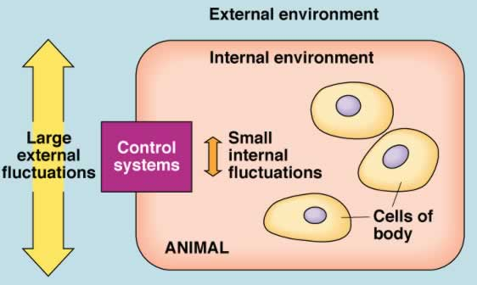

3. HOMEOSTASIS: CONTROL MECHANISMS Sept 30, Oct 03 not on midterm
3.1 Define & identify the principal characteristics of homeostasis (pp.8-11)
3.2 Introduction to the Autonomic Nervous System (pp. 525-527, 535-538)
3.3 Introduction to the Endocrine System (pp. 591-603)
J. Carnegie, UofO
Notes:
Homeostatic in an internal mechanism that maintains environment s organism can survive and thrive
ex the heart doesn’t work bby it self it has sensors to keep it regular ad tell it to pump more or less
The brain ad the heart
It will use the autonomic system and the endocrine
Cell:: need to be taken care of and there and be external and internal influence the change the enviroment (fluctuation) and great example of this is the blood fluid control systems are very important it can mean the diffecent in a segure

Slide 3
3.1.1 define homeostasis, giving at least 2 physiological examples
a system in which variables are regulated so that internal conditions remain stable and relatively constant
Temperature regulation
Blood ion concentration control
• not unchanging - rather a dynamic state of equilibrium involving many systems:
(i) adequate blood levels of vital nutrients
(ii) heart activity/blood pressure monitored & adjusted as needed
(iii) wastes must not accumulate
(iv) body temperature
http://del.icio.us/jleather/Temperature
Notes:
The point of homeostsais
to regulate temperature ( if to hot sweat ,,, cold = shiver or put on a coat
Blood ion concentration
It is a dynamic state you have a centain blood sodium level is you eat salty chips it will act
To low of glucose you body will react and can be detrimental to the brain since it is a glucose hog so this is a benefit to have this regulate with homeostatsi 4

Slide 4
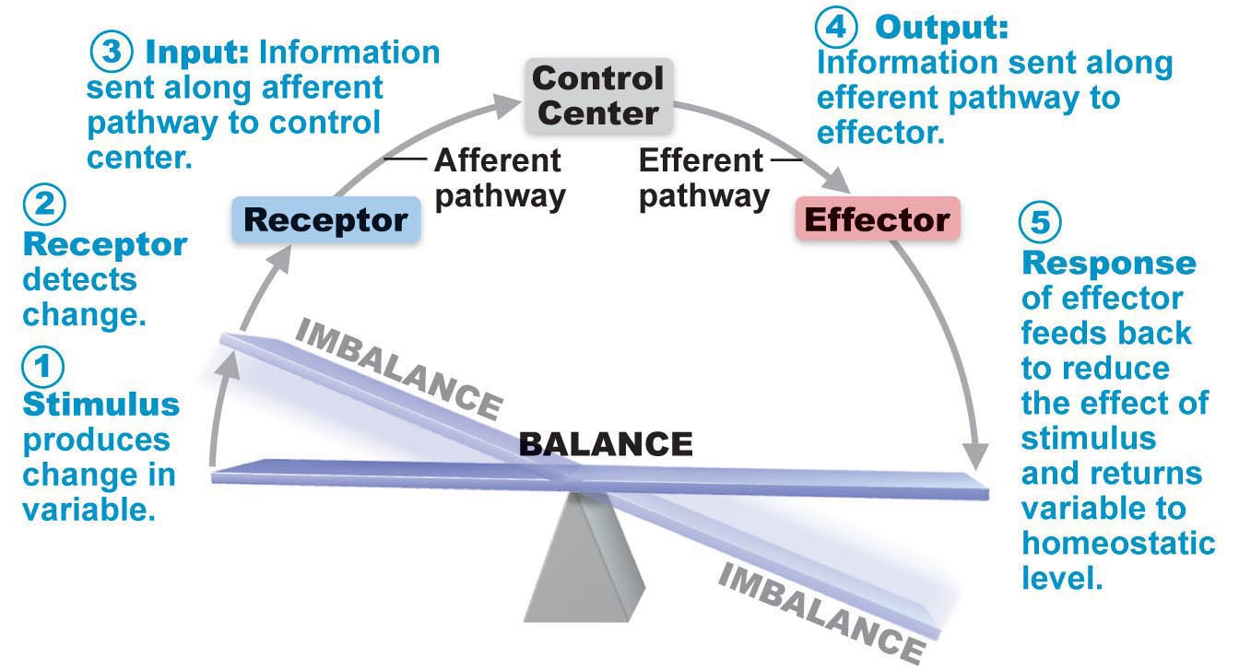
3.1.2 3 essential components of a homeostatic control mechanism
• 3 essential characteristics:
receptor: senses change (stimulus) & sends info (afferent pathway) to:
control centre: determines set point for variable maintenance; analyzes info & determines correct response
effector: provides means for response (output along efferent pathway)
feedback (negative/positive) allows for regulation within a range/enhanced response
Fig. 1.4
Notes:
Feedback asct as a reflect
just like a touch cause a sensory stimuslus so will ,,,
the input will come into a place called a control centre which produces a reaction to the stimlus and the out put is the one that is activated and the (5) it reponds
Afferent = into
Efferent = out put

Slide 5
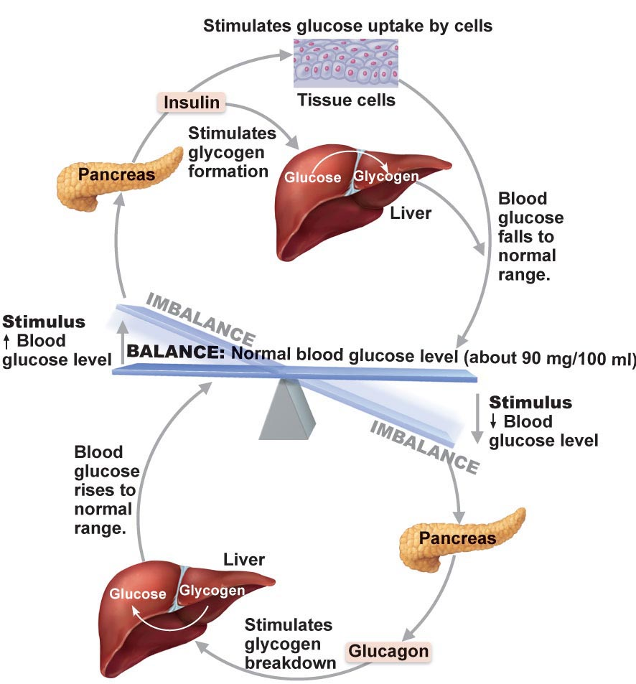
3.1.3 positive and negative feedback
Negative Feedback Mechanisms
• output reduces or shuts off stimulus
1 hormone regulating a process: negative feedback ↓ secretion
process regulated in opposite directions by 2 different hormones – eg: blood glucose
goal of negative feedback: prevent sudden, severe changes
J. Carnegie, UofO
Fig. 16.19
Notes:
The negative will contreact and stimulus or change ex if the temperature got to hot , cold air would be released to equal it out the goal is to
Bring outlying values back to the physiological range

Slide 6
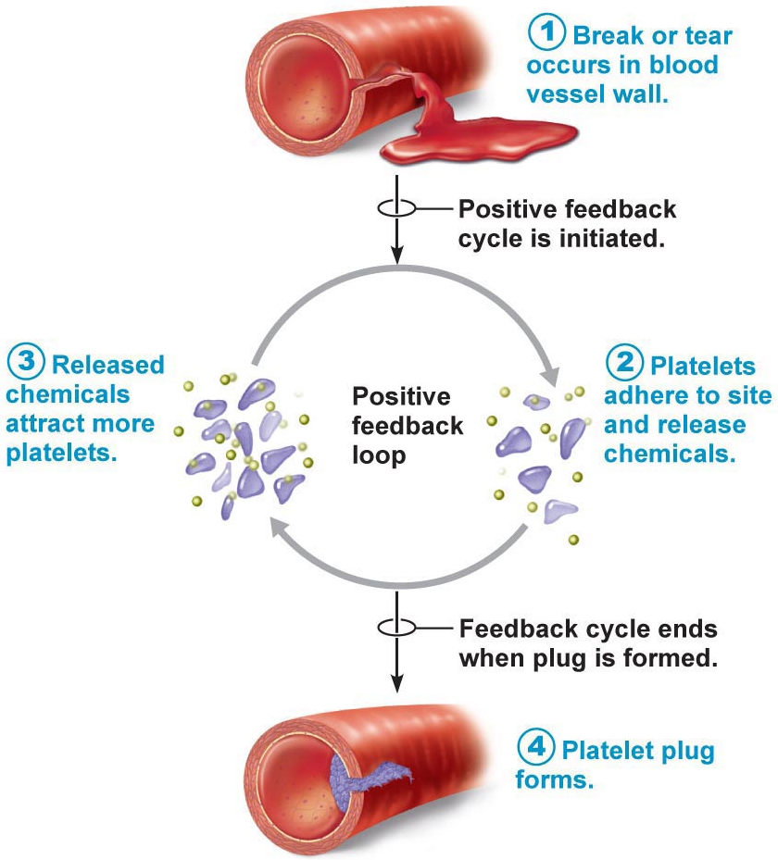
Positive Feedback
Mechanism
• response of mechanism enhances original stimulus ➢ output is further stimulated
• change occurs in same direction as original response
• goal to be attained
• eg: blood clotting -
Homeostatic Imbalance
most disease seen as a disturbance of homeostasis = homeostatic imbalance
aging associated with progressive decrease in our ability to maintain homeostasis ➢ greater risk for illness
Fig. 1.6
Notes:
Positive feed back is more rare in which the stumulus will feed back into the central system and
Ex in a capillary wall rip platelits will come and send a chemicals so more platelate come ex 2 child birth

Slide 7
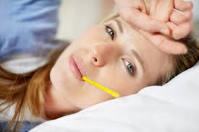
The control centre for regulating body temperature is in the hypothalamus of the brain. When the body is fighting an infection, the hypothalamus allows body temperature to climb higher than the normal value of about 38⁰C. This process involves both positive and negative feedback.
Notes:
Body temperature is controled at many levels there are multi level control to protect this bunderies and smetime you want to control it sometimes you can better fight off an infection with higher body temperature ex inflection you get a fever to help you fight it off it regulates it there

Slide 8
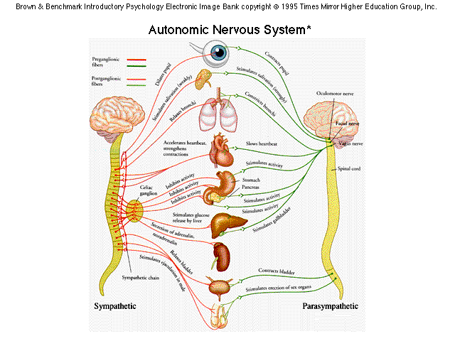
Autonomic nervous system
• auto = self; nom = govern
• ANS = system of motor neurons to smooth & cardiac muscle & glands to allow responses usually without our awareness
Notes:
Means it is automisly gouvern at different levels
Without your concious contol
2 componetmes sysmpathetic and parasympathetic but the both impact the same organs
This is because we need a greter deger of control since smoot mucsle and glands and negative efferent
inhibition inskeletal muscle mean prevention of excitation but in the autonomic inhibition is inhibition ex if you excite the heart pap you increase heart rate but if you excite the sys you get inhibition
It depends on the tissue whether you need it or not in the case
2 – majpor source of pharmetilogical to chage the stte of pait – to see how persuasive the autonomic sysytem on every bofy

Slide 9
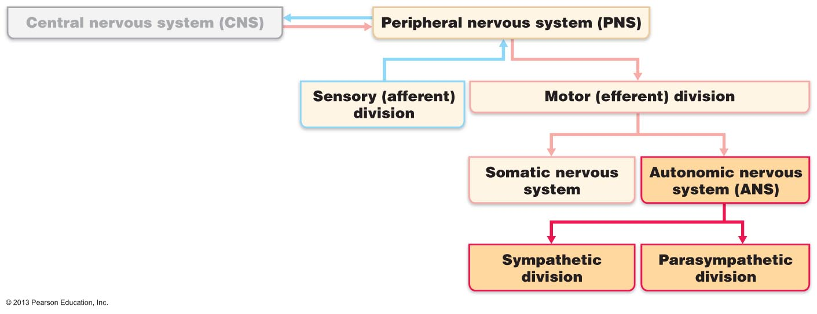
3.2.1.1 The flow chart indicates the position of the autonomic and somatic nervous systems in the structural organization of the nervous system as a whole
(i) shunt blood to more needy areas
(ii) speed/slow heart & respiratory rates
(iii) adjust blood pressure, body temp
(iv) increase/decrease gastric secretions
Fig. 14.1
Notes:
Sensory = makes us fun to study
motor

Slide 10
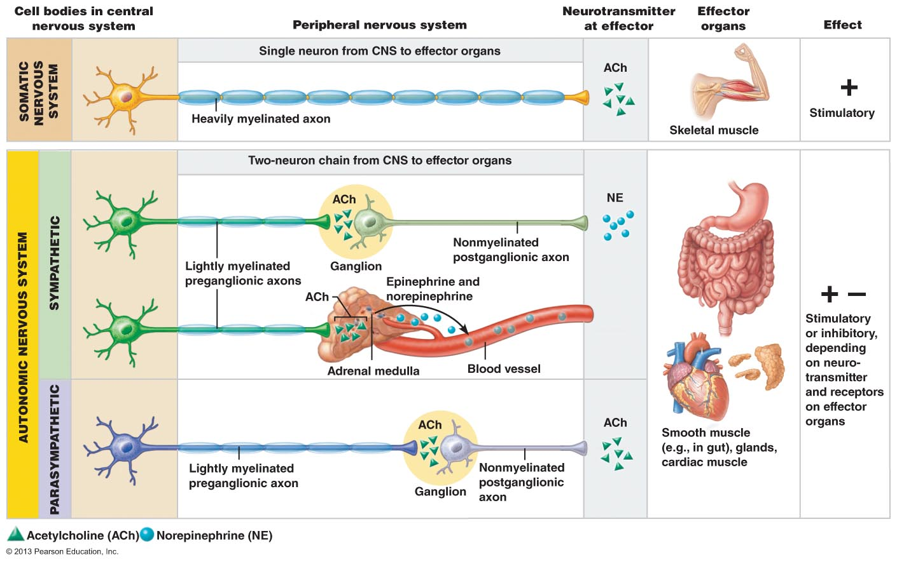
3.2.1.2 compare the autonomic and somatic nervous systems in terms of effectors, pathways, use of ganglia, transmitter effects
Fig. 14.2
Effectors:
• somatic: skeletal muscle; ANS: smooth muscle, cardiac muscle & glands
Notes:
1 ) neron in the spinal cord has a single axon and stimulate the NMJ( excitatory responds to nicotin ) with releace f acete
2a_ sysmapa found in the spinal cord from thuratic 1 to lumbaar 2 they don’t project all the way to the ,,, but just to the ganglia withing the ganglia there is a cell body and it stimulate the post ganglia as it hits the target tissue it will more adrelinin and produce the effect sometims what stand in place of using an axon to ….. Target tissue by a blood vesel and release adrelinin into the bllood stream ,, adrelin rush is when it is released into the blood stream
2b) found in the ,, inferior regions of the spinal cord cranical and sacral the make up is that the pre ganglian has a long xon which ejects close to the target tissue and the short axon will release the aceteal ( it close to the tissue infact inside so if you want to wouder why the heart is beating so fast you nneeed to open the heart and take it i=out

Slide 11
Pathways & Ganglia:
• somatic: thick, myelinated axon from spinal cord to skeletal muscle; rapid conduction of impulses (no ganglia)
• ANS: two-neuron chain: preganglionic neuron: originates in brain or spinal cord; preganglionic axon synapses with 2nd motor neuron (postganglionic) in ganglion outside CNS ➢ postganglionic axon to effector organ
• conduction is slow; preganglionic axons are thin & lightly myelinated; postganglionic axons are thinner & unmyelinated
Notes:
spinal cord to the ----
Skeletal muscle

Slide 12
3.2.2.1 Distinguish between the parasympathetic and the sympathetic nervous system
Parasympathetic Division:
• active in non-stressful situations - « resting & digesting system »
• keeps body’s energy use low while regulating « housekeeping » activities (digestion, elimination of feces & urine)
• “D” system: digestion, defecation, diuresis
B2. Sympathetic Division:
• “ fight or flight” system; also important during exercise: increased heart rate, rapid, deep breathing, cold sweaty skin(why?), dilated eye pupils
• “E” system: exercise, excitement, emergency, embarrassment
Notes:
Para; until the camera man does something to arose the lions of chimps they don’t do anything since animal needs to conserve energy and limited access to food source
Sysm; flight ot fight; so the signals will over whelm and take over the resting para state
Indepentdently activate the skin and limbs and there is no counter act by the para
B selective activation the result is when you have an overall hyper activationn of the vaso and*** COLD SWEAT you get both

Slide 13
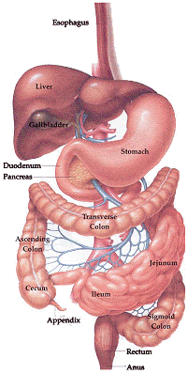
3.2.2.2 Define: sympathetic tone, parasympathetic tone
SNS and vascular tone: ➢ alpha blocking drugs to treat hypertension; blood shunting possible via vasoconstriction/vasodilation
PNS & tone: heart, smooth muscle of GI & urinary tracts- can be overridden by SNS
Notes:
Tone is the basic push pull and that become batter by the
4 different receptor for adrelinin
Usally para dominated and the body relaxs but can be quitly over riden by symp

Slide 14
3.2.2.3 identify: (i) systems regulated in opposite directions by the SNS and PNS, (ii) cooperative effects of the SNS & PNS, (iii) unique regulatory roles of the SNS
Interactions of the Autonomic Divisions
• most visceral organs receive dual innervation
Antagonistic Interactions:
• eg: activity of heart, GI system, respiratory system
 | PNS | SNS
Heart
GI System
Resp. System
Cooperative Effects:
• eg: regulation of external genitalia during intercourse:
a) PNS: dilation of blood vessels in penis
b) SNS: ejaculation, reflex peristalsis of female’s vagina
Notes:
Deflaut is the activation of gastriold activity and slavery production happens but sysmp when you do your midtem to get dry mouth

Slide 15
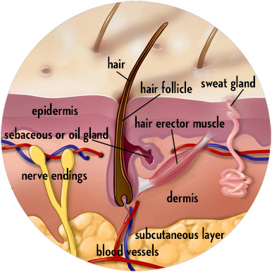
Unique Roles of Sympathetic NS:
SNS regulation only: adrenal medulla, sweat glands, arrector pili muscles of skin, kidneys, most blood vessels
also:
> thermoregulatory responses to heat
> renin release from kidneys - result will be increased blood pressure
metabolic effects:
(i) increases metabolic rate of body cells
(ii) raises blood glucose levels
(iii) stimulates mobilization of fats
(iv) increases mental alertness
(v) increases speed/strength of muscle contraction
J. Carnegie, UofO
Notes:
Releseing decretly or releasing into the blood stream
overall effts \\\7

Slide 16
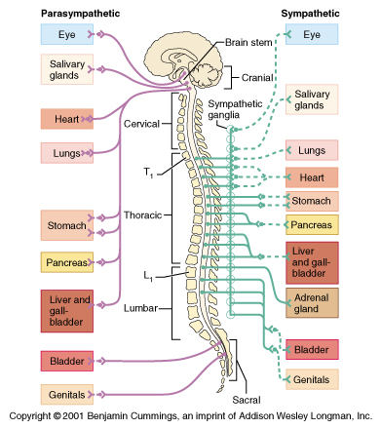
The PNS and ANS differ as to:
Sites where nerves originate
Relative lengths of pre- and post-ganglionic fibers
Locations of ganglia
Fig. 14.3
Notes:
Certain post ganglia will travel alont the spinal nerves and the s=cell body arise from the sysp chain snce it is rarely alone usally on a chian on both side of the spinal ccord,, the spinal nerves ,,, inervate the visseara ,, they are found in cluster call colatery ganglia found on the decending aorta ,, if ou are disscusing splantic nerves you are talking aabout inervata vissera

Slide 17
3.2.2.4 List the 3 levels of regulation of autonomic function, giving examples
1. Brain Stem & Spinal Cord Controls
significant direct effects on ANS-regulated activities
motor centres in ventro-lateral medulla (eg: cardiovascular centre ➢ heart rate, blood vessels; also GI, respiratory centres)
2. Hypothalamic Controls:
• hypothalamus = integration centre of ANS
> anterior regions ➢ parasympathetic
> posterior areas ➢ sympathetic
• hypothalamus contains centres to coordinate heart activity, blood pressure, body temp, water balance, endocrine activity; also centres that help mediate emotions & biological drives
Notes:
Best exp is the cardio vas which regulat heart rate
2: same thing tighter range ********** higher level contro ccenter over autonoic

Slide 18
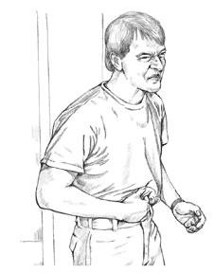
1. After surgery, patients are often unable to urinate and bowel sounds are absent. What division of the ANS is affected by anaesthetic?
2. Stress-induced stomach ulcers are due to excess sympathetic stimulation. eg: one suspected cause of ulcers is almost total lack of blood flow to the stomach wall? How is this related to sympathetic function?
Notes:
1 ) para
2) Not fair ,,, but in edition to inb=hibting digestive function but if a bear scares you right away yu quit para stolsic but you may also don’t need blood to around the stomach so there is a vessical constriction so you can have more blood

Slide 19
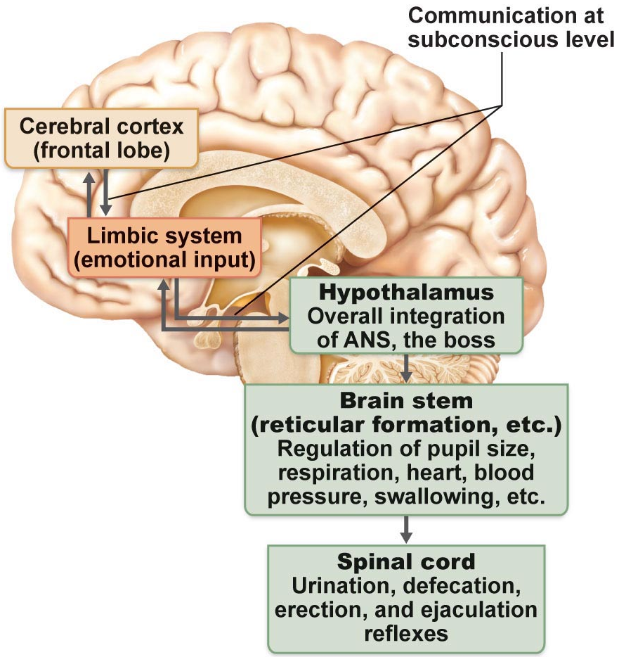
3. Cortical Controls:
• e g: meditation & biofeedback allow some conscious control over visceral activities
> e g: during meditation, can lower heart & breathing rates, oxygen use, metabolic rate
> biofeedback to improve management of migraine headaches, stress & cardiac function
Homeostatic Imbalances of ANS
• e g: hypertension:
Fig. 14.9
J. Carnegie, UofO
Notes:
Levels of auto in the ccerebral cortext and it is higher and impose that control over others ex heart rate it can incre the second you see the line on the tract for a run heart rate inc not because you are nervous but since ou are incitpation of exercise and that comes from the celerab cortext
Limbic when you are sitting on the buss beside a preety boy

