Slide 1
451 Smyth Road Ottawa ON K1H 8M5
Office: 3220
Tel.: (613) 562-5800 (8188)
Email: wstaines@uottawa.ca
Sept 25 pages 298-306
ANP 1105C
Cellular Physiology of Nerve and Muscle - (Lecture 3-7) Sept. 18, 22, 25, 29, Oct. 3 Homeostasis: Autonomic Nervous System and Endocrine System (Lecture 8-9) Oct.6, 9
The Respiratory System (Lecture 19-21) - Nov 27, Dec.1, 4, 8

Slide 2



PUT IN THE CORRECT ORDER:
1. Myosin heads bind to active sites on actin molecules
2. ATP is hydrolyzed
3. Myosin heads return to high-energy shape, ready for the next power stroke
4. Calcium binds to troponin
5. Cycling continues until calcium ions are sequestered by the SR
6. Myosin cross brides detach from actin
7. Troponin changes shape
8. ADP and P_{i} (inorganic phosphate) are released from the thick filament
9. Myosin heads pull on the thin filaments (power stroke) and slide them toward the centre of the sarcomere
10. ATP binds to the thick filament
11. Tropomyosin is moved exposing active sites on F-actin
J. Carnegie, U of O

Slide 3
PUT IN THE CORRECT ORDER:
4 1. Myosin heads bind to active sites on actin molecules
9 2. ATP is hydrolyzed
10 3. Myosin heads return to high-energy shape, ready for the next power stroke
1 4. Calcium binds to troponin
11 5. Cycling continues until calcium ions are sequestered by the SR
8 6. Myosin cross brides detach from actin
2 7. Troponin changes shape
5 8. ADP and P_{i} (inorganic phosphate) are released from the thick filament
6 9. Myosin heads pull on the thin filaments (power stroke) and slide them toward the centre of the sarcomere
7 10. ATP binds to the thick filament
3 11. Tropomyosin is moved exposing active sites on F-actin
J. Carnegie, U of O

Slide 4
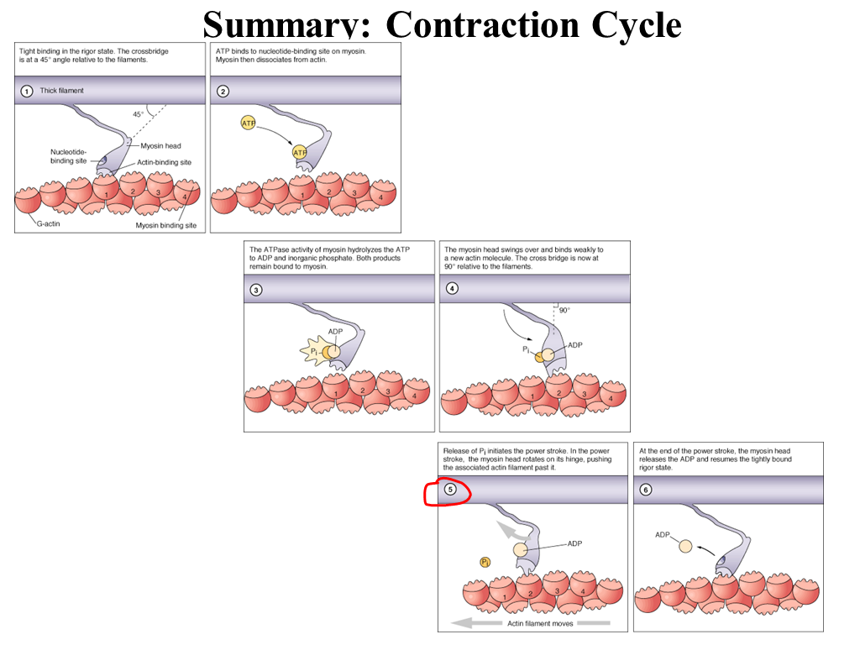

Slide 5
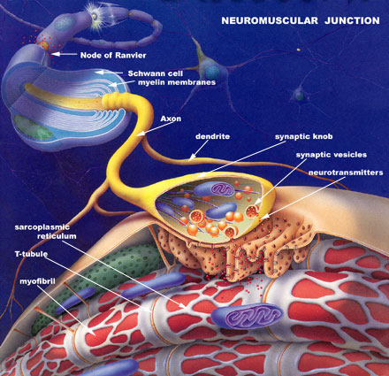
http://fig.cox.miami.edu/~cmallery/150/neuro/neuromuscular-sml.jpg

Slide 6
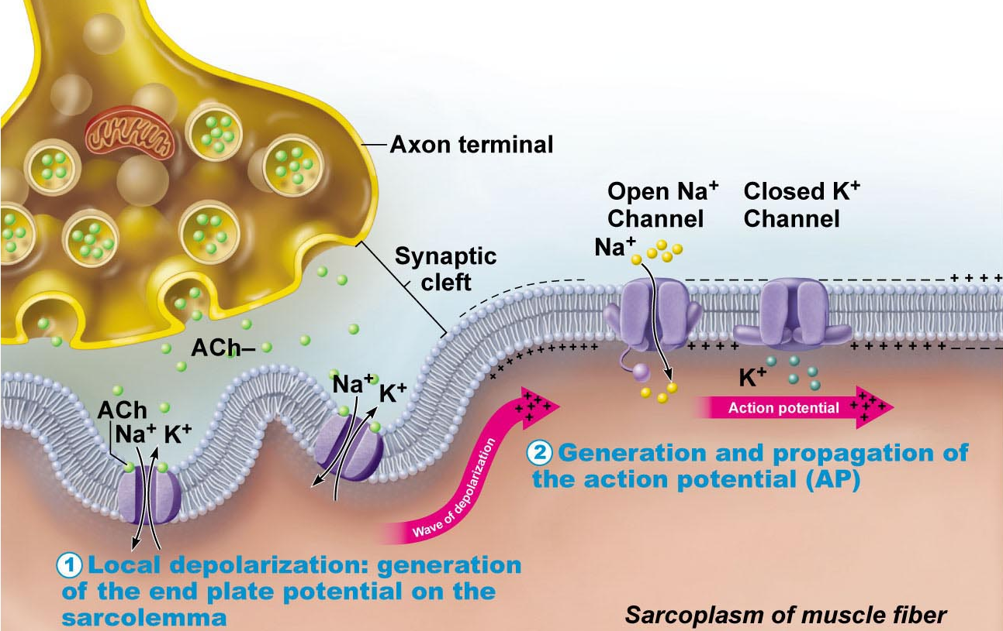
2.3.2.1 describe the structural organization of a neuromuscular junction; justify the latent period of excitation-contraction coupling
Regulation of Contraction – What is excitation-contraction coupling?
Fig. 9.9 (8th edition)
Neuromuscular junction & nerve stimulus:
• skeletal muscles stimulated by motor neurons of somatic ns
• 1 NMJ in ~middle of fiber - synaptic cleft; NT is acetylcholine
• What is the motor end plate?
• events at nerve-muscle synapse identical to those in nerve-nerve synapse
J. Carnegie, U of O

Slide 7
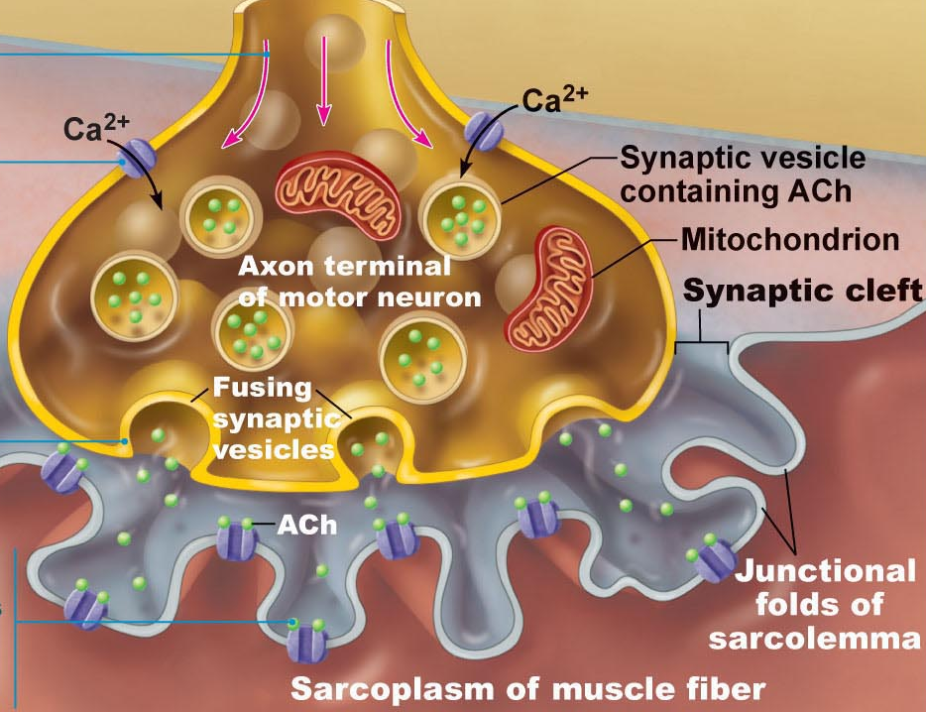
Generation of an AP across sarcolemma:
chemically gated channels: local depolarization ➢ AP in all directions
depolarization/repolarization with Na⁺, then K⁺ as for axon
Na⁺/K⁺ pump to restore
once initiated, AP is unstoppable - all-or-none response of muscle cell
AP is brief (1-2 msec); contraction can be 100 msec+
J. Carnegie, UofO

Slide 8
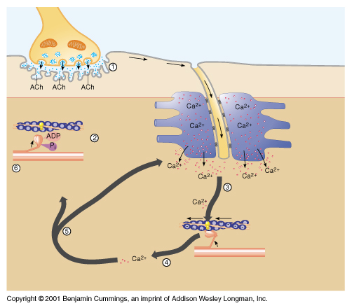
Destruction of acetylcholine:
• acetylcholinesterase (AChE) = enzyme on sarcolemma of NMJ
Fig. 9.9 (7th edition)

Slide 9
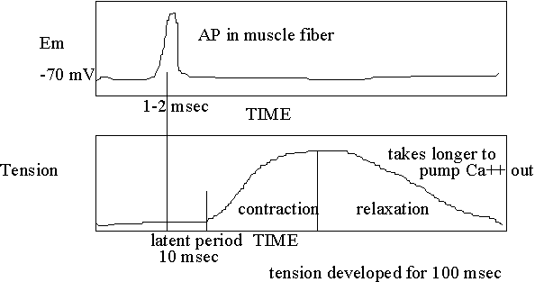
What is the latent period of excitation-contraction coupling?? Ca diffusion
What happens if nerve impulses arrive at the NMJ at high frequency?? Fusion, tetanus
http://facstaff.elon.edu/shouse/physiology/physiol14/Lecture7.html

Slide 10
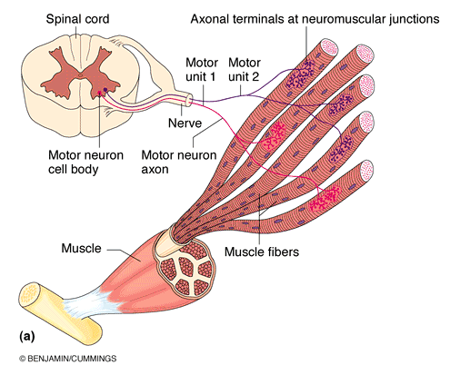

CONTRACTION OF A WHOLE SKELETAL MUSCLE
2.3.3.1 define motor unit; describe the influences of wave summation and motor unit summation on the contractile response of skeletal muscle; define tetanus in terms of muscular contraction
The Motor Unit
motor nerve (at least 1/muscle)
hundreds of motor neuron axons
each axon to many axonal terminals
each axonal terminal to NMJ of a single muscle fiber (cell)
• avg. no muscle fibers/neuron = 150 (range = 4 to hundreds)
• when neuron fires, all fibers contract
MOTOR UNIT = 1 motor neuron + all muscle fibers it supplies
Fig. 9.13
J. Carnegie, UofO

Slide 11
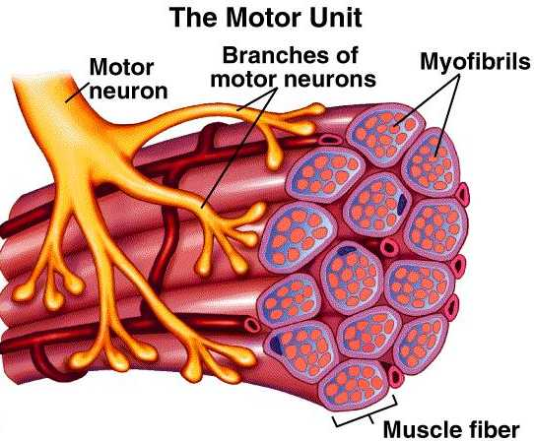
Graded Muscle Responses:
• 2 types of graded responses:
1) change speed of stimulation
2) change # of motor units activated
http://academic.wsc.edu/faculty/jatodd1/351/ch6outline.html
J. Carnegie, UofO

Slide 12
5.3.3
Muscle fiber type:
a) Slow oxidative fibers: thin cells with slow-acting myosin ATPases - - contract slowly (red = lots of myoglobin); primary energy fuel is fat
• lots of mitos, capillaries, aerobic enzymes: oxidative
• fatigue-resistant, but not powerful (thin) -
b) Fast glycolytic fibers: large, pale (white), little myoglobin & diameter 2x that of slow oxidative fibers; fast-acting myosin ATPases & contract quickly
• few mitochondria; lots of glycogen reserves: glycolytic
• will fatigue (WHY?), but powerful
c) Fast oxidative fibers: red or pink, intermediate cell size; fast-acting myosin ATPases & contract quickly; high myoglobin content & O₂-dependent; fairly fatigue-resistant
most body muscles have a mixture of fiber types; genetics can alter distributions & subsequent athletic strengths
Endurance-type activities like: …………………………………..
best for short-term, rapid, intense movements like: …………………………….
best for intermediate activities like: ………………………………………………………
J. Carnegie, UofO

Slide 13
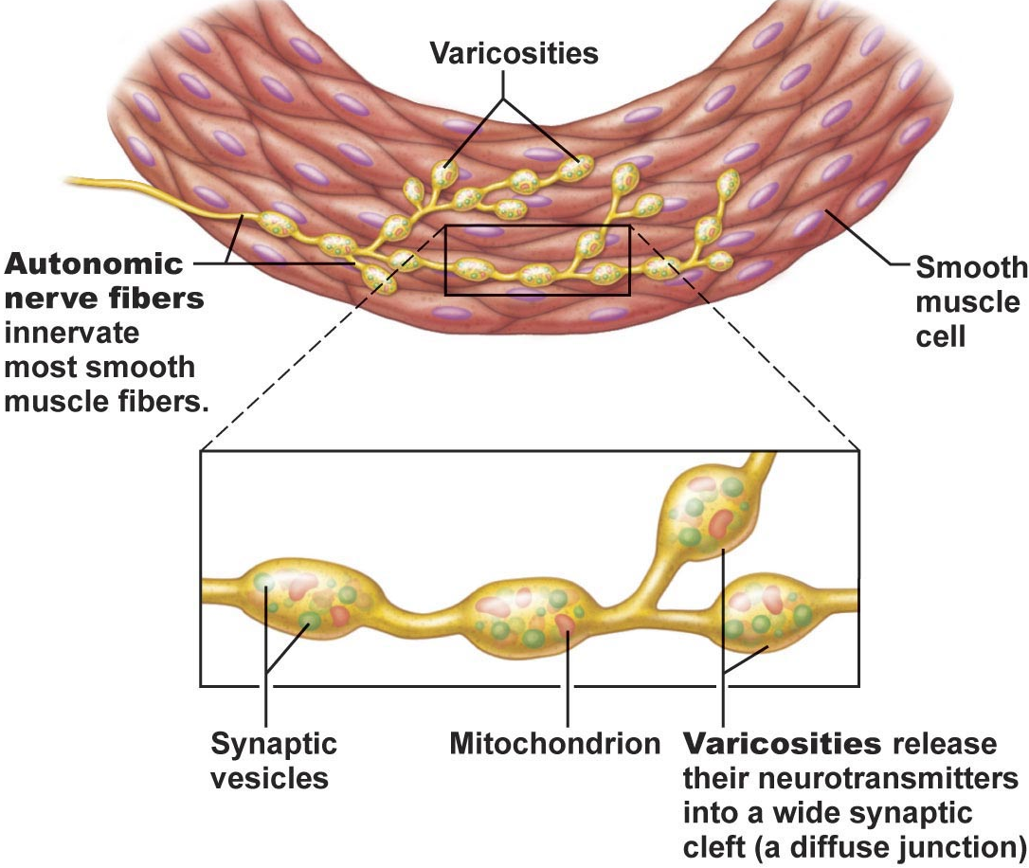
Arrangement of Fibers & Microscopic Structure
small, spindle-shaped cells; one centrally-located nucleus
diameter 2-10 um; length 100-500 um
cells separated by fine CT; sheets of closely opposed fibers; usually at least 2 sheets with opposite orientations
alternating contractions of opposing layers provide mixing, peristalsis, expelling
varicosities instead of NMJs; bulbous swellings of autonomic ns - release NT into wide synaptic cleft near smooth muscle cells - diffuse junctions
Fig. 9.26
J. Carnegie, U of O

Slide 14
• SR less developed than in skeletal muscle; no T tubules; but SR touches sarcolemma & smooth muscle cells have large SA/volume ratio
• no striations, but do have interdigitating thick & thin filaments:
1) ratio of thick:thin=1:13 (smooth) vs 1:2 (skeletal); but smooth muscle myosin has actin-gripping heads along entire length >> strength
2) tropomyosin but no troponin (calmodulin instead)
3) no sarcomeres: thick & thin filaments spiral down smooth muscle cell
4) noncontractile intermediate filaments & dense bodies (attach to thin filaments)
Contraction of Smooth Muscle
Mechanism:
• electrical coupling via gap junctions ➢ slow, synchronized contractions
• some smooth muscle cells are pacemaker cells
Mechanism:
1) actin & myosin interact by sliding filament mechanism
2) final trigger is rise in intracellular Ca⁺⁺
3) sliding process is energized by ATP
J. Carnegie, U of O

Slide 15
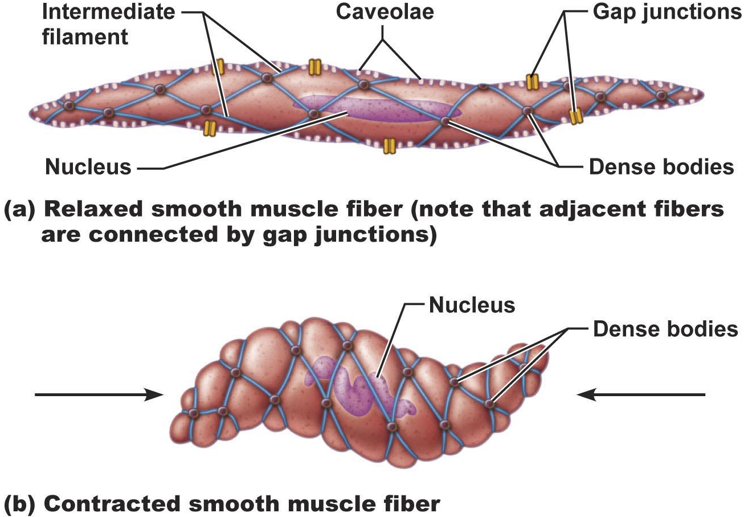
• contraction of smooth muscle is slow (30x), sustained, fatigue-resistant (24-h maintenance of tone of blood vessels, visceral organs)
• few mitos; most ATP generated aerobically – why does that work??
Fig. 9.27
J. Carnegie, U of O

Slide 16
B2. Special features of smooth muscle contraction
a) Response to stretch: more stretch (120% resting length) >> more vigorous contraction - stretching can induce brief contraction (gut) or can have stretch relaxation response (filling)
What does that accomplish?
Length & tension changes: stretches more than skeletal; can generate more tension than skeletal (contracts in a corkscrew-like manner) (150% vs 60%)
c) Hyperplasia: eg. estrogen & uterine smooth muscle cells
d) Secretory functions: collagen, elastin - make their own CT

Slide 17
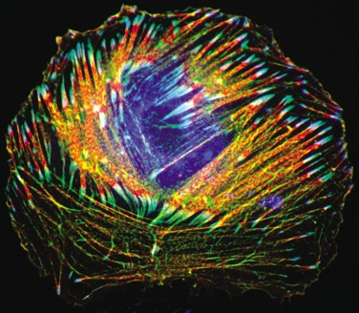
C1. Single-unit (unitary) smooth muscle:
• = visceral muscle; more common
1) contracts as a unit & rhythmically
2) electrically coupled by gap junctions
3) often spontaneous action potentials
4) all other smooth muscle characteristics
C2. Multiunit smooth muscle:
• eg: large airways to lungs, large arteries, arrector pili muscles of skin hair follicles, internal eye muscles for focus
1) gap junctions, spontaneous, synchronized depolarizations rare
2) muscle fibers structurally independent of each other
3) richly supplied with nerve endings, each forms a motor unit with a number of muscle fibers
4) responds to neural stimulation with graded contractions (still regulated by autonomic ns, hormones)
www.nature.com/.../ v5/n7/full/ncb0703-598.html
Notes:
Rat smooth muscle cell that has been transfected with green fluorescent protein (GFP)-tagged -actinin (green) and stained for filamentous actin and vinculin. The actin cytoskeleton was stained with Alexa-568-conjugated phalloidin (red) and vinculin immunostaining is shown in blue. The image was acquired using a fluorescence microscope (Axioskop, Zeiss). Scale bar represents 20 m.

Slide 18


