Slide 1
An Introduction:
Organizational Behaviour and Management
Chapter One

Slide 2
What Are Organizations?
Social inventions for
accomplishing common goals
through group effort
What is OB? What is your definition?

Slide 3
Think about your most memorable job
What did you like/dislike about your job/boss?
Did you feel respected by the Organization?
Were you treated fairly in comparison to your co-workers?
Did your co-workers help or hinder your job performance?
What did you think of the work itself?
On the whole, were you satisfied with your job?

Slide 4
Organizational Behaviour
The attitudes and behaviours…
…of individuals and groups in organizations.

Slide 5
Goals of the Field
OB is concerned with:
  Predicting
  Explaining
  Managing
  people’s behavior in the context of work

Slide 6
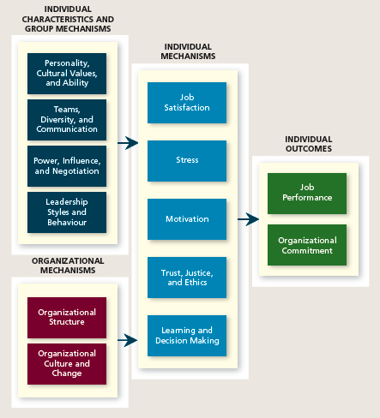
A Model of OB

Slide 7
Management
Management is the art of getting things accomplished in organizations through others.

Slide 8
Early Prescriptions Concerning Management
The Classical View
The Human Relations View
The Contingency View

Slide 9
Early Prescriptions: The Classical View
Classical studies tends to adopt the pessimistic view of human nature .Bureaucracy is Max Weber’s ideal type of organization that includes:
  Strict chain of command
  Technical competence
  Detailed rules, regulations, and procedures
  High specialization
  Centralization of power

Slide 10
The Human Relations Movement
The human relations movement called attention to certain dysfunctional aspects of classical management and bureaucracy:
  Employee alienation
  Limits innovation and adaptation
  Resistance to change
  Minimum acceptable level of performance
  Employees lose sight of the overall goals of the organization

Slide 11
Contemporary Management – The Contingency Approach
Dependencies are called contingencies.
The contingency approach to management recognizes that there is no one best way to manage.

Slide 12
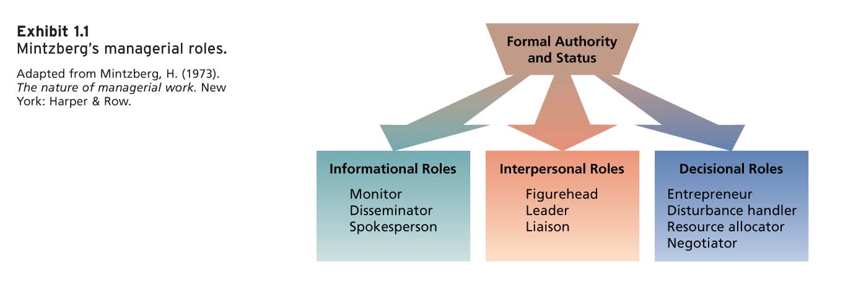
What Do Managers Do?

Slide 13
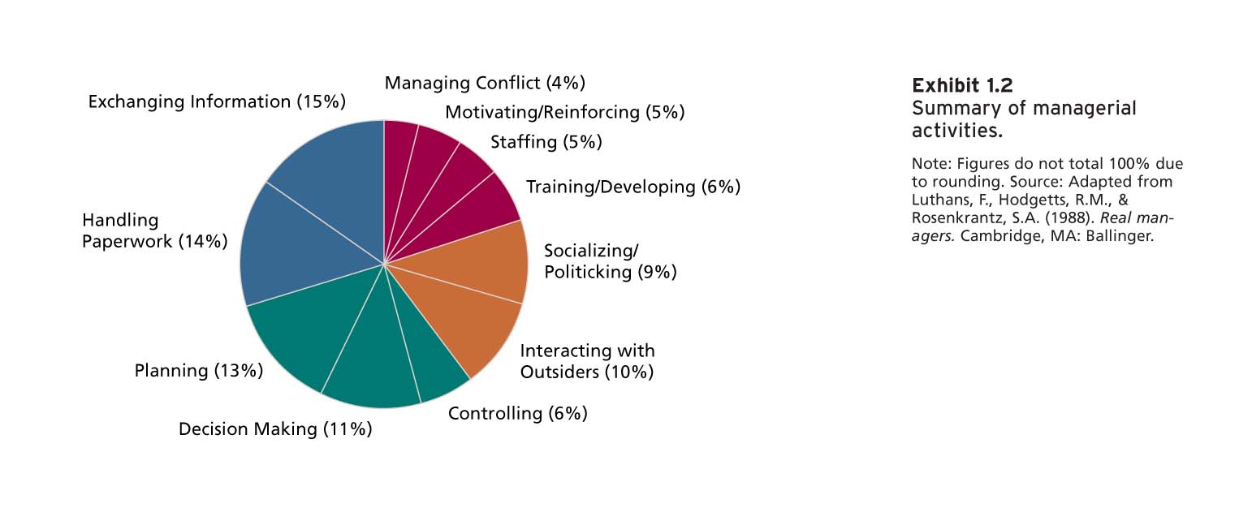
Summary of Managerial Activities

Slide 14
Managerial Minds
Experienced managers use intuition to guide many of their actions:
  To sense that a problem exists
  To perform well-learned mental tasks rapidly
  To synthesize isolated pieces of information and data
  To double-check more formal or mechanical analyses
  GRIP

Slide 15
International Managers
National culture is one of the most important contingency variables in organizational behaviour.
The management style and emphasis given to various activities varies greatly across cultures.
Cultural variations in values affect both managers’ and employees’ expectations about interpersonal interaction.

Slide 16
Management Practices of the Best Companies to Work for in Canada
Flexible work schedules
Stock-options, profit-sharing, and bonuses
Training and development programs
Family assistance programs
Career development programs
Wellness and stress reduction programs
Employee recognition and reward programs

Slide 17
Job Performance
Chapter 2

Slide 19
What is Job Performance?
Job performance is
  Behaviour
  Under employees’ control
  Contributes positively or negatively
  To organizational goals

Slide 20
What is Job Performance?
Task Performance
Organizational Citizenship Behaviours
Counterproductive Work Behaviours

Slide 21
What is Job Performance?
Task Performance:
  Behaviours that are directly involved in the transformation of resources into the goods or services
  Included in a job description
  Routine, adaptive and creative

Slide 22
What is Job Performance?
Organizational Citizenship Behaviors
  Voluntary activities that contribute to the organization by improving the work setting
  Interpersonal
    Helping
    Courtesy
    Sportsmanship
  Organizational
    Voice
    Civic virtue
    Boosterism

Slide 23
What is Job Performance?
Counterproductive Work Behaviors:
  behaviours that intentionally hinder organizational goal accomplishment
  Interpersonal
  Organizational

Slide 24
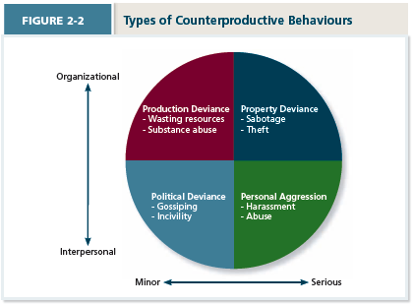
What is Job Performance?

Slide 25
Short discussion
Think of customer service
What was your best experience?
What was your worst experience?
Describe and jot down behaviours

Slide 26
Short discussion
Classify the customer service behaviors in
  Good/poor task performance
  OCB
  CWB

