Slide 1
1
Getting the Message Across

Slide 2
Introduction
Why is communication important?
  For your career
  In the current workplace
What is communication?
Communication in organizations

Slide 3
Communicating for Change in the New Economy
The top skill recruiters look for is effective communication
Employers want you to
  structure and organize information effectively
  speak and write so your audience understands

Slide 4
Communicating in the Current Workplace
Organizational change:
  Flatter organizations
  Team work environments
  Business on a global scale
  Diverse employee base

Slide 5
Communicating in the Current Workplace, cont’d
Technological change:
  The knowledge economy
  Advancing communication technologies
  Web 3.0, apps, and social media

Slide 6
Communicating in the Current Workplace, cont’d
New needs:
  Managing risk
  Sustainability

Slide 7
Communication Defined
We use symbols (words, images and gestures) to create meaning
We share stories to influence the world around us

Slide 8
Communication as a
Field of Study
Communication theory
  explains what happens when we communicate
  describes why certain symbols can mean different things

Slide 9
The Communication Process
Communication is
  situated
    dependent on the culture/environment
  relational
    may be different at different times
  transactional
    cooperative—people adapt to one another and respond to each other

Slide 10
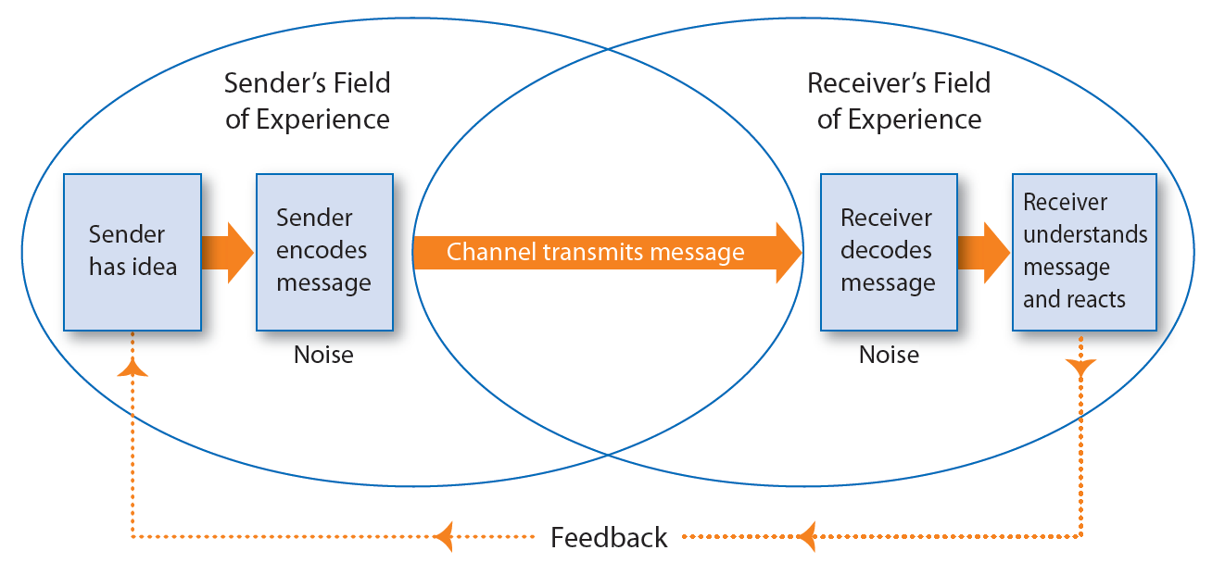
Elements of the Communication Process

Slide 11
Elements of the Communication Process, cont’d
Sender
  Person has an idea and encodes it in a message directed at an audience
Encoding
  Converting ideas into words, gestures, or other symbols to convey a message
Channel
  Communication pathway or medium over which a message travels

Slide 12
Elements of the Communication Process, cont’d
Receiver
  Person/group to whom the message is directed
Decoding
  Understanding and interpreting spoken, written, and non-verbal communication
Feedback
  Responding to the message
  Confirming if the receiver got it and understood it

Slide 13
Barriers to Effective Communication
Channel overload
  Too many messages
Information overload
  Too much information
Emotional interference
  Feelings get in the way
Semantic interference
  Interpret words differently

Slide 14
Barriers to Effective Communication, cont’d
Physical and technical interference
Mixed messages and channel barriers
Environmental interference
  Interpret messages differently based on previous experiences

Slide 15
Barriers to Effective Communication, cont’d
To overcome barriers, be
  timely and time-sensitive
  purposeful
  a good listener and a careful reader
  context-sensitive
  proactive

Slide 16
Communication Contexts
Interpersonal communication
Small-group communication
Organized communication
Intercultural communication
Mass communication

Slide 17
Non-Verbal Communication
Gestures
Eye contact
Facial expressions

Slide 18
Non-verbal Communication, cont’d
Roles:
  Repetition
  Contradiction
  Regulation
  Substitution
  Accenting and complementing

Slide 19
Non-verbal Communication, cont’d
Three domains of non-verbal skills
  Encoding
  Decoding
  Regulation

Slide 20
Components of Non-Verbal Communication
Use of space (proxemics)
Use of time (chronemics)
Paralanguage (vocalics)
Body language (kinesics)

Slide 21
Communicating in Organizations
Internal
  Audience is within organization
External
  Audience is outside organization

Slide 22
Essential Skills for Workplace Communication
Reading
Active listening
  Interaction between speaker and listener

Slide 23
Informal and Formal Channels
Formal network
  Letters, memos, reports, proposals
Informal network
  “Through the grapevine”

Slide 24
The Flow of Information
Formal communication channels:
  Upward
    Subordinates to superiors
  Downward
    Superiors to subordinates
  Horizontal
    Same organizational level

Slide 25
Ethical Communication
Business ethics
  Socially accepted moral principles and rules of business conduct
  May be based on code of ethics
Be aware of how your communications affect others
Business documents are often legally binding

Slide 26
Ethical Lapses and
Why They Happen
Why do ethical lapses happen?
  Safety in numbers
  Head in the sand
  Between a rock and a hard place
  “It’s no big deal”
  Entitlement
  Team player

Slide 27
Ethical Lapses and
Why They Happen, cont’d
To avoid ethical lapses
  Tell the truth
  Communicate clearly, carefully, and respectfully
  Take responsibility for your communications
  Don’t suppress, delay, or de-emphasize important information

Slide 28
Cross-Cultural Communication
BELF (Business English as a Lingua Franca)
  Vernacular of the new global economy
  Simple, clear, free of idioms, anchored in serviceable business vocabulary

Slide 29
Understanding Cultural Differences
Culture
  Shared customs and patterns of behaviour of a particular group or society
  Includes language, rules, beliefs, and social structures
Ethnocentrism
  Believing one’s culture is superior to others

Slide 30
Intercultural Communication Defined
Cultures differ in terms of
  power distance
  uncertainty avoidance
  individualism vs. collectivism
  masculinity vs. femininity
  short-term vs. long-term orientation

Slide 31
High- and Low-Context Communication Styles
Low-context cultures:
  Direct, explicit communication
  “What you say is what you mean”
High-context cultures:
  Social conventions, context, and courtesy are important
  Emphasis on “how you say it”
  Be aware of what is not being said
  Direct communication may seem rude

Slide 32
Communicating Interculturally
Adjust to your audience:
  Express yourself politely
  Keep language simple, literal, and direct
  Be respectful and flexible

Slide 33
Privacy in the Workplace
Privacy Act
Personal Information Protection and Electronic Documents Act (PIPEDA)

Slide 34
Privacy in the Workplace, cont’d
Organizations must
  provide accountability
  identify reason for collecting information
  gain consent
  collect only necessary information
  use information for intended purpose

Slide 35
Privacy in the Workplace, cont’d
Organizations must
  maintain accuracy
  provide safeguards
  tell people how information will be used
  give people access to their own information
  develop straightforward complaints procedures

