Slide 1
COMM 308
Introduction to Finance
Instructor: Ian Rakita
Office: MB 10-213
Email: ian.rakita@concordia.ca

Slide 2
Introduction to Finance
Syllabus

Slide 3
Introduction to Corporate Finance
Overview: Introduction; Outline
Chapter 1: Sections 1.2 to 1.4

Slide 4
INTRODUCTION TO FINANCE
Outline…
Finance
Asset Pricing
  Investor perspective
  Price formation in capital markets
  Investments
  Portfolio management
  CAPM (Capital Asset Pricing Model)
Corporate Finance
  CEO perspective
  Financial decisions of the corporation
  Capital Budgeting
  Capital Structure
  Working Capital Management

Slide 5
What is Corporate Finance?
Financial decision making process of corporations
Why focus on decisions made by corporations?
Other organizational forms:
  Sole proprietorship
  Partnership
How do these differ?

Slide 6
Partnerships
Owned by few people
Owners keep all profits
But: unlimited liability (lose shirt?)
Limited life
Insufficient capital (forgone opportunities)
Difficult to transfer ownership

Slide 7
Corporations
Separate legal entity from its owners
Owners are shareholders
Separation of ownership and management
Limited liability
Ownership easily transferred
Capital formation made easy
Unlimited life
Disadvantage - double taxation

Slide 8
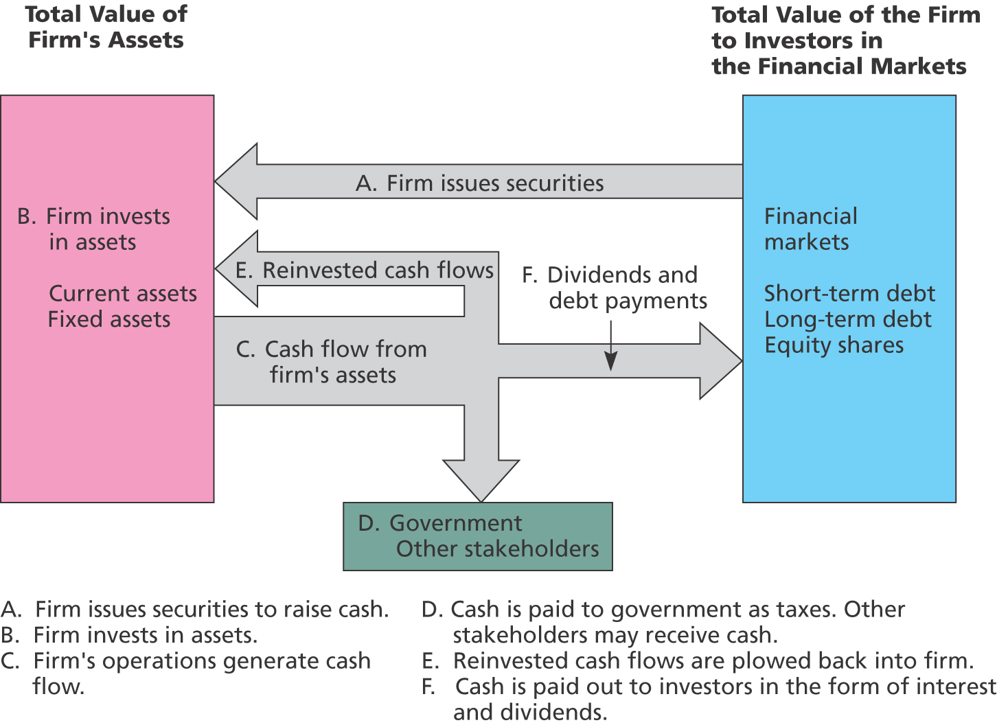
Cash Flows to and from the Firm
LO5
© 2013 McGraw-Hill Ryerson Limited

Slide 9
Investment and Financing Decisions
What to buy - Capital Budgeting
  Assets
    Real (tangible, intangible)
    Financial
How to pay for it - Capital Structure
  Mix of debt and equity
Buy low, sell high
  Theory of value

Slide 10
Goals
Survive?
Beat competition?
Maximize sales/profits?
Steady growth?
Maximize stock price?

Slide 11
Goals of a Financial Manager
Shareholders benefit if managers maximize current value of existing stock (share price)
Management should select investments and capital structure that maximize stock value (easier said...)
Is market value of stock a good measure?
  Issues of Market Efficiency

