Slide 1
Caloric Restriction
Genetically Modified Organisms
a.http://www.sciencedaily.com/releases/2007/03/070305202936.htm
Public Library of Science (2007, March 6). How Eating Less Might Make You Live Longer. ScienceDaily. Web
b. http://biotech.about.com/od/faq/f/GMOs.htm

Slide 2
http://www.youtube.com/watch?v=mwrrT_x79iQ&NR=1
  Barbara Walters
http://www.youtube.com/watch?v=aSSs1C-MmJ4
  Barbara Walters-discussion of resveratrol

Slide 3
Longevity
Have you ever met anyone who has lived to be at least 95? Did you ever hear this person give any reasons to explain their longevity? Was this person in good health? Still enjoying life?
If you were presented with an opportunity to live to at least 95, would you be prepared to take the chance, if it involved daily exercise?
What if you had to feel hungry much of the time?
There may be a way to better the odds in your favour……

Slide 4
Caloric Restriction
Caloric restriction has been suggested as a way to increase human longevity
This required consuming required nutrients but restricting calories
Caloric restriction has been shown effective in yeast, worms, flies and mice

Slide 5
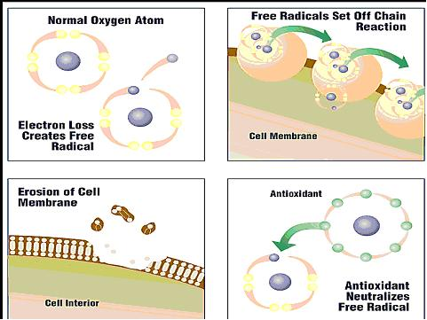
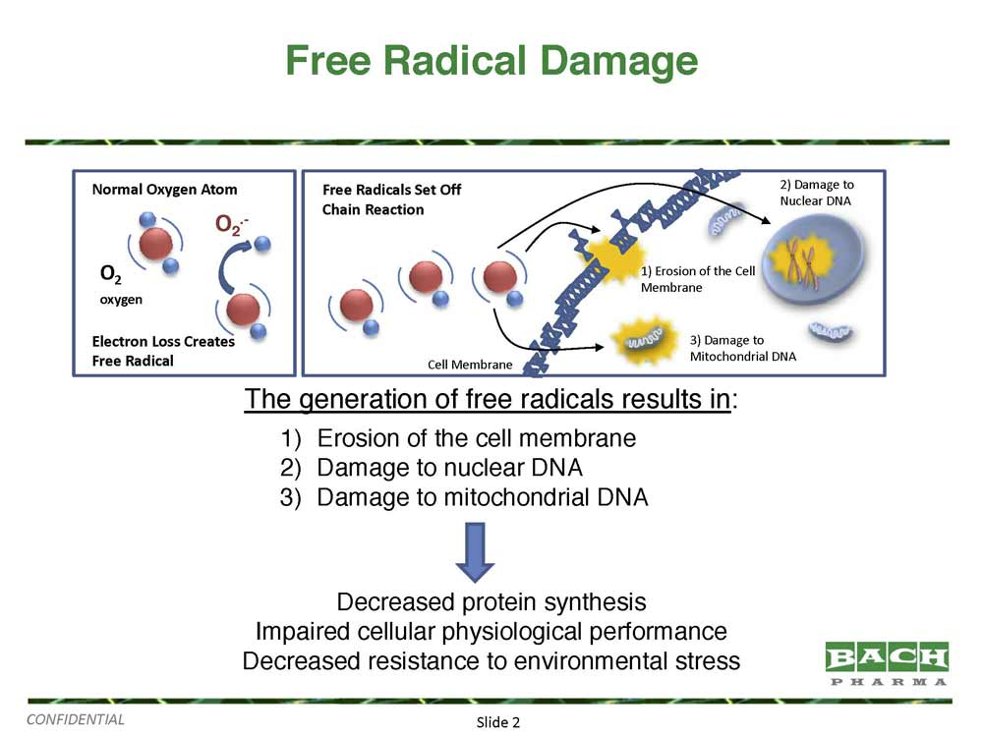
How Free Radicals Damage Cells
sciencedoing.blogspot.com

Slide 6
Caloric Restriction
The benefit may be less oxidative damage to the body’s cells, and less free-radical production
In a study of healthy human volunteers over 6 months, restricting calories by 25% from the diet, or a similar restriction from a combination of exercise and diet, decreased caloric expenditure by the body

Slide 7
Caloric Restriction
Mitochondrial function improved in both caloric restricted groups and the amount of DNA damage was reduced
This points to increased metabolic efficiency
The SIRT1 gene is one that regulates cellular metabolism in skeletal muscle and may be involved

Slide 8
Points to listen for as you watch the videos
Video 1-http://www.youtube.com/watch?v=mwrrT_x79iQ&NR=1
Video 2-http://www.youtube.com/watch?v=aSSs1C-MmJ4
  What was the caloric intake for the female of the couple shown? For the male?
  What percentage decrease in calories was this from recommended levels?
  What food group seemed to be the basis for their diet? Which component of the diet were they especially careful of, besides caloric intake?
  Four lifestyle habits were mentioned as factors to slow aging. What were they?
  What are the other methods, possibly unhealthy, that some persons use to slow their own aging process?
  Red wine has this compound. What is its name? What does it do? How much red wine would a human have to take in for thee resveratrol to be effective?
  To find out—are there other sources of resveratrol?

Slide 9
So what about caloric restriction and living longer?
Would you be willing to eat 30% less food to live longer?
Would eating 30% less food negatively affect your quality of life to justify the restriction?
What are the other suggestions for prolonging life?

Slide 10
Think about it….
As you eat your meal of mostly fruits & vegetables and think of restricting calories, another thought comes to mind.
What if these vegetables have been genetically modified?
Am I undoing all my good work of restricting calories?
Are genetically modified foods going to shorten my life?
I’ll just make sure not to ingest any of those nasty “Frankenfoods”….

Slide 11
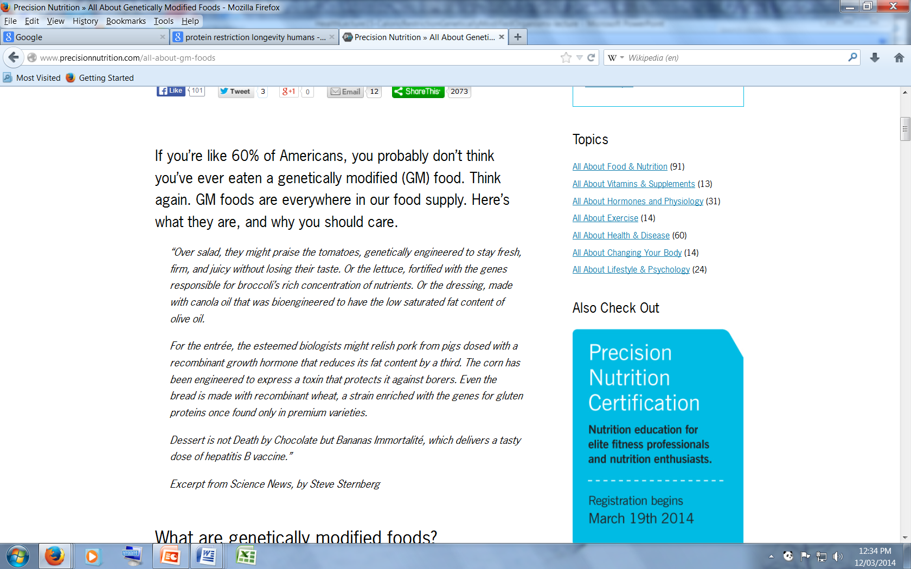
But, maybe you should read this…..
http://www.precisionnutrition.com/all-about-gm-foods

Slide 12
What are Genetically Modified Organisms (GMOs)?
The term is applied to plants, animals or microorganisms that have had non-native genes inserted into their DNA
The non-native gene is functional (expressed) in the new host

Slide 13
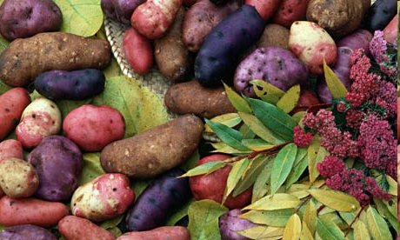
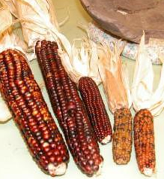
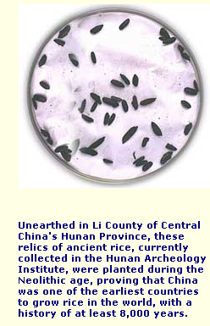
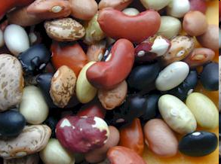
Would you eat these foods?
These have all been genetically modified, in the traditional way that is considered more “natural”

Slide 14
How Genetic Modification is Used in Modern Times
Bacterial DNA has been introduced into plants with the aim of either enhancing growth or increasing resistance to pests
This, in turn, decreases the need for artificial pesticides

Slide 15
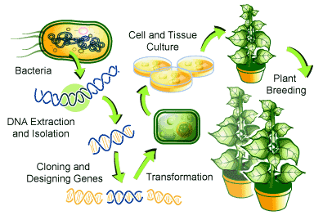
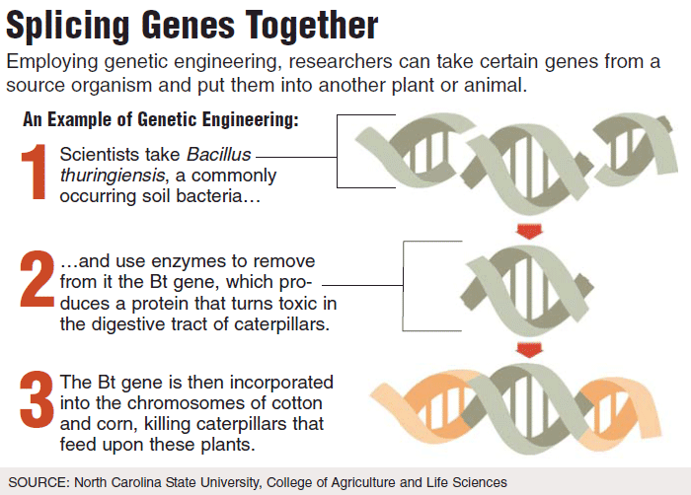
How Genetic Modification is Used-The process, and why
www.scq.ubc.ca

Slide 16
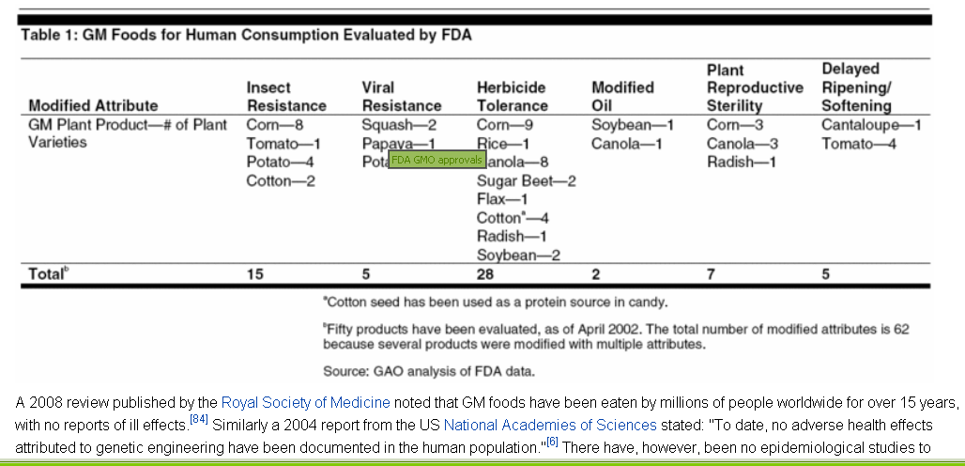
Where Genetic Modification is Used

Slide 17
What are the Concerns about GMOs?
Concern and controversy surround the technology
The fear is that the genetically altered crop may cross-breed with non-engineered crops and the altered genes will upset the ecological balance

Slide 18
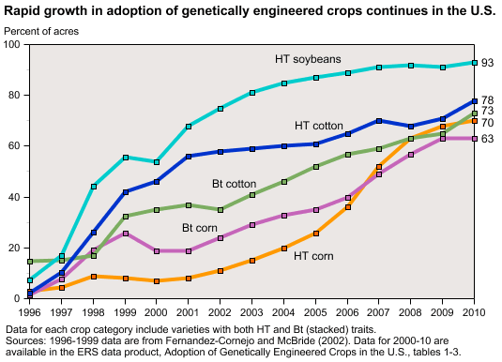
Growth in the Use of GM Agriculture

Slide 19
What are the Concerns about GMOs?
Concerns include those about health of insect populations affected by the consumption of GMO plants, leading to their decreased ability to live and reproduce
Other concerns center around the industrialization of agriculture, loss of small-scale farmers, “ownership” of seeds by the developer of the technology

Slide 20
What are the Concerns about GMOs?
Developed states have greater access to GMO technology, which is less available to farmers of less developed countries
Opposition is also raised against the production of pharmaceuticals through genetic engineering

Slide 21
What are the Concerns about GMOs?
Concerns about using the techniques in the cloning of animals is raised
Some of the animals produced have been subject to increased illness and premature death compared to conventionally raised animals

Slide 22
The choice is by no means clear…
Supporters of GM technology argue that engineered crops - such as vitamin A-boosted golden rice or protein-enhanced potatoes - can improve nutrition, that drought- or salt-resistant varieties can flourish in poor conditions and stave off world hunger, and that insect-repelling crops protect the environment by minimising pesticide use.
Other plants have been engineered to improve flavour, increase shelf life, increase hardiness and to be allergen-free (see also: hay fever-free grass). Geneticists have even created a no-tears onion to banish culinary crying, and novel caffeine-free coffee plants.
The question is-What do you think about the use of this type of technology-useful or harmful?
http://www.newscientist.com/article/dn9921-introduction-gm-organisms.html?full=true#.UyCX44X6-5J

