Slide 1
Sleep Needs & Sleep Disorders
http://www.merckmanuals.com/home/brain_spinal_cord_and_nerve_disorders/sleep_disorders/overview_of_sleep.html
“And to All a Good Night: How Sleep Deprivation May Lead to Chronic Disease.” Tufts University Health and Nutrition Letter. 22.8 (2004):8-11.. Academic Search Premier. Web
The Accession number for this article is 14749579

Slide 2
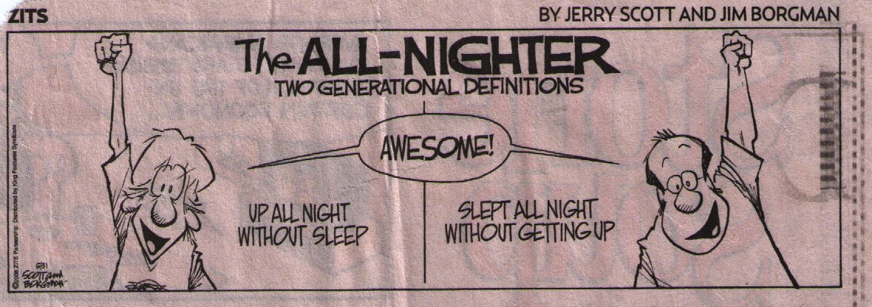
How you define how well you sleep might depend on your age……..

Slide 3
Summary
Sleep
Basics of Sleep
Types of Sleep, Non-REM, REM
Sleep Deprivation
Effects of Sleep Deprivation on Health

Slide 4
Sleep
Sleep can be disturbed by irregular bed times, stress, diet, activities before bedtime, drugs
Lack of sleep interferes with efficient daily functioning

Slide 5
Sleep
Sleep is necessary for survival and good health
Why we need sleep is still not fully known
Individuals vary in their need for sleep, but range is 6-10 hours every day

Slide 6
Sleep
Level of excitement, emotions, age, diet, drugs influence how rested one feels after a period of sleep
Older adults may not sleep as well as younger persons

Slide 7
Which species do you think sleeps the longest? Why do you think so? Body size? Brain size?
Animal | Hours sleep/day
Chimpanzee
Cat
Rabbit
Human
Brown bat
Horse
Dog
Giraffe
Cow
The info on this slide is for your interest only

Slide 8
Which species does really sleep the longest?
Animal | Hours sleep/day
Chimpanzee | 10.8
Cat | 13.2
Rabbit | 8.7
Human | 8
Brown bat | 19.9
Horse | 2.9
Dog | 10.7
Giraffe | 1.9
Cow | 4
The info on this slide is for your interest only

Slide 9
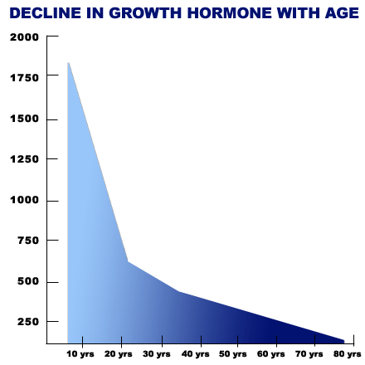
Decline in Growth Hormone with Age
http://farmacieverde.ro

Slide 10
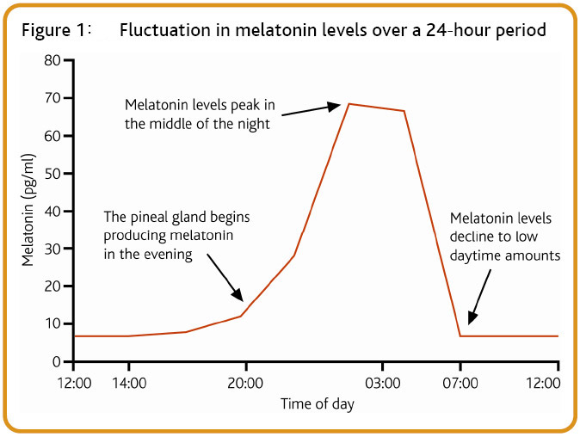
Change in Daily Melatonin Levels
www.epgonline.org

Slide 11
Aging and Sleep
With less physical activity in older persons, falling asleep may be more difficult
With aging, the body produces less growth hormone and less melatonin, 2 hormones that are related to sleep
Less exposure to sunlight may also become a problem

Slide 12
Aging and Sleep
Older persons fall asleep earlier, wake up earlier and tend to wake up more often
Older persons may have sleep difficulties induced by medical problems or the medications used to treat those problems

Slide 13
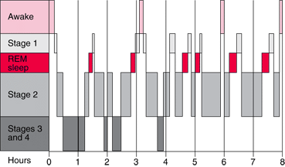
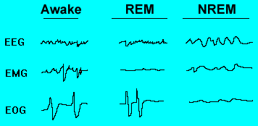
The Basics of Sleep
Stages of the Sleep Cycle
Merck Home Health Edition
faculty.washington.edu

Slide 14
Types of Sleep
Two stages of sleep
  Non-REM
    This type of sleep has 4 stages
  REM (Rapid Eye Movement)

Slide 15
Types of Sleep
In a typical night of sleep, people cycle through the 4 stages of non-REM punctuated by an interval of REM sleep
Each cycle lasts about 90 minutes, with 5-6 cycles every night

Slide 16
Types of Sleep
Non-REM
  Accounts for the majority of time spent in sleep
  Stage 1 is the first and lightest stage of sleep, stage 4 is the deepest level, from which it is difficult to arouse the sleeper
  Blood pressure, heart rate and breathing are at their slowest in stage 4 of non-REM sleep

Slide 17
Types of Sleep
REM sleep
  Electrical activity in the brain is very high
  The eyes move rapidly behind the eyelids
  Respiration rate is increased, although the muscles are paralysed
  Most vivid dreaming occurs during REM sleep
  An example—
    http://www.youtube.com/watch?v=yKNCjkR7oO0&NR=1

Slide 18
Sleep Deficit or Sleep Deprivation
Evidence is pointing to the idea that sleep is a predictor of how long one will live
Chronic sleep deprivation increases the risk for developing diseases such as those of the heart
The relation may come from the diminished time that the body has to repair itself

Slide 19
Sleep Deficit or Sleep Deprivation
The amount of sleep people get has been decreasing over the last 100 years since the development of the light bulb
The recommended amount of sleep for adults is 8 hours per night

Slide 20
Sleep Deficit or Sleep Deprivation
The theory is that sleep time is necessary for the body to repair damage of daily living

Slide 21
What do the Experts Say?
Part 1
  Listen for the relationship between sleep and memory
  What are the emotional responses in the college subjects who were deprived of sleep?
  Carefully observe the response time of the young lady in the experiment
  What was the term used to describe the “tuning out” of a person who is chronically sleep deprived? How much time elapses before coming out of lane while driving? How much time would it take for a driver to end up in the ditch?
  What are some incidences in the news that are thought to have been related to sleep deprivation?
  Explain the response of sleep-deprived subjects to disturbing images, and the suggested explanation for the atypical reaction.
The Science of Sleep
  http://www.cbsnews.com/video/watch/?id=4181992n

Slide 22
What did you hear?
Part 1
  If you or your classmates are deprived of sleep, what is the likely response to this situation?
  What was the term used to describe the “tuning out” of a person who ins chronically sleep deprived? What is a possible result if this occurs?

Slide 23
What do the Experts Say?
Part 2
  List the different effects of sleep deprivation
  Which chronic diseases may be related to sleep deprivation?
  What were the physical effects on the young man in the study who was profiled in this segment?
  Which type of sleep was he being deprived of—deep sleep or REM sleep?
Part 2
  http://www.cbsnews.com/video/watch/?id=4181994n

Slide 24
What did you hear?
What is the solution for society of widespread sleep deprivation in the population?

Slide 25
Sleep Deprivation-Why Sleep is Important
Elements of tanker disaster: Drinking, fatigue, complacency.
New York Times Year: 19890522 Vol: 138 Iss: 47878 Page: B7
Drowsiness can spell disaster at the wheel: Perchance to Sleep;
PEGGY CURRAN. The Gazette. Montreal, Que.: Sep 28, 2006. p. A.1.
Hockey team bus crash 'heartbreaking':; [Final Edition]Donald McArthur. Edmonton Journal. Edmonton, Alta.: Jan 31, 2005. pg. A.4

Slide 26
Sleep Deficit-Cardiovascular System
The Nurses Health study has shown that women who slept less than 6 hours per night had an 18% higher risk of heart attack
Those who slept 5 hours per night had a 39% increased risk

Slide 27
Sleep Deficit-Cardiovascular System
During REM sleep, blood pressure and heart rate increase
Stress hormones adrenaline and cortisol are released just before waking
If sleep is reduced, stress on the heart may be increased

Slide 28
Sleep Deficit-Cardiovascular System
Sleep apnea is a condition in which the airway is obstructed during sleep
Breathing can stop many times through the night

Slide 29
Sleep Deficit-Cardiovascular System
To counteract the effect of the stoppage in breathing, the body’s reaction is to hyperventilate
During the hyperventilation, BP and heart rate increase markedly

Slide 30
Sleep Deficit-Diabetes
Post-breakfast blood sugar levels showed dramatic rise in one study
Secretion of insulin was lowered
In another study, women who were sleep-deprived were more likely to develop diabetes than those who slept 8 hours per night

Slide 31
Sleep Deficit-Hormonal Imbalances
Levels of thyroid hormones are abnormal in persons who are sleep deprived

Slide 32
The Basics of Sleep-Immunity
Immune defence will decrease if one accumulates a sleep deficit, even after only one night of sleep deprivation
One night of recovery sleep allowed some return of immune system to normal

Slide 33
The Basics of Sleep-Weight Gain
Recent research is showing that being deprived of sleep increases the appetite
The mediator may be leptin, a hormone that signals satiety after eating, which may be reduced in those who are sleep-deprived
The result is that there is an increase in appetite

Slide 34
Sleep Deprivation-Weight Gain
Growth hormone release is diminished with lack of sleep
This hormone is needed to encourage healing and repair, even in adults, and controlling percentages of fat and muscle in the body
Growth hormone is secreted during sleep, and the amount secreted declines with age

Slide 35
Sleep Deprivation-Weight Gain
Caloric intake for those who stay awake longer than usual tends to increase over and above the amount required to cover the extra activity needs of the body

