Slide 1



Achieving Success in Changing Environments – Course Introduction, Note Taking and Exam Prep
Week 1

Slide 2
Today’s Agenda
Opportunity details
Welcome and Roll Call Attendance Sheet
Introductions and Course make up
General Administrative Stuff
Assignment Submission Requirements
The first lesson, and
A fun video to check out (if there is time)

Slide 3
Opportunity
Opportunity details
        If you have prior experience in writing code
        If you consider yourself clear on basic programming logic
        This may be for your consideration
Job Title – Software Developer
        Employer is a very large multinational law firm
If you’re interested
        Email your CV to me ONLY at phil.beals@gmail.com within next 7 days
        I will schedule interviews to short list
        Short list will be forwarded to the firm

Slide 4
This is a Hybrid Course
Two hours in class –
      Lectures and miscellaneous activities
One hour outside of class –
    Online activity – either on Blackboard or the Internet
    Reading assignments each week
Bring your laptop for in class activities and tests

Slide 5
Administrative Stuff - Who am I
Phil Beals
    A little of my background
    My teaching style
    Reaching me by Email
        Preferred email – phil.beals@gmail.com
        College email – bealsp1@algonquincollege.com

Slide 6
Administrative Stuff - Communication
  Official Course stuff – i.e. Course Outline and Course Section Information, etc
Communication from my desk:
    All communications will either be sent by email to your @algonquinlive email only, or posted as an announcement on Blackboard
Communications to me and submissions
    All communications to me and all submissions, whether by email or in print, must be from an email address that reflects the name you are registered under at the college.
    I will not search to try and find out who you are if you use any other name or a nickname

Slide 7
Other Administrative Stuff
    Participation is key to success
        If you:
        Are here
        Do the assignments
        Work well in team assignments
        Submit on time
        You will pass
    This is an EASY PASS but a MUST PASS course
    It is not easy to ace this course

Slide 8
Administrative Stuff – Hybrid Assignments
Hybrid Assignment Submissions
  Submit online on Blackboard ONLY
  Format – Per the Assignment Submission Requirements document
  The title is always the heading on the assignment
No late or delayed submissions are permitted without prior approval in writing.
        Only the last submission prior to the deadline will be marked
        Assignment Submission Requirements document takes precedence in all cases

Slide 9
Administrative Stuff – Major Assignments
Major Assignment Submissions
  Submit major assignments ONLY BY EMAIL
        Only the last submission prior to the deadline will be marked
  Assignment is deemed late if prior approval is not granted in writing
  After 24 hours late, and it will receive a Zero (0)
  Assignment Submission Requirements document as posted on Blackboard takes precedence in all cases

Slide 10
Administrative Stuff – Text Books
Required Text Book
Professionalism: Skills for Workplace Success, 3rd Edition by Lydia E. Anderson and Sandra B. Bolt ISBN-10: 0132624664 • ISBN-13: 9780132624664 • Prentice Hall • Published 12/27/2011

Slide 11
Administrative Stuff – Text Books
Recommended:
The 7 Habits of Highly Effective People, Stephen Covey, by Steven Covey, Free Press, ISBN 978-0743269513
Suggested Reading:
On Writing Well, 25th Anniversary: The Classic Guide to Writing Nonfiction [Paperback], ISBN# 0060006648 (free download from the internet)

Slide 12
Administrative Stuff – Earning Marks
Attendance = 15%
Hybrids = 15% of Final
Three in class group activities = 15%
Major group assignment = 20%
Two Exams = 35%
      Exams are based on lectures; textbooks; end of class videos; and miscellaneous handouts.
      On time attendance for exams is mandatory
I do not use Blackboard to track marks

Slide 13
Administrative Stuff – Exam Dates
One mid term exam:
      Week of October 18th
Final Exam
      Week of December 13th
          Study material will be provided two weeks in advance for each

Slide 14
First Lesson

Slide 15
The Importance of Notetaking
Taking notes combats memory fading
Effective notes backs up and reinforces memory
Research shows a high correlation between the quality of notes and test and grade performance

Slide 16
The Importance of Notetaking
Studying from effective notes is more time efficient than rereading chapters multiple times
Well-developed notes provides effective study tools to rehearse and review
Effective note taking strategies saves study time.

Slide 17
The Note Taking Process
Note Taking:
Involves condensing or reducing large amounts of information into more manageable units.
Requires you to think carefully about information, break it down, analyze it, and select what is important to learn.
Is a multisensory process that uses visual, kinesthetic, and auditory encoding.
Individual chapters may require using more than one note taking system to create study and review tools.

Slide 18
Annotation
Annotating:
      The process of highlighting, underlining, making marginal notes, or marking specific information in printed materials.
Annotating:
      Is an active learning process
      Holds information longer in working memory
      Reduces the risk of information fading

Slide 19
Tips for Recording Notes
Introductions: Create and underline a heading for the information; then list and number key points.
Headings and Subheadings: Copy and underline headings and subheadings in your notes. Number key points under each heading or subheading.
New Headings: Add new headings if you want to reorganize or insert more helpful headings.
Marginal Notes: Take notes on any important marginal notes in the textbook

Slide 20
Tips for Recording Notes
Double Spacing: Double space before beginning a new heading; this chunks or groups information into meaningful units.
Sufficient Information: Avoid being too brief; record sufficient details to support main ideas.
Meaningful Phrases or Sentences: Check that phrases or shortened sentences are clear.
Annotations: Use your annotations to guide you in deciding what information to include.

Slide 21
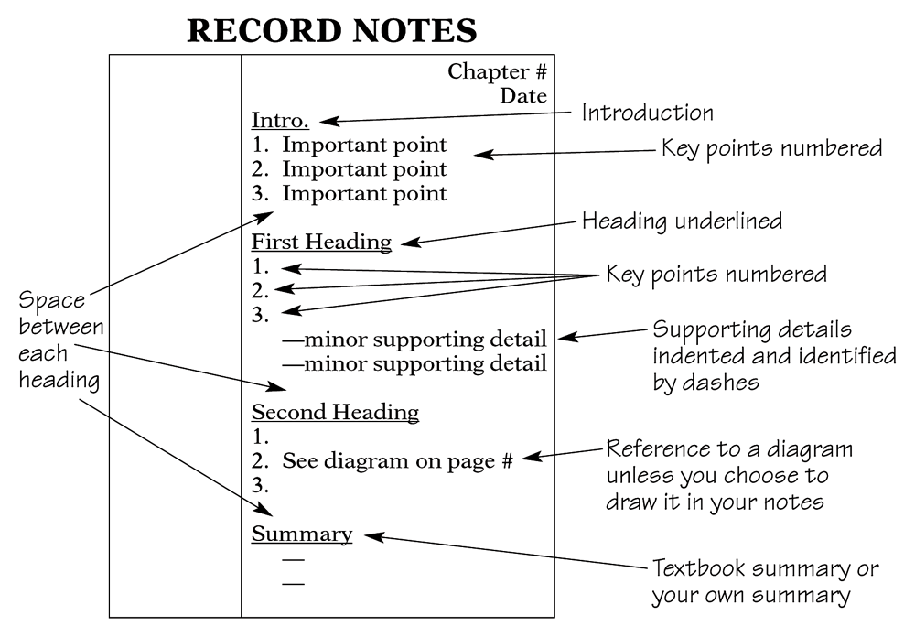
The Cornell System

Slide 22
The Two-Column System
Step 1: Write the topics, vocabulary terms, questions, or math problems in the left column.
Step 2: Write any explanations, details, or definitions in the right column.
Topic Voc. Term Study Question Formula | 1. 2. 3. Definition Answer Example

Slide 23
The Three-Column System
Write the topics in the left column.
Identify labels or categories of information in the middle and the last column.
Work with all three columns: cover a column, recite, and check accuracy.
Topic Topic Problem Problem | Source Def. Rework Steps | Source 2 Example Solution Example

Slide 24
The Dreaded Exam/Test-Preparation
Study Groups are a powerful way to prepare for an exam
Why are study groups powerful?
        Social interaction breeds success
        Take advantage of others strengths & what was retained or understood by them
        Put yourself into the role of professor – when you are explaining something to someone else, more of the brain is engaged
        Q & A’s with each other

Slide 25
Preparing for Exams
Listen for favorite themes and concepts that professors keep returning to
Know the format and value of the exam before hand
Review your notes, text material, assignments, and quizzes
Review the night before but don’t cram
Get a good night’s sleep

Slide 26
Preparing for Exams (cont’d)
Make sure you have eaten to keep your blood sugar up (AVOID ENERGY DRINKS)
Give yourself plenty of travel time
Stay calm outside the exam and stay away from people that are peeking
If something comes up that stops you from attending, stay calm and prepare your case and have proof

Slide 27
Writing the Exam
Read the instructions carefully and slowly
Underline key words
Write legibly. If the professor cannot read your writing, don’t expect a mark.
Pace yourself - check your pace at 1/4 of the time
If you begin running out of time - use point form
Ask if you are not sure

Slide 28
4 Steps to a 5 Day Study Plan
Be specific and realistic: List the topics and materials you need to review.
Set target dates and times: Organize study blocks on four different days; reserve day 5 for reviewing summary notes.

Slide 29
4 Steps to a 5 Day Study Plan
Identify the steps and a plan of action: Identify what you intend to study in each study block for each of the five days.
Plan a reward: Identify an intrinsic or an extrinsic reward for yourself after you finish your five-day study plan and complete the test.

Slide 30
Computer Based Tests
Know the rules.
Allow ample time.
  Go to the lab when you are not rushed.
  Go when you feel mentally sharp.
  Choose a computer away from the flow of traffic.
Understand the testing software commands.
Read and choose answers carefully.
  Read each question carefully.
  Convert each option into T or F.
  Carefully select the best answer.

Slide 31
Testing Anxiety – Dealing with it
Test anxiety: excessive stress that hinders performance before and during tests.
Symptoms of test anxiety include:
Physical symptoms
Emotional symptoms
Cognitive symptoms
Behavioral symptoms

Slide 32
Testing Anxiety – Dealing with it
Test anxiety is a learned behavior.
To deal with test anxiety, begin by identifying what triggers your test anxiety.
Test anxiety may stem from:
  under-preparedness and cramming.
  past experiences.
  fear of failure.
  weak test-taking skills.

Slide 33
Testing Anxiety – Dealing with it
Use relaxation techniques.
Use positive self-talk.
Reread questions in a whispering voice.
Do not stay stuck on a question.
Use paper or your arm to block other parts of the test.
Circle or highlight key words.
Slow down the reading process; go into retrieval mode.

Slide 34
Hybrid 1
Spend time on Blackboard and review all material posted for this course, especially the Assignment Submission Requirements document.
Also on Blackboard, under Exercises, do the “What is Your Learning Style” quiz. Do not submit the results.
In 150 to 200 words, write what you might change in your learning style to more efficiently learn, or explain why no changes are necessary, supporting it with how you learn now.
Don’t forget to put your registered name and the assignment title at the top of the page.
Due by the next class time
    Textbooks Review Assignment:
    Review chapters 2 and 3 of the mandatory textbook, Professionalism: Skills for Workplace Success, 3rd Edition

Slide 35
Video – Paradigms of Education
With permission from: RSAnimate (www.theRSA.org), and CognitiveMedia (www.cognitivemedia.co.uk)

Slide 36

Q & A

