Slide 1
Thermodynamics I
Lecture 17: Entropy
Prof: Dr. P. Q. Gauthier

Slide 2
The Entropy Change of Ideal Gas
In general, as shown in the previous lecture, the Tds relationship can be obtained as:
For a closed system
For ideal gas

Slide 3
The Entropy Change of Ideal Gas
As well
Substituting (2) and (3) into (1)
Or:

Slide 4
The Entropy Change of Ideal Gas
Integrating equation (4) yields:

Slide 5
The Entropy Change of Ideal Gas
In a similar manner, another Tds relation can be obtained from the definition of h, as

Slide 6
The Entropy Change of Ideal Gas
For an ideal gas

Slide 7
The Entropy Change of Ideal Gas
Integrating equation (6) yields

Slide 8
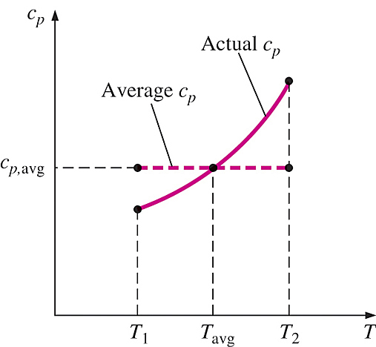
Constant Specific Heats: Approximate Analysis
Under the constant-specific heat assumption, the specific heat is assumed to be constant at some average value

Slide 9
Constant Specific Heats: Approximate Analysis
Equation (5) with constant specific heats can be written as:

Slide 10
Constant Specific Heats: Approximate Analysis

Slide 11
Constant Specific Heats: Approximate Analysis
Entropy change can also be expressed on a unit mole basis by multiplying the equation 8 and 9 by molar mass:

Slide 12
Variable Specific Heats: Exact Analysis
The exact entropy change during a process can be determined by substituting c_{p}(T) and c_{v}(T) into equation (5), and performing the integration. Instead of performing these integral each time, we have a new process, it is convenient to perform these integral once and tabulate the results, as follows:

Slide 13
Variable Specific Heats: Exact Analysis
Define the function s˚ as:
Using this function, we will find:

Slide 14
Variable Specific Heats: Exact Analysis

Slide 15
Example
Nitrogen gas is compressed from an initial state of 100 kPa and 17°C to a final state of 600 kPa and 57°C. Determine the entropy change of the nitrogen during this compression process by using:
  (a) property values from the nitrogen table
  (b) Average specific heats

Slide 16
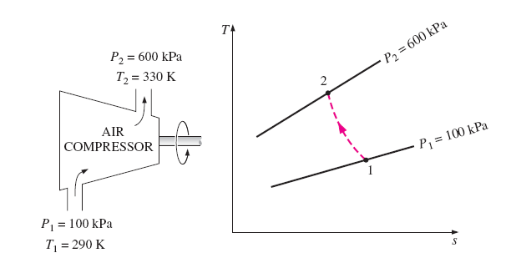
Example

Slide 17
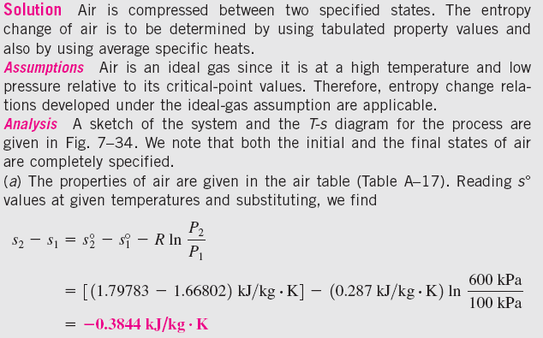
Solution

Slide 18
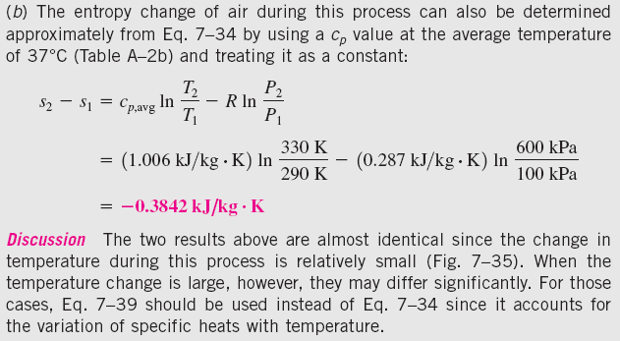
Solution

Slide 19
Isentropic Process of Ideal Gases
Constant specific heats: approximate treatment

Slide 20
Isentropic Process of Ideal Gases

Slide 21
Isentropic Process of Ideal Gases
Equation 14 is the first isentropic relation for ideal gases under the constant specific heat assumption
The second isentropic relation is obtained in a similar manner from

Slide 22
Isentropic Process of Ideal Gases
From equation 14, 15 and 16, we can say that:

Slide 23
Variable Specific Heats: Exact Treatment
This section is considered as a homework
Read and let me know if you have any questions

Slide 24
Example
Air is compressed in a car engine from 22˚C and 95 kPa in a reversible and adiabatic manner. If the compressor ratio V₁/V₂ of this piston-cylinder device is 8, determine the final temperature of the air

Slide 25
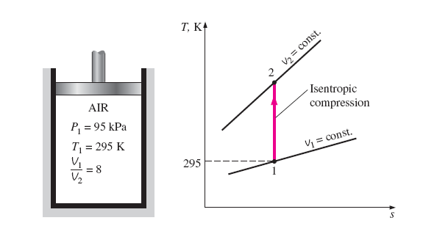
Example

Slide 26
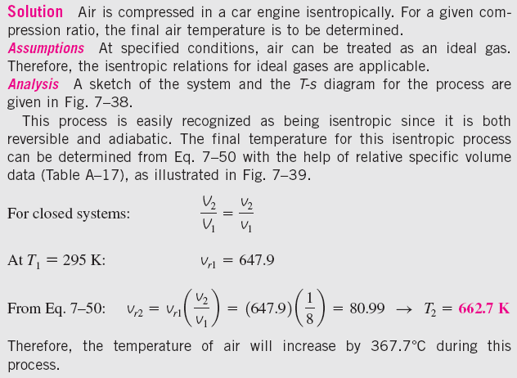
Solution

