Slide 1
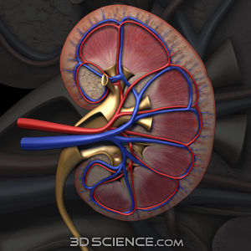
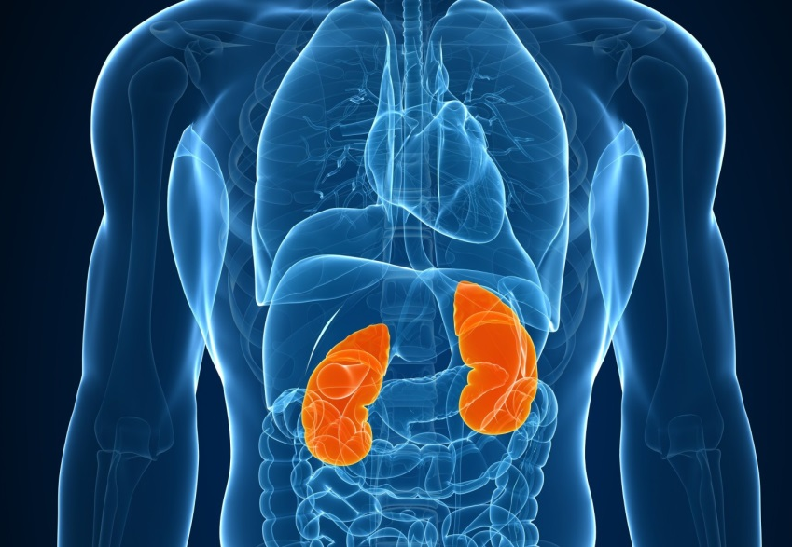
The Urinary System
LECTURE 1
Chapters 25 and 26
Rania Nasrallah, Ph.D.
rnasrall@uottawa.ca
Based on slides by J Carnegie

Slide 2
Chapter 25 & 26: The Urinary System, Fluid, Electrolytes & Acid-base
3.1 Describe the gross & microscopic anatomy of the male & female urinary systems
3.1.1 describe the gross anatomy of the kidneys, including the blood & nerve supplies
3.1.2 describe the structure of a nephron; differentiate between cortical & juxtamedullary nephrons
3.1.3 describe the structural organization of the juxtaglomerular apparatus
3.1.4 differentiate between micturition pathway in males versus females
3.2 Describe the nephron as the functional unit of the kidney
3.2.1 list the 2 primary & 4 additional functions carried out by the kidneys
3.2.2 define glomerular filtration, tubular reabsorption, tubular secretion; differentiate between filtrate & urine
3.2.3 describe the functional anatomy of the filtration membrane
3.2.4 define net filtration pressure
3.2.5 define glomerular filtration rate; be aware of normal value
3.2.6 list & describe the 3 regulatory influences on GFR
3.2.7 indicate the importance of tubular reabsorption; distinguish between active and passive tubular reabsorption; list 3 substances that are not reabsorbed & indicate why
3.2.8 link tubular reabsorption with different regions of the renal tubules
3.2.9 list (giving examples) 4 functions associated with tubular secretion
3.2.10 describe the role of the countercurrent mechanism in the regulation of urine concentration & volume; define osmolality; define osmosis
3.3 Describe the regulation of urine concentration & volume
3.3.1 explain the influence of ADH on urine concentration and volume
3.3.2 define diuretic & provide some examples
3.3.3 define renal clearance & express this parameter in terms of U, V & P
3.3.4 describe the physical characteristics of urine & summarize its chemical composition; be aware of key body constituents that shouldn’t be in urine
3.3.5 describe the regulation of micturition
3.3.6 define renal failure; indicate potential causes & options for treatment
3.4 Demonstrate understanding of the role of the kidneys in fluid & electrolyte balance (Ch26)
3.4.1 define the fluid compartments
3.4.2 remind yourselves of the differences between electrolytes & non-electrolytes and of the key electrolytes in ICF & ECF
3.4.3 define water balance; describe the thirst mechanism
3.4.4 justify the role of sodium as the only solute exerting significant osmotic pressure and describe the influences on sodium balance of: aldosterone, cardiovascular baroreceptors, ADH and ANF
3.4.5 outline the main features of potassium balance
3.4.6 outline the main features of calcium and phosphate balance
3.4.7 describe the 3 mechanisms of acid-base balance used in the body; describe in detail the 3rd mechanism – the role of the kidneys

Slide 3
Chapter 25 & 26: The Urinary System, Fluid, Electrolytes & Acid-base
3.1 Describe the gross & microscopic anatomy of the male & female urinary systems
3.1.1 describe the gross anatomy of the kidneys, including the blood & nerve supplies
3.1.2 describe the structure of a nephron; differentiate between cortical & juxtamedullary nephrons
3.1.3 describe the structural organization of the juxtaglomerular apparatus
3.1.4 differentiate between micturition pathway in males versus females
3.2 Describe the nephron as the functional unit of the kidney
3.2.1 list the 2 primary & 4 additional functions carried out by the kidneys
3.2.2 define glomerular filtration, tubular reabsorption, tubular secretion; differentiate between filtrate & urine

Slide 4
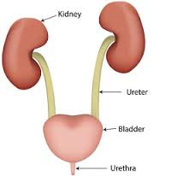
The Urinary System Organs
Kidneys
major excretory organs
Ureters
transport urine from kidneys to urinary bladder
Urinary bladder
temporary storage reservoir for urine
Urethra
transports urine out of body

Slide 5
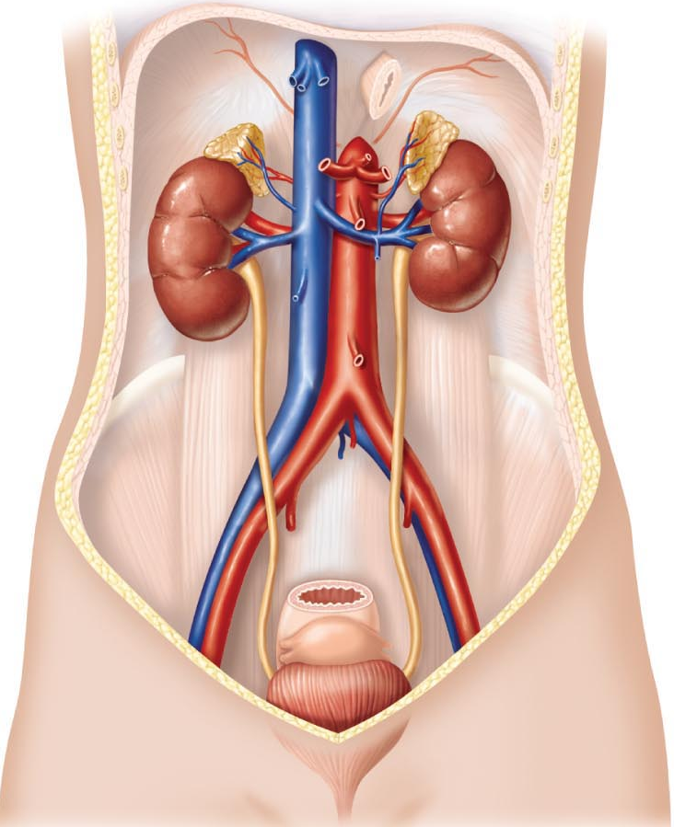
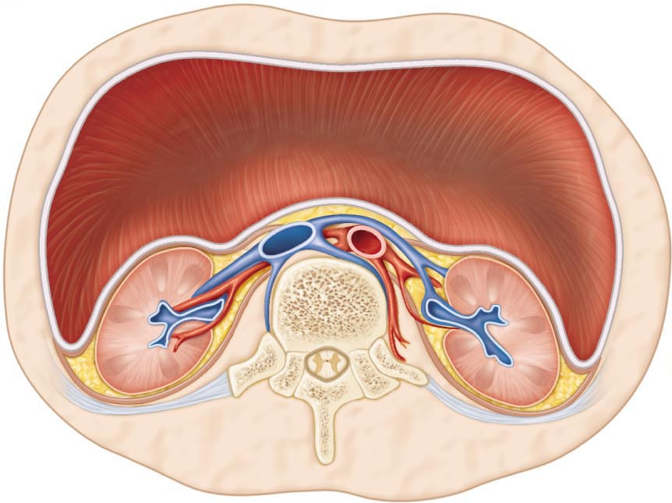
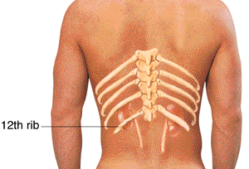
Anatomy of the male & female urinary systems
Gross anatomy of the kidneys, blood & nerve supplies
• two bean-shaped; retroperitoneal
• superior lumbar region: from thoracic vertebra to lumbar vertebra
• some protection from ; rt kidney pushed lower by liver
• ~150 g; 12 x 6 x 3 cm
• adrenal glands sit on top of kidneys
Fig. 25.1
Fig. 25.2

Slide 6
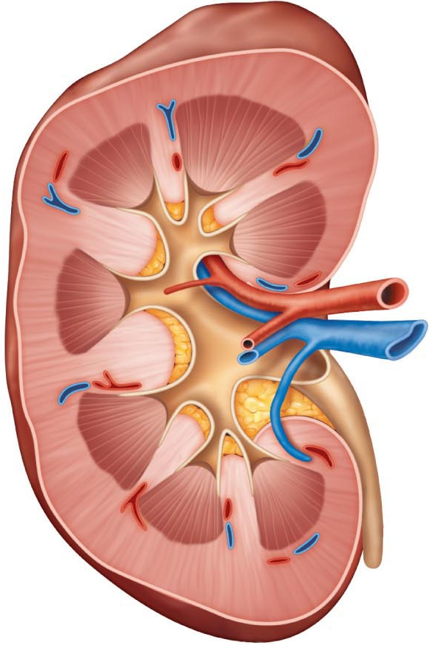

concave medially: renal hilus to renal sinus
3 layers of supportive tissue
renal capsule: fibrous, adheres directly to kidney surface, strong barrier to infection
perirenal adipose capsule: fatty cushion, helps hold kidney in place
What is renal ptosis? – when kidney drops (ex. Rapid weight loss) obstruction of outflow to kidney - hydrophosis
renal fascia: dense fibrous connective tissue surrounds adrenal gland & kidney; anchor role
Fig. 25.3
http://biology.clc.uc.edu/fankhauser/Labs/Anatomy_&_Physiology/A&P203/Urinary_Tract_Histology/Anatomy/urinary_anatomy.html
J. Carnegie, UofO
Notes:
Hollow cavity that contains vessels (sinus)

Slide 7
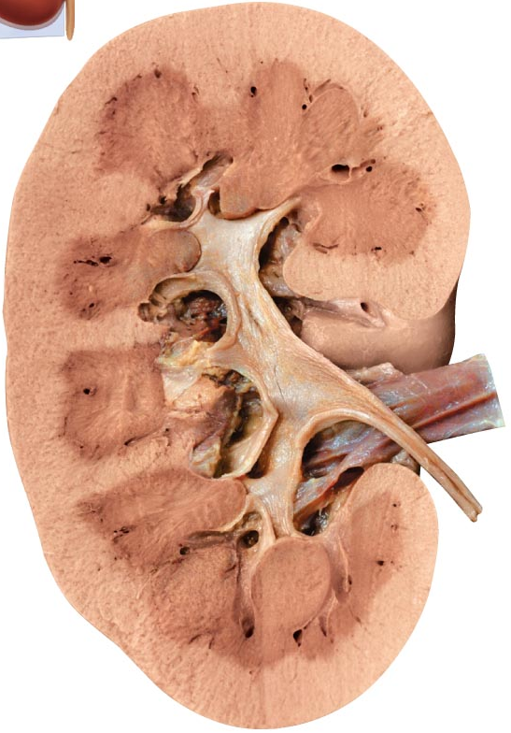
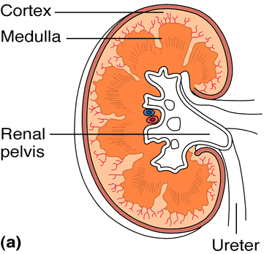
INTERNAL ANATOMY
cortex: lighter colour, outer part of kidney What process occurs here? – filters urine
medulla: darker colour, deeper core; medullary or renal pyramids; separated by renal columns (cortical tissue); each medullary unit = ~1/8 of kidney
Why do they appear striped ? – tubes (collecting ducts, that are brought down to pelvis)
pelvis: flat, funnel-shaped tube continuous with ureter; major & minor calices; minor calices enclose papillae of pyramids; calices collect urine
walls of calyces, pelvis, ureter contain smooth muscle; propel urine by peristalsis
Urine flow
  Renal pyramid → minor calyx → major calyx →
  renal pelvis → ureter
Fig. 25.3
What is pyelitis? - inflammation of pelvis
What is pyelonephritis? – renal tissue infected
Notes:
Pyramids: divide kidney into lobes
Pelvis = hollow, filled with urine
Minor calyx at tip of every pyramid

Slide 8
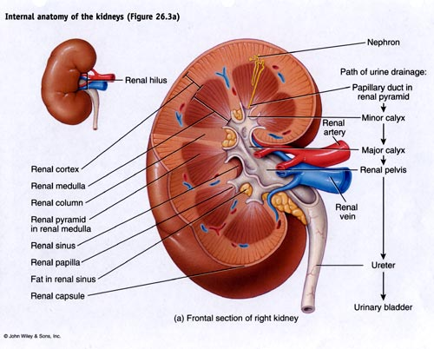
Notes:
Hylem = entering part

Slide 9
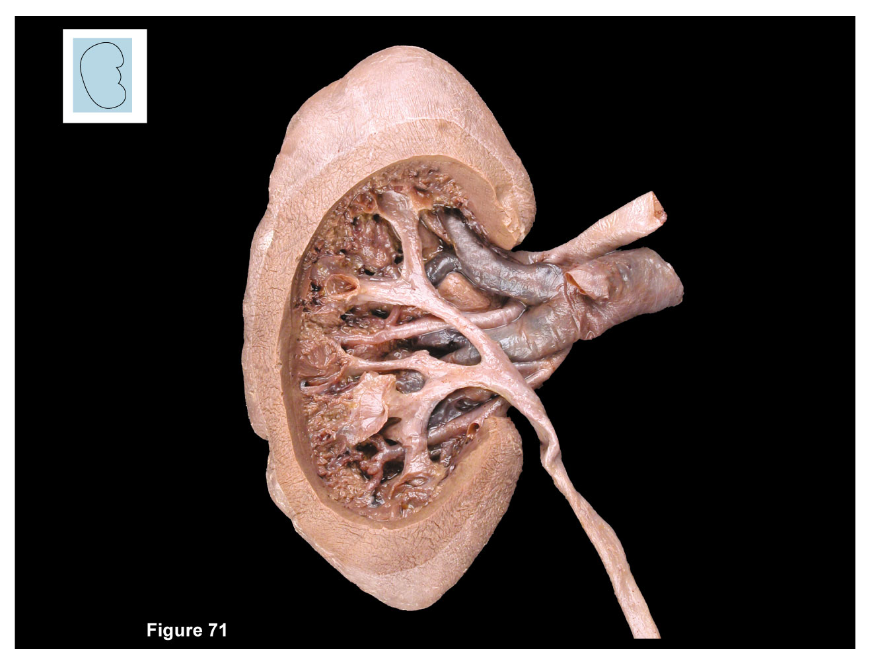
Figure 71
Renal capsule
Cortex
Medulla
Renal artery
Renal vein
Segmental artery
Major calices
Medullary pyramid
Major calices
Renal papilla
Renal pelvis
Renal column
Ureter
Minor calices
Kidney, internal structure in frontal section

Slide 10
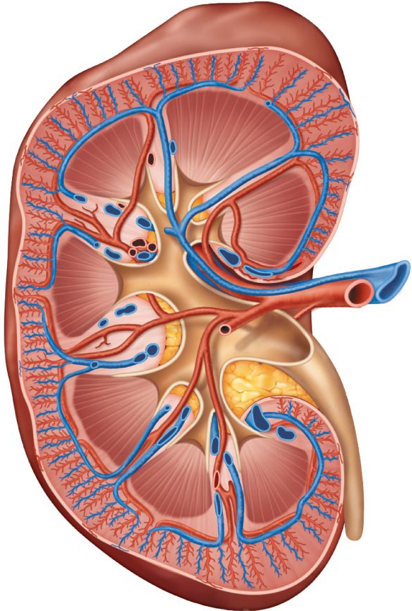
Circulatory Pathway through Kidney
renal artery
segmental artery
interlobar artery
arcuate artery
cortical radiate artery
afferent arteriole
efferent arteriole
cortical radiate vein
arcuate vein
interlobar vein
renal vein
Fig. 25.4
Notes:
Renal artery longer on right side
Renal artery branches off into segmental arteries
Interlobar in between pyramids

Slide 11
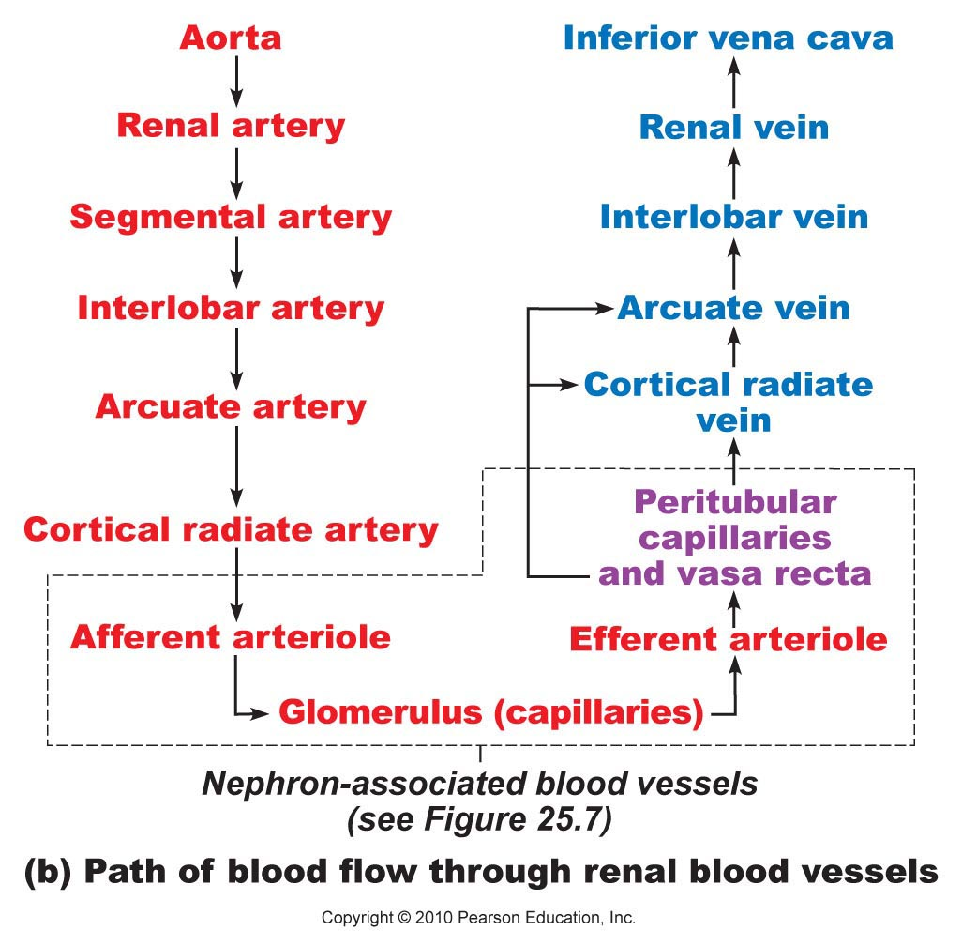
Fig. 25.4b

Slide 12
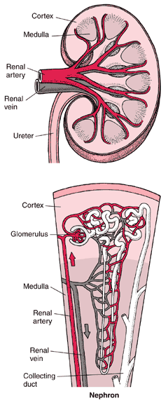
BLOOD & NERVE SUPPLY
renal arteries: ~1/4 total systemic CO (~1.2 L) to kidneys/min
arterial branches pass up between medullary pyramids to reach cortex; venous branches drain back via same route
nerve supply provided by renal plexus:
primarily sympathetic fibers ➔ regulate renal blood flow by adjusting diameters of renal arterioles
http://www.merck.com/media/mmhe2/figures/fg145_1.gif

Slide 13
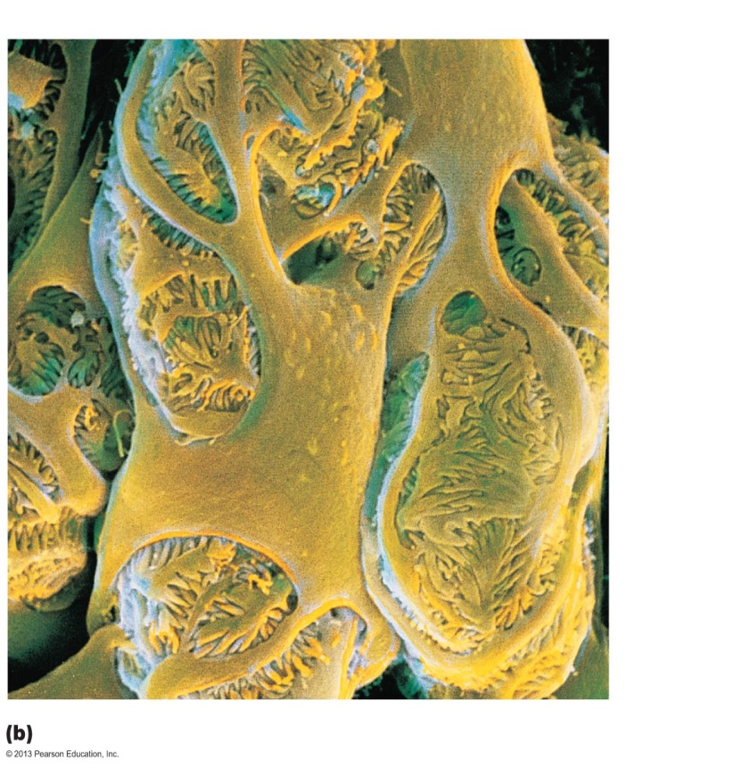
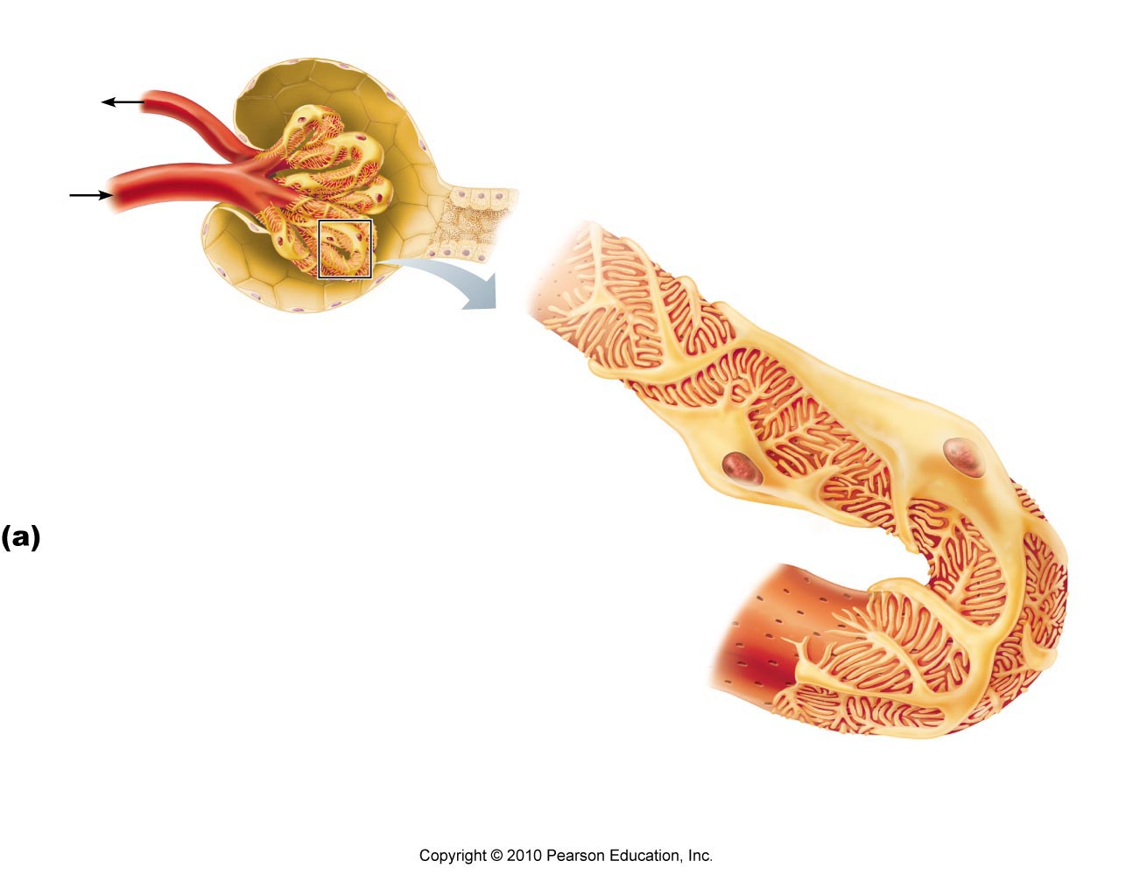
The Glomerulus
Nephron: structural and functional units that form urine
Two main parts: corpuscle and tubule
  renal corpuscle: glomerulus (capillary tuft), Bowman’s capsule
  > 1 million nephrons and 1000 collecting ducts/kidney
  Site of filtration: fenestrated glomerular endothelium, glomerular basement membrane, podocytes (body, foot processes, filtration slits)
Filtration slits
Podocyte
cell body
Foot
processes
Fig. 25.10
Notes:
Nephron = functional unit of the kidney

Slide 14
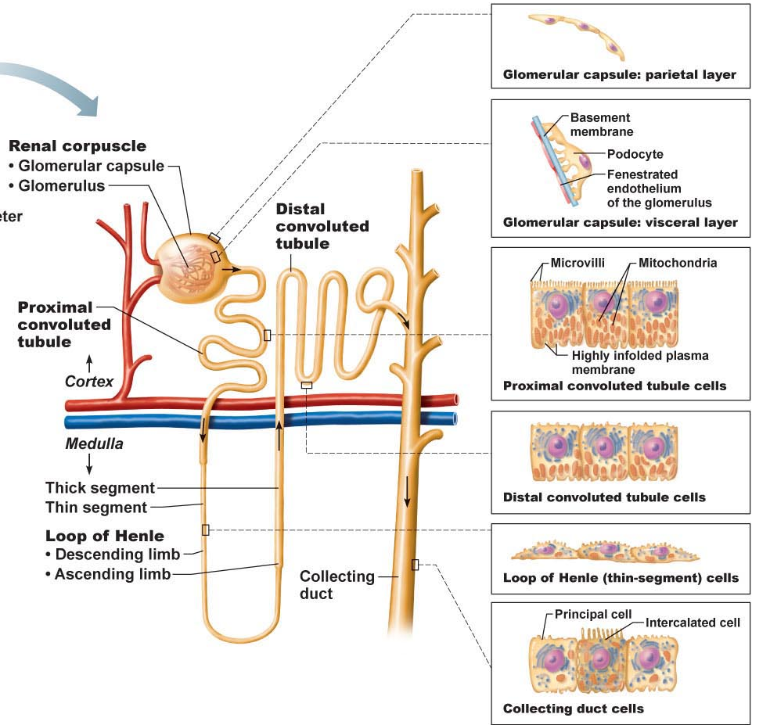
proximal convoluted tubule
↓
loop of Henle
↓
distal convoluted tubule
↓
collecting duct
↓
papillary duct
↓
minor calyx
The Nephron
collecting duct has:
principal cells (lack microvilli; salt & H₂O balance)
intercalated cells (microvilli; acid-base balance)
Fig. 25.5
Notes:
Proteins are retained

Slide 15
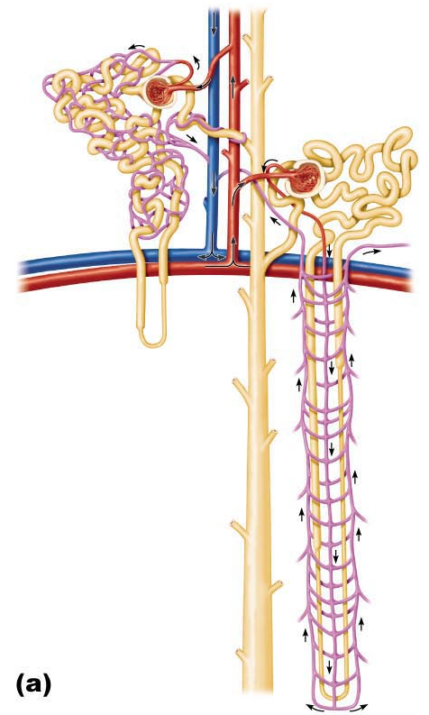
2 types of nephrons:
cortical (85%) – mini nephrons (no loops, located in cortex)
juxtamedullary (15%) – go into medulla
J. Carnegie, UofO
Fig. 25.7

Slide 16
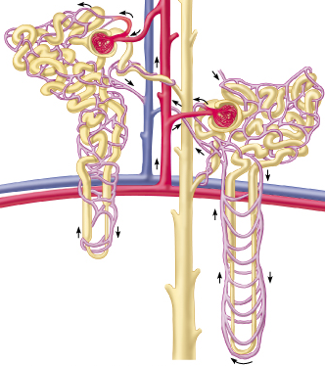
Microcirculation of the Nephron
Glomerulus: specialized for filtration
➢ both fed & drained by arterioles
  arterioles are high resistance vessels
  afferent arteriole has larger diameter
  Peritubular Capillaries:
  arise from efferent arterioles which drain into renal venules
What is the vasa recta and where is it found?? – blood vessel capillary system around loops of hemley in medulla, concentrating mechanism
Fig. 25.7a

Slide 17
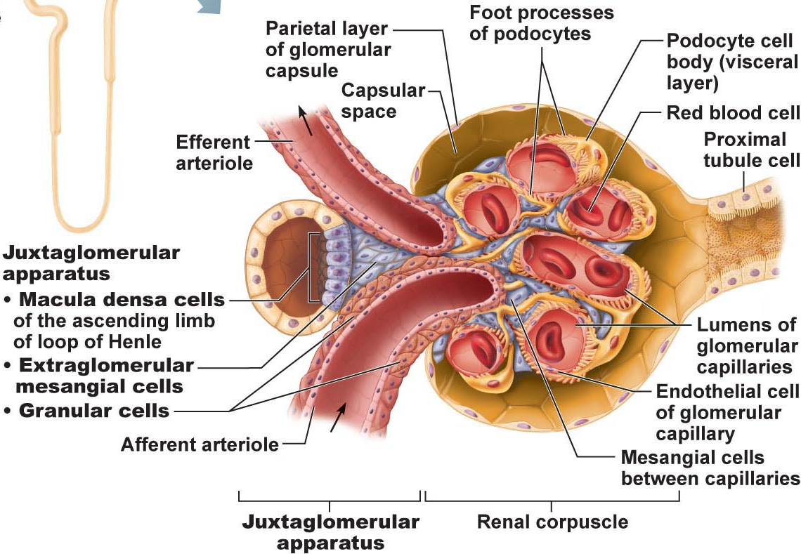
The Juxtaglomerular Apparatus
The juxtaglomerular apparatus (JGA) is at junction of thick ascending limb and afferent/efferent arterioles; regulates renal function:
arteriole walls: JG cells (granular cells) ➢ enlarged smooth muscle cells – mechanoreceptors; secrete renin
tubule wall: macula densa cells ➢ chemo- or osmoreceptors monitor filtrate & adjust GFR accordingly
JGA regulates:
a) filtrate formation
b) systemic BP
Fig. 25.8

Slide 18
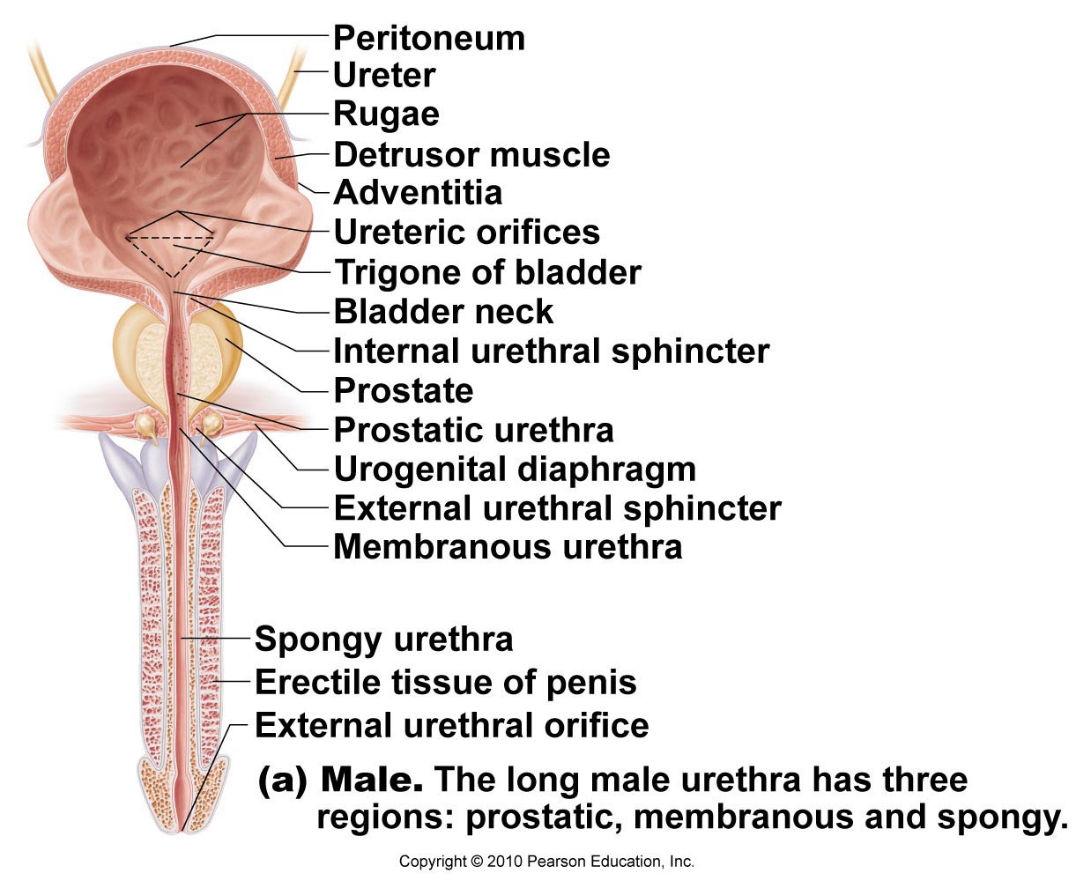
Micturition: Male vs Female
What is the trigone & why is it important clinically?
moderately full bladder (500 ml) ~12.5 cm long
can hold up to about double that volume
What forms the internal urethral sphincter?
What forms the external urethral sphincter?
Fig. 25.20a
J. Carnegie, UofO

Slide 19
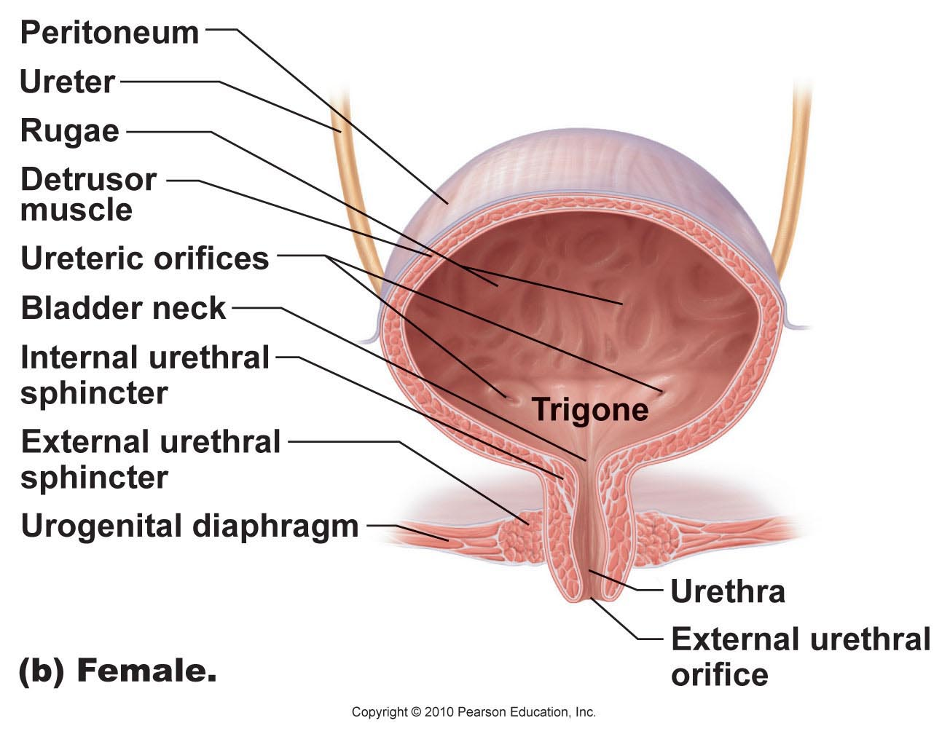
Micturition: Male vs Female
Fig. 25.20b

Slide 20
Micturition
Urination or voiding
Three simultaneous events must occur
  Contraction of detrusor by ANS
  Opening of internal urethral sphincter by ANS
  Opening of external urethral sphincter by somatic nervous system
  Pontine control centers mature between ages 2 and 3
Incontinence: urine leakage, usually from weakened pelvic muscles
  e.g. pregnancy, emotional problems, nervous system problems
  Stress incontinence
    Increased intra-abdominal pressure forces urine through external sphincter
    Overflow incontinence
    Urine dribbles when bladder overfills
    Urinary retention: bladder unable to expel urine
  Common after general anesthesia, hypertrophy of prostate
  Treatment - catheterization

Slide 21
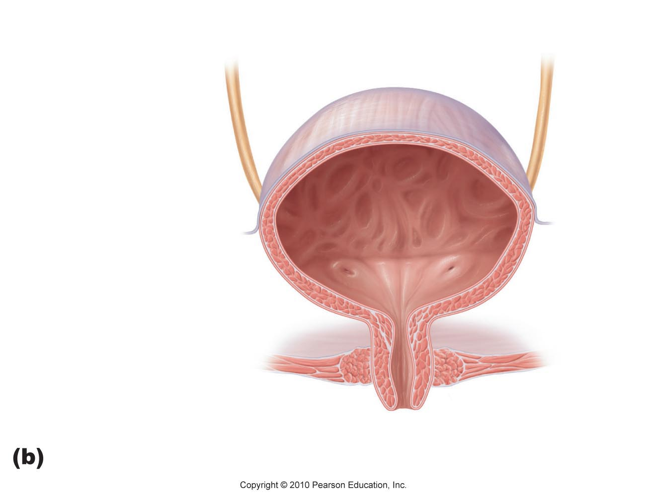
~ 200 ml urine in bladder
stretch receptors trigger visceral reflex arc
afferent to sacral region of spinal cord & efferent to bladder via parasympathetic pelvic nerves
detrusor muscle contracts & internal sphincter relaxes ➔ urine through internal sphincter into upper part of urethra
afferent also to brain; one feels urge to void
external sphincter under voluntary control
Regulation of micturition
detrusor muscle contracts
internal sphincter
relaxes
external sphincter
relaxes
relax external sphincter & empty bladder
reflex subsides in ~1 min; occurs again as urine accumulates

Slide 22
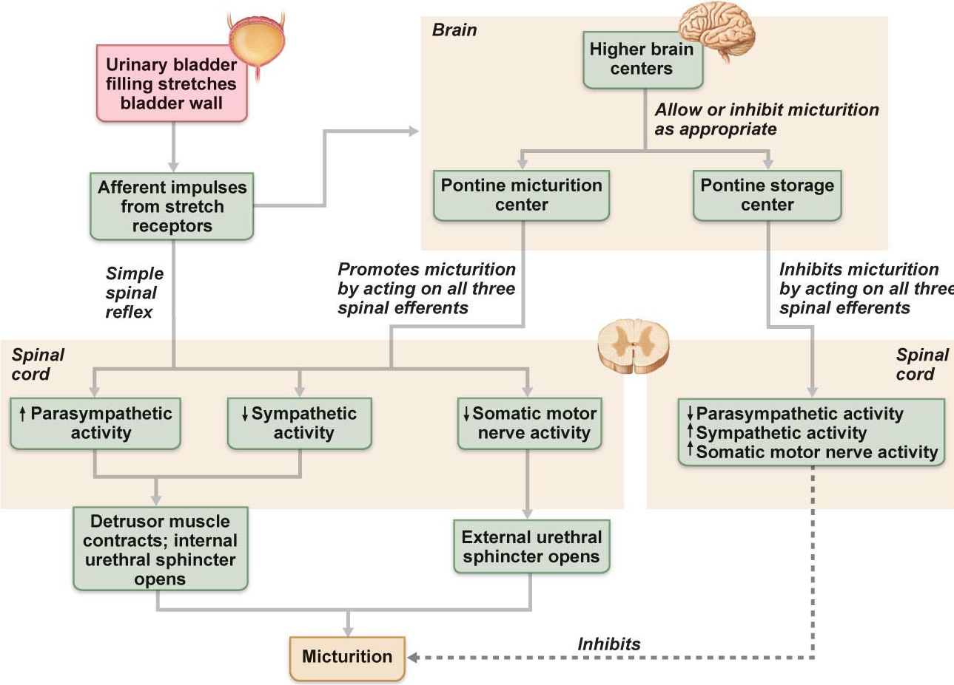
Fig. 25.21

Slide 23
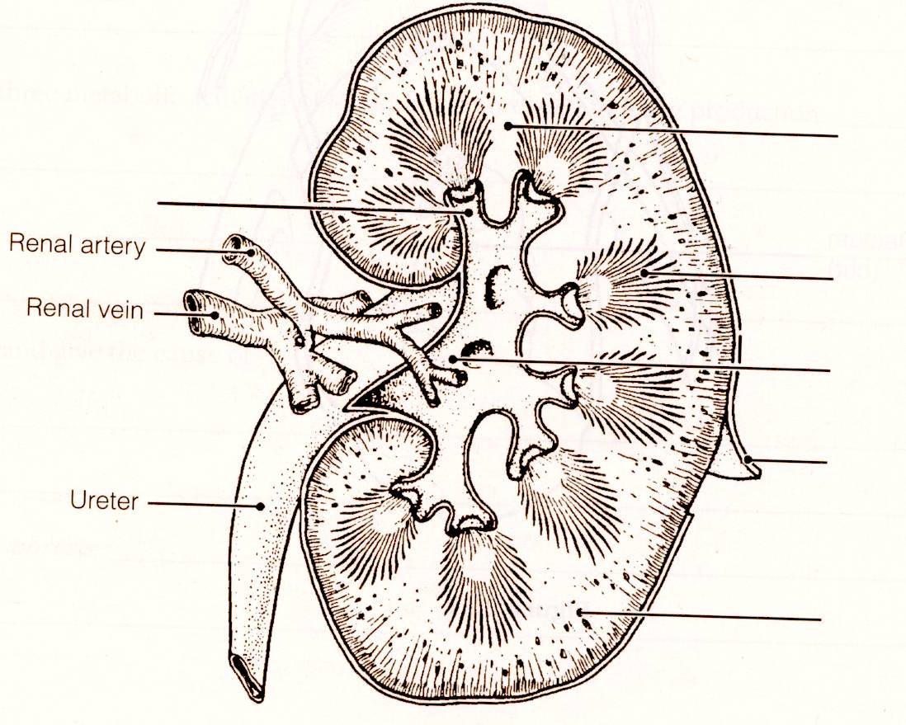
J. Carnegie, UofO

Slide 24
RENAL PHYSIOLOGY
The kidneys are major excretory organs: perfect examples of homeostatic organs
Main function:
filter several litres of fluid from bloodstream daily
(i) toxins, metabolic wastes, excess ions leave body in urine
(ii) materials still needed by body returned to bloodstream
Additional functions:
regulate blood volume & composition
produce enzyme renin, helps regulate BP & kidney function (RAAS)
produce hormone erythropoietin (regulation red blood cell production)
metabolize vitamin D to its active form
Gluconeogenesis during prolonged fasting
long term acid-base regulation

Slide 25
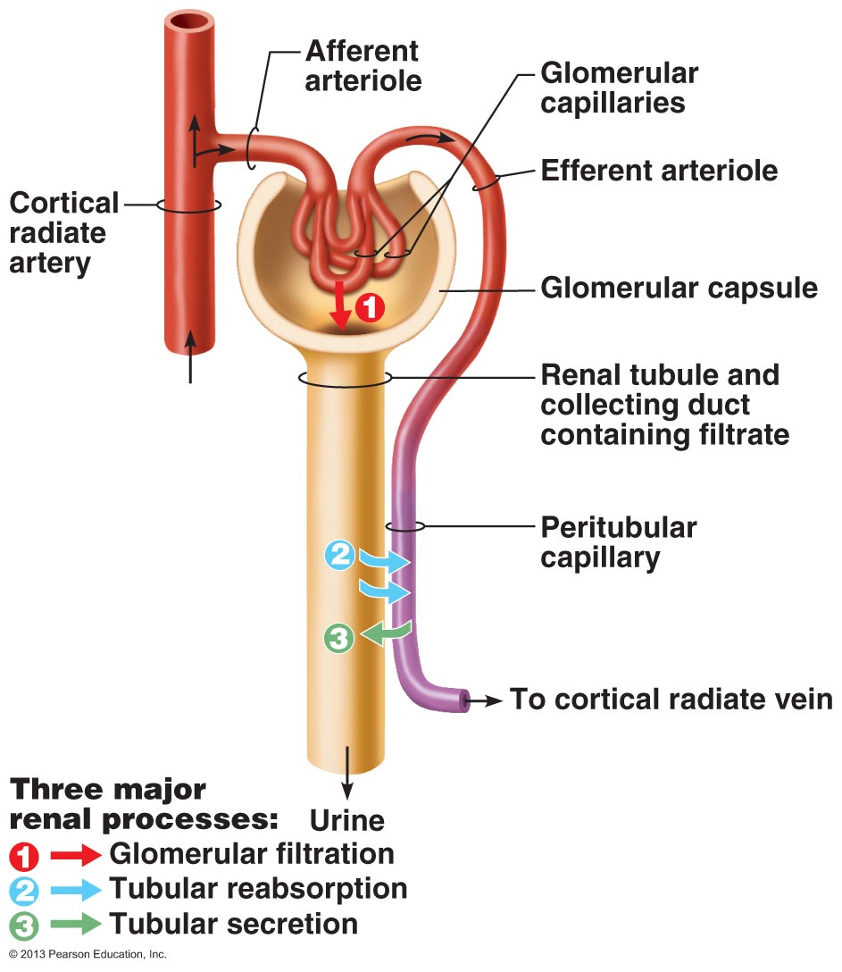
Filtration, Reabsorption, Secretion, Excretion
1000-1200 ml of blood pass through glomeruli each minute;
~650 ml plasma; of this 120-125 ml plasma forced into renal tubules every minute!, equiv to filtering entire plasma volume >60 times/day
kidneys process ~180 L fluid/day; ~1% is urine (~1.5 L)
filtrate = plasma minus proteins
urine = filtrate minus nutrients, essential ions, most H₂O
3 processes of urine formation:
(i) glomerular filtration
(ii) tubular reabsorption
(iii) tubular secretion
Fig. 25.9
J. Carnegie, UofO

Slide 26
Mechanisms of Urine Formation
Glomerular filtration
– produces cell- and protein-free filtrate from blood
Tubular reabsorption
  Selectively returns 99% of substances from filtrate to blood in renal tubules and collecting ducts
Tubular secretion
  Selectively moves substances from blood to filtrate in renal tubules and collecting ducts

Slide 27
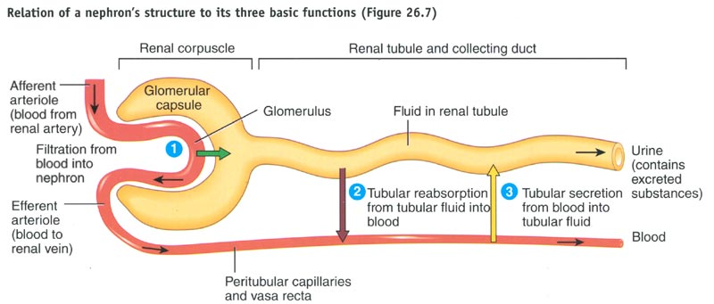

Slide 28
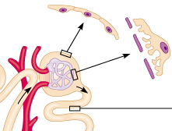
Glomerular Filtration
passive, nonselective ➔ fluids & solutes forced thru by hydrostatic pressure
glomerulus very efficient filter because:
(i) filtration membrane 1000X more permeable than other cap membranes
(ii) glomerular pressure higher than in other cap beds (55 vs < 18 mm Hg)
180 L filtrate formed by kidney caps vs 3-4 L by all other cap beds combined!
fenestrated glomerular endothelium
glomerular basement membrane
podocytes

Slide 29
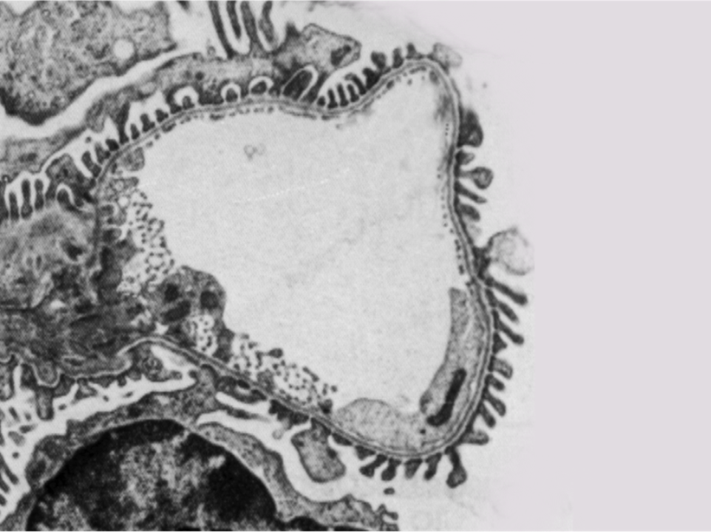


Blood cells
Electrolytes
Toxins
Large proteins

