Slide 1
Muscle Diseases
(WHO Classification III)
(Topic 5C)

Slide 2
Muscle Diseases: Definitions and Types
Any disorder or disease that affects the human muscle system:
Primary Muscle Disease
Secondary Muscle Disease

Slide 3
Muscle Diseases: Examples
Any disorder or disease that affects the human muscle system:
Primary Muscle Disease – McArdle’s Disease; Forbe’s Disease
Secondary Muscle Disease –
  Neuromuscular disease/disorder – Parkinson’s Disease; muscular dystrophy
  Musculoskeletal disease/disorder -
  Inflammatory muscle diseases/disorders - Dermatomyositis
  Autoimmune muscle diseases/disorders – Multiple Sclerosis; Myositis; Muscle Rheumatism

Slide 4
Muscle Diseases: Symptoms/Indications
Muscle atrophy
Pain
Tetany
Muscular stiffness
Biochemical parameters

Slide 5
Muscle Diseases: Symptoms/Indications
Muscle weakness – failure to develop an expected force which can be attributed any one of the processes required for force generation. This is associated with all types and examples of muscle diseases/disorders

Slide 6
Muscle Diseases: Muscle Weakness
Muscle Weakness – Etiology/Cause – at different sites:
Muscle contraction results from a chain of events that begins with a:
nerve impulse traveling in the upper motor neuron from the cerebral cortex in the brain to the spinal cord.
The nerve impulse then travels in the lower motor neuron from the spinal cord to the neuromuscular junction;

Slide 7
Muscle Diseases: Muscle Weakness
Muscle Weakness – Etiology/Cause
where the neurotransmitter acetylcholine is released. Acetylcholine diffuses across the neuromuscular junction, stimulating acetylcholine receptors to depolarize the muscle membrane (sarcolemma).
The result is the decreased contraction force of the muscle fibre (active/passive forces)
Contraction depends on the integrity of each of these parts; disease or disorder in any part causes muscle weakness.

Slide 8
Muscle Diseases: Muscle Weakness
Causes/Classifications by Sites:
Upper motor neuron disease
Lower motor neuron disease
N-M junction disease
Sarcolemma
Decreased contraction force

Slide 9
Muscle Diseases: Muscle Weakness
Classifications:
Upper motor neuron disease
Muscle weakness typical of upper motor neuron disease includes:
CV- stroke producing weakness of one side of the body.
With upper motor neuron disease the muscle bulk is usually well preserved
Other causes…

Slide 10
Muscle Diseases: Muscle Weakness
Classifications:
Lower motor neuron disease:
Spinal Cord
Peripheral Nerve (two types)

Slide 11
Muscle Diseases: Muscle Weakness
Classifications:
Lower motor neuron disease
Spinal Cord- muscle wasting is prominent → shrinkage and eventual death of neurons → denervation of muscle.

Slide 12
Muscle Diseases: Lower motor neuron disease
Classifications:
Peripheral Nerve Diseases (peripheral neuropathies or polyneuropathies) –
    Symptoms usually begin in the hands and feet and progress toward the body - also associated with sensory disturbances
Peripheral neuropathies - degeneration of the axons (core of nerve fibres)

Slide 13
Muscle Diseases: Lower motor neuron disease
Classifications:
Myelin Sheath - degeneration of the myelin sheaths (covering of axons) - demyelinating neuropathies
  Causes of peripheral neuropathy include impaired glucose function (diabetes mellitus), nerve trauma chronic renal failure, and inherited factors
    symptoms are similar to axonal neuropathies but since the axons remain intact, the muscles rarely atrophy.
    recovery from demyelinating neuropathies can be rapid

Slide 14
Muscle Diseases: N-M Junction Disease
Diseases of the neuromuscular junction typically involve the generation of an end-plate potential that is too low to propagate an action potential in the muscle fibre.
Diseases of neuromuscular transmission may be acquired or inherited and may be the result of autoimmune disorders, such as myasthenia gravis congenital disorders; toxins such as those present in botulism
These diseases are associated with weakness and fatigability with exercise.

Slide 15
Example Muscle Disease NMJ: Myasthenia Gravis
Myasthenia gravis is an acquired autoimmune disorder that involves a failure in the transmission of nerve impulses to the muscles and is characterized by persistent muscular weakness and a tendency of muscles to be easily fatigued.
Symptoms include; a) weakness is particularly of the face, limbs, and neck; b) double vision; c) difficulty swallowing and breathing, and d) excessive muscle fatigue during exercise with partial recovery after rest.

Slide 16
Muscle Diseases: Myotonic Diseases (SL)
Myotonia is a difficulty in relaxing (slow relaxation) a muscle after contraction (i.e., relaxing the hand after a handshake).
Causes:
continuing electrical activity of the sarcolemma
delayed myosin and actin
Physical inactivity and cold enhance the condition.

Slide 17
Muscle Diseases: Muscle
The muscular dystrophies are a group of hereditary disorders (n=9) characterized by progressive muscular atrophy and weakness. In most varieties the muscles of the limb girdles—the pelvic and shoulder muscles—are involved.
There is a progressive loss of muscle size and strength which is caused by loss of muscle proteins (enzyme efflux theory) later changing to muscle fiber death and tissue death

Slide 18
Nine Types of Muscular Dystrophy
Steinert’s Disease or Myotonic Muscular Dystrophy :
It is the type of muscular dystrophy which is most common in adults, as its name tells , in this disorder the muscles remain in spasms or become stiffened after slight use or exercise, and lower temperatures increase these symptoms.
This type affects both males and females

Slide 19
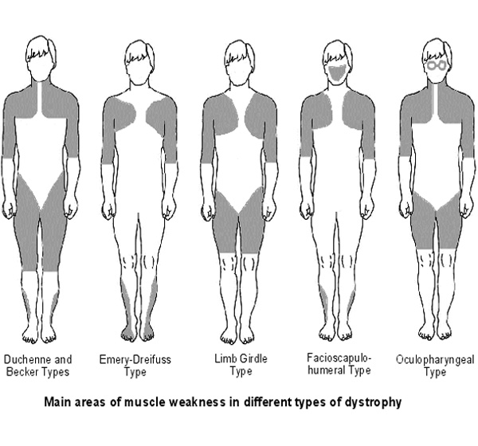
Duchenne Muscular Dystrophy : It is the type which is most common in children and it only affect males between 2-6 years of age, decrease in the mass of muscle is progressive and in most cases the children are wheelchair ridden by the start of their teen years,
usually do not survive more than 20 years
Becker Muscular Dystrophy : This type similar to Duchenne but the symptoms are milder and can appear till 25 years of age. Usually the affected people can live and enjoy life and are also able to walk but they have some heart problems and is present only in males.

Slide 20
Emery-Dreifuss :
It is the type which affects from childhood to teen years and is present only in the males.
It affects the muscles of pectoral region to upper arms and lower parts of legs
and along with that patients have extreme heart problems that are usually fatal.

Slide 21
Limb-Girdle :
It is the type which affects from teenage years to adulthood and is present in both males and females.
As the name indicates, in this type the problem starts from hip (pelvic girdle) region and then reaches to the shoulders (pectoral girdle ) and later legs and arms are also affected,
the sufferers are unable to walk and most patients live past mid adulthood.
2
1
3

Slide 22
Fascioscapulohumeral Muscular Dystrophy :
As the name indicates in this type of muscular dystrophy the muscles of face, scapula (shoulder blade) and humerus (shoulder joint and elbow joint) are affected,
it affects both males and females but about half of the sufferers are able to walk throughout their life
and almost all the patients live a normal life span.

Slide 23
Oculophyrangeal Muscular Dystrophy :
It is the type of muscular dystrophy which affects primarily the muscles of eyes and throat which occur around 40s to onward ages,
symptoms include the weakness of eyes and fascial muscles which could later cause swallowing problems,
this type predisposes the patients to pneumonia and choking.
<5%

Slide 24
Review Slide

