Slide 1
Welcome, Students!
ANP1107 Tutorial #1

Slide 2

HI!!!
I’m David

Slide 3
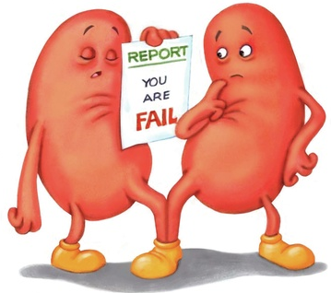
Objectives
Getting pumped for physiology!!
Foundational knowledge
Renin-angiotensin system
Aldosterone
Atrial natriuretic peptide
Buffer systems
Sample questions

Slide 4

Get pumped!

Slide 5
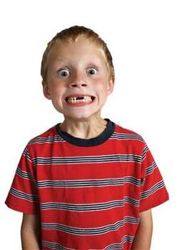
EXCITED!?!?!?

Slide 6
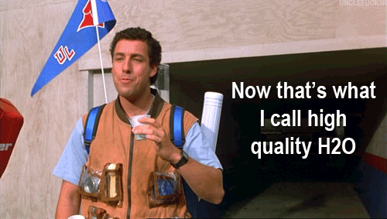
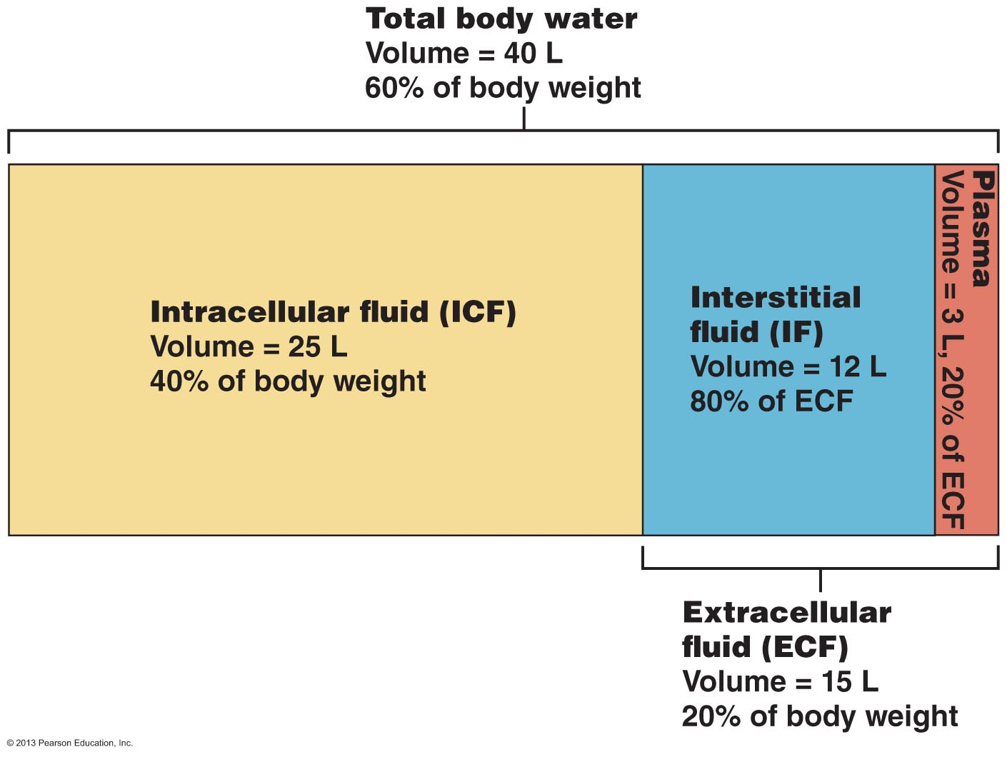
Fluid
Water Content! Anyone know approx. how much?
Serves as a medium for all physiological processes!
The Three Compartments:
Intracellular (majority)
Interstitial
Plasma
Extracellular
Notes:
When we talk about fluid, we are essentially talking about water content
I like to keep interstitial and plasma separated because they can be very different. eg. Blood brain barrier

Slide 7
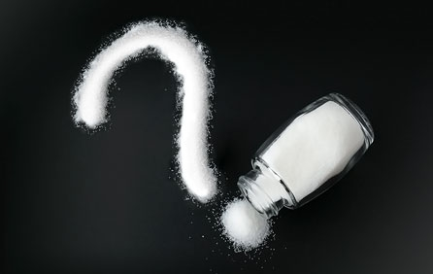
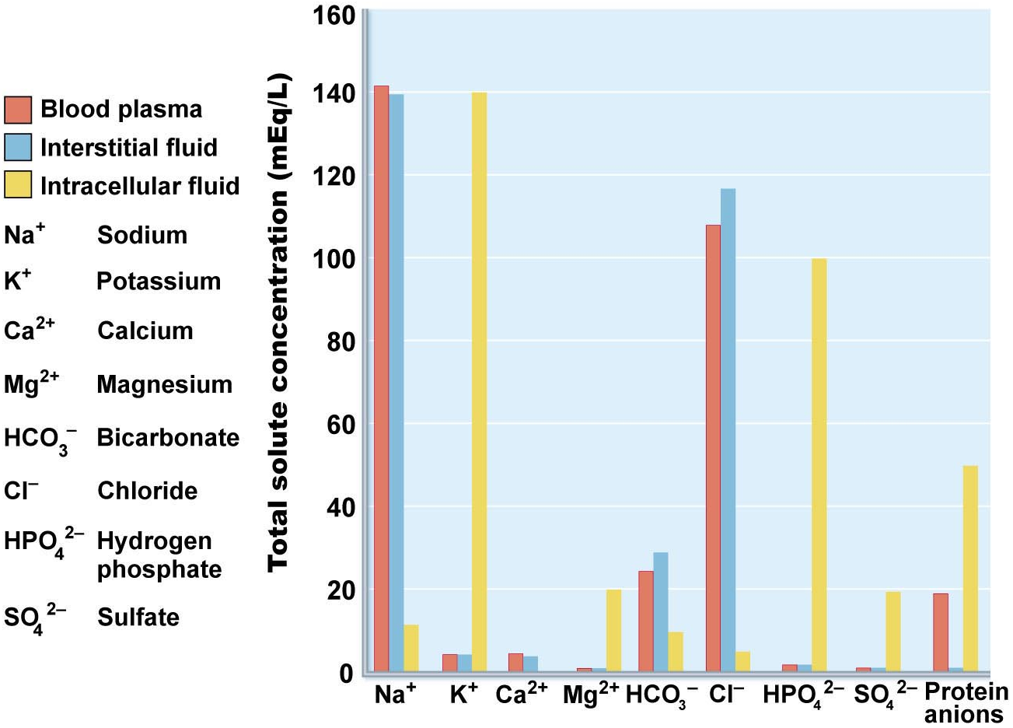
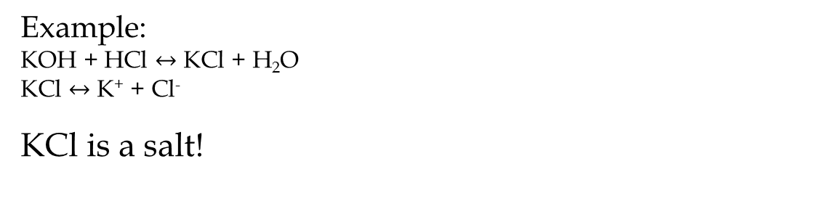
Salt
What is a salt?
Ionizable compounds formed from acid/base neutralization
Example:
KOH + HCl $↔$ KCl + H₂O
KCl $↔$ K⁺ + Cl⁻
KCl is a salt!
Most common ions of the compartments?
Intracellular: Cation – K⁺, Anion – HPO4²⁻ (phosphate)
Extracellular: Cation – Na^{+,} Anion – Cl⁻
Notes:
Not just NaCl!!!
Electrolytes = salts + acids + bases

Slide 8
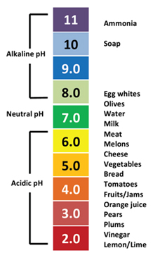
pH
What is pH?
A measure of the acidity/basicity of a solution. pH above 7 = alkaline
pH below 7 = acidic
Calculation:
pH = -log[H⁺]
What is an average physiological pH?
7.35-7.45
What’s it called when pH is above this range?
Alkalosis
If much of what we eat is acidic, how do we maintain such a constant pH?
What’s it called when pH is below this range?
Acidosis

Slide 9
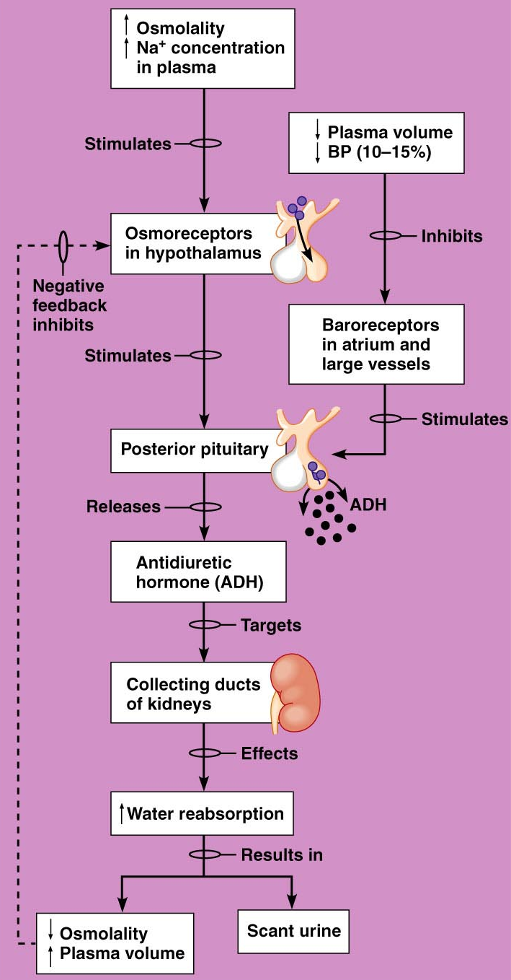
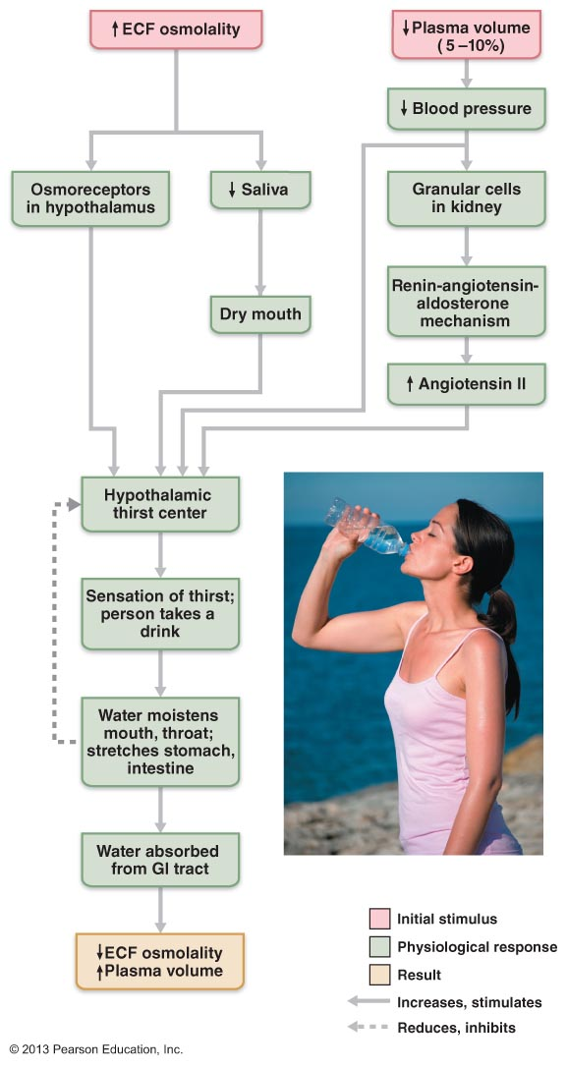
Thirst Mechanism
Origin of the thirst signal?
Hypothalamus
What initiates signal? (Four things)
Decreased plasma volume
Increased ECF osmolarity
Angiotensin II
Dry mouth
Link to antidiuretic hormone (ADH)
Many of same stimuli
Therefore thirst often associated with ADH secretion

Slide 10
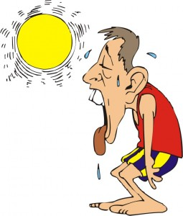
Mr. D. Hydrated gets in from his run…
He has clearly been sweating, his mouth is dry, and he’s begging for water. What can we assume about his water balance? (Higher or lower than “normal”). Effect on blood pressure?
Low! His fluid output has exceeded his fluid intake. Can result in decreased blood pressure if no compensation occurs
What about his blood osmotic pressure?
High. By losing fluid through perspiration (note: hypotonic!), the salt in plasma becomes more concentrated. More solutes/litre = higher osmotic pressure.
What about his blood pH? (For the sake of this question, lets assume sweat pH = 7.4)
No change.
Food for thought: Sweat pH is slightly acidic (~6.3). Could extreme perspiration affect blood pH?

Slide 11
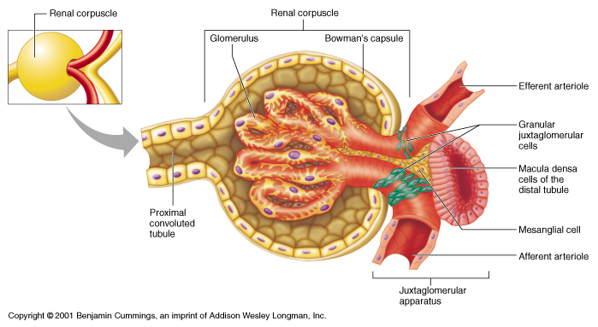
Renin-angiotensin system
Decreases in blood pressure sets the stage for activation of the renin-angiotensin system
Renin is secreted by juxtaglomerular (JG) cells in response to…
Macula densa cells: Detect low filtrate osmolarity in distal convoluted tubule.
JG Cells: Detect low pressure in afferent and efferent arterioles.
Sympathetic stimulation

Slide 12
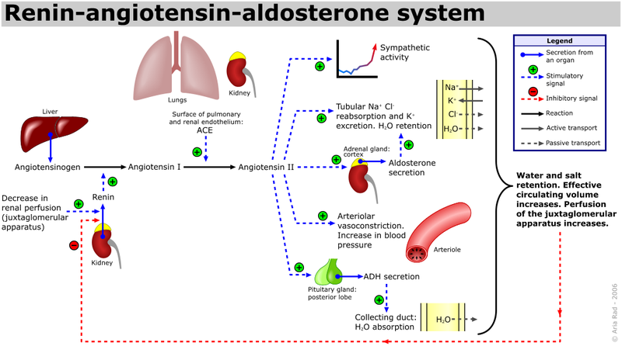
Renin-angiotensin system
ACTIVE COMPOUND
Renin
ACE
Angiotensinogen
Angiotensin I
Angiotensin II

Slide 13
Back to Mr. D. Hydrated
Increased perspiration leads to small decrease in blood pressure.
Afferent and efferent arteriole pressure decreases and JG cells secrete renin into circulation.
The decreased pressure leads to decreased GFR. This causes increased reabsorption of Na⁺ which decreases filtrate osmolarity. Macula densa cells in DCT signal JG cells to secrete renin.
Renin converts angiotensinogen to angiotensin I
ACE converts angiotensin I to angiotensin II
Angiotensin II exerts its effects which consequently increase blood pressure and filtrate osmolarity, removing the stimuli for renin release

Slide 14
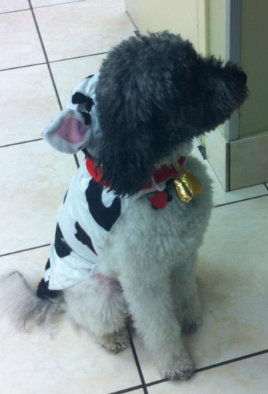
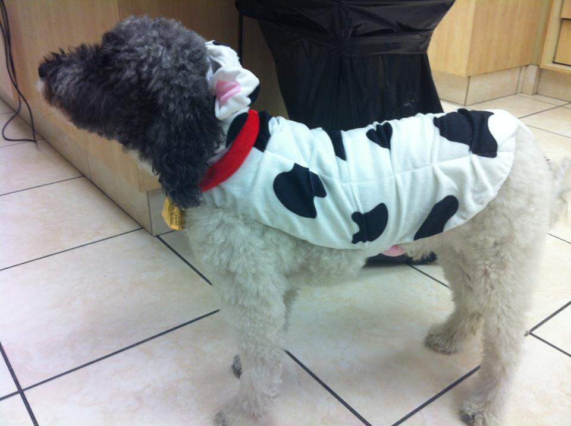
Meet Ned
My mini-labradoodle
…In a cow costume
Has Addison’s disease

Slide 15
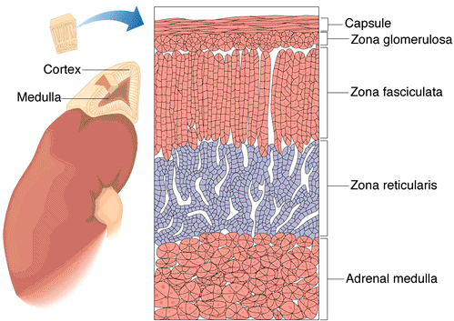
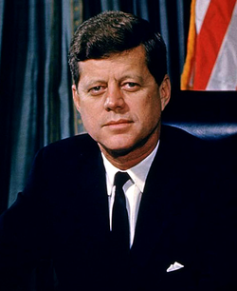
Addison’s Disease
(Chronic Renal Insufficiency)
What is it?
Chronically low production of aldosterone and cortisol by the adrenal cortex
Mineralocorticoids
eg: aldosterone
Glucocorticoids
eg: cortisol
JFK had it!
Notes:
What is it?
What causes it? Most common = autoimmune

Slide 16
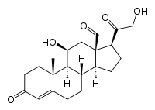
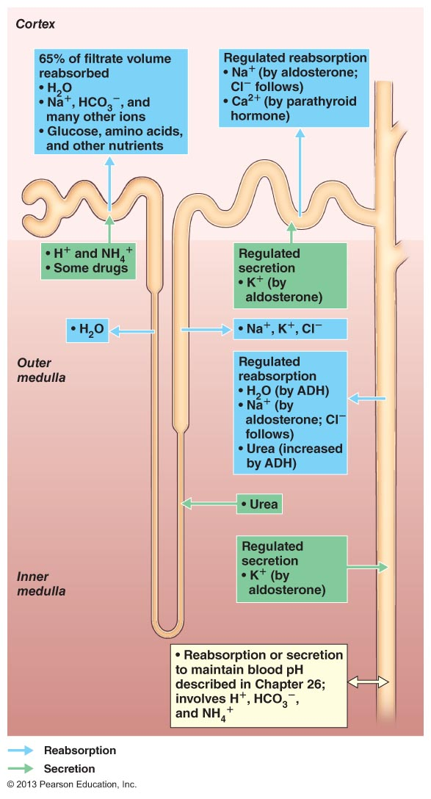
Aldosterone
What does it do?
Cliffs notes: Increases plasma Na+, decreases plasma K+, increases plasma volume
But how?
Increases number of Na+/K+ ATPase channels in distal convoluted tubule and collecting duct
What about water balance???
“Water follows salt”
Rate of Na+ reabsorption must be faster than rate of K+ secretion in order to increase plasma osmolarity
Notes:
Cliffs notes version is essentially the variables that you see change in an experiment
“But how?”
- What channels have they been exposed to that transports Na+ across a membrane? Notice that this regulation occurs late in the process of urine formation. The later steps are associated with hormonal regulation
-This mechanism is just an amplification of a normal process (Na/K ATPase)

Slide 17
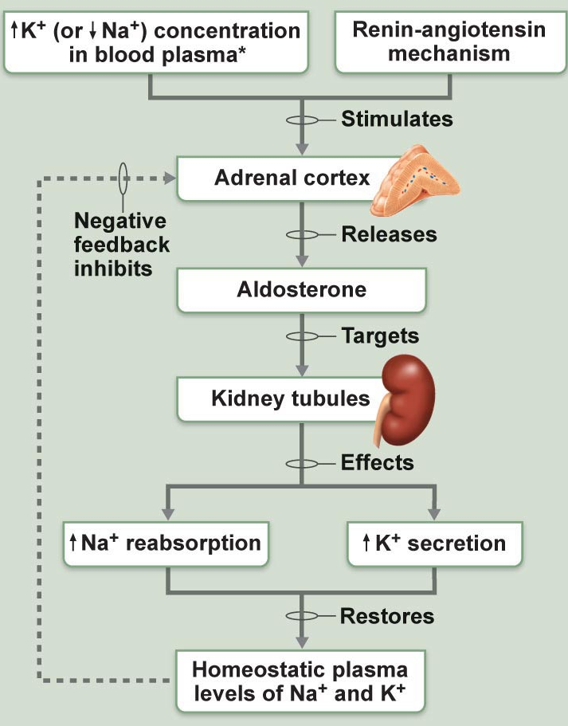
Aldosterone
What stimulates its release?
(HINT: Think of its effects and the idea of negative feedback)
High potassium
Low sodium (sort of)
ACTH (adrenocorticotropic hormone)
Angiotensin II (Renin-angiotensin system)
Notice the role of negative feedback in aldosterone regulation

Slide 18
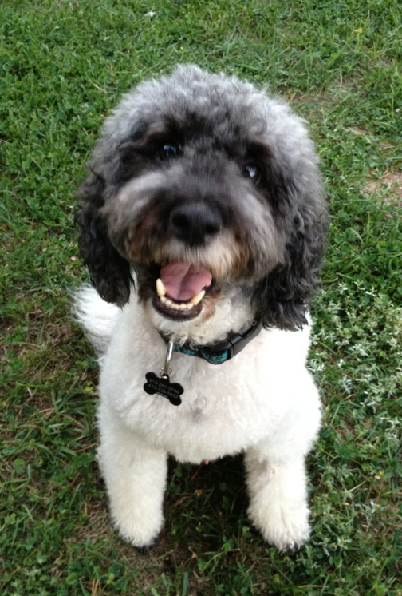
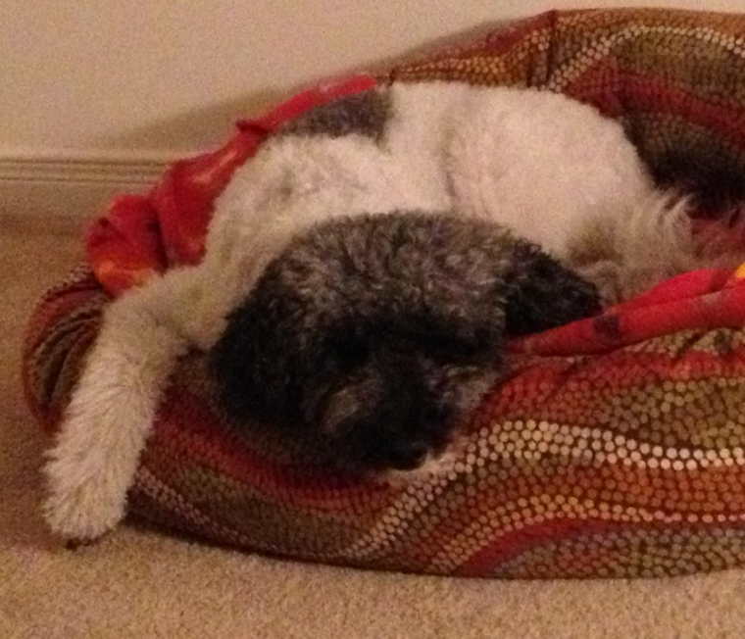
Back to Ned…
If his condition goes unregulated, what will happen?
Low blood pressure (hypovolemia)
Elevated K+ (hyperkalemia)
Low Na+ (hyponatremia)
Can cause…
Nausea and abdominal pain
Fatigue
Coma
Heart arrhythmia
Death

Slide 19

What about regulation of high blood pressure?
Increases blood pressure:
Renin-angiotensin system
Aldosterone
Antidiuretic hormone

Slide 20

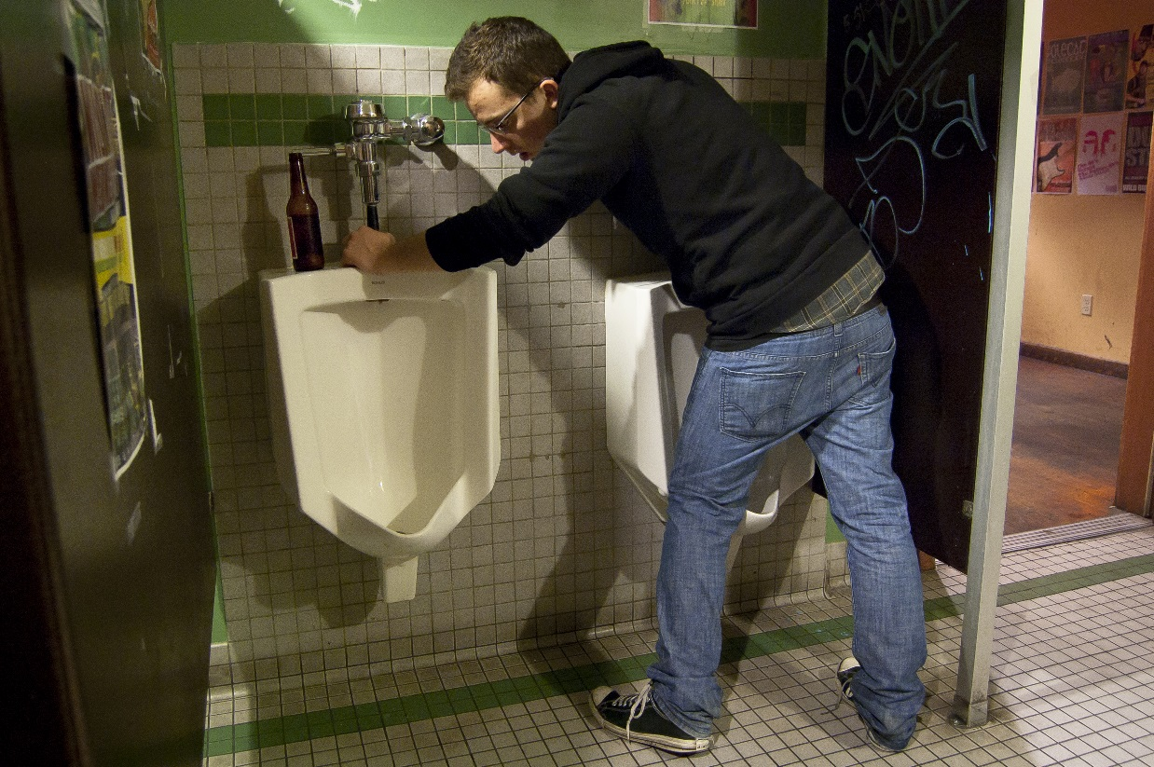
What about regulation of high blood pressure?
Alcohol inhibits ADH secretion!
“But I thought ADH secreted when blood pressure is low, why does a perfectly hydrated person urinate more when drinking alcohol (inhibiting ADH)? Shouldn’t there be no circulating ADH if his water balance and osmotic pressure are normal?”
What does this tell us about ADH levels during homeostasis?
There is a tonic activity of the ADH system! This is also the case for the other systems mentioned! Therefore activation and inhibition of these systems causes effects in both “directions”
Notes:
With systems that have tonic activity it can be assumed that if increases in osmolarity activate these systems, than decreases will reduce the activity of the system.

Slide 21
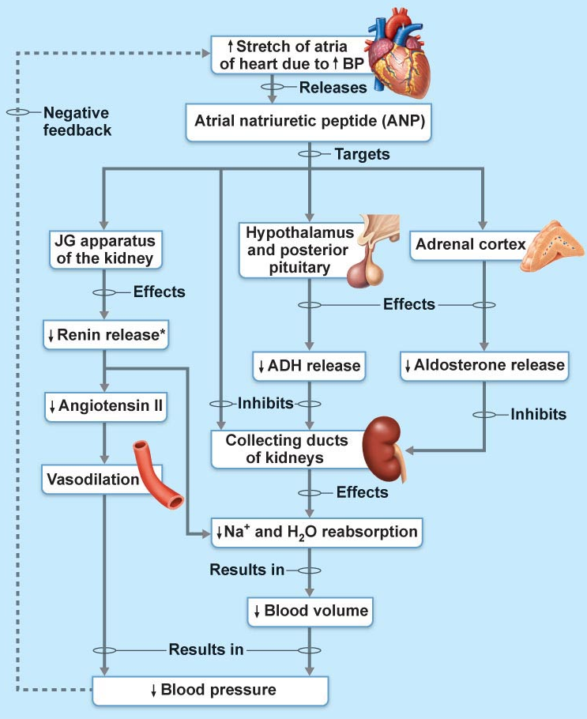
What about regulation of high blood pressure?
One more mechanism!
Atrial Natriuretic Peptide/Factor (ANP/ANF)
Function is based on the tonic activity of the other systems
Acts by inhibiting the three systems mentioned previously
Endocrine signals originate from heart atria
Discovered by Adolfo de Bold at the University of Ottawa

Slide 22
Summary
Antidiuretic hormone (ADH):
Aldosterone:
Angiotensin II:
Atrial natriuretic peptide (ANF):
Increases water reabsorption in DCT and collecting duct
Increases Na+ reabsorption
Increases K+ secretion
Increases plasma volume
Potent vasoconstrictor
Increase Na+ reabsorption, K+ secretion
Stimulates aldosterone release
Stimulates ADH release
Inhibits the three above!

Slide 23
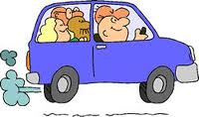
Moving on!

Slide 24
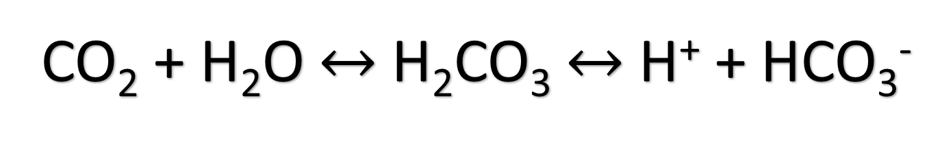
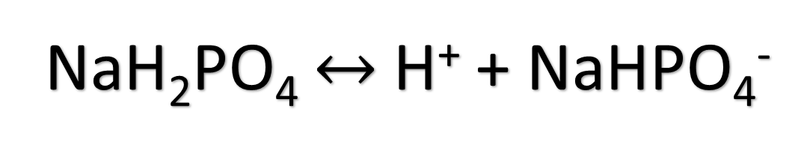
Acid/base Homeostasis
Le Chatelier’s Principle
When a change is made to a chemical equilibrium, the equilibrium will shift to counteract the imposed change.
Buffer systems
Chemical equilibria that resist drastic changes in pH. Note that buffering capacity is limited.
NaH₂PO₄ $↔$ H⁺ + NaHPO₄⁻
CO₂ + H₂O $↔$H₂CO₃ $↔$ H⁺ + HCO₃⁻

Slide 25
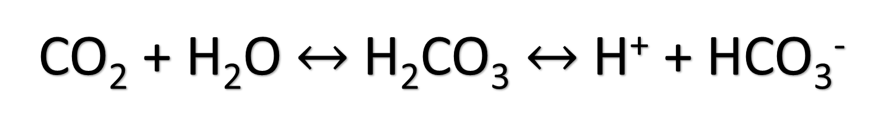
Acid/base Homeostasis
Anaerobic muscle metabolism generates H⁺. What happens to bicarbonate (HCO₃⁻) levels during compensation?
Decreases! According to Le Chatelier’s Principle, the equilibrium will shift left
If respiration is impaired, CO2 levels can build up. What would the consequence be on pH if buffering capacity is exceeded?
Decreases! According to Le Chatelier’s Principle, the equilibrium will shift right, increasing the amount of H⁺
Bicarbonate Buffer System
CO₂ + H₂O $↔$H₂CO₃ $↔$ H⁺ + HCO₃⁻

Slide 26
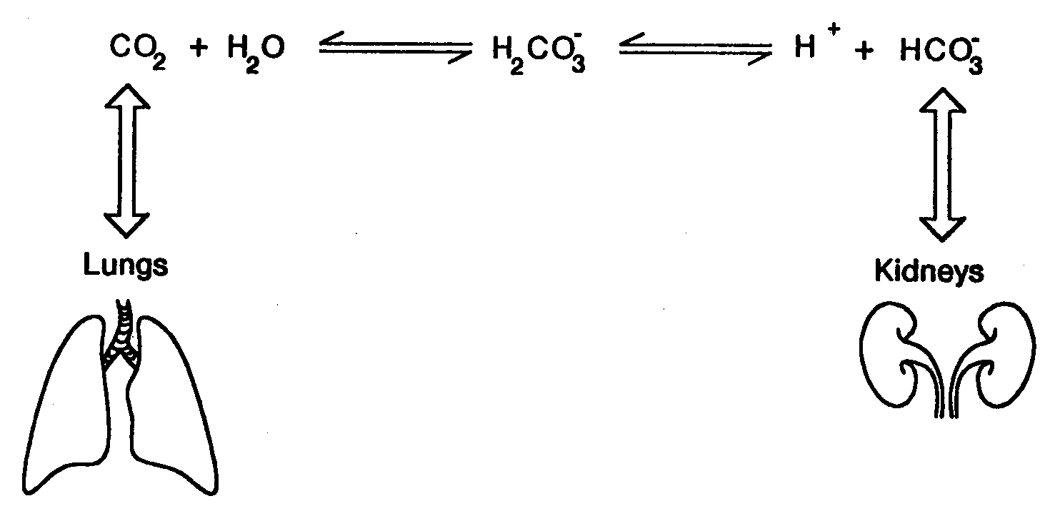
Acid/base Homeostasis
Notice the beauty of the bicarbonate buffer system in regards to human physiology
We have ways to regulate the equilibrium from both ends of the equation, allowing for regeneration of buffering capacity

Slide 27
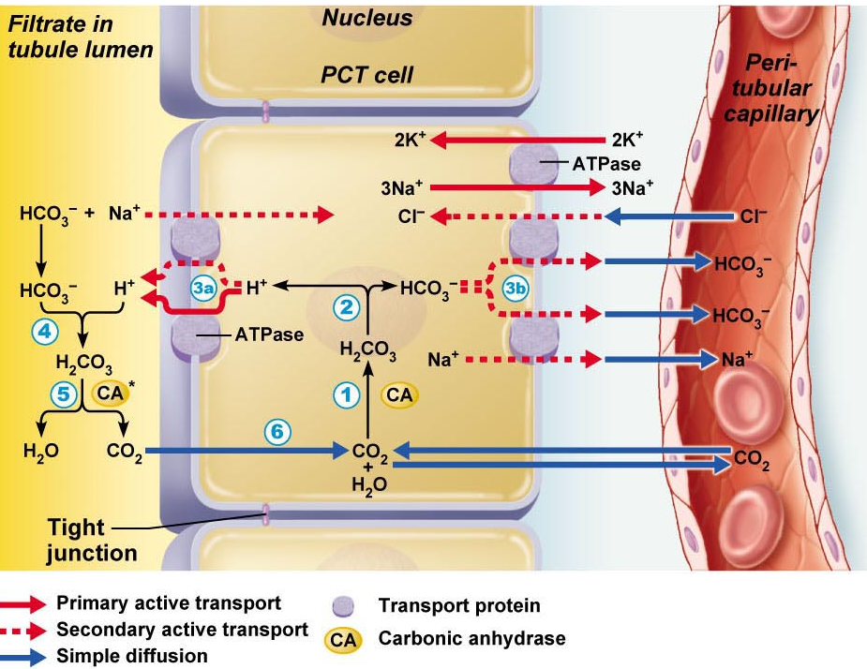
Acid/base Homeostasis
H+ formation is CONSTANTLY occurring! CO2 is generated from oxidative metabolism.
This is not an issue as long as there is enough HCO3- to buffer it!
Need mechanism in place to recycle filtered bicarbonate and to generate more if needed

Slide 28
Acid/base Homeostasis
Bicarbonate Reabsorption (recycling)
Indirect process
Bicarbonate generated IN luminal membrane. Not reabsorbed like other compounds
Bicarbonate molecule that enters plasma is not the same molecule that entered filtrate
NO NET GAIN OR LOSS OF HCO3- IN PLASMA
So how do the kidneys handle the constant formation of new H+?

Slide 29
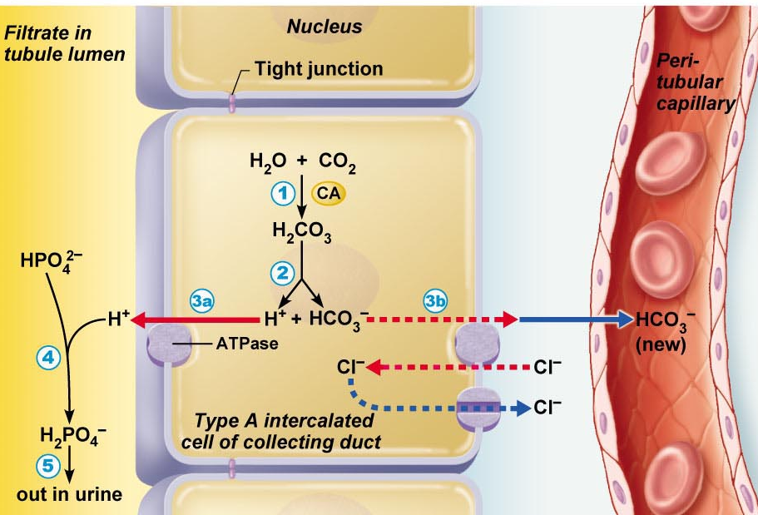
Acid/base Homeostasis
By locking up H+ with non-bicarbonate buffer!
Example: Phosphate buffer
Once all HCO3- is recycled, there is still secretion of H+ into renal lumen
H+ binds with phosphate and is excreted
This leads to an addition of one new bicarbonate ion in plasma
NET GAIN OF HCO3-.
Can “lock up” extra H+, raising pH

Slide 30
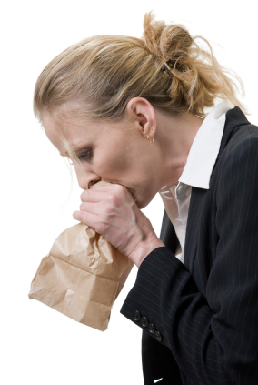
Acid/base Homeostasis
pH imbalances associated with respiratory dysfunction
Hypoventilation:
Respiratory acidosis
Direct effect: CO2 levels elevated
Compensation: Equilibrium shifts right. [H+] increases, bicarbonate increases (this shift is what causes acidosis)
Hyperventilation
Respiratory alkalosis
Direct effect: CO2 levels below normal
Compensation: Equilibrium shifts left. H+ and bicarbonate are consumed (decrease). pH increases (this shift is what causes alkalosis)

Slide 31
Acid/base Homeostasis
pH imbalances associated with non-CO₂ changes
Renal disease:
Metabolic acidosis
Direct effect: Increased H+ in plasma (or decreased HCO3-)
Compensation: Equilibrium shifts left. pCO₂ will increase temporarily and respiration increases to blow more off
Gastric suctioning:
Metabolic alkalosis
Direct effect: Decreased H+ in plasma
Compensation: Equilibrium shifts right. pCO₂ will decrease temporarily and respiration decreases to allow CO2 to build up
Think about why we breathe faster after exercise
Notes:
Renal Disease: Kidneys may not be removing enough H+ in filtrate > results in build up

Slide 32
Questions?

Slide 33
Test-style Questions
1. The function of aldosterone is to:
Increase the rate of Na+ reabsorption
Increase the rate of K+ reabsorption
Activate the renin-angiotensin system
(a) and (b)
None of the above
2. A decrease in plasma pH is associated with:
Respiratory alkalosis
Metabolic acidosis
Respiratory acidosis
Decrease in H+ concentration
(b) and (c)
(b), (c), and (d)
A
E

Slide 34
Test-style Questions
3. Mr. D. Hydrated became anxious after his run and begins hyperventilating. He starts showing signs of alkalosis. What could be done to restore blood pH?
Connect him to a conc. oxygen tank
Make him breathe in and our of a paper bag
Drink Gatorade to restore his Na+ and K+
Keep hyperventilating, it will go away soon
4. The phosphate buffer system:
Is involved in the recycling of bicarbonate ions
Doesn’t buffer pH, it is involved in bone formation
Is the major buffer system in the plasma
Is involved in generating new bicarbonate ions
(a) and (c)
B
D

Slide 35
Test-style Questions
5. Angiotensin converting enzyme (ACE) catalyzes the formation of:
Aldosterone
Antidiuretic hormone
Angiotensin I
Angiotensin II
6. Addison’s disease is associated with:
Low renin production
Low Na+ concentration in plasma
High K+ concentration in plasma
Low K+ concentration in plasma
(b) and (c)
D
E

Slide 36
Test-style Questions
7. Dehydration after vigorous exercise is associated with:
Low plasma osmolarity
High plasma osmolarity
No change in plasma osmolarity
6. In the case of Mr. D. Hydrated, which systems would likely be stimulated after his vigorous exercise?
Renin-angiotensin system
Aldosterone
Atrial natriuretic peptide
Antidiuretic hormone
(a), (b), and (d)
All of the above
B
E
Notes:
Note sweat is hyperosmotic

Slide 37
Test-style Questions
7. Most of the fluid in our body is in:
Interstitial space
Plasma
Intracellular space
Bladder
8. Common cation in intracellular space is ________, and most common anion is __________:
K+, Cl-
K+, HPO4-
HPO4-, K+
Cl-, K+
Na+, Cl-
C
B

Slide 38
You Guys Rock!

