Slide 1
Ancient Brawl

Slide 2
Premise
A game which helps 9th graders learn world history.
Has a single player aspect as well as a multiplayer mode.
Combines mini games with historical events.
Within every event there will be multiple choice questions which need to be answered in order to progress to the next event.

Slide 3
Structured Model
The ADDIE system will be used in order to complete this game.

Slide 4
Analysis
Children that are in the 9th grade (14-15 years old) are characterized by the search for independence and fitting in with their peers. Also a desire for knowledge that is useful in real life situations.
The objective would be to relate these adolescent conundrums to historical characters and events in order to create a
connection to situation they face.

Slide 5
Analysis (cont.)
The objective of the game itself is to complete the single player campaign and amass as many achievements and awards in order to compete in multiplayer mode.
The pedagogical aspect would be that all content except for a few discrepancies inside the mini games would be historically accurate.

Slide 6
Analysis (cont.)
The timeline for the completion of the game would be the length of the high school year (September – June) in preparation for the final exam. Different chapters will be accessible to the user depending on what material is being reviewed in class. The single player campaign would be about 20 hours.

Slide 7
Design
The introduction (which could be skipped by pressing esc) would display the different landscapes that will be studied during the game. It would resemble something like Sid Meier's Civilization V : Gods and Kings intro.
The main menu would consist of five icons: Single player, Multiplayer, Mini game vault, Shop and options.

Slide 8
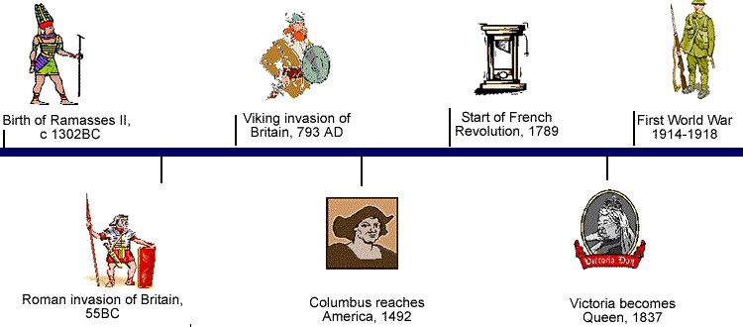
Single Player
A timeline would be displayed allowing the player to select which era he would like to play. Example:

Slide 9
Single Player (cont.)
The objective is too complete every era with as much precision as possible. Once an era is completed at 100% the player has gathered the maximum amount of points. All of these points can be spent in the shop.
Once the era is selected a cinematic will roll and will preface the historical event that takes place and then it cuts to a mini game. This cannot be skipped.

Slide 10
Single Player (cont.)
The game will attempt to span all of the curriculum which is covered in 9th grade history.
For example the Renaissance which took place between the 1300’s to 1600’s was a time where the populous started questioning authority (the targeted audience can relate to this) and sparked reformation. A man called Galileo Galilei did just this by revealing his research that it was the earth which orbited the sun instead of the opposite.

Slide 11
Single Player (cont.)
A tutorial will appear before every mini game explaining the controls and objectives. These tutorials can be turned off at any time by checking the box next to the “turn off tutorials” at the pause screen.
In this mini game the user would control Galileo as he tries to retrieve and hide his research and inventions from the authorities. This would take on a platform style of video game going from left to right.
Arrows would pop up indicating the location of the item or where it needs to be hidden when the player is near said location. These items will be relevant to the character such as Galileo’s manuscripts about astronomy, modified telescope, modified compass,

Slide 12
Single Player (cont.)
The player will dispose of 5 points of health.
Depending on the height of a fall the player will lose health (approximately 1 point of health for each floor (fall down 2 floors = 2 hp lost).
If the player loses all his hp or is caught by a npc representing the Italian authorities he will need to restart from the last acquired item or hidden item checkpoint.

Slide 13
Single Player (cont.)
When the mini game is completed a quiz game then appears.
All of the questions relate to the historical event or character that has been played previously.
The questions will either be multiple choice or a text box will appear where the answer needs to be typed.

Slide 14
Single Player (cont.)
Here are two sample questions
  - What did Galileo find out about the sun?
  The earth orbits around the sun
  The sun orbits around the earth
  That it is very hot
  That it is essential for the survival of the human race
  What instrument that aids in the observation of remote objects did Galileo modify?
  A: The telescope

Slide 15
Single Player (cont.)
If answered correctly the player is given points which can be spent at the shop.
The quicker the answer is given the more points the player receives.
There will be a total of 10 questions per quiz.
The bank of questions will be very large.
The questions being asked will be picked at random from the bank.

Slide 16
Single Player (cont.)
The game will switch genres depending on the mission which needs to be accomplished. It will mostly be a platform game when a historical figure is being represented. When it is an event or a war it will shift to a strategy genre which will resemble clash of clans. (the video is quite long and shouldn’t be watched to it’s completion. It is just to give an idea of what would be desired.)

Slide 17
Single Player (cont.)
Other mini game ideas:
  Side scrolling maze where you navigate Christopher Columbus’ ship from France to Quebec.
  Strategy base encounter between the Romans and the Ottoman Turks which saw the fall of the great Byzantine Empire.
  Platform game of Voltaire's escape from the authorities which saw him end up in Jail.
  Voltaire’s teachings eventually sparked the French revolution. Platform level where a French civilian needs to join the militia in order to overthrow the government.
  Strategy game where the various battles that occurred during the battle of independence are relived in the game.
  A memory game consisting of finding the two tiles that have the
  same painting on them. When they are matched the artist and
  name are revealed.

Slide 18
Multiplayer
This portion will have the same gameplay as the single player but he will be facing off with another user.
The winner will be decided upon who can get the most points.
Points are awarded for speed in which the mini game is completed.
The points in the quiz portion depend on speed as well as getting the correct answer. A point multiplier is given depending on how many questions are answered correctly in a row. So if the user gets two questions right his point total is multiplied by two and so on.

Slide 19
Multiplayer (cont.)
The points which will be awarded in this mode will be much higher then in the single player since they are going against an opponent.
There will be an all-time, monthly, and weekly leader board that will display the top 50 users who have gathered the most points.
Ranks will be awarded in this mode. The more points you gather the higher your rank. Ranks will help match players with similar skill level against one another.

Slide 20
Mini Game Vault
This area will have the same timeline as the single player but once an era is selected all content which was seen in the single player campaign will be able to be selected individually. Sort of like a scene selection menu when you watch a movie.
So for example if I wanted to play the Galileo quiz I could access it straight away without having to watch the cinematic or play the mini game.

Slide 21
Mini Game Vault (cont.)
The entire bank of questions and answers will be able to be viewed in this area.
Any content which has not been seen in the single player mode will be locked until it is played in single player. The teacher or supervisor will be given admin commands which will allow them to unlock anything.

Slide 22
The Shop
This is where all the points which have been gathered can be spent.
Every mini game will have upgrades and esthetics that can be purchased here at the shop. For example in the Galileo mini game he will not be wearing any shoes. Here you can purchase him shoes which will make him run faster. The color can be customized by using points buy a die which will change the color of any item.

Slide 23
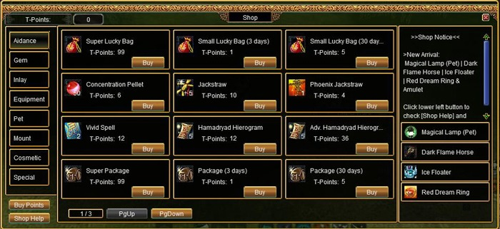
The Shop (cont.)
Every item will be specific to one mini game and will not transfer to other characters.
The shop will be similar in display to the image shown below:

Slide 24
Options
The option menu includes text speed, game music volume, game sound effects volume, and game difficulty.
Text speed can be set to fast or slow
Game music volume and game sound effects can be set to the preference of the player

Slide 25
Options (cont.)
Game difficulty (does not apply for multiplayer mode)
Easy: Very few enemies during mini games, no timer during quizzes
Medium: Increased enemies during mini games and more items to collect, 30 seconds for each question during quizzes
Hard: A lot of enemy npc’s and items to collect, 15 seconds for each question during quizzes
*note that more points are awarded depending on the level of difficulty. Hard difficulty being the
one that gives the most points.

Slide 26
Development
The user interface will be clear and simple.
The game environment will be cartoony in order for the game to be run smoothly on older devices.
Avatars will be given depending on your rank. At rank 50 your avatar would be a peasant and at rank 1 it would be Napoleon.
This game would be instructor-led and facilitated e-learning model since the part of the game which would be played would coincide with what was taught
that day.

Slide 27
Development (cont.)
Players will have a 25% chance of being awarded a random drop item after they have completed a mini game and a quiz. There are four categories of items : common (99.81%), rare (73.11%), Unique (19.73%), and Historical (6.33%). The percentages next to each category is the probability of the player getting that type of item.
Achievements will also be given if certain tasks are carried out such as:
  Finishing a mini game without taking damage
  Finishing a mini game at full health
  Getting all the answers to the Roman empire quiz correct
  Fail 5 times in the Galileo mini game

Slide 28
Implementation
Procedures to train the facilitators and the learners will be developed.
The facilitators' training should cover the course curriculum, learning outcomes, method of delivery, and testing procedures.
Preparation of the learners include training them on new tools (software or hardware).
The project manager will ensure that the books, hands on equipment, tools, CD-ROMs and software
are in place, and that the game runs smoothly on
the chosen platform.

Slide 29
Evaluation
Summative and formative evaluations will be performed.
The transfer evaluation should reveal that the game helps in various ways such as:
  Preparing students for tests which have time constraints
  Realizing that the struggle for independence is not only a problem that they face
  Even big historical names can face rejection
  When you give enough time and effort you shall be rewarded
  Failure is acceptable
  History can be fun

Slide 30
Conclusion
This game does not only represent landmarks which have laid the tapestry of our current civilization. It lets children at the grade 9 level customize things in order for them to distort it slightly to their liking. With the evolution of technology and patience diminishing because of the on demand world the younger generation live in we need to adhere to the educational program to their needs. One thing history has taught us is that we need to evolve with the present times or consequences will soon come to fruition.

