Slide 1
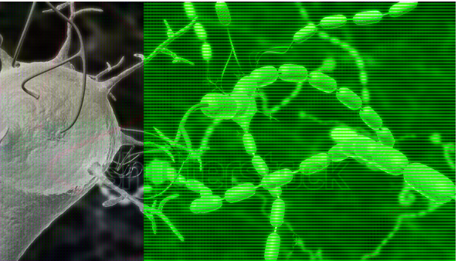
Posted March 12, 11:30 PM
ANP1106D Anatomy & Physiology II, Part 2
F Feiner, PhD, MD
Friday, March 13
ANP 1105 Review: Fundamentals of the Nervous System and Nervous Tissue

Slide 2
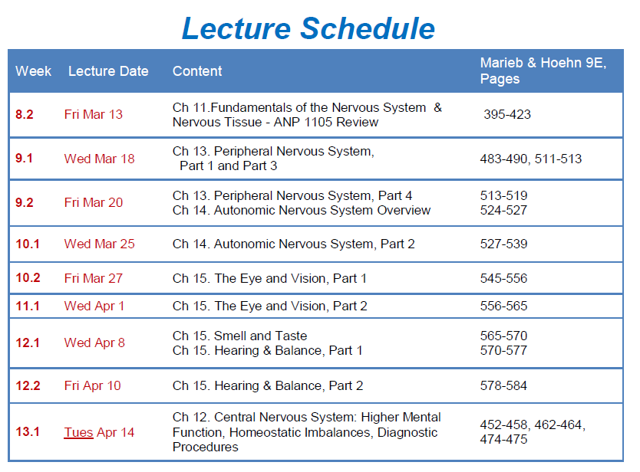

Slide 3
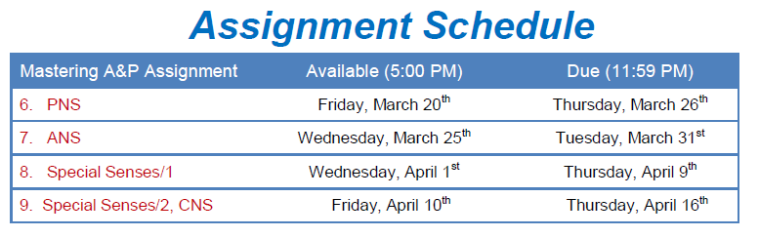
Final Exam
Friday, April 24th
9:30 AM
Location: TBA

Slide 4

Lecture Content
ANP 1105 Review: Fundamentals of the Nervous System and Nervous Tissue (Ch 11, pp 395 – 423)
Membrane potential
Graded potentials
Action potentials
Synaptic transmission
Neurotransmitters
Neurotransmitter receptors
Patterns of neural processing

Slide 5
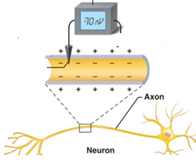


Membrane Potentials
    Resting Membrane Potential of Neuron
Plasma
membrane
Cytoplasm inside plasma membrane -vely charged relative to outside
Membrane “polarized” (-70 mV)
Gives rise to current flow
Figure 11.7
Ohm’s law: current (I) voltage (V)
Resting membrane potential generated by:
Differences in [Na⁺] and [K⁺] inside/outside cell
Differences in permeability of the Na⁺ and K⁺ ion channels in membrane
Changes in resting membrane potential allow neurons to receive/ integrate/send information/ signals
Notes:
Different types of neurons have different resting membrane potentials (RMP): -40 to -90mV
[Na+] inside <<< [Na+] outside
[K+] >>> [K+] outside

Slide 6
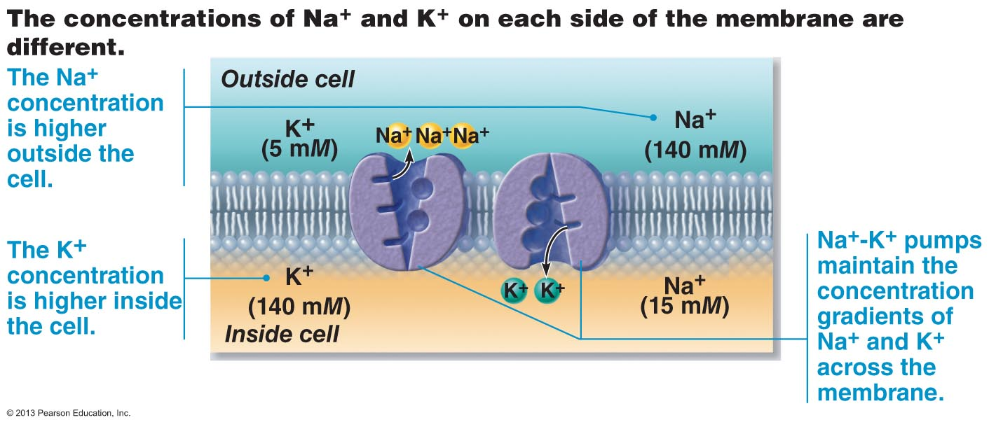
Membrane Potentials
    Generating a Resting Membrane Potential:
Figure 11.8a
Because of these concentration gradients, K⁺ diffuse out of the neuron and Na ⁺ enter
Since K⁺ diffuse out much more easily than Na⁺ enter, neuron is more negative inside (-70 mV)
Na⁺- K⁺ pump requires energy (ATP ➔ ADP), without which neuronal signaling/life would cease
Notes:
The difference in concentrations and the concentrations themselves are necessary for survival

Slide 7
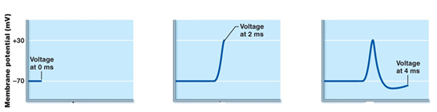


Membrane Potentials
Two ways in which membrane potential changes:
Depolarization: less -ve (eg -70 mV ➔ -65 mV, or -70 mV ➔ +30 mV )
Increases strength of nerve impulses
Hyperpolarization: more -ve (eg -70 mV ➔ -75 mV)
Reduces strength of / stops nerve impulses
Repolarization
Depolarization
Hyperpolarization
Figure 11.12
Changes in membrane potential give rise to two types of signals:
Graded Potentials
Action Potentials

Slide 8
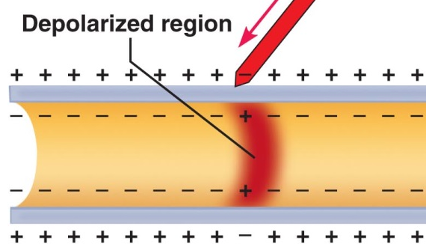
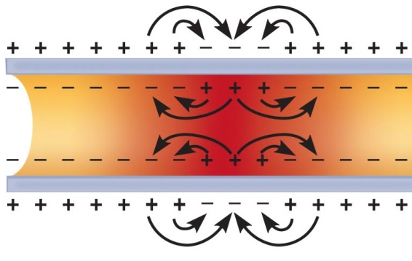
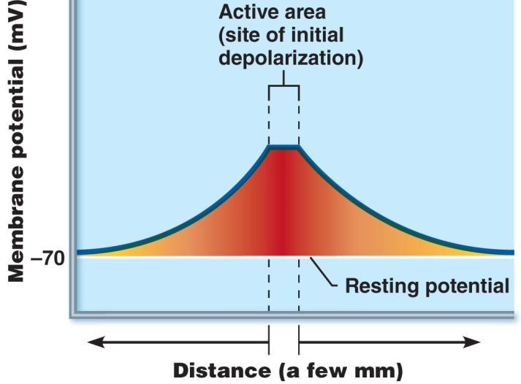
Graded Potentials
    Plasma membrane
Short-Range Communication:
    Stimulus depolarizes small
    area of membrane: polarity
reverses: -ve out, +ve in
    Signal initiated (nerve impulse)
    Regions next to depolarized area reverse polarity: depolarization spreads
    Membrane is permeable (leaky): charges lost within a few mm
Figure 11.10
    Signal quickly dies out
    But moves in all directions

Slide 9
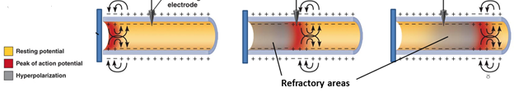
Action Potentials
    Long-range Communication
    Once depolarization occurs it spreads – if it is strong enough – in one direction along the nerve call body
Axon cell body and hillock
Repolarization (K⁺ out)
Depolarization (Na⁺ in)
Figure 11.12
Hyperpolarization (more K⁺ out)
Notes:
Stimulus > threshold potential is applies
AP travels down axon
DEPOLARIZATION: Na+ channels open (Na+ into axon)
REPOLARIZATION: K+ channels open (K+ moves out of axon)
HYPERPOLARIZATION: additional K+ slow brief –ve shaft
Prevents AP from travelling backwards
Nerve impulse travels to axon terminal and signals other neurons

Slide 10
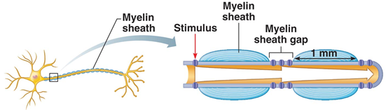
Action Potentials
    aka ‘Nerve Impulses’. Differ from graded potentials:
Do not decay with distance
Only occur in axons
Begin as graded potentials in dendrites/cell bodies
All-or-nothing response: only if stimulus adequate
Conduction velocity varies widely:
Reflex actions (Group A): 150 m/sec (540 Km/hr!)
Internal organs, eg gut, glands, blood vessels (Groups B and C):15 – ≤1 m/sec)
Axon diameter: larger - faster
Degree of myelination: more = faster
Figure 11.15c

Slide 11

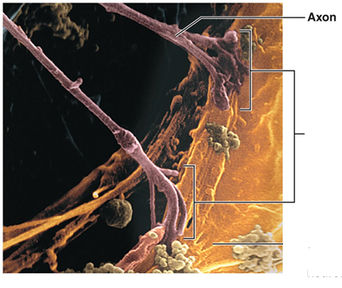

Synapses
    Definitions:
Synapse: Junction [gap] mediating information transfer between pre- and post-synaptic neurons
of presynaptic
neurotransmitters
neuron
Synapse
Cell body
of postsynaptic
neuron
Presynaptic neuron: sends information ➔ synapse
Postsynaptic neuron: receives information from synapse

Slide 12
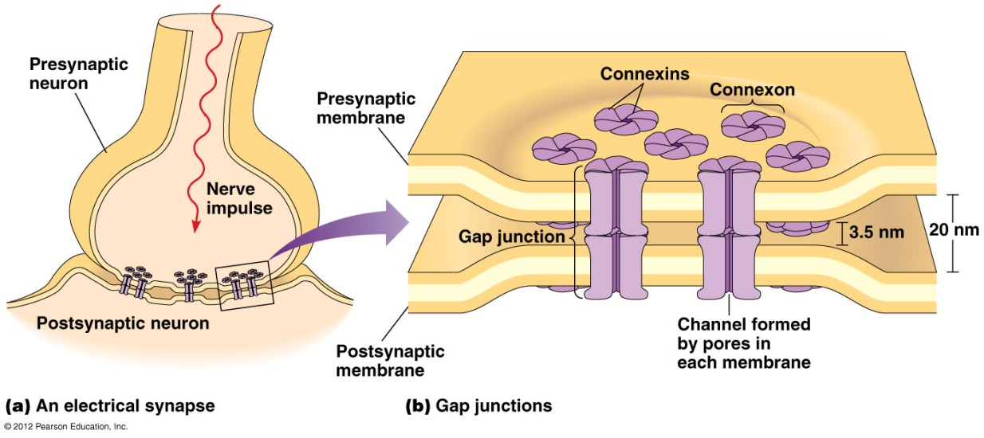
Synapses
    Electrical Synapses (less common):
No synaptic gulf
Presynaptic and postsynaptic neurons in direct contact
Gap junctions [Text, p 67] containing connexon protein channels ➔ very rapid communication
Ion flow synchronizes interconnected neurons
Found in hippocampus in brain (memory/emotion)
Very common in embryo – guide CNS development
[Figure not in our Text (9E). Found online]

Slide 13
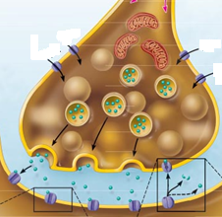
Synapses
    Chemical Synapses:
Specialized to release and receive chemical neurotransmitters (NTs)
Axon terminal of presynaptic neuron. Has many synaptic vesicles, each filled with thousands of NTs
NT receptor region on postsynaptic neuron’s membrane (cell body/dendrite)
‘Huge’ ~40 nm synaptic cleft in between (fluid-filled)
NT size ~ 1 nm
Figure 11.17

Slide 14
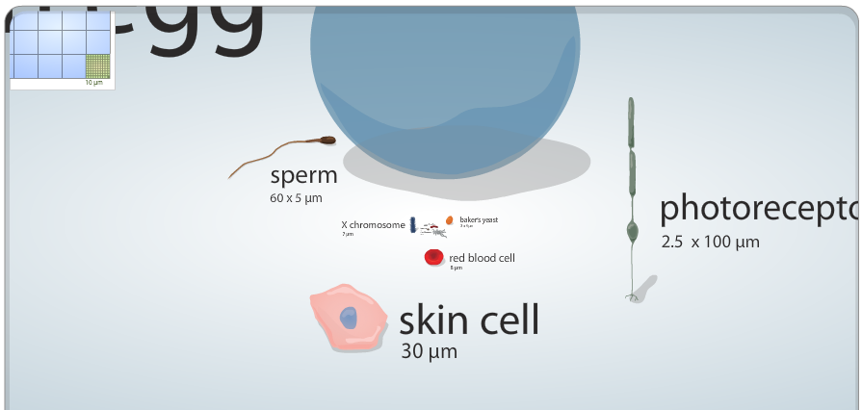
Cell Size and Scale
http://learn.genetics.utah.edu/content/begin/cells/scale/

Slide 15
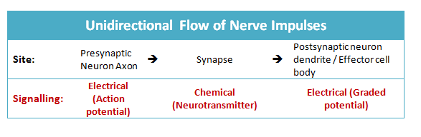
Synapses
    Chemical Synapses (continued):
Nerve impulses not directly transmitted cell-to-cell
Instead, a chemical event: NT release, diffusion, receptor binding

Slide 16
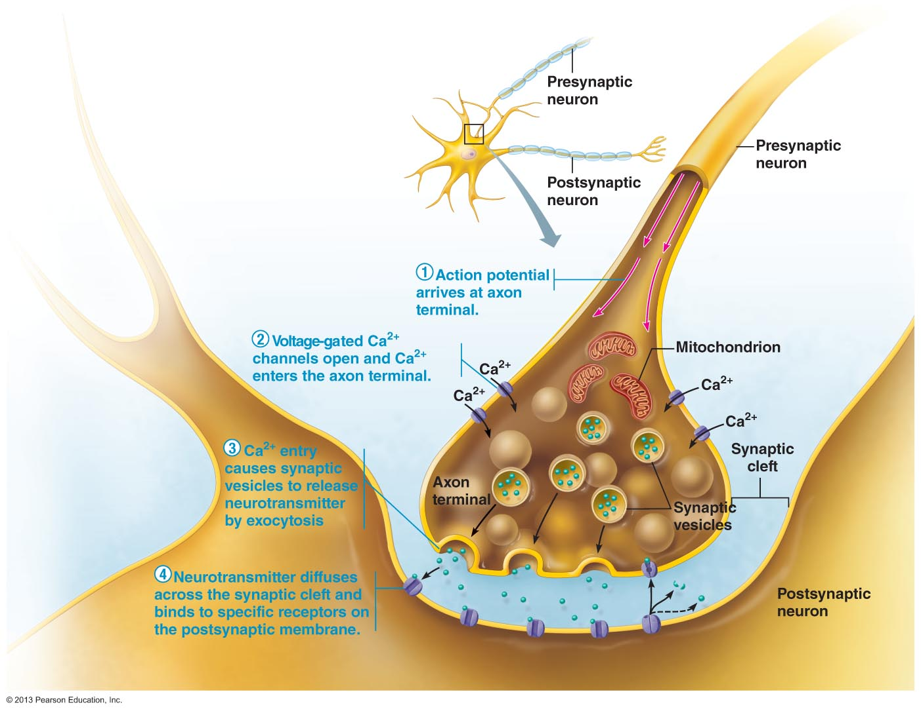
Information Transfer Across Chemical Synapses
    Presynaptic and Synaptic Events
Presynaptic neuron
Figure 11.17

Slide 17
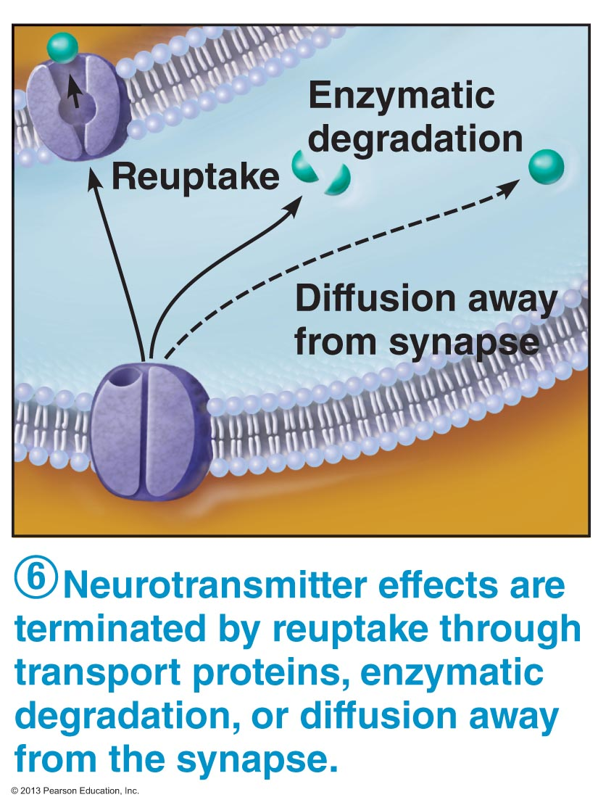
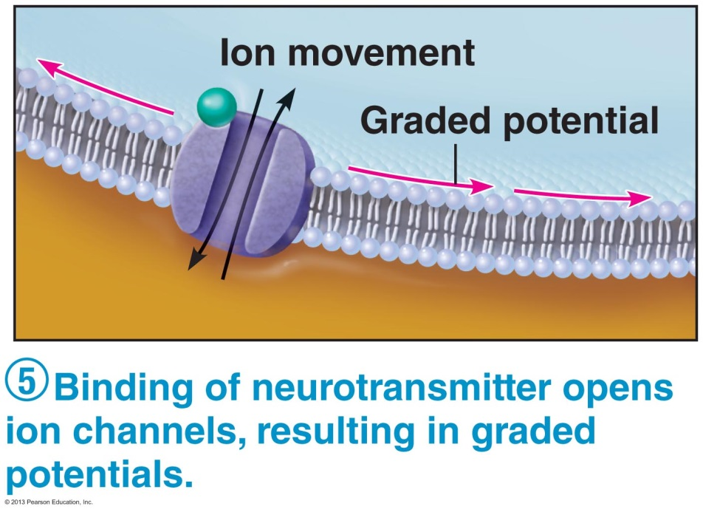
Information Transfer Across Chemical Synapses
    Postsynaptic Events
Figure 11.17
Figure 11.17
Notes:
Binding of neurotransmitter to post-synaptic receptor is not chemical (no covalent bonds are formed)

Slide 18
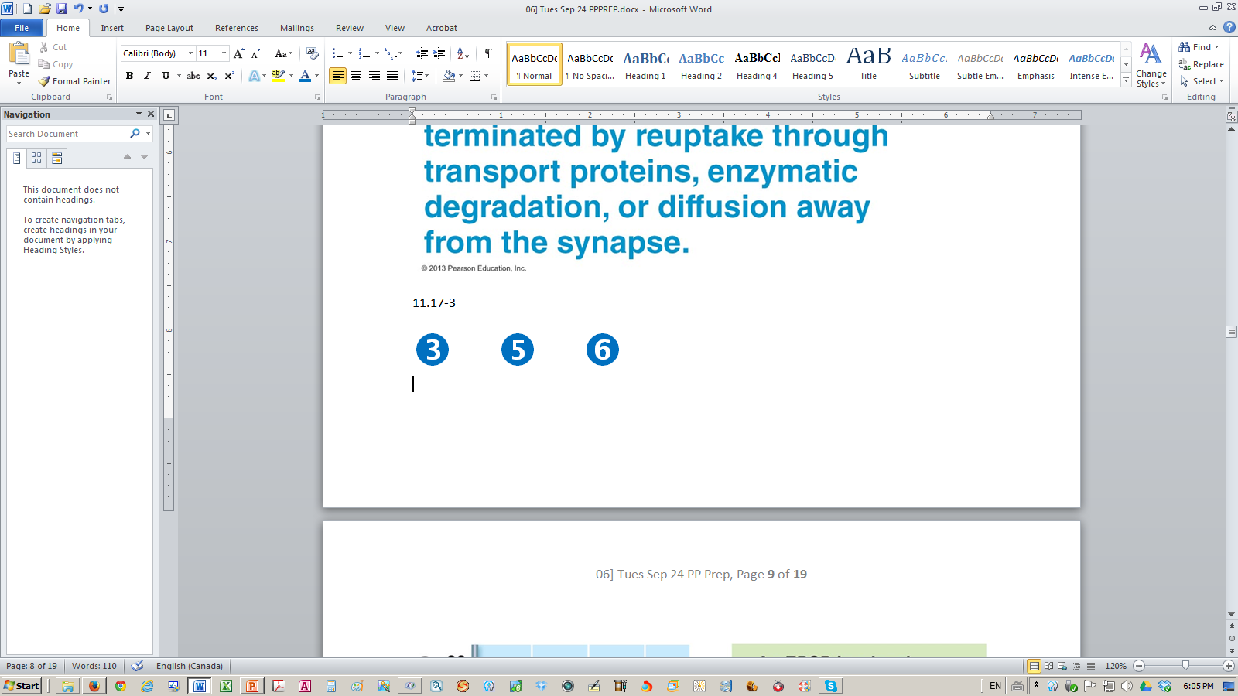
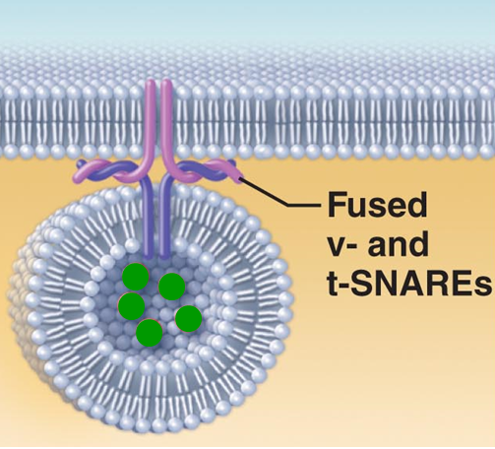
Information Transfer Across Chemical Synapses
    Calcium Entry
Mitochondrion
Enters cell via Ca⁺⁺ channels
Intracellular messenger
Binds with synaptotagmin
Ca ⁺⁺-sensing protein
Changes conformation
Interacts with SNARE proteins
Vesicles fuse with axon membrane
NTs emptied into synaptic cleft
by exocytosis
300 vesicles/nerve impulse
As stimulus á strength, so does impulse frequency / # vesicles
(p 77)
Figure 3.13
[Ca⁺⁺ pumped out of axon / into mitochondria]

Slide 19
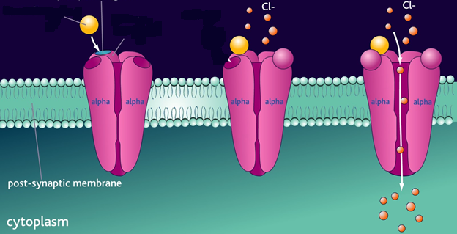
Information Transfer Across Chemical Synapses
    Binding of neurotransmitter to postsynaptic receptor
➔ Conformation/shape change in receptor (protein)
➔ Ion channels open, ions enter postsynaptic cell
➔ Graded potentials created
Depending on receptor protein/type of ion channel, postsynaptic neuron excited / inhibited (see below)
Neurotransmitter
Graded potential
Postsynaptic
receptor
Cl⁻ ion channel

Slide 20
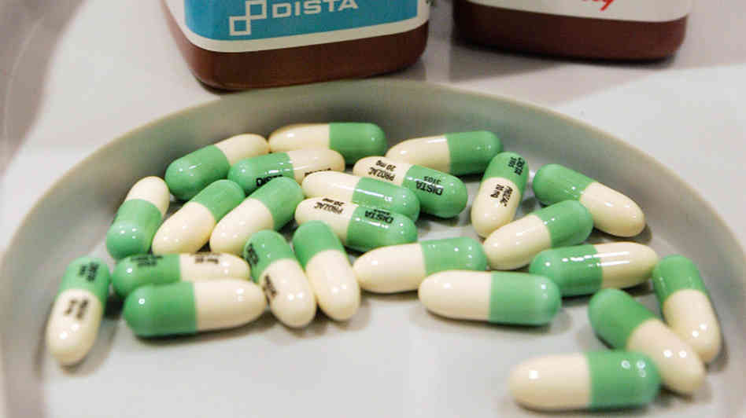

Information Transfer Across Chemical Synapses
    Termination of Neurotransmitter Effects
Binding of NT to its receptor is reversible
NT can bind / come off / re-bind . . .
Important that this not indefinite, ie that “postsynaptic slate is wiped clean” after a few milliseconds, via:
Reuptake by astrocytes / presynaptic terminal. Will be reused/destroyed
(eg norepinephrine, serotonin)
Degradation by enzymes from postsynaptic membrane or in synapse (eg acetylcholine)
Figure 11.17
Diffusion away from synapse
Notes:
SSRI = serotonin selective reuptake inhibitor
By preventing reuptake, serotonin continually stimulates the post-synaptic neuron
Recent research is showing that this is not a very good approach
Green and white pills are Prozac/fluoxetine which is an SSRI/anti-depressant

Slide 21
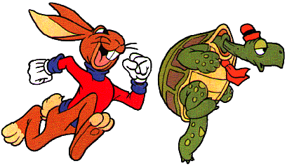
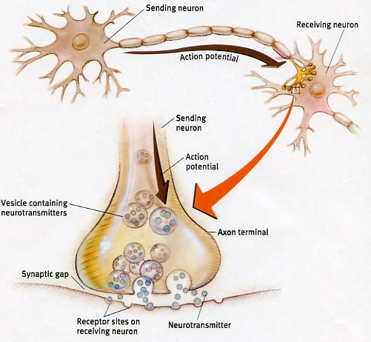

Information Transfer Across Chemical Synapses
    Synaptic Delay:
Speed of nerve impulse down axon:
≤ 150 meters/sec
Fast!
Neural transmission across synapse:
0.3 – 0.5 milliseconds
Rate-limiting (slowest) step
Explains why transmission along neural pathways involving only a few (2 -3 ) neurons is rapid compared to that for multisynaptic pathways typical of higher mental functioning
In practical terms, differences not noticeable

Slide 22
Information Transfer Across Chemical Synapses
    Postsynaptic Potentials:
Postsynaptic receptors often contain ion channels
Chemical signals (neurotransmitters) converted to electrical signals
Channel-opening generates local graded potentials, not long-distance action potentials
Vary in strength according to:
Amount of neurotransmitter released
Length of time it remains in the synapse
Chemical synapses either be excitatory (EPSP, trigger APs) or inhibitory (IPSP, reduces neuron’s ability to generate APs)

Slide 23
Neurotransmitters
    Overview:
Role: Along with electrical signals, are the “language of nervous system”
Definition: Chemical messengers released by neurons that, on binding to other neurons or effector cells, stimulate or inhibit them
Currently > 50 NTs /NT candidates identified
Most neurons make ≥2 NTs
Stimulation frequency determines which released
Co-release of 2 NTs from same vesicle known!
Allows neuron to exert several different effects
Notes:
Effector cells such as muscle cells and glands

Slide 24
Neurotransmitters
Classification by Structure (partial list)
Acetylcholine
Biogenic amines
Amino acids
Peptides
Purines
Gasses/lipids
    Classification by Function:
Excitatory (eg glutamate): depolarization
Inhibitory (eg GABA, glycine): hyperpolarization
Either (eg Acetylcholine [Ach], norepinephrine [NE) )
ACh excitatory at neuromuscular junction in skeletal muscle
ACh inhibitory in cardiac muscle
Function of a NT determined by receptor it binds to
Notes:
Ach can be either excitatory or inhibitory

Slide 25
Neurotransmitters
    Classification by Function (continued):
Classification by Function – Actions:
Direct (eg ACh, amino acids)
Bind to/open ion channels – rapid response
Indirect (eg biogenic amines, neuropeptides, gases)
Via G protein 2nd messenger – long-lasting

Slide 26
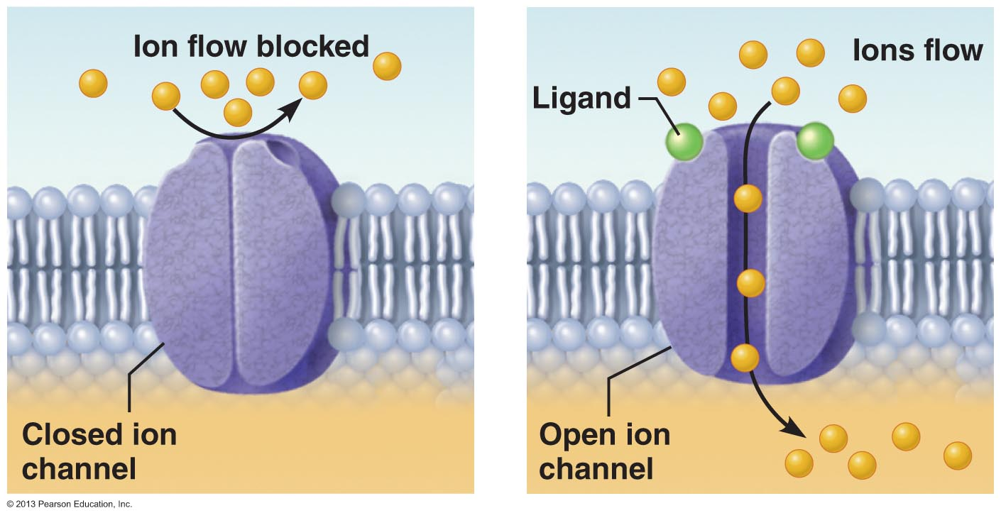
Neurotransmitter Receptors
    Channel-Linked (Ionotropic) Receptors :
Ion
Direct, simple and fast (≤1 msec)
Receptor protein includes a chemically-gated ion channel
NT/ligand binding ➔ conformation change
Channel opens / ions flow
Membrane potential changes ➔ GP ➔AP (if excitation)
NT/
At excitatory receptors, channels for Na⁺, K⁺, Ca⁺⁺ cause depolarization
At inhibitory receptors, channels for Cl⁻ cause hyperpolarization
Figure 11.20

Slide 27
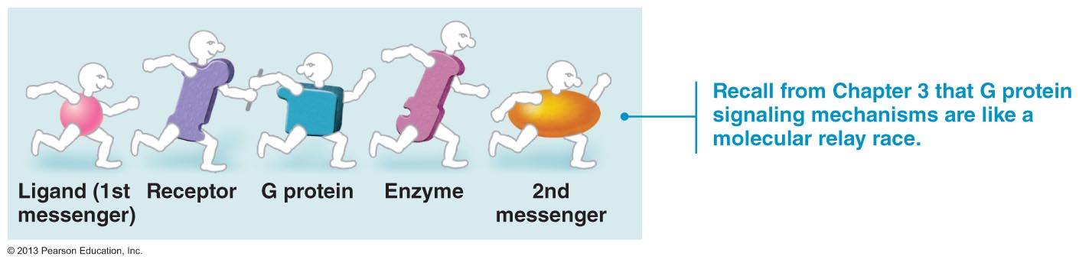
Neurotransmitter Receptors
    G Protein-Linked (Metabotropic) Receptors:
Indirect, complex, slow (hundreds of msec) / prolonged
G protein receptors are also transmembrane, but it contain no channels
NT/ligand (1st messenger) binding ➔ G protein conformation change ➔ an enzyme is activated
Leads to production of a 2nd messenger
Figure 11.21a

Slide 28
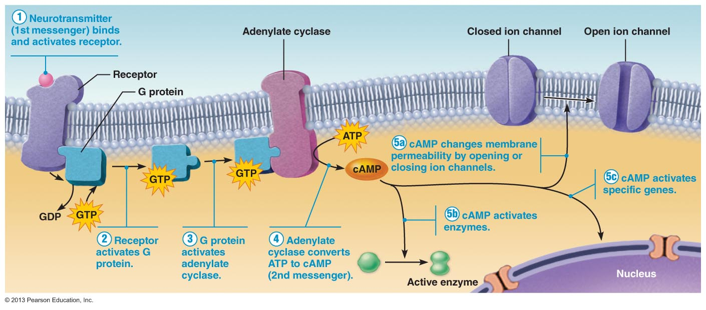
Neurotransmitter Receptors
    G Protein-Linked (Metabotropic) Receptors (continued):
. . .
*
. . .
*G protein changes shape, releases GDP, binds GTP (energy source)
Figure 11.21b

Slide 29
Neurotransmitter Receptors
    G Protein-Linked (Metabotropic) Receptors (continued):
. . .
Figure 11.21b

Slide 30
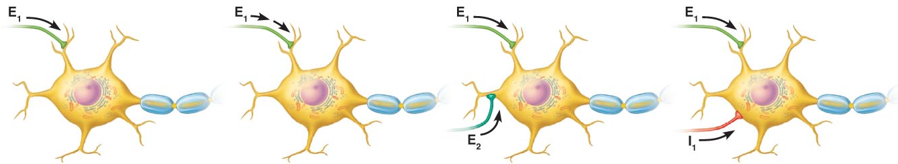
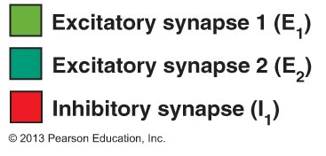
Integration/Modification of Synaptic Events
    Multiple Events:
A single nerve cell has 1,000 - 10,000 axon terminals making synapses
Each signal excitatory/inhibitory, and can repeat
Each neuron’s axon hillock keeps a running account of all signals it receives (post-synaptic neuron)
Acts as a neural integrator, as signals summate
4 Very simple examples:
    No Summation
    Temporal Summation of EPSPs
    Spatial Summation of EPSPs
    Spatial Summation of EPSPs and IPSPs

Slide 31
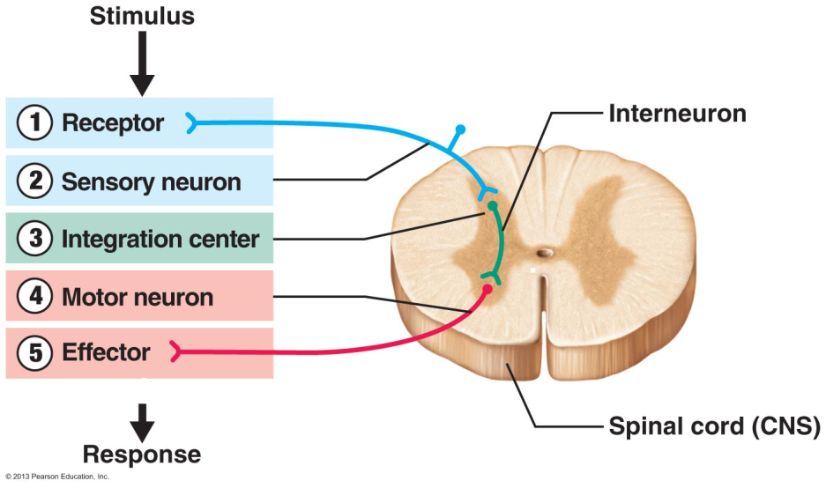
Patterns of Neural Processing
    Serial Processing:
One neuron stimulates the next, which stimulates the next, and so on
All-or-nothing response
(Muscle/gland)
Examples:
Figure 11.24
Spinal Reflex Arc
Motor: spinal reflex
Rapid automated stereotyped (always same)
Repetitious and dependable
eg Hot object/jerk hand, startle eye/blink
Response occurs over neural pathway: reflex arc.
Note 5 essential components - brain not included
Sensory: ‘straight-through’ receptor ➔ brain

Slide 32

Patterns of Neural Processing
    Parallel Processing:
Inputs segregated into many pathways
Different neural circuits working simultaneously
Not automated stereotyped, or repetitious
High level: quickly process large amounts of information
Example: step on a nail while barefoot:
Serial processing: spinal reflex arc
No thought/analysis -automatic
Rapidly withdraw foot
Parallel processing: pain/pressure impulses speed to brain, which:
Recognizes cause
Assesses damage
Chooses response
Put this into action
Rub foot/apply medicine/cry for help/next move

Slide 33

Next Lecture – Wed Mar 18
    The Peripheral Nervous System, Parts 1 and 3
Sensory Receptors and Sensation (Ch 13, pp 483-490)
Motor Endings and Motor Activity (Ch 13, pp 511-513)
Kaitlyn Weaver and Andrew Poje (2014)
No Mastering A&P Assignment is due

