Slide 1

Posted March 20, 12:30 PM
ANP1106 Anatomy & Physiology II, Part 2
F Feiner, PhD, MD
Friday, March 20
Reflex Activity
The Autonomic Nervous System. Overview
Ty Cobb (1914)
Kaitlyn Weaver and Andrew Poje (2014)
Ty Cobb (1886-1961) /Detroit Tigers

Slide 2

Lecture Content
Reflex Activity (Ch 13, pp 513-519)
The Reflex Arc
Muscle Spindles and Tendon Organs
Stretch Reflex
Tendon Reflex
Flexor and Crossed Extensor Reflexes
Superficial Reflexes
Autonomic Nervous System, Overview (Ch 14, pp 524-527)
Comparison of Somatic and Autonomic Nervous Systems
ANS Divisions

Slide 3
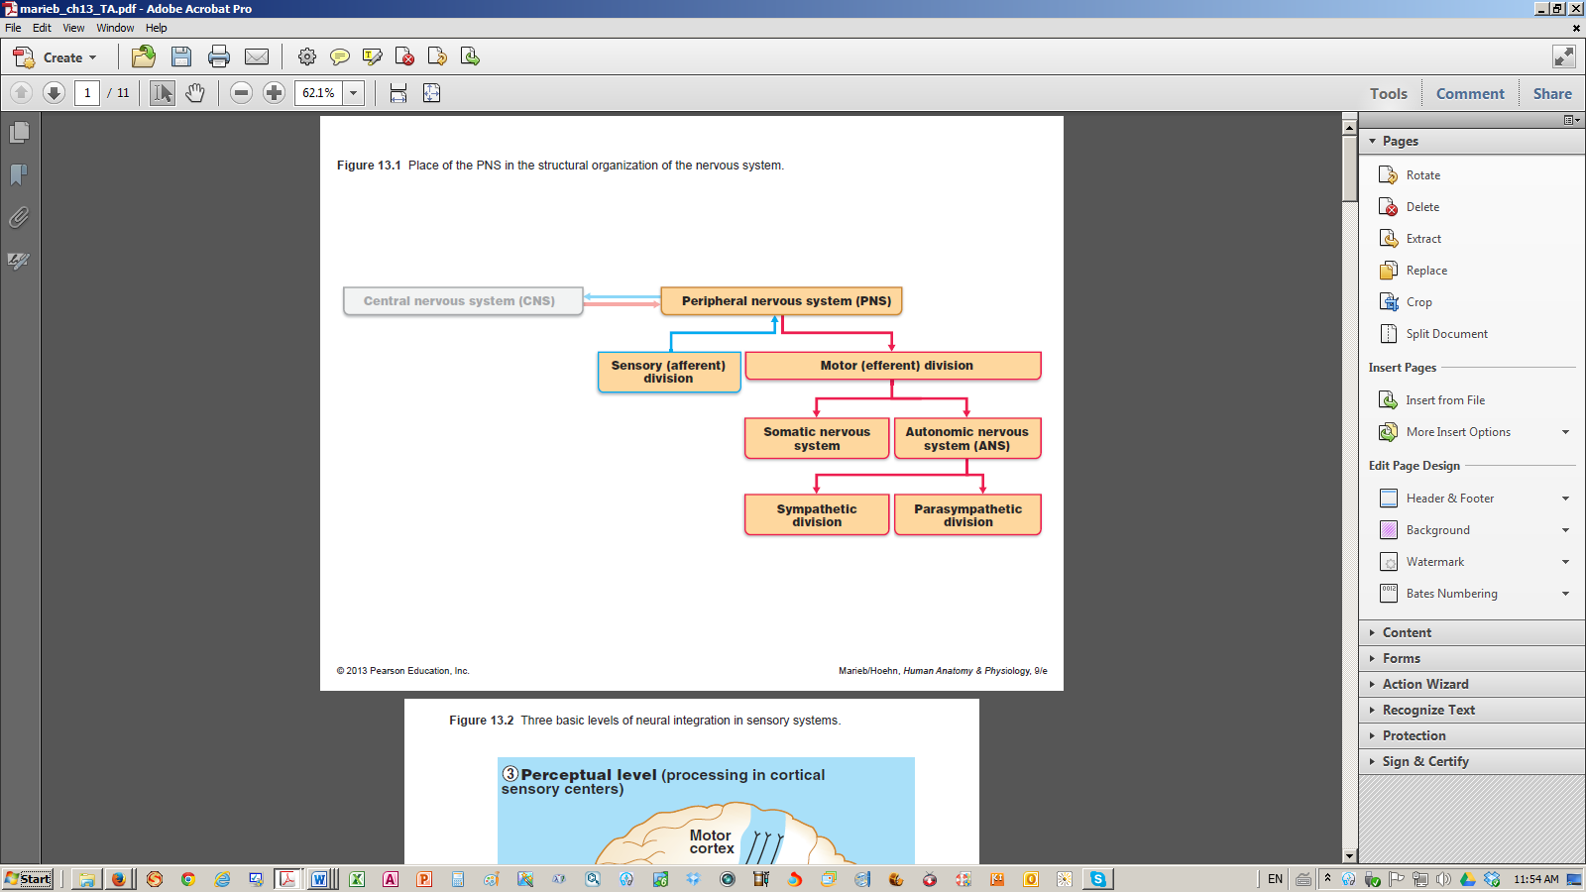
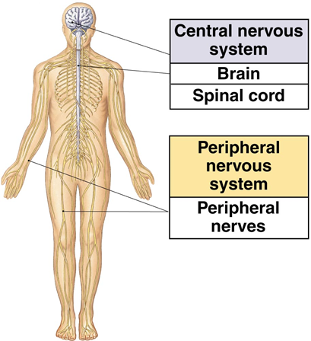
Organization of the Peripheral Nervous System
[Motor Endings]
[Sensory receptors]
Figure 13.1

Slide 4
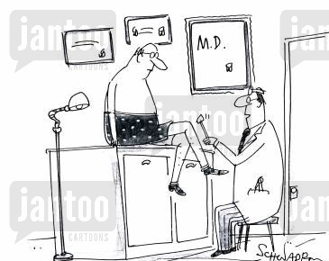
Peripheral Nervous System
PART 4. Reflex Activity

Slide 5
The Reflex Arc
    Two Types of Reflexes
    Inborn (Intrinsic) Reflex
Rapid predictable motor response to a stimulus
Unlearned, unpremeditated, involuntary, built in
Prevent having to think about maintaining posture, avoiding pain and controlling visceral activities
May (eg drop pot of splashed hot water) or may not (eg change in BP) be aware of reflex response
    Learned (Acquired) Reflex
Results from practice/repetition (eg driving a car)
    No clear distinction: inborn reflexes can be modified

Slide 6
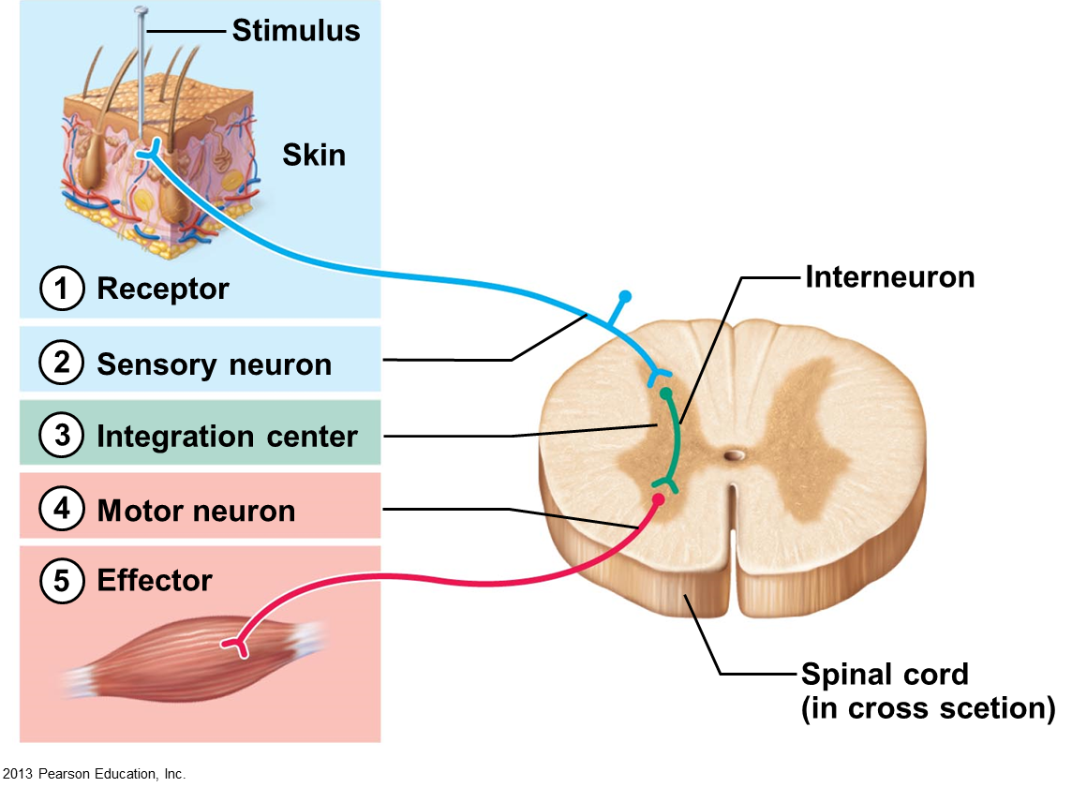
Components of a Reflex Arc
    1 - Receptor
    Site of stimulus
    2 - Sensory neuron
    Afferent impulse ➔ CNS
    3 - Integration center
    1 (monosynaptic-shown) or more (polysynaptic) links between  and 
    4 - Motor neuron
    Efferent impulse ➔ effector organ
Figure 13.15
    5 - Effector
    Muscle fiber/gland cell contracts/secretes

Slide 7
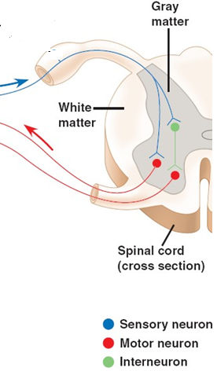
Components of a Reflex Arc
    Knee-Jerk Reflex
    Integration
    center
    Integration center
    more complex
    Sensory neuron  branches

    One monosynaptic link and one polysynaptic link between sensory neuron  and motor neurons 

    Added component: interneuron in one branch

Slide 8
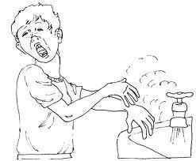
Spinal Reflexes
    Somatic actions mediated by spinal cord
    No direct involvement of higher brain centres
    But, brain “advised” - can facilitate / inhibit / adapt
Pull arm away before pain is felt
Awareness of surroundings may govern action
    In fact, continuous facilitating signals from brain required for normal spinal reflexes
    Exaggerated, distorted or absent reflexes indicate pathology of specific higher cortical regions (see below)
Notes:
Pain requires activity of the brain
If reflexes are absent or exaggerated, it is an indicated that is going on in higher level activity
If one is in a coma or experience a stroke, reflexes may be absent due to impaired functioning

Slide 9
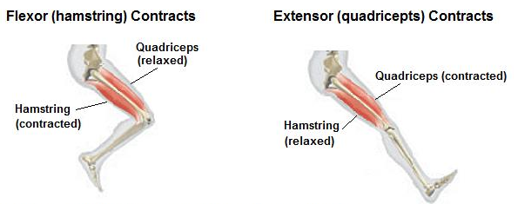
Antagonistic Pairs of Muscles
    Flexing / extending of opposing muscles
    Hamstring and quadriceps muscles oppose
    each other, ie are antagonistic:
    When hamstring contracts, quadriceps relaxes
    When quadriceps contracts, hamstring relaxes
Tendons attach
muscle to bone
Hamstring
(relaxed)
Notes:
Tendon: attaches muscle to bone

Slide 10
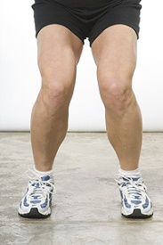

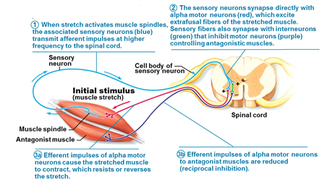
Patellar/Knee-Jerk Stretch Reflex/1
    Physiological: reciprocal inhibition insures
    constant muscle length
    Stand up ➔ Knees begin to buckle
➔ Quads lengthen . . .
of quads
Figure 13.18a
reflex muscle contraction
hamstrings
Notes:
Goal is to keep the muscle at a constant length
Recipical inhibition– prevents muscle from contracting or lengthening too quickly
Signal goes to both agonist and antagonist
Step 1- spindles send signal to spinal cord
Step 2- synapse – 2 synapse, 1 for agonist (quad- contract) and second to antagonist (to lengthen) – prevent knee from buckling

Slide 11
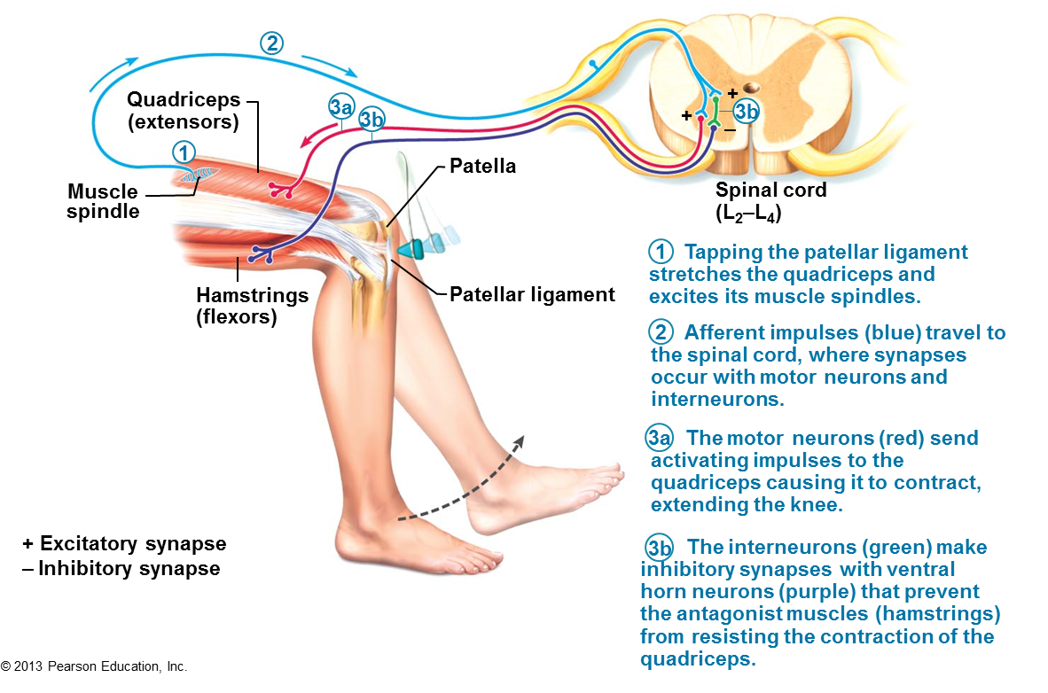
Patellar/Knee-Jerk Stretch Reflex/2
    Clinical: Test Sensory & Motor Connections and Spinal
    Cord Functioning
    Tapping kneecap (patella) stretches quadriceps . . .
reflex
muscle contraction
Figure 13.18b
Notes:
1-Action of taping stretches the quad
2-Send signal to spinal cord

Slide 12
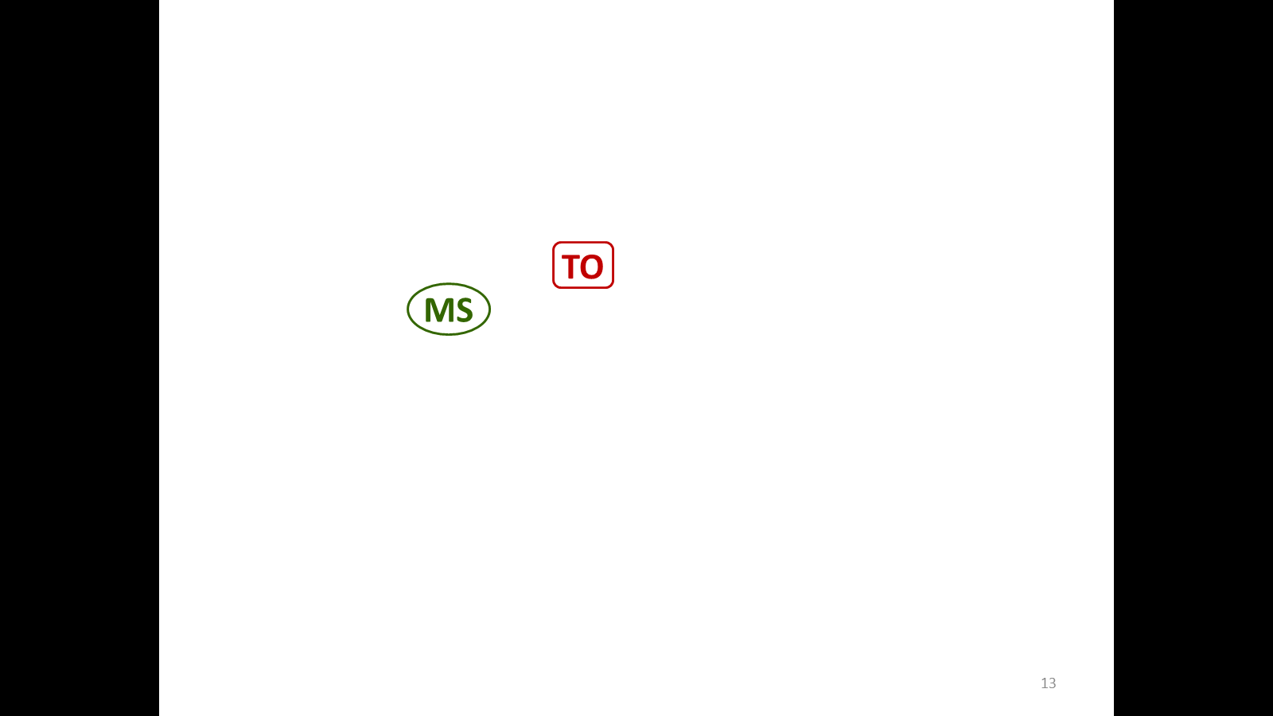
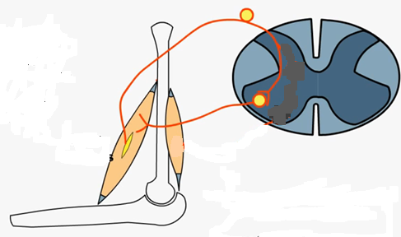
Muscle Spindles and Tendon Organs
    Muscle Spindle
    Sensory proprioceptor within muscle fiber - measures its length
    Mediates a stretch reflex, a feedback loop that controls rate of muscle lengthening
    Muscle lengthens: detects change
    Output to spinal cord, which relays back a signal to
the muscle, causing it to contract (spinal reflex)
    Protective: maintains constant muscle length
Muscle lengthens
then
contracts
    Overriding messages from CNS can tell muscle to continue to lengthen
Spinal cord
Source
Notes:
Muscle spindle sends the signal to spinal cord → relay a signal back to muscle
Goal: keep the muscles at a constant length for protective function
If there was no overriding function from the brain, there would be no movement, spinal cord would keep your arm frozen

Slide 13
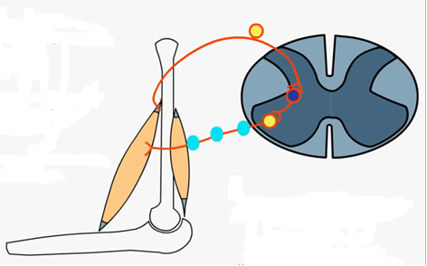
Muscle Spindles and Tendon Organs
    Tendon Organ
    Sensory proprioceptor within tendon - measures its tension
    Mediates a stretch reflex, a feedback loop that controls amount of tension on tendon
    Muscle lengthens: force transmitted to tendon
    detects increase
    Output to spinal cord, which relays back a signal to
the muscle, causing it to stop lengthening (spinal reflex)
inside tendon
    Shutdown of muscle contraction protective – prevents tendon from being pulled off bone
Muscle and tendon lengthen
then
shorten
Spinal cord
Source
Notes:
If there was not that protective function from tendon, muscles would be ripped off bone -- tendon reflex

Slide 14
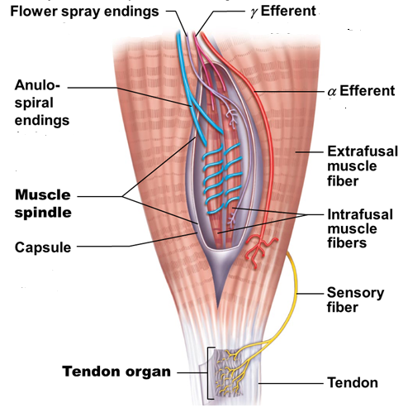
Muscle Spindle
    Muscle spindle anatomy:
    Capsule
    Muscle fibers:
    Intrafusal (inside)
    Noncontractile
    Extrafusal (outside)
    Sensory Nerves:
    Anulospiral (Iº)
    Flower spray(IIº)
    Sensory fiber
(to tendon organ)
    Motor Nerves:
(See below)
    γ Efferent to muscle spindle
Figure 13.16
    α Efferent to extrafusal muscle fibers
Notes:
Blue= sensory nerves
Anuspiral– sensory nerves
Flowar spray – nerve ending
Why this complexity? Next slides

Slide 15
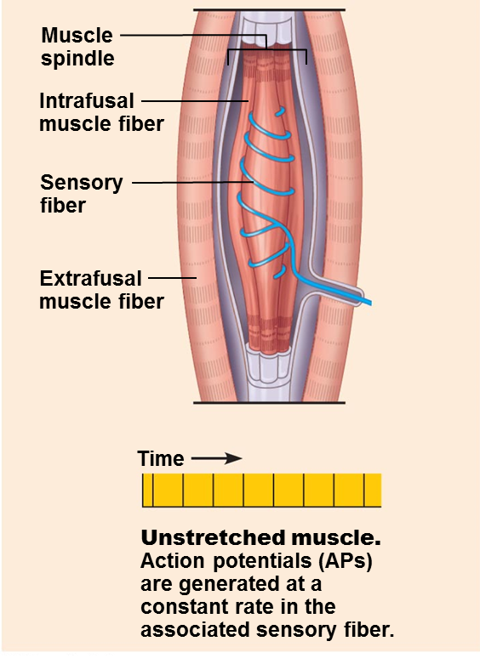
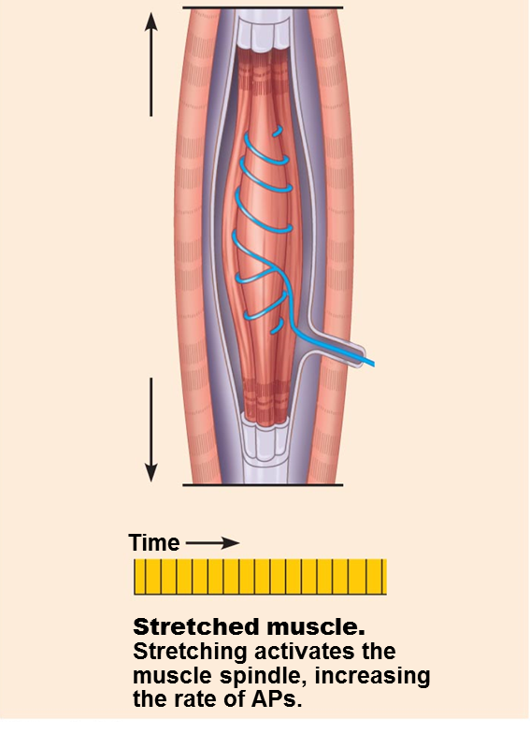

Muscle Lengthens / Muscle Spindle Stretched
Figure 13.17a

Slide 16
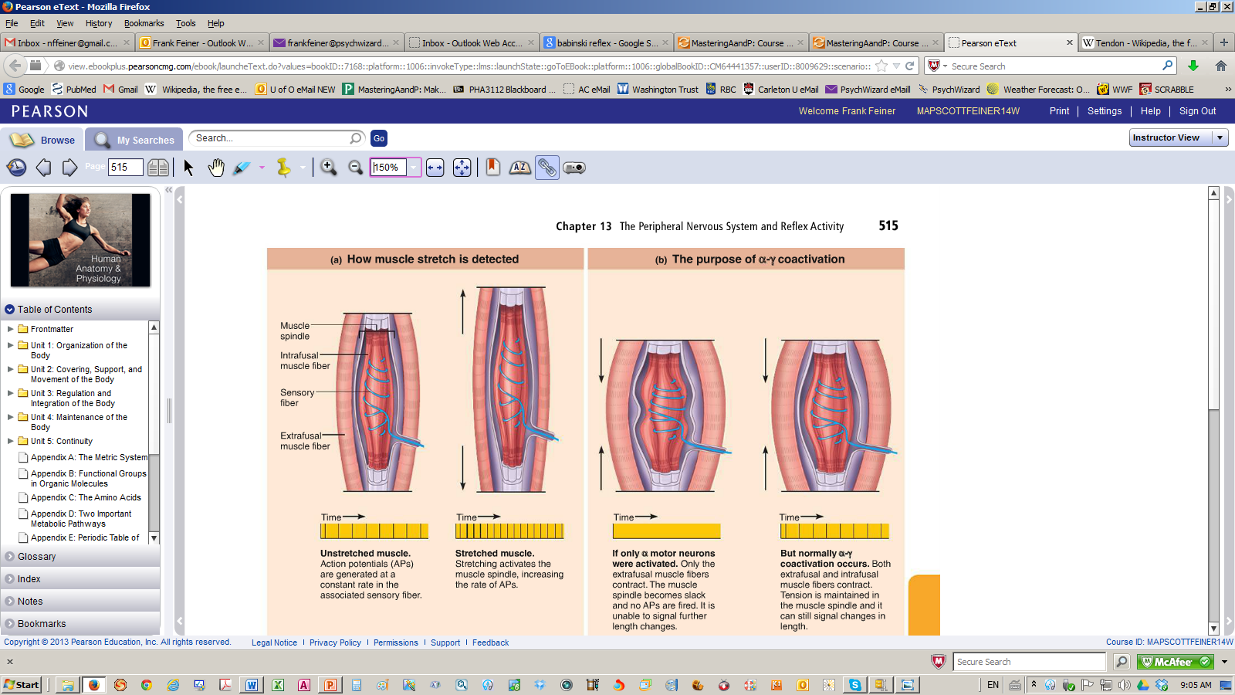
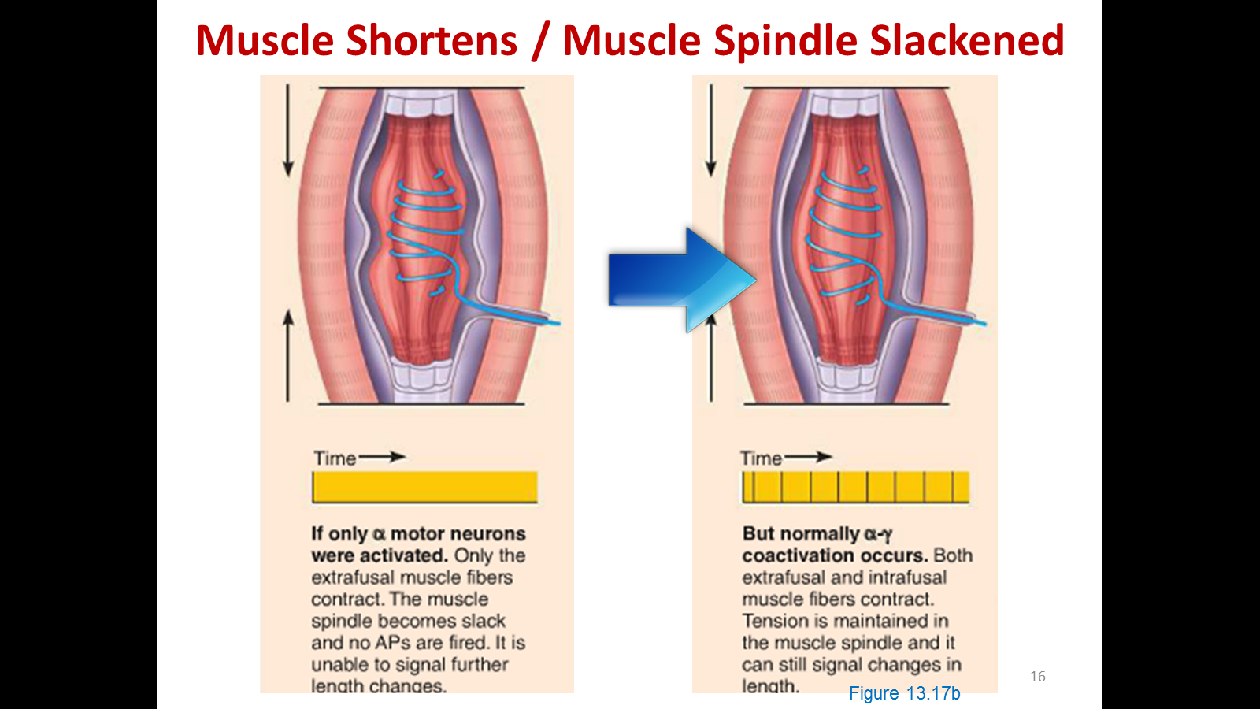
Muscle Shortens / Muscle Spindle Slackened
Figure 13.17b
Notes:
Alpha-gamma coactivation
Ensures when muscles contracts, ensures muscle spindle also contracts

Slide 17
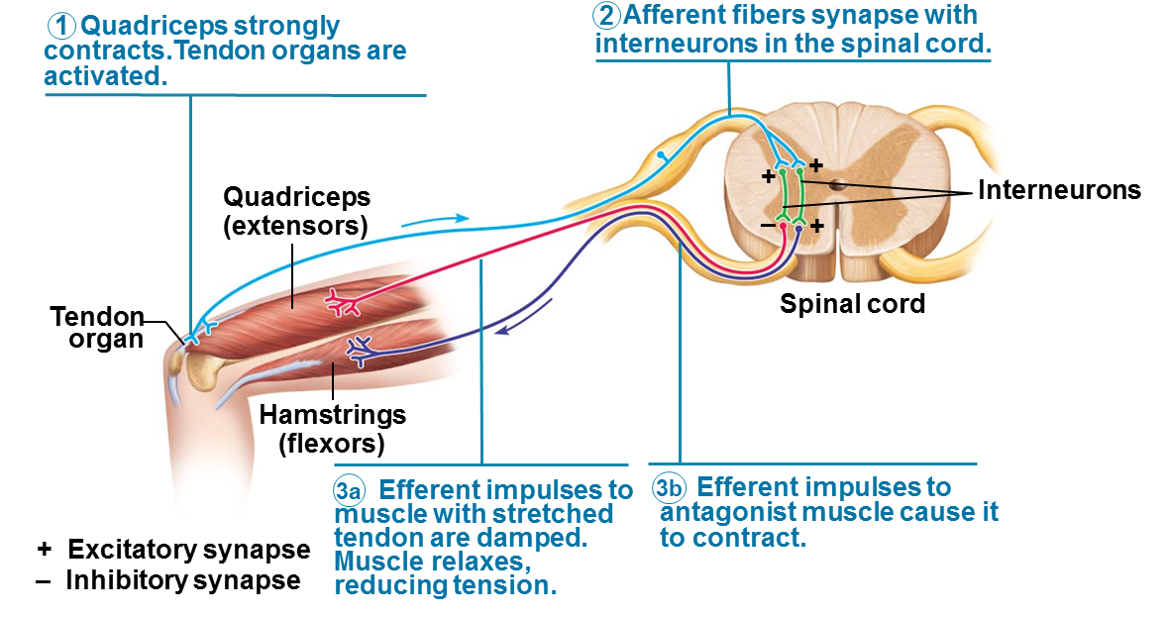
Tendon Organ / Tendon Reflex
    Diametric opposite of the stretch reflex
    Reciprocal activation of antagonist prevents muscles /
    tendons from tearing
Also insure smooth onset/termination muscle contract^{n}
Report muscle tension
Figure 13.19
Notes:
Tendon Reflex
2 Polysynaptic branching in spinal cord
“NEGATIVE” output tells the muscle to slow down
“POSITIVE” = excitatory synapse

Slide 18
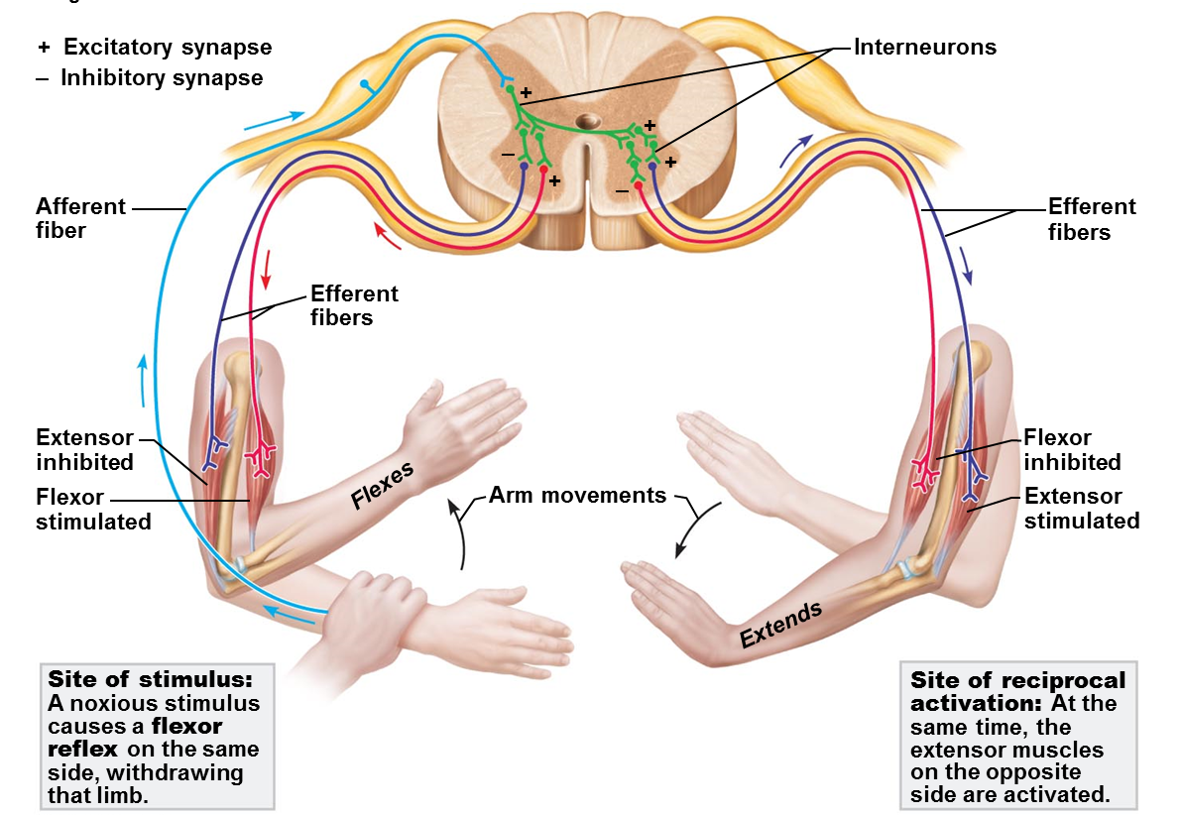

The Flexor and Crossed-Extensor Reflexes
    Flexor (aka Withdrawal) Reflex
    eg R arm withdrawn with finger-prick/attacker grab
    Crossed-Extensor Reflex
    Opposite response on contralateral side to eg push away attacker or maintain balance
    Descending signals from brain can override all reflexes
Notes:
On the contralateral response, opposite side of body responds to stimulus
Don’t need to know this diagram
Know definitions

Slide 19
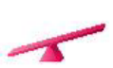
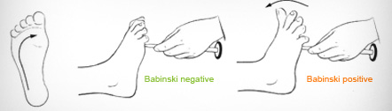

Superficial Reflexes
    Tests for intact corticospinal tract & cord-level structures
    Plantar reflex
    Draw blunt object upward along lateral aspect plantar surface of foot
Normal response: toes remain together and curl downward
Abnormal response: Babinski sign. Tows spread apart, big toe upgoing. Sign of an upper motor neuron lesion. Normal in infants
:
normal response is plantar reflex
Notes:
Start at bottom and move up
Babinski sign– indicates upper motor neuron lesion (in adults)

Slide 20
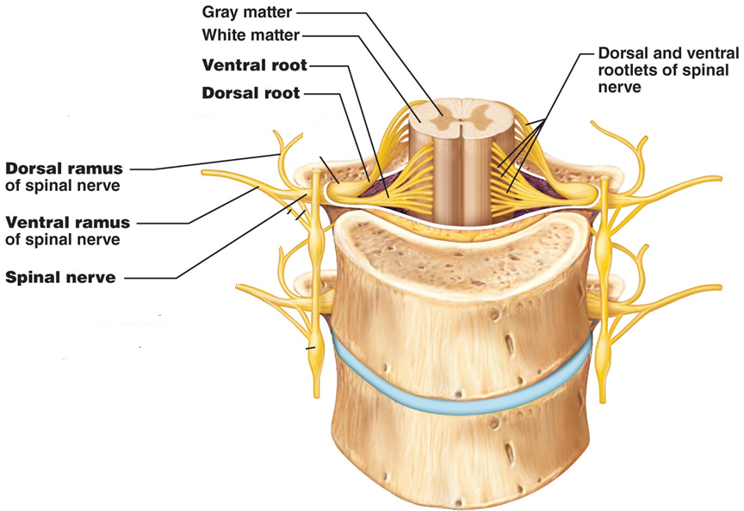
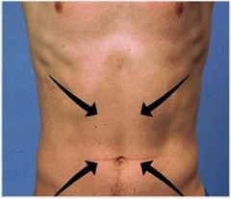
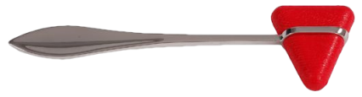
Superficial Reflexes
    Tests for intact corticospinal tract & cord-level structures
    Abdominal reflex
    Stroke skin of abdomen towards umbilicus
    Normal response: umbilicus moves towards stimulus
    Checks integrity of ventral rami from T₈ to T₁₂
Œ

Figure 13.8a
Notes:
Scratch “hammer” across abdomen toward umbilicus
Response -> umbilicus moves toward stimulus

Slide 21
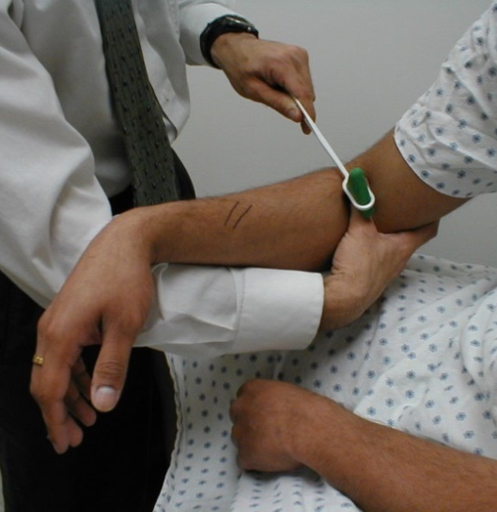

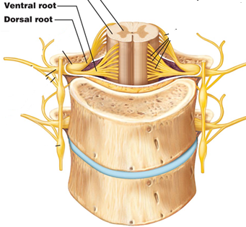
Homeostatic Imbalance
    Clinical Importance of Stretch Reflexes
    Hypoactive/absent reflexes: peripheral
    nerve damage/ventral horn injury
    eg Chronic diabetes, neurosyphilis, coma
IIIº syphilis (tabes dorsalis): dorsal horn injury
decades after infection, paresthesias (morbid cutaneous sensations/ formication ),ataxia, deafness, visual impairment, dementia [ref]—rarely seen today because of penicillin
Notes:
Should see arm jerk
Must do multiple times to ensure that stimulus is being applied correctly and there is no response
Neuropathy in diabetics– glucose damages neurons
If one is in a coma, will have absent reflexes
Dorsal Horn injury in neurosyphilis – excellent antibiotics against syphilis
Syphilis used to cause morbid cutaneous and sensation of ants crawling on skin
-Section in textbook that may be wrong

Slide 22
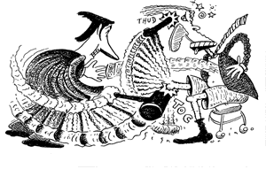
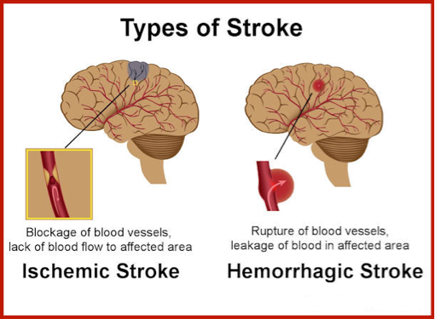
Homeostatic Imbalance
    Clinical Importance of Stretch Reflexes
    Hyperactive: corticospinal tract lesions reduce reciprocal inhibition
    eg cerebrovascular accident (‘CVA, stroke’)
Notes:
CVA- cerebrovascular accidents
Two types of stokes:
1-Ischemic stroke– blood supply to brain is cut off → lead to infract (tissue death due to lack of O2)
2- Hemorrhagic stroke – brain bleed → results in loss of blood supply → tissue death
TXT for two types of strokes couldn't’t be more different

Slide 23
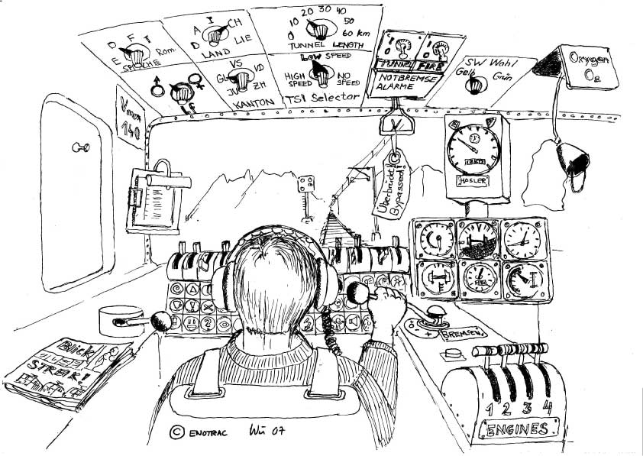
ANS Overview
    “Exquisitely sensitive to changes in internal environment, balancing competing demands for resources under ever changing conditions”

Slide 24
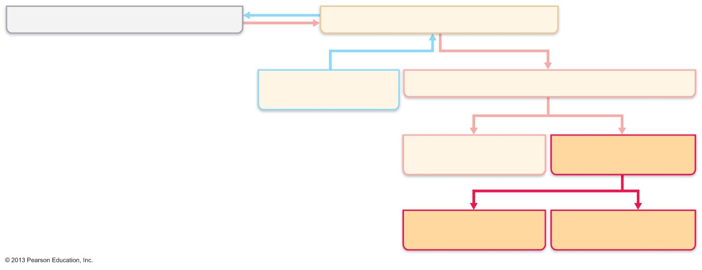
Place of ANS in the (Highly Integrated) Nervous System
Central nervous system (CNS)
Peripheral nervous system (PNS)
Sensory (afferent)
division
Motor (efferent) division
Somatic nervous
system
Autonomic nervous
System (ANS)
***
Sympathetic
division
Parasympathetic
division
*** There are sensory nerves in the ANS!

Slide 25
The Autonomic Nervous System
    Principle system that stabilizes our internal environment
    Motor neurons that innervate smooth/cardiac muscle and glands
    Respond to sensory signals from visceral (internal) organs
    General functions:
    Ensures optimal support for body activities
    Shunts blood to ‘needy’ areas
    Speeds up/slows down heart (áHR, âHR)
    Blood pressure (BP), body temperature (T) á or â
    Stomach secretions á or â
    Mostly without our awareness, attention or control
    Aka involuntary nervous system or general visceral motor system
Notes:
Involves primarily motor neurons– signal going to muscle (smooth and cardiac muscle, and glands)
ANS ensures that all body activity is receiving maximum nutrients it needs, via the blood, to perform activity

Slide 26
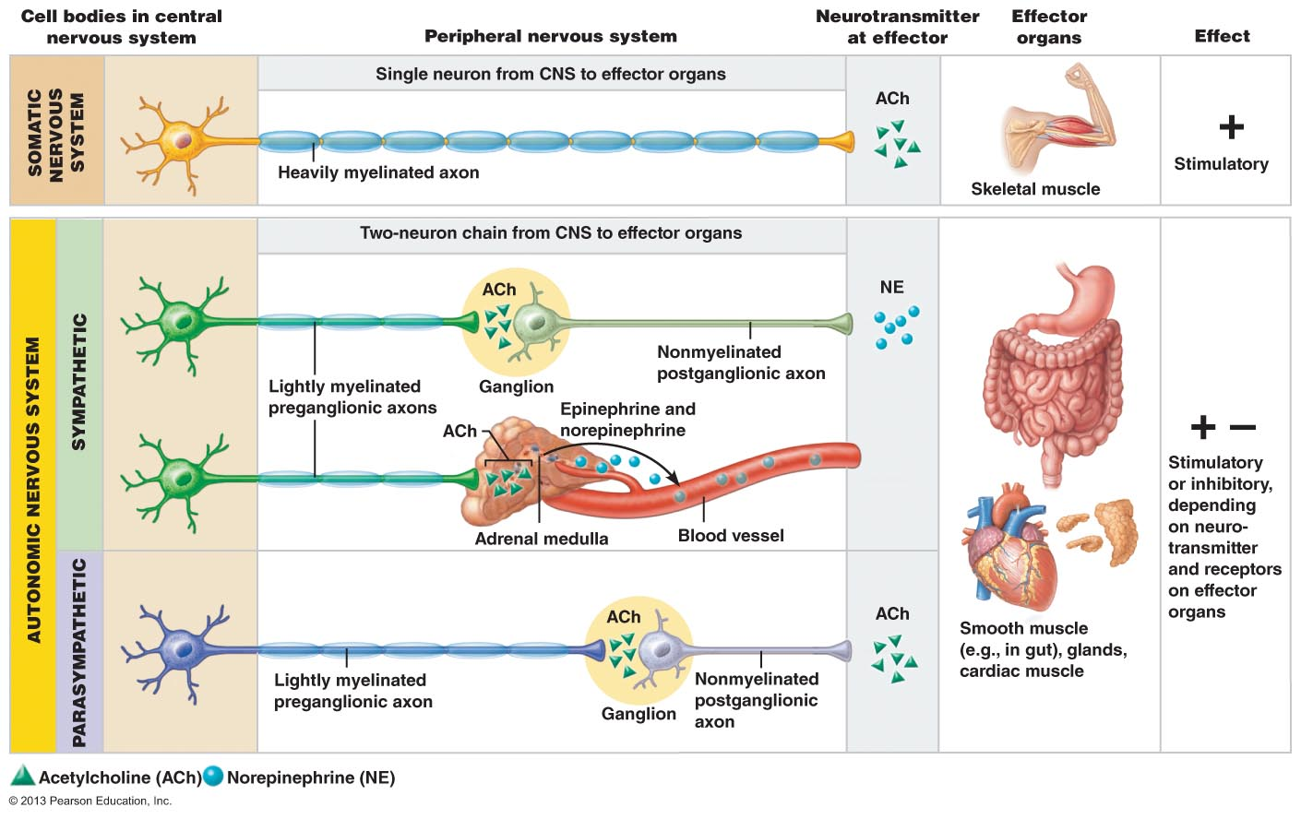
Motor Neurons: Somatic v ANS
Figure 14.2
26
Notes:
Cell body in CAN
Axon comes out, to go to the effector organs

Slide 27
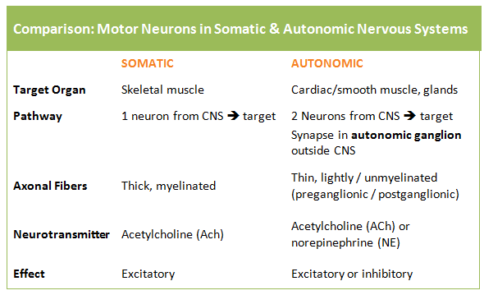
Motor Neurons: Somatic v ANS

Slide 28

ANS DIVISIONS
    Parasympathetic Nervous System
    Rest / Digest:
    Minimizes body energy use
    Maintenance: digestion / elimination
    BP/HR low normal
    GI actively digesting
    Pupils constricted /lenses accommodated (close vision)

Slide 29

ANS DIVISIONS
    Sympathetic Nervous System
    Fight or Flight:
    Mobilize body during activity
    HR/BP/respiration rate á
    Dry mouth
    Cold/ sweaty skin
    Dilated pupils
    Constricts blood vessels: shunts blood to heart/skeletal muscles
    Provides energy: bronchioles dilate, more glucose from liver
Notes:
Does not mean blood is shunted away from the brain; must keep blood flow to brain because it is the most demanding organ

Slide 30
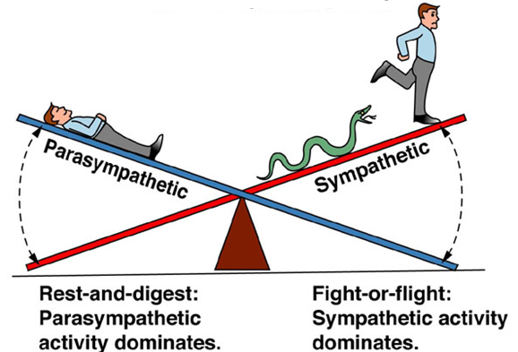
ANS DIVISIONS
    Usually, both divisions serve same visceral organ
    Parasympathetic: Digestion, Defecation, Diuresis
    Sympathetic: Exercise, Excitement, Emergency
    Homeostasis: dynamic antagonism / counterbalancing
Notes:
There is a balance between SYM and PARA
One inputs and one is elevated
The output of the other decreases

Slide 31
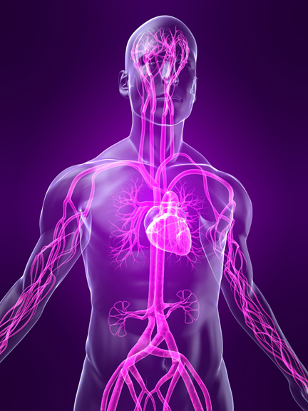
Next Lecture – Wed March 25
    The Autonomic Nervous System, Part 2:
    Anatomy, Physiology, Homeostatic Imbalances (Ch 14, pp 527-539)
Mastering A&P Assignment #6 (PNS) will be posted today
at ~5 pm and is due by Thursday Mar 26 at 11:59 pm
Notes:
NO CHAPTER 11 ON EXAM

