Slide 1
Durkheimian Politics
Mirgine, Deniqua, kory, Victoria, Tammy

Slide 2
Research
According to Durkheim’s concepts of social facts and the state, how can the changing dynamics of the Canadian-Aboriginal relationship be analyzed in relation to the social-political movement Idle No More?

Slide 3
Focus
"Professional Ethics and Civic Morals"
- Durkheim's political approach
- Order and stability
- The State
- Political Society
- Sui generis
- Indigenous territory
Morphology- highly crystalized forms of norms
Institutions
  Treaty 8
  Bill C-45
Morals

Slide 4
Video:
Idle No More: Indigenous-Led Protests Sweep Canada for Native Sovereignty and Environmental Justice
https://www.youtube.com/watch?v=PvwAt9MRW-0
What would Durkheim say concerning Canada-Aboriginal relations in regards to the Idle No More social-political movement?

Slide 5
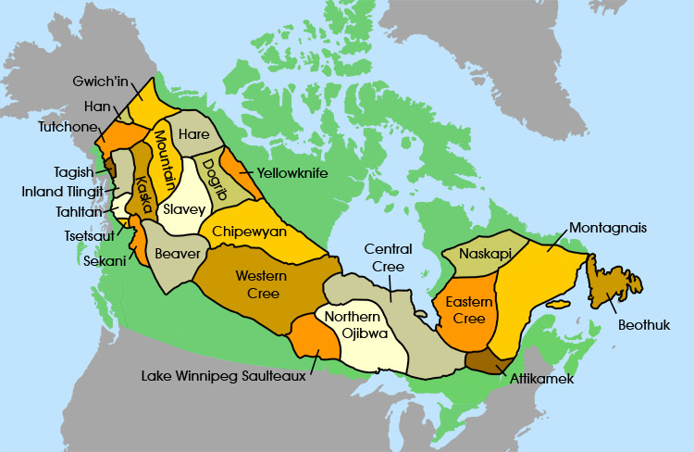
The State and Political Society
Defining The State
“Canada’s First Peoples”. http://firstpeoplesofcanada.com/fp_groups/fp_subarctic1.html

Slide 6

Defining Political Society
“Idle No More_ Feather-Flag”. http://warriorpublications.files.wordpress.com/2013/07/idle-no-more-feather-flag-graphic.jpg

Slide 7
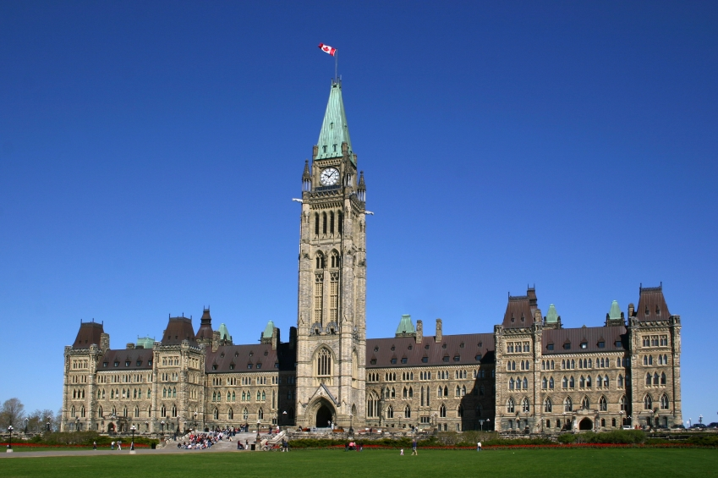
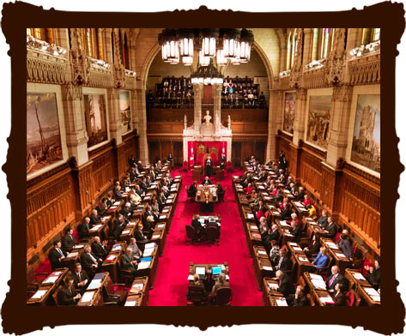
The state as Sui Generis
Canada Parliament Building. http://democracychange.org/2013/05/2013-fda-global-electoral-fairness-report-on-canada/canadian-parliament-building/
“Senate of Canda”. http://www.parl.gc.ca/About/Parliament/Education/OurCountryOurParliament/TeacherGuide/activities-sect2-e.asp

Slide 8

Order and Stability
Social Change should fulfill the ideals of liberty, equality, and fraternity.
  Durkheim believes that the state should prevent the strong from exploiting the weak and individuals developing their potential.

Slide 9

Idle No More- Issues
The Aboriginals believe that there is a clear lack of moral and ethical recognition from the Canadian Federal Government
- Idle No More and Bill C-45
Niagara at Large. ”Stand Up- Idle No More”.
http://niagaraatlarge.com/2012/12/18/standing-up-for-canadas-first-nation-people/stand-up-idle-no-more/

Slide 10
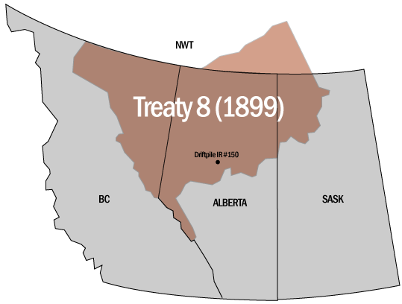
Treaty 8- Durkheim’s thought’s on Peace treaties
“Map of Treaty 8” http://www.driftpilecreenation.com/default.aspx?ID=General+Maps

Slide 11
Conclusion
What are some key Durkheimian political concepts?
- In what ways does Durkheim suggest the political system should change?

Slide 12
LITERATURE REVIEW
Barnes, H. E. (1920, June Vol. 35, No. 2). Durkheim's Contribution to the Reconstruction of Political Theory. Political Science Quarterly, pp. 236-254.
Daitsman, R., & O'Brien, P. (2013, Spring). The "Idle No More" Movement. Peace and Freedom, pp. 23-24.
Dickason, O. P., & Newbigging, W. (2010). A Concise History of Canada's First Nations. Don Mills, Ontario: Oxford University Press.
Huseman, J., & Short, D. (2012, January Vol. 16, No. 1). ‘A slow industrial genocide’: tar sands and the indigenous peoples of northern Alberta. The International Journal of Human Rights, pp. 216–237.

Slide 13
LITERATURE REVIEW
Maher, S. K. (2011, Vol. 14 No. 1). Narrating administrative order: Treaty 8 and the geographical fashioning of the Canadian north. Postcolonial Studies, pp. 63-74.
Thompson, K. (2004). Readings from Emile Durkheim. 29 West 35th Street, New York, NY 10001: Taylor & Francis e-Library.
Turner, K. L., & Bitonti, C. P. (2011, Volume 2, Issue 2, Article 3). Conservancies in British Columbia, Canada: Bringing Together Protected Areas and First Nations' Interests. The International Indigenous Policy Journal, pp. 1-18.

