Slide 1
Growth in the Open Economy
Econ 255

Slide 2
Motivating Questions
Does openness (globalization) help income growth?
If so, through what channels?
How does each channel work?
What is the source of opposition to globalization?

Slide 3
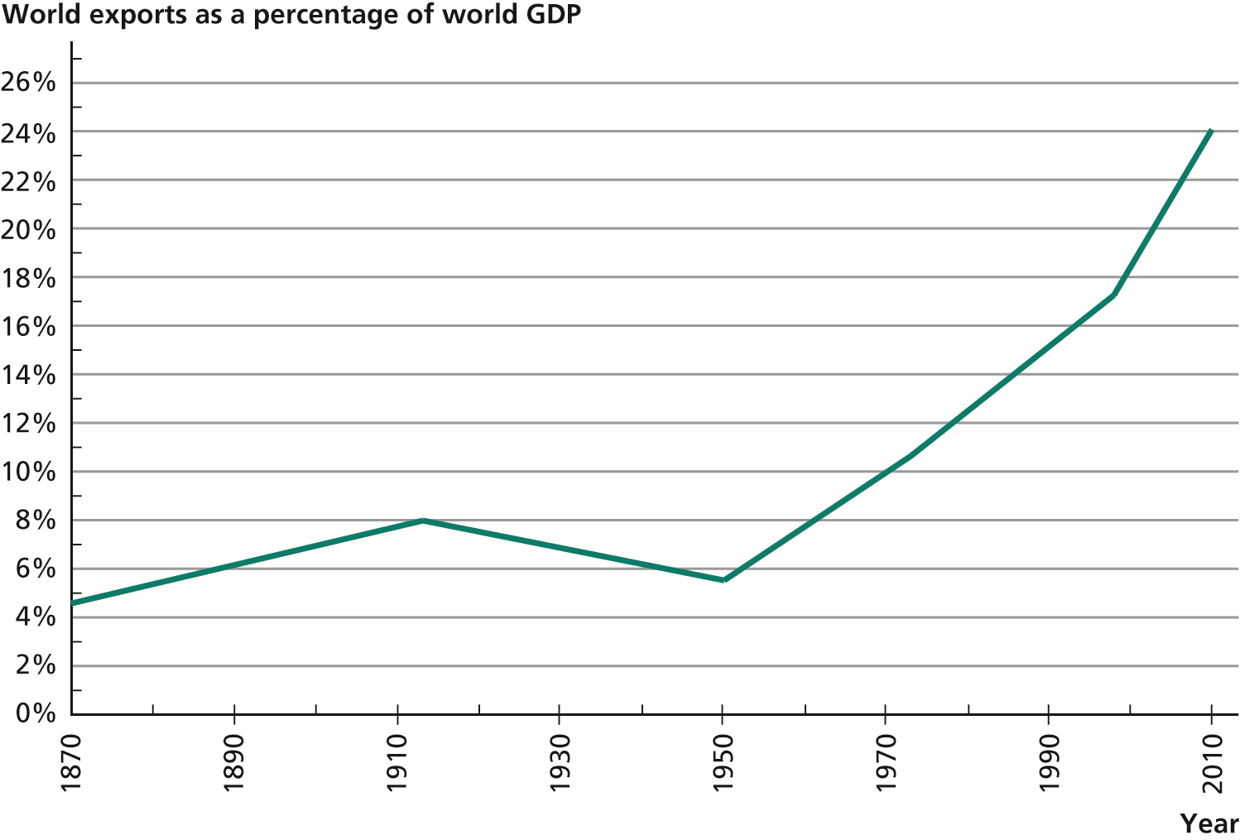
Growth of World Trade 1870-2010

Slide 4
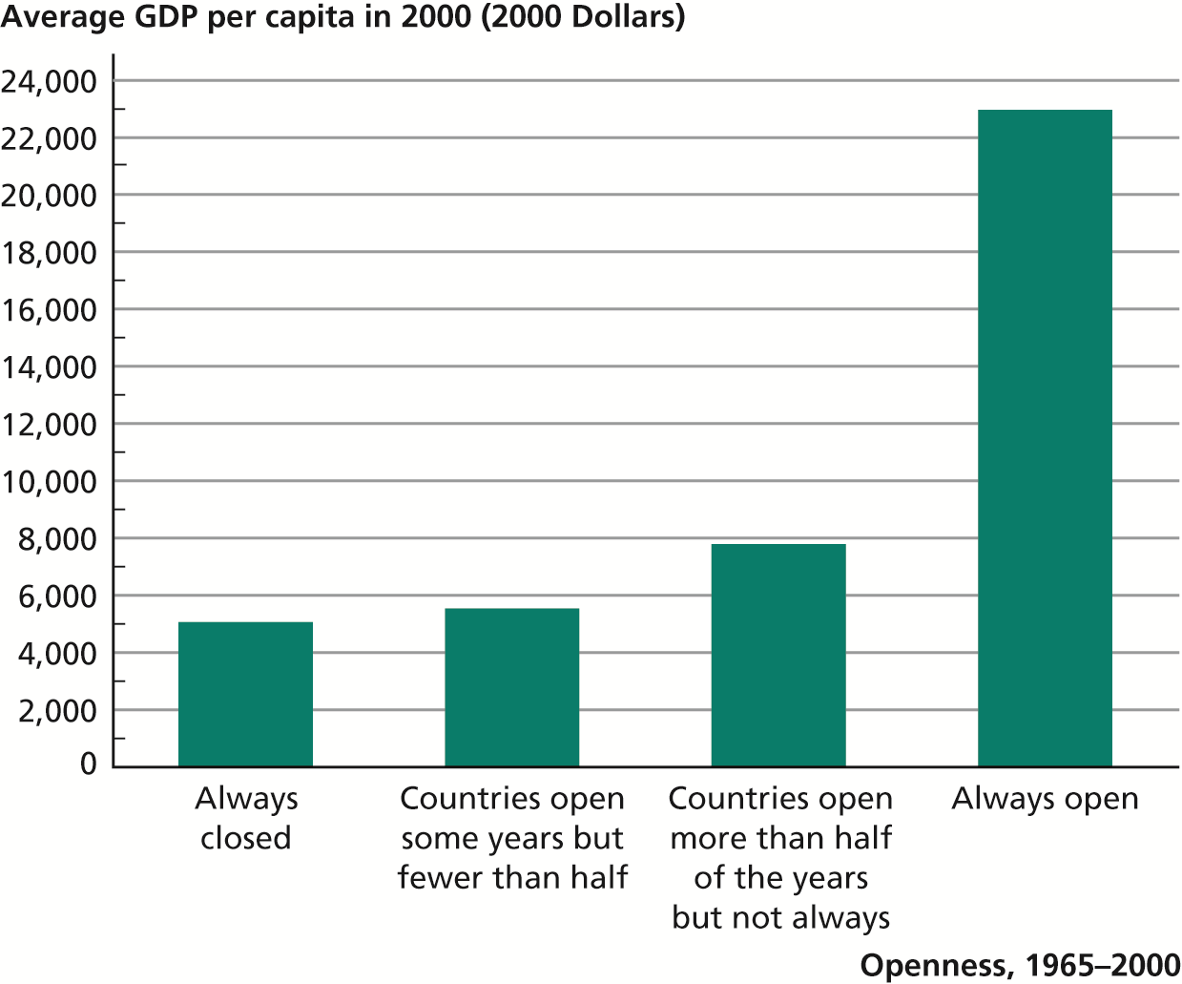
Relationship between Economic Openness and GDP per Capita

Slide 5
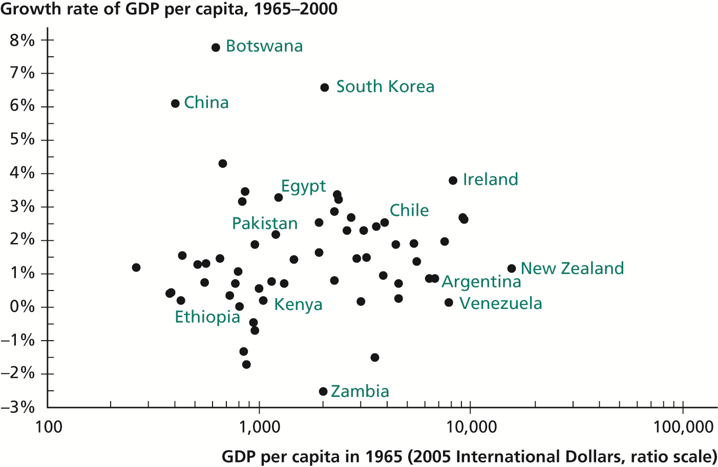
Growth in Closed Economies

Slide 6
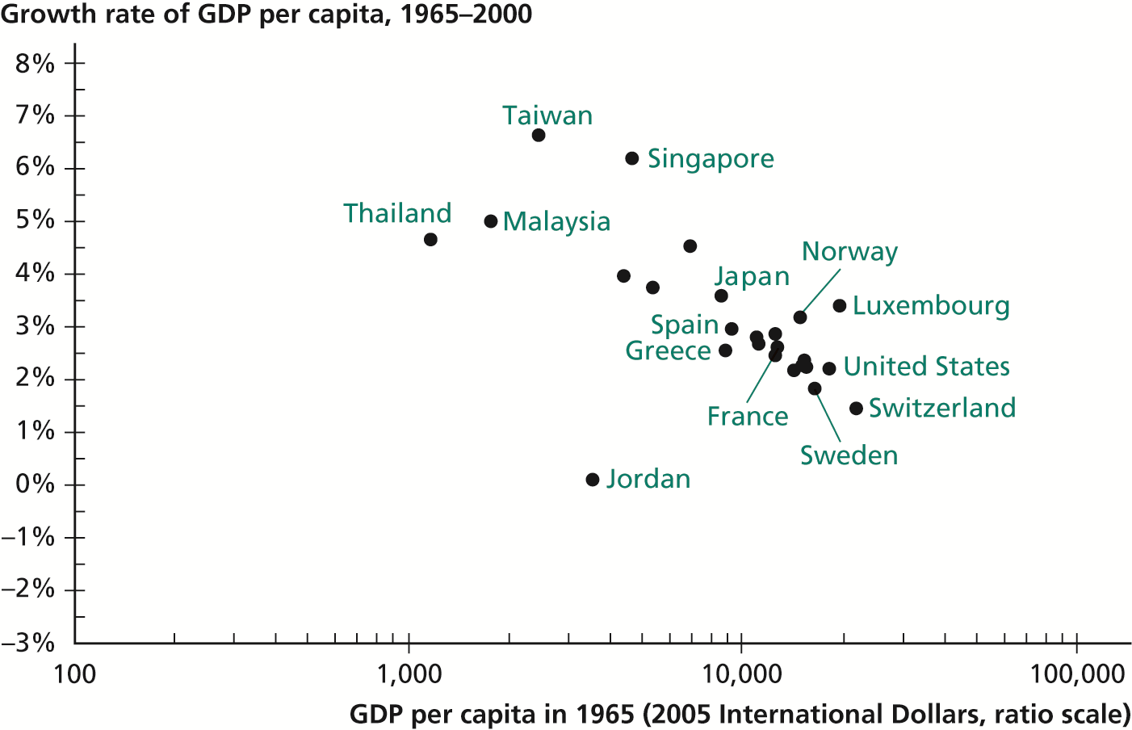
Growth in Open Economies

Slide 7
How Does Openness Help Growth?
More efficient to produce according to your comparative advantage, exporting it and importing what is expensive to produce in your country. (Trade as technology)
Technology transfer (FDI, purchase of key inputs or machinery, organizational knowledge)
Creating incentives for new technologies. Bigger markets mean more profits
Competition from abroad deters domestic monopolization, increases efficiency

Slide 8
Opposition to Openness
Trade generates winners and losers. Sectors where a country has no comparative advantage will oppose openness.
Gains from trade to consumers are diffused but producers who are adversely affected can be united in lobbying for protection.
Low skill workers in developed countries, already at the bottom of the totem pole can become worse off through trade with low wage countries.
Environmental arguments
Loss of national sovereignty
Political manipulation by foreign capital

