Slide 1
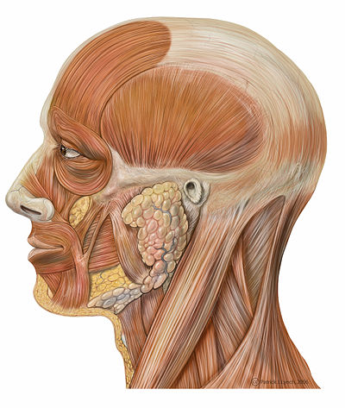
Topic 5: Anatomy of the
Muscular System
Chapter 10
http://en.wikibooks.org/wiki/Human_Physiology/The_Muscular_System

Slide 2
5.1 GROSS ANATOMY OF A SKELETAL MUSCLE
• recall that muscle fiber is the name of a single muscle tissue cell
• several different levels of CT wrapping
1) endomysium: fine layer of CT that surrounds each muscle fiber (cell)
perimysium: sheath around a fascicle
3) epimysium: dense, fibrous CT that surrounds & holds together a group of fascicles = outside layer of a single muscle
5) deep fascia: still coarser layer of dense CT that binds muscles into functional groups »» eg: hamstrings vs quadriceps

Slide 3
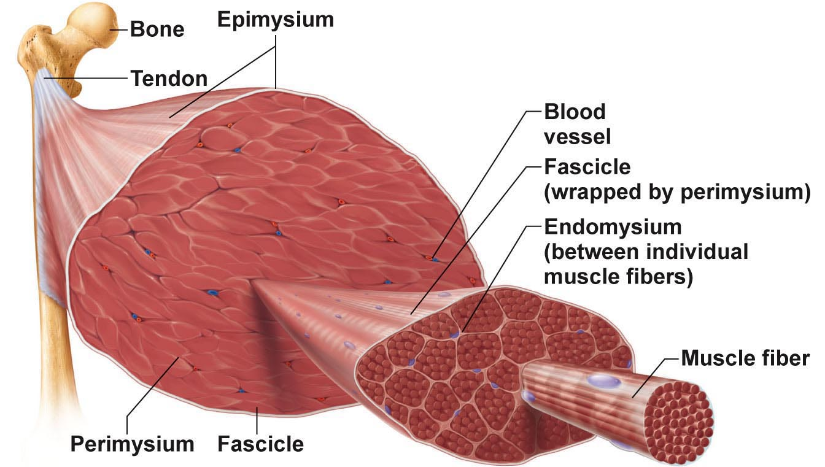
Fig. 9.1a
MUSCLE ATTACHMENTS
• most muscles span joints
• most muscles are attached to bones in at least 2 places
origin: ……………………..
insertion: ……………………..
Most attachments are indirect attachments involving either a tendon or an aponeurosis

Slide 4
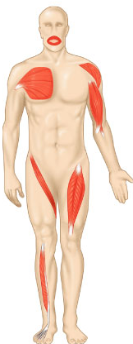
ARRANGEMENT OF FASCICLES
• all skeletal muscles have fascicles
• 4 basic patterns:
Parallel:
• can be straplike (sartorius) or fusiform (biceps brachii)
Pennate: unipennate (eg: extensor digitorum longus)
bipennate (eg: rectus femoris)
multipennate (eg: deltoid)
Convergent: muscle is triangular or fan-shaped (eg: pectoralis major)
Circular: concentric rings surround ext openings & contract to close opening (eg: obicularis oris)
Fig. 10.1

Slide 5
5.2 INTERACTIONS OF SKELETAL MUSCLES
• muscles can work together or in opposition
• 4 functional groups: prime movers, antagonists, synergists & fixators
1) Prime Mover:
• ……………………………………………………………………………………..
• eg: biceps brachii & elbow flexion
2) Antagonist:
• ……………………………………………………………………………………..
• can provide resistance to prevent overshoot or control rate of movement
• a single muscle can be a prime mover for one action & an antagonist for another action - eg: biceps brachii & triceps brachii
3) Synergists:
• muscles that help the prime mover by:
a) promoting the same movement
b) reducing undesirable movements (eg: finger flexor muscles cross both wrist & phalangeal joints)
4) Fixators:
• immobilize a bone - eg: muscles involved in posture

Slide 6
Naming Skeletal Muscles
Location of muscle: bone or body region – eg: temporalis, intercostal
Shape of muscle: eg: deltoid (triangular), right & left trapezius muscles form a trapezoid
Relative size of muscle: maximus, minimus, longus, brevis – eg: gluteus maximus & gluteus minimus
Direction of muscle fibers: eg: rectus = straight, parallel to midline (rectus femoris); also transversus abdominis, oblique
Number of origins: biceps, triceps, quadriceps – eg: biceps brachii
Location of muscle’s origin and/or insertion: if both indicated, origin always indicated first – eg: sternocleidomastoid (neck region – dual origin on sternum and clavicle & insertion on mastoid process of temporal bone)
Action of the muscle: flexor, extensor, adductor – eg: adductor longus for thigh adduction & suppinator muscle in forearm
What can we say about the extensor carpi radialis longus???

Slide 7
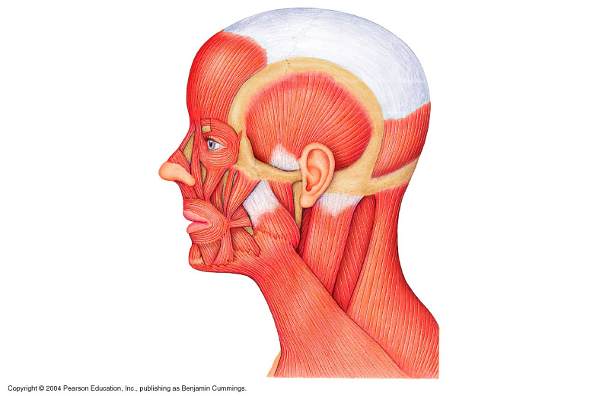
5.3 Muscles of the Head – Facial Expression
• insert into skin or other muscles, not bones; innervated by the facial nerve
epicranius = main muscle of scalp – consists of:
(i) frontalis: raises eyebrows, wrinkles forehead
(ii) occipitalis: pulls scalp posteriorly
orbicularis oculi: surrounds rim of orbit; protects eyes from light/injury – blinking, squinting, also draws eyebrows down
zygomaticus (cheek to corner of mouth):
smiling muscle
orbicularis oris:
lips; multi-layered; closes, purses, protrudes lips
mentalis (mandible to chin):
V-shaped pair – protrudes lower lip; wrinkles chin
ʘ buccinator (mandible/maxilla to orb.oris): deep to masseter – whistling, sucking; hold food in place when chewing; especially in nursing infants
platysma (fascia of chest to mandible):
helps depress mandible; tenses skin of neck
epcranial aponeurosis
galea aponeurotica
Fig. 10.7

Slide 8
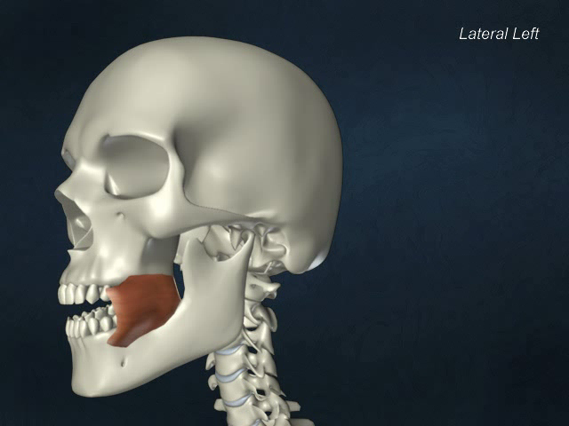
Buccinator

Slide 9
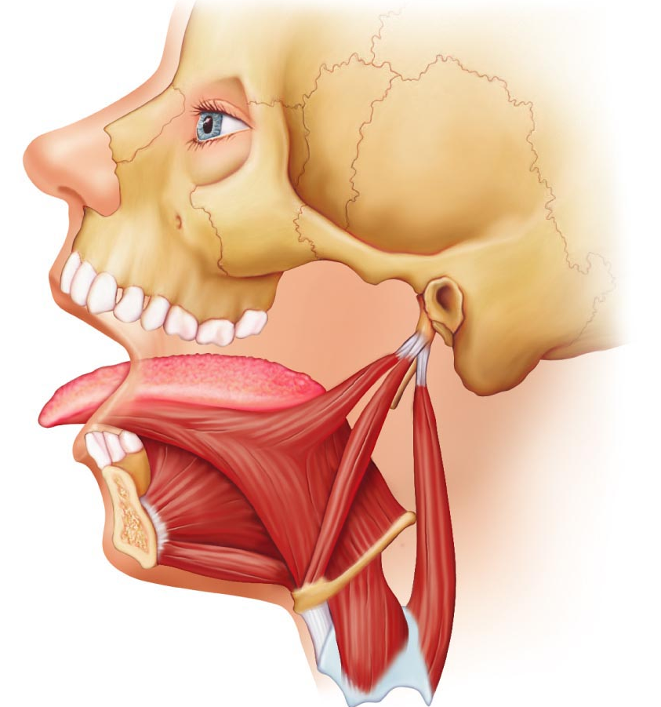
5.4 Muscles that move the tongue
genioglossus (mandible to inferior tongue & hyoid bone): prime mover of tongue protrusion; anchors tongue to prevent obstruction of respiration
hyoglossus (hyoid bone to inferolateral tongue): depresses tongue, especially lateral margins
styloglossus (styloid process of temporal bone to inferolateral tongue): retracts & elevates tongue
Fig. 10.8c

Slide 10
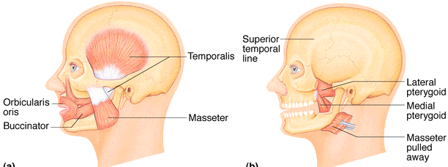
Muscles of the Head: Mastication, etc
• 4 pairs involved in chewing; all innervated by mandibular division of cranial nerve V
ʘ masseter (zygomatic to mandible): prime mover of jaw closure (powerfully)
ʘ temporalis (temporal to mandible): elevates and retracts mandible (closes jaw); maintains closed jaw at rest
medial and lateral pterygoid (sphenoid to mandible): both two-headed; additional jaw movements (eg: side-to-side grinding movments)
buccinator (mandible/maxilla to orbicularis oris): helps keep food between grinding surfaces of teeth during chewing
Fig. 10.8

Slide 11
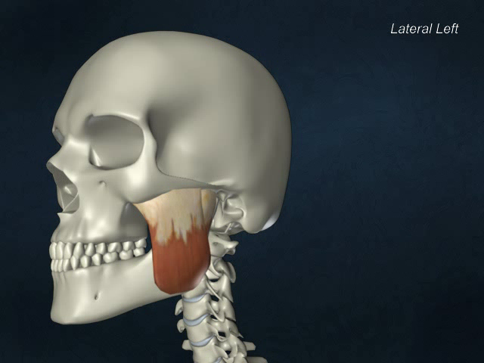
Masseter

Slide 12
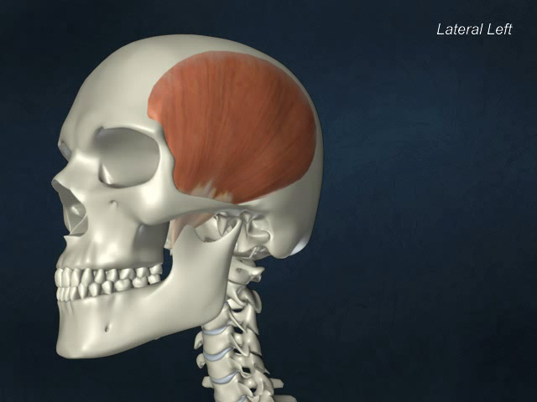
Temporalis

Slide 13
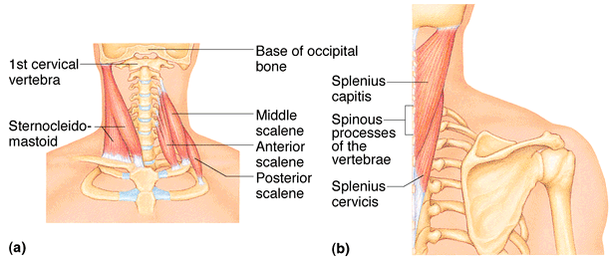
5.5 Muscles of the Neck & Vertebral Column: Head & Trunk Movements
• head moved by muscles originating from axial skeleton
sternocleidomastoid (manubrium/clavicle to mastoid process of temporal): 2-headed; deep to platysma; prime mover (both muscles) of head flexion; individual muscle action for head rotation to side, head tilts
scalenes (cervical vertebrae to 1st 2 ribs): more laterally and deep to platysma & sternocleidomastoid – elevate first 2 ribs, role in coughing, flex & rotate neck
ʘ splenius (vertebrae to mastoid process of temporal): superficial; “bandage muscle”; head extension (both sides) or rotation, tilts
Fig. 10.10a,b
posterior
anterior

Slide 14
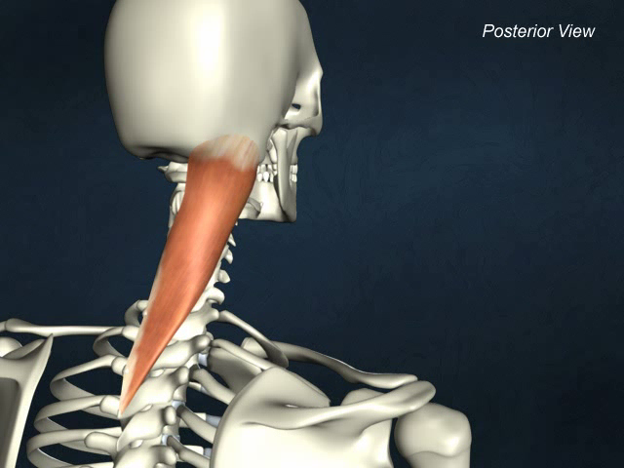
Splenius capitis

Slide 15
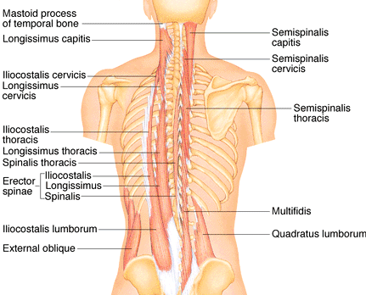
5.6 Muscles of the Neck & Vertebral Column: Head & Trunk Movements
erector spinae: prime mover of back extension; consists of 3 columns of muscles (iliocostalis, longissimus, spinalis); resistance to bending forward & extensors for return to erect position
ʘ semispinalis: deeper, composite muscle from thoracic region to head; extends vertebral column & head, rotation of head, synergistic with sternocleidomastoid muscles of opposite side
quadratus lumborum (iliac crest to lumbar vertebrae): individual muscles flex vertebral column laterally; jointly to extend lumbar spine & fix 12th rib; maintain upright posture
Fig. 10.10d

Slide 16
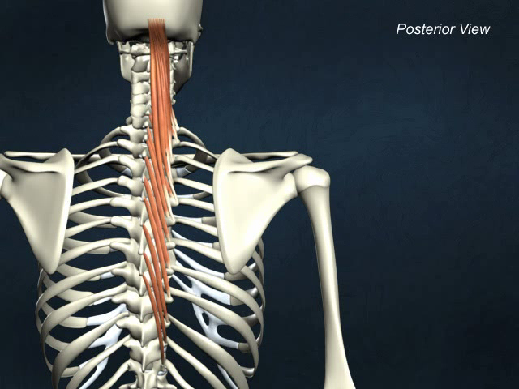
Semispinalis capitis

Slide 17
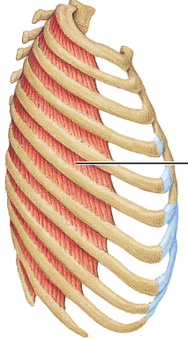
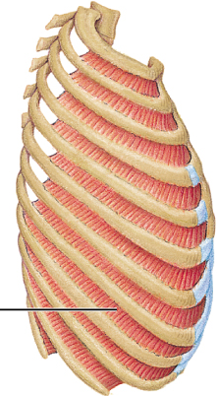
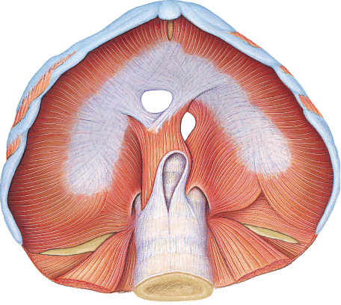
Fig. 10.11
External
Internal
5.7a Muscles of Respiration
ʘ external intercostals: 11 pairs, between ribs; oblique; pull ribs together to elevate rib cage (inspiration;1st ribs fixed by scalene muscles)
internal intercostals: 11 pairs, between ribs; ⊥ external intercostals; draw ribs together to depress rib cage (expiration; 12th ribs fixed by quadratus lumborum)
diaphragm: dome-shaped when relaxed; prime mover of inspiration

Slide 18
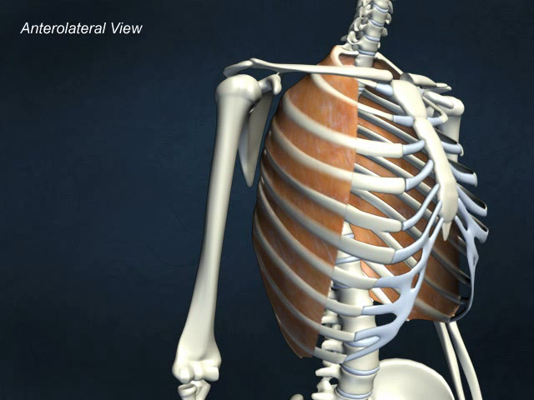
External intercostals

Slide 19
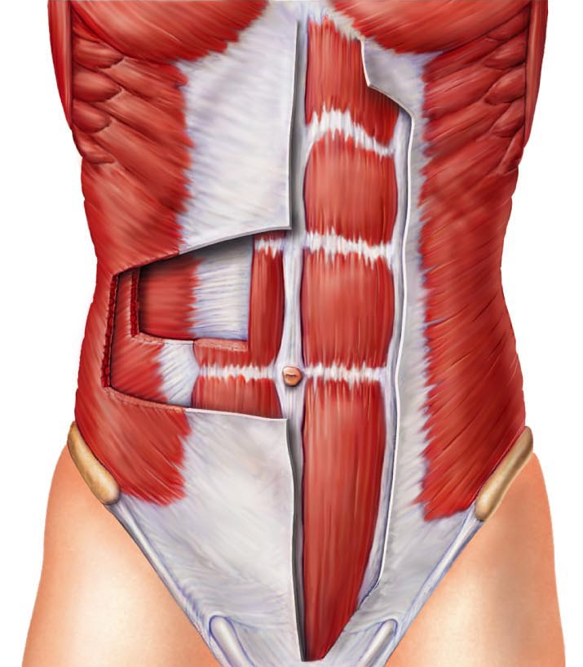
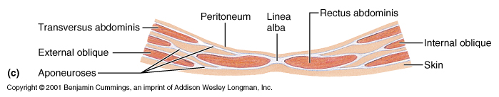
5.7b Muscles of the Abdominal Wall
ʘ rectus abdominis – medial superficial; pubis to rib cage; lumbar rotation, fix & depress ribs, stabilize pelvis during walking
external oblique – largest & most superficial lateral muscle; together ➢ increase ab pressure, flex vertebral column; individual ➢ rotation
internal oblique – deeper, but same actions as ext obliques
ʘ transversus abdominis – deepest; compresses abdominal contents

Slide 20
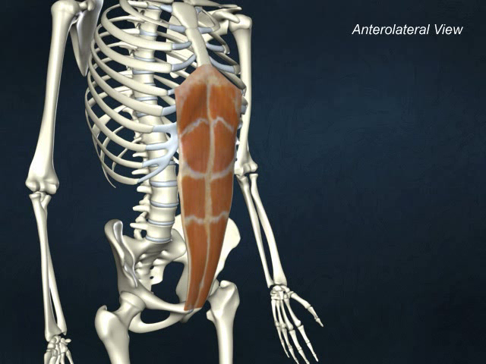
Rectus abdominis

Slide 21
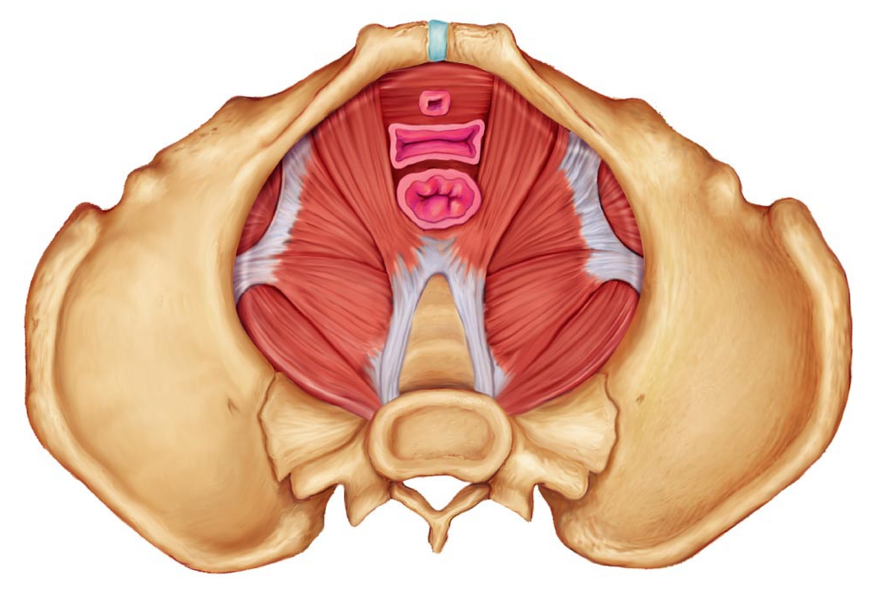
5.8 Muscles of the pelvic floor and perineum
levator ani (pubis to inner coccyx): supports pelvic viscera & forms supportive sling at anorectal junction & vagina; resists increases in intra-abdominal pressure
coccygeus (spine of ischium to sacrum & coccyx): supports pelvic viscera & coccyx
urogenital diaphragm: supports pelvic viscera and constricts urethra

Slide 22
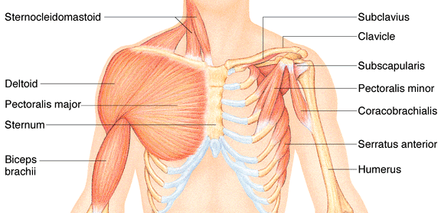
5.10 Superficial Muscles of Thorax:arm movements
ʘ pectoralis major (sternum/rib cartilages to humerus): prime mover of arm flexion; rotates arm medially; adducts arm; climbing, throwing, pushing
ʘ latissimus dorsi (vertebrae to humerus): broad, flat back muscle; prime mover of arm extension, arm adductor, rotates arm at shoulder, rowing, swimming
ʘ deltoid (clavicle/scapula to humerus): thick, rounded, site of IM injection, prime mover of arm abduction (all fibers); also lateral & medial rotations, flexion or extensions if only some fibers used; swinging arm when walking
Fig. 10.14

Slide 23
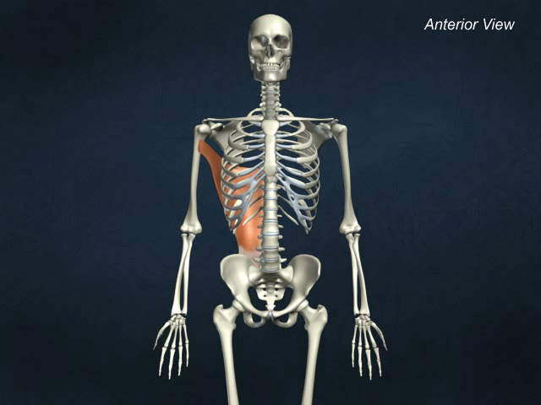
Latissimus dorsi

Slide 24
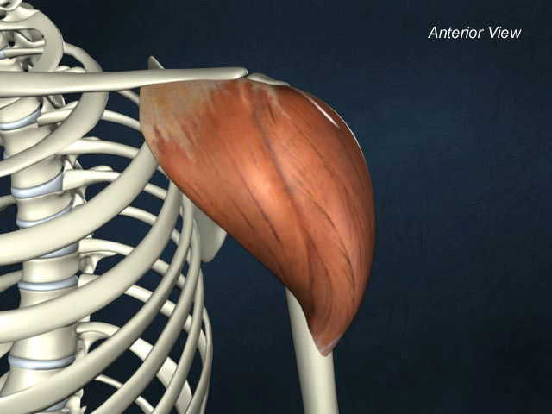
Deltoid

Slide 25
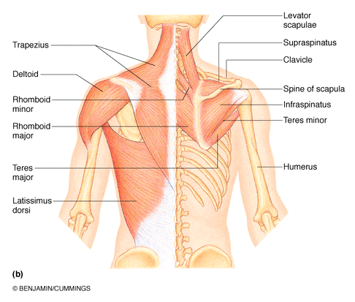

ʘ trapezius (occipital & vertebrae to scapula): superficial, stabilizes, raises, retracts, rotates scapula
rhomboids (vertebrae to scapula): deep to trapezius; aid in scapula movements (eg: squaring shoulders, rotation when lowering arm)
+ subscapularis = rotator cuff muscles
Fig. 10.14

Slide 26
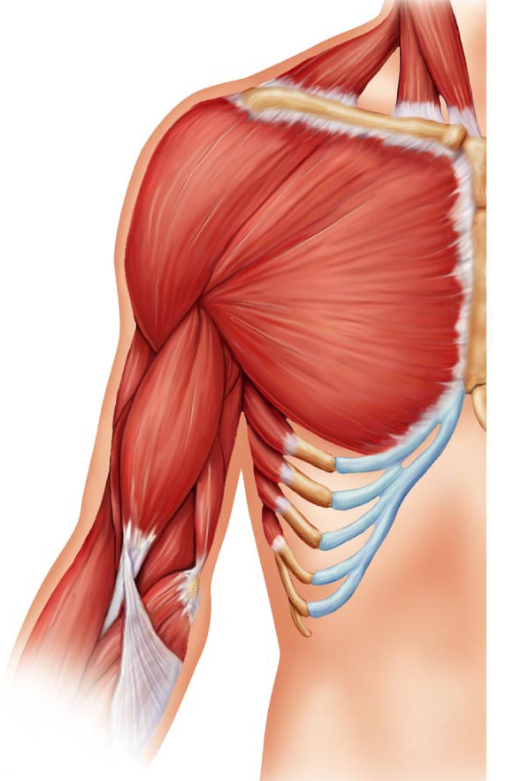
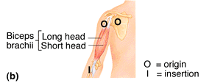
5.10 Muscles Crossing the Shoulder & Elbow Joints
ʘ triceps brachii (scapula/humerus to ulna): only muscle of posterior compartment of arm; powerful forearm extensor, may help stabilize shoulder joint
ʘ biceps brachii (shoulder to radius): anterior, flexes elbow joint & supinates forearm; weak flexor of arm at shoulder
ʘ brachialis (humerus to ulna): immediately deep to biceps brachii; major forearm flexor (strong) – lifts ulna as biceps lifts radius
ʘ brachioradialis (humerus to radius): superficial; from distal humerus to distal forearm; synergist in forearm flexion

Slide 27
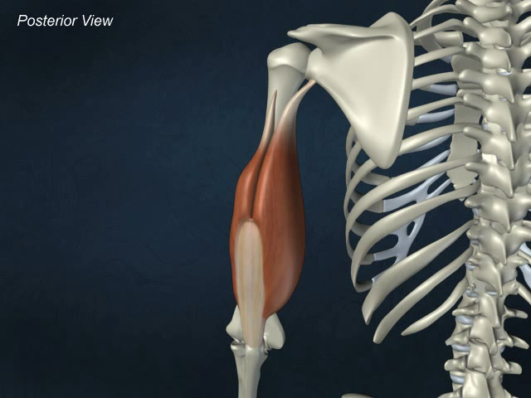
Triceps brachii

Slide 28
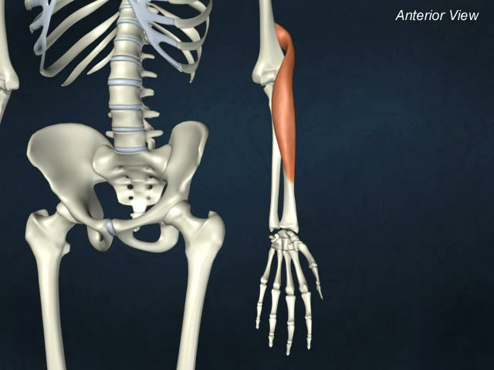
brachioradialis

Slide 29
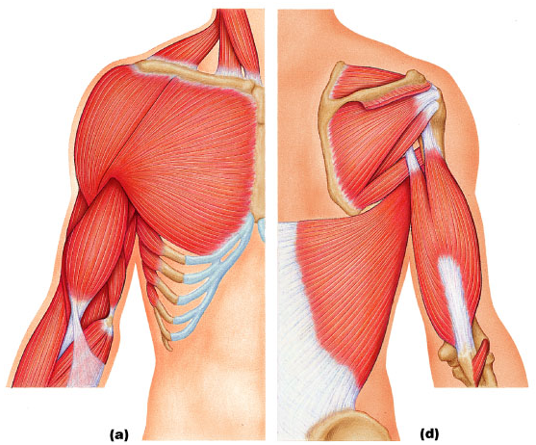
Fig. 10.15
Anterior
Posterior

Slide 30
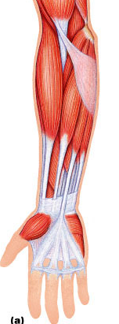
Muscles of the Forearm: Movements of the Wrist, Hand & Fingers
2 functional groups allow for movements of (i) the wrist and of (ii) the fingers and thumb
ʘ pronator teres (humerus/ulna to lateral radius): pronates forearm, weak flexor of elbow
ʘ flexor carpi radialis (humerus to metacarpals): diagonally across forearm, powerful flexor of wrist; abducts hand
ʘ flexor carpi ulnaris (humerus/ulna to metacarpals): powerful flexor of wrist; also adducts hand in concert with extensor carpi ulnaris; stabilizes wrist during finger extension
ʘ flexor digitorum superficialis (humerus/ulna to phalanges): 2-headed, deeper; flexes wrist & middle phalanges of fingers 2-5
flexor retinaculum
Fig 10.16a

Slide 31
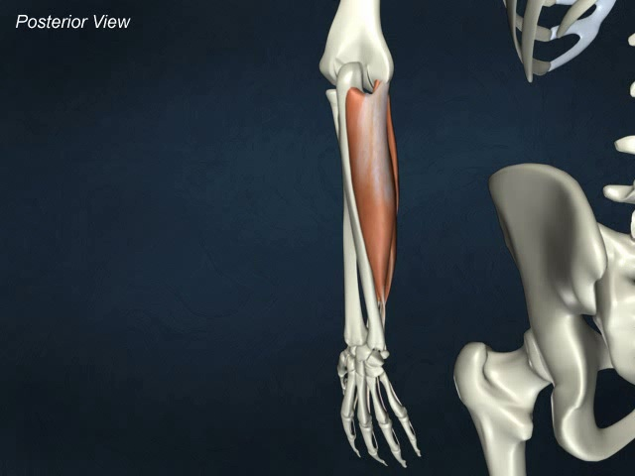
Flexor carpi ulnaris

Slide 32
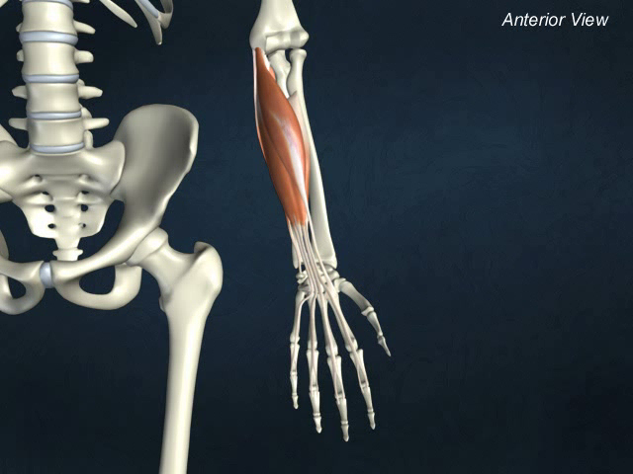
Flexor digitorum superficialis

Slide 33
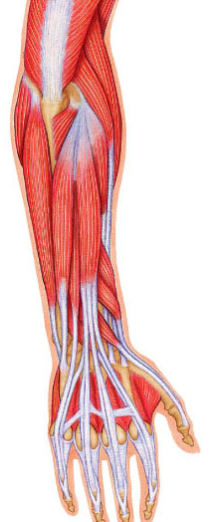

ʘ extensor carpi radialis longus/brevis (humerus to metacarpals): extends & abducts wrist
ʘ extensor digitorum (humerus to phalanges): prime mover of finger extension; extends wrist, can abduct fingers
ʘ supinator (humerus to radius): deep; assists biceps brachii to supinate forearm
10.17a

Slide 34
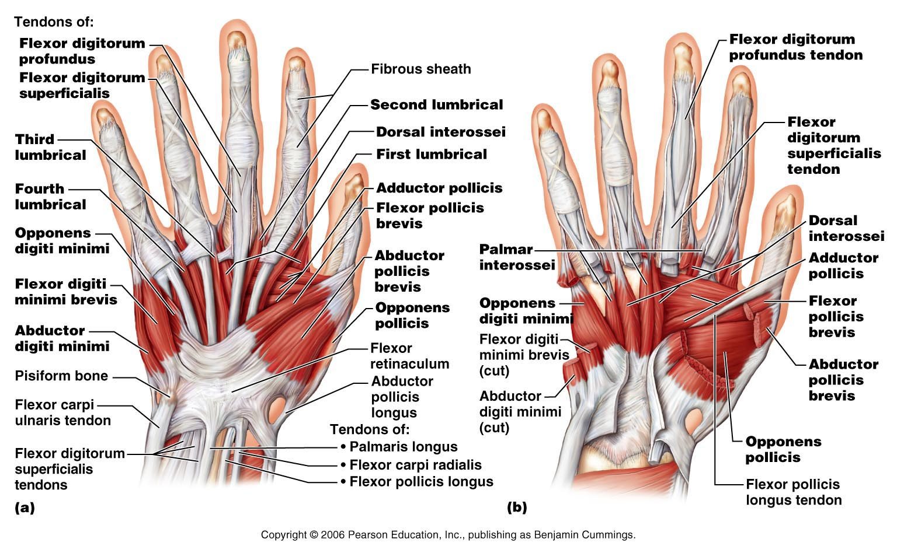
Fig. 10.18: Ventral Views of Right Hand

Slide 35
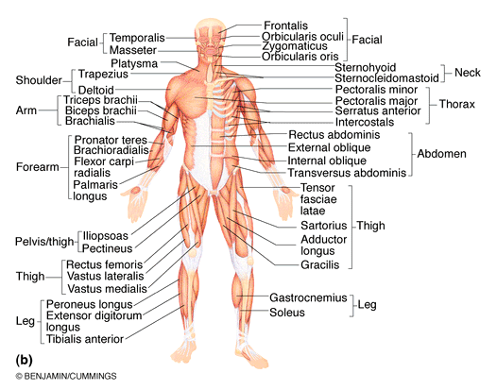

Fig. 10.5
Muscles of Hip, Thigh & Leg
ʘ iliopsoas (iliac crest & lumbar vertebrae to femur): composite of 2 muscles; prime mover of hip flexion
ʘ sartorius (iliac spine to medial tibia): strap-like; longest muscle; flexes & laterally rotates thigh; weak knee flexor
adductors (magnus, longus, brevis) (pubis to femur): all adduct, flex, medially rotate thigh – eg: riding a horse, walking, fixing hip when knee flexed

Slide 36
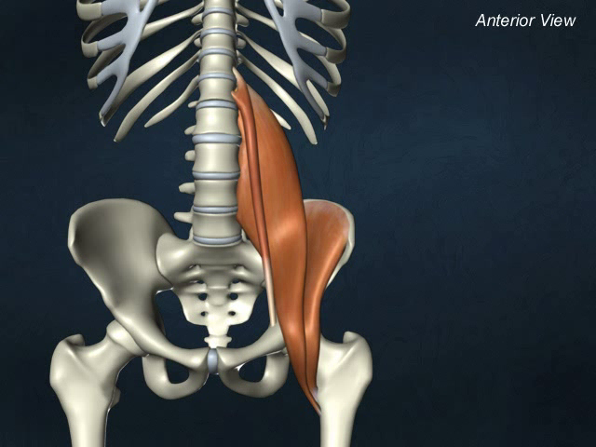
iliopsoas

Slide 37
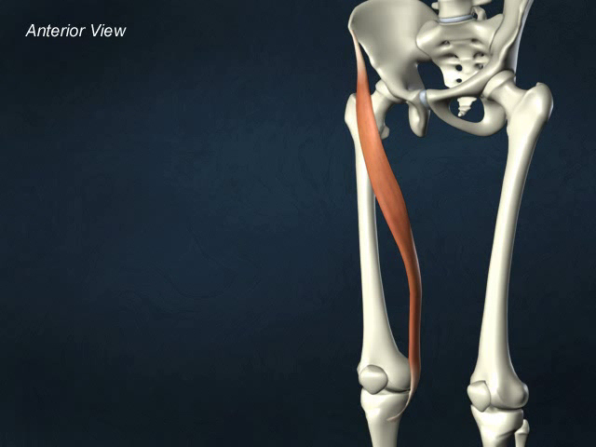
sartorius

Slide 38
ʘ pectineus (pubis to femur): adducts, flexes & medially rotates thigh
gracilis (pubis to medial tibia): adducts thigh, medially rotates leg (walking)
ʘ rectus femoris (iliac spine to patella & tibia): extends knee; flexes thigh at hip
ʘ vastus (lateralis, medialis, intermedius): all extend the knee
ʘ tibialis anterior (tibia to tarsals): prime mover of dorsiflexion; inverts foot
ʘ extensor digitorum longus (tibia to phalanges): dorsiflexes foot; prime mover of toe extension

Slide 39
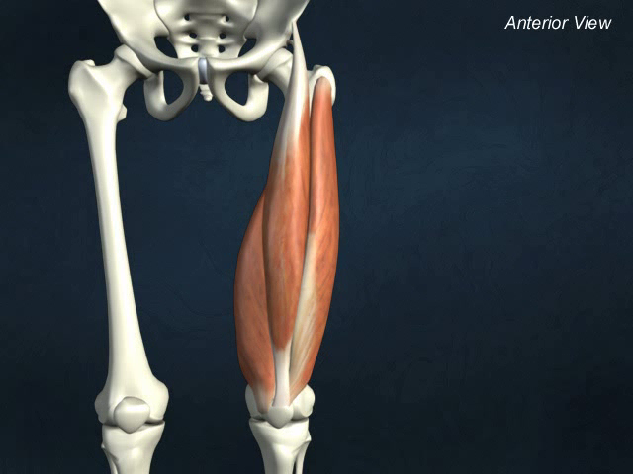
rectus femoris

Slide 40
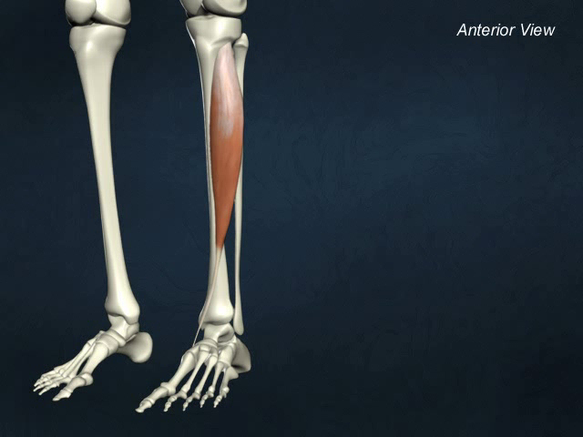
tibialis anterior

Slide 41
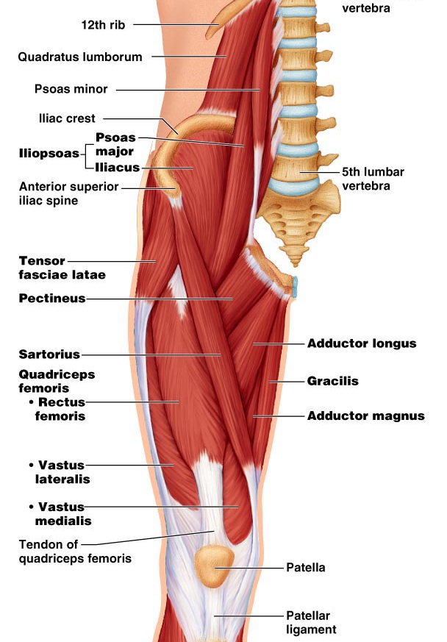
Figs. 10.20

Slide 42
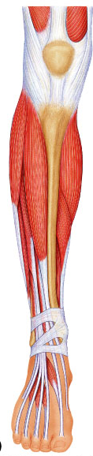
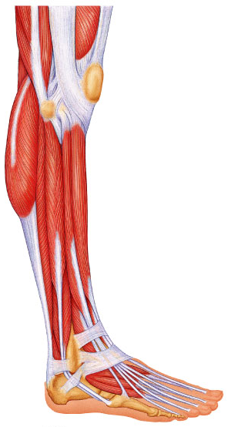
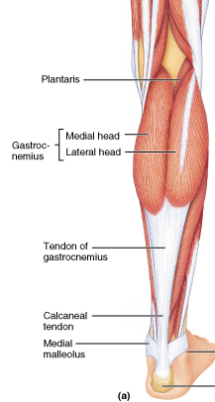
Fig. 10.24
tibialis anterior
extensor digitorum longus
Fig. 10.22
Fig. 10.23

Slide 43
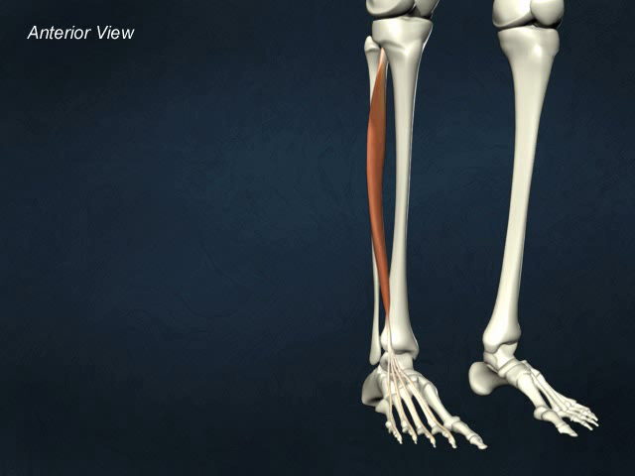
Extensor digitorum

Slide 44
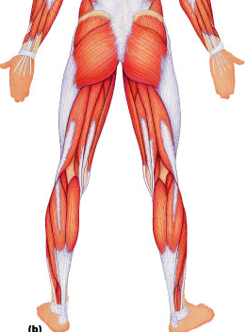
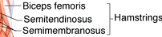
Fig.10.6
ʘ gluteus maximus (ilium/sacrum to femur): largest & most superficial buttock muscle; major thigh extensor - climbing stairs, running (im injection)
ʘ gluteus medius (ilium to femur): abducts & medially rotates thigh; esp. during walking (im injections)
ʘ hamstrings (ischial tuberosity to tibia/fibula): 3 muscles; all extend thigh & flex knee

Slide 45
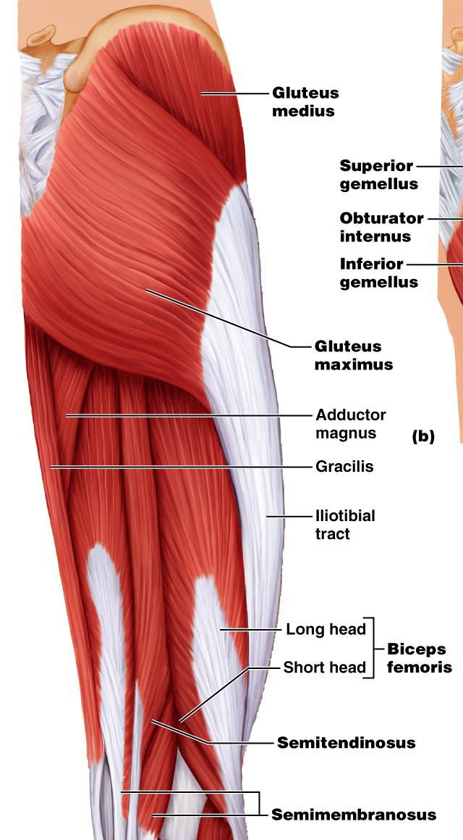
Fig. 10.21

Slide 46
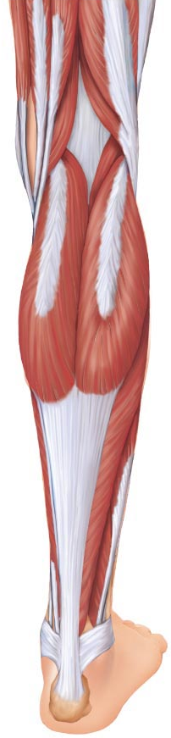
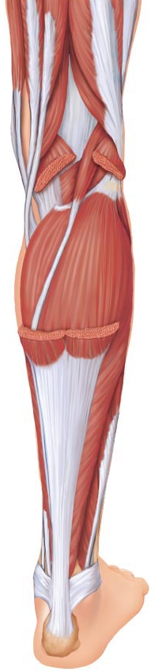

Fig. 10.24
ʘ gastrocnemius (femur to calcaneal tendon): plantar flexes foot when knee extended; flex knee if foot dorsiflexed
ʘ soleus (proximal tibia/fibula to calcaneus): deeper, plantar flexes ankle: walking, running, dancing
ʘ fibularis (peroneus) longus (fibula under foot to 1st metatarsal): plantar flexes & everts foot;helps keep foot flat on ground
calcaneal (Achilles tendon): largest tendon in body (G & S)

Slide 47

gastrocnemius

Slide 48

fibularis longus

Slide 49

Fig. 10.25

