Slide 1

Intelligence & Schooling I
PSY 2105G
Younger, Adler, & Vasta, 2012

Slide 2
Psychometric Approach to Intelligence
Psychometric: emphasis on the use of standardized tests to determine individual differences among people
IQ tests provide ordered differences among people
IQ tests are pragmatically oriented
Notes:
-THE OPPOSITE of what Piaget wanted to do – here, they want to find the individual differences
-indicates whether a child is more intelligent than another and if a child lies below or above average (evaluative)
-IQ tests were for practical purposes

Slide 3
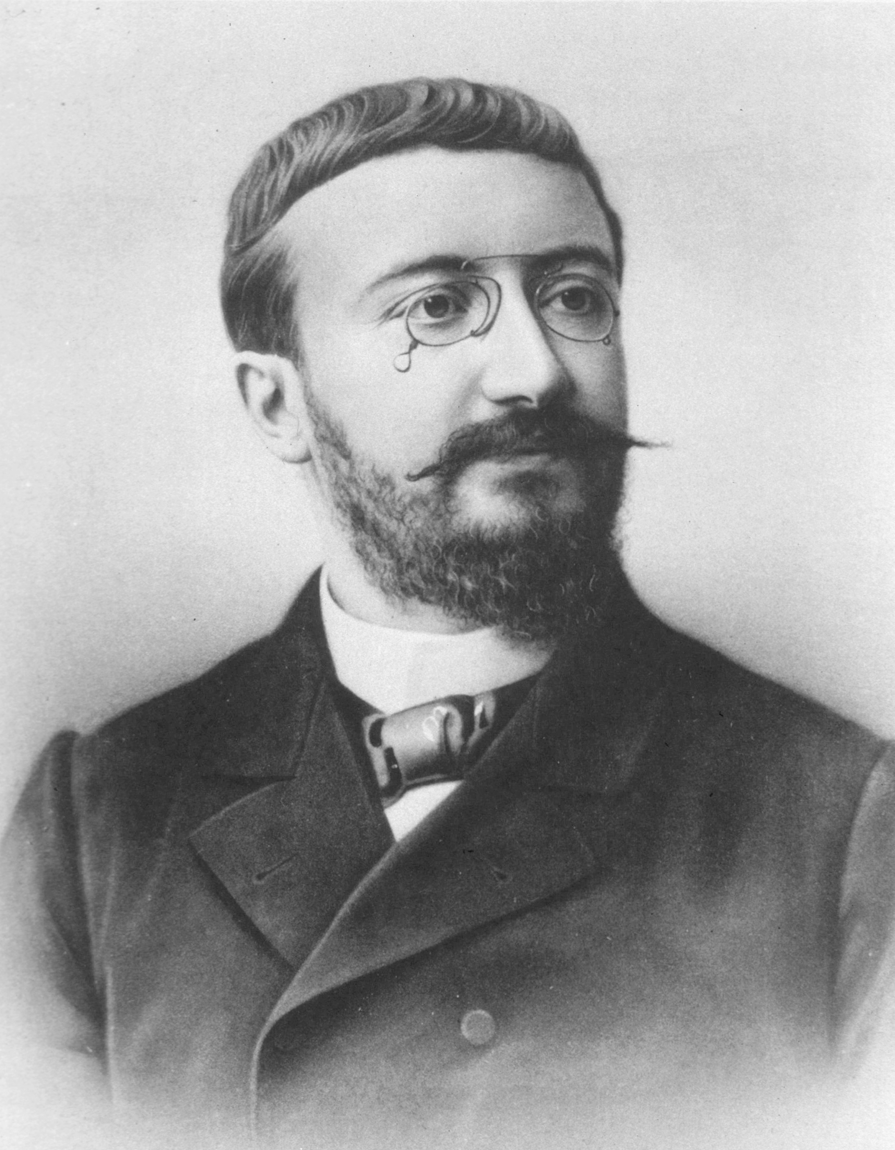
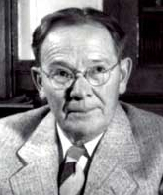
History and Construction of IQ tests
1905: First successful intelligence test developed by Alfred Binet and Theodore Simon
  Binet-Simon Test
IQ approach associated to success in school
Goal: discriminate children who did and did not do well in school. Children who needed further help could be identified.
Criteria for a measure of childhood intelligence: improvement with age
Binet and Simon created the basic model for IQ tests.
Notes:
-the 2 psychologists that hired PIAGET to conduct intelligent tests
-Binet was approached by the French government to design the test to see if someone should be placed in special education in the schooling system; good or bad in school
-wanted to discriminate children who needed more help not to create an IQ test
-a child should improve with age
-ex: identifying body parts, familiar objects,

Slide 4
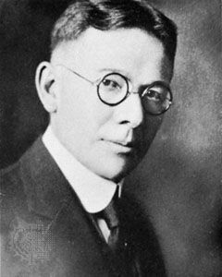
Binet Approach to Measuring Intelligence
Stanford-Binet Intelligence Scale:
  Descendant of the Binet-Simon test
  Developed in 1916 by Lewis Terman
  Test of childhood intelligence: yields a global score (IQ)
  Evaluates verbal and academic skills that are important in school:
    Fluid reasoning; knowledge; quantitative processing; visual-spatial processing; working memory
Notes:
-descendent from the BINET and this guy went to Stanford
-intended for school age children (global IQ score) – developmental delays, and learning disabilities are identified; used in research and schooling
-gives verbal and non verbal IQ scores
-ex: spatial paper folding and cutting task

Slide 5
Standardized test of intelligence
Important feature of standardized test of intelligence:
  Comparing the performances of different groups of children
No absolute metric for measuring intelligence
Mental age: level of performance relative to other children
Intelligence Quotient (IQ):
Mental age X 100
Chronological age
Notes:
-always a comparative evaluation compared to children of the same age
Ex: if a child answers 7 yr old questions his mental age is 7 (even if he is really 6)
-The norm is 100 (average)

Slide 6
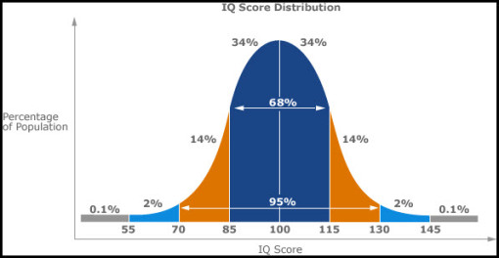
Frequency Distribution of IQ Scores
http://purestonepartners.com/2010/11/08/analytics-frequency-distribution-bell-curves/

Slide 7
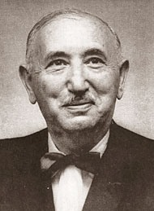
Other tests of Childhood Intelligence
Wechsler Scales
  Intelligence Scale for Children (WISC-IV)
    6-16 years of age
  Wechsler Preschool and Primary Scale of Intelligence (WPPSI-III)
    2.5-7 years of age
  Scales include: verbal comprehension, perceptual reasoning, working memory, and processing speed
Notes:
-Wechsler Scales – American Psychologist – created Whisk for children 6-16 and preschool 2,1/2-7 for primary school
-Perceptual reasoning ex: geometric designs

Slide 8
Other tests of Childhood Intelligence
Kaufman Assessment Battery for Children (KABC-II):
  Constructed to be culturally fair
  3-18 years of age
  Grounded in information processing conceptions of intelligence
  Cognitive abilities: visual processing, fluid reasoning, short-term memory, long-term storage and retrieval
Bayley Scales of Infant and Toddler Development:
  1-42 months of age
  Evaluates sensorimotor skills
  Motor scale + Mental scale
Notes:
-minimize verbal responses and culturally fair
-none of these tests include infants; except Bayley’s but it is more about motor skills

Slide 9
Assessing Intelligence Tests
Standardized tests must meet two criteria:
  Reliability: consistency or repeatability of the instrument
  Validity: does the instrument accurately measure what it is suppose to measure?
    Criterion validity: establishes whether scores on a test relate to performance on an external criterion
      E.g. School performance (r = 0.5 to 0.6)
Notes:
-Reliable – consistency or repeatability (under similar conditions) – if you test a child’s IQ, 2 weeks later they should test around the same Wheschler and stanford binet are reliable
-Validity – are we actually measuring what we are supposed to measure? IQ and school performances do correlate; and job status as adults

Slide 10
Issues in the study of Intelligence
Organization of intelligence
Stability of IQ
Individual differences

Slide 11
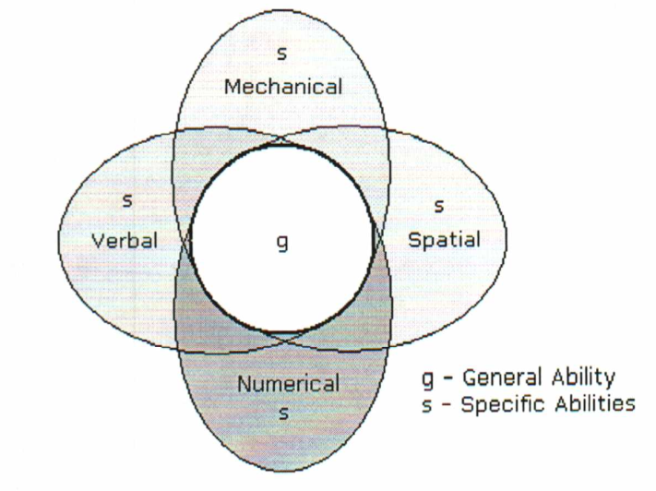
Organization of Intelligence
General intelligence versus different specific intelligence
  Exploring the different pattern of correlations across various measures of intelligence
Spearman’s two-factor theory of intelligence:
  General intelligence: g
  Specific intelligence: s
Thurstone:
    Seven primary mental abilities: Verbal comprehension, verbal fluency, number, spatial visualization, memory, reasoning, and perceptual speed
Solution: Hierarchical model of intelligence
Notes:
-one major issue – psychometric approach
-through any IQ or intelligence test, the person would score the same thing (in general intelligence)
-g was the most important thing for Spearmen
-Thurstone thought there was 7 mental abilities – and no general intelligence
-BROAD GENERAL ABILITIES AT THE TOP, and specific ones at the bottom (a bit of both in the hierarchical solution)

Slide 12
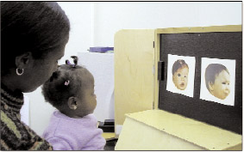
Stability of IQ
Little to no correlation between performance on traditional tests of intelligence in infancy and performance on childhood IQ tests
Why?
  Infant intelligence is based on a distinct skill set than later intelligence
  However, some research findings suggest that infant reaction to novelty is linked to IQ
Notes:
-researchers use a longitudinal study to see if IQ changes
-there seems to be little to no correlation between Bayley scales and later IQ test scores
-different skill sets (ex: Bayley’s was more sensori-motor abilities)
-FAGAN test – habituation and if a child looks longer at a new picture, it is linked to curiosity which can predict later IQ (moderate correlation)

Slide 13
Stability of iq
Degree of stability decreases as the time between the testing increases
  IQ between 3 years of age and 6 years of age is usually more similar than IQ between 3 years of age and 12 years of age
The older the child, the higher the correlation between IQ scores, regardless of the time elapsed between tests
  Greater correlation between IQ at 9 years of age and 12 years of age than correlation between IQ at 3 years of age and 6 years of age
Notes:
-child has more experience
-many changes in infancy and preschool years

Slide 14
Individual Differences
Family studies:
  The more closely related individuals are, the higher the correlation between their IQs
Adoption studies:
  Adopted children’s IQ correlates more strongly with the IQs of the biological parents than with the IQs of the adoptive parents
    Suggesting genetic effects
  Adopted children tend to have above average IQs
    Suggesting environmental effects
Notes:
-nature vs nurture – family studies help us understand genetics and environments (more closely related, higher the correlation in intelligence)
-siblings parents etc also show similar environments
-adoption studies show environmental effects, and adopted parents are usually highly motivated parents etc.
-prenatal environment, some early attachments if not separated
-screening for adopted parents

Slide 15
Individual differences
Twin studies:
  Identical twins raised together present the highest correlation regarding IQ
  Identical twins raised apart present a higher correlation regarding IQ than fraternal twins raised together
Differences in genes + differences in environments = differences in IQ
Notes:
-NATURE AND NURTURE ARE IMPORTANT

Slide 16
Heritability
How can we determine the relative importance of genes compared to environment?
Heritability: Proportion of variance in a trait that can be attributed to genetic variance in the sample being studied
  Statistic that ranges from 0 (all the differences stem from the environment) to 1 (all the differences stem from genetics)
Notes:
-when we talk about an individual – it is a bit of both,
-when we talk about a sample, we use heritability statistic/index

Slide 17
Heritability
Limitations:
  1) Heritability can be calculated in different ways and thus affects the value
  2) Specific to the sample studied and cannot be generalized to other samples:
    Tells us nothing about the future
      Flynn Effect
    Tells us nothing about comparisons between other samples
  3) Heritability of IQ varies depending on the environment
Notes:
2) ex: natural disaster – tells us nothing about the future
Flynn Effect - increasing overall IQ performance over time
-low socio-economic environments (more environment); and high socio-economic environments (more on genes)

