Slide 1
Chapter 3
Interdependence and the Gains From Trade

Slide 2
Recall from Chapter 1
Principle 1 – People face Trade-offs – Production possibilities frontier
Principle 2 – The True cost of something is what you must give up in order to get it – Opportunity cost
Principle 5 – Trade can make everyone better off
  In lecture one we touched on the idea that specialization and trade benefits all involved parties
  We will now see this mathematically with a simple model based on a story

Slide 3
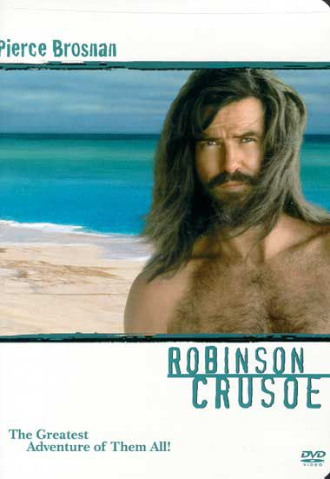
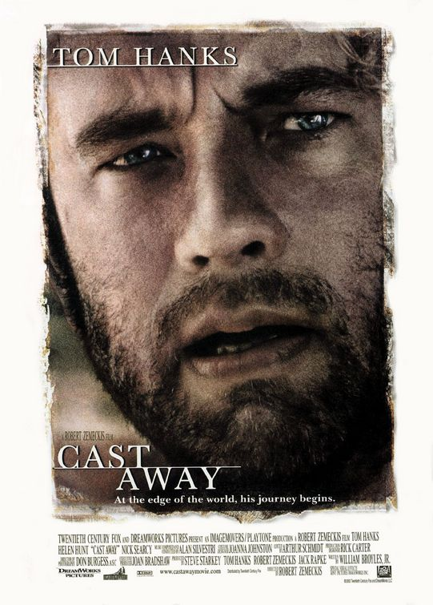
Our model will be based on characters from two (older) movies
Robinson Crusoe, starring Pierce Brosnan (1997)
“The greatest adventure of them all!”
Based on an English novel from the 1700s
Cast Away, starring Tom Hanks (2000)
“At the edge of the world, his journey begins.”
Award for best actor

Slide 4
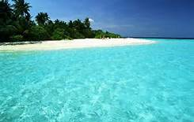
Our model assumes that both of these characters were stranded on the same island
There are only 2 things to eat – coconuts and fish
Each man has 8 hours per day to gather food. They spend the other 8 waking hours completing other tasks – gathering firewood, building shelter, tending the signal fire, ect.

Slide 5
Assumptions
Looking at only the food gathering decision
There are also other trade-offs, for instance, less time can be spent gathering food in order to build a better shelter, or more resources could be put into getting rescued, at the expense of food and shelter
Assume that this decision is already made – the 8 hours spent gathering food is fixed

Slide 6
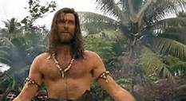
Pierce Brosnan
Has lived on the island for some time, and is good at gathering food
Can catch 3 fish for every 2 hours spent fishing (1.5 fish per hour)
Can gather 2 coconuts per hour spent gathering
Pierce is able to gather 16 coconuts per day, or 12 fish per day, or some combination in between, as long as he does not spend more than 8 hours total

Slide 7
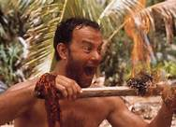
Tom Hanks
New to the island… still has a lot to learn
Can catch one fish per hour spent fishing
Can gather one coconut per hour spent gathering
Tom is able to gather 8 coconuts per day, or 8 fish per day, or some combination in between, as long as he does not spend more than 8 hours total

Slide 8
Initial Allocations
Assume Pierce spends 2 hours fishing and 6 hours gathering coconuts
  3 fish, 12 coconuts
Assume Tom spends 4 hours fishing and 4 hours gathering coconuts
  4 fish, 4 coconuts

Slide 9
Pierce is clearly better than Tom at collecting both foods…
Pierce gets 2 coconuts per hour, compared to Tom’s 1
Pierce gets 1.5 fish per hour, compared to Tom’s 1
Pierce has what we call an ‘Absolute Advantage’ compared to Tom in both coconuts and fish
  Absolute Advantage – Able to produce the good cheaper in terms of the resource. In this case the resource is time
    Compares productivity

Slide 10
Should they trade?
Pierce has an absolute advantage for fish and coconuts as compared to Tom
How would Pierce benefit from trading with someone less productive? Wouldn’t he be better off simply working on his own?
What can Tom do that Pierce could not do cheaper (or better)?
  Nothing! (at least at first glance)

Slide 11
Recall Principle number 2:
The true cost of something is what must be given up in order to get it – the opportunity cost
So far we have only looked at this problem in terms of the cost of the resource (time)
In order to understand the true cost of these goods, we need to examine what is given up in order to get them
What is the cost of coconuts in terms of fish?
  In order to get more fish, we will need to spend less time gathering coconuts -> more fish means less coconuts
What is the cost of fish in terms of coconuts?
  In order to get more coconuts, we will need to spend less time catching fish -> more coconuts means less fish

Slide 12
The problem needs to be examined in terms of the Trade-off
In order to do this we need to look at each person’s opportunity cost for each good
This requires us to examine each person’s production possibilities frontier

Slide 13
Pierce Brosnan’s PPF
0
Fish
Coconuts
Coconuts
12
0
Initial allocation
9
4
6
8
3
12
18
RUN: 12
0
16
15
-16
12
Slope =
= -4/3 = -1.33
12
RISE: -16
9
Slope = Opportunity Cost
6
Opportunity Cost of one Fish = 1.33 Coconuts
3
Opportunity Cost of one Coconut = 0.75 Fish (1/1.33)
0
Fish
2
4
6
8
10
12
Notes:
13
Trade un-tethers consumption from production. The light blue point represents consumption. Notice that the consumption point is above the PPF. Without trade, it would not be possible to consume this combination of the two goods!
In a sense, international trade is like technological progress: it allows society to produce quantities of goods that would otherwise not be possible.

Slide 14
Tom Hanks’ PPF
0
Fish
Coconuts
Initial allocation
Coconuts
8
0
6
2
4
4
2
6
18
0
8
15
-8
12
Slope =
= -1
8
9
RUN: 8
Slope = Opportunity Cost
6
Opportunity Cost of one Fish = 1 Coconut
RISE: -8
Opportunity Cost of one Coconut = 1 Fish
3
0
Fish
2
4
6
8
10
12
Notes:
14
Trade un-tethers consumption from production. The light blue point represents consumption. Notice that the consumption point is above the PPF. Without trade, it would not be possible to consume this combination of the two goods!
In a sense, international trade is like technological progress: it allows society to produce quantities of goods that would otherwise not be possible.

Slide 15
Opportunity Costs Summary
Pierce
  1 additional fish costs 1.33 coconuts
  1 additional coconut costs 0.75 fish
Tom
  1 additional fish costs 1 coconut
  1 additional coconut costs 1 fish
What do we notice here?

Slide 16
Answer
In terms of coconuts, fish are cheaper for Tom
In terms of fish, coconuts are cheaper for Pierce
This means that Tom has a Comparative Advantage in producing fish and Pierce has a Comparative Advantage in producing coconuts
Comparative Advantage – Able to produce the good cheaper in terms of the other good
  Compares opportunity cost
  Compares the trade-off

Slide 17
Comparison of Advantages
Pierce
Tom
Fish
Absolute Advantage
Comparative Advantage
Coconuts
Absolute Advantage
Comparative Advantage
Key Points
  You do not need an Absolute Advantage to have a Comparative Advantage
  Absolute Advantage compares the input cost, whereas Comparative Advantage compares the Opportunity Cost

Slide 18
Specialization
Both parties will be better off if they specialize in what they have a Comparative Advantage in, and trade between themselves
Pierce – Comparative Advantage in coconuts
  Spends all day collecting coconuts
    16 coconuts, 0 fish
Tom – Comparative Advantage in fish
  Spends all day fishing
    8 fish, 0 coconuts

Slide 19
Terms of trade
Tom will not trade one of his fish unless he gets at least one coconut
  If he can’t trade for at least one coconut, he is better off getting the coconut himself (opportunity cost = 1 fish per coconut)
Pierce will not trade one of his coconuts unless he gets at least 0.75 fish
  If he can’t trade for at least 0.75 fish, he is better off getting it himself (opportunity cost = 1.33 coconuts per fish)

Slide 20
Final Price (this is tricky!)
Coconuts: The price could be anywhere between 0.75 or 1 fish per coconut (the lowest Pierce is willing to accept vs the highest Tom is willing to pay)
Fish: Expressed in the other way, between 1 and 1.33 coconuts per fish (the lowest amount Tom is willing to accept vs the highest Pierce is willing to pay)
The final price depends on the preferences both men have for fish and coconuts, and the bargaining power between the two of them
  Beyond this course – you will only be asked to express the possible ranges that the final price could fall in

Slide 21
The Trade
Assume Tom and Pierce settle on a price of 0.8 fish per coconut, or, 1.25 coconuts per fish (1/0.8 = 1.25)
Assume Tom sells 4 fish to Pierce in exchange for 5 coconuts (4*1.25 = 5)
Final Allocation
  Pierce – 4 fish and 11 coconuts
  Tom – 4 fish and 5 coconuts

Slide 22
Allocation Comparison
Before Specialization and Trade
Pierce
Tom
Total
Fish
3
4
7
Coconuts
12
4
16
After Specialization and Trade
Pierce
Tom
Total
Fish
4
4
8
Coconuts
11
5
16
One more fish in total
Tom is clearly better off (one extra coconut)
Is Pierce better off? The answer is yes, but it is a little less obvious than in Tom’s case

Slide 23
Is 4 fish and 11 coconuts better than 3 fish and 12 coconuts?
For Pierce Brosnan, the answer is YES
  This is because of what we know of his opportunity cost of fish
Specialization has essentially allowed Pierce to trade one coconut for one fish, compared to the initial allocation
But without trade, Pierce would have had to give up 1.33 coconuts to get one fish by reallocating his food gathering time
Specialization and Trade allows Pierce to get fish for a lower ‘price’ than if he were simply producing on his own

Slide 24
Pierce Brosnan’s PPF With Trade
0
Fish
Coconuts
Coconuts
3
12
Initial allocation
Specialized Production
0
16
18
Trade
4
-5
Allocation with Trade
4
15
11
12
9
6
3
0
Fish
2
4
6
8
10
12
Notes:
24
Trade un-tethers consumption from production. The light blue point represents consumption. Notice that the consumption point is above the PPF. Without trade, it would not be possible to consume this combination of the two goods!
In a sense, international trade is like technological progress: it allows society to produce quantities of goods that would otherwise not be possible.

Slide 25
Pierce Brosnan’s PPF With Trade
0
Fish
Coconuts
Coconuts
3
12
Initial allocation
Allocation with Trade
4
11
18
-The Allocation with Trade lies outside of Pierce’s PPF -This means he would not be able to reach this allocation on his own
-More is always better – so this allocation is better for Pierce
-Specialization and Trade allows Pierce to increase his overall consumption without increasing his resources
15
12
9
6
3
0
Fish
2
4
6
8
10
12
Notes:
25
Trade un-tethers consumption from production. The light blue point represents consumption. Notice that the consumption point is above the PPF. Without trade, it would not be possible to consume this combination of the two goods!
In a sense, international trade is like technological progress: it allows society to produce quantities of goods that would otherwise not be possible.

Slide 26
Tom Hanks’ PPF With Trade
0
Fish
Coconuts
Coconuts
4
4
Initial allocation
Specialized Production
8
0
18
Trade
-4
5
Allocation with Trade
4
15
5
12
9
6
3
0
Fish
2
4
6
8
10
12
Notes:
26
The red point again represents production.
Trade un-tethers consumption from production. The light blue point represents consumption. Notice that the consumption point is above the PPF. Without trade, it would not be possible to consume this combination of the two goods!
In a sense, international trade is like technological progress: it allows society to produce quantities of goods that would otherwise not be possible.

Slide 27
Tom Hanks’ PPF With Trade
0
Fish
Coconuts
Coconuts
4
4
Initial allocation
Allocation with Trade
4
5
18
15
-Tom’s Allocation with Trade is obviously better – Tom gets one more coconut without giving up any fish
-Tom’s Allocation with Trade is also outside of the bounds of his PPF
12
9
6
3
0
Fish
2
4
6
8
10
12
Notes:
27
The red point again represents production.
Trade un-tethers consumption from production. The light blue point represents consumption. Notice that the consumption point is above the PPF. Without trade, it would not be possible to consume this combination of the two goods!
In a sense, international trade is like technological progress: it allows society to produce quantities of goods that would otherwise not be possible.

Slide 28
Summary
Even though we told this story through two men stranded on an island, the overall principle and results can be applied to many different situations
This scenario can be just as easily applied to a setting where there are two countries who produce two goods using one input (Wheat and Computers from lecture on chapter 2)
This scenario also gives us a better understanding of the benefits of specialization at the micro (individual) level
  Specialization of tasks benefits the society as a whole
  While some people may not have an Absolute Advantage, everyone has a Comparative Advantage in something

Slide 29
Key Terms that were not covered
Export – A good that is produced domestically and sold abroad – in our example, Pierce exported coconuts and Tom exported fish
Import – A good that is produced abroad and sold domestically – in our example, Pierce imported fish and Tom imported coconuts
Autarky – A nation that produces everything that it consumes – no trade
  In our example, until Tom got stranded on the island as well, Pierce was an Autarky

