Slide 1
ANP1106D
Bones and Skeletal Tissues
Chapter 6
Kyle Scott, MSc
W2015

Slide 2
Chapter 6 – Bones and Skeletal Tissues
Bone is a living dynamic tissue which responds to its environment:
  Bone reacts to amount of force applied by increasing both the density & amount of roughening on bone or decreasing density when force is reduced or eliminated (eg: paralysis) (deposition vs resorption)
  Bone stores calcium – resorbed & transferred to bloodstream when needed
Functions of Bone
SUPPORT:
PROTECTION:
MOVEMENT:
MINERAL STORAGE:
BLOOD CELL FORMATION:
FAT STORAGE:
HORMONE PRODUCTION:

Slide 3
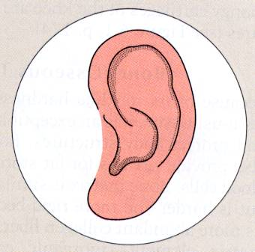
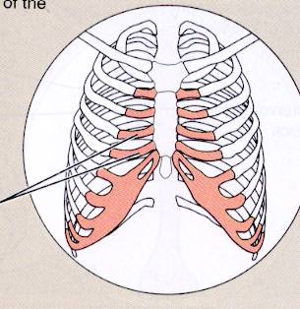
3.1: Compare the structure of bony tissues and cartilages
Cartilage features between dense CT & bone → tough, but flexible
  avascular, devoid of nerve fibers
  ground substance contains lots of the GAGs chondroitin sulfate & hyaluronic acid - also chondronectin, (adhesive protein)
  collagen fibers (can have some elastic fibers)
  up to 80% H₂O
Some terms relating to cartilage:
perichondrium:
  In damaged areas, perichondrium can form scar tissue because poorly vascularized cartilage repairs badly; ossification of cartilage with aging!!
chondroblasts
  high MR: immature cartilage cells - actively form cartilage
chondrocytes:
  low MR: mature cartilage cells → maintain cartilage
lacunae
  localized clusters of chondrocytes in cartilage

Slide 4
Types of Cartilage
HYALINE CARTILAGE
  most abundant; firm support + pliability; lots of collagen; appears glassy blue-white; chondrocytes - only 1-10% of volume
  Loc: embryonic skeleton, ends of long bones (epiphyseal plates in growing children), costal cartilages of ribs, cartilages of nose, trachea, larynx
  Fcn: supports & reinforces; resilient cushioning & resists compressive stress
ELASTIC CARTILAGE
  like hyaline cartilage, but more elastic fibers
  Loc: external ear, epiglottis - why does this make sense??
  Fcn: maintains shape while giving lots of flexibility
FIBROCARTILAGE:
  rows of chondrocytes alternating with rows of thick collagen fibers; structural intermediate between hyaline cartilage & dense regular CT
  Loc: intervertebral discs, pubic symphysis, discs of knee joints (where hyaline cartilage meets a ligament or a tendon)
  Fcn: tensile strength with ability to absorb compressive shock

Slide 5
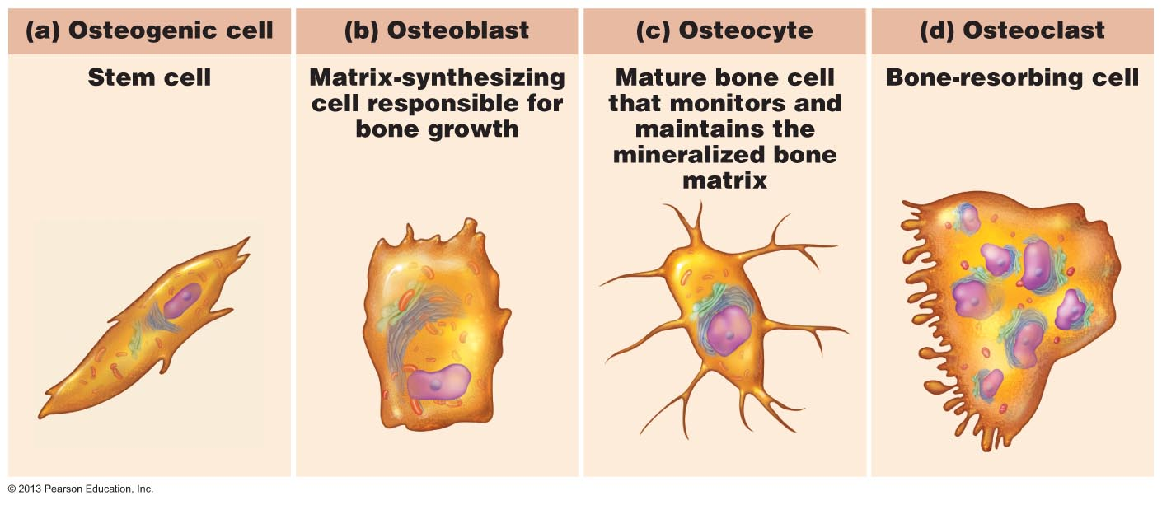
Microscopic Anatomy of Bone
calcium salts
  give hardness & strength for support and protection of softer tissues; cavities for fat storage & synthesis of blood cells
osteoblasts:
osteocytes:
osteoclasts:

Slide 6
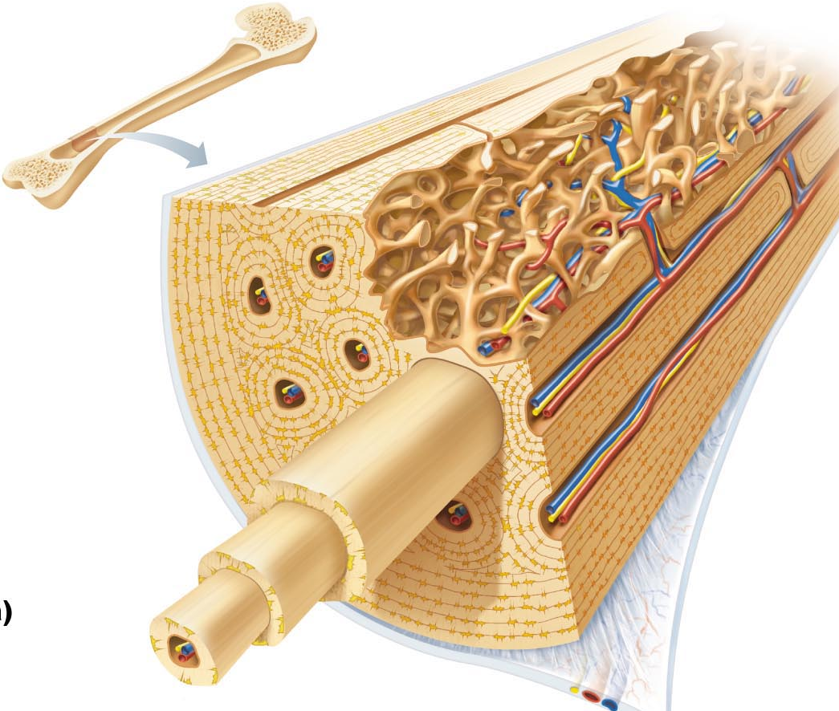
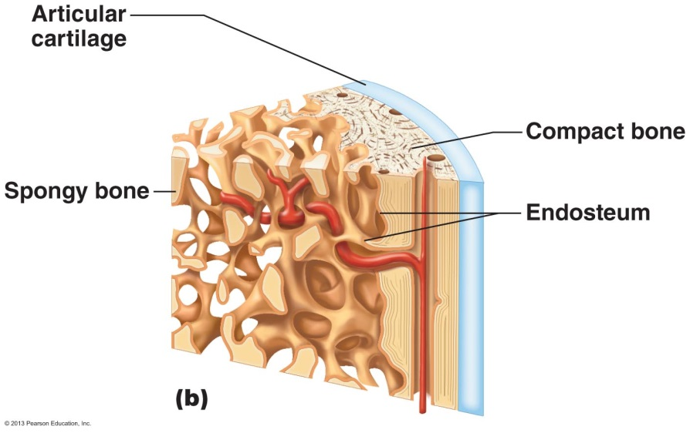
Bone Tissue
Calcified tissue:
  compact bone: dense outer layer
  spongy bone: trabeculae (red marrow found in spongy bone)
Linings: (“blasts & clasts”)
  periosteum: outer fibrous layer + inner osteogenic layer
  endosteum: covers trabeculae of spongy bone & lines canals of compact bone
Fig. 6.7
Fig. 6.4b

Slide 7
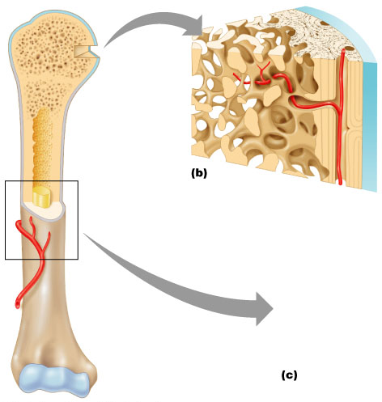
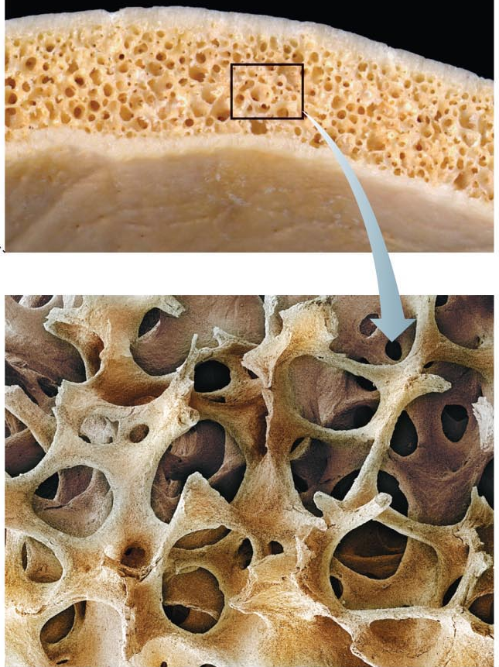
Classification of Bones
lots of variation in size/shapes of bones
  eg: pisiform bone vs femur
unique shape of each bone fulfils a particular need
  eg: femur ➢➢ maximum strength with minimum weight - achieves this with hollow cylindrical design
bones classified by their SHAPE and not SIZE
  long, short, flat, irregular
structure the same for all bone shapes:
compact bone provides the external surface
spongy (trabecular) bone
  a honeycomb of trabeculae
Fig. 6.4
Fig. 6.3

Slide 8
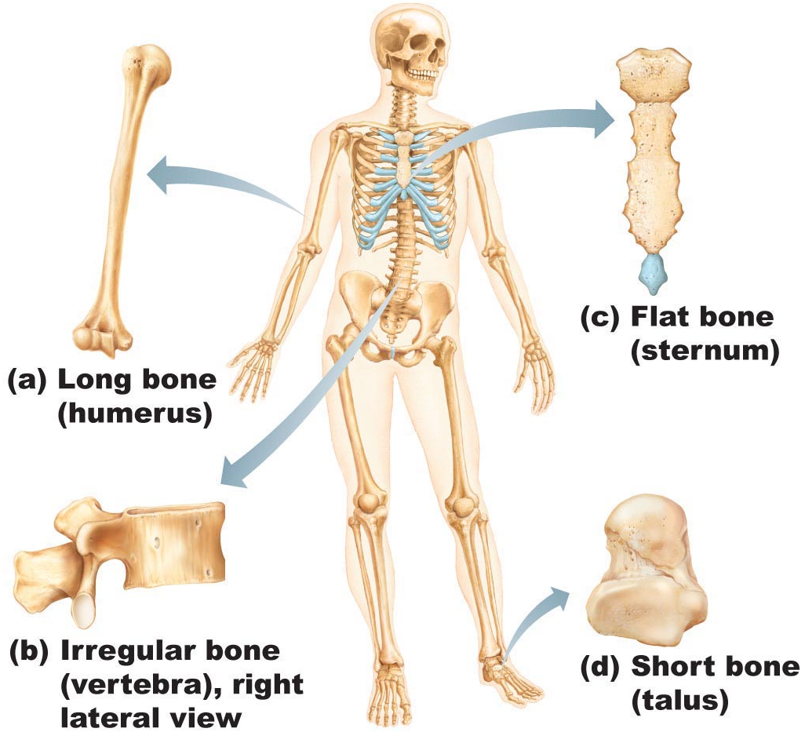
Classification of Bones
Fig. 6.2
Long Bones
much longer than wide; a shaft + 2 ends
mostly compact bone with hollow centre (marrow cavity); spongy bone near joint ends
Short Bones
roughly cube-shaped; eg: wrist, ankle, sesamoid bones
primarily spongy bone + thin outer layer of compact bone

Slide 9
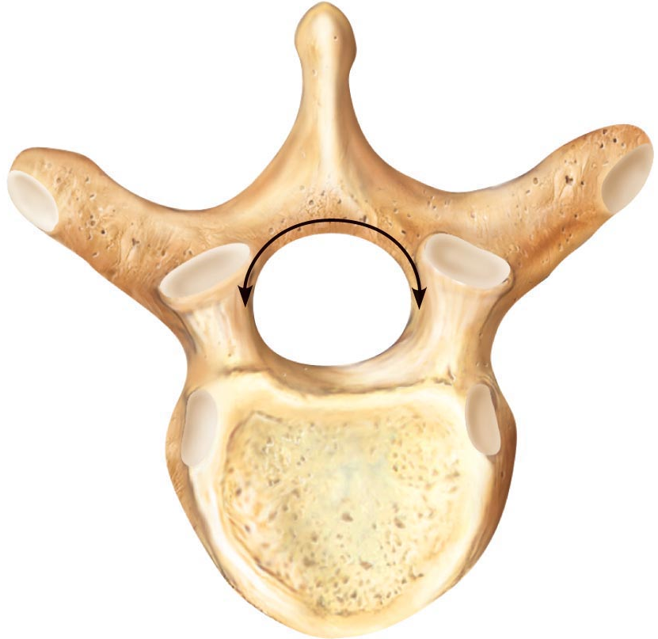
Classification of Bones
Flat Bones
  thin, flattened & sometimes curved
  include skull bones, ribs & breastbone
Irregular Bones
  leftovers: e.g. vertebrae & hip bones
  complicated shapes: primarily spongy bone + thin covering layer of compact bone
Fig. 7.18

Slide 10
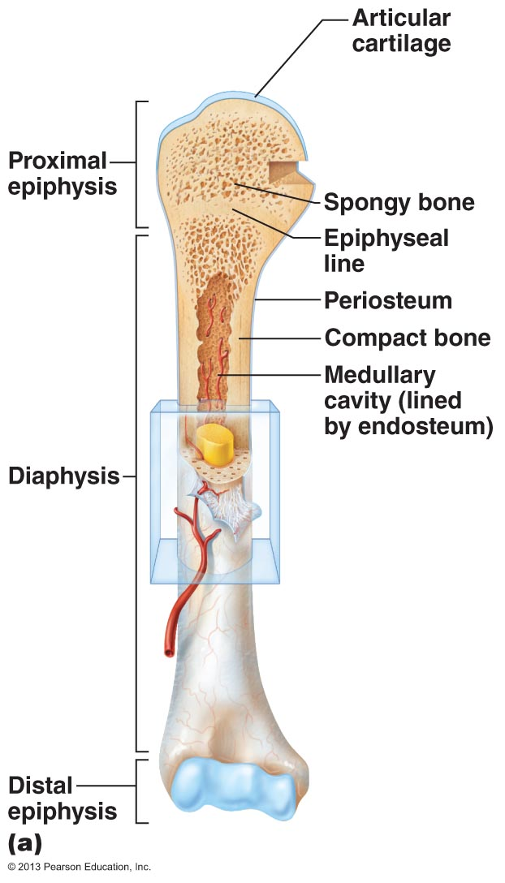
3.2 Describe the microscopic structure of long bones
DIAPHYSIS
  tubular shaft of a long bone = long axis of the bone
  collar of compact bone surrounding marrow cavity ( medullary cavity)
  in adults, medullary cavity contains fat (yellow marrow or yellow bone marrow cavity)
EPIPHYSES: (sing. = epiphysis)
  extremities of a long bone; expanded for articulation with other bones
  compact bone forms thin outer layer; interior filled with spongy bone
  thin layer of hyaline (articular) cartilage – why?
EPIPHYSEAL LINE
  between diaphysis & each epiphysis; remnant of epiphyseal plate

Slide 11
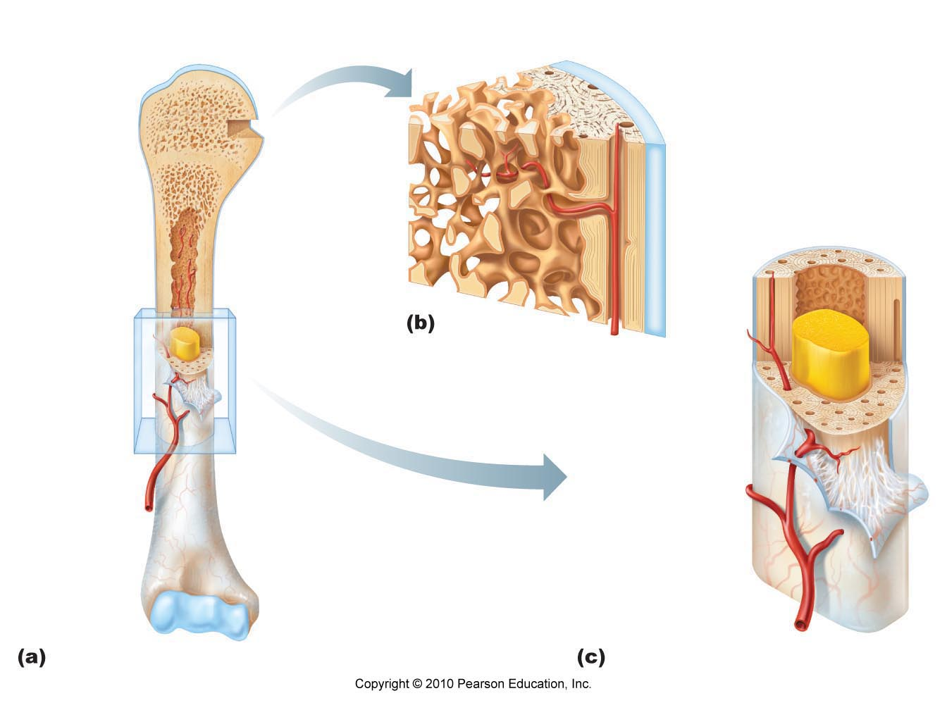
3.2 Describe the microscopic structure of long bones
MEMBRANES
cover outer & inner surfaces of long bones
Periosteum covers the outer surface; contains osteoblasts and osteoclasts
Endosteum covers the inner surface (lines marrow cavity); delicate layer of CT that also contains osteoblasts & osteoclasts

Slide 12
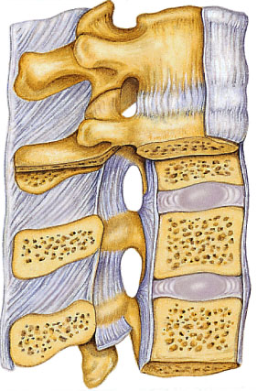
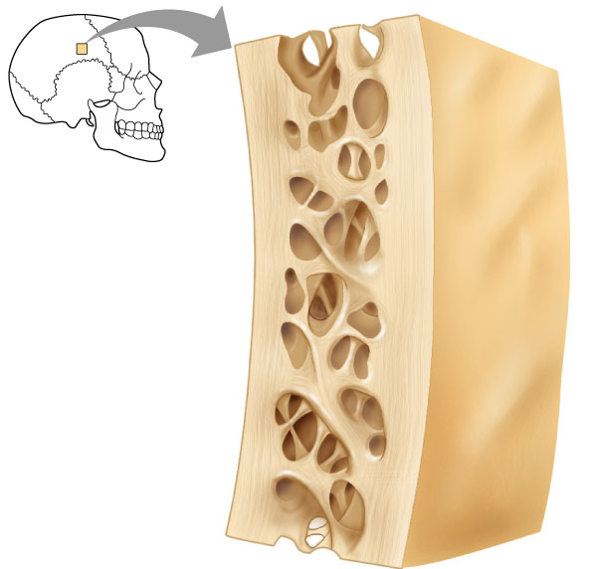
Structure of other bone types
all 3 other types have similar structure
compact bone outside; spongy bone inside
compact covered with periosteum & spongy lined with endosteum
not cylindrical so no shaft, marrow cavity or epiphyses - but do contain bone marrow between trabeculae
Fig. 6.3

Slide 13
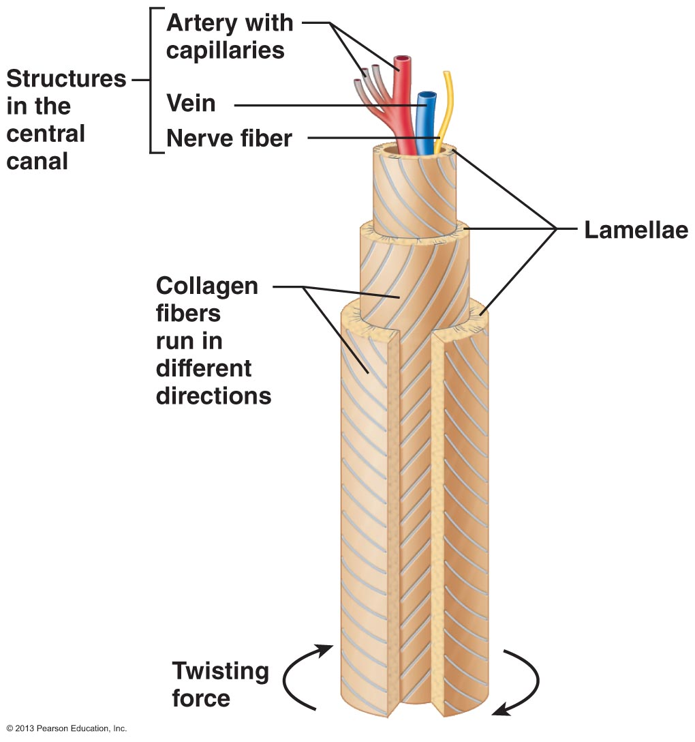
Microscopic structure of compact bone
Osteon (Haversian) System
this is the structural unit of compact bone
osteon: an elongated cylinder oriented parallel to the long axis of bone
think of an osteon as a tiny, weight-bearing pillar
a single osteon is a group of hollow tubes of bone matrix
  think of the rings of a tree
  each of the matrix tubes is called lamellar bone
Note orientation of collagen fibers in successive lamellae

Slide 14
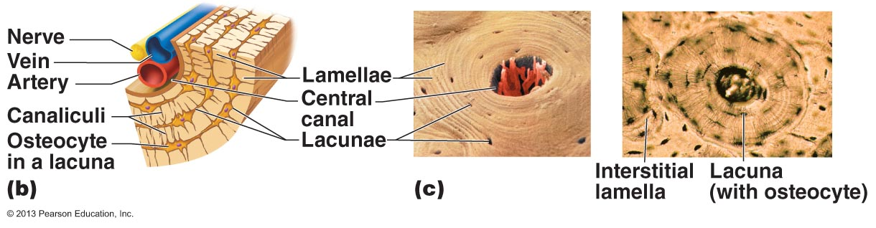
OSTEOCYTES
  mature bone cells; sit within small cavities (lacunae) within bony matrix in areas where adjacent lamellae meet
CANALICULI
  small canals that connect the lacunae with each other; also connected to central canal of Haversian system
INTERSTITIAL LAMELLAE
  fill the gaps between forming osteons or are leftovers of osteons that were partially destroyed by bone remodeling
CIRCUMFERENTIAL LAMELLAE
  sheets of bone located just deep to periosteum; extend around entire circumference of shaft
HAVERSIAN (CENTRAL) CANAL:
VOLKMANN’S (PERFORATING) CANAL:
  perpendicular to long axis of bone (& to Haversian canals);

Slide 15
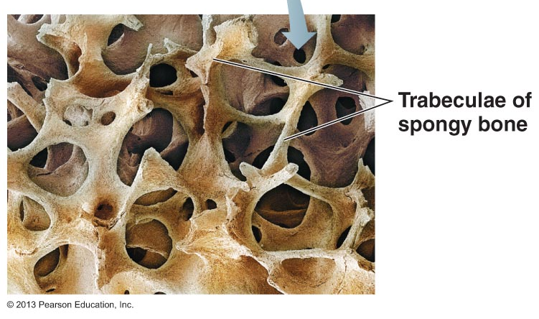
Microscopic structure of spongy bone
contains trabeculae, lamellarly arranged osteocytes & canaliculi
trabeculae arranged along lines of stress; helps bone to resist stress
trabeculae only a few cell layers thick; contain irregularly arranged lamellae & osteocytes interconnected by canaliculi
there are no osteons
nutrients diffuse through canaliculi from the marrow spaces between the trabeculae to reach the osteocytes

Slide 16
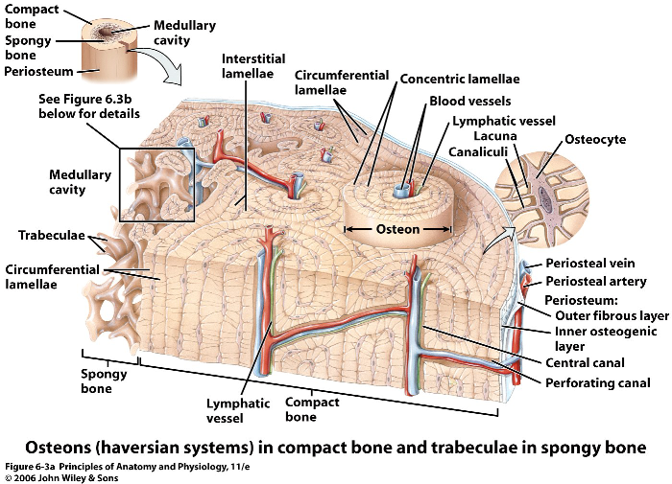

Slide 17
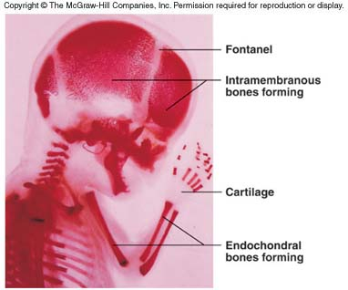
3.3 Describe bone formation and remodeling and explain the factors that affect them
osteogenesis or ossification
includes formation of bony skeleton in embryos, growth of bones during childhood & adolescence & remodelling/repair of bones in adults
Intramembranous Ossification
  bone develops from fibrous CT membrane containing mesenchymal cells
  cranial bones of the skull and the clavicles – these are flat bones
  begins at about 8 weeks of embryonic development
Endochondral Ossification
  bone development via the replacement of a hyaline cartilage model
  all bones below the skull (except the clavicles)
  begins in second month of development
  more complex – why?

Slide 18
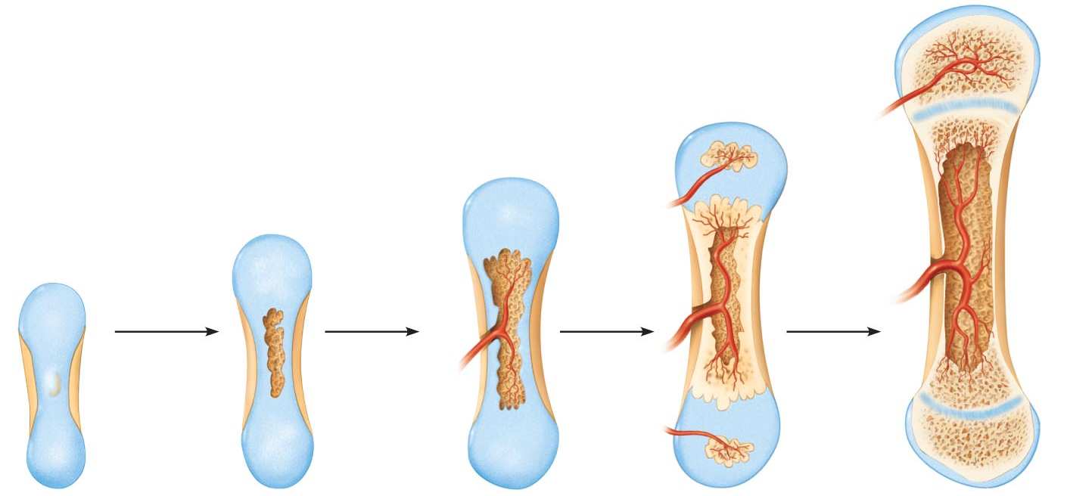
NB: in short bones, only the primary ossification centre is formed; most irregular bones are formed using several distinct ossification centres
When secondary ossification is complete, hyaline cartilage remains:
  on the epiphyseal surfaces as the articular cartilages
  at the junctions of diaphysis and epiphyses where it forms the epiphyseal plates ➢ this is the area where long bones continue to grow
Fig. 6.8

Slide 19
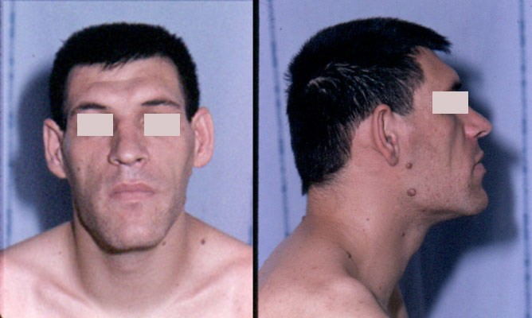
Mechanisms of bone growth
during infancy & youth, long bones lengthen entirely by interstitial growth of the epiphyseal plates and all bones grow in thickness by appositional growth
most bones stop growing during adolescence or in early adulthood - some facial bones (eg: nose & lower jaw) continue to grow (almost imperceptibly) throughout life

Slide 20
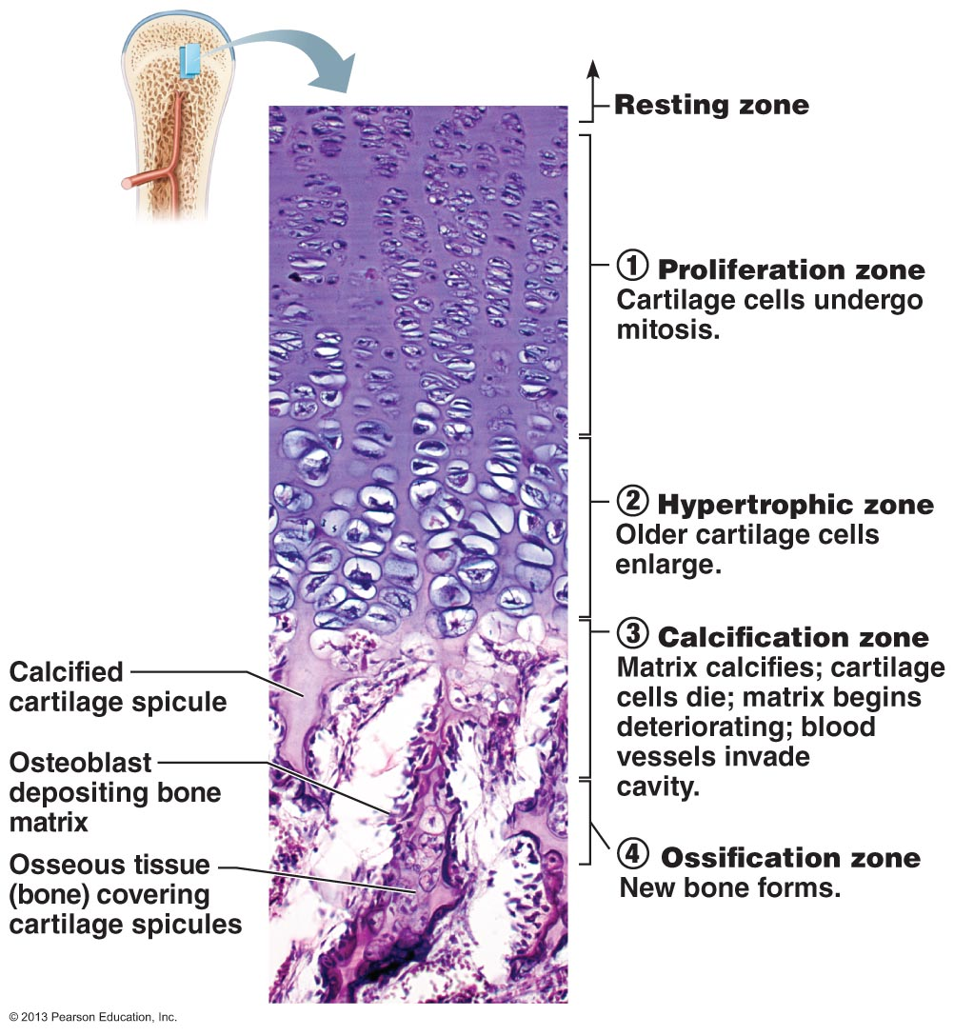
Fig. 6.10: Growth in length of a long bone
endochondral ossification process

Slide 21
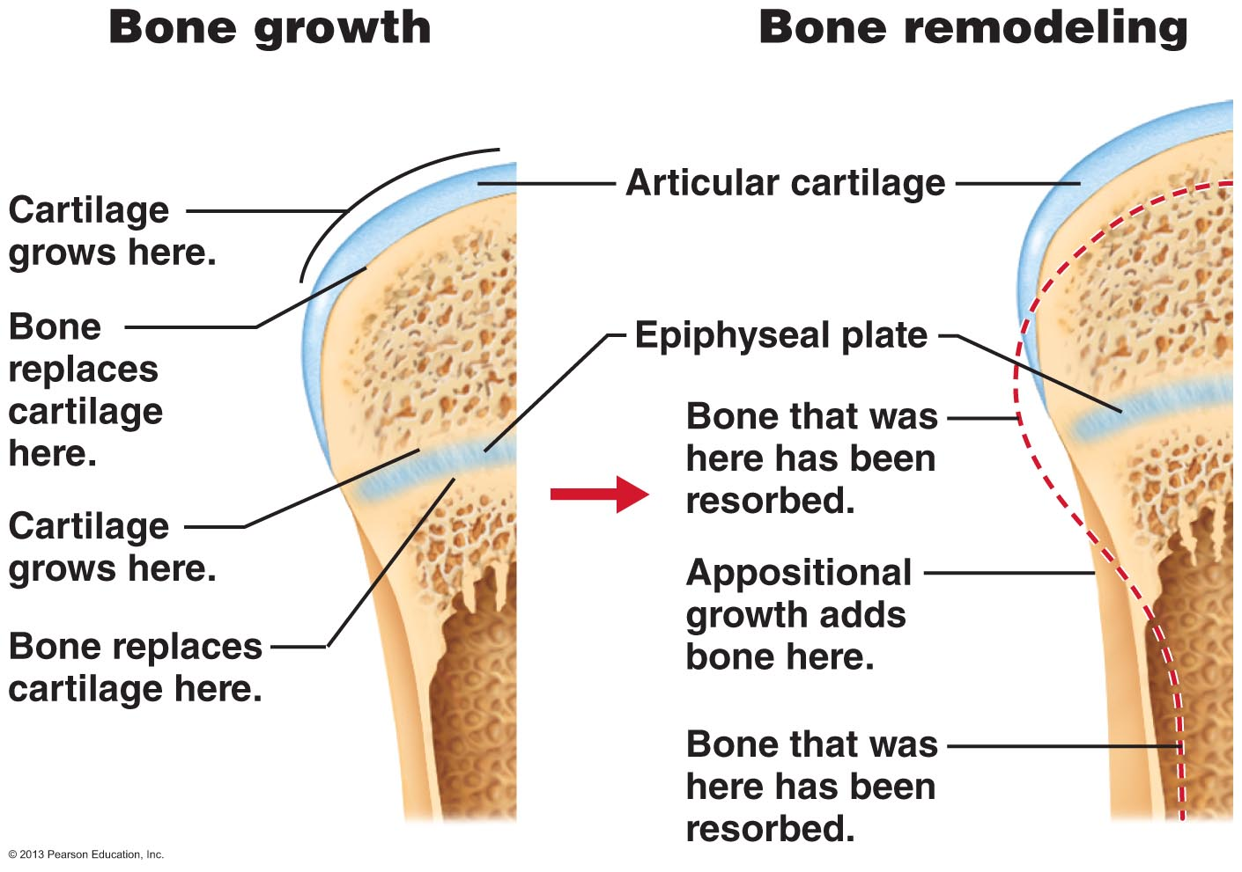
as the long bone lengthens, the shape of the ends must be altered (remodeling)
remember that the ends are wider than the shaft
as length increases, external surface of ends made slimmer while internal surface is thickened
in summary, bone is destroyed by osteoclasts and laid down by osteoblasts on both the inner and outer surfaces of a growing long bone
Fig. 6.11

Slide 22
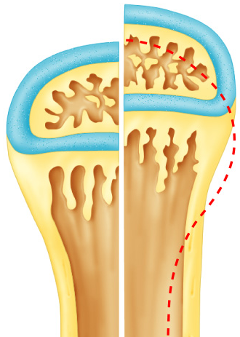
Bone Remodelling
epiphyseal plate stays ~ same size throughout childhood & adolescence (Why??)
epiphyseal plate then becomes thinner (cartilage cells in zone 1 multiply more & more slowly)
longitudinal growth ends when bone of the epiphysis & diaphysis fuses = epiphyseal plate closure (about age 18 in females; age 21 in males)
GROWTH IN WIDTH
growth in width = appositional growth
layers of bone are laid down on top of one another
  osteoblasts on periosteal side secrete bone matrix
  osteoclasts on the endosteal side remove bone matrix
do these 2 processes occur at exactly the same rate?

Slide 23
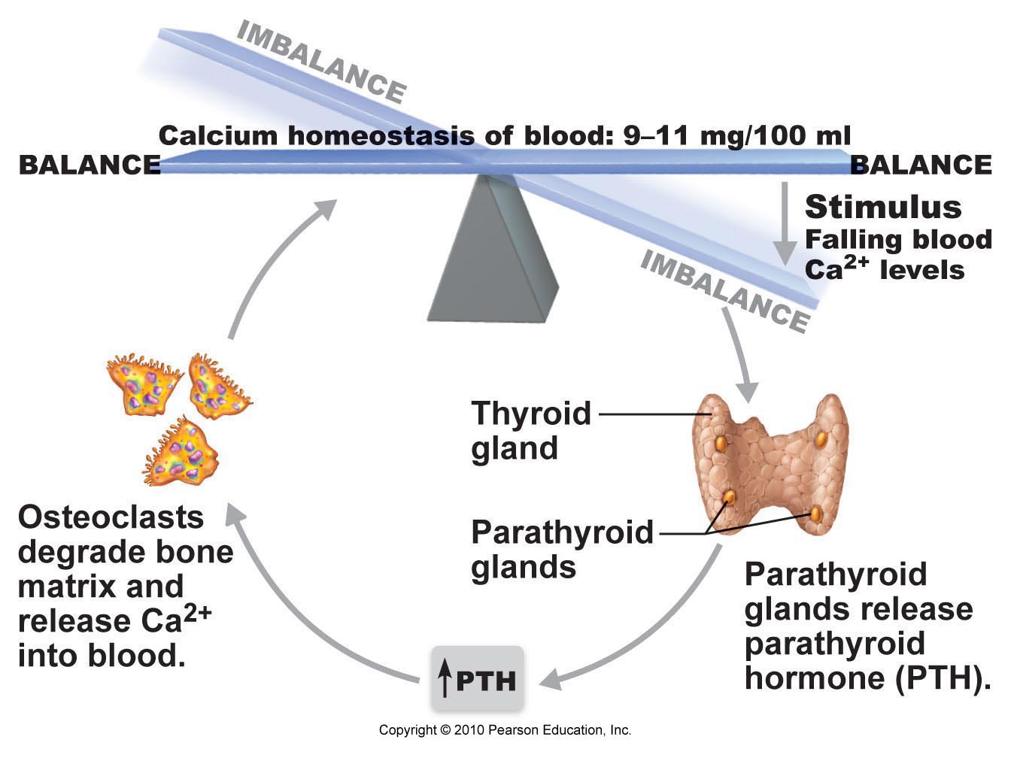
Fig. 6.12: Parathyroid hormone (PTH) control of blood calcium

Slide 24
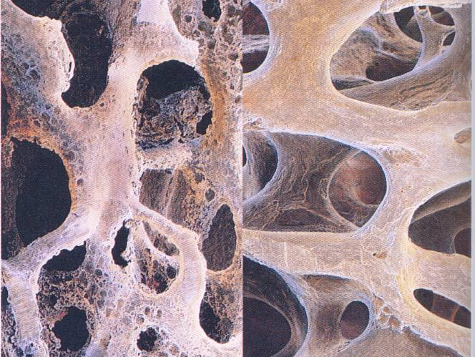
CLINICAL NOTE: Osteoporosis
bone resorption outpaces bone formation ➢ bone becomes porous
some areas of skeleton especially vulnerable: spine, neck of femur
age a factor: estrogen & testosterone promote bone health by restraining osteoclast activity and promoting deposition of new bone
other contributing factors include: insufficient exercise, diet poor in calcium & protein, abnormal vit D receptors, smoking (reduces estrogen levels)
Fig. 6.14

Slide 25
Define the following terms:
compact bone
spongy bone
epiphysis
diaphysis
osteoblast
osteocyte
osteon
Haversian canal
Volkmann’s canal
interstitial versus circumferential lamella
canaliculus
periosteum versus endosteum
epiphyseal line
red versus yellow marrow

