Slide 1
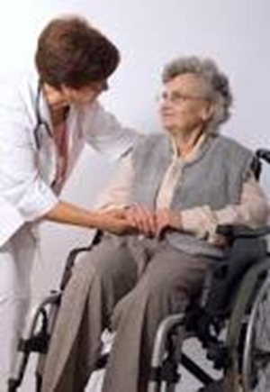
Communication Essentials in Nursing
Sept. 22, 2014
Sept. 22, 2014
Sheila McBurney

Slide 2
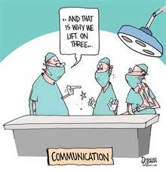

Slide 3
“People will forget what you said, people will forget what you did, but people will never forget how you made them feel”
Maya Angelou

Slide 4
Therapeutic Relationship
A helping relationship
Includes communication skills that are used for listening, understanding, exploring and intervening.
Today: Listening, responding with an emphasis on understanding and beginning empathy.

Slide 5
Objectives
Describe and reflect on the meaning of therapeutic communication
Describe and reflect on the process and skills of effective listening
Describe your own usual ways of responding
Identify and explain different types of responses to clients
Reflect on the importance of developing skills of giving therapeutic and empathic responses
Reading: Chapter 5 and 6 in J. Stein-Parbury (2009). Patient & Person

Slide 6
Listening
Why is it so important?
Individual exercise.

Slide 7


Slide 8
Listening
Powerful and complex
Different from hearing
Active versus passive

Slide 9
Readiness to Listen

Slide 10
Have the time and availability
Don‘t interrupt
Don’t judge, evaluate, advise or impose your own ideas
Be open to what is said
Reduce internal and external interference

Slide 11
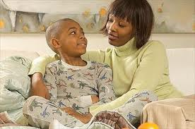
The skills of listening
Attending - SOLER
Observing
Perceiving
Interpreting
Recalling

Slide 12
Moving towards empathetic responses
  Moving beyond listening
  Responding in broad context of nursing practice encounters
  Empathetic responses

Slide 13
Your usual style of responding
Think about how you respond to people.
Do you respond the way you would like to respond? (when and why)
What would you like to change about the way you respond?

Slide 14
Various ways of Responding
  advising and evaluating
  analyzing and interpreting
  reassuring and supporting
  *questioning and probing and
  *paraphrasing and understanding

Slide 15
Understanding
Attempting to view the world from the patient’s point of view.

Slide 16
Understanding skills
Expressing empathy
Connecting
Paraphrasing
Reflecting feelings
Summarizing
Seeking clarification

Slide 17
Examples of responses
“The least they could have done was warn me that Dad was going to be sedated. Those doctors didn’t even tell me beforehand so I could have a quick visit with him. Now I need to leave the hospital without even speaking to Dad”

Slide 18
Responses
1. You sound like one of those people who likes to be in control.
2. The doctors are really busy. Otherwise I am sure they would have told you.
3. I can see you are frustrated and angry about not getting to talk to your Dad.
4. If this happens again, I would say something if I were you.
5. What exactly did they tell you?
                Stein & Parbury, 2009, p.147

Slide 19
Example of responses
I’m just so fed up with being sick and in pain. I’m tired of having a to rely on the nurses all the time.
                Stein & Parbury, 2009, p. 146

Slide 20
Responses
1. It’s o.k. to rely on us. That’s why we are here.
2. You are an independent type of person who prefers to do things for yourself.
3. All of this is really starting to get you down.
4. Just relax and let us help you.
5. What is bothering you the most?

Slide 21
Empathy
Knowing and feeling what it is like to be that person
Requires emotional intelligence and a strong sense of one self in order to fully appreciate the reality of another.

Slide 22
Self-reflection
Who serves as your role model in becoming an effective helper? Think of someone in your life who is helpful to you.
What is this person like? What makes them helpful?
What are their characteristics?
Adapted from Stein-Parbury, p. 74

Slide 23


