Slide 1
Lecture 2
Water- Chapter 2 (V+V)
Intermolecular interactions- Chapter 2 sec 4abc
Non-covalent
Acids/bases- Chapter 2
Notes:
Be familiar with chapter 3→ delta H (enthalphy) , delta S (entropy) and delta G (Gibbs Free Energy)

Slide 2
Many Important Biomolecules are Polymers
lipids
proteins
carbo
nucleic acids
monomer
polymer
supramolecular
structure
Notes:
Nucleic acids and proteins are best characterized biomolecules
Carbohydrates→glycobiology is the study of biology of carbohydrates.
Last category is lipids. Very important component of living organisms, do more than just generate membranes.
Lipidomics

Slide 3
MW
H,C,N,O,P,S
1-32
20 amino acids
5 aromatic bases, ribose
Palmitate, glycerol, choline
100-250
Glucose
100-800
peptides
Phospholipids
Nucleotides
Sugars
10⁴-10⁹
Proteins
Nucleic acids
Polysaccharides
10⁶-10¹⁰
Multienzyme complexes, ribosomes, chromosomes, membranes, structural elements
Organelles, Cells, Tissues, Organs, Organsims
Notes:
Not the main components of the earths crust
Key atoms: H,C,N,O,P,S
Not the only atoms, help from a few other atoms: Mn, Fe, Co, Cu, Zn, Na, Mg, Cl, K, Ca
NEED TO KNOW ALL OF THESE→ 20 AMINO ACIDS, 5 AROMATIC BASES, GLUCOSE AND 7 OTHER SUGARS
Understand building blocks and the way they interact enables us to make sense of more complex systems like cells

Slide 4
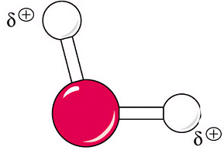

Properties of water
Very polar
Oxygen is highly electronegative
Notes:
Essential for life, anywhere we find water we can find life
Life under ice in Antarctic Nature 2014, 512 p 245
O2 is sp3 and has 2 lone pairs, making the angle between the 2 bonds is 104.5 cegrees.(tetrahedral)
oxygen is highly electronegative: attraction of atom for bonding electrons
Oxygen en= 3.5
Hydrogen en = 2.2

Slide 5
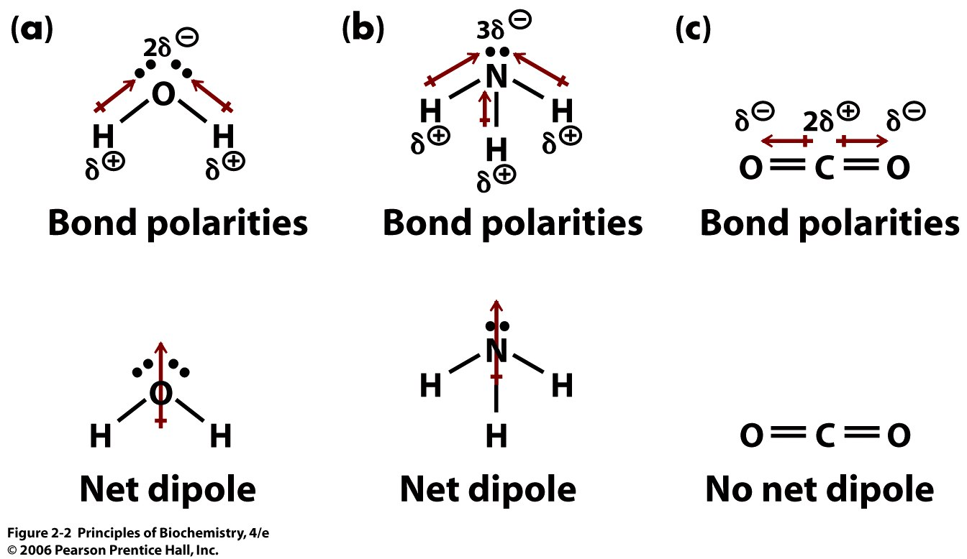
Notes:
Bond polarities: sum dipoles of bonds to get dipole of molecule. Net dipole: strong net dipole
Bond polarities: N en = 30

Slide 6
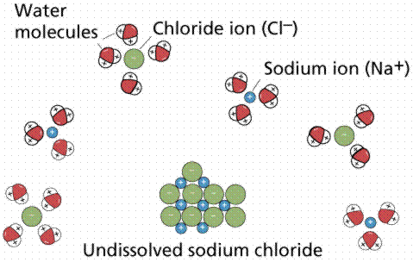
Water dissolves polar compounds
solvation shell
or
hydration shell
Notes:
This is why water can dissolved polar molecules
Positive end of dipole interacts with anions. Negative end interacts with cation
Salvation shell/hydration shell: dipole ion interactions are stronger than cation ion interactions

Slide 7
Properties of water
Very polar
Oxygen is highly electronegative
H-bond donor and acceptor
Notes:
H-bond donor and acceptor- IMPORTANT

Slide 8
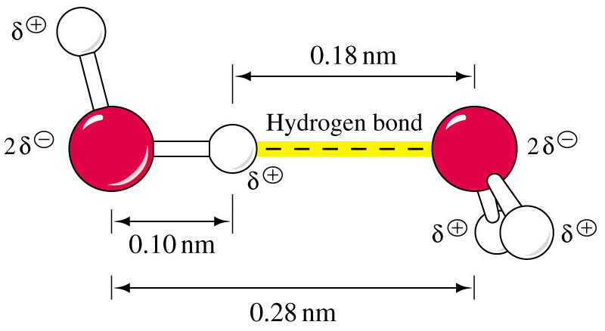
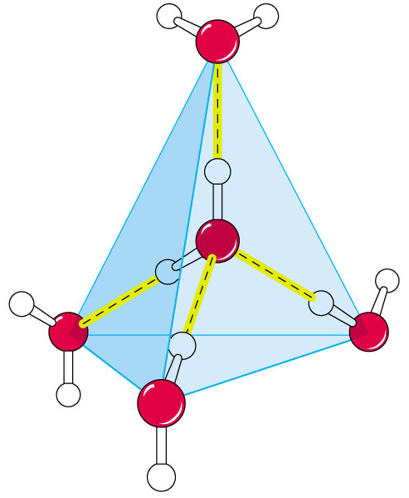
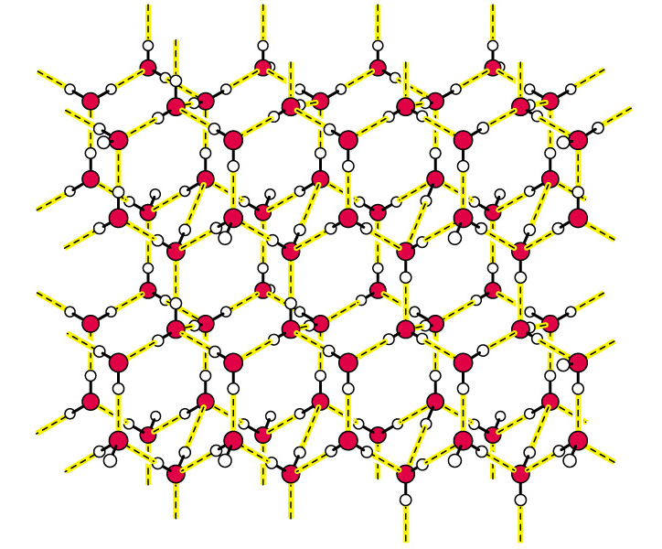
Hydrogen Bonding of Water
One H₂O molecule can
associate with 4
other H₂0 molecules
Ice: 4 H-bonds per water molecule
Water: 3.4 H-bonds per water molecule
Crystal lattice of ice
Notes:
Left is donor, right is acceptor
Can form a complex where 1 water molecule can react with 4 other molecules (ice)→ static bonds
When you melt ice you don’t lose a lot of bonding, they just become much more dynamic and move around a lot
Formation of 1 hydrogen bond to water will make it want to form another bond

Slide 9
Properties of water
Very polar
Oxygen is highly electronegative
H-bond donor and acceptor
High b.p., m.p., heat of vaporization, surface tension
Notes:
Reason for high boiling point of water is h-bonding

Slide 10
Biomolecule shapes and interactions are mediated by 4 types of non-covalent bonds.
These bonds are responsible for the overall shape and interaction among biomolecules and can be modified by thermal energy.
Notes:
4 types we’re going to talk about. All non covalent and are mostly responsible for intermolecular (molecular interactions), some are intramolecular (protein to fold up and form a structure)
Typically weaker than covalent bonds

Slide 11
1) Electrostatic interactions
by coulombs law F= kq₁q₂ q are charges
r²D r is radius
D = dielectric of the media, a shielding of charge.
And k =8.99 x10⁹Jm/C²
D = 1 in a vacuum
D = 2-3 in grease
D = 80 in water
Responsible for ionic bonds, salt linkages or ion pairs, optimal electrostatic attraction is 2.8Å
Notes:
Interaction between a cation and anion is distance dependent→ the closer they come together the stronger it will be
Have to get the two ions very close together (2,8A) to have a strong bond
Example: carboxylate eg: aspartic acid sidechain (COO2 + ammonion ion (eg: lysine side chain) --NH3
This ionic interaction is called “salt bridge”

Slide 12
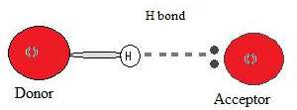
2) Hydrogen bonds
H bond donor H bond acceptor
weakly acidic weakly basic
very strong angle dependence
Notes:
donor: polarized bond
Large energy difference
Weaker bond
High electronegativity
Acceptor: lone pair of energy
- often described as dipoles interacting
Very strong angle dependence→ orbital description gives angle dependency on the strength of hydrogen bonds (180 degrees gives the best overlap) therefore strongest hydrogen bonds are the ones that are linear
cX—H X--
H-bond donor H-bond acceptor
C=empty antibonding orbital (o*) filled orbital

Slide 13
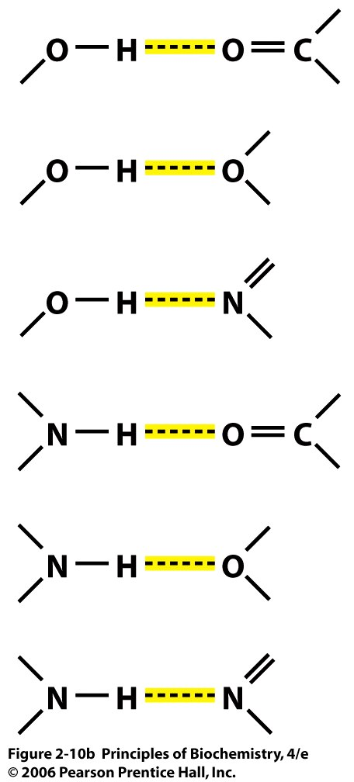
Biological Hydrogen Bonds
Notes:
Donors: alcohols, carboxylic acids, amines, amides
Acceptors: Carbonyls, ethers, nitrogens,

Slide 14
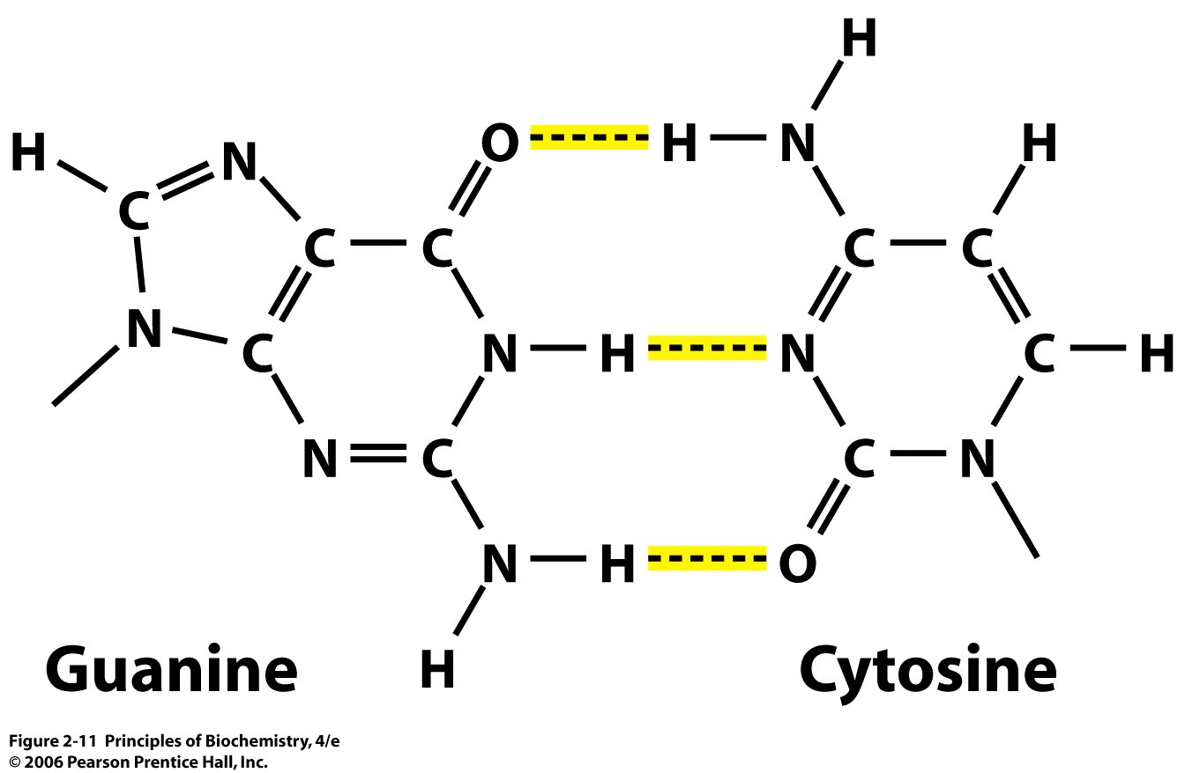
Notes:
H-bond plays a major role in biopolymer stability
DNA base pairing of G and C has 3 H-bonds
This is why only these react with eachother and not with A or T

Slide 15
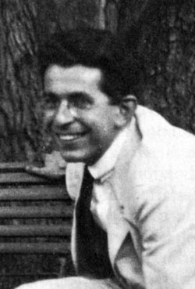
    .
3) van der Waals attraction- all non ionic non-H-bonding forces)
London force (dispersion force)
weak van der Waals attractive force which exists
between any pair of molecules --
even ones which have no permanent dipole moments
Fritz London
1900-1954
Notes:
Molecular dipole moments result in electrical attractions, then molecules that have no dipole moments should not form any bonds at all. (A hydrocarbon, for example, which has no electronegative atoms like O or N, has no significant dipole moments.) That’s classical (pre-quantum) physics. But atoms don’t obey the rules of classical physics! Atoms obey the rules of quantum mechanics. Atoms behave as though they are surrounded by constantly swirling and shifting delocalized clouds of electrons. Even if a molecule has no permanent dipole moment (resulting from the unequal sharing of electrons in covalent bonds), it will still have a transient dipole moment, because, at any instant, the distribution of the electron clouds is not symmetrical. And a transient dipole moment in one molecule will exert a electrical force on any other molecule that is near, inducing a transient dipole moment in it, You might think that all these shifting dipoles would cancel out, but they don’t; all the electron motions correlate and add up to a net attractive force. The physicist who took the then-new theoretical tools of quantum mechanics and proved this (back in the 1920s) was named Fritz London. (London grew up in the Germany. And he was Jewish, so he had to escape, after the Nazis seized power in 1933. He managed to get to North Carolina, USA, and he became a US citizen. So the textbooks call him a “German-American” physicist.)
We call these forces “London forces” or “dispersion” forces, since they result from the “dispersion” of the electron clouds in molecules. Most people consider London forces to be a special sub-class of “van der Waals interactions”.
On the next page of notes, we explain why London forces are so important.

Slide 16
Dispersion forces are stronger
between molecules that …
⇨ are more easily polarized,
e.g., heavier atoms
Strongest london forces
Largest atom, easiest to polarize
I
Cl₂ Br₂ I₂
g l s
Gas
Solid at room temp
⇨ can fit together snugly
Cannot pack closely
CH₃
Can pack closely
Increase london forces
H₃C
H₃C
CH₃
C
CH₃
CH₃
l
(b.p. 36C)
g
(b.p. 10C)
Notes:
London forces are a bit like gravity. Gravity is actually a very weak force (compared to electrical forces) but it’s always attractive. So, when you have lots of mass, gravity adds up to a big force. When you let go of a wine glass, it crashes to the floor (unless you are in the Space Station, and they probably have any wine glasses up there.)
London forces are also very weak - individually, they are weaker than other van der Waals interactions. But every atom attracts every other atom by London forces, at least when the two atoms are fitting snugly together. So, because of London forces, atoms behave like sled dogs on a cold night: they try to huddle together. The more tightly they can pack, the more tightly they bind to one another. How tightly they can pack depends on their shapes. You can pack books into a carton very tightly, but you can’t pack coffee mugs into a carton very tightly, because the shapes don’t fit together very well.
Look at the examples above. None of these molecules has any charge or any significant permanent dipole moment, so their intermolecular attractions are mediated mainly by London forces. Heavier atoms have “looser” (more easily polarizable) clouds of electrons, so they experience bigger London attractions. That’s why, for example, iodine is a solid, and bromine is a liquid, and chlorine is a gas, at room temperature. Look at the hydrocarbons on the bottom. n-Pentane molecules pack together like books, so the substance is more “cohesive” and it is a liquid at room temperature (it boils at 36ºC). But neo-pentane (2,2-dimethylpropane) molecules pack together like coffee mugs, so it is a gas (it boils at 9ºC).
On the next slide, we will look at what this all means for biomolecules.

Slide 17
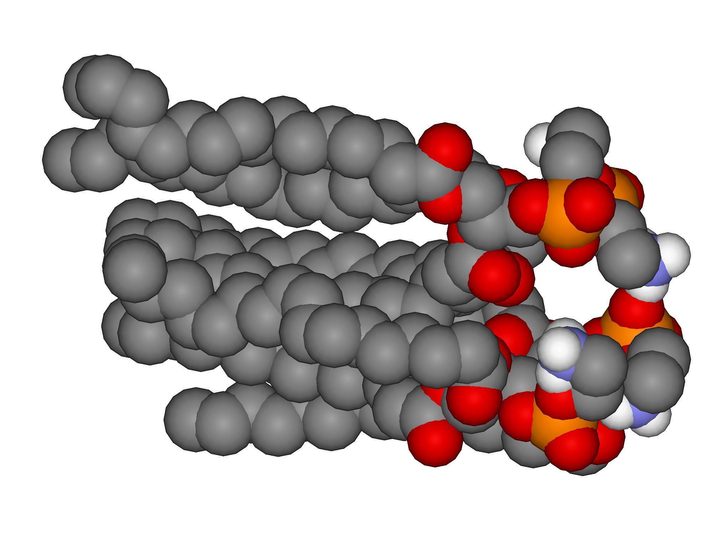
Leaflet- one side of a lipid bilayer
Non-polar carbon chains
Polar head group- O
Pack closely
- London forces attract them
Notes:
CBC: London forces, although individually weak, are very important determinants of biochemical structure.
This is a picture of a little piece of one “leaflet” (one side) of a lipid bilayer membrane. The coloured atoms on the right are O, P, and N atoms, which are polar and interact well with water. So they stick out into the aqueous compartment. The long chains of grey atoms on the left are the straight hydrocarbon “tails” of the lipids: CH₂ - CH₂ - CH₂ … - CH₃. The tails are non-polar, so they don’t interact well with water (that’s the “hydrophobic effect”, which we will discuss soon. They stick to one another very well, because they can pack tightly. So that’s how they form a nice tight continuous lipid membrane.
Something pretty similar happens with most proteins and nucleic acids. They wrap up into balls of tightly-packed atoms, with the most non-polar bits tucked into the middle. The balls are very compact (tightly-packed), with almost no spaces or gaps between the atoms, because the atoms all stick together, via London forces. We will see this in more detail when we talk about macromolecular structure.

Slide 18
OTHER Van Der Waal forces- permanent dipoles
+
ion-dipole
δ+ ...... δ-
Like water dissolving a salt
C
O
Na⁺
dipole-dipole
δ+ ...... δ-
δ+ ...... δ-
Like london forces but permanent dipoles
C
O
C
O
Notes:
Here are two kinds of van der Waals interactions involving molecular dipoles, that is, molecules with an unequal internal distribution of electrical charge.
An ion can attract a dipole, swinging it around so that the attractive interaction is closer and stronger than the repulsive interaction. And two dipoles can do the same thing.
Here, we are showing carbonyls (C=O) as examples of dipoles. The O is more electronegative than the C, of course.
Notice that van der Waals interactions of dipoles, like hydrogen bonds, are strongly orientation-dependent: they tend to force molecules into particular spatial conformations.

Slide 19
    Solvent dielectric constant
    hexane 1.9
    benzene 2.3
    diethyl ether 4.3
    CHCl₃ 5.1
    acetone 21.4
    Ethanol 24
    methanol 33
    H₂O 80
    HCN 116
H₂O is an excellent solvent and dissolves a large array of polar molecules.
However, it also weakens ionic, hydrogen, and dipole-charge bonds
Therefore, biological systems sometimes exclude H₂O to form maximal strength bonds!!
Dipole of solvent impacts its dielectric constant
- Ability of solvent to support charge
Water has a very high dielectric solvent, meaning it is very good at dissolving, but problem because can disrupt ionic interaction, h-bonding interactions (displace hbonds) and can disrupt dipole interactions
Notes:
In many cases biological systems work to exclude water because of these interactions
Example: when a big protein wants to fold up it has to exclude water because it will disrupt with the h-bonding and dipole bonding

Slide 20
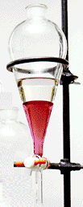
4* Hydrophobic interactions
Non-polar groups cluster together
Important parameter for determining a biomolecule’s structure.
.
The “hydrophobic effect
oil and water do not mix
water
Not an attraction between hydrophobic molecules
- Due to the water itself
CHCl₃
Major driving force for membrane formation and protein folding
Notes:
Biochemists talk about the “hydrophobic effect”. They mean that non-polar molecules, or parts of molecules, prefer not to interact with water. That’s why salad oil separates out from vinegar in a salad dressing, and similarly it is the basis for making an organic solvent extract (like in the separatory funnel in he picture). This “hydrophobic effect” is such an important factor in the behaviour of molecules (and macromolecules) that people sometimes think that there is a “hydrophobic force”. But there isn’t. The “hydrophobic effect” is just a consequence of van der Waals interactions.

Slide 21
Hydrophilic Hydrophobic
hydros = water hydrology
philos = love philosophy
phobos = hate agoraphobia
“There is no actual repulsion between individual water molecules and paraffin chains, nor is there any very strong attraction of paraffin chains for one another. There is, however, a very strong attraction of water molecules for one another, in comparison with which the paraffin-paraffin or paraffin-water attractions are slight.”
- G.S. Hartley, 1936
H-bonding much stronger than london forces
Notes:
Hydrophobic and hydrophilic – biochemists use these concepts, and these words, a lot. Let’s make sure that we understand their etymology and know how to spell them.: one “L”, not two, in hydrophilic.
G.S. Hartley, an English chemist, understood this concept well. He realized that there is no “repulsion” involved in the hydrophobic effect. It’s simply that water molecules are very very cohesive: they really want to stick together. Pushing a hydrocarbon molecule into aqueous solution would require replacing strong water-water interactions with weak water-hydrocarbon interactions, and that is energetically unfavourable. So the polar water and the non-polar hydrocarbon separate out into two distinct liquid phases.
(When he says “paraffin”, which is wax, you can take that to be any hydrophobic molecule, like a fatty acid or a hydrocarbon.)
CBC: The “hydrophobic effect” drives formation of lipid bilayer membranes, the folding of proteins into globular molecules, the winding of DNA into the double helix, and many other aspects of biochemistry.

Slide 22
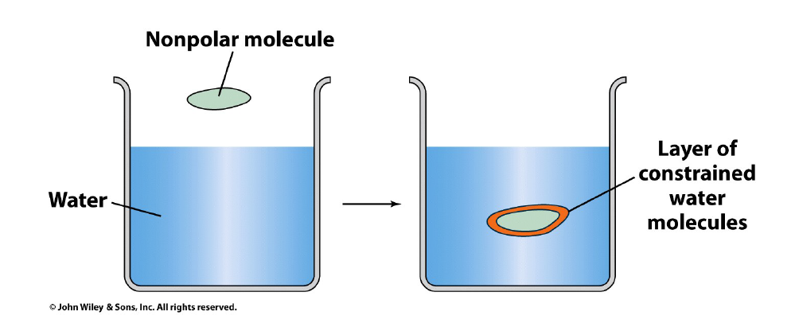
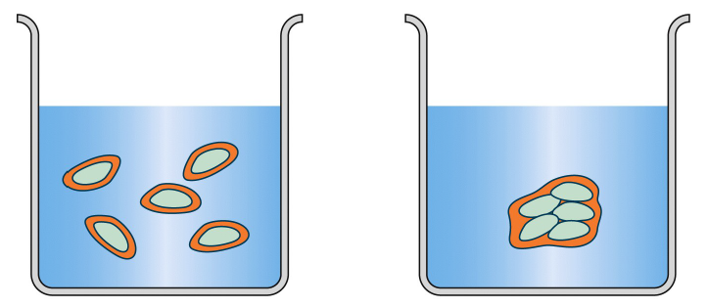
Hydrophobic molecule
H2O has fewer h-bonds at the interface
Large volume of water that is destabilized so system is going to try to decrease this volume by taking all the molecules and have them come together
Aggregated hydrophobic reduces volume of constrained water molecules
→
Less stable
More Stable

Slide 23
Hydrophilic organic functional groups:
- ionic groups (acids and bases)
- alcohols
- amines
- carbonyls
Hydrophobic organic functional groups:
- hydrocarbon chains
- aromatic and heterocyclic rings
Amphiphilic molecules combine hydrophobic
and hydrophilic functionalities
- amides
Many molecules will have both hydrophillic and hydrophobic→amphiphillic
Notes:
Here is an important skill that you need to develop: You should be able to look at the structure of an organic molecule and pick out the functional groups that tend to make it hydrophobic or hydrophilic. Then you can roughly estimate how soluble it will be in water or in an organic solvent, and whether it would be found mainly in the cytosol or in the environment of a lipid membrane. You will get lots of practice as we progress through the course.

Slide 24
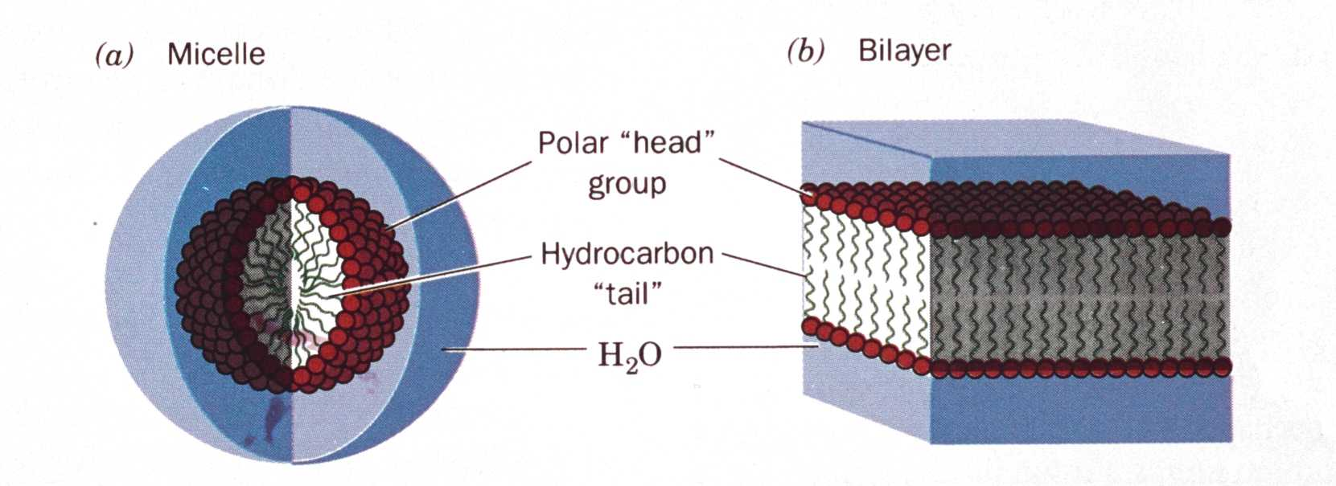
Amphiphiles form micelles, membrane bilayes and vesicles
Notes:
- Will form spontaneously

Slide 25
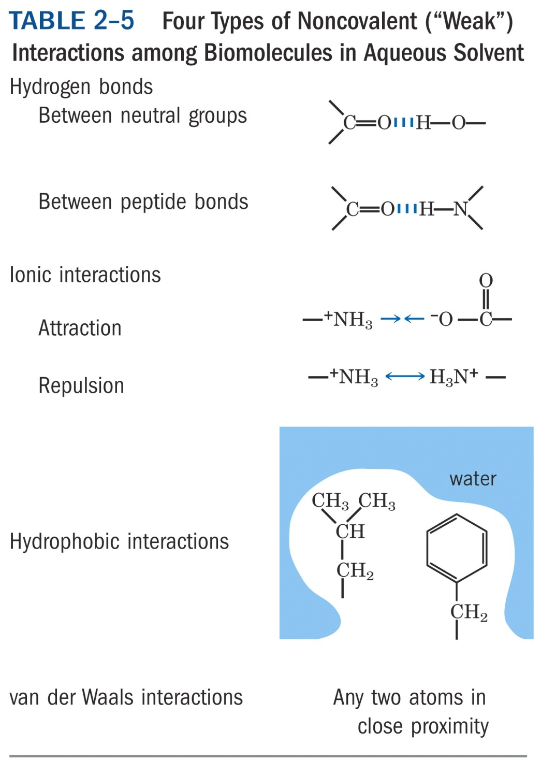
Typical covalent bond ~400kj/mol
Approximate Bond Strength, kJ/mole
12-30
20
<40
0.4 – 4.0
Distance,nm
0.3
0.25
-
0.2
~20
stongest
Weak force
Bond lengths have to be very close for an interaction to occur
Notes:
The weak bonds are Exceptionally Important !

Slide 26
Acid-base chemistry
Maintenance (homeostasis) of internal ionic composition - including pH - is critical for the structure and function of biomolecules.
Control of pH is critical in biochemical experiments.
Notes:
Acid-base chemistry is not really so difficult; we will develop the subject step by step. One should appreciate how very important the control of acidity is. As acidity changes, molecules change their charge states - that is, they accept protons or give up protons - and that, in turn, changes their chemical behaviour greatly.
If we had five cents for every experiment that went wrong because someone used an inappropriate buffer, we’d be rich.
People tend to take buffers for granted, but they shouldn’t.

Slide 27
Ionization of water
water can ionize
H₂O H⁺ + OH⁻
The free proton is associated with a water molecule to form the hydronium ion
H₃O⁺
Rapid reactions due to high ionic mobility by proton jumping

Slide 28
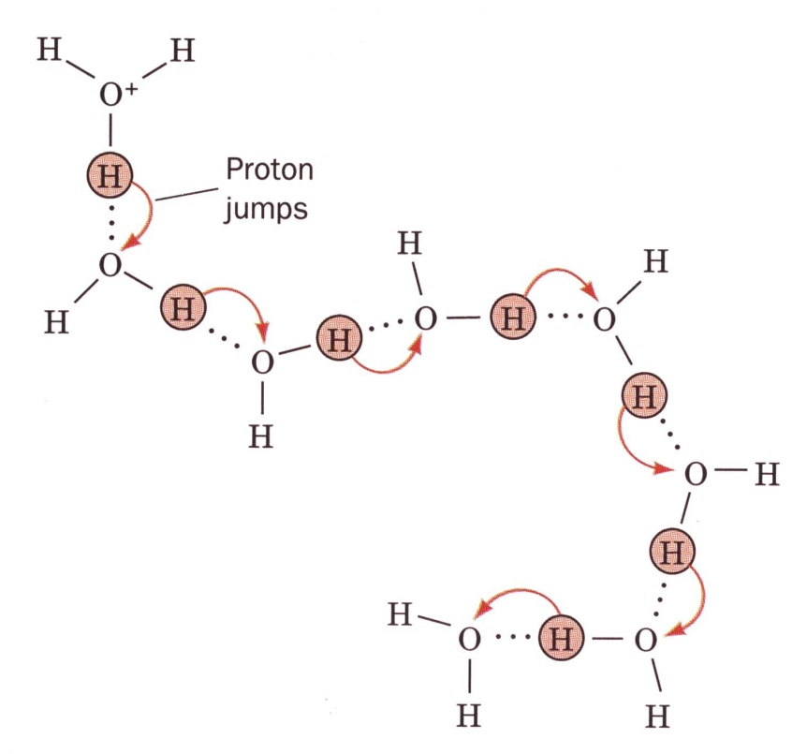
Proton Jumping
Large proton and hydroxide mobility
H₃O+ : 362.4 x 10⁻⁵ cm²•V⁻¹•s⁻¹
Na⁺: 51.9 x 10⁻⁵ cm²•V⁻¹•s⁻¹
Hydronium ion migration; hops by switching partners at 10¹² per second

Slide 29
Equilibrium reaction
Described by:
K = [H⁺][OH⁻]
[H₂O]
Where K is the dissociation constant
Considering [H₂O] constant yields
K_{w} = [H⁺][OH⁻]

Slide 30
K_{w}
K_{w} = [H⁺][OH⁻]
Where K_{w} is the ionization constant of water
For pure water ionization constant is
10⁻¹⁴ M² at 25º
For pure water
[H⁺] = [OH⁻] = (K_{w})^{1/2} = 10⁻⁷ M

Slide 31
Acids and bases
For pure water (neutral)
[H⁺] = [OH⁻] = (K_{w})^{1/2} = 10⁻⁷ M
Acidic if [H⁺] > 10⁻⁷ M
Basic if [H⁺] < 10⁻⁷ M

Slide 32
Brønsted Acids and Bases
Acid is a substance that can donate a proton.
Base is a substance that can accept a proton.
HA + :B A⁻ + HB⁺
Notes:
LeChatelier principle

Slide 33
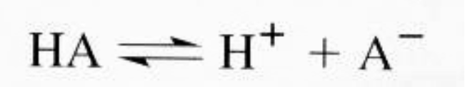
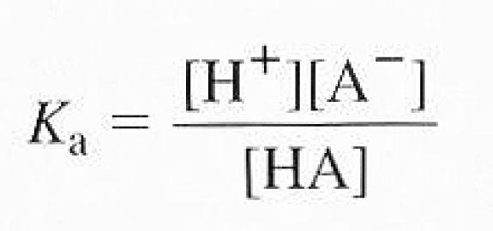
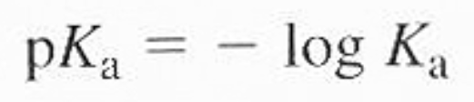
Acid dissociation reaction
acid conjugate base

Slide 34
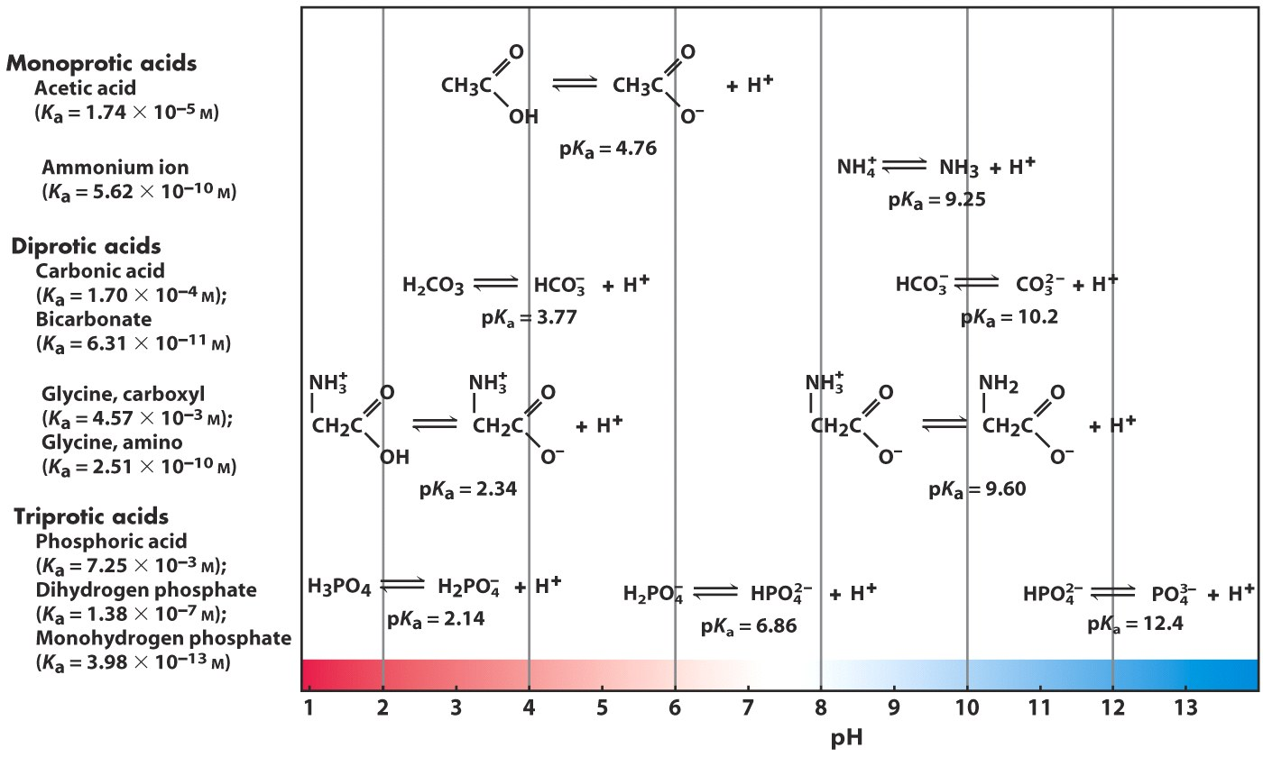
Strength (pKa) of some biologically relevant acids
Notes:
pKa’s speak to the strength of the weak acids. Check out the difference in carboxyl pka’s. Phosphate has three pKa’s keep these in mind, we will use it later in the course.

