Slide 1
Culture and Consumerism
Monday October 27th

Slide 2
Culture – what is it? And what do we mean by it?
  Culture is one of the most complex words and concepts in existence and very hard to define because anything really can be a form of culture
  It can refer to many things, it can mean many things and is a slippery concept in many, many ways .
Cultural or Social? Is there a difference?
  In the 1970s the cultural turn in the social sciences
  -people starting thinking a lot about culture (power, domination, class, nation, gender, race etc)

Slide 3
So culture began to be seen in political terms rather than simply neutral/descriptive terms
Culture and Power
  A key area of study re: culture has to do with representation.
    How are different groups of people represented?
    Who has the power to represent others?
    Media isnt just in the media (movies, fiction, news)but also through textbooks and history
reel injun
Our knowledge of various groups of people and places is partially gained through cultural representations of those groups of people and places

Slide 4
One aspect of cultural analysis is to make something that is implicit into something that is explicit
  Reel Injun documentary looks at some of the implicit and unquestioned aspects of Hollywood US native representations and makes those explicit – subtexts, narrative, accuracy of portrayal etc
A question to ask when looking at cultural representation is Whether representations serve to legitimize the political status quo, help to naturalize certain narratives etc
So even though we live our lives ‘in’ culture we can also analyze the cultural products of societies and get a better idea of through these cultural products to get a better understand of the bigger picture.
How power operates through seemingly innocent/entertainment programs, books etc
Notes:
We can see cultural not just on its own but with a political veiw

Slide 5
Cultural is something that is implicit
  we learn it ‘naturally’ when we are socialized
  -it is easy to understand but very hard to define and explain
  - when you try to explain it to other people you begin to realize how difficult it is to explain exactly
Example
  What is ‘dating’?
    We have all experienced dating but we cant really explain it and give it an official definition
    Comedy is typically very culturally specific-
    what is considered funny? Rick Mercer Weather Canada
http://www.youtube.com/watch?v=wkDvqQKGgDA
Culture is something that must be interpreted
  The exact same behavior can have very different meanings depending on the cultural context (where you’re from).
Examples?
  How burping in one cultuers at the table is seen as appreciative of a meal where other cultures veiw it as rude

Slide 6
Symbols are cultural items, either tangible or intangible
  Take on tremendous meaning within a culture or subculture of a society
Symbols
  material objects (e.g. the Canadian flag)
  It can also be inmaterial object (Canadian national anthem)
  We can say that any culture is symbolically constructed through shared symbols
  Symbols meanings can be interoperated differently among cultures
Emile Durkheim describes symbols as Collective Representations
-People do not have to be the same but generally agree upon or identify with these shared symbols

Slide 7
Sometimes there is a struggle/conflict about the meaning of a particular symbol
Culture is also contested and shaped through conflict and contestation- this can be how culture can be changed and evolved
Example
    1991 Baltej Singh Dhillon became the first RCMP officer to wear his Sikh turban and beard in the line of duty.
    He successfully fought the federal government ban prohibiting turbans in the RCMP.

Slide 8
Ways of thinking about culture
1.Culture as territorialized
  e.g. Canadian culture is in Canada
    When we talk about Canadian culture we usually mean that Canadian people are also part of that-
  So the political boundaries can relate to national boundaries
So culture, like ethnicity, can mean something about a specific group of people

Slide 9
2. Culture as something that people possess or don’t possess –
  that person is very ‘cultured’ (cultural capital-Bourdieu-’taste’ as something that is acquired/learned)
  Someone who is very cultured, high brow or low brow
So culture can exist in a status hierarchy that we all make in terms of culture
  opera vs pop music, art house cinema vs Hollywood blockbusters
  Popular culture, high culture

Slide 10
3.Culture as Something that is shared or collective
– There’s no such thing as ‘Billy culture’ you cannot have a culture based on one individual
  Culture is about meaning, values and interpretation
  We must interpret culture, cultural products and cultural practices.
  It isnt a set definition, it has mulitlple interperatations

Slide 11
4.Cultures Meaning is contested and complex
  There’s no society or culture where everyone agrees on everything
    Important point because when we describe other cultures we can essentialism and homogenize them, we sum up the entire culture with on symbol that doesn’t apply to all
  Culture can be reduced to a series of stereotypical symbols or representations
    Halloween costumes can do this

Slide 12
Agency;
  is the capacity to influence what happens in one’s life
  Canadian sociologist Dennis Wrong argued that individuals have the capacity to resist the messages that our socializing agents (e.g. media) give us.
    For example people are able to build there own interpretations of something and develop their own oppinion
Advertisement and Culture
Advertisements implicitly contain and transmit a series of cultural values and representations
Teach us how to think about something
They teach us how to think about something

Slide 13
Interpretive Exercise
Preferred reading of cultural products- makers of add have a main message they want there advertisement to portray
Subtexts- there are more interoperations then just the oblivious
Implicit values and norms
‘Counter hegemonic’
Producing alternative and contesting discourses to the dominant cultural ones

Slide 14
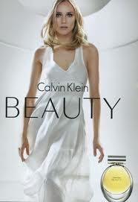

Slide 15
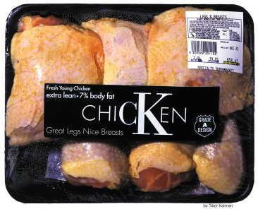

Slide 16
5.Mainstream vs. subculture and counterculture
When one indicates that there is main stream culture that have to be alternatives
  Subcultures: are distinct cultural groups that exisits within main stream societies,
    Example:
      Hipsters?
      Skateboarders
hipster

Slide 17
Countercultures –
  provide an alternative to mainstream culture
  E.g. collective forms of ownership v’s individualistic forms of ownership
  Non-hierarchical power structures
  Values – agricultural sustainability, non exploitative relationship to animals etc,

Slide 18
Sociolinguistics is the study of language as part of culture
Sapir Wharf Hypothesis (strong and weak)
Language determines our experience and understanding of the world
An individual's thoughts and actions are determined by the language or languages that individual speaks
Language use is nuanced and complex
What are the different ways one can say ‘sorry’?

Slide 19
Consumerism

Slide 20
Consumerism
What is an ‘ism’
  A way of referring to something
What does it mean to say that we live in a consumer society?
What about the production of commodities?
Is consumerism a way/philosophy of life
Are consumption and production separate processes
Ethical consumption?
  Are policys like fare trade just for the wealthy?

Slide 21
Karl Marx - production
  He ever really discusses consumption because the idea of mass consumption was at large in society
  With the development of mass production we also see the development of mass consumption
  Discussed how we spend our money and consume is an important part of who we are – status and class
  Its an important part of who were are, a sense of self
Erving Goffman - status symbols have ‘expressive significance’
They say something about who we are, the ‘type’ of person we are, the kinds of values we hold
We use our consumption of commodities and services to say something about ourselves- not nessararily intentional
We see ourselves (values, outlook etc) in the things we buy

Slide 22
Weber’s status groups-
  the monopolization and consumption of certain cultural goods-membership
  We can look at consumption as hierarchy of prestige
  A lot of the things we consume are in some ways unnecessary
  A lot of things we consume are also necessary – food, clothing etc but again it is more than just meeting the basic need

Slide 23
Thorsten Veblen and consumption
Came up with Key Concepts:
1)Conspicuous consumption:
-pecuniary emulation, conspicuous waste, leisure class
-what one consumes can reprints their social clas
The Leisure Class
  Conspicuous consumption of valuable goods is a means of representing wealth
  The basis on which prestige or status ultimately is the result that the presige of what we by respresents wealth (wealth)
  Pecuniary emulation ‘keeping up with the Jones’

Slide 24
Veblen
  The means of showing pecuniary strength, and therefore of gaining or retaining status , are leisure and a conspicuous consumption of goods. (shared lifestyle)
  “In order to gain and hold the esteem of men it is not sufficient merely to possess wealth or power…{it} must be put in evidence, for esteem is awarded only on evidence
  You can by yourself out of it

Slide 25
Leisure: ‘the non-productive consumption of time’
  Conspicuous leisure & consumption, it doesn’t leave a product when one consumes a product (like watching tv)
  Conspicuous waste
    The use of both for the purposes of reputability or prestige/status lies in the element of waste (non-productive/utilitarian) that is common to both.
    It is a ‘waste’ of time and effort, it is a waste of goods.
He believes that Goods are ‘humilific’ if they are purely functional (lacking in prestige and status) and do not have any surplus frills
Cheap things become ‘cheap’- ie they will fall apart
Consumer goods become semantically coded through an honor/status system within todays society

Slide 26
Consumption / Status is aspirational and competitive
Can TV programs be a means of producing aspirational values and feelings of inadequacy?
  Yes because tv shows and advertising plays off envey
Charlie Brooker
Style by Jury

Slide 27
Naomi Klein No Logo
In the mid 1980s– she found that successful corporations must primarily produce brands as opposed to products
Corporations were weighed down by too many ‘things’
What these companies produced were not things but images of their things
    their real work was in marketing not manufacturing
New goal-a divestment of the world of things, shift from making stuff to getting others to make it and sticking your brand on things

Slide 28
So they would no longer produce products and advertise them but buy products and brand them
This is at the same time that companies were outsourcing their manufacturing to poorer countries –
Nike etc were all producing these products really cheap but selling them at a high price-Klein deals with this in other chapters of her book
Manufacturing 1911 = 14% 1954= 17% 2006= 7%

Slide 29
She says that Branding called for a completely different set of tools and materials- cultural tools
Advertising vs branding
  Its not the same although branding is a form of advertising - advertising is only one part of a brand strategy
  Branding-
  giving society a name they can trust
    Example: Home hardware “home owners helping homeowners”
    -applying it to a large variety of consumers
Home Hardware
??

Slide 30
The brand is the core meaning of a corporation
the ad is the vehicle used to convey that meaning
  Coke advertises its products but more importantly its advertises Coke and what coke as a cultural value is “happieness” (and what that means)
OPEN Happiness
So another way to think about it is that corporations-that have a brand identity-
  They use products to sell themselves / lifestyle and their identity

Slide 31
BRANDS
We see brands as a ‘natural’ part of our world according to Kline
  inserted into our lifeworld of values, beliefs etc
Originally branding was used to differentiate mass produced products and give the product a sense of familiarity and trust – image based difference
The emergence of the corporate personality advertising was ‘spiritual’-
  She means that a company has The ‘soul’ of a company was defined through its brand – companies could have their own identities defined and shaped through the brand
She states that Advertising companies became the ‘philosopher kings’ of consumer culture; it has given us things that what we want in need but has also given us values
carousel

Slide 32
She discusses The added value of the branding work
  So if the surplus value is created through the production process through wage labor it is also created through the marketing/consumption process by adding value to brands

Slide 33
lifestyle philosophers
Just Do It! Impossible is Nothing-
  this nike add motivates consumers well being totalitarianism
  They want to get that impossible is nothing

Slide 34
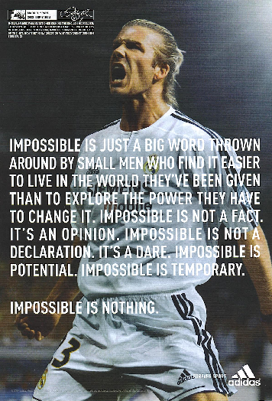

Slide 35
She believes that Corporations are more and more permeating our world and transforming it in the process-
  they are colonizing the lifeworld world a more organic approach to image building
One of her key points is that private corporations are taking over public space
  The way that they are taking it over is through branding which we identify with and thus more easily accept-the brand becomes a part of who we are and our life-Coke
  Branding becomes a natural part of our life

Slide 36
Summary of kline
Brands must establish emotional ties Starbucks , Nike: we all have some brands we identify with
Branding in its truest and most advanced incarnations is about corporate transcendence?
What does she mean by this?
The brand as experience and lifestyle
“Nike is a marketing orientated company and the product is our most important marketing tool”
Polaroid is not selling a camera it’s selling a social lubricant- “Kodak sells memories”

Slide 37
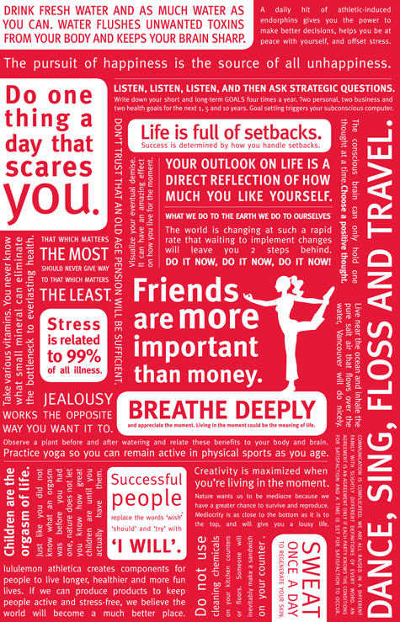
Brands are built around reputation, values , attitudes

Slide 38
Evolution

Slide 39
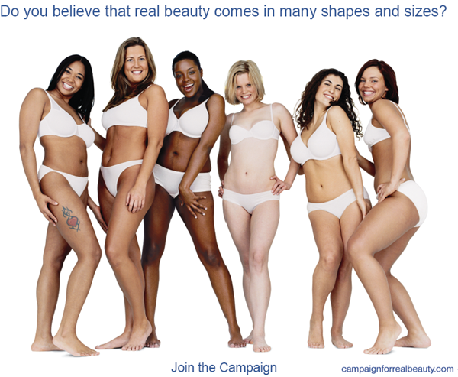

Slide 40
For Dove, the shampoo/conditioner launch is the latest in an effort to turn what began in the 1950s as a U.S. bar-soap brand into a global personal-care "master brand."
Dove has grown from a $200 million North American brand at the beginning of the 1990s to a $1.7 billion global brand, growing at a rate of 25% annually worldwide
This sold people not only a product but a movement that then increased sales

Slide 41
Onslaught

Slide 42
Dove sales rose 10.1% to $589.2 million in 2006, according to Information Resources Inc., after a 12.5% increase in 2005.
That compares to only 2% in 2004, when the campaign launched in September.
But what about the corporation behind the brand?
Unilever
Fair and Lovely
Axe
AXE effect

Slide 43
Midterm Exams
Kirk Moran Office Hours
FSS2014 on Wednesday, October 29th 10am - 11am
Arden McBride Office Hours
FSS 2014-P2 Tuesday 28th October 1:00 - 2:00 p.m.

Slide 44
Q1: Provide 5 reasons/criticisms for why functionalist explanations of stratification cannot fully account for inequalities in Canadian society.
Wealth and social power is inherited and endures across generations
Feminist Theory (patriarchy, gender roles, labor force participation, sexism etc)
Marx and Weber theories on class and power etc
Functional explanations tend to justify/legitimize stratification rather than critique/question it etc
Racialized inequalities (discrimination etc)

Slide 45
Q2: Make a brief counter-argument that elaborates 5 sociological reasons as to why we need to continue to think critically about gender in society. (5x2=10)
Gender as socially constructed rather than the result of biology
Economic inequalities (glass ceiling, wage gap, pink ghetto etc)
Sexism, violence against women etc (victim blaming etc
Transgender issues etc
Social power and gender relations etc

Slide 46
Q3: Sociological Imagination
What is it? a quality of mind that allows the person to shift from the close up scenes of everyday life to the bigger picture of social structure
the ability to grasp the intersection of history, biography and social structure
the ability to see the connections between the micro-sociological and the macro-sociological
The ability to link the personal troubles of milieu with the public issues of social structure
Its importance?
It allows people to become politically involved as members of a public rather than remain purely private citizens
It allows individuals to conceive of themselves as historical, social and political actors rather than as disconnected and discrete individuals
Its important to social change etc

Slide 47
Q4: Why Max Weber’s criticism of Marx’s theory of class and capitalism is considered a more sociologically useful way of understanding how inequality functions in society
Marx has a narrow definition of class (relationship to the means of production)
Weber – 3 elements of class - shared class situation and relationship to life chances,, market, economic interests
how status groups not based on economic elements can be the source of social power
status situation can also affect life chances
‘parties’ can also reflect non economic forms of power and thus inequality in terms of how that power is unequally distributed

Slide 48
Q5: Identify and briefly explain 5 key theories and/or ideas that have contributed to the development of ‘race’ as an apparently valid scientific category
Carl Von Line ‘natural system’
Darwinian evolutionary theory,
scientific racism,
evolutionism,
Herbert Spencer ‘survival of the fittest,
Eugenics
Charles Murray The Bell Curve etc

