Slide 1
Engineering Economics
ECO 1192
Topic 11: Project Management
Claude Théoret
University of Ottawa

Slide 2
Outline
1. Introduction
2. Project Management Lifecycle
  2.1 Initiation
  2.2 Planning
  2.3 Execution
  2.4 Monitoring and Controlling
  2.5 Closure
3. Project Management Tools
  3.1 Work Breakdown Structure
  3.2 Gantt Charts
  3.3 The Critical Path Method
  3.3.1 Project Scheduling and the Critical Path Method
  3.3.2 Project Crashing and Time-Cost Tradeoffs

Slide 3
1. Introduction
Project
  temporary activity that is carried out to deliver a specific product or service.
Project Management
  planning such projects
  monitoring its processes
  Implementing deliverables
Challenge
  to bring about goals and objectives of project within constraints of time, scope and budget

Slide 4
2. Project Management Lifecycle
Dividing work into stages aids the Project Manager (PM) plan resources for each stage, gauge achievements, justify project
Stages:
  Initiation: nature and scope defined (project charter)
  Planning: broken down into modules, sequence, resources
  Execution: work carried out to deliver product or service
  Monitoring and Control
  Closure: ensure customer satisfaction and agreement
Some projects may pass through iterations of 2-3 when events require “going back to the drawing board”

Slide 5
2.1 Initiation
Initiated by an “idea” that Management feels worthwhile
Sponsor identified: project “champion” with resources
Sponsor leads development of Project Charter which includes the following components:
  Background: Why? Who benefits?
  Objectives: Key project goals – are they measurable?
  Methodology: What methodology will be used?
  Justification: Is it feasible? Do benefits outweigh costs?
  Requirements: What are the required features and functions?
  Constraints: What restrictions are there (i.e. time and budget requirements)
  Assumptions: What factors are considered “true”?
  Risks: What uncertainties would impact the project? Controllable?
  Deliverables: What outcomes are necessary to meet objectives?

Slide 6
2.2 Planning
With Initiation phase approved, the PM is responsible for developing a detailed project plan (from charter).
Project Plan includes
  Project Scope
  Project Team
  Work Breakdown Structure
  Project Schedule
  Budget
  Risk Plan
  Communication Plan

Slide 7
2.3 Execution
Actual work of the project is done.
Initiating processes defined in the project plan.
PM selects the team and coordinates people and resources to produce the deliverables.

Slide 8
2.4 Monitoring and Controlling
This process takes place through the execution stage
PM tracks progress such that potential problems are identified and corrective action taken
This stage includes:
  Reviewing project activities
  Monitoring project constraints
  Identifying corrective actions
  Implementing changes

Slide 9
2.5 Closure
Closure
  occurs when all activities defined in project charter are completed, project signed off with sponsor, team is disbanded.
  the report documents the conclusion of the project, assessing its performance
“Lessons learned” should be noted.
Documents that the sponsor has accepted final deliverables.

Slide 10
3. Project Management Tools
This is the stage at which project viability is analyzed.
Three tools are considered:
  Work Breakdown Structure (WBS)
  Gantt Chart
  CPM Networks

Slide 11
3.1 Work Breakdown Structure (WBS)
Used to organize all project work
  Decomposes a project into smaller units.
Lowest level is “work package” representing a deliverable.
Useful tool to avoid potential duplication of activities.
Two depictions:
  Diagram (chart) that resembles an organizational chart.
  Indented List.

Slide 12
EXAMPLE 11.1
Primary activities in constructing a simple Beam Bridge:
  Setting up site services
  Preparing the site
  Building the substructure
  Building the superstructure
  Building the deck
  Site clean-up
  Figure 11.1 depicts the first two levels of the WBS
  Table 11.1 shows an indented view of same

Slide 13
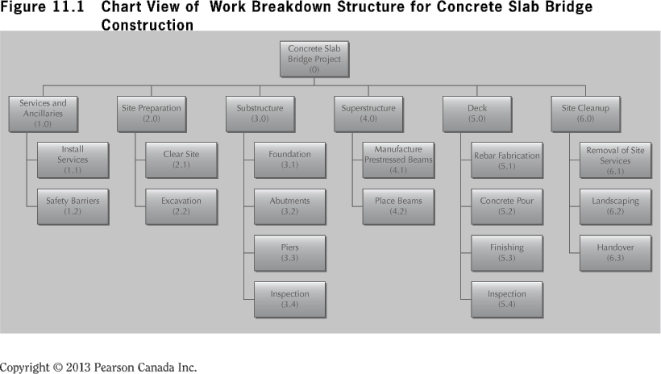
Figure 11.1 Chart View of WBS for Concrete Slab Bridge Construction

Slide 14
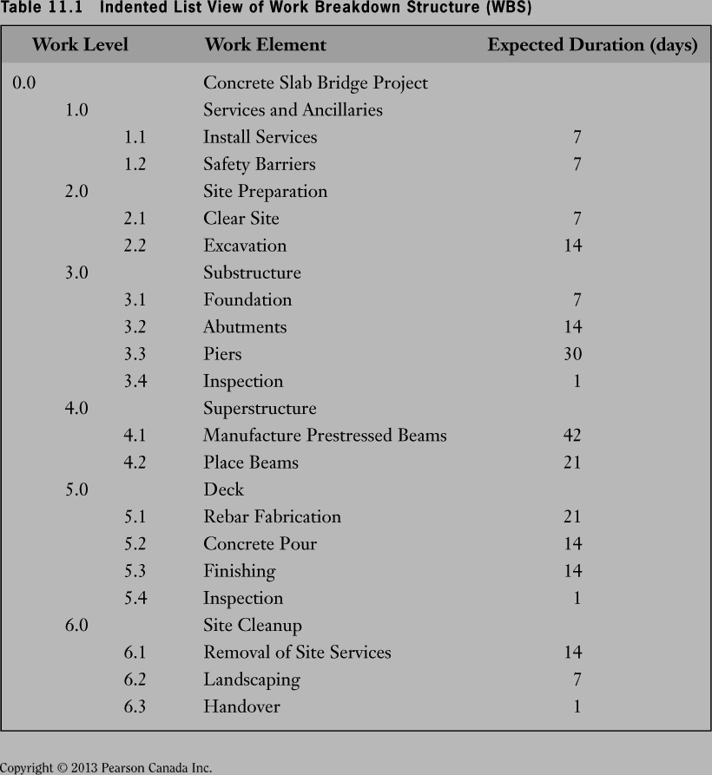

Slide 15
3.2 Gantt Charts
Gantt charts
  depict timing and sequence of project activities
  simplest, most fundamental tools available
  consist of a list of work items and a diagram indicating when each item begins and ends
Gantt charts start from the Work Breakdown Structure (WBS).
Figure 11.2 is a Gantt chart for the concrete slab bridge project of Example 11.1
One activity ➔ one row.
Bars indicate the start and end of activities.
Diamonds indicate an event.

Slide 16
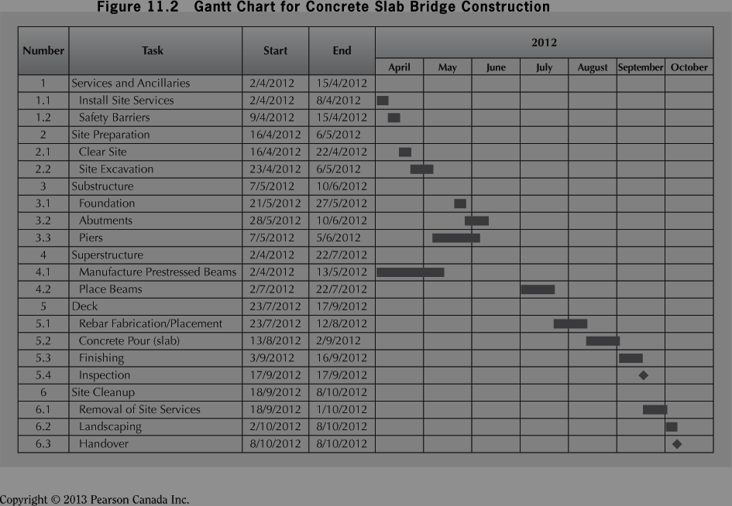
Gantt Chart for Concrete Slab Bridge Construction

Slide 17
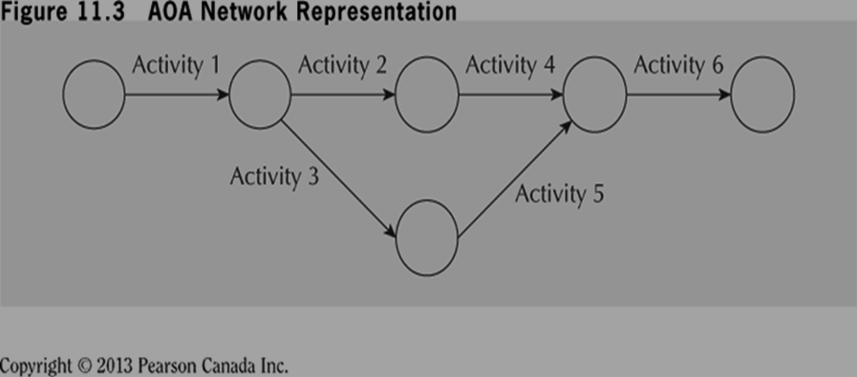
3.3 The Critical Path Method (CPM)
Gantt has lead to development of more sophisticated scheduling methods:
  CPM (Critical Path Method)
  PERT (Project Evaluation and Review Technique)
PERT designed to add uncertainty to task times.
The two have been integrated into present PERT/CPM.
Project activities are represented by “nodes” and “arcs”
See Figure 11.3.3 AOA Network Representation

Slide 18
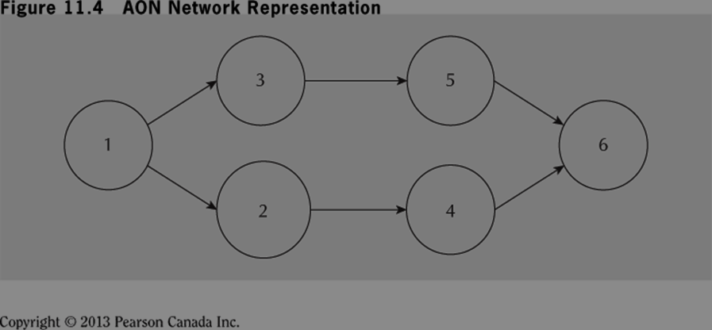
11.3.3 The Critical Path Method (cont’d)
Second style is “activity on node” (AON)
Nodes represent the activities instead of the arcs.
Has become most popular method – used from now on.
Figure 11.4 depicts the same project as shown in Figure 11.3 using an arc-on-node (AON).

Slide 19
Selected Definitions
Work Breakdown Structure (WBS)
  Task oriented family tree of activities that organizes, defines and graphically displays the total work to be accomplished in order to achieve the final objectives.
Predecessors
  Activities that must be completed before initiation of another or other activities.
Earliest start (ES) date
  The earliest possible time an activity can start based on network logic and schedule constraints
  Can change as the project progresses.
  Determined by working forward in the network of activities
Latest start (LS) date
  The latest possible time an activity may begin without delaying a milestone.
  Determined by working backward on the network of activities

Slide 20
Selected Definitions
Path
  A sequence of activities defined by the project logic.
Critical Path
  The project path with the longest duration.
  Activities on the critical path have no slack (float).
  Can change as activities are crashed.
Slack (float)
  The amount of time an activity can be delayed without delaying the finish of the project.
  Slack = (LS-ES) = (LF-EF)

Slide 21
Selected Formulas
EF = ES + T
LS = LF - T
ES = Max(EF of immediate predecessors)
LF = Min(LS of successor activities)
S = LS – ES = LF - EF

Slide 22
Your Turn!!! [11.15]
Activity | 1 | 2 | 3 | 4 | 5 | 6 | 7 | 8 | 9 | 10
Predecessor | - | 1 | 2 | 2 | 4 | 3,5 | 6 | 3,5 | 7,8 | 9
Duration | 6 | 4 | 6 | 7 | 9 | 3 | 3 | 5 | 3 | 2
(a) Construct an AOA network representation for the project.
(b) Construct an AON network representation for the project.

Slide 23
New Pickling Plant
Activity | Description | Expected Completion Time (weeks) | Predecessor Activities
1 | Obtain RFPs | 6 | ----
2 | Select vendor | 4 | 1
3 | Order Equipment | 6 | 2
4 | Design new layout | 7 | 2
5 | Implement layout | 9 | 4
6 | Install computers | 3 | 3,5
7 | Configure Software | 3 | 6
8 | Install equipment | 5 | 3,5
9 | Test system | 3 | 7,8
10 | Train users | 2 | 9
Fraser and Jewkes, Engineering Economics, 5th edition, Pearson

Slide 24
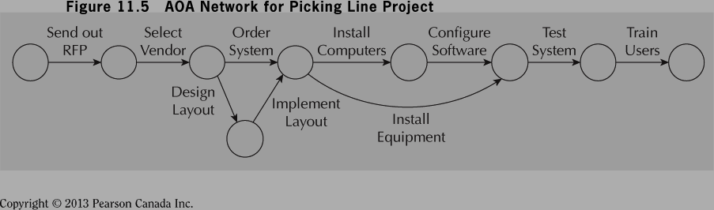
Fraser and Jewkes, Engineering Economics, 5th edition, Pearson

Slide 25
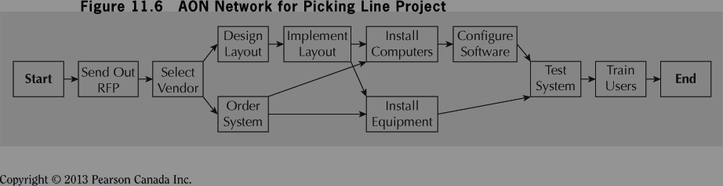
Fraser and Jewkes, Engineering Economics, 5th edition, Pearson

Slide 26
3.3.1 Project Scheduling and the Critical Path Method
Network representation along with precedence relationships enables PM to identify critical path
Critical path
  set of activities that must be completed exactly as planned to keep project on schedule
  no slack time or “wiggle” room.
Delaying any one activity will cause Project Delay.
Finding critical path involves two passes through network
  Forward Pass (1st pass)
    earliest start/finish (ES/EF) times for each activity is determined
  Backward Pass (2nd pass)
    starts with completion time (established in 1st pass) and computes latest time each activity can start and finish (LS/LF)

Slide 27
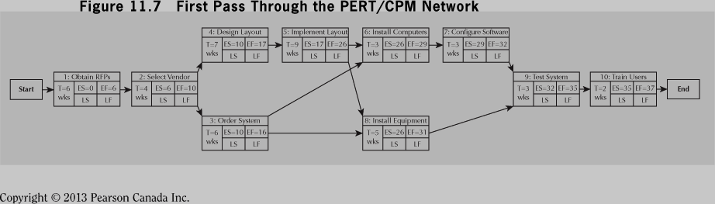
Source: Fraser and Jewkes, Engineering Economics, 5th edition, Pearson

Slide 28
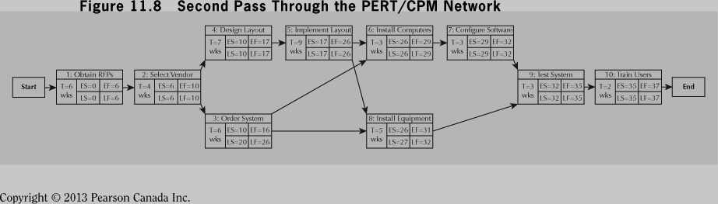
EF = ES + T; LS = LF - T
ES = Max(EF of immediate predecessors)
EF = Min(LS of successor activities)
S = LS – ES = LF - EF
Fraser and Jewkes, Engineering Economics, 5th edition, Pearson

Slide 29
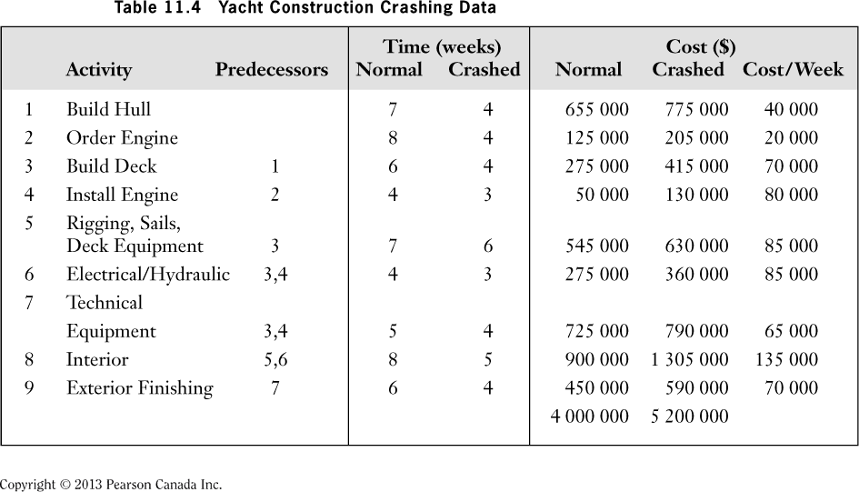
Table 11.4 Yacht Construction Data

Slide 30
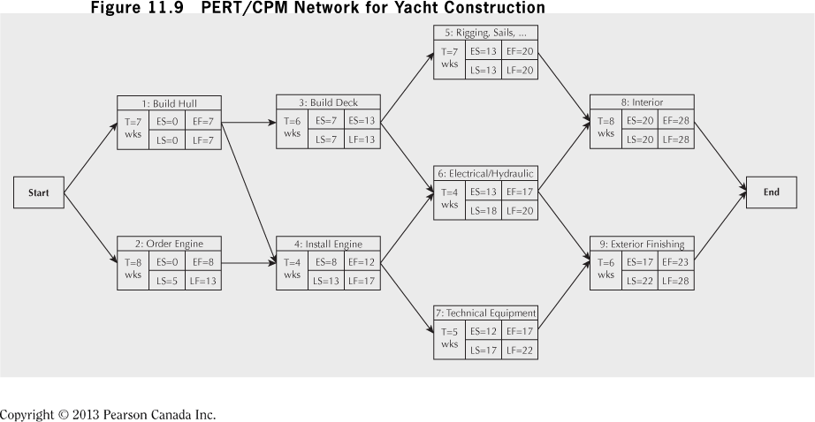
PERT/CPM Network for Yacht Construction
Critical Path
The CPM network presented below shows completion time of 28 weeks
Critical Path: Activities 1-3-5-8; Time required = 28 weeks

Slide 31
Yacht Construction Crashing Data

Slide 32
Project Crashing and Time-Cost Trade-offs
Strength of CPM is mechanism for crashing project.
  i.e. reduce completion time with additional resources
Resources can be overtime, extra equipment, additional staff – all at greater cost.
  ===================================
Tasked with Project Management of building a yacht
Overall budget is $4M (see Table 11.4)
Planned completion is 28 weeks, but customer has asked for price on speeding delivery up by 5 weeks
Table 11.4 shows how much each activity can be crashed and crash costs

Slide 33
Project Crashing and Time-Cost Tradeoffs
To deliver the yacht earlier, one or more activities on the critical path (CP) must be crashed according to procedure:
Identify activities least expensive to shorten
Shorten max amount (or until another CP occurs)
Repeat until desired project completion is attained
Use crash cost/unit time to know activities to crash
Crash Cost/unit time
= (Crash cost-Normal cost)/(Crash time-Normal time)
Assumes a linear relationship as shown in Figure 11.10
From Table 11.4 cheapest activity to crash is Activity 1
But…how much? Ensure another CP isn’t created!

Slide 34
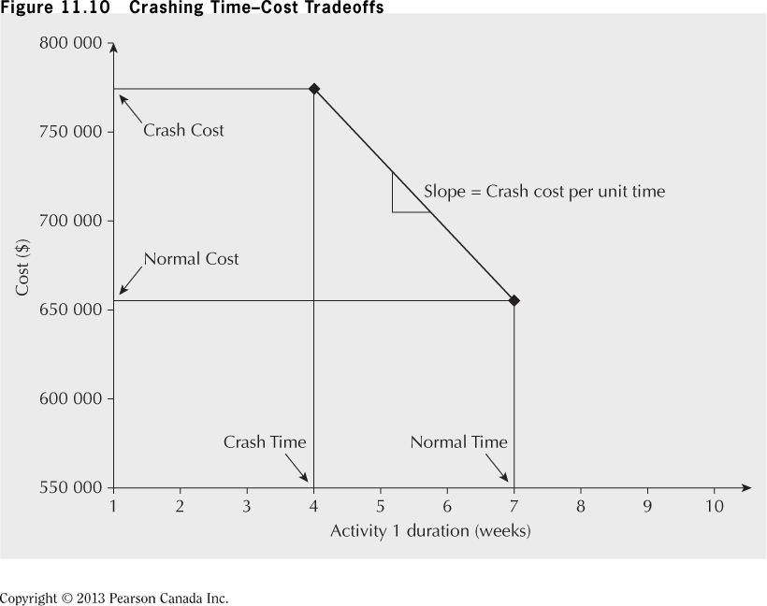
Crashing Time Cost Trade-offs

Slide 35
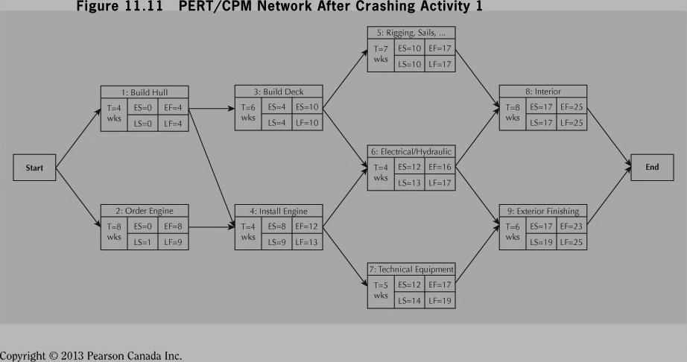
Example 11.5 (cont’d)
Activity 1 can be fully crashed to 4 weeks ($40 000 per week)
Update diagram to reflect new schedule.
PERT/CPM Network after Crashing Activity 1

Slide 36
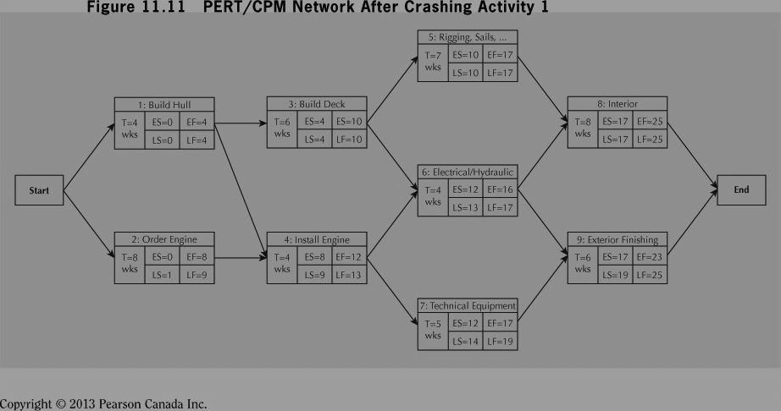
After completely crashing activity 1
New completion time is now 25 weeks and critical path is still 1-3-5-8
Slack in activities 2, 4, 6 is one week; 7, 9 is two weeks
From Table 11.4, next cheapest activity is Activity 2
Can be crashed two weeks at $70 000 per week
BUT… duration can only be reduced 1 week before other critical path opens! (Activity 4, 6 become active)
Figure 11.12 shows result of crashing Activity 3 by 1 week – tow critical paths open, 1-3-5-8 and 2-4-6-8
Both have duration of 24 weeks.

Slide 37
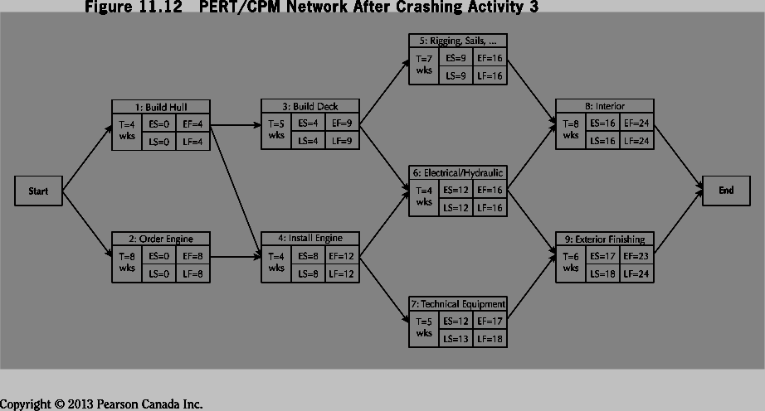
PERT/CPM Network after Crashing Activity 3

Slide 38
When two paths are simultaneously critical, both paths must crashed for least total cost.
Inspection of Figure 11.12 reveals:
Reduce Activities 3 and 4 by 1 week each for $150 000
Reduce Activities 5 and 6 by 1 week each for $170 000
Reduce Activity 8 by one week for $135 000
Reason only 1 week required is that Activity 8 is common to both paths.
Despite higher individual cost it is least expensive option to reduce the project by the extra week!

Slide 39
Your Turn!!! [11.11]
Activity | 1 | 2 | 3 | 4 | 5 | 6 | 7 | 8 | 9
Predecessor | - | - | 1 | 1,2 | 1,2 | 3 | 4,5 | 5,7 | 6,8
Duration | 3 | 2 | 4 | 4 | 2 | 4 | 8 | 3 | 1
(a) Construct a Gantt chart assuming each activity starts at the earliest time possible.
(b) How long will the project take to complete?
(c) Compute the ES, EF, LS, and LF times for each activity using a CPM network.
(d) What is the critical path?
(e) Which activities have slack?
(f) How much slack does each activity have?

Slide 40
Activity | 1 | 2 | 3 | 4 | 5 | 6 | 7 | 8 | 9 | 10 | 11 | 12 | 13 | 14 | 15 | 16 | 17 | 18 | 19 | 20
1
2
3
4
5
6
7
8
9
10
Activity | 1 | 2 | 3 | 4 | 5 | 6 | 7 | 8 | 9
Predecessor | - | - | 1 | 1,2 | 1,2 | 3 | 4,5 | 5,7 | 6,8
Duration | 3 | 2 | 4 | 4 | 2 | 4 | 8 | 3 | 1

Slide 41
Critical Path = 19 weeks
Activity 7: Duration=8 wks
ES=7 EF=15
Activity 3: Duration=4 wks
Activity 5: Duration=2 wks
LS= 7 LF=15
ES=3 EF=7
ES=3 EF=5
LS= 10 LF=14
LS=5 LF=7
Activity 1: Duration=3 wks
S
T
A
R
T
ES=0 EF=3
Activity 8: Duration=3 wks
LS=0 LF=3
Activity 6: Duration=4 wks
ES=15 EF=18
ES=7 EF=11
LS=15 LF=18
Activity 2: Duration=2 wks
LS=14 LF=18
ES=0 EF=2
LS=1 LF=3
Activity 9: Duration=1 wk
E
N
D
Activity 4: Duration=4 wks
ES=18 EF=19
ES=3 EF=7
LS=18 LF=19
LS=3 LF=7
Activity | 1 | 2 | 3 | 4 | 5 | 6 | 7 | 8 | 9
Predecessor | - | - | 1 | 1,2 | 1,2 | 3 | 4,5 | 5,7 | 6,8
Duration | 3 | 2 | 4 | 4 | 2 | 4 | 8 | 3 | 1

Slide 42
Normal Cost Activities
Activity | Time | ES | EF | LS | LF | S
1 | 3 | 0 | 3 | 0 | 3 | 0
2 | 2 | 0 | 2 | 1 | 3 | 1
3 | 4 | 3 | 7 | 10 | 14 | 7
4 | 4 | 3 | 7 | 3 | 7 | 0
5 | 2 | 3 | 5 | 5 | 7 | 2
6 | 4 | 7 | 11 | 14 | 18 | 7
7 | 8 | 7 | 15 | 7 | 15 | 0
8 | 3 | 15 | 18 | 15 | 18 | 0
9 | 1 | 18 | 19 | 18 | 19 | 0
Critical Path = 1,4,7,8,9

Slide 43
Summary
The project management lifecycle involves:
  Initiation
  Planning
  Execution
  Monitoring and Controlling
  Closure
Important project management tools include:
  Work Breakdown Structure
  Gantt Charts
  CPM
  Project Scheduling and the Critical Path
  Project Crashing and Time-Cost Tradeoffs

Slide 44
Engineering Economics
ECO 1192
Topic 11: Project Management
Claude Théoret
University of Ottawa

