Slide 1
POL1101
Week 11a

Slide 2
Let’s think for a minute about agenda setting.
Imagine the following setting:
  Three people: Gus, Sharon and Gladys
  They have to decide between three policies
    Build a road (R)
    Build a bridge (B)
    Do nothing (S)
  Preferences are:
    Gus: BpRpS
    Sharon: RpSpB
    Gladys: SpBpR

Slide 3
Our three people decide to vote to determine which project (if any) will be constructed.
  Use majority rule in which two alternatives are compared
  First round winner runs against third alternative
  Winner of second round is the overall winner
  Ordering of the votes constitutes an agenda

Slide 4
Agenda 1:
  Vote 1: Bridge vs. Road: Bridge Wins
  Vote 2: Bridge vs. Status Quo: Status Quo wins
Agenda 2:
  Bridge vs. Status Quo: Status Quo wins
  Status Quo vs Road: Road wins
Agenda 3:
  Road vs. Status Quo: Road wins
  Road vs. Bridge: Bridge wins
  Preferences are:
    Gus: BpRpS
    Sharon: RpSpB
    Gladys: SpBpR
Depending on the agenda, any of the alternatives could win majority approval
Demonstrates that directly voting on a policy does not ensure that the policy chosen will be the will of the people
Quality of all voting systems
Caveat: voting systems do not always fail: if Gus preferred road to bridge then road would be the clear majority winner regardless of the agenda.

Slide 5
So what?
Shows that:
  Voting systems can fail to produce clear democratic winners
  If voting system fails then winner will be chosen in an arbitrary or non-democratic manner
  When voting systems fail, we usually don’t know about it.

Slide 6
Kenneth Arrow –
Impossibility Theorem

Slide 7
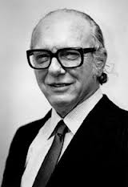
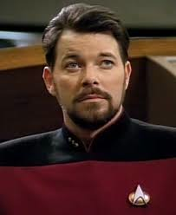
Even more important…
William Riker:
  Suggests that strategic politicians can take advantage of the fact that no general will of the people can be determined
  Eg. if Sharon controls the order of voting (the agenda) then she will pick Agenda 2.
  By being a strategic politician, Sharon can turn out to be a dictator.
  Agenda setting is very important to understanding politics
  Institutions are very important to shape and constrain agenda setters
This guy →
Not this guy →

Slide 8
Party Systems

Slide 9
Party Systems
What is a party system?
  Means of classifying or describing the parties and their interaction in a political system
What is the relationship between parties and issues?
  Linked to political cleavages (eg. Ireland, Canada…) and the electoral system (Duverger’s Law).
What is the role of ideology?

Slide 10
Number of parties
Political parties are based on the politicization of issues by proposing new policy alternatives
The number of issue dimensions (I) plus one equals the number of parties
I + 1 = P(+/-1)

Slide 11
Types of Party Systems
One Party System
  There is only one party, no alternative
  Communist Party
Two Party System
  Two credible contenders for power
Two Party (plus) System
  Two main parties with smaller parties competing for power
Multi party System
  Three or more political parties with a realistic chance of participating in government
Party Systems in part determined by electoral system (talk about this on Friday)

Slide 12
Number of Parties
Main Issue Dimensions
  Socioeconomic (taxes, market, regulation, social spending, agriculture)
  Moral (Family, sex, religion)
  Ethnic (territorial, language, race)
  Foreign policy, political regime, environment…

Slide 13





State involvement in economy, social programmes
Significant State
Involvement
Limited State
Involvement

Slide 14
Ideology
A simplified set of policy issues and values
Examples: conservatism, liberalism, environmentalism, nationalism, socialism, communism, fascism…
Symbols: colours, emblems, flags, animals, heroes etc…

Slide 15
Ideology
Ideologies are needed in politics to reduce information costs and deliver the parties’ messages to mass audiences.
An ideology needs to be internally consistent

Slide 16
Ideology
The left right spatial axis is the most widely accepted ideological representation of political party positions
It is not the only one
  In the USA, the “conservative-liberal” axis is also widely used.
  What about in Canada?

Slide 17
Conclusions
“political parties created democracy, and modern democracy is unthinkable save in terms of parties” (Schattsschneider, 1942)
Parties have a number of roles in the polity – all trying to solve different aspects of collective action problems.
Parties can be arranged on a number o different scales – depending on the issue.

Slide 18
POL1101
Week 11b

Slide 19
Announcements
Optional Midterm Next Wednesday
  Takes place during class hours
  Will send location
  Cumulative, emphasis on materials since last midterm.
  “Should I do the optional midterm?” calculator

Slide 20
Prelim to presidents and assemblies
Not in Colomer so pay attention.
  Current material sourced from M. Golder, S. Golder.
We have talked about authoritarian regime types and we have talked about democracies
Now focusing on democracies and their institutions, esp. government

Slide 21
Democracies can be sorted into three types:
Presidential
Parliamentary
Semi-presidential
What makes them different?
  Depends on the relationship between
    The government
    The legislature
    The president (if there is one)

Slide 22
Classifying parliamentary, presidential and semi-presidential democracies

Slide 23
What do we mean by responsibility?
Legislative responsibility refers to a situation in which a legislative majority has the constitutional power to remove a government from office without cause.
  Eg. a vote of no confidence
  Canadian examples?
    1926 Arthur Meighan (B)
    1963 Diefenbaker (B)
    1974 Trudeau (B)
    1979 Clark (B)
    2005 Martin (VNC) – following Gomery Commission Report
    2011 Harper (VNC – contempt of parliament)

Slide 24
Different Types of Votes of No Confidence
A vote of no confidence is initiated by the legislature; if the government does not obtain a legislative majority in the vote, it must resign. (New government without election (eg. Italy, Denmark); VNC → election, eg. Ireland.
A constructive vote of no confidence must indicate who will replace the government if the incumbent loses a vote of no confidence, eg. Germany, Belgium, Spain.
A vote of confidence is initiated by the government; if the government does not obtain a legislative majority in this vote, it must resign.

Slide 25
What else distinguishes them?
A presidential democracy is one in which the government does not depend on a legislative majority to exist
A parliamentary democracy is one in which the government depends only on a legislative majority to exist
A semi-presidential democracy is one in which the government depends on a legislative majority and the head of state is popularly elected.

Slide 26
Presidential System
Grows out of the American Revolution and a backlash against strong monarchical government.
Consists of:
  President
  Cabinet
  Congress (House of Reps. and Senate)
  Judiciary

Slide 27
President
Article II of the Constitution outlines the powers of the executive branch.
Article II
Section 1.
The executive power shall be vested in a President of the United States of America. He shall hold his office during the term of four years, and, together with the Vice President, chosen for the same term, be elected, as follows:…

Slide 28

President
4 year term elected by all electors in the nation
Head of State
  Greets foreign dignitaries
Head of Government
  Appointment powers
    Cabinet
    Judges
    Ambassadors
No responsible government

Slide 29
President
Qualifications
  Be a natural-born citizen of the United States
  Be at least 35 years old
  Have been a permanent resident in the US for at least 14 years
22nd Amendment
  President may only serve a maximum of 2 terms (8 years)

Slide 30
Electoral College
The Electoral College is the formal body that chooses the President of the United States (270/538)
Established in 1787
“Upstanding citizens” chosen by voters in the state, determined by the total number of congressmen/women and senators in the state.
  Texas: 36 Congressmen/women, 2 Senators → 38 Electoral College votes: vote along party lines

Slide 31
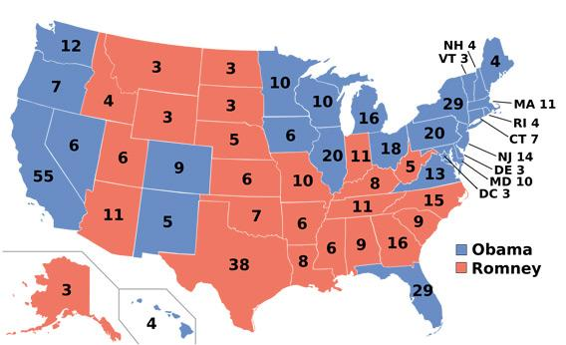

Slide 32

Vice President
2nd in charge, first in line
President of the Senate, breaks ties
Qualifications
  Be natural born US citizen
  Not be younger than 35 years old
  Have lived in US for at least 14 years
  Not have already served two terms as President of the United States.

Slide 33
Congress: Bicameral Legislature
Congress consists of two “houses”:
House of Representatives
  435 members; elected based on representation by population
  Term of two years
  Roles: Pass legislation; initiate revenue bills, impeach officials, elect President when no majority in electoral college.
Senate
  100 members; two from each state
  Elected for a 6 year term, with 1/3 of senators facing election every two years
  Advice and consent:
    Treaties, Cabinet secretaries, Judges,Others…
    Trial of impeached officials

Slide 34
Cabinet Secretaries
Senior officers of the executive branch (15)
Nominated by President, confirmed by Senate
  Can’t appoint immediate family members: post JFK
May not hold a seat in Congress
Serve at the pleasure of the President
Do not meet as a group as in parliamentary systems. Nixon’s cabinet only meet every few months.

Slide 35
White House Staff
President
White House Staff
“Chicago mafia”
Cabinet Secretaries
Executive Office
Admin Departments

Slide 36
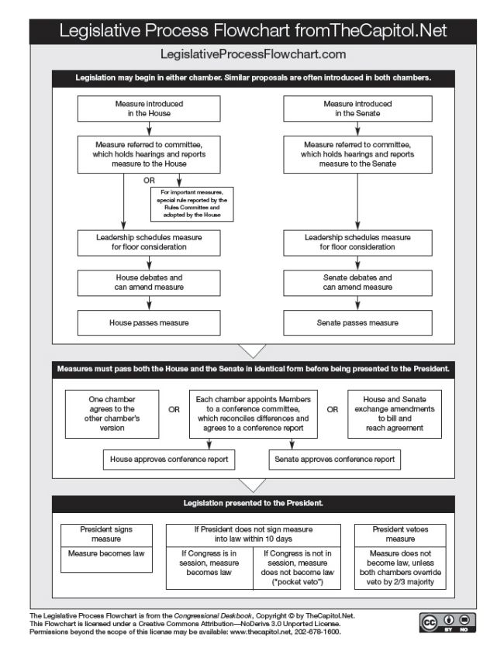
Legislative Process

Slide 37
Veto
President
  Bill passed by both HOR and Senate
  President has four options
  Sign bill into law
  Do nothing: (10 days with no signature/veto then the bill becomes law
  Regular veto: 10 days after arrival, send back to Congress unsigned with reasons
  Pocket veto: if Congress is not sitting, simply refuse to sign (10 days)

Slide 38
Overriding the veto
Congress can respond to a presidential veto with a 2/3 majority vote in both houses any time during the Congress when the veto was issued.
However, if one house fails to get 2/3 then the other house does not vote.

Slide 39
Presidential Advantages/Disadvantages
Advantages | Disadvantages
Separate of powers | Too fragmented
Checks and balances limit the power of government | Voters must wait for election to unseat an unpopular member
Low party discipline | Hard for voters to pin responsibility on one party

Slide 40
Central to what we are talking about here is “choosing”
Criteria for a good choice?
  Pareto criterion: A decision is efficient if it increases the satisfaction of some voters/choosers or at least does not worse any when compared to the previous situation.
How can we choose?
  Unanimity?
    Requires the agreement of all the voters
    Produces consensual winners in homogenous communities with clear common interest.
    What the problem?
    Unanimity rule may favour the stability of the status-quo or the continuation of the incumbent ruler, even if an alterative is preferred by many voters.

Slide 41
So we come up with an alternative(s)
Majority rule; different varieties
Absolute majority: 1/2 | Qualfied or supermajority: 2/3. 3/5. ¾ etc. Simple majority
Relative majority or plurality | Qualified plurality: 1/3, 2/5 etc. (less than ½) Simple plurality: the greatest number (even if less than ½

Slide 42
Absolute majority rule works well if there are only two candidates by giving the victory to the median voter’s preference.
But what about when there are more than two candidates
Questions about legitimacy of decisions in close votes:
  1995 QC referendum? Who won?

Slide 43
Majority Rule Procedures
Majority runoff:
  Absolute majority in the first round
  If no absolute majority then have a second round between the candidates with the two highest vote counts
  Eg. presidents of France and Brazil.
  Encourages multiparty competition in the first round and the formation of two broad coalitions in the second round.

Slide 44
Example of Majority runoff:
Presidential election in France in 2007
Ideology: Left --------------------- Center ----------------------------- Right
Candidates: 5 leftists Royal Bayrou Sarkozy Le Pen, far right
% votes
1st round: 1, 2, 2, 2, 4 26 19 31 11, 2
Median voter
2nd round: 47 53
Winner

Slide 45
Majority Rule Procedures
Plurality or relative majority
  Does not require an absolute majority of votes, but only a higher number than any other candidate
  Eg. US Electoral College; individual Canadian ridings; majority status in the Can House of Commons

Slide 46
Majority Rule Procedures
Plurality rule creates incentives for potential candidates to coordinate into only to candidacies in order to secure majority support (eg. American party system)
It is highly dependent on irrelevant alternatives. Encourages tactics like “merge and win” and “divide and win”. Eg. Reform+PCP
With multiple candidates, the plurality winner can be the candidate most rejected by a majority of winners.

Slide 47
. tab voteshare2
voteshare2 | Freq. Percent Cum.
------------+-----------------------------------
0 | 6,482 62.51 62.51
1 | 3,887 37.49 100.00
------------+-----------------------------------
Total | 10,369 100.00

