Slide 1
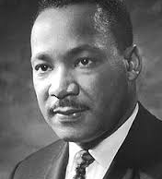
Martin Luther King Jr.
Why He Is a Great Leader
Educated
Brought change
Intellectual tactics
Commitment
legacy

Slide 2
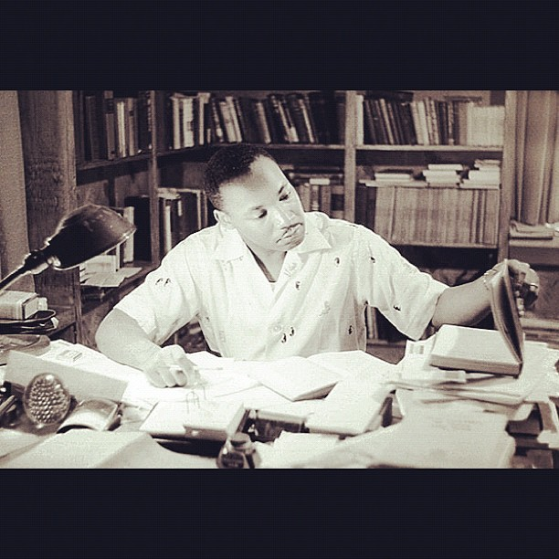
MLK’s Education
Grew up in a middle-class family
Excellent speaker
Great passion for his cause
Great approach to situations

Slide 3

Changing Status Quo
Evolution and Innovation
Advocacy for Peace
Persistent
Social, Cultural, and Technological Change

Slide 4
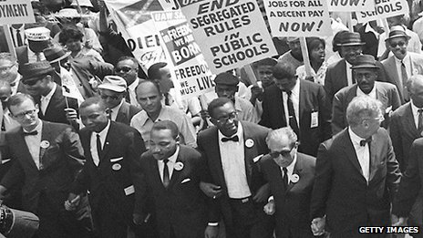
Tactics
Brought True Freedom
Protests
Non-violence
Boycott

Slide 5
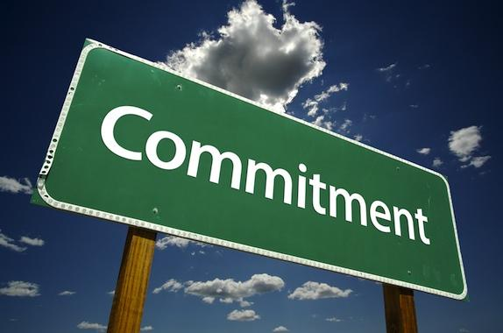
Commitment
Worked to His Full Potential
Wanted Equal Rights for everyone
Received Constant Death Threats
Stayed Determined and Never Gave Up

Slide 6
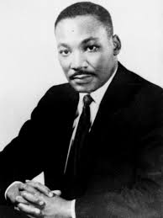
MLK’s Legacy
Martin Luther King Day
Inspired us to become better entrepreneurs and leaders
Highly influenced great leaders of today’s generation

