Slide 1
Midterm review
Agnes Crnic
agnes.crnic@gmail.com

Slide 2
Midterm: the basics
Saturday March 2, 2013 1-4 PM
42 Multiple choice questions
  26 Mezl
  16 Figeys/Xu
Essay questions: answer 3 out of 4
  2 Mezl
  2 Figeys/Xu
Content
  Mezl: start of lecture notes to end of sugars, Chapter 1 readings
  Figeys: start to end of proteins (NO KINETICS), Chapter 6 readings
3 hours

Slide 3
Todays review
Quick concept review
Dr. Mezl
  Water
  Carbohydrates
Dr. Figeys/Dr. Xu
  Amino acids
  Primary structure
  Secondary structure
  Tertiary structure
  Quaternary structure
  Denaturation

Slide 4
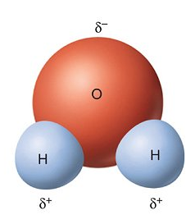
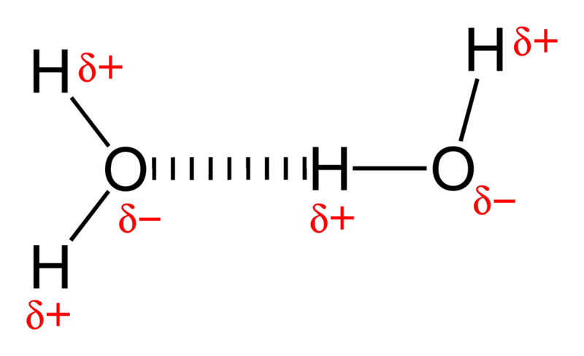
water
Water is polar: differences in electronegativity between H and O. Very electronegative O attracts electrons, making region around it more negative than region around H. Slightly negative charge around O and slightly positive charge around H
Electrostatic attraction between partial positive charge at H and partial negative charge at O creates hydrogen bonds
Density: 1,000.00 kg/m³ Boiling point: 99.98 °C Molar mass: 18.0153 g/mol Formula: H2O Melting point: 0.0 °C
Hydrophobic: nonpolar substances, no H-bonds, insoluble in water
Hydrophilic: polar substances, form H-bonds, soluble in water

Slide 5
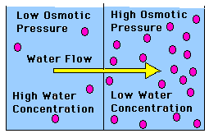
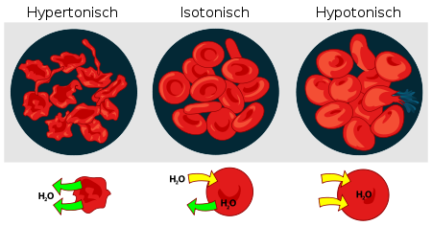
Osmosis and diffusion
Osmosis: net movement of solvent molecules through semi-permeable membrane into region of higher solute concentration
Osmotic pressure (π): pressure required to prevent the movement of solvent molecules across the semi-permeable membrane
π = c (molar concentration) R (gas constant,) T (temperature, Kelvins)
Hypertonic Isotonic Hypotonic
In the cell: osmotic pressure inside must balance osmotic pressure outside
Isotonic solution: [solute] in = [solute] out
Hypertonic: [solute] in < [solute] out
Hypotonic: [solute] in > [solute] out

Slide 6
Dissociation of water
Ionization of water (rare! 1 in 10⁹)
H₂O → H⁺ + OH⁻
K = [H⁺][OH⁻]/[H₂O]
Relatively high [water]
K_{w} = [H⁺][OH⁻]
Dissociation constant K_{w} (how much does water want to separate into H⁺ and OH⁻) = 10⁻¹⁴

Slide 7
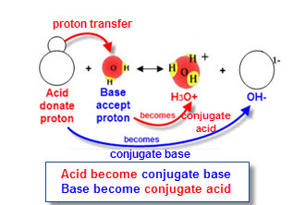
Acids and bases
Acid: wants to donate protons and increase solution H⁺, pH < 7
Base: wants to accept protons and decrease solution H⁺, pH > 7
Acid dissociation:
HA = H⁺ + A⁻
Henderson-Hasselbach equation: pH is function of ratio of base to acid in a solution
pH = pK + log ([base]/[acid])
pH = - log [H⁺]
pOH = - log [OH⁻]
pH = 14 - pOH

Slide 8
Biological buffers
Add 1mmol of H⁺ to each beaker
#1) 1 mmol = 10⁻³ mol
pH = -log [10⁻³ mol]
= 3
Big change!
#2) HZ is weak acid: Z⁻ will bind H⁺ to create HZ
As a result, will lost 1mM of Z⁻ and gain 1mM of HZ
Z⁻ = 20 mM – 1 mM = 19 mM
HZ = 20 mM + 1 mM = 21 mM
pH = pK + log (19/21)
= 6.96
Small change!
Allow for pH control: pH in biological systems very important
Acts as hidden acid and hidden base: neutralizes any acid or base added
Has pK close to pH you want to work at
Ex: Have 2 solutions
#1) 1L pure water
#2) 1L water + 40 mM weak acid HZ (pK = 7)
HZ→ H⁺ + Z⁻
40 mM → 20 mM + 20 mM

Slide 9
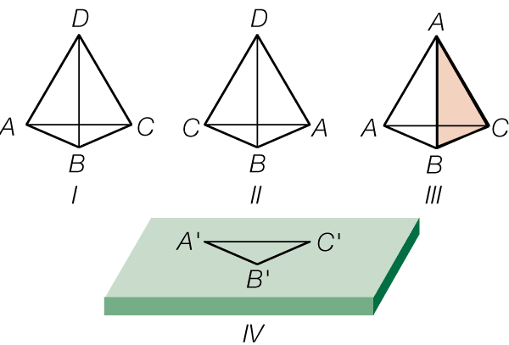
Organic molecules
Stereoisomers: molecules with same molecular formula but different 3D orientations
  D and L forms
  Named on how they turn light (D turns light to the right and L to the left)
Enantiomers: non-superimposable mirror images with one or more chiral centre, opposite chirality
Diastereosimoers: stereoisomers that are not enantiomers, not all chiral centres of opposite chirality
Important: life is stereospecific
  Certain proteins only work on certain stereoisomers
  Some stereoisomers poisonous in one form but not other

Slide 10
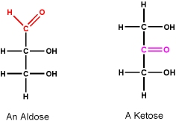
Carbohydrates
Small organic chain, has OH group on most carbons and aldehyde/ketone on one carbon
Act as energy source, structural building blocks, etc
Monosaccharides/disaccharides = 1-2 units, simple sugars
  Aldose: aldehyde functional group
  Ketose: ketone functional group

Slide 11
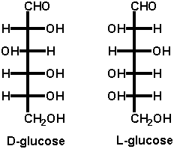
Carbohydrates-structure
Form stereoisomers: L and D configurations
Find chiral carbon furthest away from carbonyl group
  D = functional group (OH) pointing right
  L = functional group (OH) pointing left
Called “reference carbon”

Slide 12
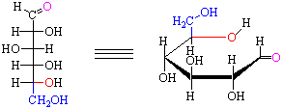
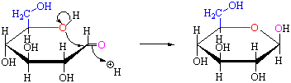
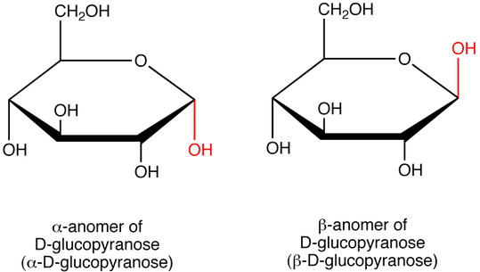
Carbohydrates-Aldohexoses
Stable form: Aldohexoses form cyclic hemiacetal
  6 atom pyranose ring
  Hemiacetal: addition of alcohol to carbonyl group
Ring = Haworth projection
Alpha Isomer: C1 OH group has same orientation as reference carbon
Beta Isomer: C1 OH group has opposite orientation as reference carbon

Slide 13
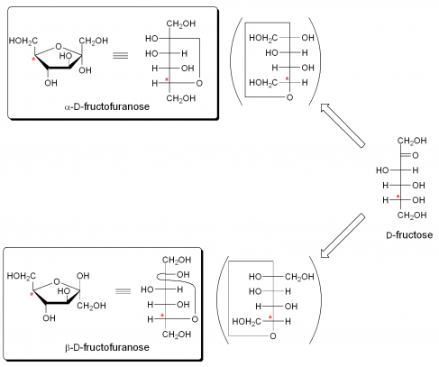
Carbohydrates-aldopentoses
Stable 5 atom ring: furanose

Slide 14
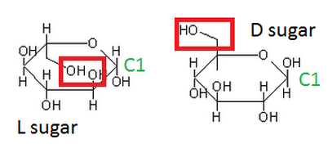
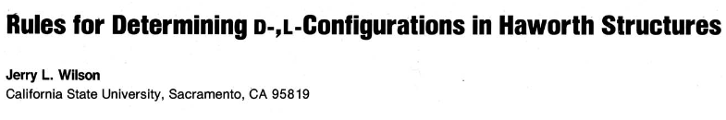
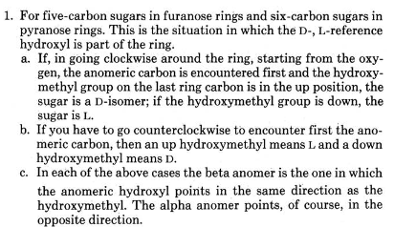
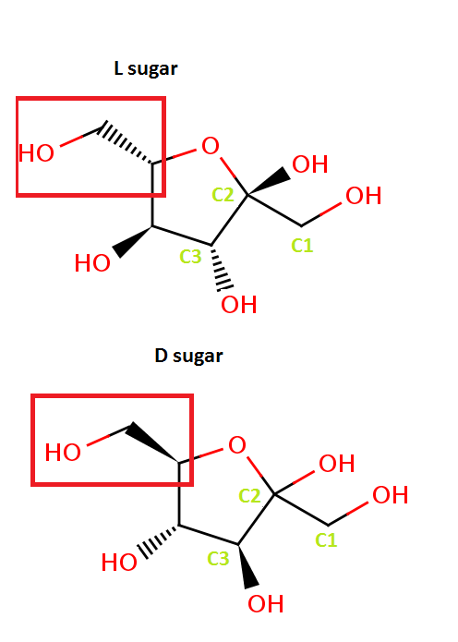
Carbohydrates- d or l cyclic

Slide 15
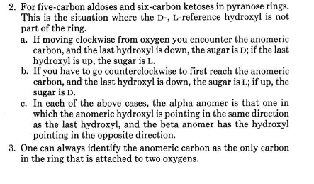
Carbohydrates- d or l cyclic

Slide 16
monosaccharides
Colourless in solution: no resonance (no double bonds) so decrease light absorption
Very soluble, form H-bonds
Can undergo mild oxidation and reduction: chemical or enzymatic
  Chemical results in both isomers but enzymatic is stereospecific

Slide 17
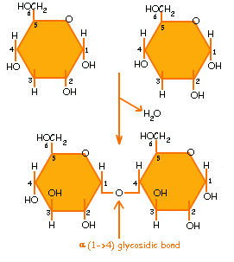
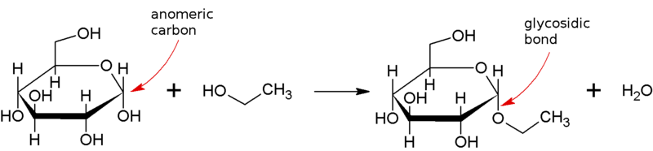
Bonds between sugars
Glycosidic bond: formed between hemiacetal of one sugar and hydroxyl group of another
} glycoside

Slide 18
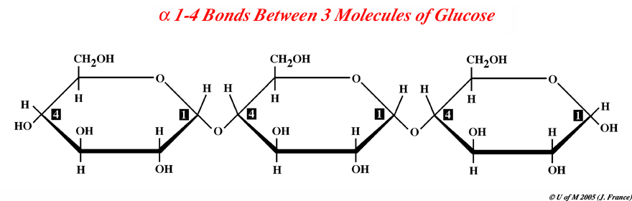
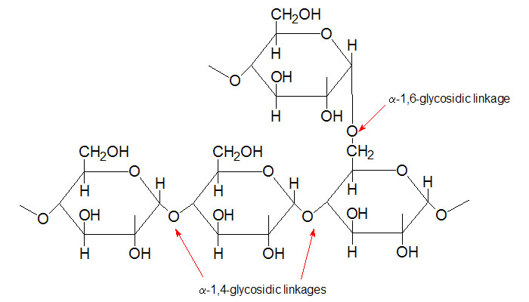
Polysaccharides-energy
> 10 sugar units, energy stores
Starch (plants):
  Amylose: 100-1000 glucose units linked with α-1,4 bonds, helical
  Amylopectin: chains of glucose units linked with α-1,4 bonds with branching α-1,6 bonds every 24-30 residues
Glycogen (animals):
  Chains of glucose units linked with α-1,4 bonds with branching α-1,6 bonds every 8-12 residues
  Compact and very large
To use these energy molecules: need enzymes to cleave glycosidic bonds and release individual units

Slide 19
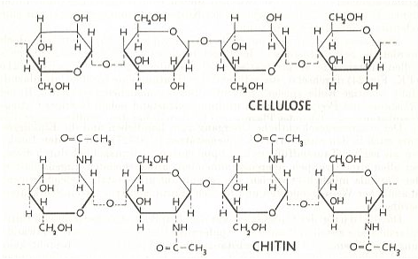
Polysaccharides-structure
Cellulose (plant cell wall)
  Linear glucose units linked with β-1,4 bonds
  Rotation of one glucose residue around glycodisic bond puts two rings in same plane: creates long straight chain
  H-bonds between structure provides strength
Chitin (invertebrate shell)
  Linear N-acety-glucosamine polymer with β-1,4 bonds

Slide 20
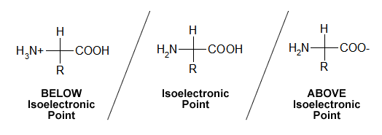
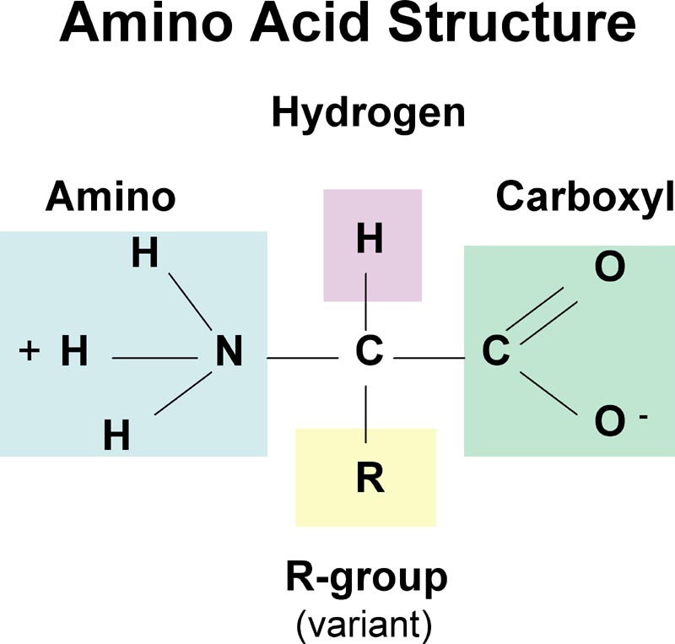
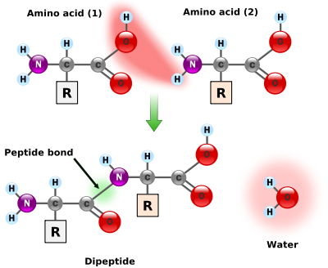
Amino acids
cation (fully protonated)
zwitterion
anion (fully deprotonated)
Isoelectric point (pI): pH at which the molecule will be neutral
pKa: dissociation constant, larger # = smaller likelihood of deprotonation
α
pKa = ~ 10
pKa = ~ 2
Peptide bond: Covalent bond formed through condensation reaction
know pka of ionisable side groups

Slide 21
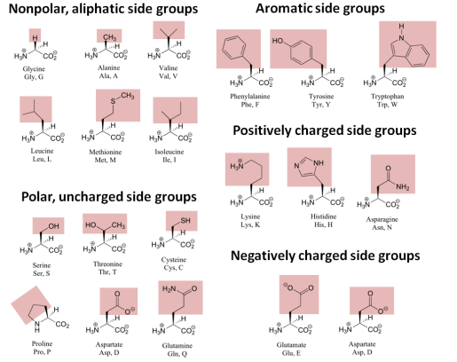

Slide 22
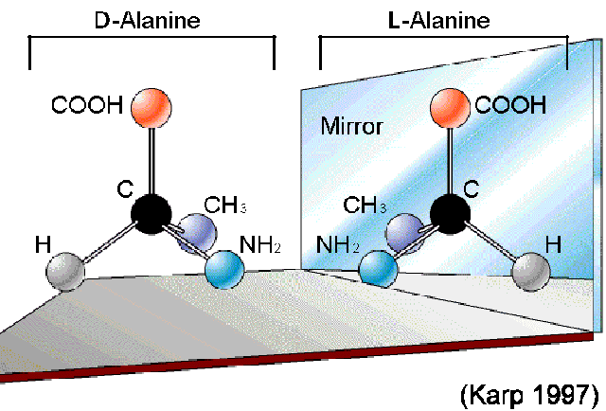
Amino acid Stereochemistry
Stereoisomers: molecules with same molecular formula but different 3D orientations
Enantiomers: non-superimposable mirror images
All amino acids (except glycine) optically active:
  Have 2 stereoisomers if have one chiral carbon
  Have 4 stereoisomers if have two chiral carbons (threonine and isoleucine)

Slide 23
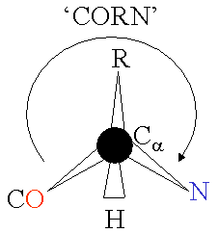
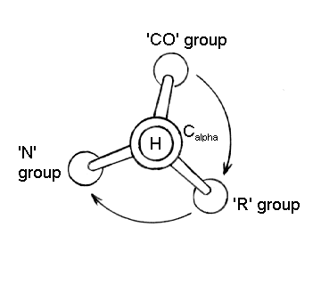
Amino acid Stereochemistry
All amino acids have L stereochemical configuration
“CORN” rule:
Looking at C-alpha with H pointing out at you, will read “corn”
Indicates L-amino acid

Slide 24
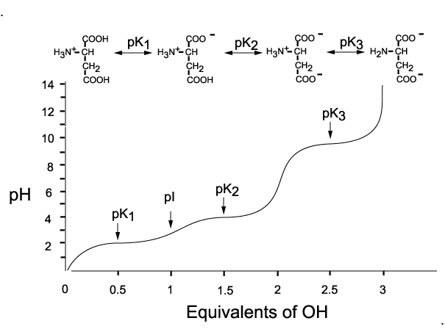
Amino acid Titration Curve

Slide 25
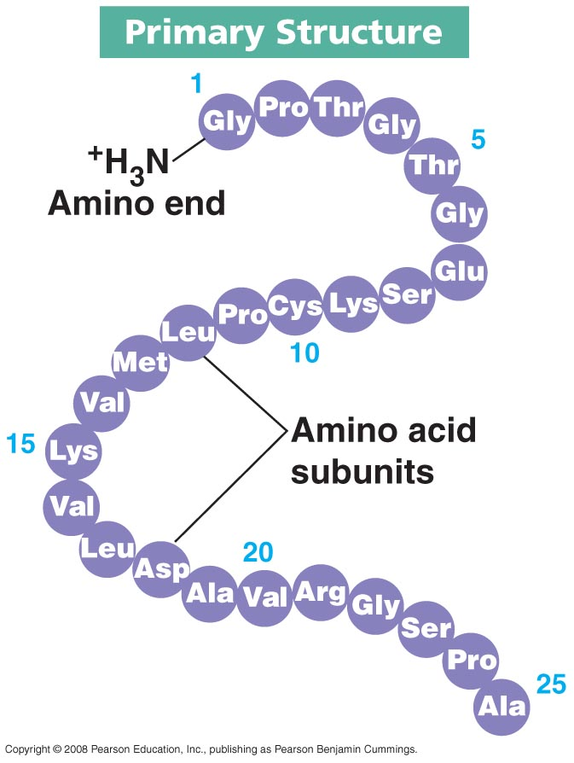
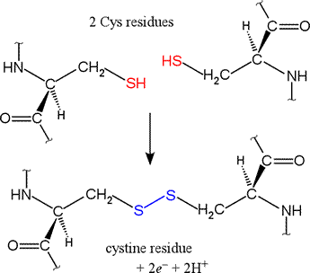
Primary structure
50+ amino acids joined together by peptide bonds = polypeptide
Specific sequence of amino acids contained in a peptide/protein and their linkages
Read starting at N-terminus (free amino group) and ending at C-terminus (free carboxyl group)
Disulfide bond: formed between cysteine molecules, contributes to structure

Slide 26
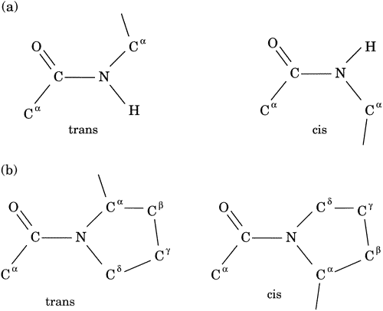
Secondary structure: peptide bond
Peptide bond: partial double bond character, renders it planar
Trans configuration favoured, except when Pro present (cis favoured)
Less steric hindrance
More steric hindrance
No difference in either configuration

Slide 27
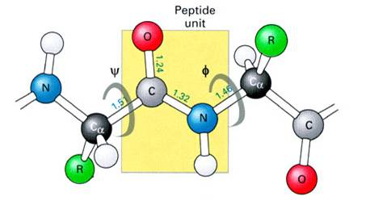
Secondary structure: peptide bond
Angles of rotation:
Psy (ψ): Cα-C bond Phi (ϕ): N-Cα bond
Rigid peptide bond

Slide 28
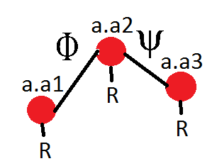
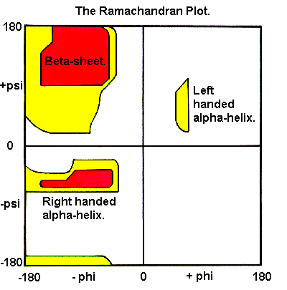
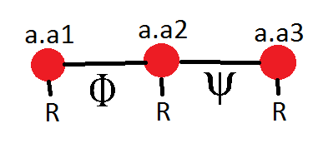
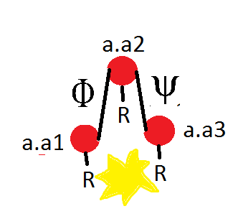
Ramachandran plot
Plots permitted ϕ and ψ angles that do not cause steric hindrance within the polypeptide
Red: ideal angles, side chains further apart, least amount of hindrance, create α-helices and β-sheets
Yellow: side chains slightly closer together, but no steric hindrance
White: angles at which side chains too close together, steric hindrance
steric
hindrance

Slide 29
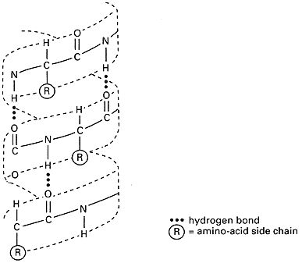
Secondary Structure: alpha Helix
Right handed coiled structure, from 4-40 a.a.
Formed by H-bonds between C=O and N-H between turns
Each turn = 3.6 amino acids
Proline creates bend
H-bonds all oriented in same direction, create strong dipole

Slide 30
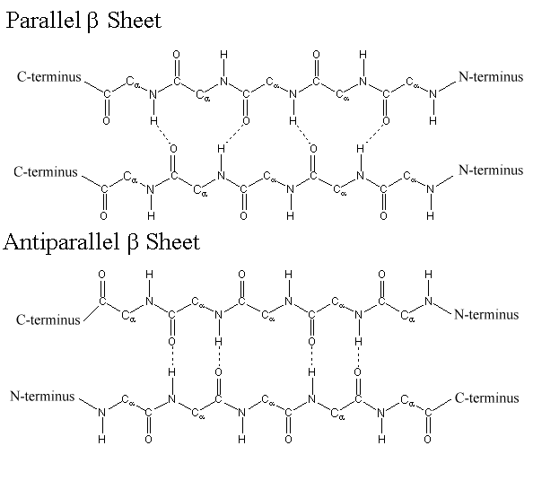
Secondary Structure: Beta Sheets
Polypeptide chains (2+) aligned next to each other
Stabilized via H-bonds between chains
Antiparallel and parallel configurations
Antiparallel sheets connected via hairpin loop
Parallel sheets connected via right-handed (more common) or left-handed loop

Slide 31
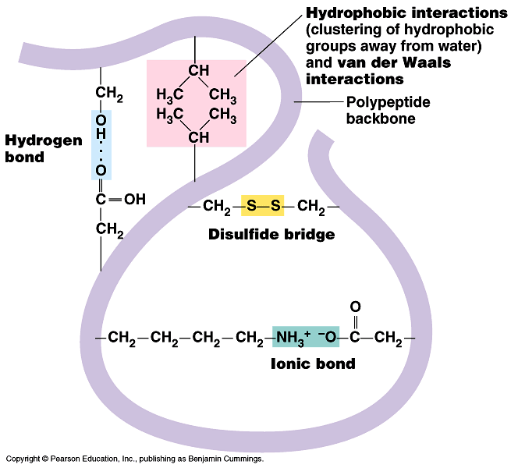
Tertiary Structure
Final specific geometric shape that a protein assumes
Determined by bonding between amino acid side chains
  Disulfide bonds
  Hydrogen bonds
  Hydrophobic interactions
  Electrostatic interactions
  Van der Waals interactions
  Individually, all weak interactions but combined have greater effect

Slide 32
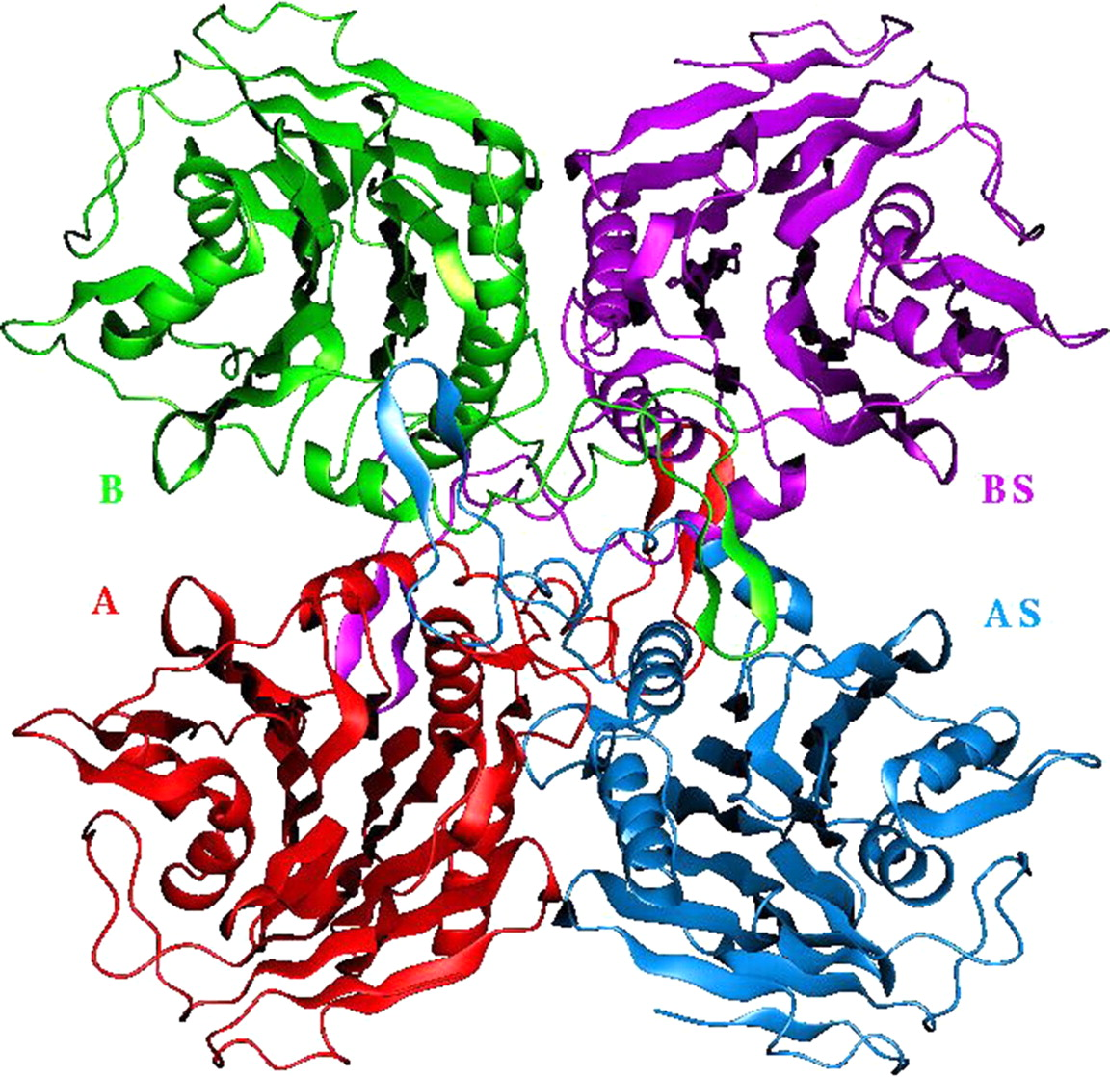
Quaternary Structure
Combination of several individual peptides into final protein structure
Represents interconnections between multiple polypeptide chains
All held together via intermolecular forces: H-bonds, hydrophobic interactions, disulfide bonds and salt bridges

Slide 33
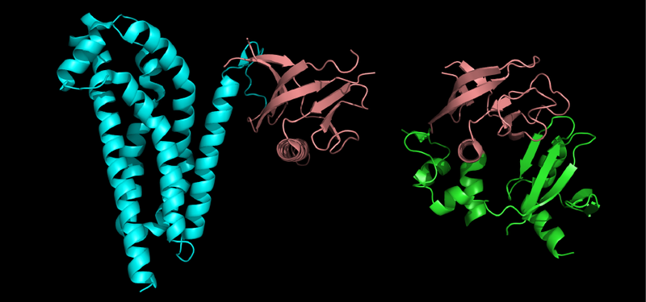
Quaternary Structure: Domains
Tightly folded conserved subregions of a single polypeptide
Independent unit of function: one domain can appear in many proteins
Defined by structure not only sequence
23-500 amino acids

Slide 34
Protein stabilization
Determined by tertiary structure
  Non-polar hydrophobic interactions:
    Non-polar, hydrophobic R side chains hidden in interior when folding protein to prevent destabilization
    Polar, hydrophilic side chains positioned to be able to interact with water as more energetically favourable
    Polypeptide backbone positioned such during folding to allow H-bond interactions
  Hydrogen bonds
    Enhance stability
  Ionic interactions
    Modulate protein structure but contribute little to stability
  Dipole-dipole interactions
    Weak but numerous

Slide 35
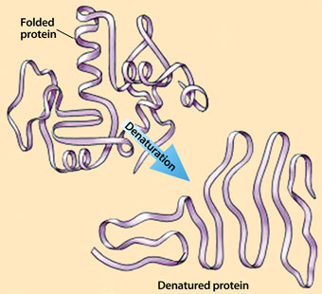
Protein denaturation
Disruption/destruction of secondary and tertiary structure
  Heat: disrupts hydrogen bonds and non-polar hydrophobic interactions
    Increased kinetic energy = increased molecular vibration, bonds broken
  Salt: alters melting point and alters electrostatic interactions
  Urea: alters H-bonds, hydrophobic interactions

Slide 36
Midterm: the basics
Saturday March 2, 2013 1-4 PM
42 Multiple choice questions
  26 Mezl
  16 Figeys/Xu
Essay questions: answer 3 out of 4
  2 Mezl
  2 Figeys/Xu
Content
  Mezl: start of lecture notes to end of sugars, Chapter 1 readings
  Figeys: start to end of proteins (NO KINETICS), Chapter 6 readings
3 hours

