Slide 1
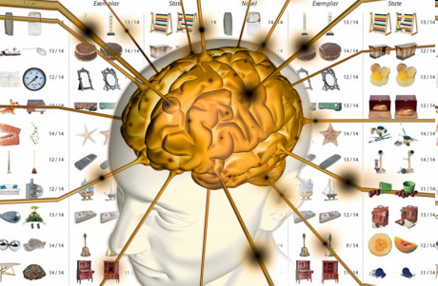
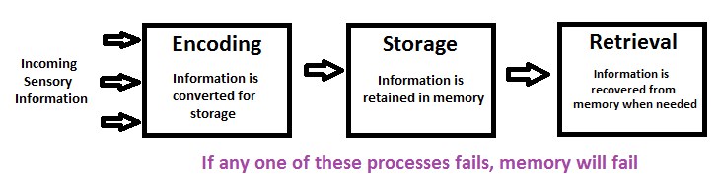
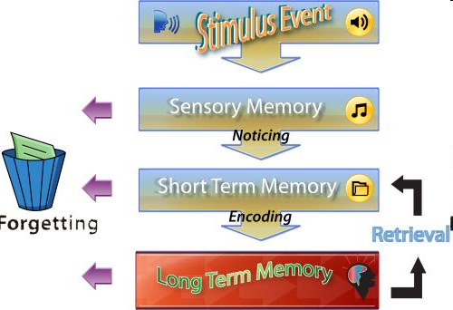
Memory
The persistence of learning over time through the storage and retrieval of information
Information Processing Model of Memory
  Encoding
  Storage
  Retrieval
Stages Model of Memory
  Sensory Memory
  Working Memory
    Short-term memory
  Long-Term Memory

Slide 2
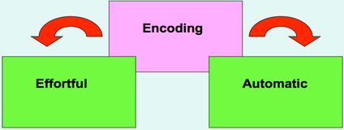
Effortful vs. Automatic Encoding
Automatic Processing
  Unconscious encoding of incidental information
  Space
  Time
  Frequency
  Familiar information
  Classically conditioned associations
Effortful Processing
  Encoding that requires attention and conscious effort
    E.g., Rehearsal
  Class information, people’s names, directions, phone numbers
  Working memory system responsible for effortful encoding

Slide 3
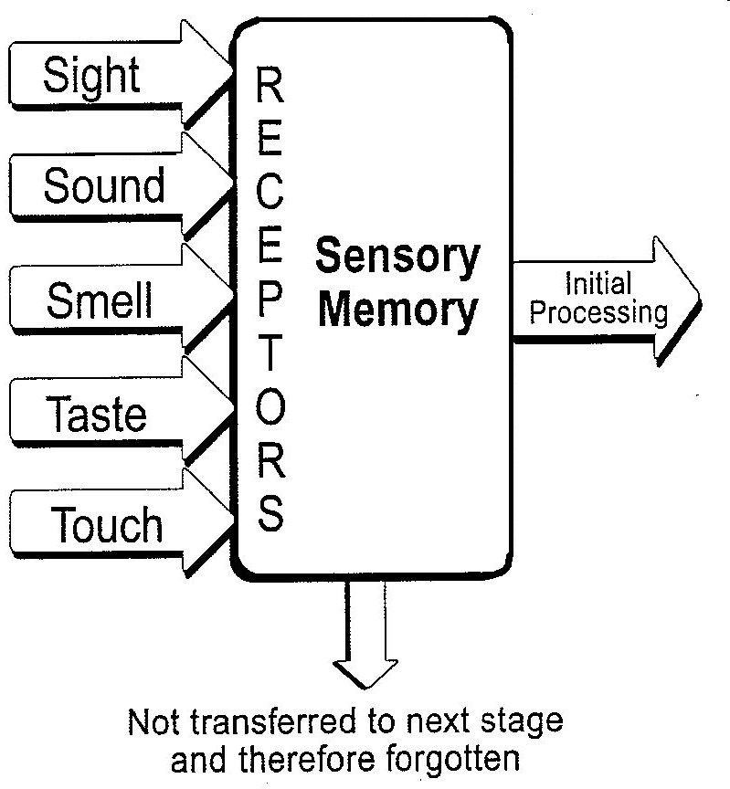

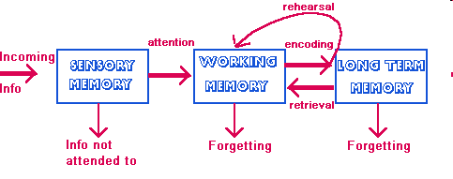
Sensory Memory
Sensory Memory
  First stage of memory
  Relatively exact representation of a sensory experience
  All sensory information
Stored very briefly
  Requires attention or lost
  40/11,000,000
Duration
  Depends on the sensory system
  E.g., vision
    Sperling study

Slide 4

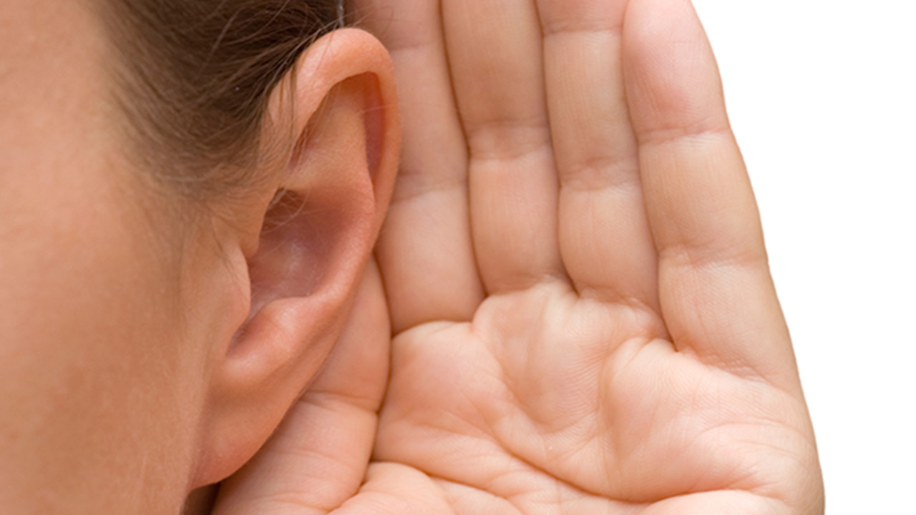
Sensory Memory (cont’d)
Sperling Study
  Recall about half when trying to recall whole array of letters
  Recall almost perfect when trying to recall only one row
Visual Sensory Memory
  Iconic memory
  Half a second
Auditory Sensory Memory
  Echoic memory
  Cocktail Party Phenomenon
  3-4 seconds
Incoming information briefly scanned for relevant/important information

Slide 5
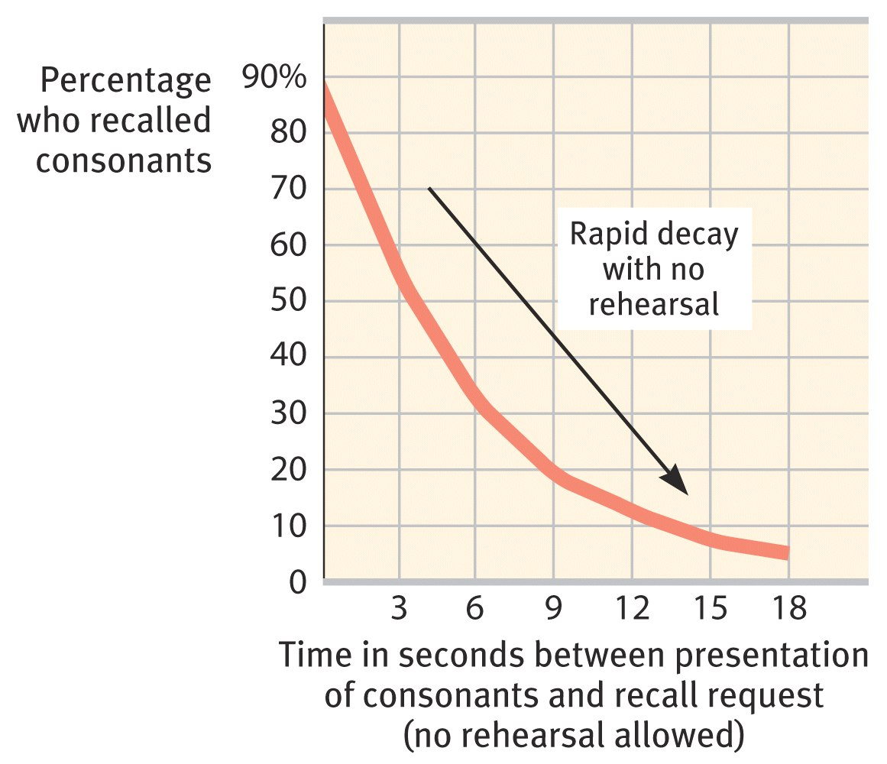
Working Memory/Short Term Memory
Contains attended information from sensory memory
Short term memory capacity
  A) Duration
    Longer duration than sensory memory for unattended information
    Peterson & Peterson Study
  B) Number of units
    7 digits
    6 letters
    5 words
Working memory capacity
  The number and efficiency of mental task performance

Slide 6
Video
http://www.youtube.com/watch?v=WmzU47i2xgw&feature=related
  Man with 30 second memory

Slide 7
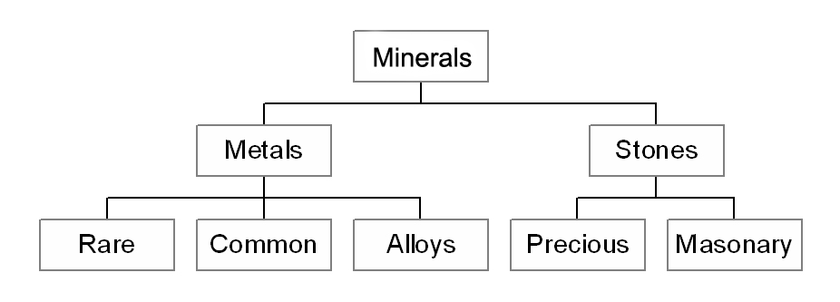
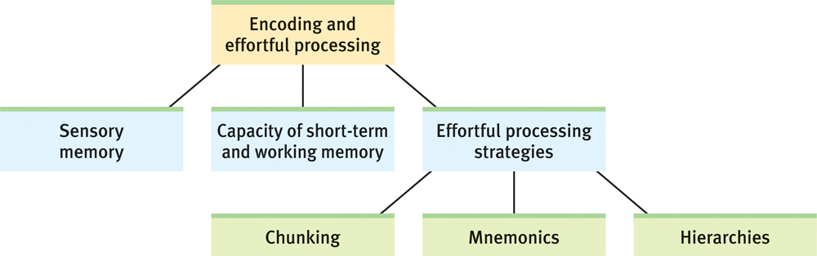
Effortful Processing Strategies
Chunking
  Organizing information into familiar, manageable units
    E.g., phone numbers, SIN number, passcodes
    Chess, basketball, football
      Requires expertise
Hierarchies
  Organization of concepts
    Requires expertise
  Creating categories
    Cat, chair, rain, bed, bird, snow, mouse, sunny, table
    Furniture, weather, animals
NPCNMHEBBLLICAB
NPC NMH EBB LLI CAB
NHL PEI CBC NBA MLB

Slide 8
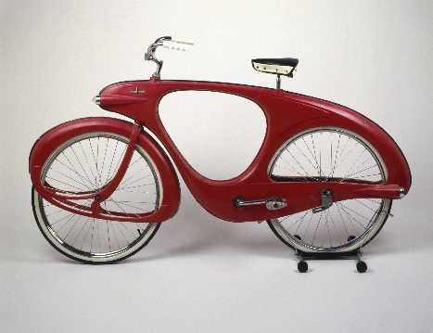



Effortful Processing Strategies (cont’d)
Mnemonics
  Memory aids, especially those techniques that use vivid imagery and organizational devices
Often use visual Imagery
  Creating mental pictures
  Easier with concrete words
    Bicycle, cigarette, fire
    Void, inherent, process
E.g., the peg-word system
  One is a bun, two is a shoe, three is a tree, four is a door, five is a hive, six is sticks, seven is heaven, eight is a gate, nine is swine, ten is a hen
Acronyms
  Chunking mnemonic

Slide 9
crate
TABLE
CLOUD

Slide 10
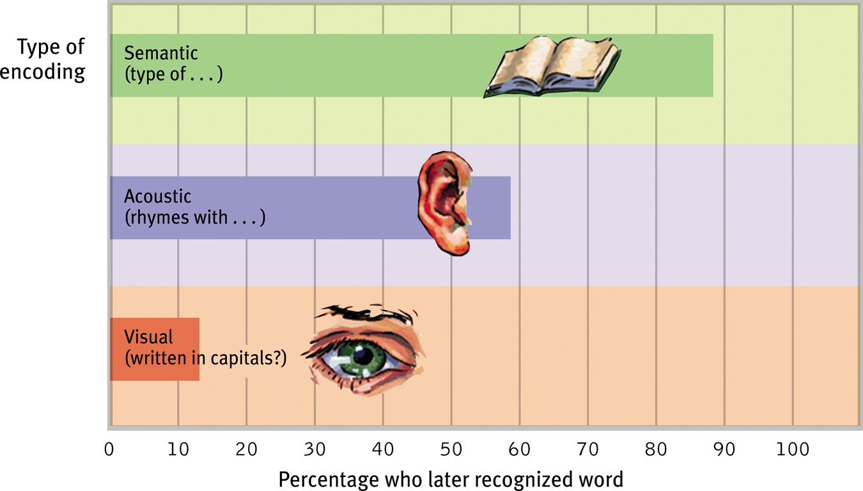
Levels of Processing
Degree of processing of meaning
Craik & Tulving Study
  1) Physical structure (visual encoding)
  2) Phonemic analysis (acoustic encoding)
  3) Semantic analysis (semantic encoding)
Remember something better if it has meaning
The self-reference effect

Slide 11
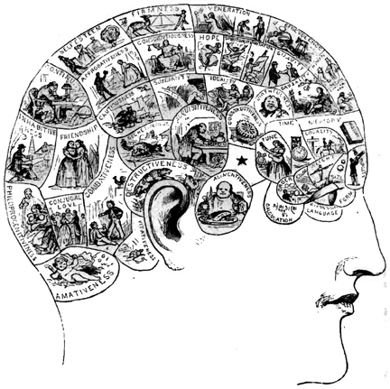
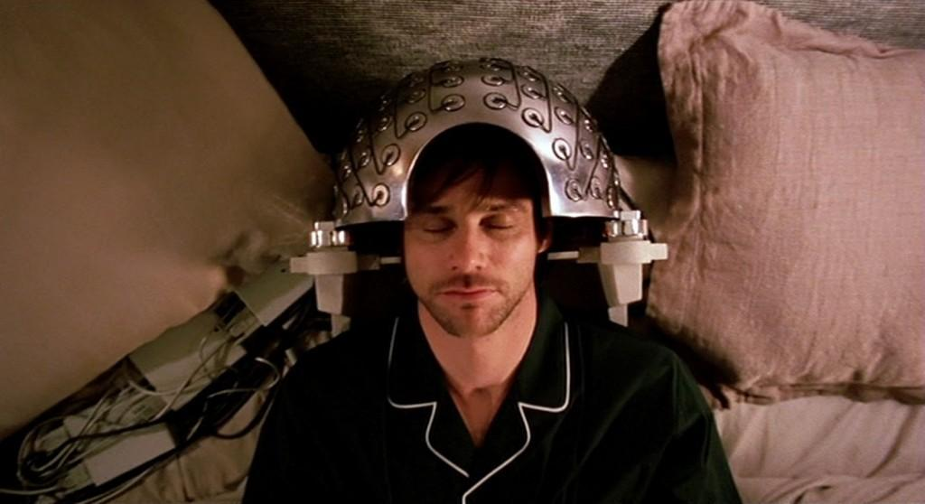
Long-Term memory
Long-Term Memory
  The relatively permanent and limitless storehouse of the memory system
  Minutes to years
Explicit memory
  Memory of facts and experiences that one can consciously declare
  Declarative memory
Implicit memory
  Memory retention independent of conscious recollection
  Non-declarative memory
  Memory of how to do things
    Procedural memories
    E.g., Ride a bike, type
Distributed neural networks
  Memories stored across large networks

Slide 12
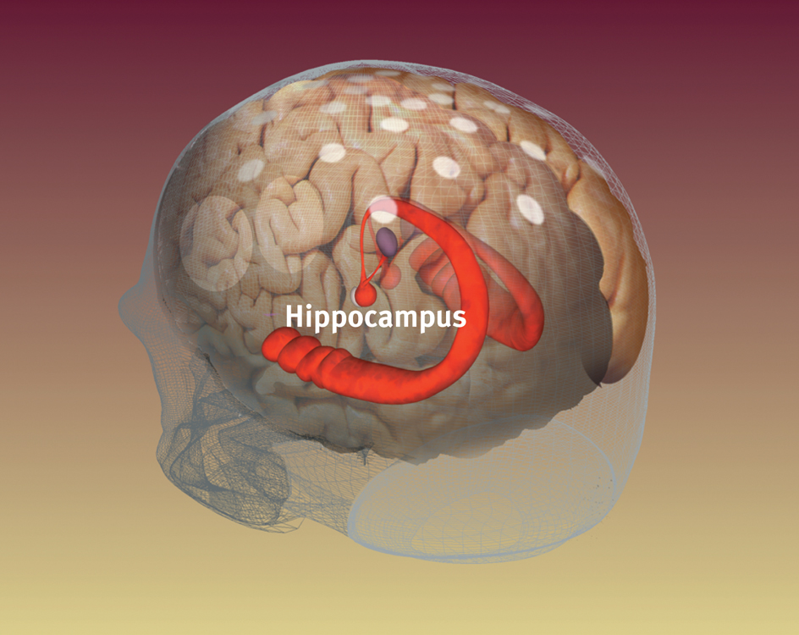
Memory Storage
Explicit Memory System
  Explicit memories are processed and stored by the frontal lobes and hippocampus
Frontal lobes
  Working memory processing
    New information and old memories
Hippocampus
  Saving and retrieving the processed information
    Working memory – Long term memory
    Long term memory – working memory
  Memories not stored in hippocampus
    Registers and holds information to be remembered
    But passes it on to association areas (during deep sleep)
Left-right differences
  Left: verbal information
  Right: visual-spatial information

Slide 13
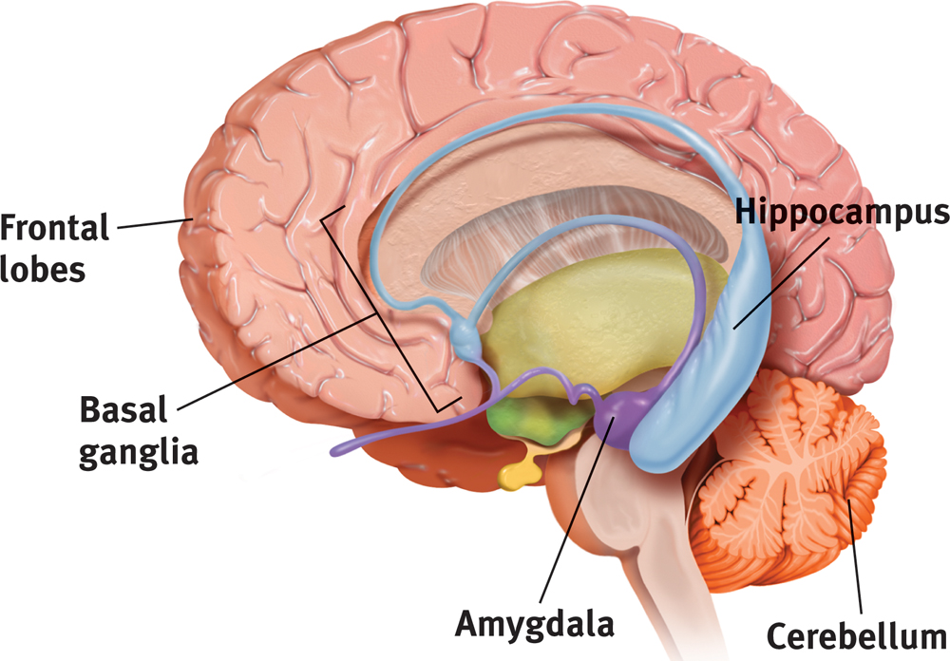
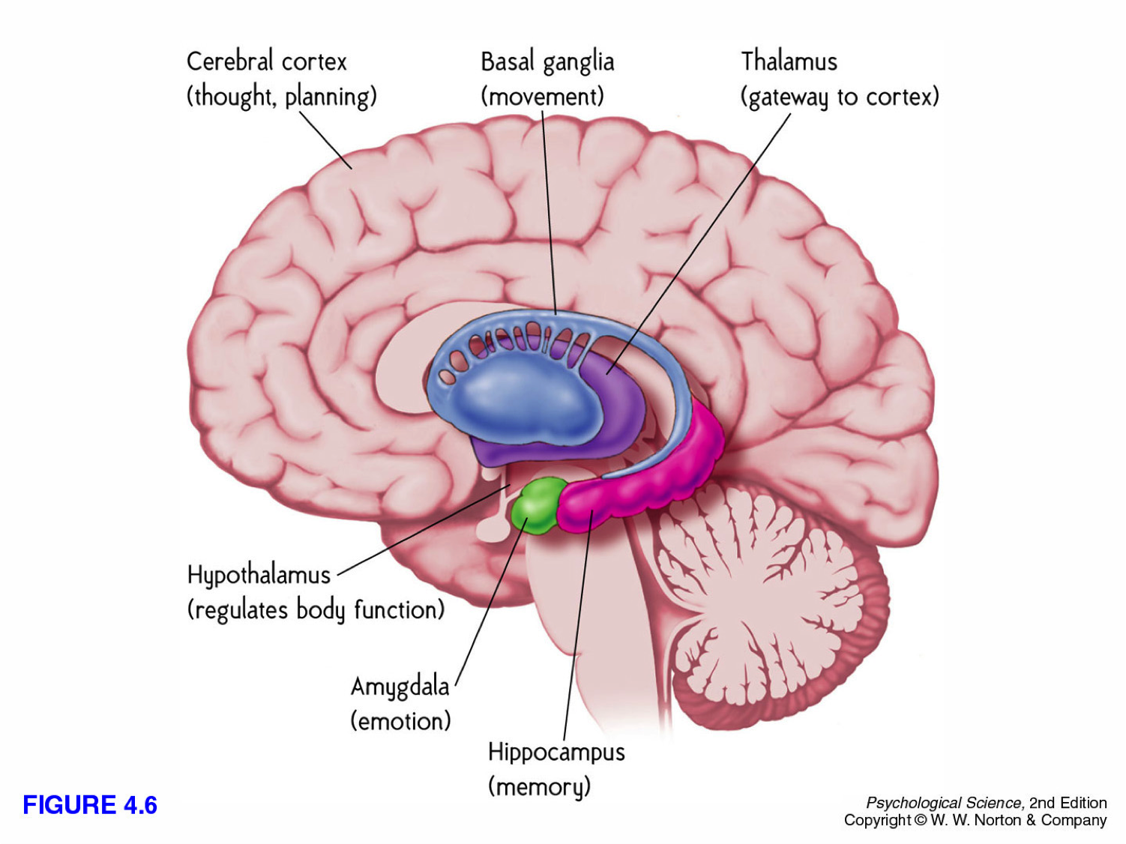
Memory Storage (cont’d)
Implicit Memory System
  Implicit memories are processed and stored by the cerebellum and basal ganglia
Classically conditioned memories
  E.g., hand prick
  E.g., friendly faces
  Disrupted with cerebellum damage
Procedural memory
  Involves the basal ganglia
    Motor control

