Slide 2
QuicksTop
By: The Analyzers
Elliott, Corina, Jacob, Matt, Omar, Owen

Slide 3

Agenda
Critical Assumptions
Problem Analysis
Alternative Summary
Recommended Solution
Implementation

Slide 4
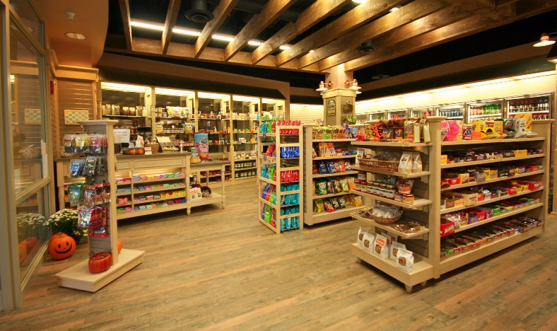
Case Summary
Chain of variety stores
Locations Across Ottawa
Operated by Mikaela West
Owned by Richard Smith

Slide 5

Critical Assumptions
Richard smith is a very capable business man with more than enough experience to run the Quickstop
The traditional recruitment method will not be sufficient for find a replacement manager
Richard smith should consider giving up some control of the business

Slide 6

Primary Problem
Quickstop must replace their retiring manager

Slide 7

Implications on the organization
Company could collapse after Mikaela Retires
Profits could be damaged
Organization will be destabilized

Slide 8

Implication on the Personnel
Morale will be decreased at the loss of a trusted manager
Mikaela’s knowledge and experience will be lost
Richard is at risk of losing another business

Slide 9

Alternative Summary
Executive search
Partnership
Interim Management

Slide 10

Executive Search
Specialized recruitment firm
Seeks out suitable employees from competing firms
Have applied quantitative process to employee placement
Unparalleled abilities

Slide 11

Partnership
Mr. Smith would share business
Find another owner of variety stores
Give up half of equity
Form new business
Other owner would run business

Slide 12
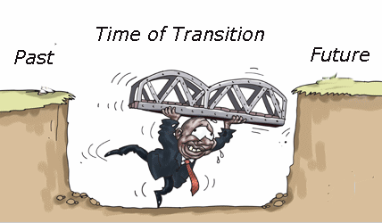
Interim Management
A period of change is recognized
A very skilled manager steps in
Search for new manager
Thoroughly train new manager
Hand off business to new manager

Slide 13

Pros and cons
Pros | Cons
Mr. Smith’s business will make the transition very fluid | He will have to sacrifice his time
The new manager will be better adjusted and more likely to succeed | Mr. Smith’s other businesses may suffer
Because of Mr. Smith’s business skill the company may grow | If the new manager is incompetent he will be stuck

Slide 14

Analysis
Immediate and long term management needs satisfied
New manager will be perfectly molded
Company will be stronger
No monetary cost

Slide 15

Recommendation
Completely solves primary problem and some satellite
Does so at no monetary cost
Other options require sacrifice of equity or capital
Start using contingency planning

Slide 16

Implementation:
Immediate
Hire an interim manager with the appropriate skills and experience to manage a small business
Let the interim manager work hand in hand with the current manager to get a feel of the working environment and to gain the experience before managing it all on his/her own.

Slide 17

Implementation: short term
Interim manager develops a relationship with the supervisory management staff to have better control over the business
More major management roles and tasks for the interim manager to complete

Slide 18

Implementation: long term
New manager is succeeding in controlling all branches of the Quickstop across Ottawa
Leads stores to new success and profits

Slide 19

Conclusion
Large Transition
Can be managed with recommended alternative
Lots of growth into the future

