Slide 1
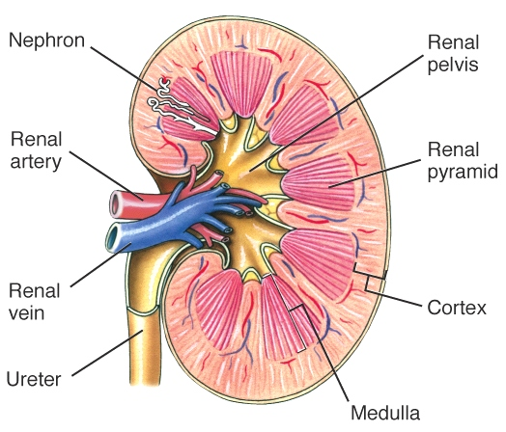
The vertebrate kidney
Kidney
  1% body weight but 20-25% of cardiac output
  Layers
    Cortex
    Medulla
    Renal pelvis
  Functional unit =
  nephron
  Ureters, bladder,
  urethra
Fig. 14-17, Randall et al. 2002

Slide 2
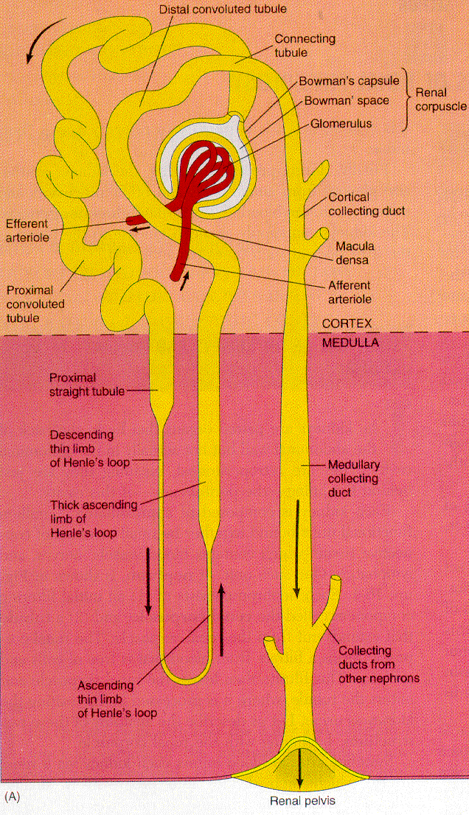
Nephron
  Regions
    (1) Bowman’s capsule
    [Renal corpuscle = Bowman’s capsule + glomerulus]
    (2) Proximal tubule
    (3) Loop of Henle
    - descending limb
    - ascending limb
    (4) Distal tubule
    (5) Collecting duct
Mammals
& birds
only
Fig. 16-1 Vander et al. 1994

Slide 3
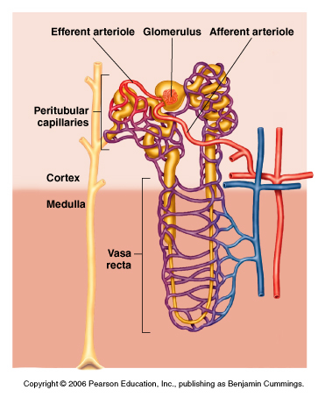
  Renal circulation
    afferent arteriole
    efferent arteriole
    peritubular capillaries and
    vasa recta
Fig. 10.21

Slide 4
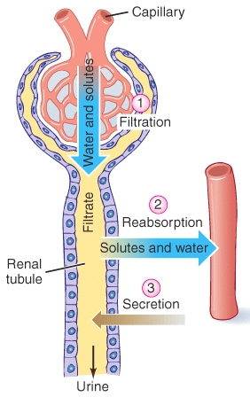
Urine formation
Overview - 3 processes
  (1) Filtration
    Molecular size
    filtrate = blood plasma - proteins
    Glomerular filtration rate (GFR)
      15-25% of H₂O and solutes are filtered
      125 mL min⁻¹
  (2) Reabsorption
    99% H₂O and salts
    active and passive mechanisms
  (3) Secretion
    Selective
    active transport
Fig. 14-21, Randall et al. 2002

Slide 5
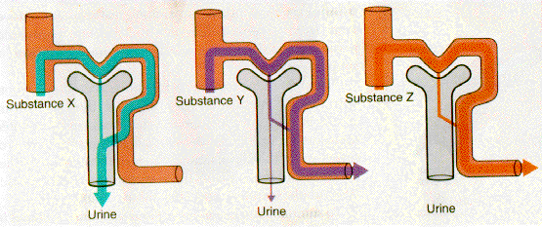
Quantification of renal solute handling
  See Box 10.3
  Renal clearance ratio
  = appearance in urine / appearance in filtrate
  = [X]_{u}· V_{u}
  [X]_{p}· GFR
  RCR values
    RCR = 1 filtration only
    RCR > 1 = net secretion
    RCR < 1 = net reabsorption
  GFR determined from inulin
    RCR = 1
    GFR = [inulin]_{u}·V_{u}
    [inulin]_{p}
X
[X]_{p}, GFR
X
[X]_{u}, V_{u}
X
Fig. 16-7, Vander et al. 1994

Slide 6
Quantification of renal solute handling
  See Box 10.3
  Renal clearance ratio
  = appearance in urine / appearance in filtrate
  = [X]_{u}· V_{u}
  [X]_{p}· GFR
  RCR values
    RCR = 1 filtration only
    RCR > 1 = net secretion
    RCR < 1 = net reabsorption
  GFR determined from inulin
    RCR = 1
    GFR = [inulin]_{u}·V_{u}
    [inulin]_{p}
X
[X]_{p}, GFR
X
[X]_{u}, V_{u}
X
Example:
[Na⁺]_{u} = 710 mmol L⁻¹
V_{u} = 1 L day⁻¹
[Na⁺]_{p} = 150 mmol L⁻¹
GFR = 180 L day ⁻¹
RCR = ?

Slide 7
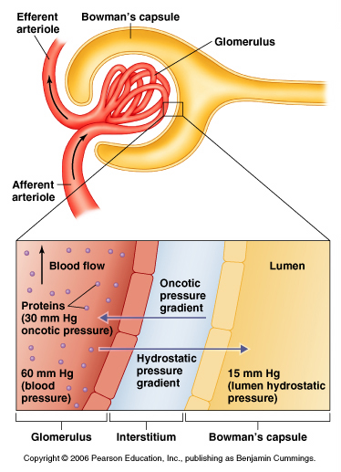
Glomerular filtration
  Pressure gradients
  (1) hydrostatic pressure
  difference = BP - P_{BC} = ~45 mmHg
  (2) colloid osmotic pressure
  difference = ~30 mmHg
  - plasma proteins
  So net filtration pressure
  = 5 to 25 mmHg
  How can this be varied?
Fig. 10.31

Slide 8
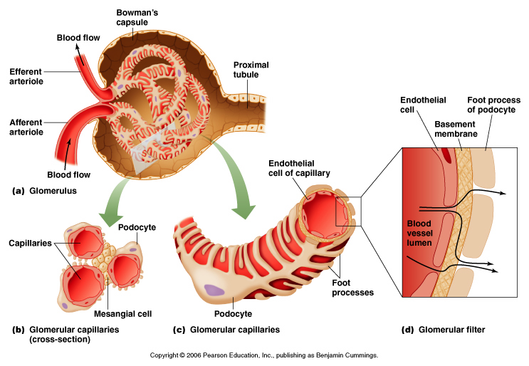
  Permeability - 3 layers
Fig. 10.22

Slide 9
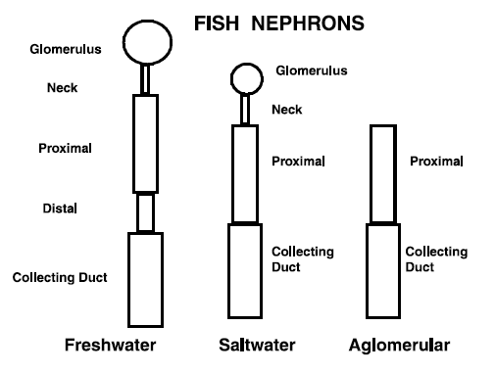
  Comparative considerations – Freshwater vs marine teleosts
    FW – need to eliminate osmotic influx of water
      Many nephrons, well-developed glomeruli → high GFR
    SW – need to conserve water owing to osmotic efflux of water
      Fewer nephrons, small glomeruli → low GFR
      Aglomerular nephrons in ~30 species of marine fish
      - urine formation by secretion
    Euryhaline species
      Adjustment of GFR and secretion under hormonal control
GFR (mL kg⁻¹ h⁻¹)
Fish
Eel
Rainbow trout
Killifish
Freshwater
4.6 ± 0.54
8.6 ± 0.95
25
Seawater
1.0 ± 0.22
1.2 ± 0.05
1.4
Data from Dantzler 1989
Reimschussel 2001

Slide 10
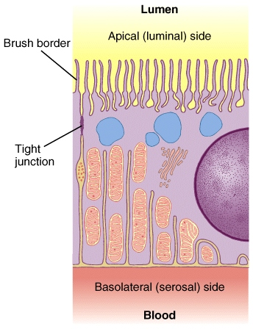
Reabsorption
  Rapid modification of
  original filtrate
    99% H₂O reabsorbed
    99% NaCl reabsorbed
    all glucose, aa’s reabsorbed
    44% urea reabsorbed
  Active and passive
  transport mechanisms
  Note structural characteristics of transport epithelium
    Many mitochondria
    Elaborate membranes
    Tight junctions
Fig. 14-19, Randall et al. 2002

Slide 11
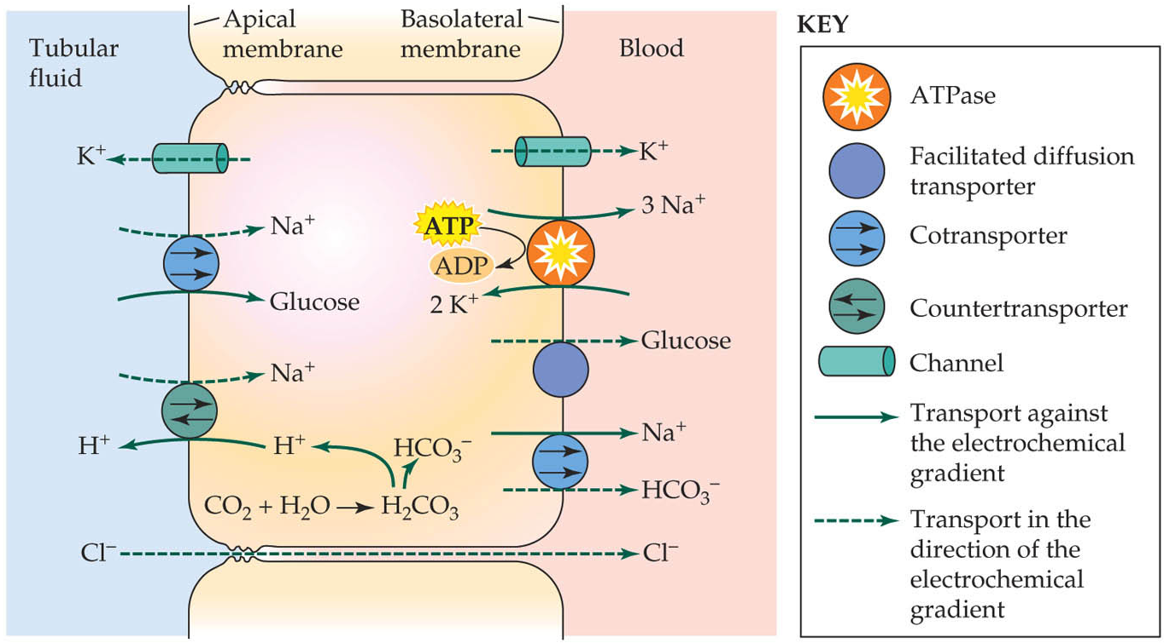
  Mechanisms vary along nephron
    Parallels with FW fish gill, e.g. Compare Na⁺ reabsorption, H⁺ secretion in proximal tubule with acid-secreting MR cell
Proximal tubule
Fig. 27.16 Hill et al. 2004

Slide 12
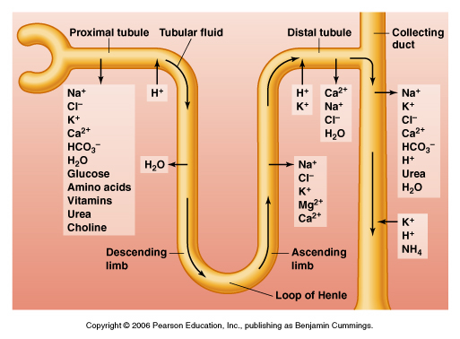
  Through nephron…
    Proximal convoluted tubule
      Reabsorption
      70% NaCl & H₂O
      75% filtrate
    Descending limb
      No active salt transport
      Low NaCl permeability
      H₂O reabsorption
    Ascending limb
      NaCl reabsorption
      Low H₂O permeability
      Filtrate becomes hypo-osmotic
    Distal tubule
      Active NaCl transport
      Aldosterone
      Water follows passively
100
300
800
400
400
600
1000
800
1200
1200
Fig. 10.25
    Collecting duct
      Variable permeability to H₂O
      ADH
      Final step in forming hyperosmotic urine

Slide 13
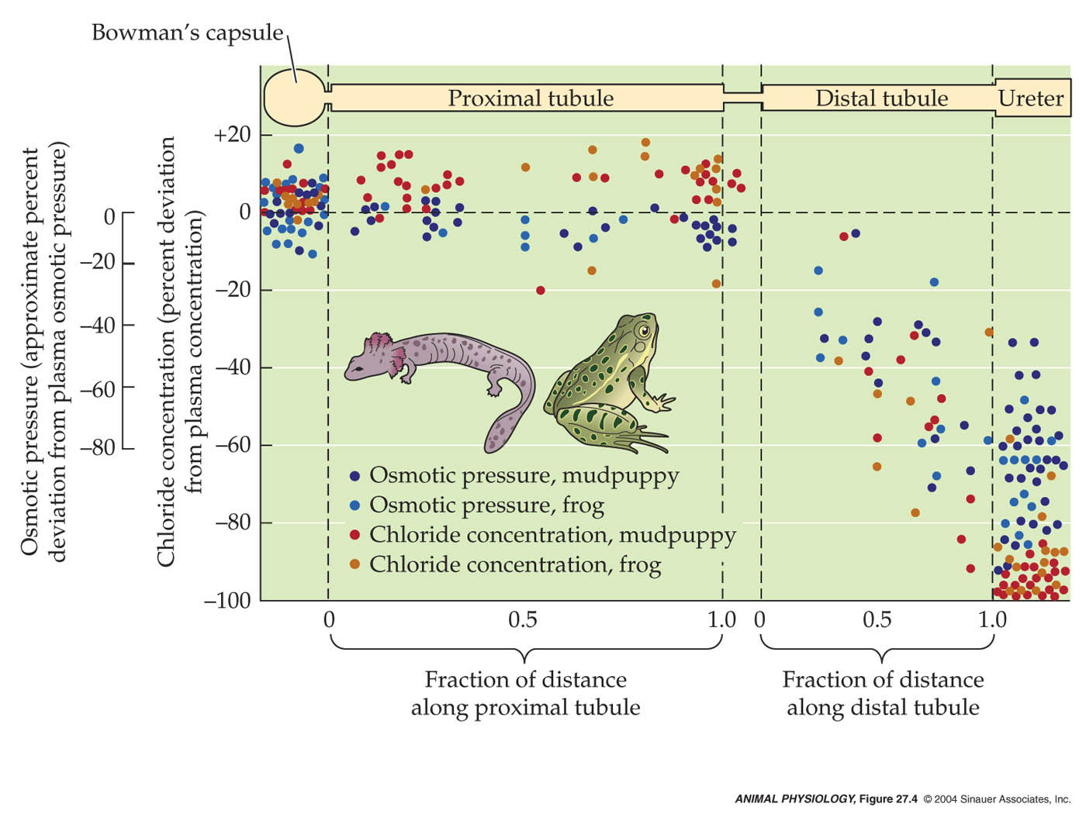
  Comparative considerations – Role of distal tubule
    FW amphibians and fish → “diluting” segment
      Active NaCl reabsorption
      Permeability to H₂O under hormonal control (AVT)
    Marine teleosts → lack distal tubule
Fig. 27.4, Hill et al. 2004

Slide 14
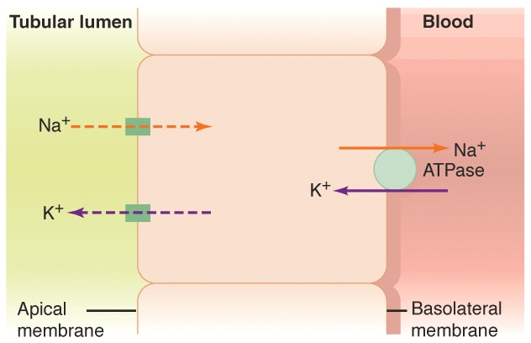
Secretion
  K⁺, H⁺, NH₃, acids and bases
  Distal tubule (see Fig. 10.25)
  Comparative considerations – mechanism of urine formation in aglomerular marine teleosts
    Occurs in proximal tubule
    Active transport of Na⁺, Cl⁻, Mg²⁺, SO₄²⁻ is followed by water and solute influx
Fig. 14-31, Randall et al. 2002
Reimschussel 2001

Slide 15
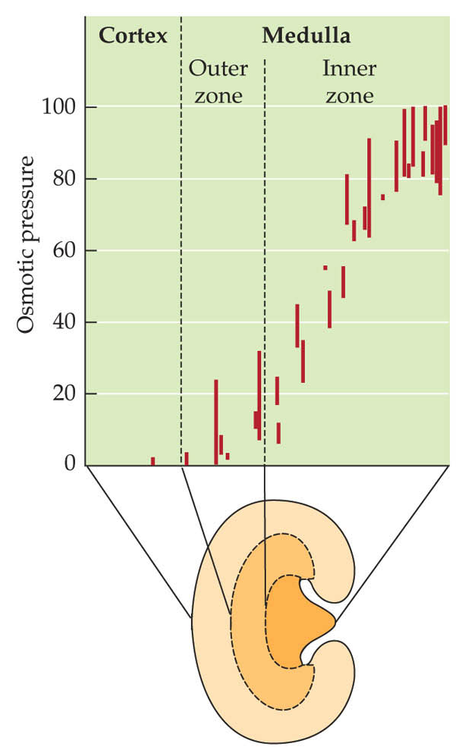
Renal concentrating mechanism (mammals and birds)
  Osmotic removal of water from
  collecting duct
  Corticomedullary concentration gradient
    Increases in [NaCl] and [urea] from cortex to inner medulla
    Based on Loop of Henle
      anatomical layout
      functional asymmetry in permeability and salt transport
      countercurrent principle
Fig. 27.13, Hill et al. 2004

Slide 16
Bowman’s capsule
Proximal tubule
Distal tubule
300
300
Collecting duct
H₂O reabsorption
Active reabsorption
of NaCl
Loop of Henle
1200
1200
See also Fig. 10.25

Slide 17
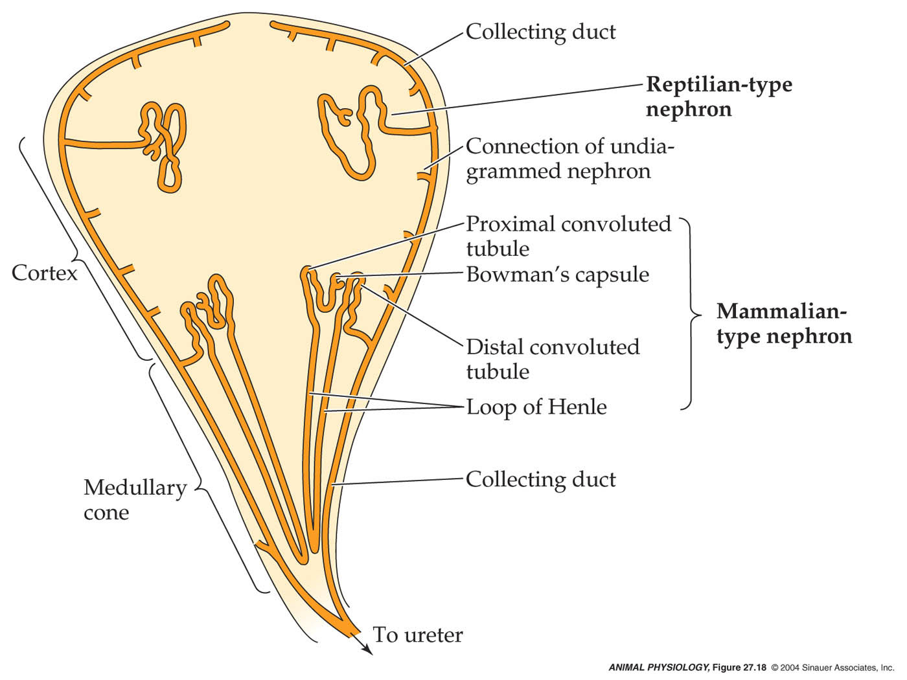
  Comparative considerations
    Fish, amphibians and reptiles lack loop of Henle
    In birds, 10-30% of nephrons have loop of Henle
    In mammals, relative length of loop of Henle
    reflects environment
Fig. 27.18, Hill et al. 2004

Slide 18
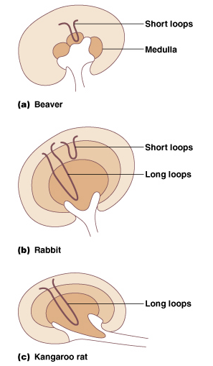
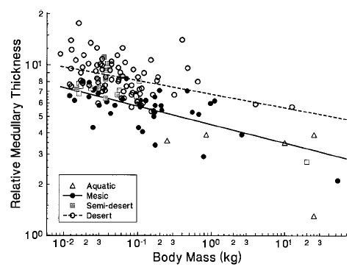
  Comparative considerations
    Fish, amphibians and reptiles lack loop of Henle
    In birds, 10-30% of nephrons have loop of Henle
    In mammals, relative length of loop of Henle
    reflects environment
Al-kahtani et al. 2004 PBZ 77, 346-365
Fig. 10.38

Slide 19
  Sketch the mammalian nephron and indicate where the processes involved in urine formation (i.e. filtration, reabsorption, secretion) occur.

Slide 20
Control of salt and water balance
Ionic and osmotic homeostasis
Neural and/or endocrine control mechanisms
3 methods of regulation
  (1) control of GFR
  (2) Control of salt reabsorption
  - NaCl represents >90% osmotic activity of ECF
  - linkage between salt and water reabsorption
  (3) control of water reabsorption

Slide 21
Case study: BIO 3137 kidney lab
  Three treatments: control, 2% salt water, and water (~0.5-1 L)
  Measure urine flow rate and urine osmotic concentration every 30 min
    time = 0 is pre-treatment
  What data belong to each treatment?

Slide 22
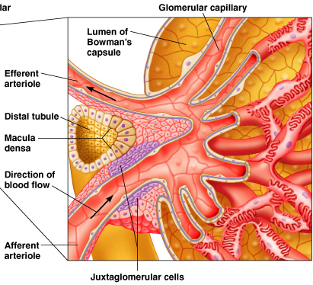
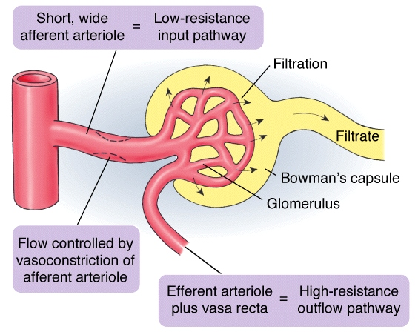
Control of GFR
  Autoregulation (intrinsic control)
    Adjust resistance to flow to maintain
    constant glomerular BP
    Myogenic mechanism (see Fig. 10.33a)
    Paracrine mechanisms (see Fig. 10.33b)
  Extrinsic control
    Alters glomerular BP
    Neural mechanisms (SNS)
    Hormonal mechanisms
      Angiotensin II
      ADH (AVP or AVT)
Fig. 10.32
Fig. 14-20, Randall et al. 2002

Slide 23
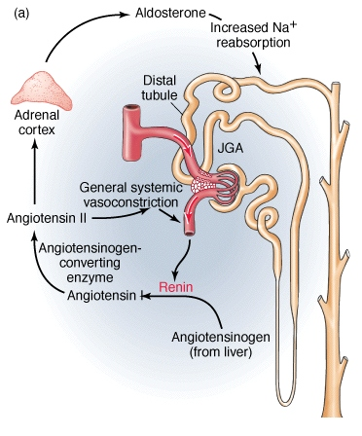
Control of Na⁺ reabsorption
  Juxtaglomerular cells stimulated by
    ↓ [Na⁺], flow (macula densa)
    ↓ blood pressure or volume
    sympathetic stimulation or
    circulating catecholamines
  Response
    renin release
    angiotensin II
      blood pressure
      stimulates aldosterone
    aldosterone
      promotes Na⁺ reabsorption
(ACE)
Fig. 14-29, Randall et al. 2002

Slide 24
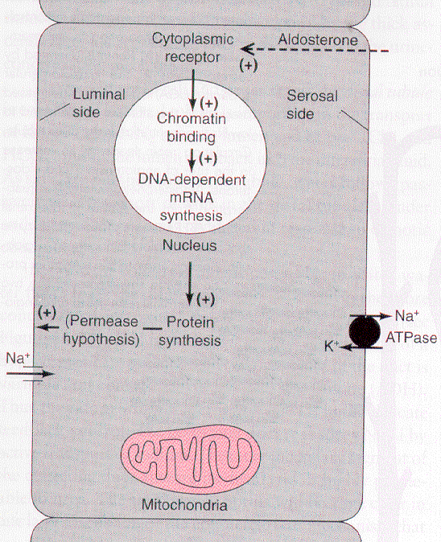
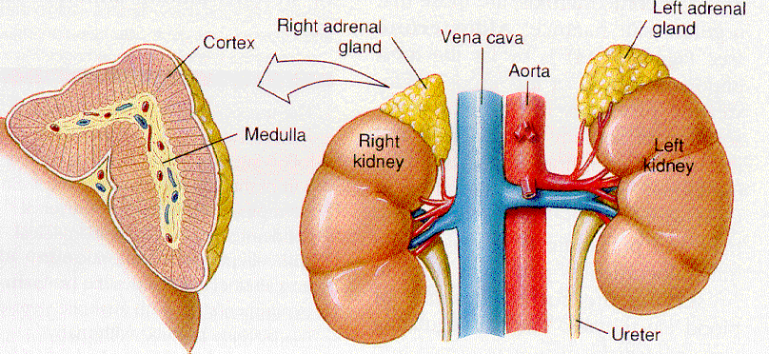
  Aldosterone
    Steroid hormone synthesized by adrenal cortex
    Increases transcription of proteins involved in Na⁺ reabsorption at distal tubule
      # of Na⁺ channels increases
      # of Na⁺ pumps increases
  Comparative considerations → fish
  lack aldosterone
Cortex
(steroid producing cells)
Medulla
(chromaffin cells)
Fig. 37-13, Hickman et al. 1997

Slide 25
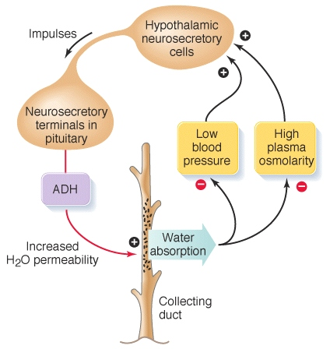
Control of water reabsorption
  ADH secretion controlled by:
    plasma osmolarity
    - hypothalamic osmoreceptors
    blood pressure
    - via baroreceptor reflex and atrial stretch receptors
  ADH regulates
    Collecting duct permeability in mammals (AVP)
    Distal tubule permeability in FW fish, amphibians (AVT)
    What else does AVT do in fish and amphibians?
Fig. 14-35, Randall et al. 2002

Slide 26
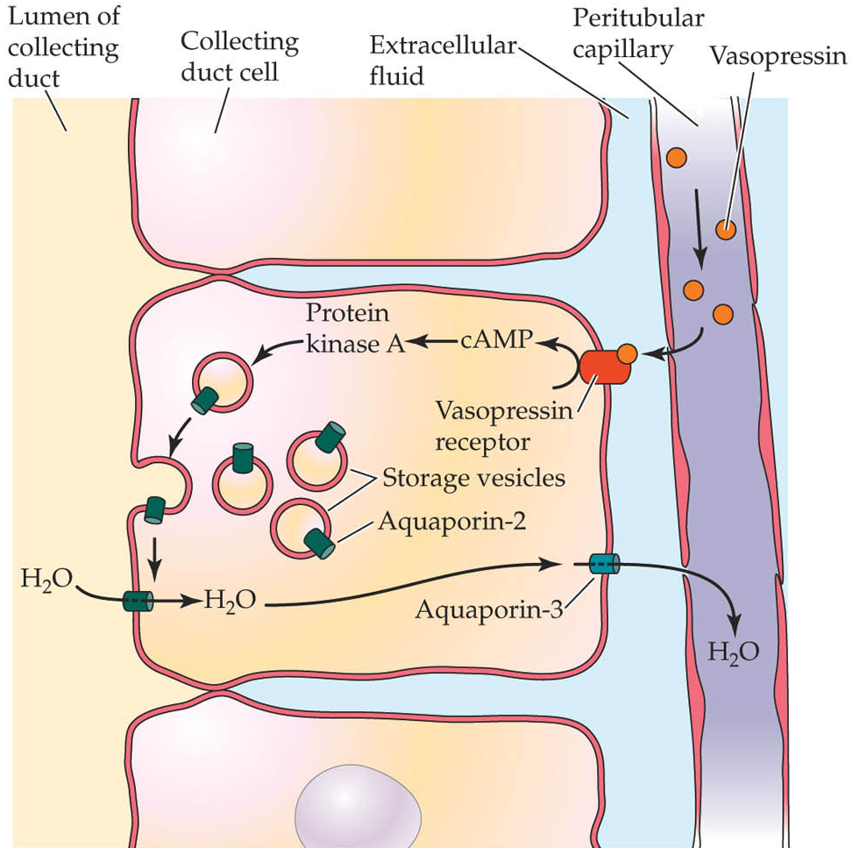
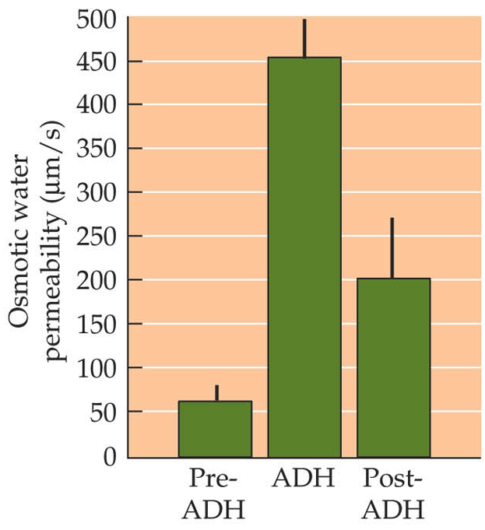
  ADH increases water permeability of collecting duct
    peptide hormone
    Insertion of aquaporins (AQP 2) in apical membrane
Fig. 27.17, Hill et al. 2004
Fig. 14.13, Hill et al. 2004

Slide 27
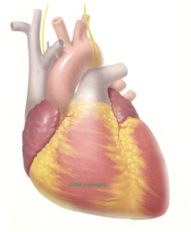
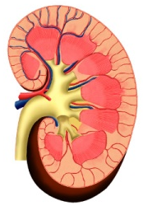
Atrial natriuretic peptide (ANP)
  Involved in control of both salt and water balance
  Responds to increased plasma volume by increasing salt and water excretion
  Stretch-sensitive cells in wall of atrium: stretch → ANP
  ANP increases urinary loss of Na⁺
    inhibits release of renin
    inhibits secretion of aldosterone
    inhibits ADH release
    increases GFR
ANP
↓ Renin
GFR
↓ ADH
-
↓ Aldo
↓ blood
volume
Natriuresis
Diuresis
↓ blood pressure

Slide 28
Case study: BIO 3137 kidney lab
  Three treatments: control, 2% salt water, and water (~0.5-1 L)
  Measure urine flow rate and urine osmotic concentration every 30 min
    time = 0 is pre-treatment
  Can you explain the trends and predict the hormonal responses to these treatments?

Slide 29
Regulation of acid-base balance
Integration of respiratory physiology and ionoregulation/ excretion
  Text: p 455 “The respiratory system can regulate blood pH”
Why regulate pH?
  Protein function
Factors affecting pH
  Intrinsic factors
    H⁺ production by metabolism
    (e.g. ‘lactacidosis’)
    H⁺ fluxes during digestion
    Alterations of breathing
  Extrinsic factors
    Acid or base consumption
    Temperature
    Exposure to conditions that cause acid-base disturbances
      Hypercapnia
      Acidic or basic water

Slide 30
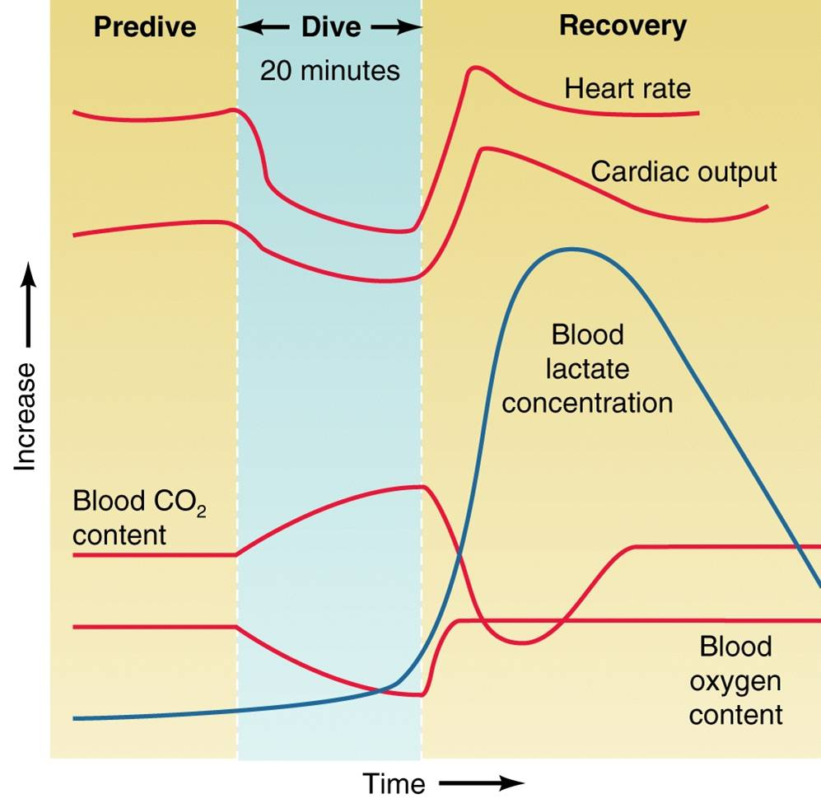
Acid-base disturbances
  Recall CO₂ + H₂O ↔ HCO₃⁻ + H⁺
  Metabolic – pH changes but PCO₂ does not
    Metabolic acidosis, e.g. H⁺ release following exercise, acid infusion
    Metabolic alkalosis, e.g. alkaline tide, base infusion
  Respiratory – pH and PCO₂ change
    Respiratory acidosis, e.g. Exposure to hypercapnia, hypoventilation
    Respiratory alkalosis,
    e.g. hyperventilation
Fig. 12-48, Randall et al. 2002

Slide 31
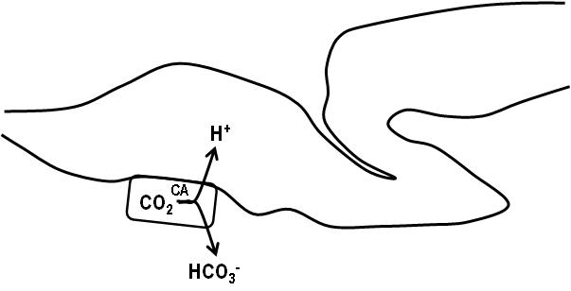
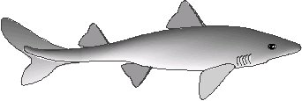
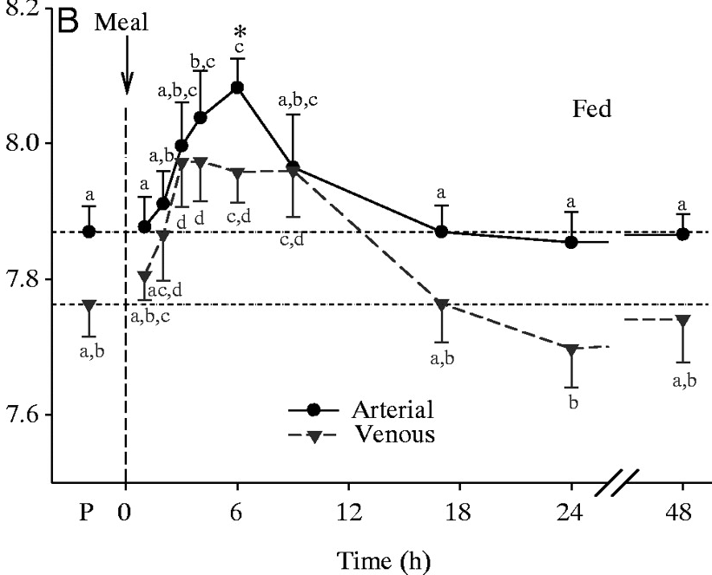
Acid-base disturbances
  Recall CO₂ + H₂O ↔ HCO₃⁻ + H⁺
  Metabolic – pH changes but PCO₂ does not
    Metabolic acidosis, e.g. H⁺ release following exercise, acid infusion
    Metabolic alkalosis, e.g. alkaline tide, base infusion
  Respiratory – pH and PCO₂ change
    Respiratory acidosis, e.g. Exposure to hypercapnia, hypoventilation
    Respiratory alkalosis,
    e.g. hyperventilation
pH
20 mmol L⁻¹
(0.02 mol L⁻¹)
  CO₂ + H₂O ↔ HCO₃⁻ + H⁺
pH 7 → 10⁻⁷ mol L⁻¹
(0.0000001 mol L⁻¹)
Wood et al. 2005 JEB 208, 2693-2705

Slide 32
Acid-base disturbances
  Recall CO₂ + H₂O ↔ HCO₃⁻ + H⁺
  Metabolic – pH changes but PCO₂ does not
    Metabolic acidosis, e.g. H⁺ release following exercise, acid infusion
    Metabolic alkalosis, e.g. alkaline tide, base infusion
  Respiratory – pH and PCO₂ change
    Respiratory acidosis, e.g. Exposure to hypercapnia, hypoventilation
    Respiratory alkalosis,
    e.g. hyperventilation
20 mmol L⁻¹
  CO₂ + H₂O ↔ HCO₃⁻ + H⁺
pH 7 → 10⁻⁷ mol L⁻¹

Slide 33
Compensation for acid-base disturbances
  Recall CO₂ + H₂O ↔ HCO₃⁻ + H⁺
  Respiratory compensation – adjustments of PCO₂ (via breathing)
  Metabolic compensation – direct adjustments of H⁺ and/or HCO₃⁻ (via gills, kidney or skin)
  To correct an acidosis ([H⁺] too high)
    “Blow off” CO₂: CO₂ ← HCO₃⁻ + H⁺
    Accumulate HCO₃⁻ and/or excrete H⁺
  To correct an alkalosis ([HCO₃⁻] too high)
    Retain CO₂: CO₂ → HCO₃⁻ + H⁺
    Excrete HCO₃⁻ and/or accumulate H⁺

Slide 34
Acid-base disturbances – a bit of practice
  Describe the acid-base disturbance caused by each of the following situations as (1) an acidosis or alkalosis and (2) metabolic or respiratory. How could each one be corrected?
    The hyperventilation experienced by a human at high altitude
    Prolonged, severe vomiting (hint – acid is added to the stomach in digestion)
    Release of lactic acid from muscles after surfacing from a prolonged dive (beyond the aerobic limit) by a Weddell seal
    Exposure of a rainbow trout to hyperoxic water (high O₂ water)

Slide 35
Compensation for acid-base disturbances: tetrapods vs fish
  Differ in reliance on respiratory compensation
  Differ in primary organ for metabolic compensation
  Tetrapods
    Alter ventilation
    Rely on HCO₃⁻ adjustment via the kidney
      During acidosis, HCO₃⁻ is retained by
      enhancing tubular HCO₃⁻
      reabsorption
CO₂
H⁺
HCO₃⁻

Slide 36
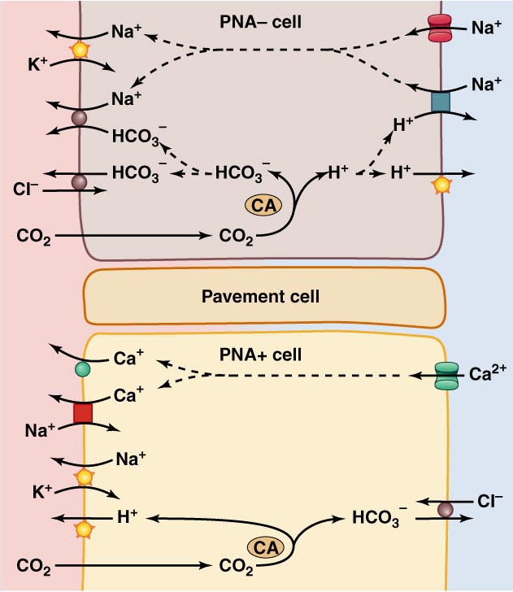
  Teleosts
    No respiratory compensation
      PCO₂ very low
      Fish cannot afford to hypoventilate
    Rely on H⁺/HCO₃⁻ adjustment via the gills
      H⁺ excretion linked to
      Na⁺ uptake
      HCO₃⁻ excretion linked to
      Cl⁻ uptake
    Kidney plays supporting role
Acid-secreting cell
H⁺
HCO₃⁻
Base-secreting cell
H⁺
HCO₃⁻
Cl⁻
Fig. 10.11

Slide 37
Nitrogen Excretion
Why must N₂ be excreted?
Carbohydrates
Fats
H₂O
CO₂
H
Nucleic acids
Nitrogenous bases
C skeleton
+
-NH₂ group
N
Proteins
Amino acids
H
H
Ammonia
Toxicity:
Fish - 0.05-1.0 mmol L⁻¹
Mammals - <0.05 mmol L⁻¹

Slide 38
Nitrogen end products
  Role of environment, particularly environmental water availability
Ammonia
Urea
Uric acid
highly toxic
less toxic
much less toxic
0.5 L g⁻¹ N
0.05 L g⁻¹ N
0.001 L g⁻¹ N
synthesis requires
ATP
synthesis requires
ATP
Ammonotelic animals:
Aquatic invertebrates,
bony fish,
larval amphibians
Ureotelic animals:
Mammals,
adult amphibians
Uricotelic animals:
Birds, reptiles
terrestrial insects

Slide 39
Ammonia-excreting animals
  Aquatic invertebrates, bony fish, larval amphibians
  Excreted by diffusion across gills or body surface
    Role of Rh glycoproteins
    Need for NH₄⁺ transporters
  Linkage with CO₂ excretion – “acid-trapping” mechanism
Water
(pH ~8)
Plasma
(pH ~7.8)
CO₂
CO₂
CO₂
+
H₂O
↓
H⁺
+
HCO₃⁻
ATP
NH₄⁺ ↔ NH₃ + H⁺
At physiological pH,
NH₄⁺ >> NH₃
NH₄⁺ ← H⁺ +
NH₃
NH₃
NH₃
NH₄⁺
H⁺
gill

Slide 40
Urea-excreting animals
  pros and cons
  Excreted via kidneys or gills
    Role of urea transporters
  Synthesis pathways
    OUC – mammals, adult amphibians, elasmobranch fish, a few teleost fish
    uricolysis (invertebrates), arginolysis (most teleost fish)
NH₄⁺ + HCO₃ ⁻
Arginine
NH₄⁺ + HCO₃⁻
2ATP
arginase
Carbamoyl
phosphate
Ornithine
UREA
Ornithine
UREA
arginase
90% ammonia
10% urea
Citrulline
Arginine
Aspartic
acid
Arginosuccinate

Slide 41
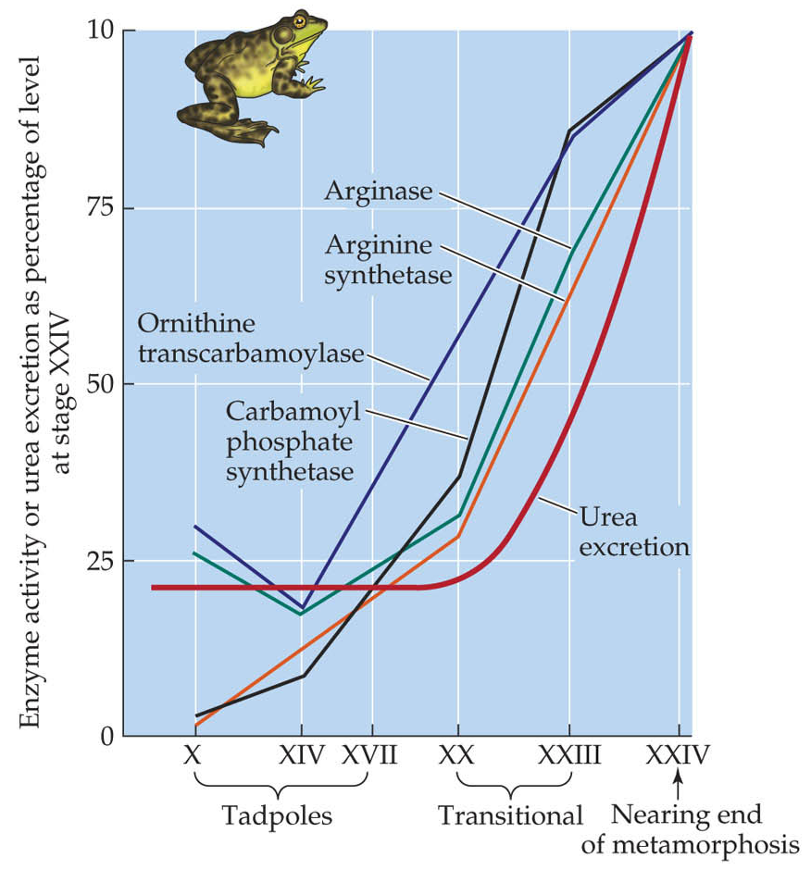
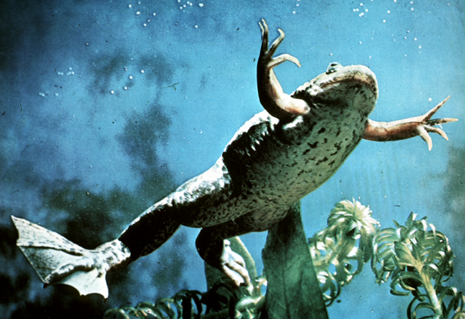
  Link to environmental water availability
    Amphibian metamorphosis
Fig. 27.24, Hill et al. 2004
Xenopus

Slide 42
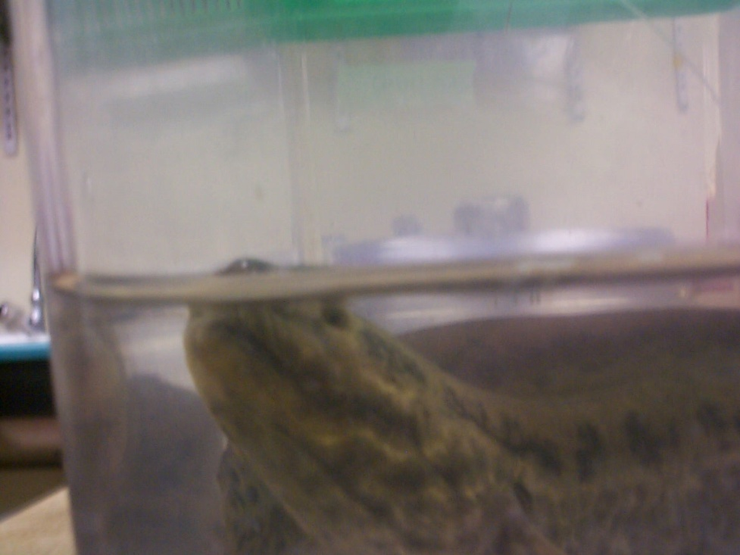
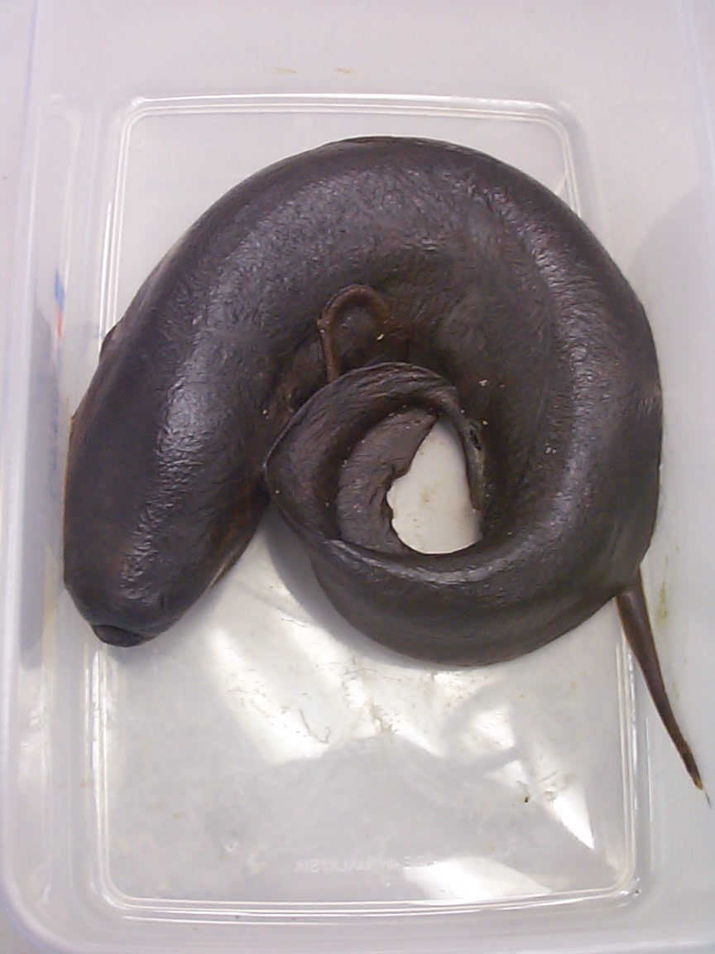
    Lungfish – drought results in urea synthesis by OUC (facultative ureotele)
    - also climbing perch, snakehead, mudskipper, amphibious blenny
NH₃
urea

Slide 43
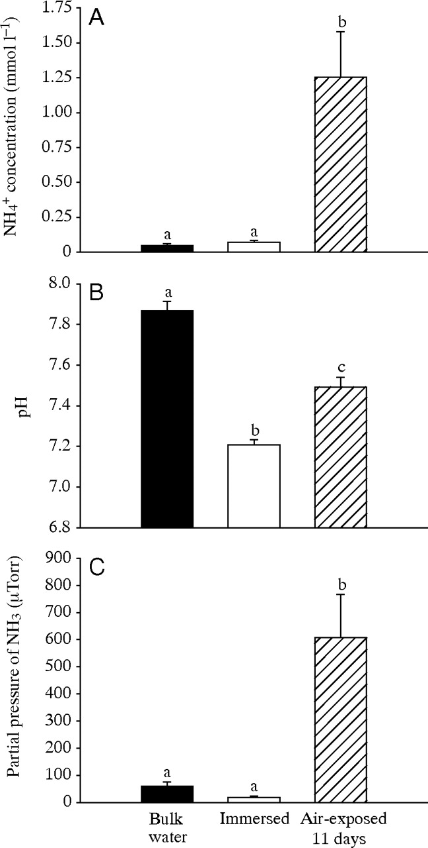
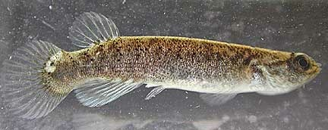
  Interesting exception – NH₃ volatilization by the mangrove killifish
    can survive >1 month out of water
Litwiller et al. 2006, JEB 209, 1737-1745

Slide 44
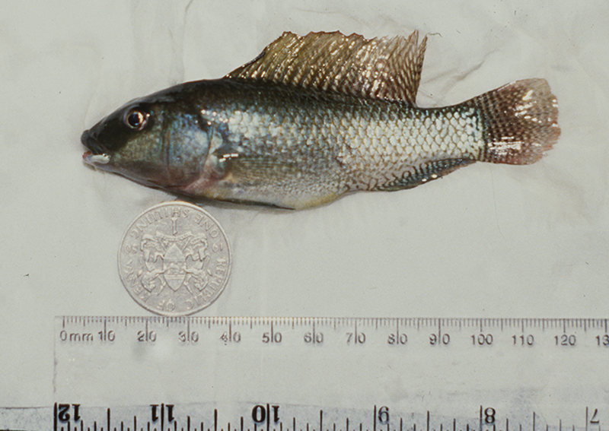
  High pH water and the Lake Magadi tilapia
    Obligate ureotele (OUC)
    Lake Magadi – pH ~10, highly buffered
    Partial pressure gradient for NH₃ excretion
    eliminated by high pH → no acid-trapping
CO₂
CO₂
CO₂
Randall et al., 1989, Nature 337, 165-166
H⁺
ATP
NH₄⁺ ↔ NH₃ + H⁺
pK ≈ 9.5
*recall “normal” water, pH ~8
NH₃
NH₃
NH₃
water
gill
blood

Slide 45
  Osmoregulatory strategy
    urea plus trimethylamine oxide (TMAO)
    Elasmobranch fish, chimaerans, coelacanth
[urea] = 400 mM
[TMAO] = 70-100mM
Sea water
Dogfish
Flounder
[Na⁺]
473
269
180
[Cl⁻]
552
258
160
[Mg²⁺]
54
1.1
1
[SO₄²⁻]
28
1
0.2
[Ca²⁺]
10
3.2
3
[K⁺]
10
4.3
4
O.C.
~1000
~1000
337
[ion] in mmol L⁻¹; O.C. in mOsmol L⁻¹

Slide 46
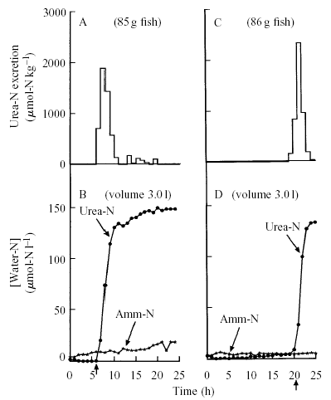
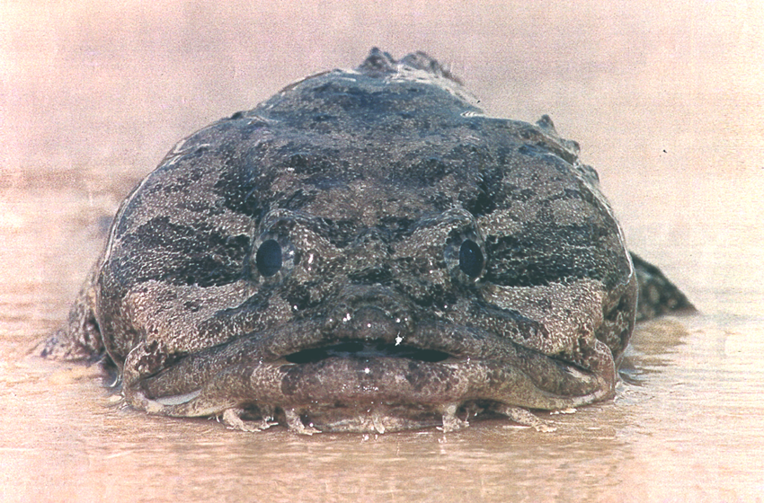
  Chemical cloaking?
    Gulf toadfish following confinement or exposure to high water NH₃
    Facultative; OUC
    Elimination is pulsatile; involves mobilization of urea transporters in gills
Wood et al. 1995, JEB 198, 1729-1741

Slide 47
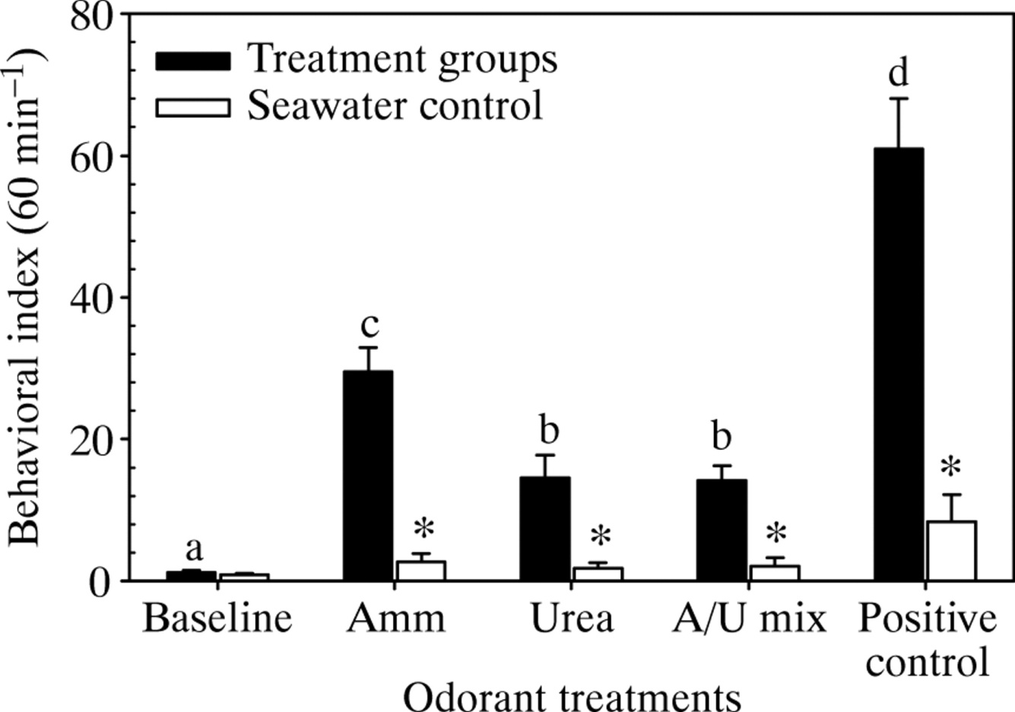
  Chemical cloaking?
    Gulf toadfish following confinement or exposure to high water NH₃
    Facultative; OUC
    Elimination is pulsatile; involves mobilization of urea transporters in gills
Barimo & Walsh 2006 JEB 209, 4254-4261

Slide 48
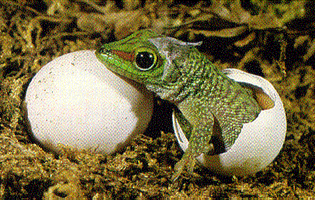
Uric acid-excreting animals
  pros and cons
  Birds, reptiles, terrestrial insects
    Exceptions - crocodiles
  Uric acid synthesis
  Excretion by kidneys or Malpighian tubules
    Excreted as urate salts of K⁺, Na⁺ or NH₄⁺
    or as precipitated uric acid
    Secreted by bird and reptile nephrons
    - precipitation in cloaca
  Uric acid retention - Cleidoic eggs, fat bodies in some insects
nucleic acid
metabolism
amino acids
transaminases
glycine, aspartate,
glutamate
purine ring
URIC ACID

