Slide 1
Marketing Revision
Eric Martineau

Slide 2
What is Marketing?
Marketing is a process by which companies create value for customers and build strong customer relationships to capture value from customers in return
Marketing is managing profitable customer relationships.

Slide 3
The Marketing Process
Understand the marketplace & customer needs and wants
Design a customer-driven marketing strategy
Construct a marketing program that delivers superior value
Build profitable relationships and create customer delight
Capture value from customers to create profits and customer equity

Slide 4
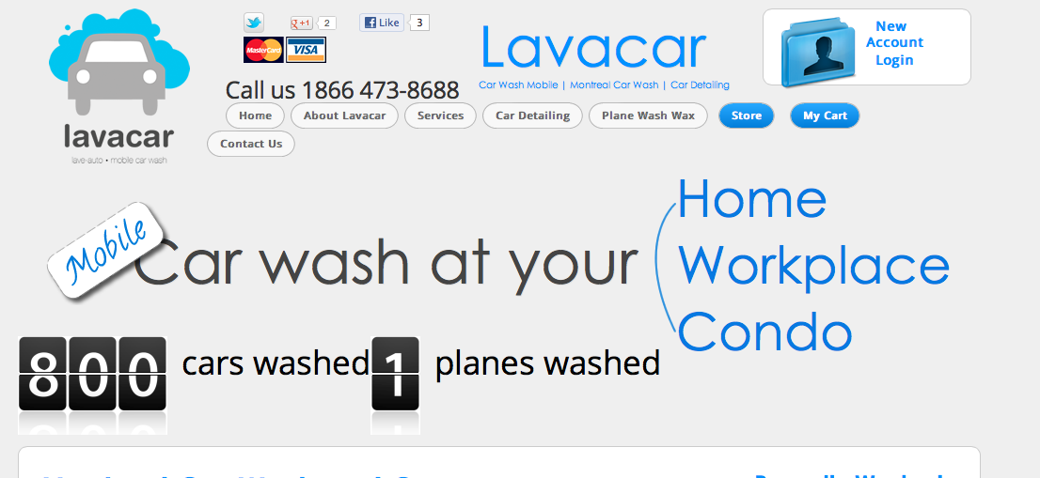
Lavacar

Slide 5
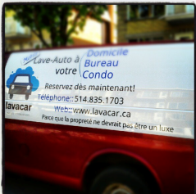
The Marketing Process
Starting with needs, wants & demands.
Understand the marketplace & customer needs and wants
Clean car
Efficient
Time saving

Slide 6
The Marketing Process
Segmentation & differentiation
Design a customer-driven marketing strategy
Who gets their cars washed?
How is this service better then the competition?
What is the unique value created with this service?

Slide 7
The Marketing Process
Create a marketing mix where strategy is
Implemented through the use of the 4 P’s
Construct a marketing program that delivers superior value
Price
Promotion
Place
Product

Slide 8

The Marketing Process
Monitoring customer satisfaction
Build profitable relationships and create customer delight
Build profitable relationships and create customer delight
Customers will repeat purchase
Purchase more products
Exchange of value
What is value?
Sales, Profit, Customer Equity

Slide 9
Designing a customer-driven marketing strategy
Marketing management is the art and science of choosing target markets and building profitable relationships with them
  What customers will we serve?
  How can we best serve these customers?

Slide 10
Designing a customer-driven marketing strategy
Market segmentation refers to dividing the markets into segments of customers
Target marketing refers to which segments to go after
It is impossible to serve every client in every way.

Slide 11
Designing a customer-driven marketing strategy

Slide 12
Designing a customer-driven marketing strategy
The marketing mix is the set of tools (four Ps) the firm uses to implement its marketing strategy.
  Product,
  Price,
  Promotion,
  Place.

Slide 13
Analyzing the Marketing Environment
Strengths
Weaknesses
Opportunities
Threats
Internal capability that may help the company reach it’s objectives
Internal limitation that may interfere with a company’s ability to achieve its objectives
External forces that the company may be able to exploit to its advantage
Current and emerging external factors that may challenge the company’s performance

Slide 14
Analyzing the Marketing Environment
Microenvironment
Strengths
Weaknesses
Opportunities
Threats
Internal capability that may help the company reach it’s objectives
Internal limitation that may interfere with a company’s ability to achieve its objectives
External forces that the company may be able to exploit to its advantage
Current and emerging external factors that may challenge the company’s performance

Slide 15
Analyzing the Marketing Environment
Marketing
Company
Suppliers
Intermediaries
Competitors
Publics
Customer
Marketing
Company
Suppliers
Intermediaries
Competitors
Publics
Customer
Very reliable staff
Contract with a Montreal-based supplier

Slide 16
Analyzing the Marketing Environment
Macroenvironment
Strengths
Weaknesses
Opportunities
Threats
Internal capability that may help the company reach it’s objectives
Internal limitation that may interfere with a company’s ability to achieve its objectives
External forces that the company may be able to exploit to its advantage
Current and emerging external factors that may challenge the company’s performance
Strengths
Weaknesses
Opportunities
Threats
Internal capability that may help the company reach it’s objectives
Internal limitation that may interfere with a company’s ability to achieve its objectives
External forces that the company may be able to exploit to its advantage
Current and emerging external factors that may challenge the company’s performance

Slide 17
Analyzing the Marketing Environment
Marketing
Demographic
Economic
Natural
Technologic
Political
Cultural
Marketing
Demographic
Economic
Natural
Technologic
Political
Cultural
Car ownership by region
Average worth of a car
Core beliefs: cleanliness

Slide 18
Creating the research plan
Marketing research is the systematic design, collection, analysis, and reporting of data relevant to a specific marketing situation facing an organization
Will there be a demand for this product?
Marketing research

Slide 19
Creating the research plan
Secondary data consists of information that already exists somewhere, having been collected for another purpose
  PMB
  GMID
  Statistics Canada
Primary data consists of information gathered for the special research plan
Marketing research

Slide 20
Creating the research plan
Research Approaches
Observational
Ethnographic
Survey
Experimental
Research Approaches
Observational
Ethnographic
Survey
Experimental
Marketing research

Slide 21
Understanding my clients
Through the research, I understood more about my potential clients.
Cultural
Social
Personal
Psychological
Buyer

Slide 22
Understanding my clients
Cultural
Social
Personal
Psychological
Buyer
Personal
Economic situation
Lifestyle
Age & life-cycle stages
Occupation
Personality & self-concept
Personal
Economic situation
Lifestyle
Age & life-cycle stages
Occupation
Personality & self-concept
Lifestyle is a person’s pattern of living as expressed in his or her psychographics
Measures a consumer’s AIOs to capture information about a person’s pattern of acting and interacting in the environment
  Activities
  Interests
  Opinions
Personal
Economic situation
Lifestyle
Age & life-cycle stages
Occupation
Personality & self-concept
Personal income
Savings
Interest rates

Slide 23

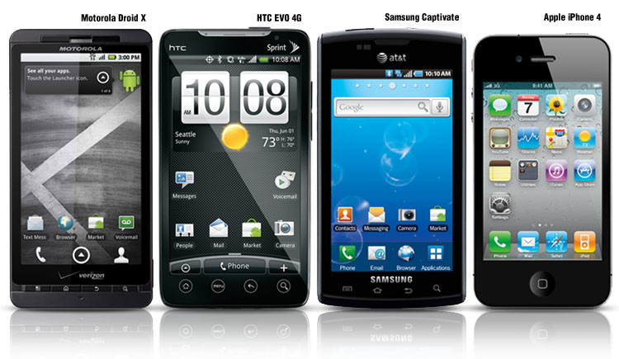
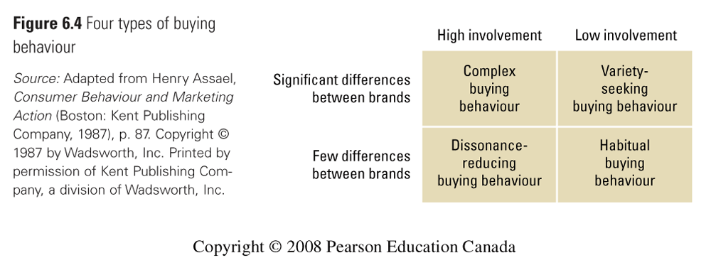
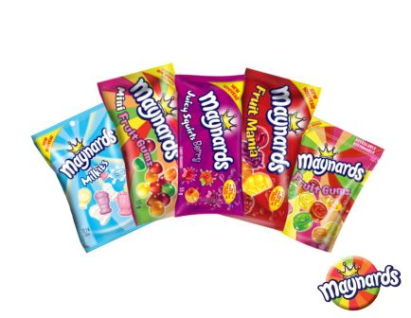
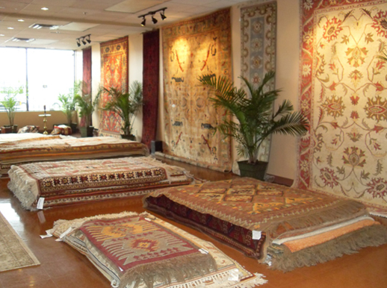
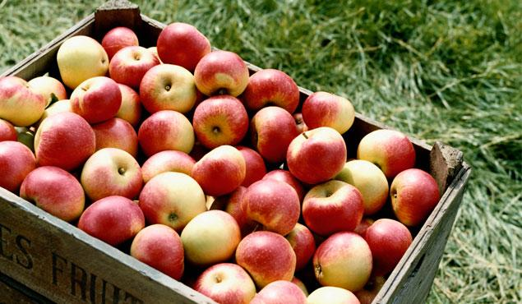
Understanding my clients
Cultural
Social
Personal
Psychological
Buyer

Slide 24
Choosing my market
Market segmentation
Targeting
Differentiation
Positioning

Slide 25
Choosing my market
Market segmentation
Targeting
Differentiation
Positioning
Market segmentation involves dividing the market into smaller groups with distinct needs, characteristics, or behaviors that might require separate marketing strategies or mixes
Market targeting (targeting) is the process of evaluating each market segment’s attractiveness and selecting one or more segments to enter

Slide 26
Choosing my market
Market segmentation
Targeting
Differentiation
Positioning
Market segmentation
Targeting
Differentiation
Positioning
Geographic segmentation
Demographic segmentation
Psychographic segmentation
Behavioural segmentation
Geographic segmentation
Demographic segmentation
Psychographic segmentation
Behavioural segmentation
Benefit segmentation divides the market into groups according to the different benefits that consumers seek from the product
Behavioural segmentation

Slide 27
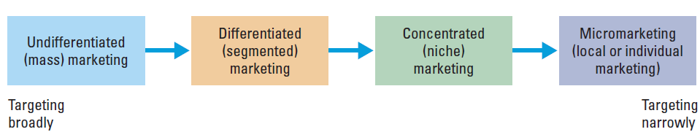
Choosing my market
Market segmentation
Targeting
Differentiation
Positioning
Market segmentation
Targeting
Differentiation
Positioning
Concentrated (niche) marketing targets a large share of one or a few segments or niches
  Limited company resources
  Knowledge of the market
  More effective and efficient
Target market consists of a set of buyers who share common needs or characteristics that the company decides to serve

Slide 28
Choosing my market
Market segmentation
Targeting
Differentiation
Positioning
Market segmentation
Targeting
Differentiation
Positioning
Identifying a set of differentiating competitive advantages upon which to build a position
Choosing the right competitive advantages
  What is the USP?
Selecting an overall positioning strategy

Slide 29




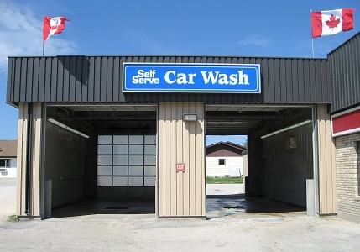
Choosing my market
Market segmentation
Targeting
Differentiation
Positioning
Market segmentation
Targeting
Differentiation
Positioning
Effectively communicate and deliver the chosen position to the market
Speed
Quality of service

Slide 30
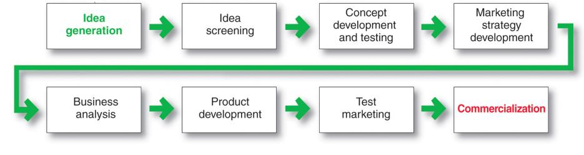
Time to launch

Slide 31
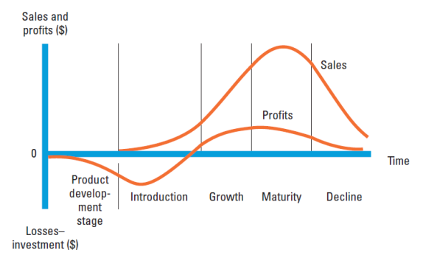
Fast track two years later
Introduction
Growth
Maturity
Decline
Product development
  Sales are zero and investment costs mount
Introduction
  Slow sales growth and profits are nonexistent
Growth
  Rapid market acceptance and increasing profits.
Maturity
  Slowdown in sales growth and profits level off or decline
Decline
  Sales fall off and profits drop

Slide 32
The Marketing Mix
Price
Product
Place
Promotion

Slide 33
The Marketing Mix
Pricing strategies
Value-Based
Value Added
Good Value
EDLP
High/Low
Cost-Based
Cost-Plus
Target profits
Target costing
Price

Slide 34
The Marketing Mix
Cost-plus pricing adds a standard markup to the cost of the product
Benefits
  Sellers are certain about costs
  Prices are similar in industry and price competition is minimized
  Consumer’s feel it is fair
Disadvantages
  Ignores demand and competitor prices
Fixed Cost
Variable Cost
Total Cost
Average cost is the cost associated with a given level of output
Price

Slide 35
The Marketing Mix
Value-added pricing attaches value-added features and services to differentiate offers, support higher prices, and build pricing power
Pricing power is the ability to escape price competition and to justify higher prices and margins without losing market share
Target costing starts with an ideal selling price based on consumer value considerations and then targets costs that will ensure that the price is met
Price
Cost-Based : 9$
Cost-Plus : 9$ x 50% = 13.50$
Value Added
  = 42$

Slide 36
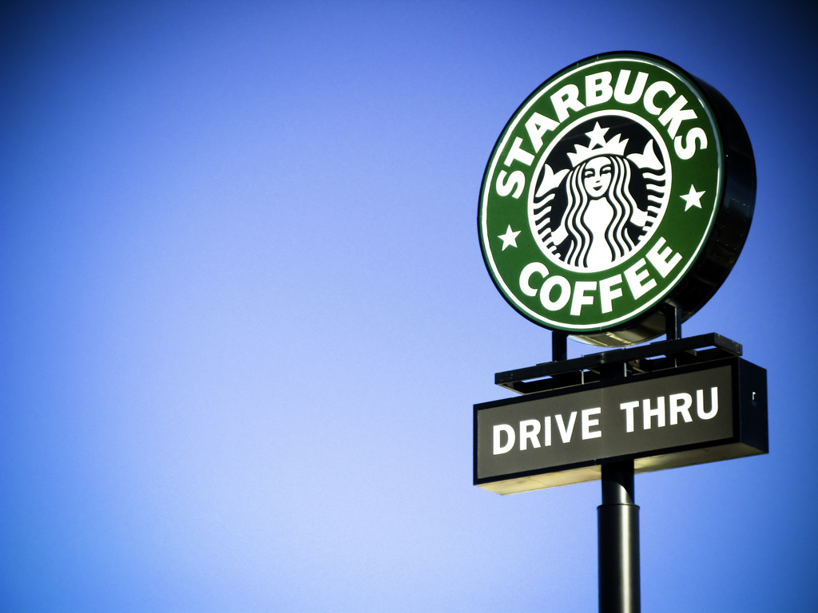


The Marketing Mix
Geographical pricing is used for customers in different parts of the country or the world
Market-skimming
Price
FOB-origin pricing
Uniformed-delivered pricing
Zone pricing
Basing-point pricing
Freight-absorption pricing
Market-penetration

Slide 37
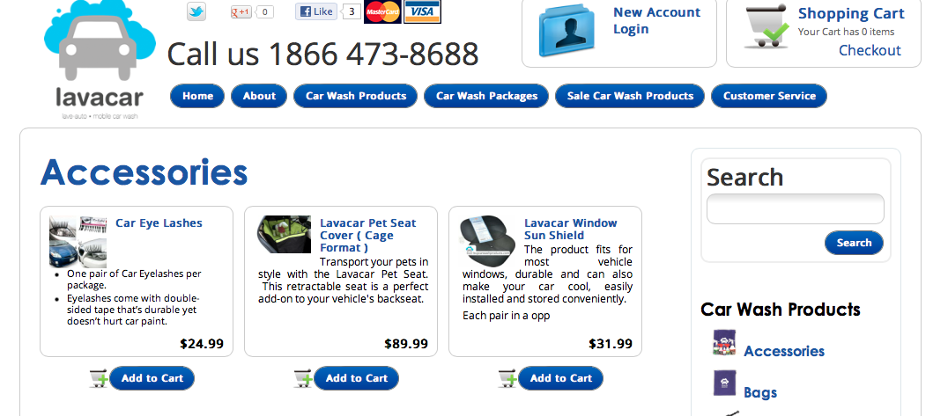
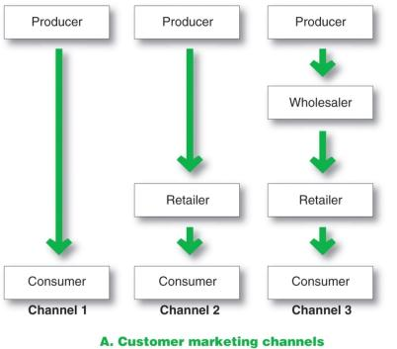
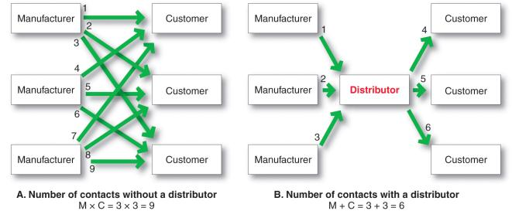
The Marketing Mix
Upstream Partners
Downstream Partners
Supply Chain
Place
(distribution)
Upstream partners include raw material suppliers, components, parts, information, finances, and expertise to create a product or service
Downstream partners include the marketing channels or distribution channels that look toward the customer

Slide 38
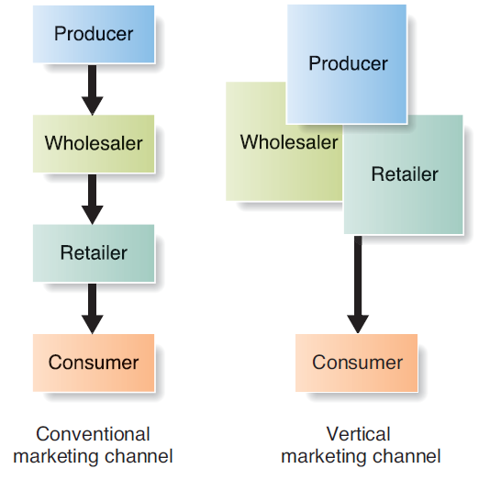
The Marketing Mix
Place
(distribution)

Slide 39
The Marketing Mix
Advertising
Sales Promotion
Personal Selling
Public Relation
Direct Marketing
Developing Effective Marketing Communication
Identify the target audience
Determine the communication objectives
Design the message
Choose the media
Select the message source
Promotion
(Communication)

Slide 40
The Marketing Mix
Determine the communication objectives
Marketers seek a purchase response that results from a consumer decision-making process that includes the buyer-readiness stages:
Promotion
(Communication)
Awareness
Knowledge
Liking
Preference
Conviction
Purchase

Slide 41
The Marketing Mix
Design the message
Emotional appeal is an attempt to stir up positive or negative emotions to motivate a purchase.
  Humor
  Controversy
Rational appeal relates to the audience’s self-interest
  Product quality
  Economy
  Value
  Performance
Promotion
(Communication)

Slide 42
The Marketing Mix
Setting a promotions budget
Affordable Budget
Percentage of sales
Competitive-parity
Objective & tasks
Affordable Budget
Percentage of sales
Competitive-parity
Objective & tasks
Identify the target audience
Determine the communication objectives
Design the message
Choose the media
Select the message source
Promotion
(Communication)

Slide 43

The Marketing Mix
Objective settings
Budget Decisions
Message Decision
Media Decision
Advertising Evaluation
Promotion
(Advertising)
Informative advertising is used when introducing a new product category; the objective is to build primary demand

Slide 44
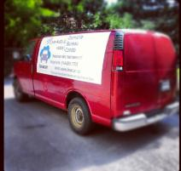
The Marketing Mix
Objective settings
Budget Decisions
Message Decision
Media Decision
Advertising Evaluation
Promotion
(Advertising)
The advertising budget is the dollars and other resources allocated to a product or company advertising program
Factors to consider when setting the budget:
Product life-cycle stage
Market share

Slide 45
The Marketing Mix
Objective settings
Budget Decisions
Message Decision
Media Decision
Advertising Evaluation
Promotion
(Advertising)
Message strategy
Creative concept
Message execution

Slide 46
The Marketing Mix
Objective settings
Budget Decisions
Message Decision
Media Decision
Advertising Evaluation
Promotion
(Advertising)
Return on advertising investment is the net return on advertising investment divided by the costs of the advertising investment
Communication effects indicate whether the ad and media are communicating the ad message well and should be tested before or after the ad runs
Sales and profit effects compare past sales and profits with past expenditures or through experiments

Slide 47
The Marketing Mix
  Public relations involves building good relations with the company’s various publics by obtaining favorable publicity, building up a good corporate image, and handling or heading off unfavorable rumors, stories, and events
  http://www.youtube.com/watch?v=VssP6Af7VRU
Promotion
(Public Relations)

Slide 48
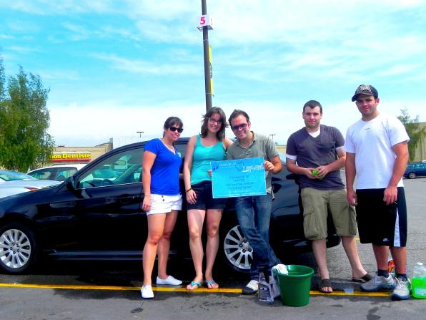
The Marketing Mix
Promotion
(Personnel selling)

Slide 49
The Marketing Mix
Personal selling is a personal presentation by the firm’s sales force for the purpose of making sales and building the customer relationships.
A salesperson is an individual representing a company to customers by performing one or more of the following activities: prospecting, communicating, selling, servicing, information gathering, or relationship building.
Promotion
(Personal Selling)

Slide 50
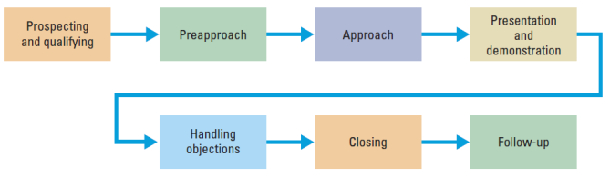

The Marketing Mix
Personal selling works best with complex selling situations
Promotion
(Personal Selling)
The long-term goal is to develop a mutually profitable relationship

Slide 51
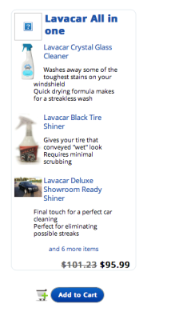
The Marketing Mix
Sales promotion refers to the short-term incentives to encourage purchases or sales of a product or service
  Goal: Buy now!
Promotion
(Sales promotion)

Slide 52
The Marketing Mix
  Premiums are goods offered either for free or at low price
  Advertising specialties are useful articles imprinted with the advertiser’s name, logo, or message that are given as gifts to consumers
  Point-of-purchase promotions include displays and demonstrations that take place at the point of sales
Promotion
(Sales promotion)

Slide 53
The Marketing Mix
Direct Marketing consists of connecting directly with carefully targeted individual consumers to both obtain an immediate response and cultivate lasting customer relationships
Direct Marketers communicate directly with customers, often on a one-to-one, interactive basis.
  Extensive use of database
Promotion
(Direct Marketing)

Slide 54
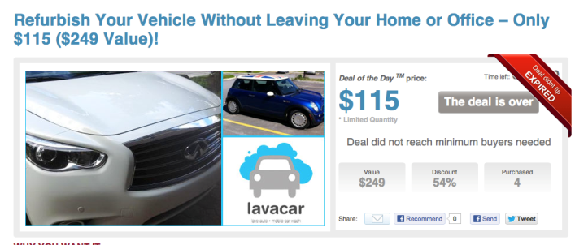
The Marketing Mix
Promotion
(Direct Marketing)

Slide 55
The Marketing Mix
Customers and prospects
Direct Mail
Catalogue Marketing
Telemarketing
Direct-Response TV Marketing
Kiosk Marketing
New Digital Technology
Online Marketing
Customers and prospects
Direct Mail
Catalogue Marketing
Telemarketing
Direct-Response TV Marketing
Kiosk Marketing
New Digital Technology
Online Marketing
Promotion
(Direct Marketing)

Slide 56
The Marketing Mix
Online marketing is a company’s efforts to market products and services and build customer relationships over the internet
Online companies are the so-called dot-coms, which operate only online without any brick-and-mortar market presence
Hybrid (Click-and-Mortar) Companies are traditional companies that have added online marketing to their operations
Promotion
(Online Marketing)

Slide 57
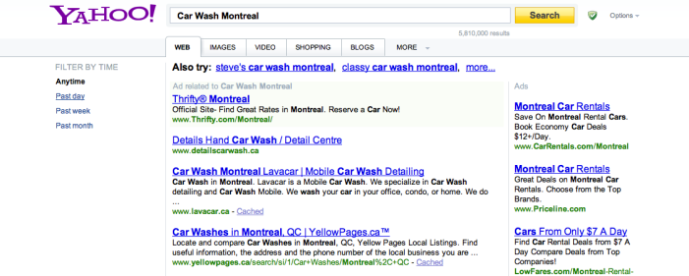
The Marketing Mix
Online advertising is advertising that appears while consumers are surfing the Web, including display ads, search-related ads, online classifieds, and other forms
  Banners are banner-shaped ads found on a Web site
  Search-related ads are ads in which text-based ads and links appear alongside search engine results on sites such as Google and Yahoo! and are effective in linking consumers to other forms of online promotion
Promotion
(Online Marketing)

Slide 58
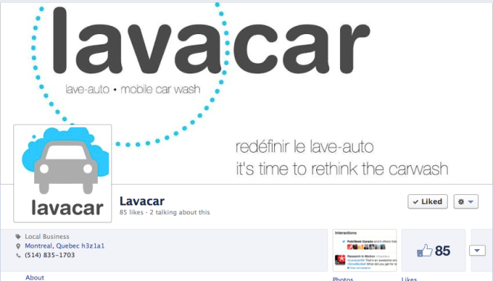
The Marketing Mix
Viral marketing is the Internet version of word-of-mouth marketing and involves the creation of a Web site, e-mail message, or other marketing event that customers pass along to friends
Promotion
(Online Marketing)

Slide 59
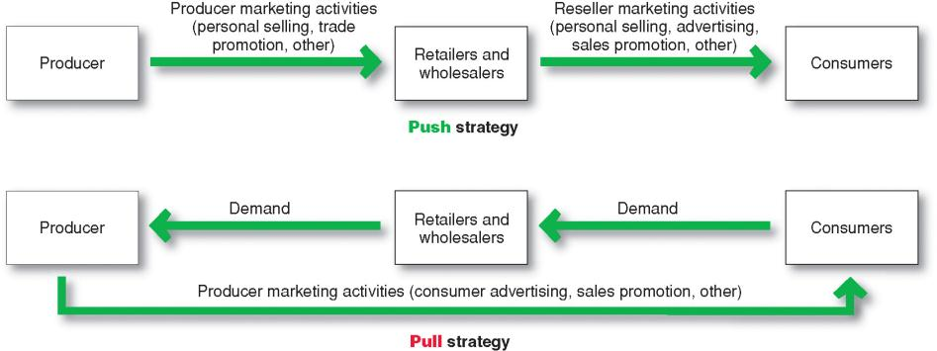
The Marketing Mix

Slide 60
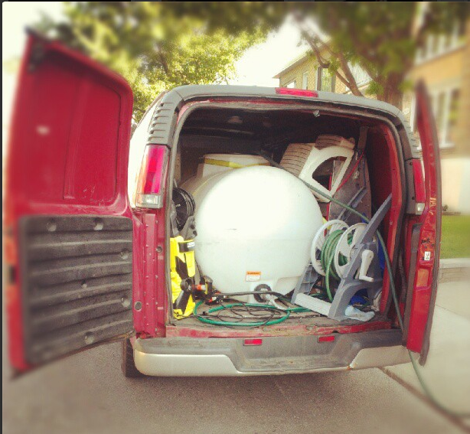
Thank you

